Slide 1
EE462L, Spring 2014
DC−DC Boost Converter

Slide 2
+ v
L
–
i
i
L
I
out
Buck converter
in
L
+
V
in
C
V
out
i
C
–
+ v
L
–
i
L
I
out
Boost converter
i
in
L
+
V
in
C
V
out
i
C
–

Slide 3
!
Boost converter
+ v
L
–
i
L
i
D
I
out
i
in
L
+
V
in
C
V
out
i
C
–
This is a much more unforgiving circuit than the buck converter
If the MOSFET gate driver sticks in the “on” position, then there is a short circuit through the MOSFET – blow MOSFET!
If the load is disconnected during operation, so that I_{out} = 0, then L continues to push power to the right and very quickly charges C up to a high value (≈250V) – blow diode and MOSFET!
Before applying power, make sure that your D is at the minimum, and that a load is solidly connected

Slide 4
Boost converter
+ v
L
–
i
L
i
D
I
out
i
in
L
+
V
in
C
V
out
i
C
–
Modify your MOSFET firing circuit for Boost Converter operation (see the MOSFET Firing Circuit document)
Limit your output voltage to 120V

Slide 5
Boost converter
+ v
L
–
i
L
i
D
I
out
i
in
L
+
V
in
C
V
out
i
C
–
Using KVL and KCL in the average sense, the average values are
+ 0 V –
I
out
I
out
I
in
L
+
V
in
C
V
out
0 A
–
Find the input/output equation by examining the voltage across the inductor

Slide 6
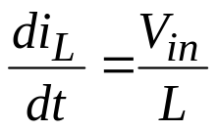
Switch closed for DT seconds
+ V_{in} −
i
L
I
out
i
in
L
+
V
in
C
V
out
I
out
–
Reverse biased, thus the diode is open
for DT seconds
Note – if the switch stays closed, the input is short circuited!

Slide 7
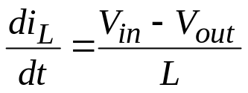
Switch open for (1 − D)T seconds
+ (V_{in} − V_{out} ) −
i
L
I
out
i
in
L
+
V
in
C
V
out
(i_{L} – I_{out})
–
Diode closed. Assume continuous conduction.
for (1−D)T seconds

Slide 8
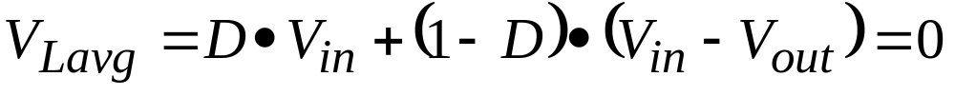
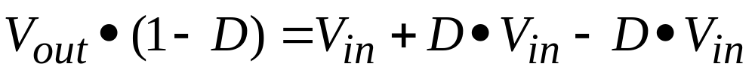
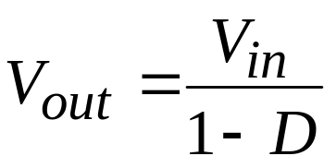
Since the average voltage across L is zero
!
The input/output equation becomes
A realistic upper limit on boost is 5 times

Slide 9
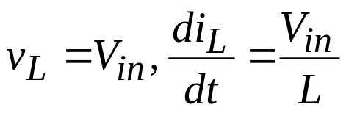
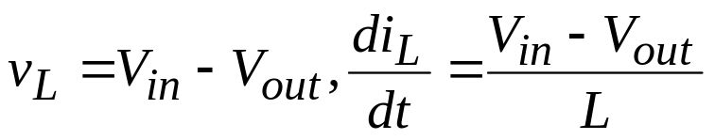
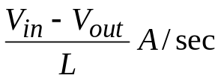
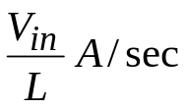
Examine the inductor current
Switch closed,
Switch open,
I_{avg} = I_{in} is half way between
I_{max} and I_{min}
i_{L}
I_{max}
I_{avg} = I_{in}
ΔI
I_{min}
DT
(1 − D)T
T

Slide 10
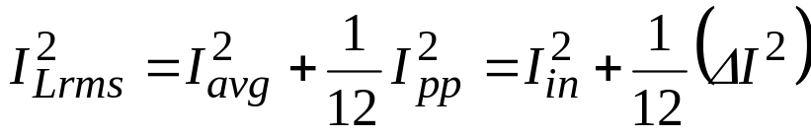
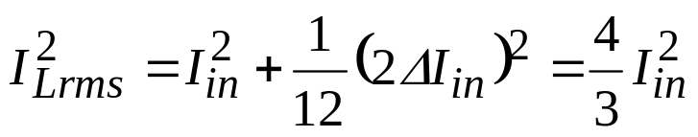
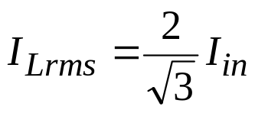
Inductor current rating
Max impact of ΔI on the rms current occurs at the boundary of continuous/discontinuous conduction, where ΔI =2I_{in}
i_{L}
2I_{in}
I_{avg} = I_{in}
ΔI
0
Use max

Slide 11
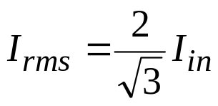
MOSFET and diode currents and current ratings
+ v
L
–
i
L
i
D
I
out
i
in
L
+
V
in
C
V
out
i
C
–
2I_{in}
0
2I_{in}
0
Use max
Take worst case D for each

Slide 12

Capacitor current and current rating
i
L
i
D
I
out
i
in
L
+
V
in
C
V
out
i
C
–
i_{C} = (i_{D} – I_{out})
2I_{in} −I_{out}
0
−I_{out}
Max rms current occurs at the boundary of continuous/discontinuous conduction, where ΔI =2I_{out}
Use max
See the lab document for the derivation

Slide 13
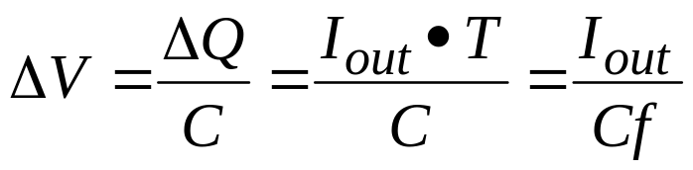
Worst-case load ripple voltage
i_{C} = (i_{D} – I_{out})
0
−I_{out}
The worst case is where C provides I_{out} for most of the period. Then,

Slide 14
Voltage ratings
Diode sees V_{out}
i
L
I
out
i
in
C sees V_{out}
L
+
V
in
C
V
out
–
i
L
I
out
i
in
L
+
V
in
C
V
out
–
MOSFET sees V_{out}
Diode and MOSFET, use 2V_{out}
Capacitor, use 1.5V_{out}

Slide 15

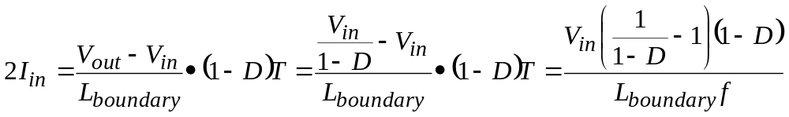
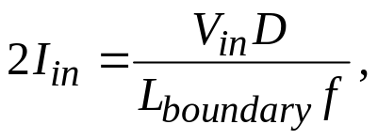
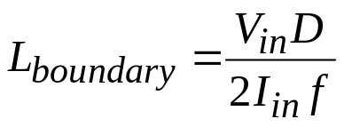
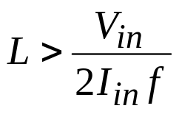
Continuous current in L
i_{L}
2I_{in}
I_{avg} = I_{in}
0
(1 − D)T
Then, considering the worst case (i.e., D → 1),
use max
guarantees continuous conduction
use min

Slide 16

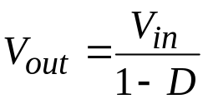
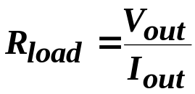

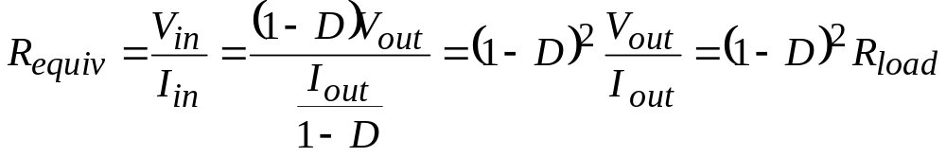
Impedance matching
I_{in}
DC−DC Boost Converter
+
V_{in}
−
+
−
Source
I_{in}
+
V_{in}
−
Equivalent from source perspective

Slide 17
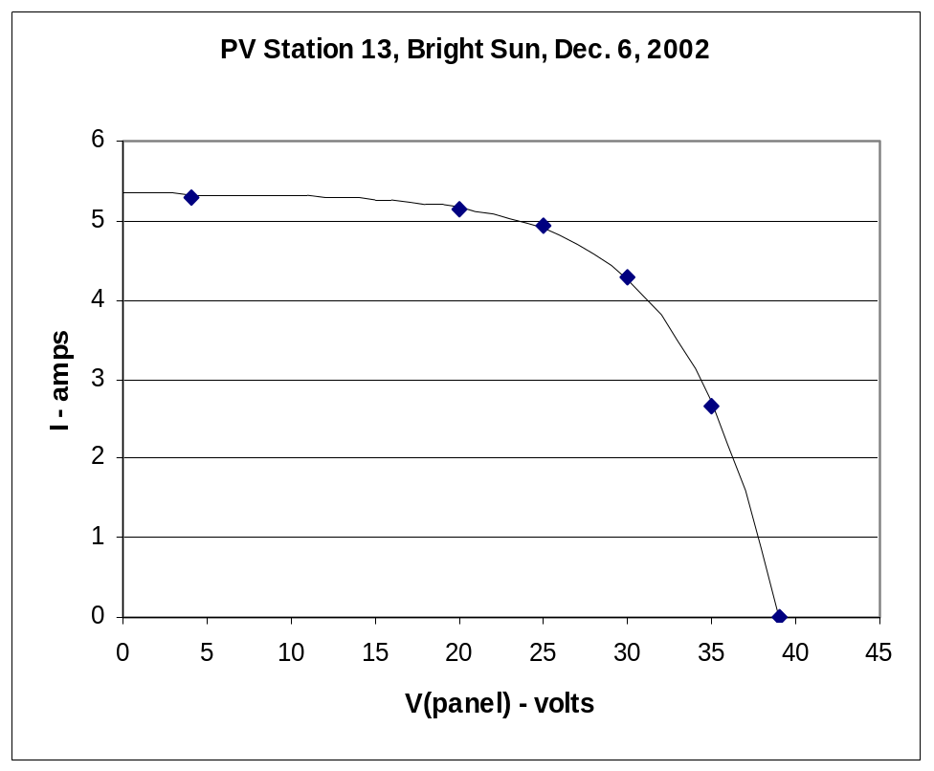

Example of drawing maximum power from solar panel
P_{max} is approx. 130W (occurs at 29V, 4.5A)
I_{sc}
For max power from panels, attach
But as the sun conditions change, the “max power resistance” must also change
V_{oc}
I-V characteristic of 6.44Ω resistor

Slide 18
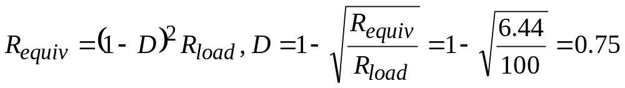
Connect a 100Ω resistor directly, extract only 14W
130W
So, the boost converter reflects a high load resistance to a low resistance on the source side
6.44Ω resistor
14W
100Ω resistor
To extract maximum power (130W), connect a boost converter between the panel and the load resistor, and use D to modify the equivalent load resistance seen by the source so that maximum power is transferred

Slide 19
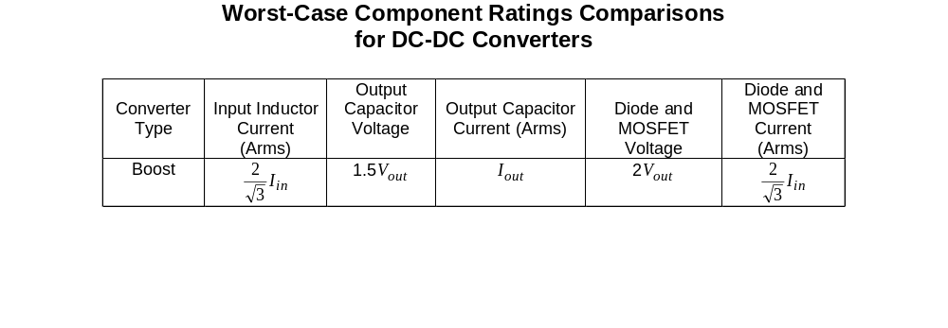
BOOST DESIGN
Our components
9A
250V
5.66A
200V, 250V
16A, 20A
10A
120V
5A
120V
10A
Likely worst-case boost situation
L. 100µH, 9A
C. 1500µF, 250V, 5.66A p-p
Diode. 200V, 16A
MOSFET. 250V, 20A

Slide 20

BOOST DESIGN
5A
0.067V
1500µF
50kHz
L. 100µH, 9A
C. 1500µF, 250V, 5.66A p-p
Diode. 200V, 16A
MOSFET. 250V, 20A

Slide 21
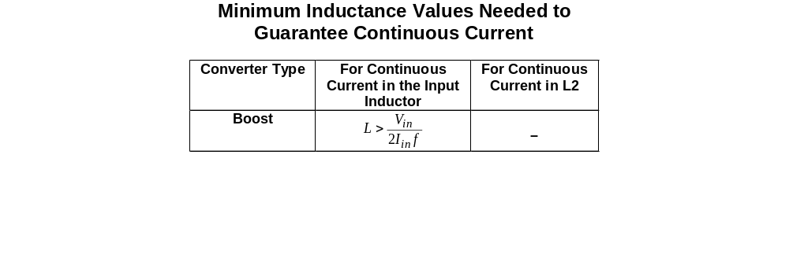
BOOST DESIGN
40V
200µH
2A
50kHz
L. 100µH, 9A
C. 1500µF, 250V, 5.66A p-p
Diode. 200V, 16A
MOSFET. 250V, 20A

