Slide 1


EE464-Term Project Martian Power Solutions
CEYHUN KOÇ 2166833
Enes Canbolat 2231546
EREN ÖZKARA 2232551

Slide 2
Table of Contents
1. Topology Selection
2. Operating Mode Selection
3. Analytical Calculations and Simulation
4. Magnetic Design
5. Component Selection and Controller
5.1. Controller
5.2 Discrete Component Selection
6. Detailed Simulation Results
7. Hardware Design
7.1. Schematic Design
8. Cost Analysis
9. Conclusion

Slide 3
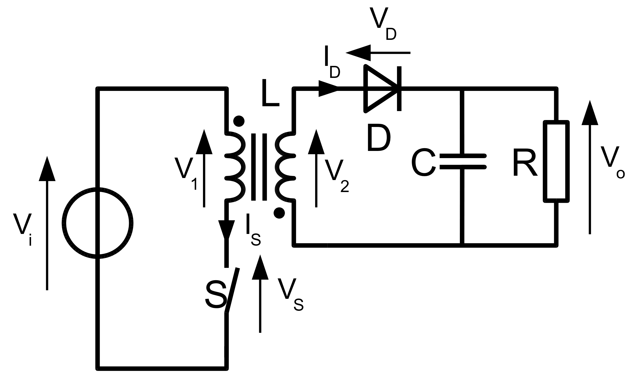
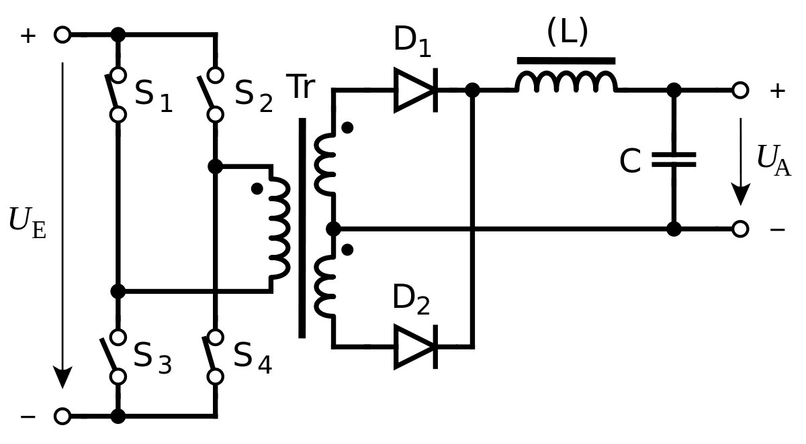
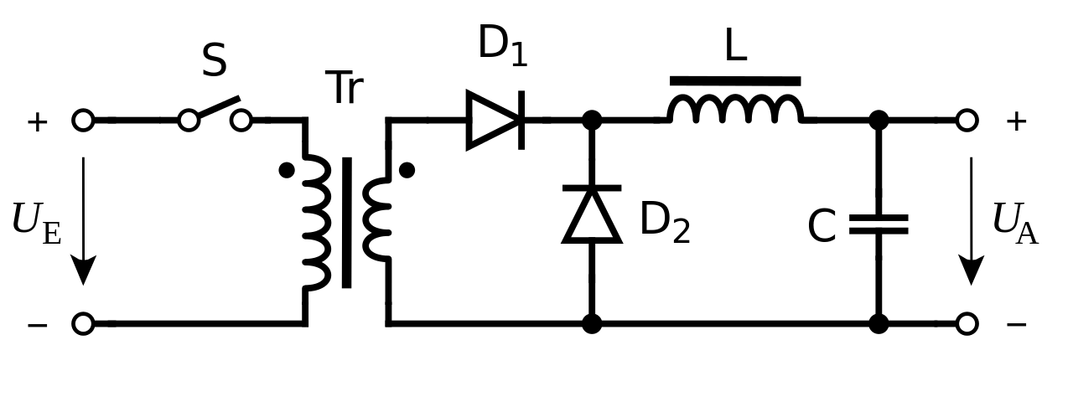

TOPOLOGY SELECTION
FLYBACK CONVERTER
FORWARD CONVERTER
PUSH-PULL CONVERTER
Notes:
Flyback: Buck-boosttan elde ediliyor. En yaygın olarak tercih edilen, dolayısıyla çok fazla kaynak ve application note var. Düşük powerlar için uygun ama güzel dizayn edilmesi durumunda 10A’e kadar çalışıyor ki bu da uygun. CCM’den DCM’ye geçerken gainde ciddi bir kayıp yok. Forward: Flyback gibi düşük powerlar için geçerli. Manyetik dizaynda gappless core kullanma avantajına sahip ama bu Lm ‘i artırır. Bu artış aslında outputta daha düşük ripple sağlar ama daha fazla komponent olduğu için daha pahalı olabilir. Ayrıca, DCM’ye geçtiğinde gainde ciddi bir düşüş oluyor bu da bizim için tercih edilesi değil. Sebebi bir sonraki slaytta. Ayrıca MOSFET çok daha dayanıklı ve büyük olmalı (size problem)
Push-Pull: Forwarda benziyor iki trafolu hali. Bu converter tipi B-H curve’ünün 1 ve 3. quadrantlarında çalışmaya izin veiyor bu da manyetik dizayn için bir +. Amaa Burada kontrol etmemiz gereken daha fazla anahtar var ve bazıları kesinlikle aynı anda çalışmaması gerekiyor. Ayrıca çok yüksek powerlar için kullanılması tavsiye ediliyor. Bütün bu sebepler bir de Martian Power Solutions mühendislerinin geçmişte Flyback üzerine tecrübesi olduğu eklenince bizi Flyback’e itti.

Slide 4
OPERATING MODE SELECTION
DCM
CCM
BOUNDARY
Low Power Applications
Better Switching Performance
Smaller Transformer Size
Higher Peak Current
Higher RMS Current
High Power Applications
Worse Switching Performance
Larger Transformer Size
Low Peak Current
Low RMS Current
Advantageous of them
Controller Features
Variable Frequency Operation
Notes:
DCM: diode yeni cycle başlamadan hemen önce akım geçmiyor. Yüksek akım ve yüksek peak output kapasitör üzerine çok daha fazla stres bindiriyor. CCM: Düşük output akımı verebildiği için yüksek akımlarda daha iyi çalışabiliyor.

Slide 5


Analytical Calculations
$$V_{out}=V_{in}\left(\frac{D}{1−D}\right)\left(\frac{N2}{N1}\right)$$
$$V_{in}=220 V , D=0.18;V_{in}=400 V , D=0.11$$
$$L_{Mmin}=\left(\frac{{\left(1−D\right)}^{2}R}{2f}\right){\left(\frac{N1}{N2}\right)}^{2}$$
$${f=100 kHz, L}_{Mmin}=91.25μ H$$

Slide 6
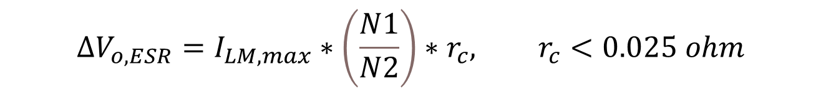
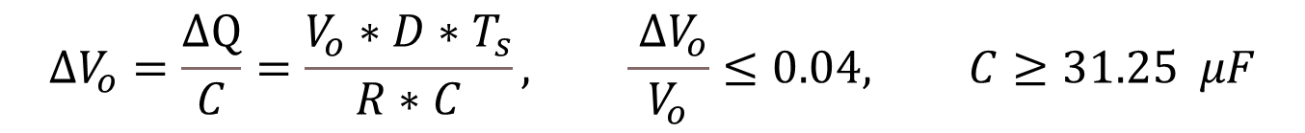
$$V_{sw_open}=V_{in}+V_{out}∗N, V_{sw_{max}}=448 V$$
$$ΔV_{o}=\frac{ΔQ}{C}=\frac{V_{o}∗D∗T_{s}}{R∗C}, \frac{ ΔV_{o}}{V_{o}}≤0.04, C≥31.25 μF$$
$$ΔV_{o,ESR}=I_{LM,max}∗\left(\frac{N1}{N2}\right)∗r_{c}, r_{c}<0.025 ohm$$
Analytical Calculations

Slide 7
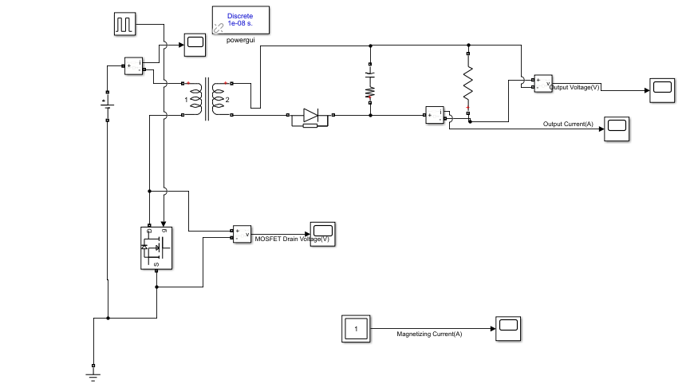
Simulations
Fig. 1 Flyback Converter Simulink Model

Slide 8
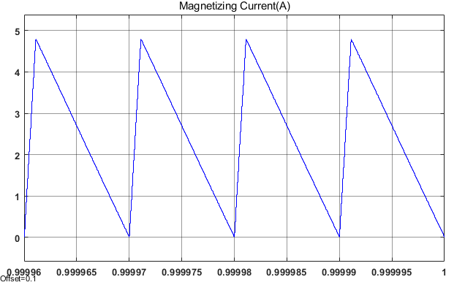
Fig. 2 Magnetizing Current of the Flyback Converter
Simulations

Slide 9
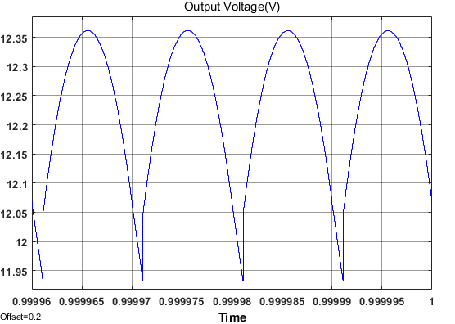
Fig. 3 Output Voltage of the Flyback Converter
Simulations

Slide 10
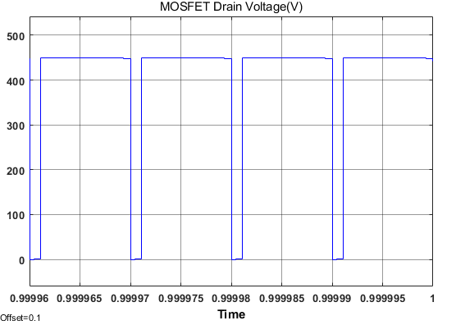
Fig. 4 Switch Voltage of the Flyback Converter
Simulations

Slide 11
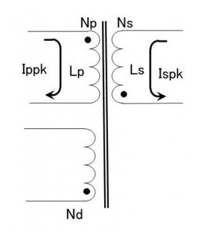
Magnetic Design
Fig. 5 Transformer Schematic

Slide 12
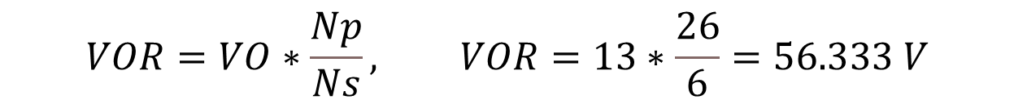
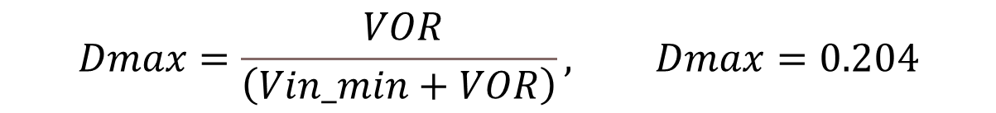
$$VO=Vout+V_{F}, VO=12+1=13 V$$
$$VOR=VO∗\frac{Np}{Ns}, VOR=13∗\frac{26}{6}=56.333 V$$
$$Dmax=\frac{ VOR}{\left(Vin_min+VOR\right)}, Dmax=0.204$$
Magnetic Design

Slide 13
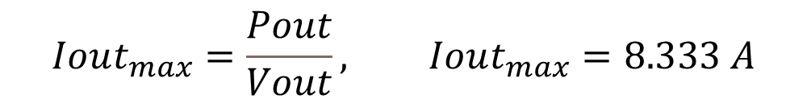



$$Iout_{max}=\frac{Pout}{Vout}, Iout_{max}=8.333 A$$
$$Ls=\frac{\left(Vout+V_{F}\right)∗{\left(1−D_{max}\right)}^{2}}{2∗Iout_{max}∗fsw_{max}}, Ls≤4.9μH, Ls=4.34μH$$
$$Ispk=\frac{2∗Iout_{max}}{1−D_{max}}=20.1 A$$
$$Lp=Ls∗{\left(\frac{Np}{Ns}\right)}^{2}=81.5 μH$$
$$Ippk=\frac{Ispk}{Np/Ns}=4.83 A$$
Magnetic Design

Slide 14
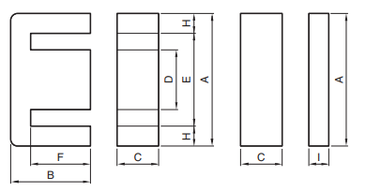
Table. 1 Magnetic Properties
Core Type | Effective Cross-Sectional Area Ae (mm2) | Maximum Magnetic Flux Density (T) | AL-Value with Air Gap (nH/N^2)
PC47EI25 | 41 | 0.42 | 125
𝐹𝑖𝑙𝑙 𝐹𝑎𝑐𝑡𝑜𝑟 : EI40, EI30 < 0.4,
EI25 = 0.41
Table. 2 Core Dimensions
Core | A (mm) | C(mm) | D (mm) | E(mm) | F (mm)
EI25 | 25.3 | 5.75 | 6.5 | 19 | 12.35
Magnetic Metarial and Core Selection

Slide 15

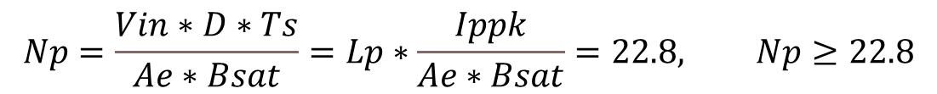

$$Np=\frac{Vin∗D∗Ts}{Ae∗Bsat}=Lp∗\frac{Ippk}{Ae∗Bsat}=22.8, Np≥22.8$$
$$Np=\sqrt{\frac{Lp}{AL}}=25.53, Np=25$$
$$MMF=Np∗Ippk=120.75 At$$
$$Ns=\frac{\frac{Np}{Np}}{Ns}=6$$
$$Nd=6$$
Calculation of Winding Turns Ratio

Slide 16
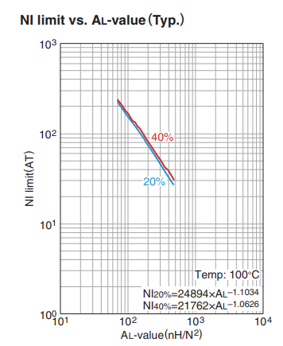
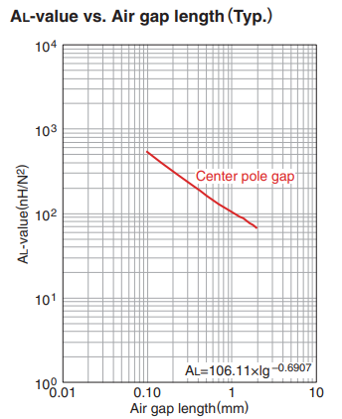
Fig. 5 NI limit and Air gap vs AL value Graphs
Datasheet of PC47EI25

Slide 17
$$Vp_{rms}∗Ip_{rms}=\frac{Np∗Ae∗Bsat}{D∗Ts}∗Ip_{rms}=P_{o}=197.5 W$$
$$Vp_{rms}∗Ip_{rms}=100 W=\frac{Np∗Ae∗B_{operating}}{D∗Ts}∗Ip_{rms}, B_{operating} =0.2 T$$
Power Calculation of Transformer

Slide 18


Table. 2 Selected Cable Properties
Wire | Area (mm2) | Diameter(mm) | Ampacity(A) (75°C) | Resistivity (p) (10^-8 Ω.m) | Absolute magnetic permeability (u) (10^-7 H/m)
AWG10 | 5.26 | 2.588 | 35 | 1.678 | 12.55
AWG20 | 0.518 | 0.812 | 11 | 1.678 | 12.55
AWG30 | 0.509 | 0.255 | 0.86 | 1.678 | 12.55
$$Window_{A}=\frac{A−D}{2}∗F=116.1 {mm}^{2}$$
$$Cable_{A}=AWG20∗Np+AWG10∗Ns +AWG30∗Nd=48 {mm}^{2}$$
$$Fill_{Factor}=\frac{Cable_{A}}{Window_{A}}=0.41$$
Cable Selection

Slide 19
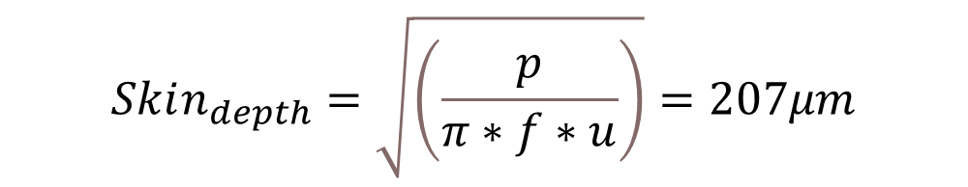
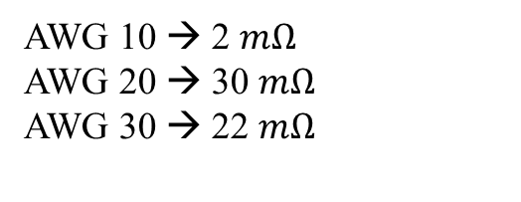
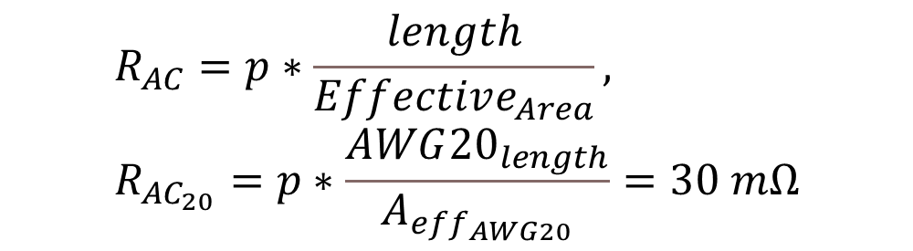
$$length=\left(C+\frac{D+E}{2}\right)∗2, AWG{20}_{length}=length∗Np=0.962 m$$
$$Skin_{depth}=\sqrt{\left(\frac{p}{π∗f∗u}\right)}=207μm$$
$$Effective_{Area}=Skin_{depth}∗pi∗Diameter,$$
$$A_{eff_{AWG20}}=Skin_{depth}∗π∗AWG{20}_{d}=0.528mm2$$
$$R_{AC}=p∗\frac{length}{Effective_{Area}}, R_{AC_{20}}=p∗\frac{AWG{20}_{length}}{A_{eff_{AWG20}}}=30 mΩ$$
AWG 10 → 2 $mΩ$
AWG 20 → 30 $mΩ$
AWG 30 → 22 $mΩ$
Skin Depth and R Calculation

Slide 20
Component Selection and Controller
Controller
Discrete Component Selection

Slide 21
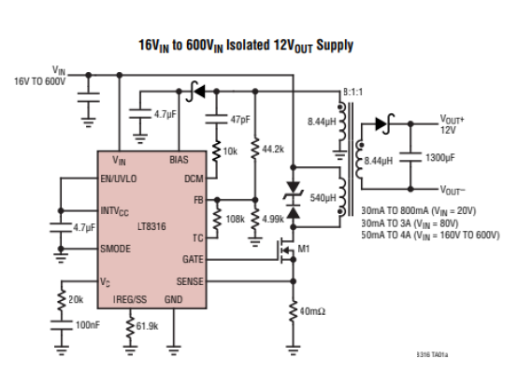
Component Selection and Controller
A. Controller
Requirements: 220V-400V input, 100W
LT8316: 16V-600V input/External MOSFET → We can select MOSFET for 100W operation
Figure-6:
Typical Application of LT8316

Slide 22
Component Selection and Controller
Feedback is taken from tertiary winding → No galvanic isolation is needed!
Reduces cost and complexity!
No need for extra logic power supplies, digital isolators and signal conditioning!

Slide 23
Component Selection and Controller
Idea of operation:
Feedback is taken from tertiary winding and sampled by FB pin.
DCM pin senses dV/dt and adjusts boundary operation.
With boundary operation output diode voltage drops to zero in every cycle, stress on diode is reduced.
With boundary mode, we are able to use a smaller transformer compared with CCM.
By adjusting sense resistor, output current is limited.
By adjusting UVLO resistors, protection is handled for low voltage

Slide 24

Component Selection and Controller
Sense Resistor:
→ Calculation gives us 17.5mohm sense resistor!
Nps=26/6
D=0.2 max
Iout=8.33A
→ We have selected 10mohm sense resistor in order to supply higher currents!

Slide 25

Component Selection and Controller
UVLO Resistors:
→ This calculation gives us 1.5Megaohm / 9.2kohm resistors for voltage division!
We will take the circuit protection under 200V input!
UVLO pin compares the input voltage with 1.22V

Slide 26
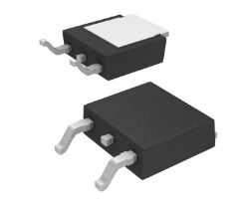
Component Selection and Controller
MOSFET Selection:
In detailed simulation, we have seen that MOSFET sees maximum 450V and 6A
We have selected Infıneon Technologies IPD50R500CEAUMA1 with 550V, 7.6A ratings! (DPAK)

Slide 27
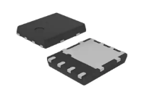
Component Selection and Controller
Output Diode Selection:
In detailed simulation, we have seen that output diode sees maximum 110V and 22A
We have selected STMicroelectronics STPS30170DJF-TR with 170V, 30A ratings!
Power-flat packaging will help us to dissipate heat!

Slide 28
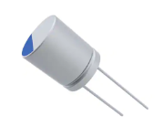
Component Selection and Controller
Tertiary Diode Selection:
In detailed simulation, we have seen that tertiary diode sees maximum 110V and 100mA
We have selected STMicroelectronics STPS1150A with 150V, 1A ratings
Output Capacitor Selection:
In detailed simulation, output capacitor has 20A ripple, and ESR must not exceed 24mohm to stay %4 ripple!
We have selected KEMET A750KK337M1CAAE014, 330uF, Aluminum-Polymer, 5A ripple, 14mOhm ESR, and we will parallel four of them, by this way, we will decrease ESR, too.

Slide 29
Component Selection and Controller
D-Z Snubber Selection
Datasheet recommends a D-Z snubber for safe switching, and diode in this configuration does not exceed 400V, and zeners does not exceed 90V, so we have selected as follows
Diode: ON Semiconductor ES1H, 450V, fast recovery
Zener: Vishay SML4764A-E3/61, 100V, 1W

Slide 30
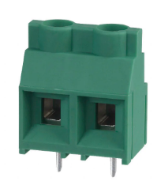
Component Selection and Controller
Connector:
Two input screw terminal for both input and output.
Capable up to 600V

Slide 31
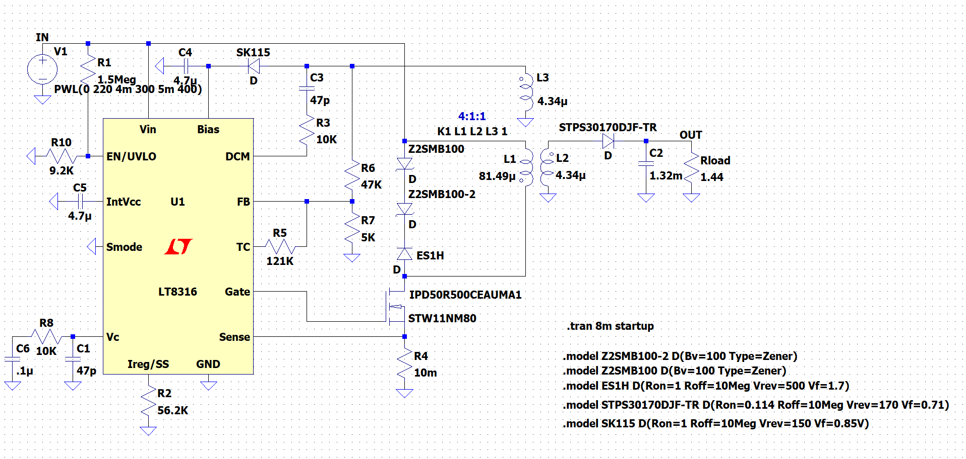
DETAILED SIMULATIONS
Fig. 7 Circuit Diagram of the Circuit

Slide 32
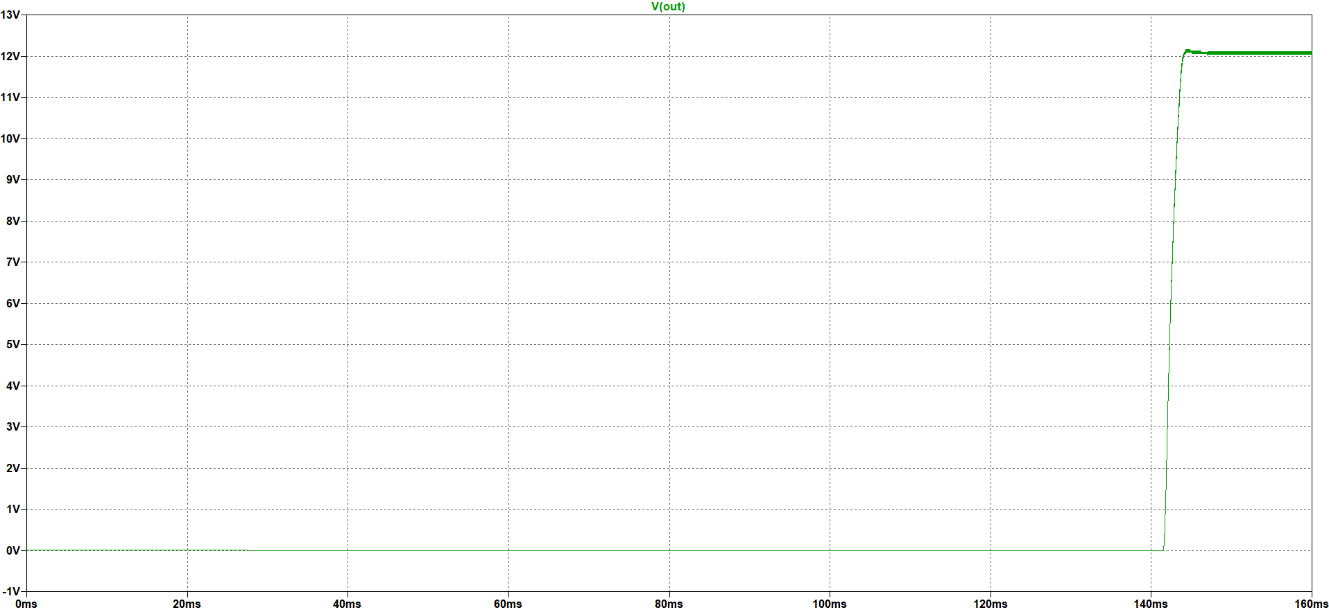
DETAILED SIMULATIONS
Fig. 8 Output Voltage Performance
Notes:
145ms civarında 12V’a ulaşıyor.

Slide 33
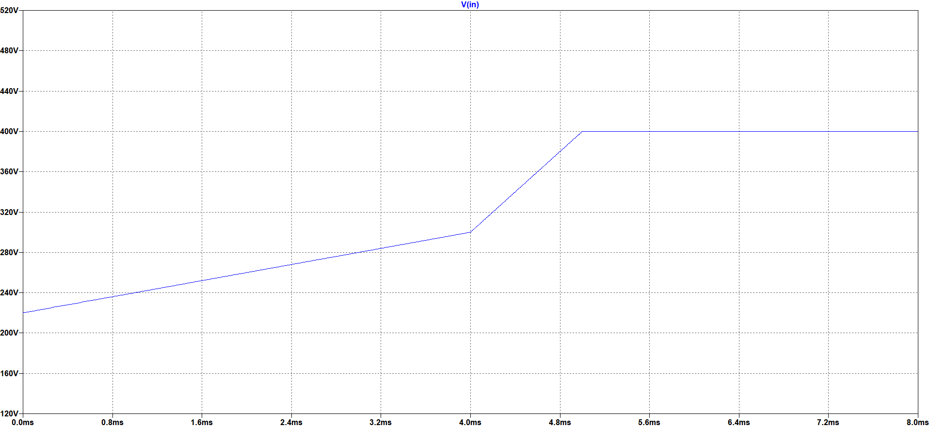
DETAILED SIMULATIONS
Fig. 9 Varying Input Voltage
Notes:
Inputu 5 ms’de 220den 400’e yükselttik ve sonucu gözlemledik.

Slide 34
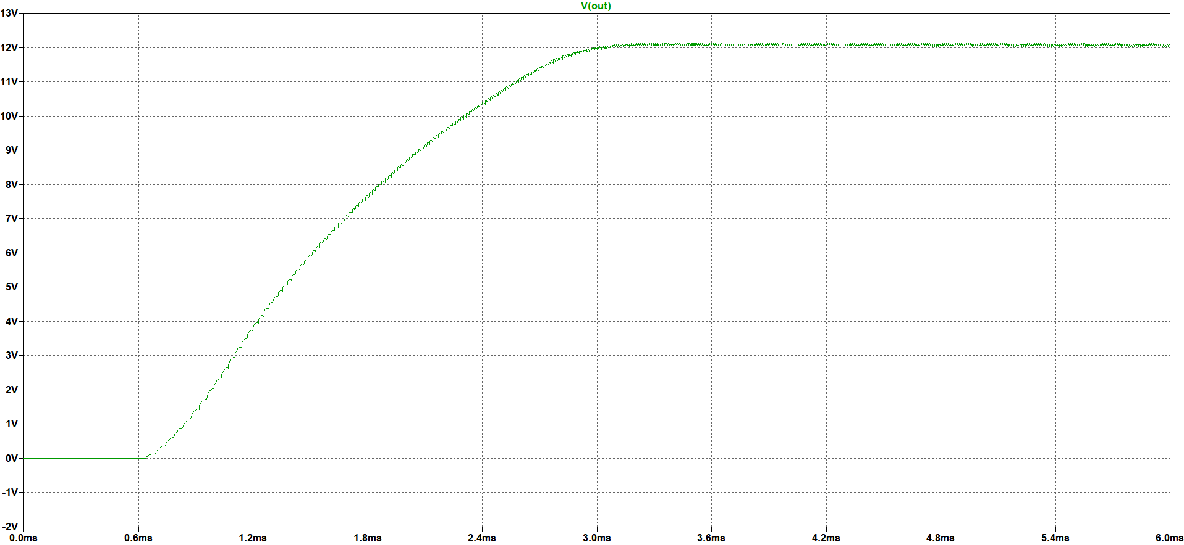
DETAILED SIMULATIONS
Fig. 10 Output Voltage Performance for Varying Input Voltage
Notes:
Çok küçük oynamalarla 12V sabit kaldı diyebiliriz.

Slide 35
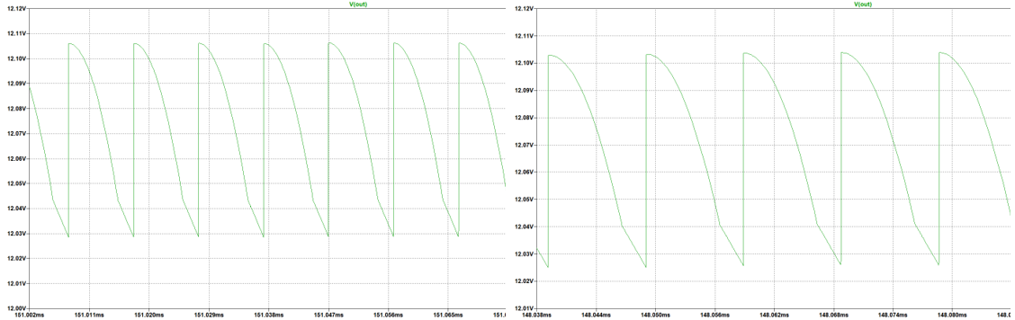
DETAILED SIMULATIONS
Fig. 11 Output Voltage Ripple for 220V (left) and 400V(right) Input Voltage
Notes:
Output ripple 0.1Voltun altında (iki ekstrem durum için de geçerli)

Slide 36
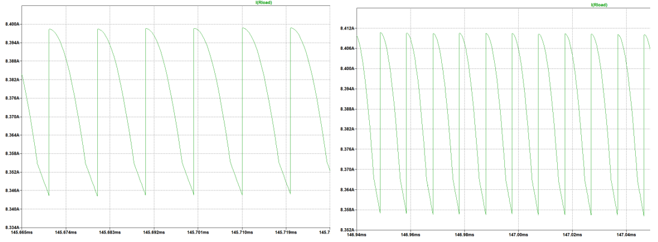
DETAILED SIMULATIONS
Fig. 12 Output Current Ripple for 220V (left) and 400V(right) Input Voltage
Notes:
0.05A civarında bir ripple var ve 8A civarında average

Slide 37
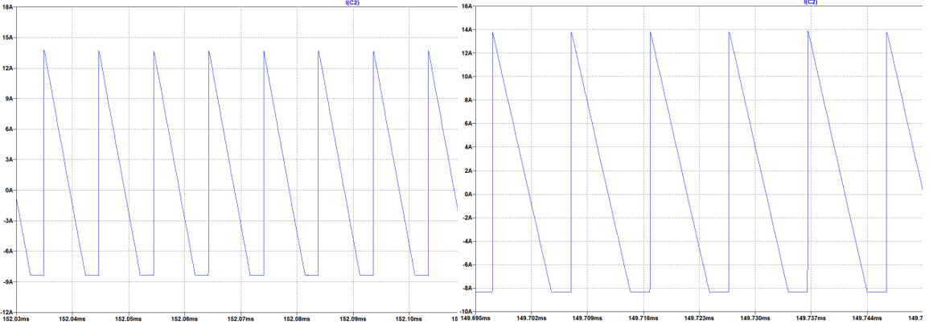
DETAILED SIMULATIONS
Fig. 13 Output Capacitor Current Ripple for 220V (left) and 400V(right) Input Voltage
Notes:
Yaklaşık 20A civarında bir ripple var kapasitör voltajı da output voltajı ile aynı zaten.

Slide 38
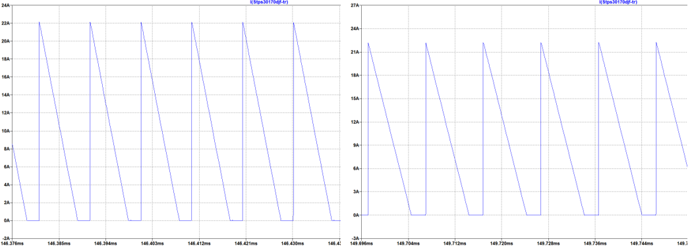
DETAILED SIMULATIONS
Fig. 14 Output Diode Current Waveform for 220V (left) and 400V(right) Input Voltage
Notes:
22A civarında bir akım geçiyor

Slide 39
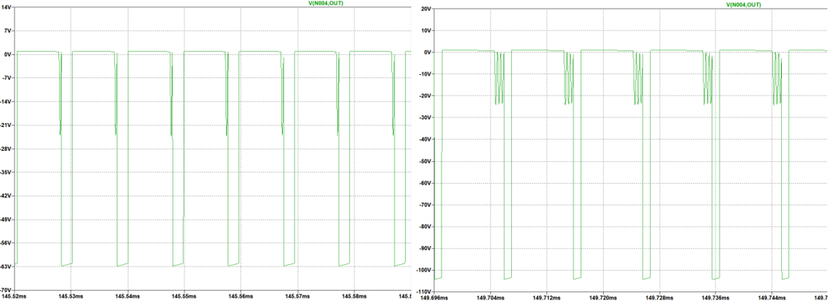
DETAILED SIMULATIONS
Fig. 15 Output Diode Voltage Waveform for 220V (left) and 400V(right) Input Voltage
Notes:
Input voltajına göre çok değişken bir reverse voltaj değeri var ve input 400V olduğunda diyotun 110V’a kadar dayanması gerekiyor.

Slide 40
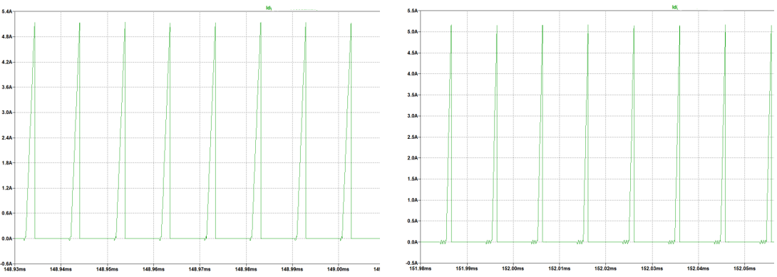
DETAILED SIMULATIONS
Fig. 16 MOSFET Gate Current Waveform for 220V (left) and 400V(right) Input Voltage
Notes:
5.1A civarında bir peak akım değeri gözlemledik

Slide 41
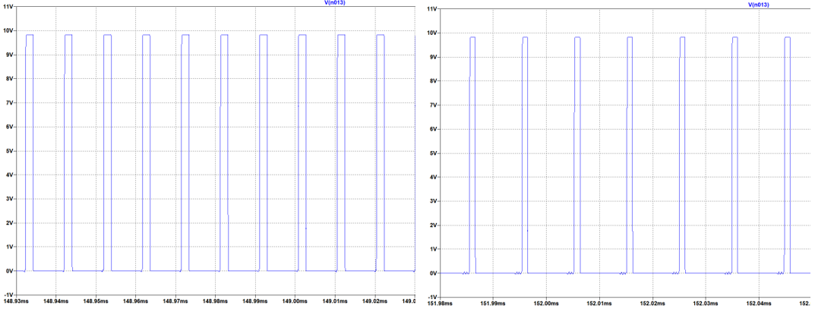
DETAILED SIMULATIONS
Fig. 17 MOSFET Gate Voltage Waveform for 220V (left) and 400V(right) Input Voltage
Notes:
Ayrıca üzerinde 10V civarında bir gerilim tutuyor. Seçilen MOSFET bunlara dayanmalıydı.

Slide 42
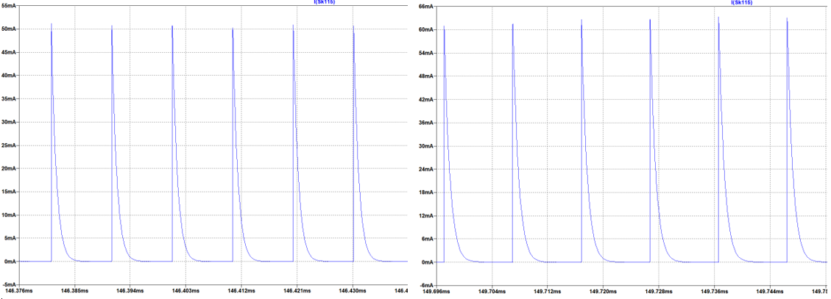
DETAILED SIMULATIONS
Fig. 18 Tertiary Diode Current Waveform for 220V (left) and 400V(right) Input Voltage
Notes:
Kontrolcünün Bias pinine giden yerdeki diyot. Akım çok fazla oynamıyor 50 60 mA peak değerinde

Slide 43
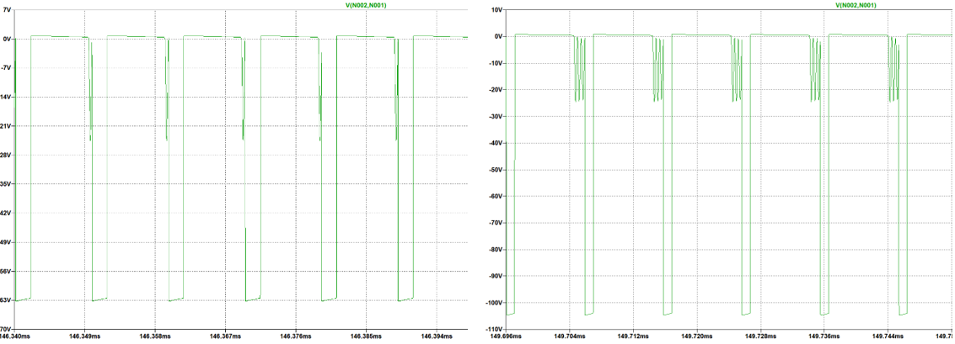
DETAILED SIMULATIONS
Fig. 19 Tertiary Diode Voltage Waveform for 220V (left) and 400V(right) Input Voltage
Notes:
Ancak üzerinde tuttuğu voltaja baktığımızda biraz daha oynama grüyoruz. 220V için 63V civarındayken input 400 olduğunda 110V’a kadar dayanması gerekiyor

Slide 44
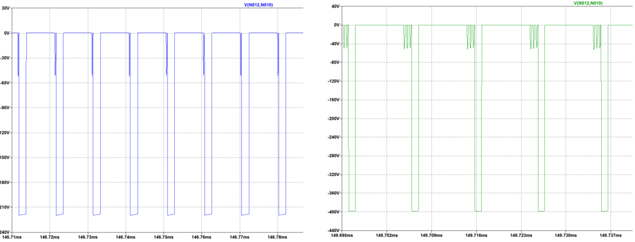
DETAILED SIMULATIONS
Fig. 20 Snubber Diode Voltage Waveform for 220V (left) and 400V(right) Input Voltage
Notes:
400Va kadar dayanması gerekiyor

Slide 45
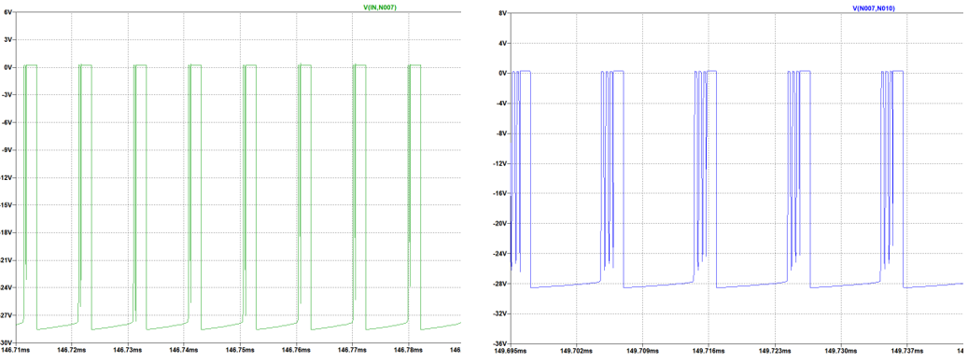
DETAILED SIMULATIONS
Fig. 21 Snubber Zener Diode Voltage Waveform for 220V (left) and 400V(right) Input Voltage
Notes:
Zener diyotlar daha az voltaj tutuyor üzerinde 30 V civarı. Sözü Hardware Desginı anlatması için Ceyhun’a devredeyim.

Slide 46
Schematic Design
Altium Designer has been used!
No galvanic isolation is needed!
Some extra components are used which are not discussed in component selection part!

Slide 47
Schematic Design
IntVCC Pin: To maintain internal VCC, datasheet recommends minimum 2.2uF ceramic capacitor. 4.7uF capacitor is used.
Bias Pin: This pin takes internal supply from output, 4.7uF ceramic capacitor is recommended.
Smode Pin: For standby operation, grounded for normal operation.

Slide 48
Schematic Design
VC Pin: For loop compensation. Datasheet recommends an R-C network to stabilize the operation generally with 20kohm and 220nF. However demo board uses 10kohm and 100nF, and when we compare these two, 10kohm and 100nF R-C networks gives better transient response.
IREG/SS Pin: For output current regulation. The formula in the datasheet gives us a 50kohm resistor to regulate output current at 8.33A.
TC Pin: For temperature compensation, experimentally adjusted. We have taken demo board value 121kohm and connected to FB pin.

Slide 49
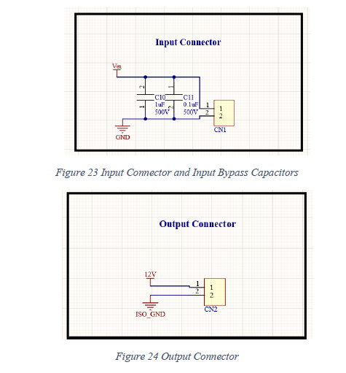
Schematic Design
We have used inut bypass capacitors to eliminate any possible high frequency noises.
We have used 20 ohm MOSFET gate resistor to limit dI/dt in the gate, for safe switching.
We have used 10kohm gate pull-down resistor for safety.

Slide 50
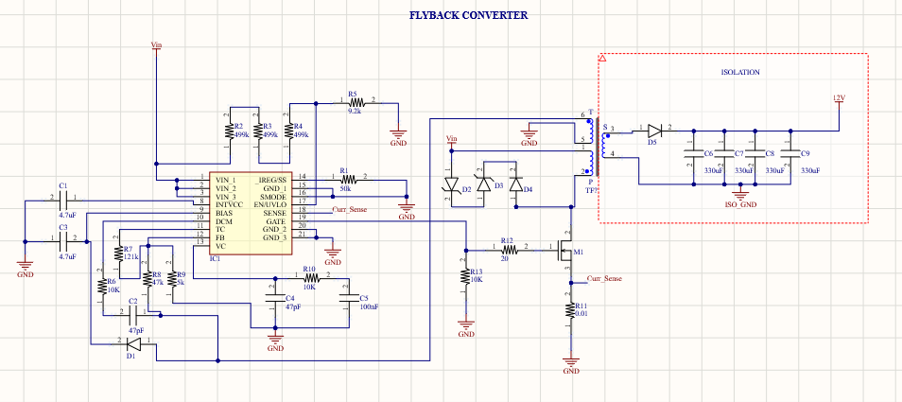

Slide 51
Cost Analysis
Manufacturer Part Number | Description | Unit Price ($) | Extended Price ($)
CL31B475KOHNFNE | CAP CER 4.7UF 16V X7R 1206 | 0,0442 | 88,40
885012005023 | CAP CER 4.7PF 16V C0G/NP0 0402 | 0,01188 | 23,76
885012206046 | CAP CER 0.1UF 16V X7R 0603 | 0,028 | 28,00
A750KK337M1CAAE014 | CAP ALUM POLY 330UF 20% 16V T/H | 0,18676 | 747,04
CHV1210N500104KXT | CAP CER 0.1UF 500V X7R 1210 | 0,109 | 109,00
CGA9P4X7T2W105K250KA | CAP CER 1UF 450V X7T 2220 | 1,3904 | 1.390,40
1714971 | TERM BLK 2P SIDE ENT 9.53MM PCB | 1,178 | 2.356,00
STPS1150A | DIODE SCHOTTKY 150V 1A SMA | 0,12421 | 124,21
SML4764A-E3/61 | DIODE ZENER 100V 1W DO214AC | 0,2057 | 370,26
SML4764A-E3/61 | DIODE ZENER 100V 1W DO214AC | 0,3388 | 67,76
ES1H | DIODE GEN PURP 500V 1A SMA | 0,10197 | 101,97
STPS30170DJF-TR | DIODE SCHOTTKY 170V 30A POWRFLAT | 0,54198 | 541,98

Slide 52
Manufacturer Part Number | Description | Unit Price ($) | Extended Price ($)
IPD50R500CEAUMA1 | MOSFET N-CH 550V 7.6A TO252 | 0,40554 | 405,54
RT1206BRD0750KL | RES SMD 50K OHM 0.1% 1/4W 1206 | 0,11034 | 110,34
LT8316EFE#PBF | 600VIN MICROPOWER, ISOLATED NO-O | 3,105 | 3.105,00
RT0603FRE07499KL | RES SMD 499K OHM 1% 1/10W 0603 | 0,01104 | 33,12
ESR03EZPJ912 | RES SMD 9.1K OHM 5% 1/4W 0603 | 0,01392 | 13,92
SFR03EZPJ103 | RES 10 KOHM 5% 1/10W 0603 | 0,0124 | 37,19
CRCW0603121KFKEAC | RES 121K OHM 1% 1/10W 0603 | 0,00652 | 6,52
CRCW060347K0FKEAC | RES SMD 47K OHM 1% 1/10W 0603 | 0,00652 | 6,52
CRCW08055K00JNTA | RES SMD 5K OHM 5% 1/8W 0805 | 0,02049 | 20,49
CFG0612-FX-R010ELF | RES 0.01 OHM 1% 1W 1206 | 0,064 | 64,00
CRCW120620R0FKEB | RES SMD 20 OHM 1% 1/4W 1206 | 0,01346 | 13,46
PC47EI25-Z | EI CORE SMPS TRANSFORMER 1 SET | 1,022 | 1.022,00
TOTAL |  |  | 10786,88
Cost Analysis

Slide 53
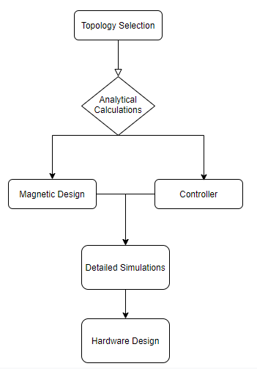
Future Works
Power loss calculations ---> Thermal calculations (heatsink) ---> PCB
Conclusion

Slide 54


