Slide 1


EE464-Term Project Martian Power Solutions
CEYHUN KOÇ 2166833
Enes Canbolat 2231546
EREN ÖZKARA 2232551

Slide 2


Analytical Calculations Before Simulation
$$V_{out}=V_{in}\left(\frac{D}{1−D}\right)\left(\frac{N2}{N1}\right)$$
$$V_{in}=220 V , D=0.18;V_{in}=400 V , D=0.11$$
$$L_{Mmin}=\left(\frac{{\left(1−D\right)}^{2}R}{2f}\right){\left(\frac{N1}{N2}\right)}^{2}$$
$${f=100 kHz, L}_{Mmin}=91.25μ H$$
$$ΔV_{o,ESR}=I_{LM,max}∗\left(\frac{N1}{N2}\right)∗r_{c}, r_{c}<0.025 ohm$$
$$V_{sw_open}=V_{in}+V_{out}∗N, V_{sw_{max}}=448 V$$
$$ΔV_{o}=\frac{ΔQ}{C}=\frac{V_{o}∗D∗T_{s}}{R∗C}, \frac{ ΔV_{o}}{V_{o}}≤0.04, C≥31.25 μF$$

Slide 3
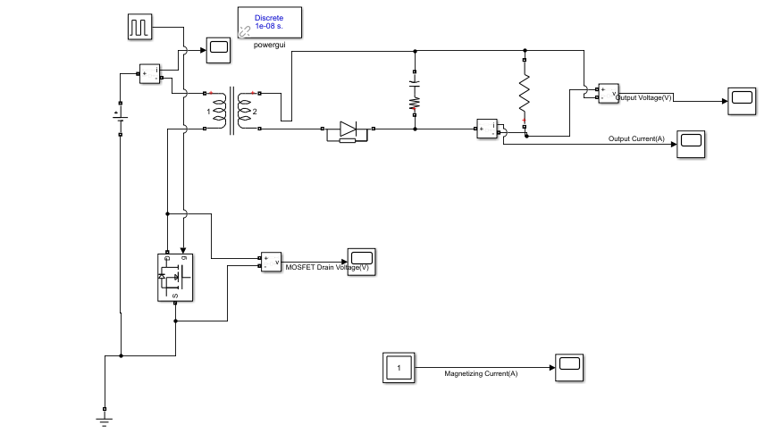
Simulations
Fig. 1 Flyback Converter Simulink Model

Slide 4
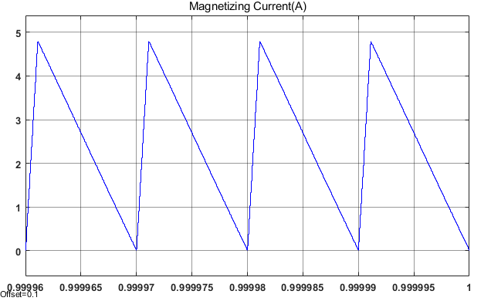
Fig. 2 Magnetizing Current of the Flyback Converter
Simulations

Slide 5
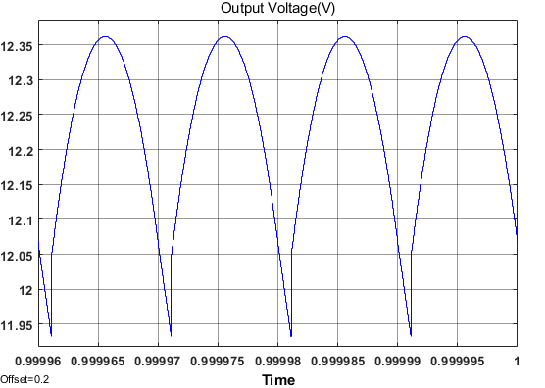
Fig. 3 Output Voltage of the Flyback Converter
Simulations

Slide 6
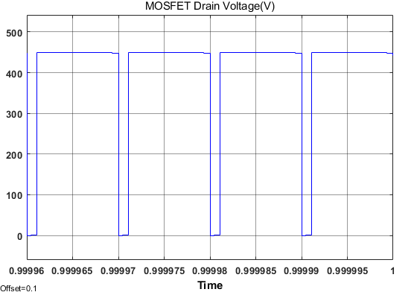
Fig. 4 Switch Voltage of the Flyback Converter
Simulations

Slide 7
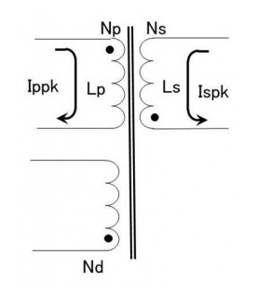
Magnetic Design
Fig. 5 Transformer Schematic

Slide 8
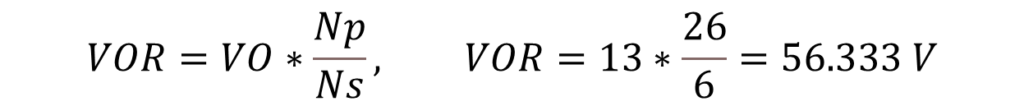
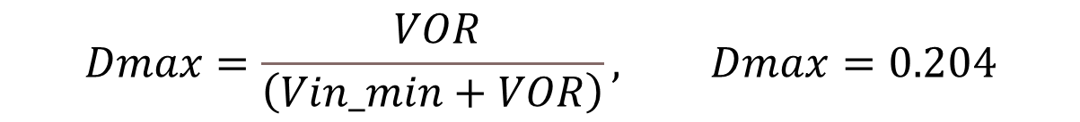
$$VO=Vout+V_{F}, VO=12+1=13 V$$
$$VOR=VO∗\frac{Np}{Ns}, VOR=13∗\frac{26}{6}=56.333 V$$
$$Dmax=\frac{ VOR}{\left(Vin_min+VOR\right)}, Dmax=0.204$$
Magnetic Design

Slide 9
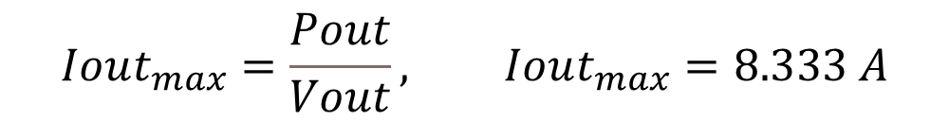



$$Iout_{max}=\frac{Pout}{Vout}, Iout_{max}=8.333 A$$
$$Ls=\frac{\left(Vout+V_{F}\right)∗{\left(1−D_{max}\right)}^{2}}{2∗Iout_{max}∗fsw_{max}}, Ls≤4.9μH, Ls=4.34μH$$
$$Ispk=\frac{2∗Iout_{max}}{1−D_{max}}=20.1 A$$
$$Lp=Ls∗{\left(\frac{Np}{Ns}\right)}^{2}=81.5 μH$$
$$Ippk=\frac{Ispk}{Np/Ns}=4.83 A$$
Magnetic Design

Slide 10
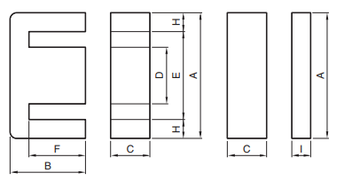
Table. 1 Magnetic Properties
Core Type | Effective Cross-Sectional Area Ae (mm2) | Maximum Magnetic Flux Density (T) | AL-Value with Air Gap (nH/N^2)
PC47EI25 | 41 | 0.42 | 125
𝐹𝑖𝑙𝑙 𝐹𝑎𝑐𝑡𝑜𝑟 : EI40, EI30 < 0.4,
EI25 = 0.41
Table. 2 Core Dimensions
Core | A (mm) | C(mm) | D (mm) | E(mm) | F (mm)
EI25 | 25.3 | 5.75 | 6.5 | 19 | 12.35
Magnetic Metarial and Core Selection

Slide 11

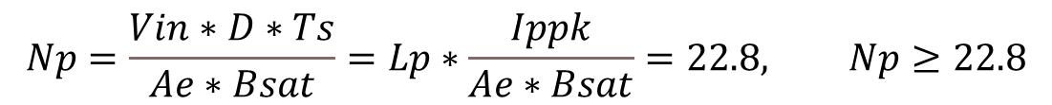

$$Np=\frac{Vin∗D∗Ts}{Ae∗Bsat}=Lp∗\frac{Ippk}{Ae∗Bsat}=22.8, Np≥22.8$$
$$Np=\sqrt{\frac{Lp}{AL}}=25.53, Np=25$$
$$MMF=Np∗Ippk=120.75 At$$
$$Ns=\frac{\frac{Np}{Np}}{Ns}=6$$
$$Nd=6$$
Calculation of Winding Turns Ratio

Slide 12
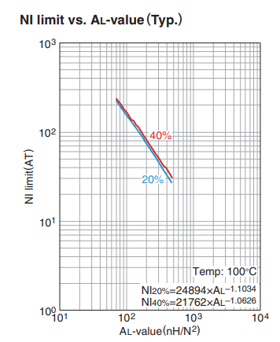
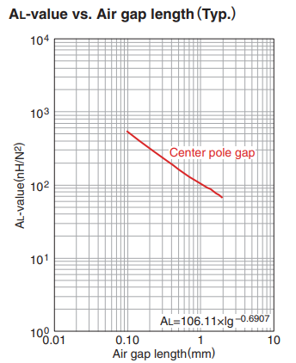
Fig. 5 NI limit and Air gap vs AL value Graphs
Datasheet of PC47EI25

Slide 13
$$Vp_{rms}∗Ip_{rms}=\frac{Np∗Ae∗Bsat}{D∗Ts}∗Ip_{rms}=P_{o}=197.5 W$$
$$Vp_{rms}∗Ip_{rms}=100 W=\frac{Np∗Ae∗B_{operating}}{D∗Ts}∗Ip_{rms}, B_{operating} =0.2 T$$
Power Calculation of Transformer

Slide 14

Table. 2 Selected Cable Properties
Wire | Area (mm2) | Diameter(mm) | Ampacity(A) (75°C) | Resistivity (p) (10^-8 Ω.m) | Absolute magnetic permeability (u) (10^-7 H/m)
AWG10 | 5.26 | 2.588 | 35 | 1.678 | 12.55
AWG20 | 0.518 | 0.812 | 11 | 1.678 | 12.55
AWG30 | 0.509 | 0.255 | 0.86 | 1.678 | 12.55
$$Fill_{Factor}=\frac{Cable_{A}}{Window_{A}}=\frac{48}{116.1}=0.41$$
Cable Selection

Slide 15

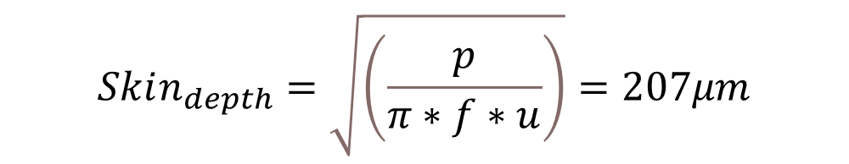
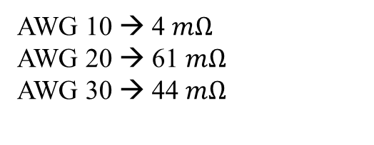
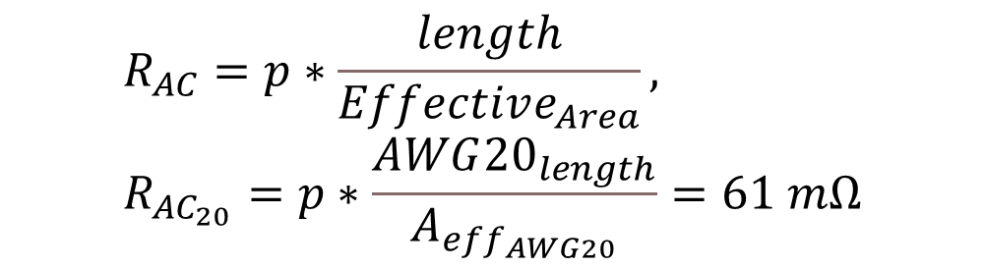
$$length=\left(C+\frac{D+E}{2}\right)∗2, AWG{20}_{length}=length∗Np=0.962 m$$
$$Skin_{depth}=\sqrt{\left(\frac{p}{π∗f∗u}\right)}=207μm$$
$$Effective_{Area}=Skin_{depth}∗pi∗Diameter,$$
$$A_{eff_{AWG20}}=Skin_{depth}∗π∗AWG{20}_{d}=0.528mm2$$
$$R_{AC}=p∗\frac{length}{Effective_{Area}}, R_{AC_{20}}=p∗\frac{AWG{20}_{length}}{A_{eff_{AWG20}}}=61 mΩ$$
AWG 10 → 4 $mΩ$
AWG 20 → 61 $mΩ$
AWG 30 → 44 $mΩ$
More than 2 W Copper Loss (Proximity effect is ignored)
Skin Depth and R Calculation

Slide 16
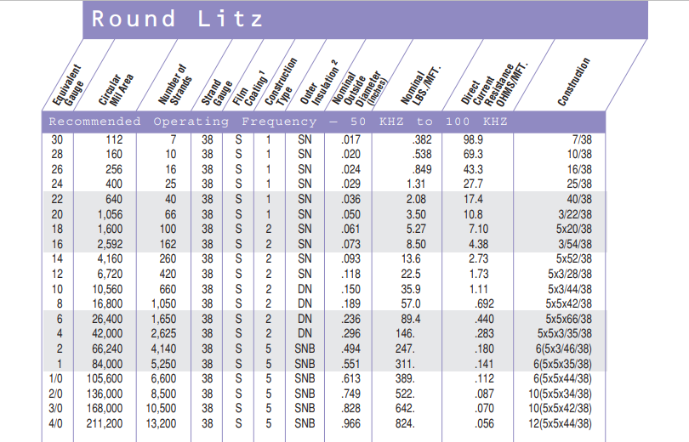



Nb → # of bunching operations
Nc → # of cabling operations
Ns → # of individual strands
$$Rdc=\frac{RS∗\left({\left(1.02\right)}^{Nb}\right)∗\left({\left(1.03\right)}^{Nc}\right)}{Ns}$$
$$R_{AC_{10}}=0.8 mΩ,$$
$$R_{AC_{20}}=34.6 mΩ,$$
$$R_{AC_{30}}=73.1 mΩ$$
The copper loss decreased to 0.1 W thanks to the Litz wire !
Litz Wire

Slide 17
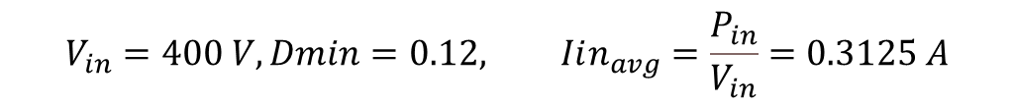

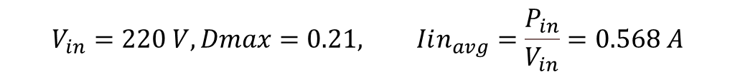

Power Calculations
$$Iout_{avg}=\frac{Pout}{Vout}, Iout_{avg}=8.333 A$$
$$V_{in}=220 V, Dmax=0.21, Iin_{avg}=\frac{P_{in}}{V_{in}}=0.568 A$$
$$Iin_{peak}=2∗\frac{Iin_{avg}}{Dmax}=5.4 A$$
$$P_{diode}=V_{F}∗Iout_{avg}=8.333 W$$
$$P_{secondary}=P_{out}+P_{diode}=108.33 W$$
$$V_{in}=400 V, Dmin=0.12, Iin_{avg}=\frac{P_{in}}{V_{in}}=0.3125 A$$
$$P_{primary}=\frac{P_{secondary}}{η_{transformer}}=120.367 W$$
$$Iin_{peak}=2∗\frac{Iin_{avg}}{Dmin}=5.2 A$$

Slide 18
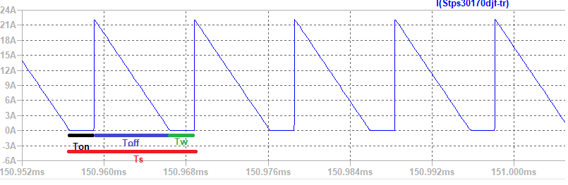
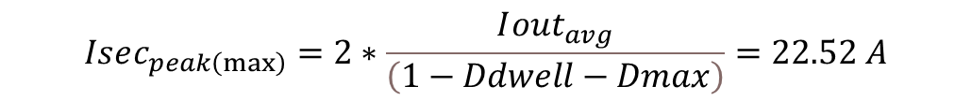
$$Ddwell=\text{0.05∗}\text{D}\text{∗}\text{Ts}$$
Secondary Side Diode Current
$$Isec_{peak\left(max\right)}=2∗\frac{I{out}_{avg}}{\left(1−Ddwell−Dmax\right)}=22.52 A$$
Power Calculation

Slide 19
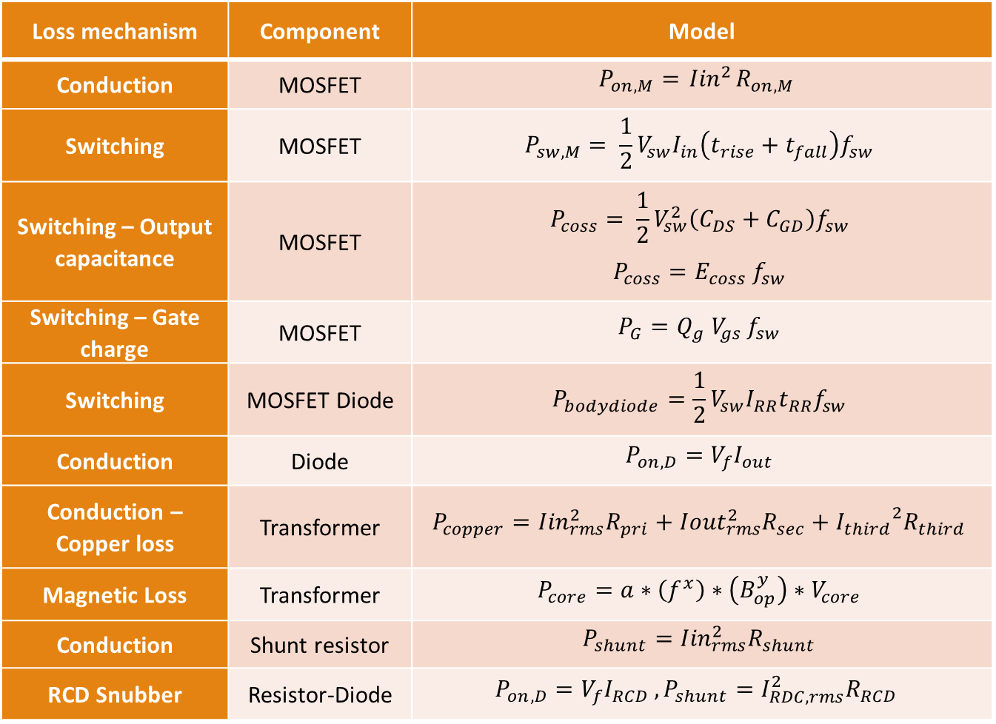
Loss mechanism | Component | Model
Conduction | MOSFET | $$P_{on,M}={ Iin}^{2}R_{on,M}$$
Switching | MOSFET | $$P_{sw,M}= \frac{1}{2}V_{sw}I_{in}\left(t_{rise}+t_{fall}\right)f_{sw}$$
Switching – Output capacitance | MOSFET | $$P_{coss}= \frac{1}{2}V_{sw}^{2}\left(C_{DS}+C_{GD}\right)f_{sw}$$ $$P_{coss}=E_{coss}{ f}_{sw}$$
Switching – Gate charge | MOSFET | $$P_{G}=Q_{g}{ V}_{gs} f_{sw}$$
Switching | MOSFET Diode | $$P_{bodydiode}=\frac{1}{2}V_{sw}I_{RR}t_{RR}f_{sw}$$
Conduction | Diode | $$P_{on,D}=V_{f}I_{out}$$
Conduction – Copper loss | Transformer | $$P_{copper}={Iin}_{rms}^{2}R_{pri}+{Iout}_{rms}^{2}R_{sec}+{I_{third}}^{2}R_{third}$$
Magnetic Loss | Transformer | $$P_{core}=a∗\left(f^{x}\right)∗\left(B_{op}^{y}\right)∗V_{core}$$
Conduction | Shunt resistor | $$P_{shunt}={Iin}_{rms}^{2}R_{shunt}$$
RCD Snubber | Resistor-Diode | $$P_{on,D}=V_{f}I_{RCD} , P_{shunt}=I_{RDC,rms}^{2}R_{RCD}$$
Power Calculation Table

Slide 20
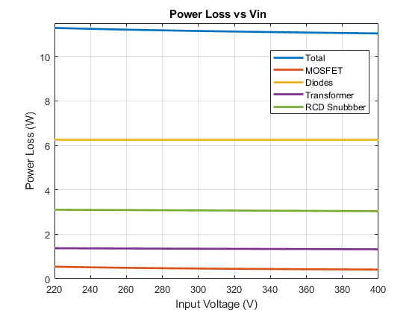
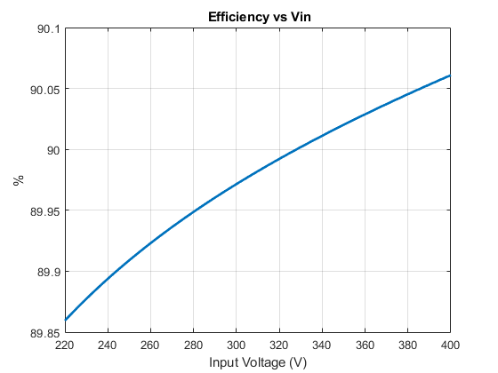
Power Calculation Results

Slide 21
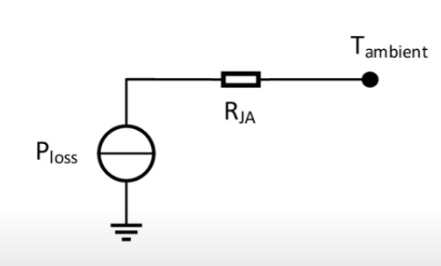
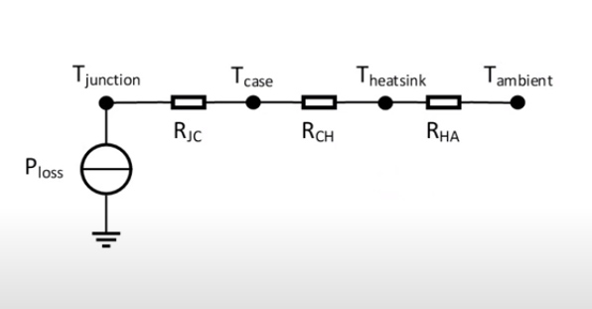
Thermal Calculations
Schematic of Junction Temperature without and with Heatsink

Slide 22
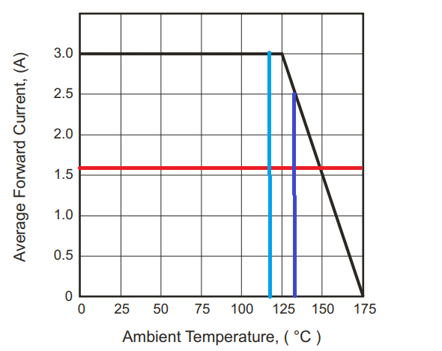
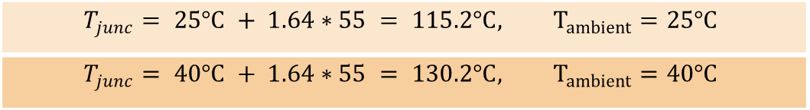
MOSFET
R_{thJA,TYP} - R_{thJA,MAX}: 35°C/W - 62°C/W
R_{DS} | Assumed T_{J} | Max. Power Loss | Calculated max T_{J}
0.50Ω | 25°C | 0.54 W | 58°C
0.60Ω | 58°C | 0.57 W | 60.3°C
0.61Ω | 60.3°C | 0.58W | 61°C
0.61Ω | 61°C | 0.58W | 61°C
No need to heatsink since MOSFET can operate up to 150°C
5 Output Diode
$$T_{junc}= 25°C + 1.64∗55 = 115.2°C, T_{ambient}=25°C$$
$$T_{junc}= 40°C + 1.64∗55 = 130.2°C, T_{ambient}=40°C$$
Typical Forward Current Derating Curve of the Diode
Snubber diode just consume 15mW.
Thermal Calculation

