Slide 1
Amazon Review Rating Prediction - NLP Study
Enes Gokce May 2020

Slide 2

Introduction
Online product review networks help to transmit information that customers can use to evaluate products in Internet commerce.
These networks frequently include an explicit social component allowing consumers to view both how community members have rated individual product reviews and the social status of individual reviewers.

Slide 3

The Problem
Seller reviews in eBay influence the probability of a sale. This raises the following questions:
•What makes a review positive and what makes it negative?
• What do good reviews and bad reviews themselves have in common?

Slide 4
The Client
The findings of these study can help sellers on Amazon:
what are the common topics that people write good review and bad review
an information-driven investment on product and service improvement

Slide 5
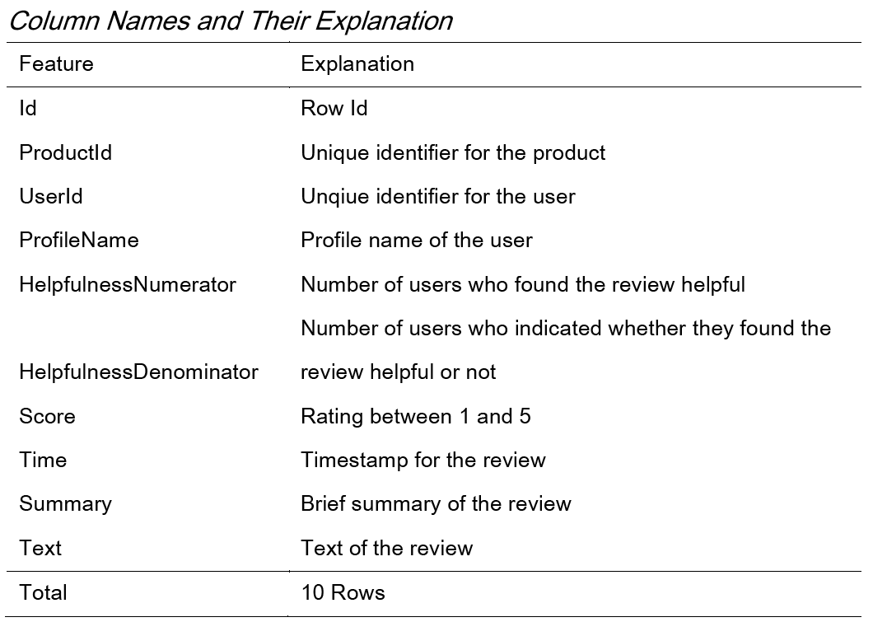
The Data

Slide 6
The flow of the Study:

Slide 7
Feature Extraction – Round 1
Number of stop words
Number of hashtag
Number of numerical characters
Number of Uppercase words

Slide 8

Text cleaning techniques
Make all text lower case
Removing Punctuation
Removal of Stop Words
Removing URLs
Remove HTML tags
Removing Emojis
Remove Emoticons
Spell Correction

Slide 9
Feature Extraction- Round 2
Number of Words: how many words there are in the review.
Number of characters: how many letters are contained in the review.
Average Word Length: average number of letters in the words in a review.
Creating the column: Good_Reviews
Score feature will be converted in Good_Reviews columns. This column has two values:
0: Reviews that have score value 1, 2 or 3
1: Reviews that have score value 4 or 5.

Slide 10
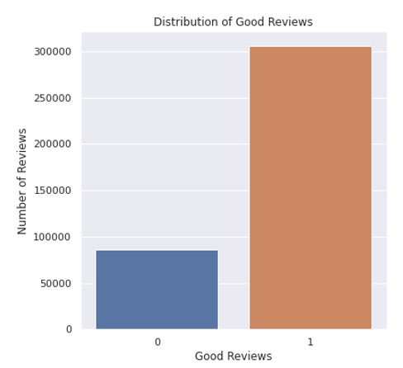
Data Visualization and Data Wrangling
This is an unbalanced data
While making prediction, model performance of unbalanced data is different than balanced data

Slide 11
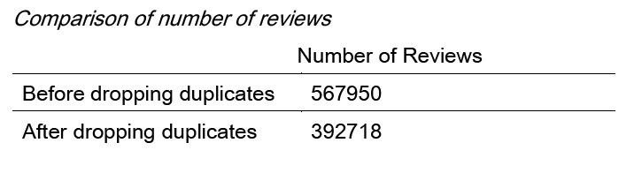
Dropping duplicate reviews

Slide 12
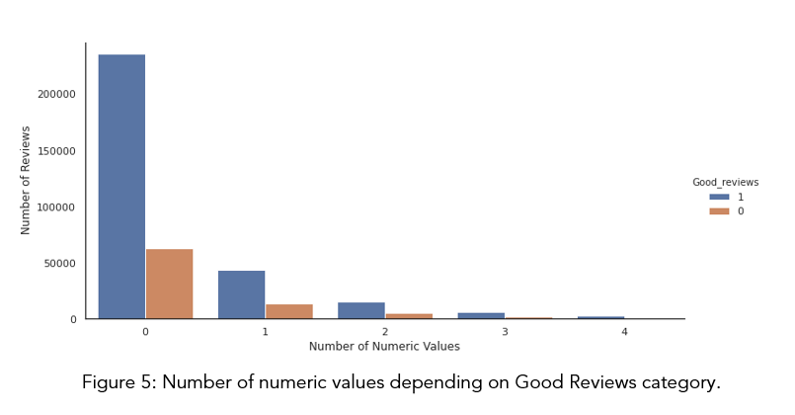
Number of numeric values depending on Good Reviews category

Slide 13
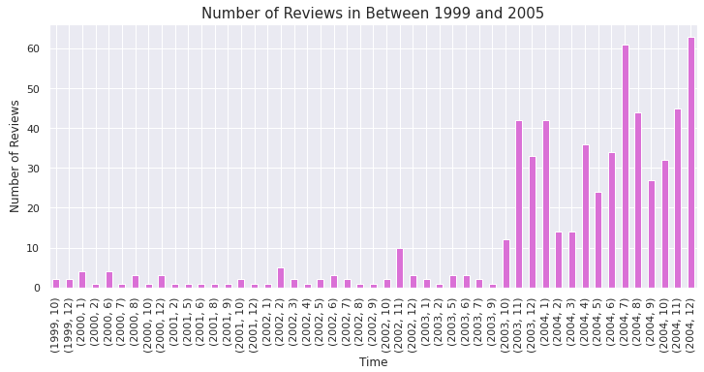

Slide 14
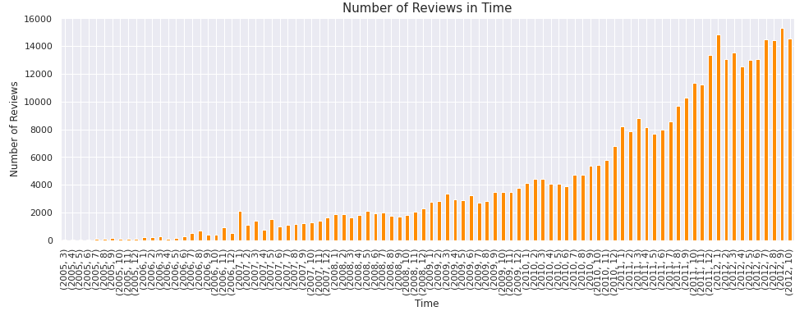

Slide 15
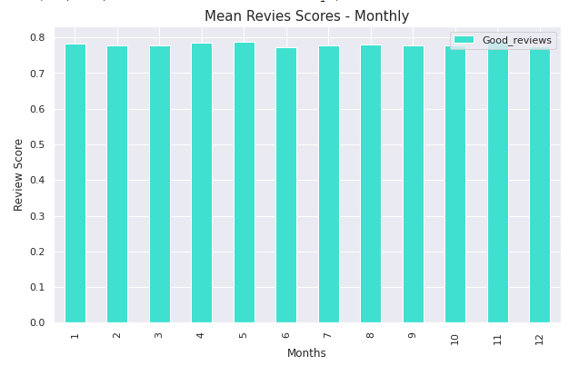
what are the coming[TS1] common topics that people write good review and bad review
[TS1]Common?

Slide 16
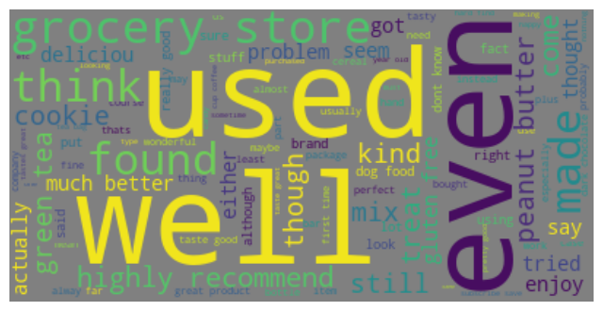
Most Frequent 100 Words
100 words

Slide 17

Sentiment Analysis
Helps us
understand the data better.
The reviews are unstructured, or unorganized.
Helps us make sense of all this unstructured text by automatically tagging it
process huge amounts of data in an efficient and cost-effective way.
In this study, two main sentiment classifiers were used:
1. Polarity
2. Subjectivity

Slide 18
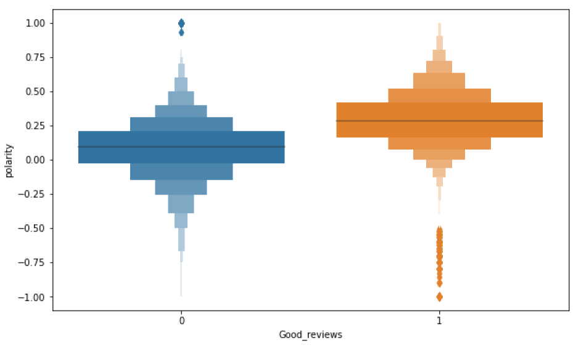
Polarity
Polarity is numerical value which lies in the range of [-1,1] where 1 means positive statement and -1 means a negative statement.
Boxplot of distribution of polarity regarding good or bad review

Slide 19
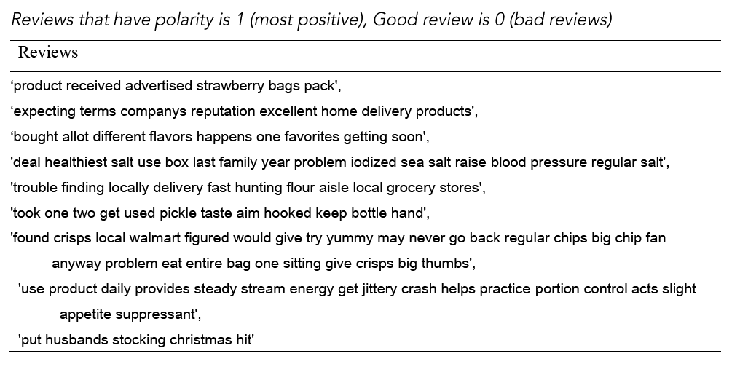
Example reviews

Slide 20
Some Reviews that have polarity of 1 (most positive), Good review is 0 (bad reviews)
‘product received advertised strawberry bags pack',
‘expecting terms companys reputation excellent home delivery products',
‘bought allot different flavors happens one favorites getting soon',
'deal healthiest salt use box last family year problem iodized sea salt raise blood pressure regular salt',
'trouble finding locally delivery fast hunting flour aisle local grocery stores',
'took one two get used pickle taste aim hooked keep bottle hand',
'found crisps local walmart figured would give try yummy may never go back regular chips big chip fan anyway problem eat entire bag one sitting give crisps big thumbs',
'use product daily provides steady stream energy get jittery crash helps practice portion control acts slight appetite suppressant',
'put husbands stocking christmas hit'

Slide 21
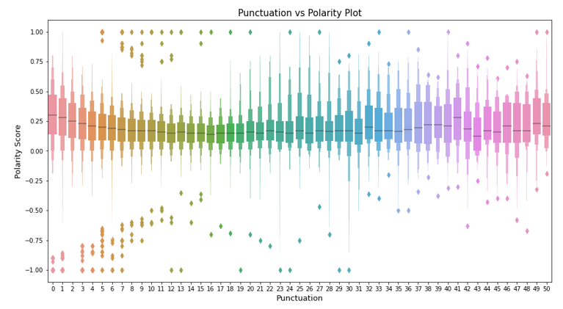
Number of punctuation and polarity score

Slide 22
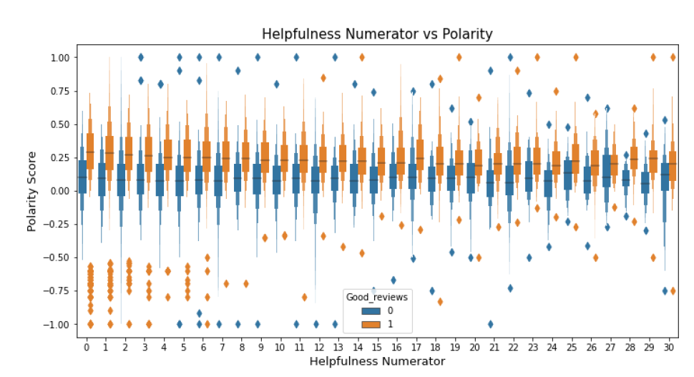
Helpfulness and Polarity in category of Good Reviews

Slide 23
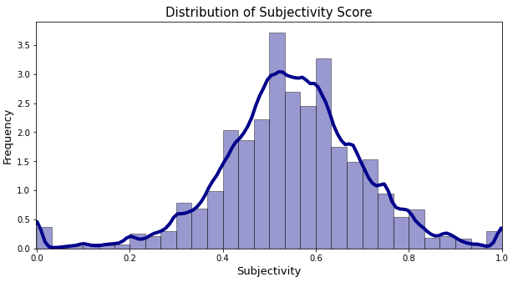
Subjectivity
subjectivity is also a numerical value which lies in the range of [0,1]. When it is close to 0, it is more about facts. When it increases, it comes close to be an opinion.
Distribution of subjectivity scores for reviews are similar to normal distribution

Slide 24
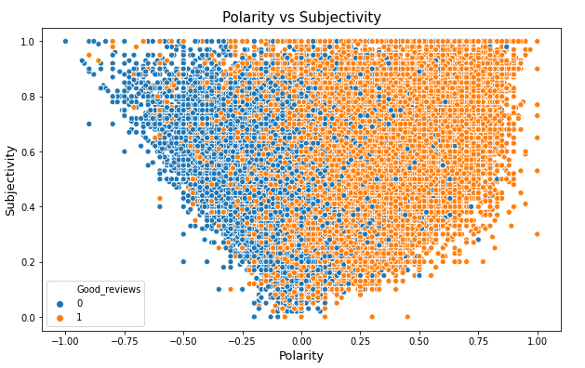
Subjectivity and polarity scores regarding to good reviews category

Slide 25
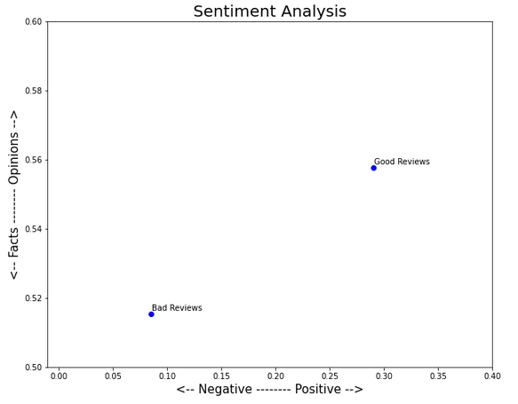
Mean value of polarity and subjectivity scores for review ratings

Slide 26
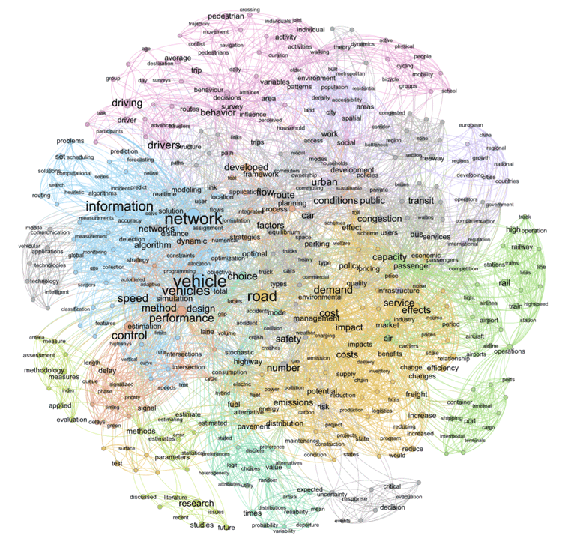
Topic Modeling
The ultimate goal of topic modeling is to find various subjects that are present in your corpus. Each document in the corpus will be made up of at least one topic, if not multiple topics.
Latent Dirichlet Allocation (LDA), which is one of many topic modeling techniques. LDA was specifically designed for text data.
3 Attempts:
Topic modeling - Attempt 1 (with all the review data)
Topic Modeling - Attempt 2 (Nouns only)
Topic Modeling - Attempt 3 (Nouns and Adjectives)

Slide 27
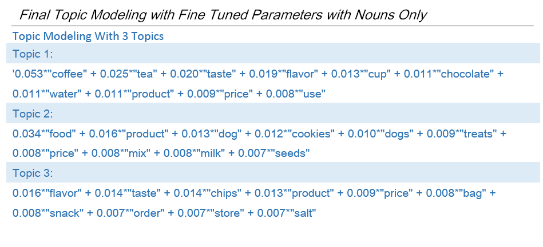
Most meaningful Groups
three main topics: (1) beverages, (2) pet items, and (3) cookies and snacks.

Slide 28

Machine Learning Models
Model will be used:
Gaussian Naive Bayes
Multinomial Naive Bayes
Bernoulli Naive Bayes
Complement Naive Bayes
Logistic Regression

Slide 29
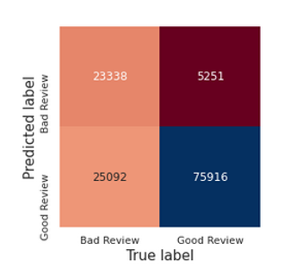
Confusion matrix for Gaussian NB model

Slide 30
Comparison of Model Performances
Measure (%) / Model | Gaussian NB | Multinomial NB | Bernoulli NB |  | Complement NB | Logistic Reg
Accuracy | 77 | 83 |  | 83 | 82 | 88
Precision | 94 | 82 |  | 90 | 94 | 90
Recall | 95 | 99 |  | 89 | 81 | 95
f1 | 77 | 83 |  | 83 | 82 | 88

Slide 31
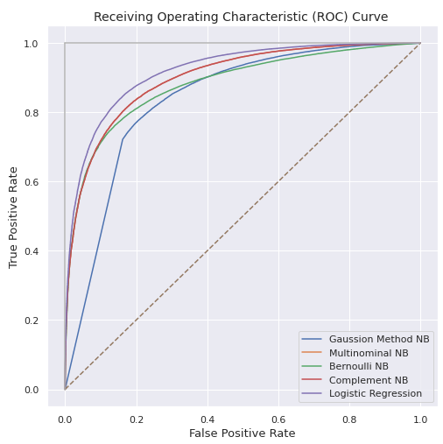
Receiver Operating Characteristic (ROC) Curve
This metric evaluates classifier output quality.
A larger area under the curve (AUC) is usually better
Highest true positive rate and lowest false positive rate is performed by logistic regression model

Slide 32
Limitations of the Study
Linguistic and socio-linguistic interpretation of emojis may be useful in sentiment analysis.
Stemming and lemmatization may improve the prediction power. They can be applied and prediction performance results can be compared.
For dealing with misspelled words, I used ‘TextBlob.correct()’ method during data cleaning. Isolated-term correction and context-sensitive correction methods may improve the spelling correction.
Predictions in this study only used text data and focused on NLP based methods. However, random forest, lasso, ridge, xgboost may also give good classification by using other features available in the dataset.

