Slide 1
Missing Values Features

Slide 2
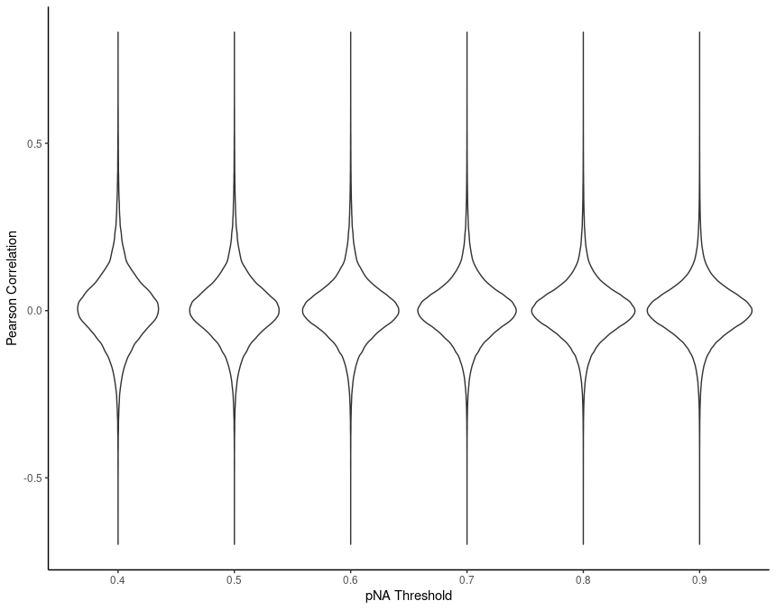
na.rm corrected!

Slide 3
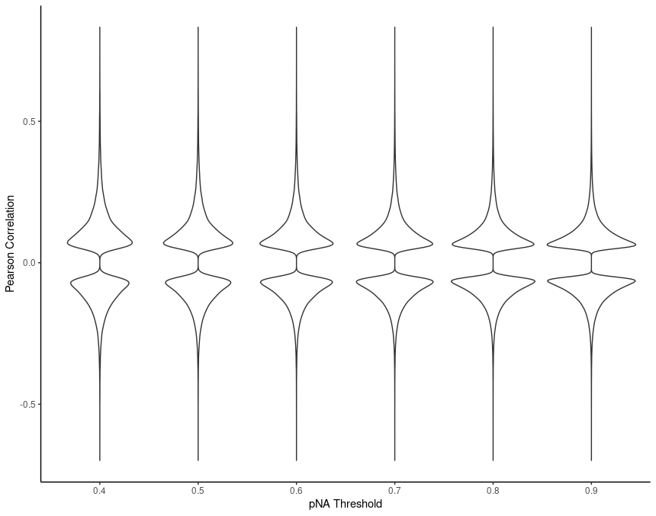
Subset p < 0.05

Slide 4
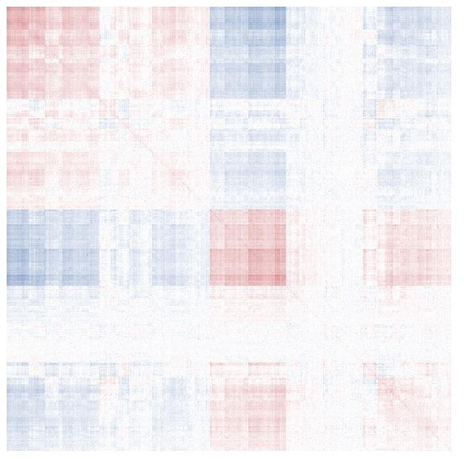
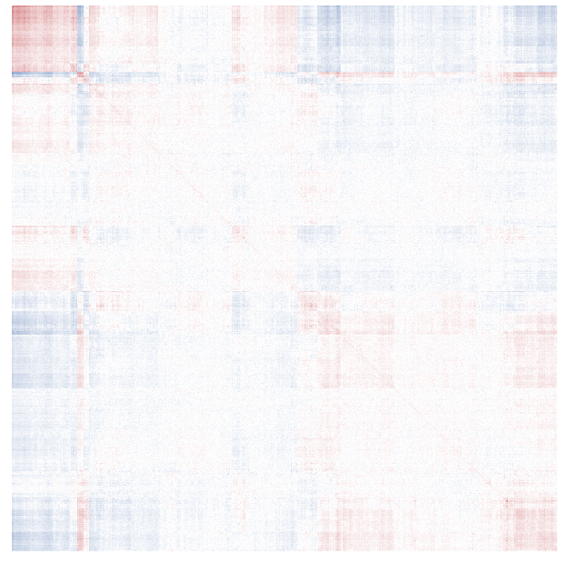
1201 Proteins (pNA 0.965), more than 96.5% missing
1188 Proteins (pNA 0.91), less than 91% missing

Slide 5
Missing Values Samples

Slide 6
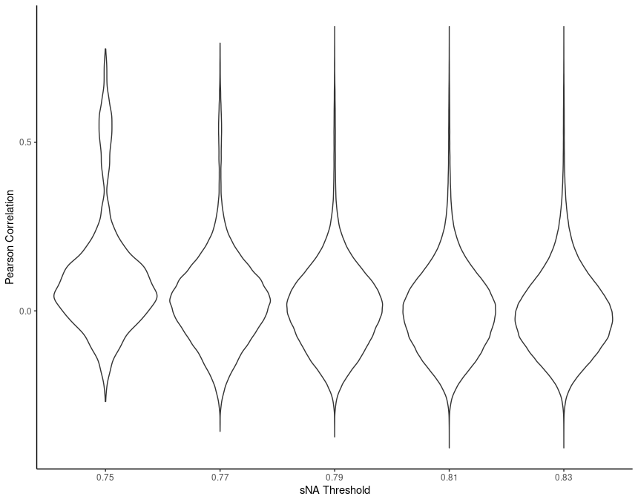
Samples with less than 0.X missing values

Slide 7
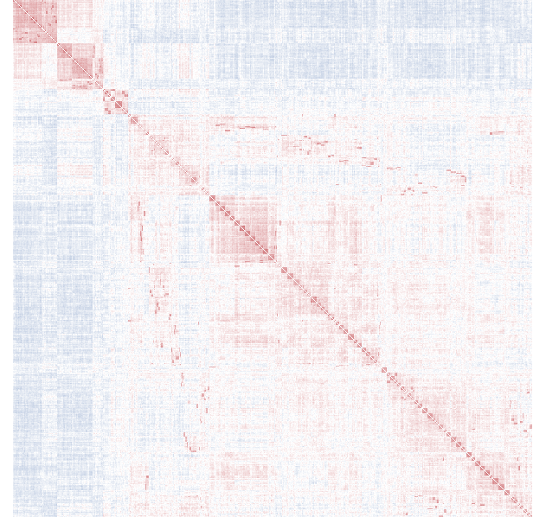
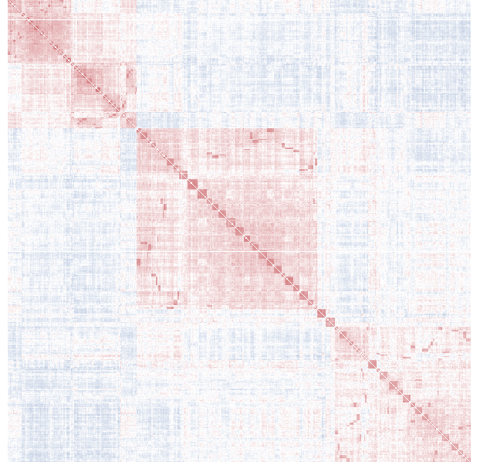
924 Samples (sNA 0.8), less than 80% missing
566 Samples (sNA 0.8), more than 80% missing

Slide 8
HVGs

Slide 9
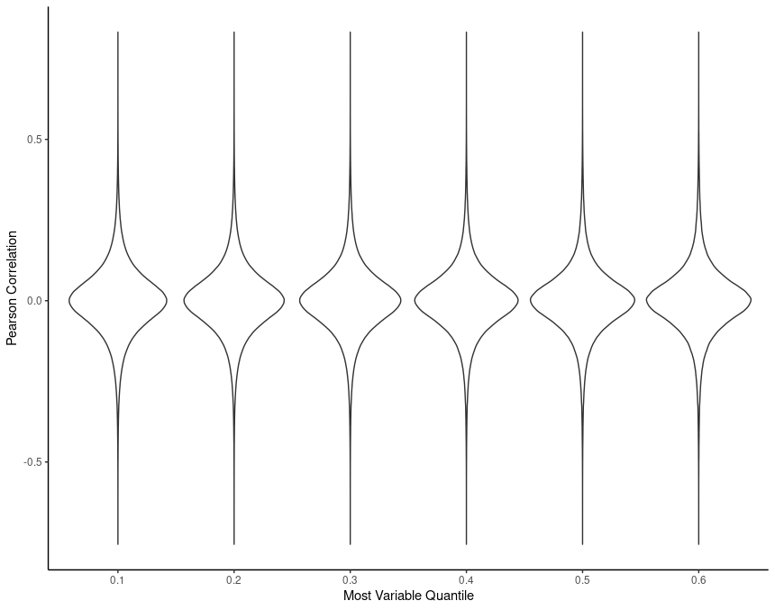

Slide 10


Slide 11
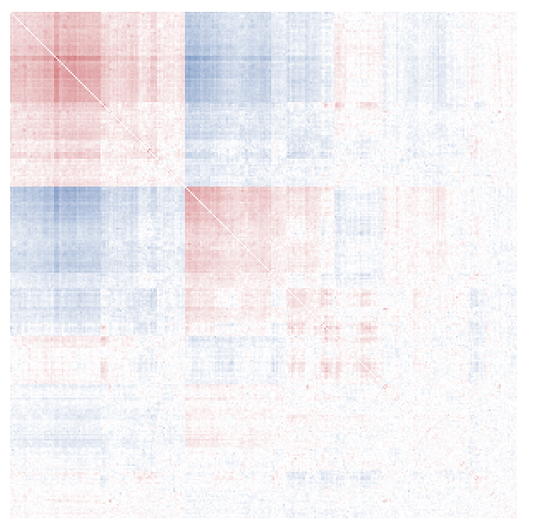
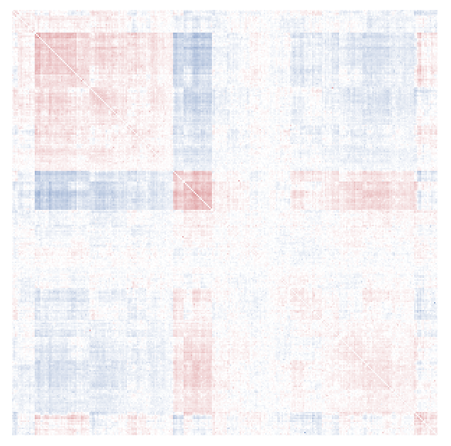
305 Proteins, most variable 10%
305 Proteins, least variable 10%

