Slide 1
Missing Values

Slide 2
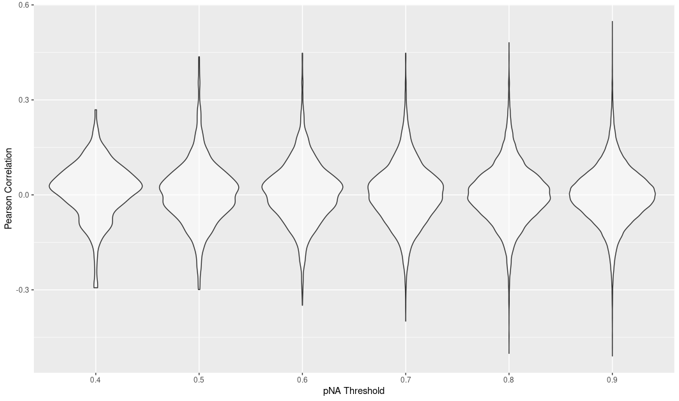
More Missing Values → Better Correlation Coefficients Observed?

Slide 3
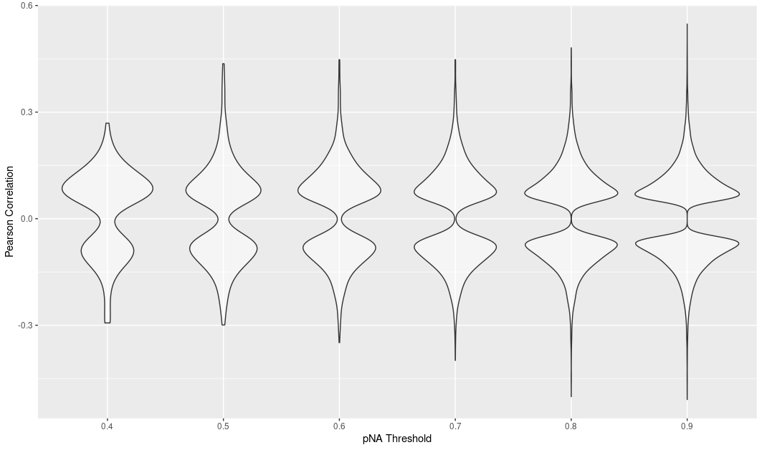
Subset p < 0.05, No effect on better correlations

Slide 4
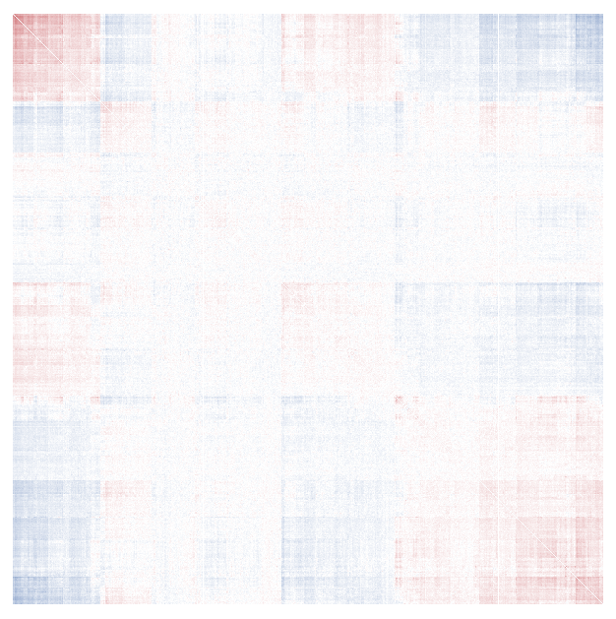
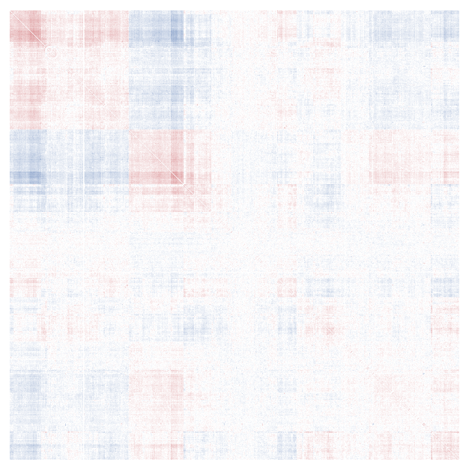
886 Proteins (pNA 0.9999), more than 99.99% missing
851 Proteins (pNA 0.965), less than 96.5% missing

Slide 5
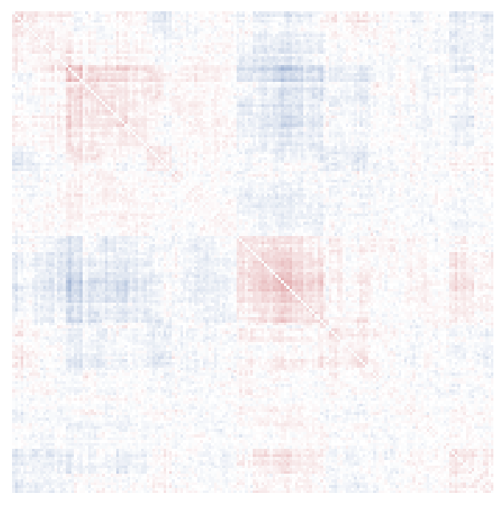
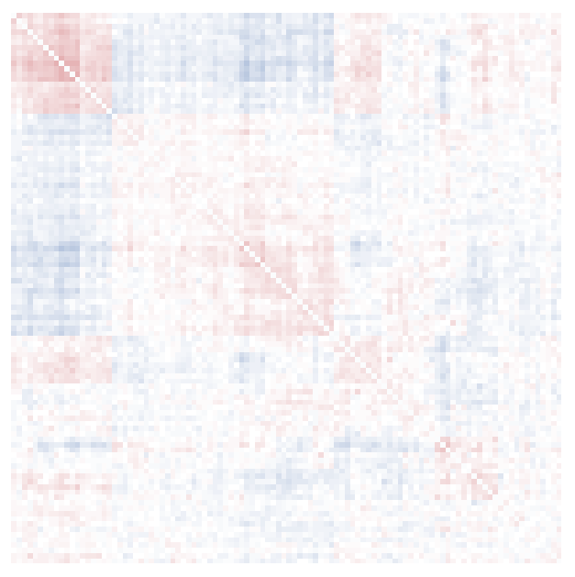
172 Proteins (pNA 0.80), less than 80% missing
104 Proteins (pNA 0.7), less than 70% missing

Slide 6
HVGs

Slide 7
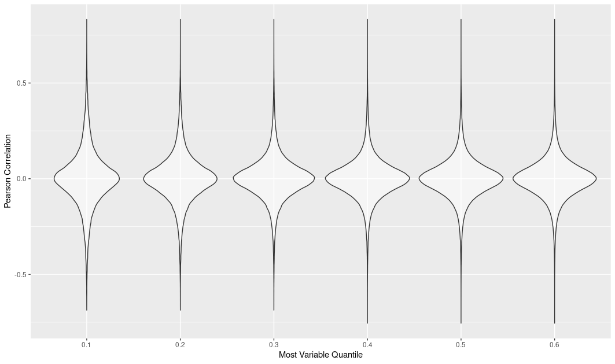

Slide 8
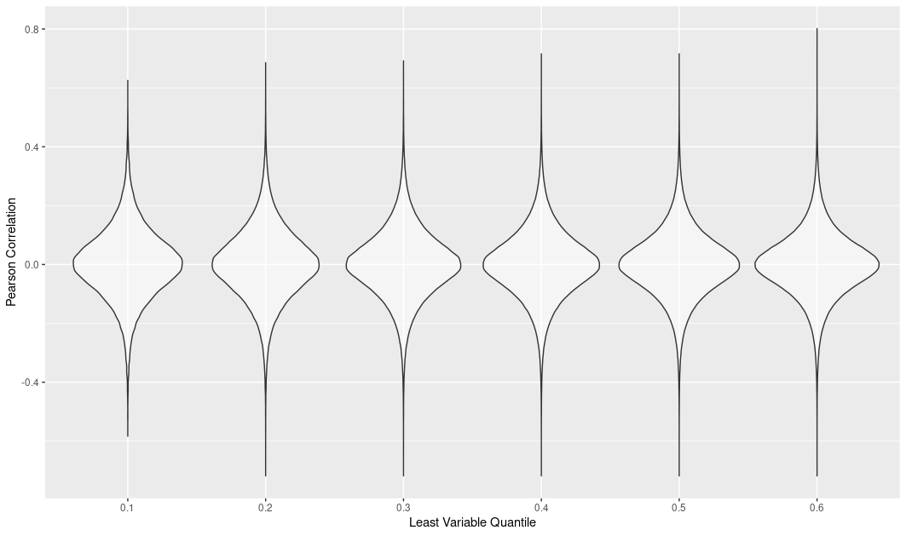

Slide 9
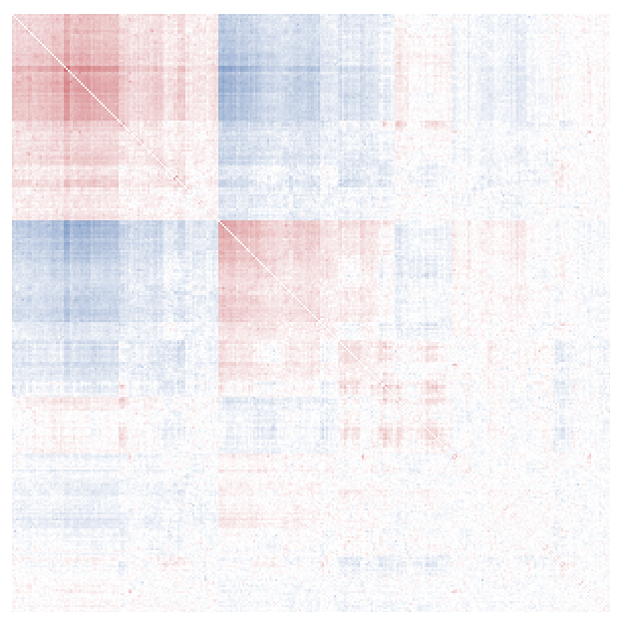
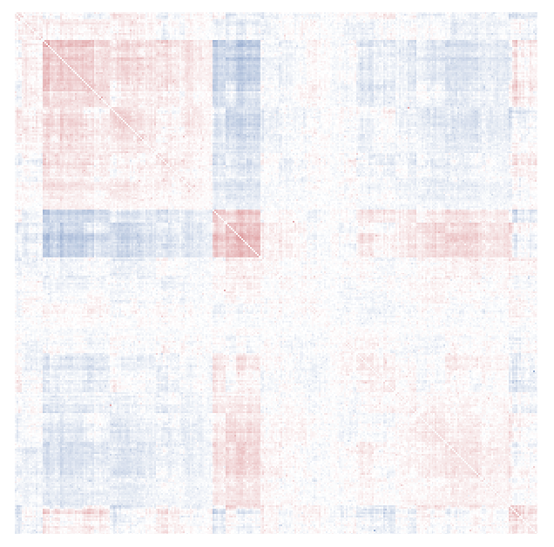
305 Proteins, most variable 10%
305 Proteins, least variable 10%

Slide 10
Combined (Missing + HVGs)

Slide 11
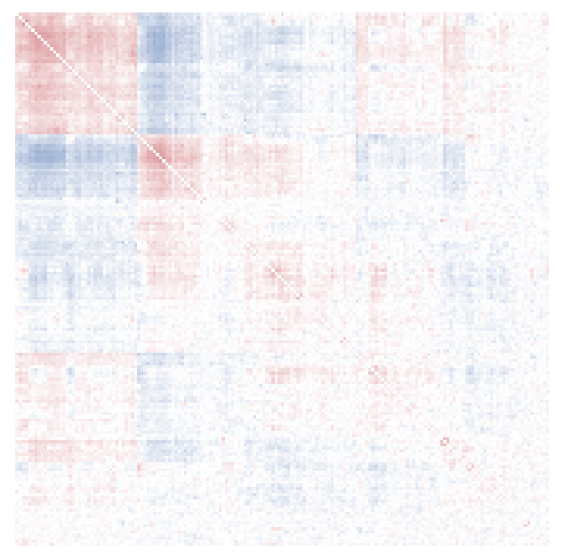
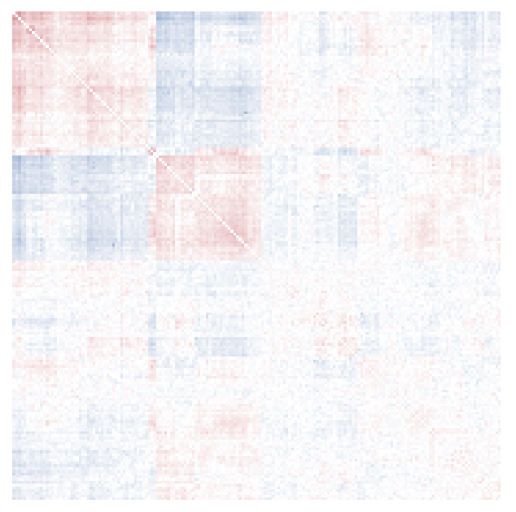
171 Proteins
less than 96.5% missing
most variable 20%
177 Proteins
more than 99.99% missing
least variable 20%

Slide 12
WGCNA Missing Values

Slide 13
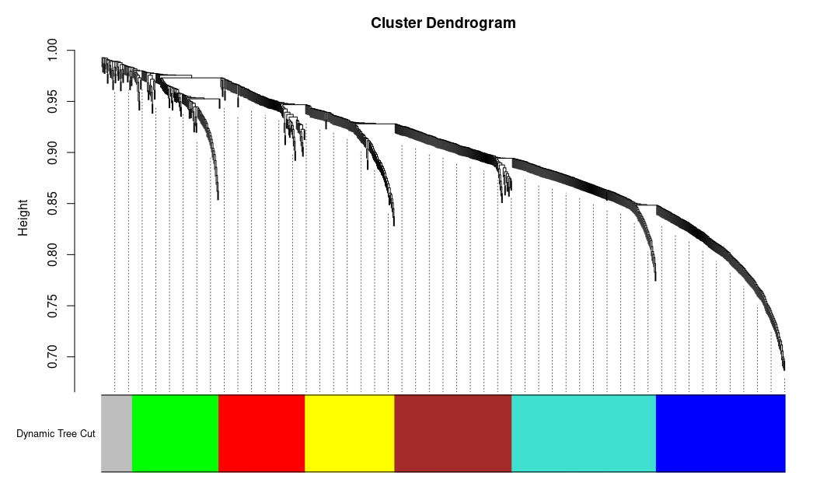
886 Proteins (pNA 0.9999), more than 99.99% missing

Slide 14
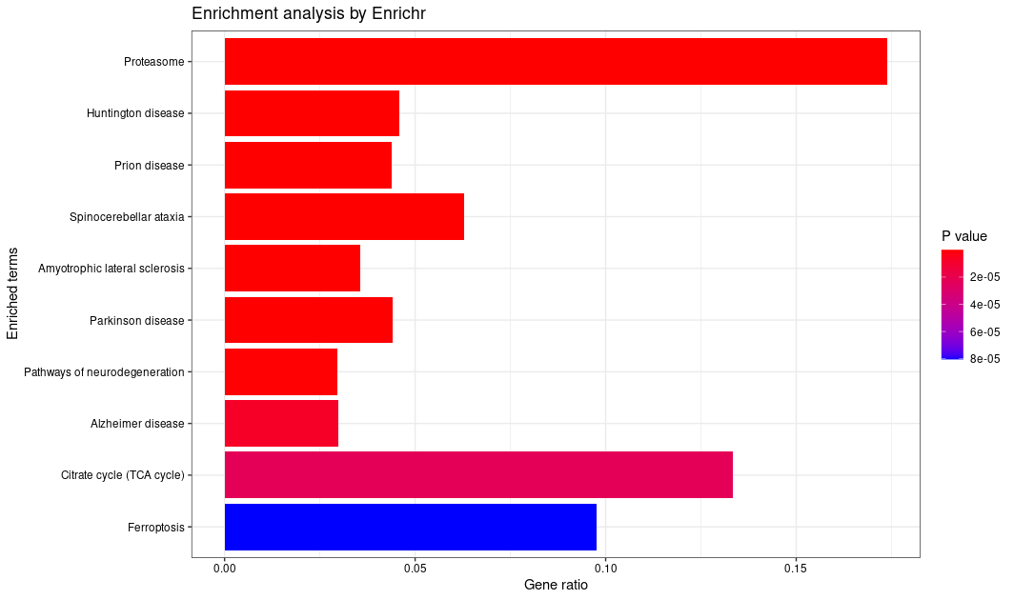
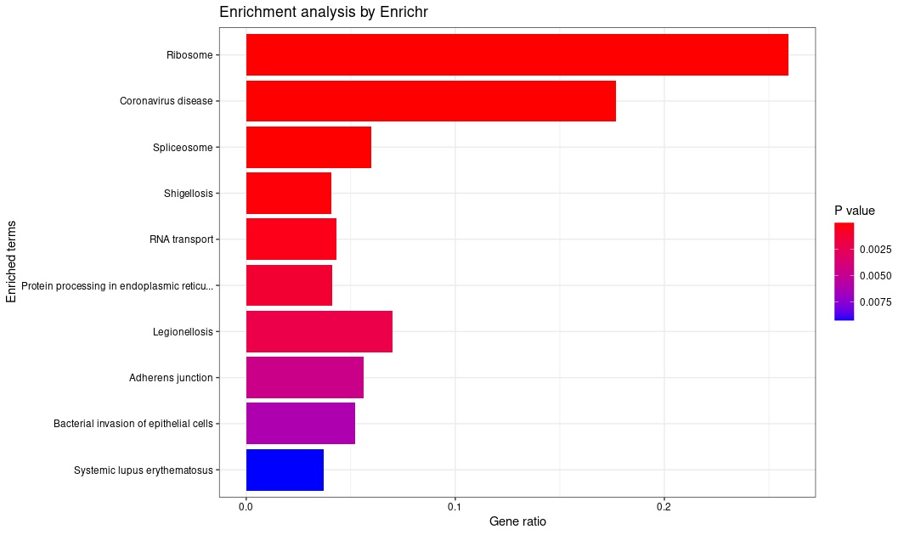
886 Proteins (pNA 0.9999), more than 99.99% missing

Slide 15
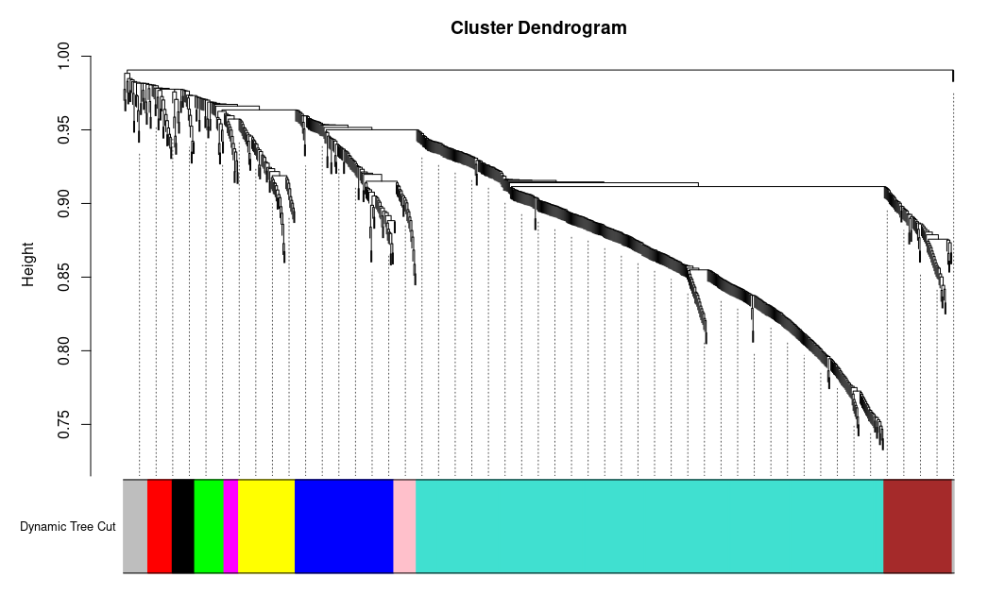
851 Proteins (pNA 0.965), less than 96.5% missing

Slide 16
No Significant Enrichment?
851 Proteins (pNA 0.965), less than 96.5% missing

Slide 17
CPM Missing Values

Slide 18
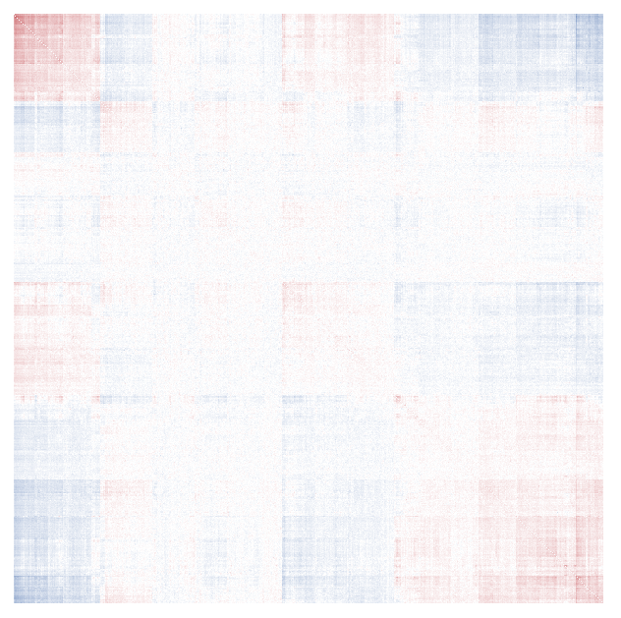
886 Proteins (pNA 0.9999), more than 99.99% missing

Slide 19
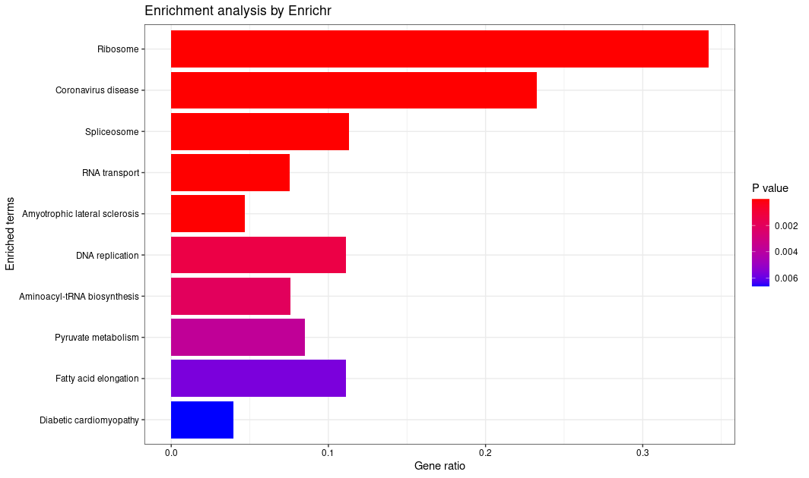
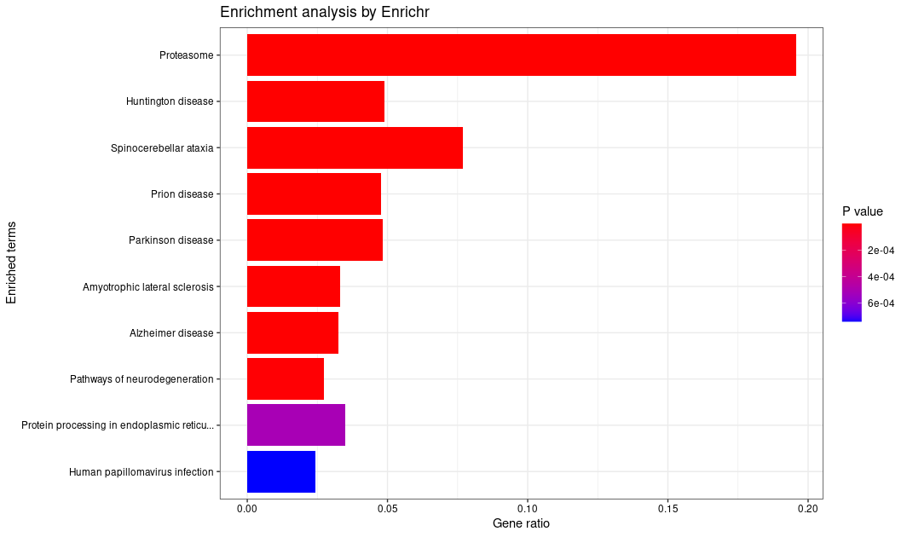
886 Proteins (pNA 0.9999), more than 99.99% missing

Slide 20

851 Proteins (pNA 0.965), less than 96.5% missing

Slide 21
No Significant Enrichment?
851 Proteins (pNA 0.965), less than 96.5% missing

Slide 22
WGCNA HVGs

Slide 23
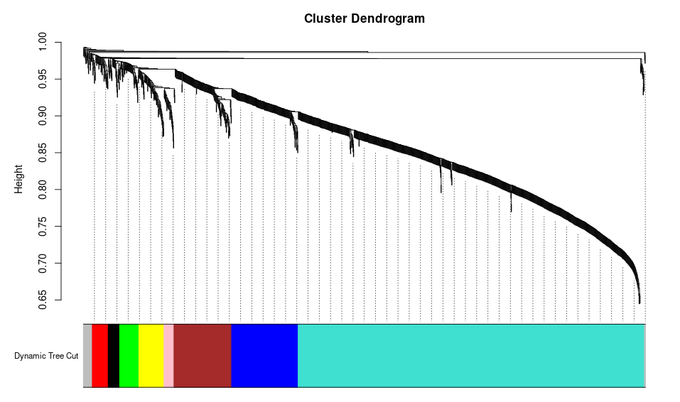
1521 Proteins, most variable 50%

Slide 24
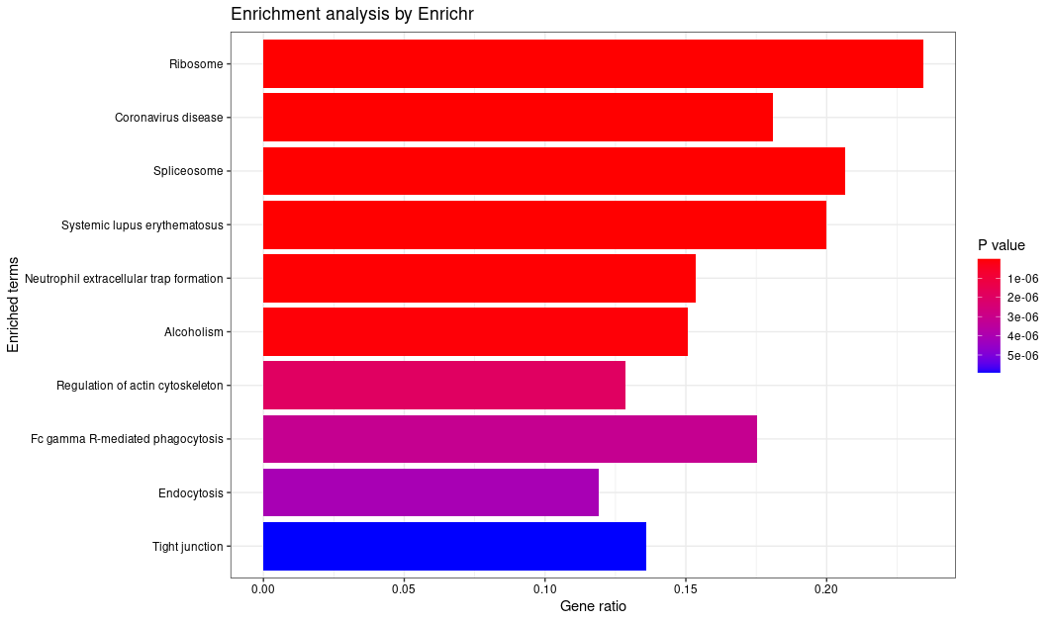
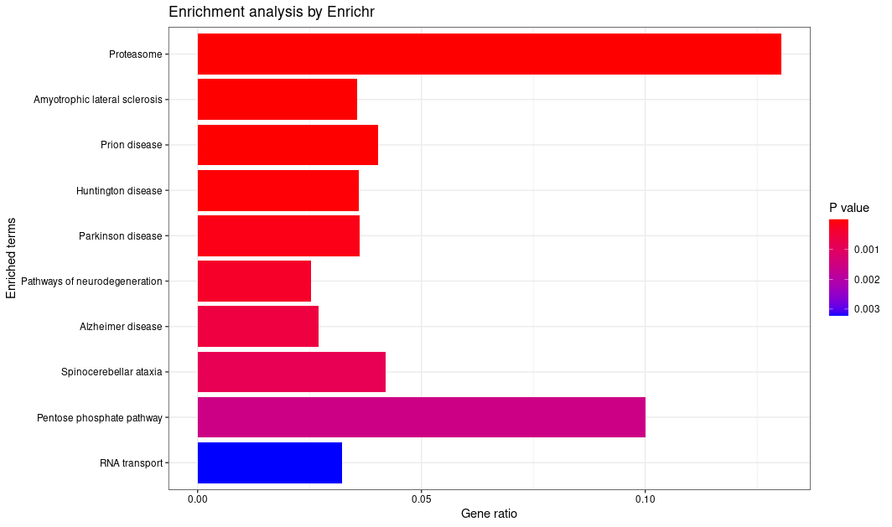
1521 Proteins, most variable 50%

Slide 25
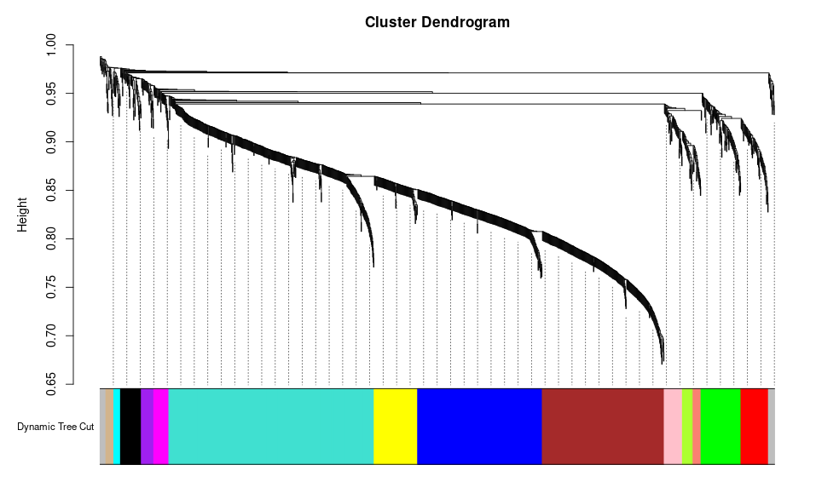
1521 Proteins, least variable 50%

Slide 26
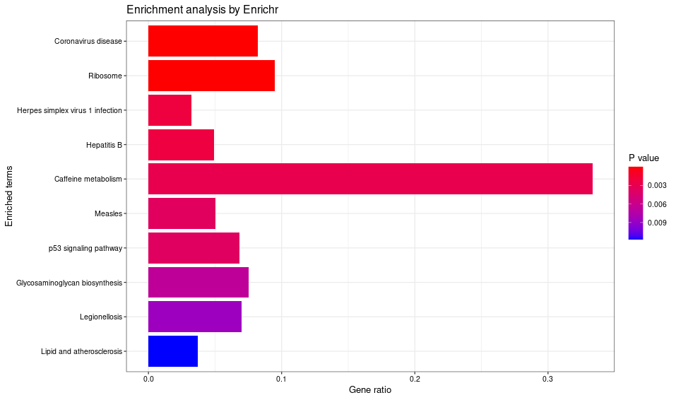
1521 Proteins, least variable 50%

Slide 27
CPM HVGs

Slide 28
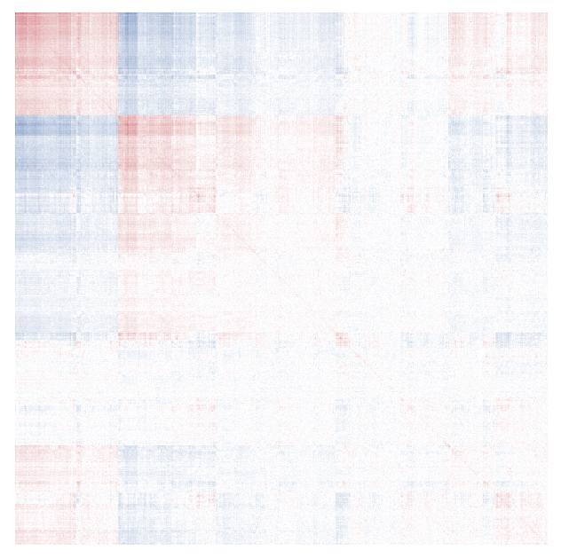
1521 Proteins, most variable 50%

Slide 29
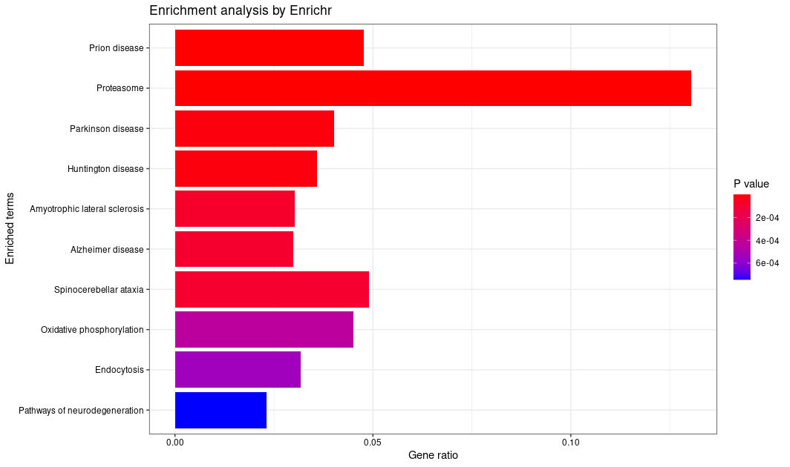
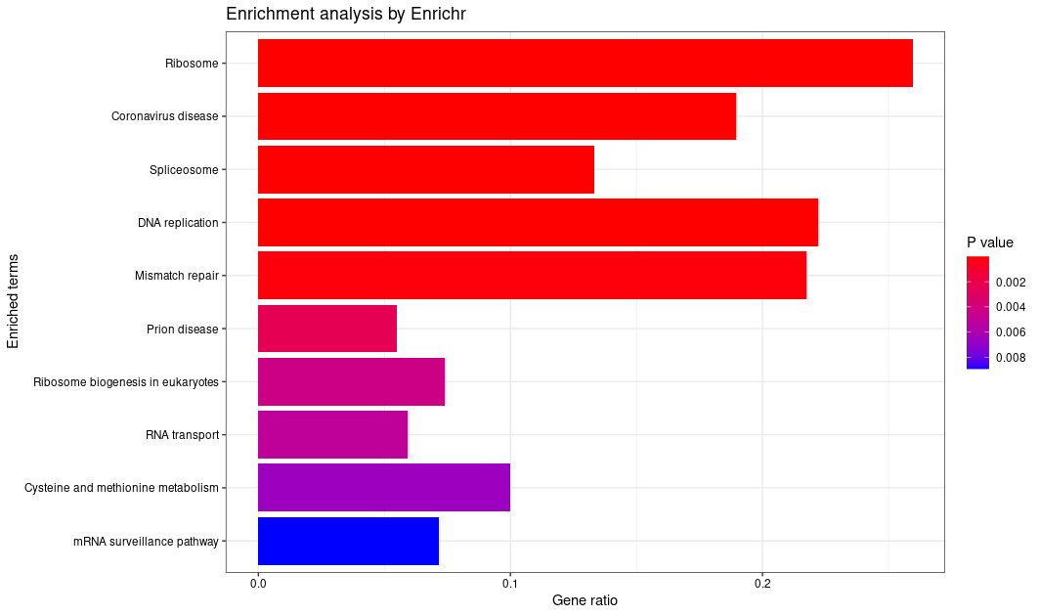
1521 Proteins, most variable 50%

Slide 30
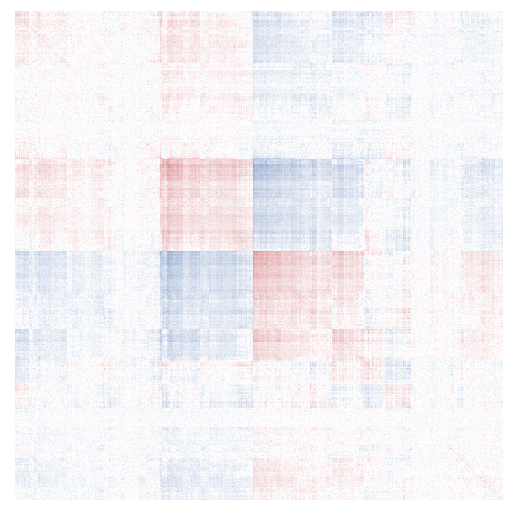
1521 Proteins, least variable 50%

Slide 31
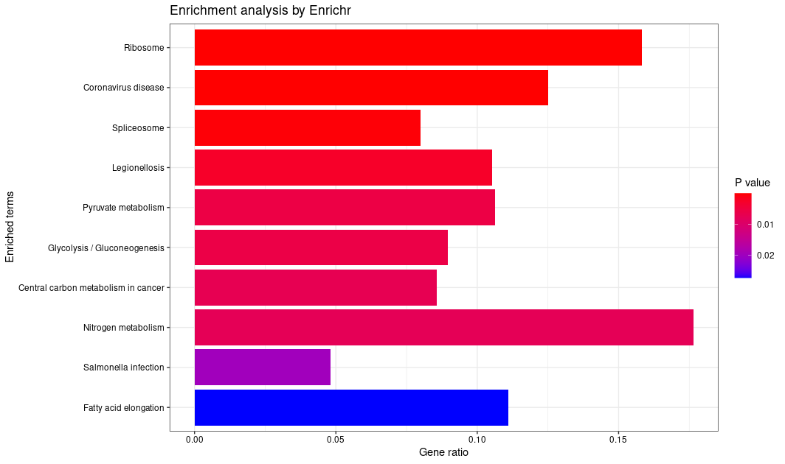
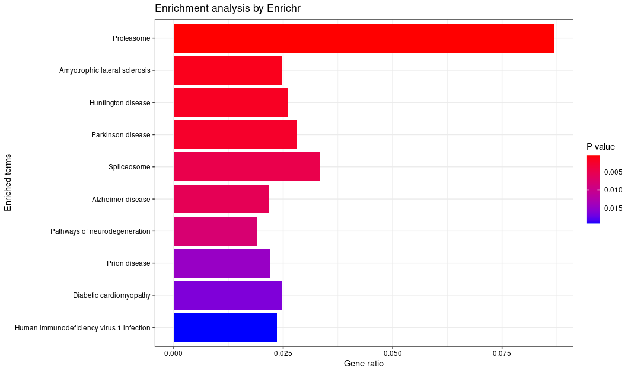
1521 Proteins, least variable 50%

