Slide 1

150117010 Süleyman Ahmet Sönmez 150117036 Muhammed Enes Aktürk 150117064 Yunus Emre Ertunç 150117004 Güneş Yüzak 150117048 Fatih Baş

Slide 2
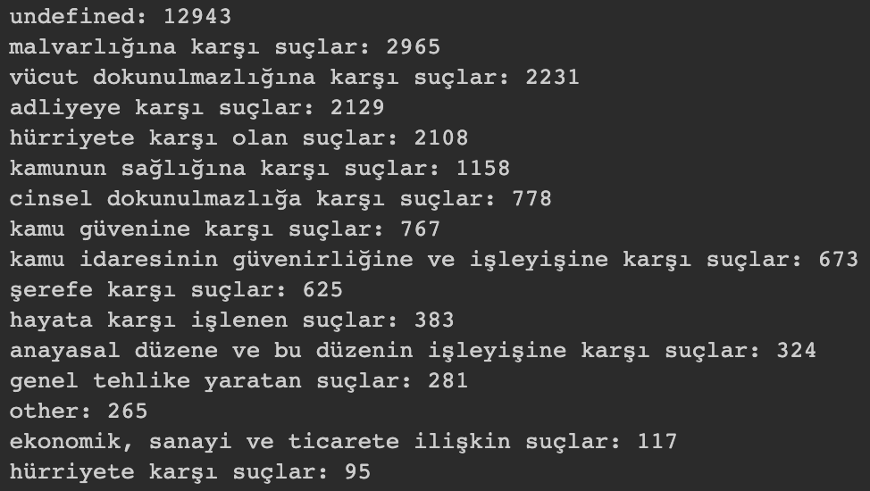
Class Labels Frequencies

Slide 3
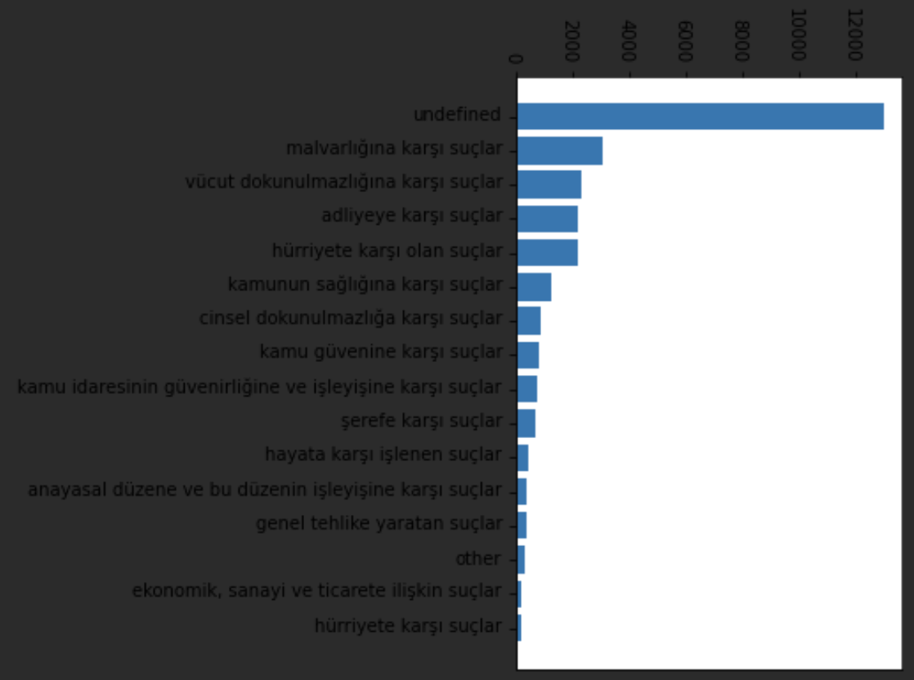

Slide 4
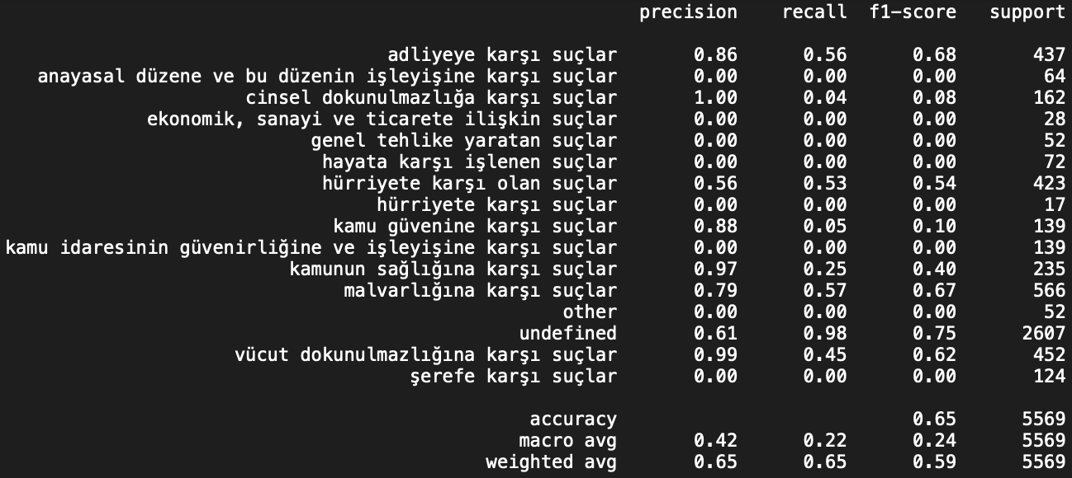
Multinomial Naive Bayes Classification
Precision, Recall, F1 Score, Macro Average

Slide 5
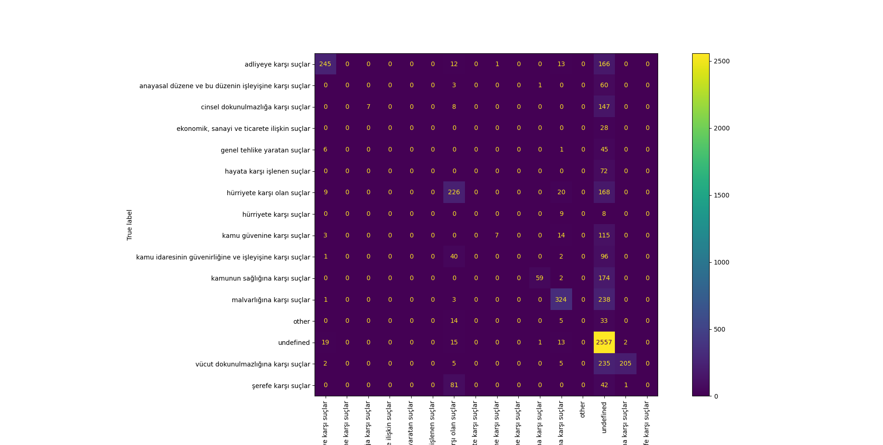
Multinomial Naive Bayes Classification – Confusion Matrix

Slide 6

Logistic Regression Classification
Precision, Recall, F1 Score, Macro Average

Slide 7
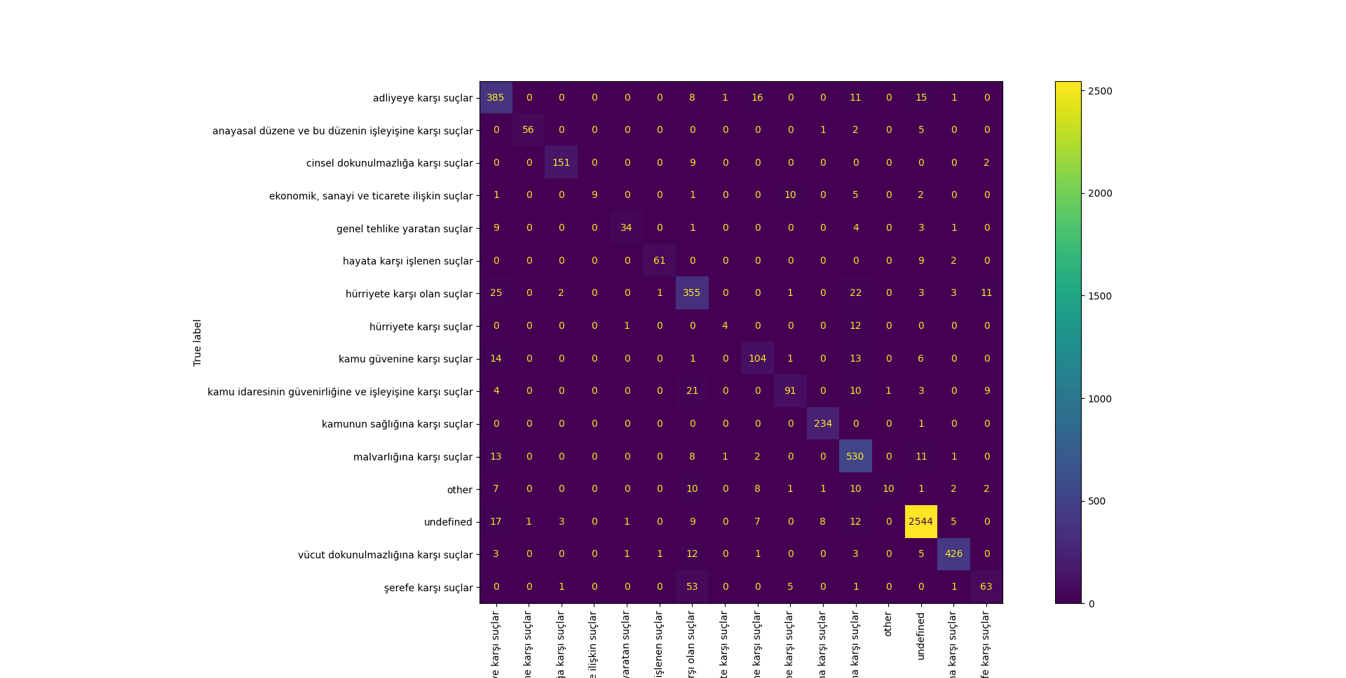
Logistic Regression Classification – Confusion Matrix

Slide 8
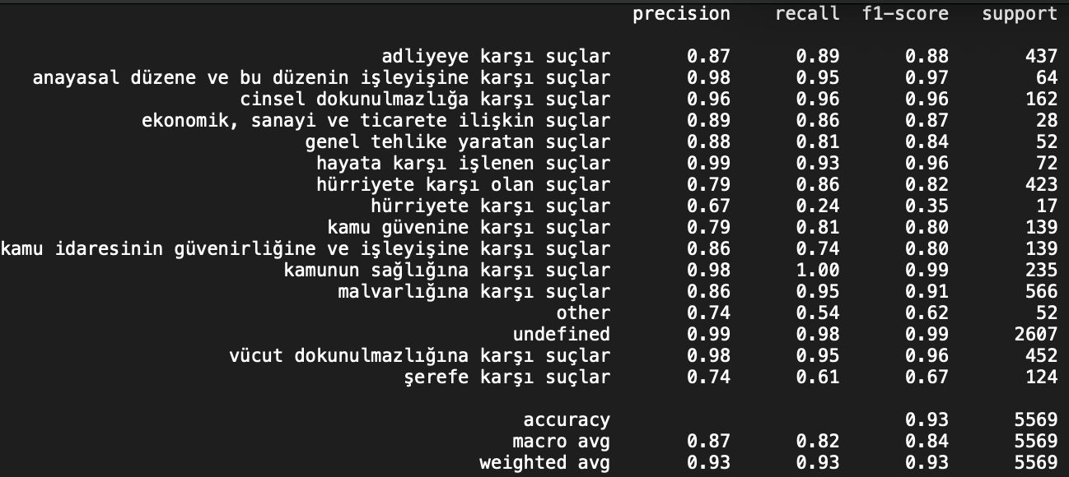
SVM Classification
Precision, Recall, F1 Score, Macro Average

Slide 9

SVM Classification
Confusion Matrix

