Slide 1
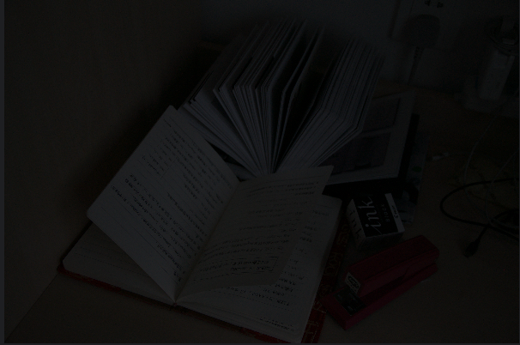
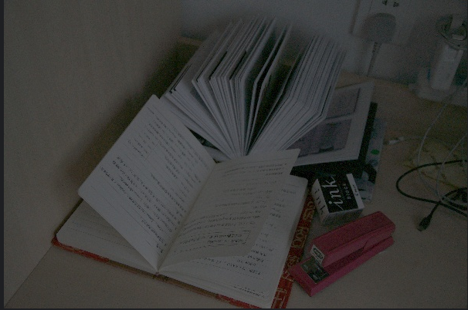
Contrast Adjustment Techniques for Low-Light Images
Image Signal Processing - Group 23
Muhammed Enes Uluç
Enes Ayaydın
Büşra Yıldız

Slide 2
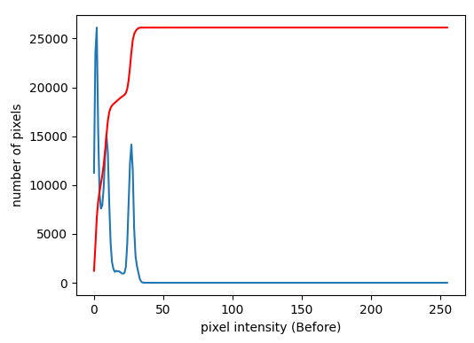
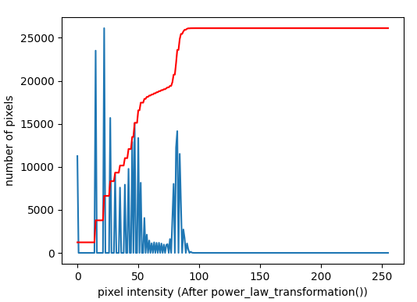
Problem Definition and Objectives
Problem:
Images taken in low-light conditions (night, indoors) suffer from low contrast. Valuable data is hidden in dark pixels.
Objective:
To uncover hidden details.
To manipulate image intensity distributions using point-wise signal processing methods.
To mathematically validate the results using Python (OpenCV & Matplotlib).

Slide 3
Dataset Description
Bullet Points:
The dataset consist of low-light RGB images collected from multiple sources.
Part of the dataset was obtained from the LOL (Low-Light) Dataset, which is a commonly used benchmark for low-light image enhancement.
Additional low-light images were collected manually by searching on Google Images to increase scene diversity.
Images were loaded in BGR format (OpenCV standard) and converted to RGB for visualization.

Slide 4
Methodology Overview
Bullet Points: We implemented three different signal processing techniques to solve this problem:
Power-Law Transformation (Gamma Correction): Focuses on global brightness and natural look.
CLAHE (Contrast Limited Adaptive Histogram Equalization): Focuses on local details and noise control.
Adaptive Thresholding: Focuses on structural segmentation (edges).

Slide 5
Processing Pipeline
1- Dataset Images
Low-light images are provided in the dataset/ directory.
2- main.py Execution
The processing pipeline is initiated by running the main.py script.
3- Automatic Folder Creation
The results/ directory is created automatically if it is not exists.
Separate subfolders are generated for each enhancement method.
4- Apply Enhancement Methods
Power-Law Transformation
CLAHE
Thresholding
5- Save Method - Results
Enhanced images are saved into their corresponding method folders.
6- Demo Analysis (Histogram & CDF)
Sample images are analyzed using histogram and CDF plotsç
Before-and-after comparisons are visualized to validate contrast improvement.

Slide 6
Method 1 - Power-Law Transformation
Bullet Points:
Formula: s=c⋅rγ
Logic: We utilized a Gamma value (γ<1) to expand dark input values into a wider range of output values.
Why we use it: It creates the most natural brightness adjustment without "washing out" the image.
Where is it used?:
Monitor & TV Calibration: To correct screen display outputs.
Medical Imaging: To improve visibility in MRI or CT scans.
Photography: To fix underexposed (dark) photos.

Slide 7
Method 2 - CLAHE (Adaptive Histogram Equalization)
Bullet Points:
Logic: It divides the image into small tiles and equalizes them individually. It limits noise amplification using a clipLimit.
Implementation: Applied only to the L (Lightness) channel in LAB color space to preserve color accuracy.
Where is it used?:
Medical X-Rays: To see bone details clearly against soft tissue.
Underwater Photography: To correct uneven lighting in murky water.
Satellite Imagery: To remove fog or haze effects.

Slide 8
Method 3 - Adaptive Thresholding
Bullet Points:
Logic: It calculates a unique threshold value for small regions (blocks) of the image.
Result: It converts the image into binary (black & white), highlighting structure over color.
Where is it used?:
Document Scanning (OCR): Reading text from scanned papers.
Robotics: Detecting lines or edges for autonomous navigation.
Biomedical Analysis: Counting cells or bacteria in microscope images.

Slide 9
Parameter Selection & Justification
Bullet:
γ < 1 expands dark pixel values
CLAHE clipLimit prevents noise amplification
Adaptive threshold handles non-uniform lighting better than global threshold

Slide 10
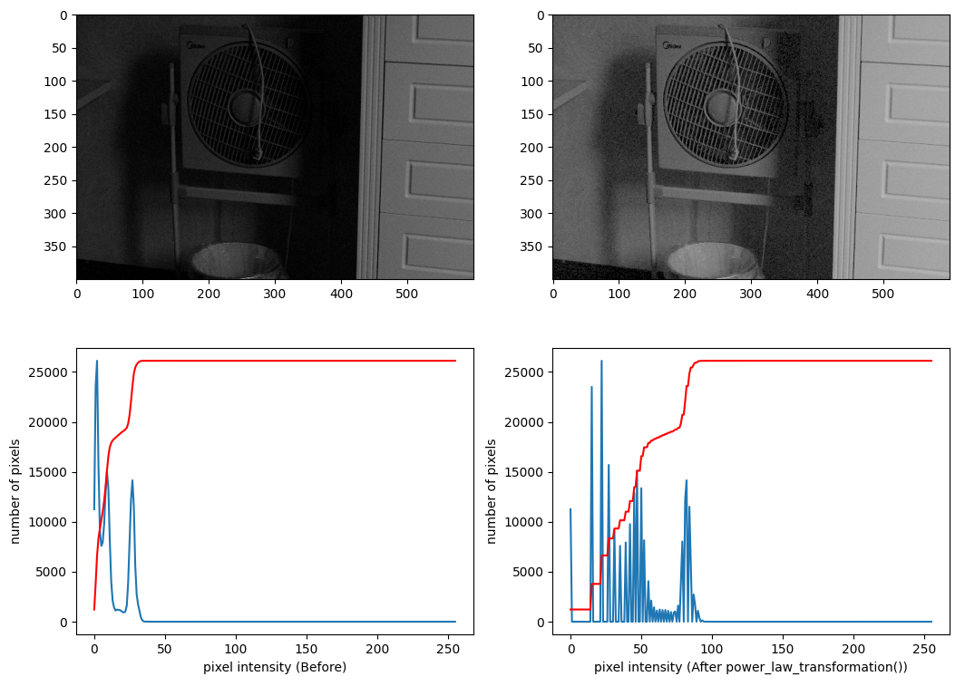
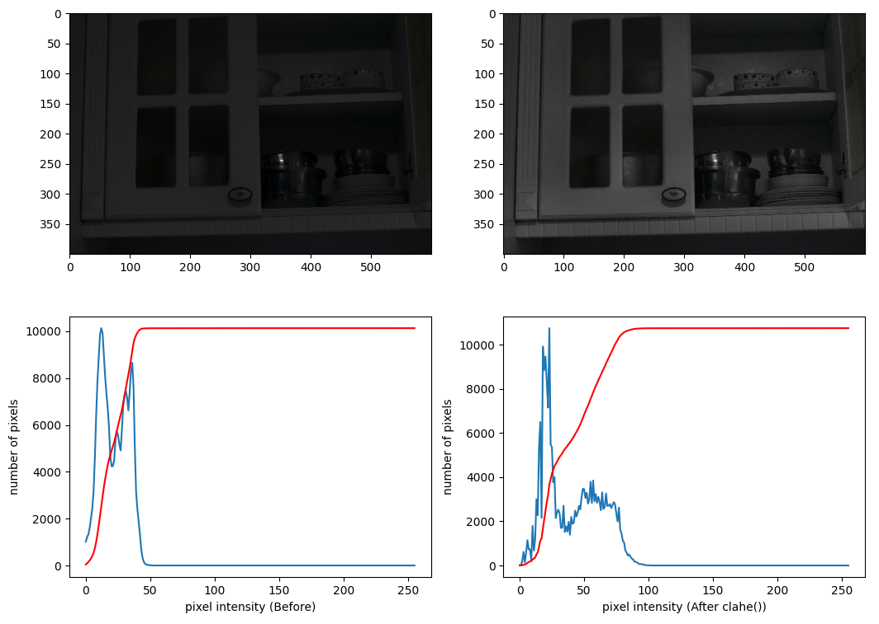
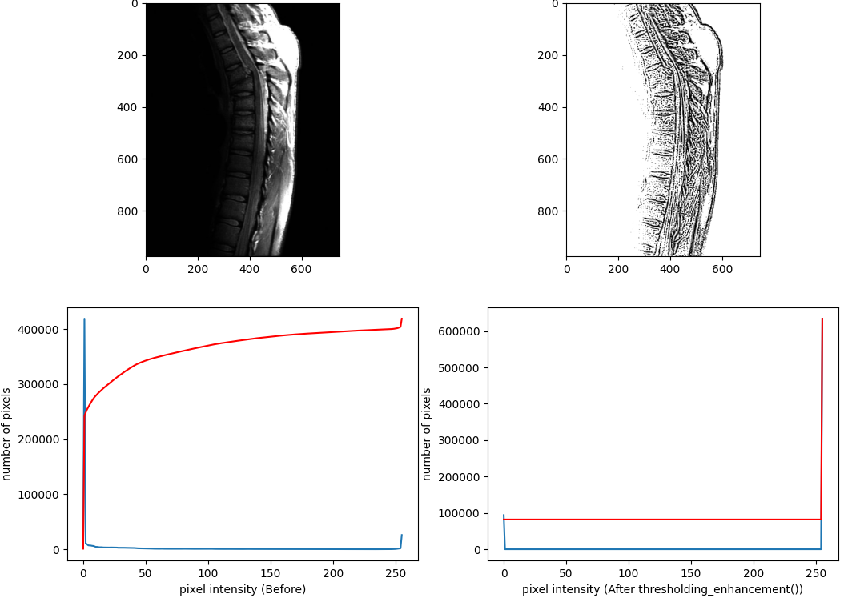
Mathematical Analysis
Bullet Points:
We used matplotlib to validate our results mathematically.
Histogram Analysis:
- Before: Pixels are squeezed in the left (dark) region.
- After: Pixels are distributed to the right (bright) region.
CDF (Cumulative Distribution Function): The linear trend in the CDF graph proves that the contrast is balanced.

Slide 11
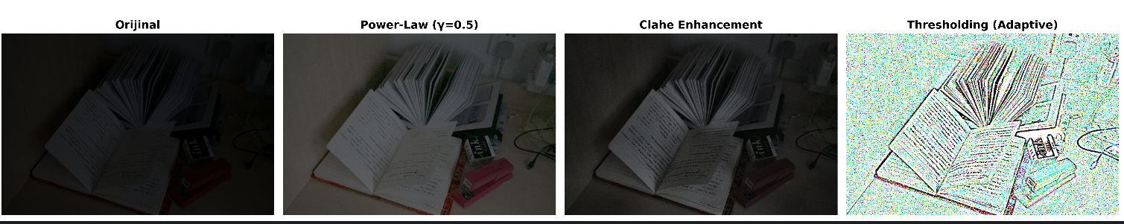
Results Comparison
Title: Visual Comparison of Results
Original: Too dark, low visibility.
Power-Law: Natural colors, balanced brightness. (Best Result)
CLAHE: High local contrast, high detail, but slightly sharper.
Thresholding: Binary output, clear edges.

Slide 12
Limitations & Failure Cases
Bullet:
Power-Law : Over-brightening if y is too small
CLAHE: Noise amplification in flat regions
Thresholding: Loss of color information

Slide 13
Conclusion & Key Takeways
Bullet Points:
Best Method: Power-Law Transformation (γ=0.5) provided the most perceptually natural result for low-light photography.
Success: We successfully manipulated pixel intensity distributions to recover lost data.
Future Work: Deep Learning models (LLIE) could be implemented for better noise reduction.
Thank you for listening :)

