Slide 1


Working Effectively
with Codex in VS Code
From AI assistance to structured software development
AI Professional

Slide 2

Recap of the Previous Session
What we already covered before today.
Integrating Codex with Visual Studio Code
Connecting Codex to a local project
Understanding the context window
Creating and using reusable Skills
Using Plan Mode and Build Mode
02

Slide 3

Codex Is More Than Code Completion
The goal is task completion, not only text prediction.
Inspects multiple files across a project
Understands structure, conventions and dependencies
Creates an implementation plan before editing
Modifies existing code and can run validation commands
Explains what changed and why
03

Slide 4

The Role of the Developer
Codex accelerates implementation, but the developer remains accountable.
Define the problem clearly
Provide relevant context
Review implementation decisions
Test the final result
Approve changes before deployment
04

Slide 5
Start with a Clear Task
A clear request creates a better implementation.
Describe what needs to be created
WEAK VS STRONGER
Weak: Create a login system.
Stronger: Add email and password authentication to the existing FastAPI application. Use the current User model, hash passwords securely, create a login endpoint and return a token after successful authentication.
Mention where it should be implemented
Reuse existing components when possible
State technical constraints
Define the expected result
05

Slide 6
Give Codex Project Context
Before implementation, explain how the project works.
Programming language and framework
EXAMPLE PROMPT
This is a FastAPI backend using SQLAlchemy and PostgreSQL. Routes are stored in routers, database models are in models, and Pydantic schemas are in schemas.
Architecture and folder structure
Database and authentication method
Naming conventions
Testing framework and restrictions
06

Slide 7
Context Should Be Relevant
More context is not always better.
Include files that affect the task
Mention the current implementation
Avoid unrelated project areas
Protect context-window space
Keep the instruction focused
07

Slide 8
Use Open Files and Selected Code
VS Code editor context can reduce unnecessary copy-paste.
Open the relevant file
EXAMPLE PROMPT
Review the selected function and identify why it returns an empty response.
Select the function or section
Ask Codex to inspect or modify it
Mention related files only when needed
Use visible errors as debugging context
08

Slide 9
Plan Before Building
Use Plan Mode before larger changes.
Identify files that need to change
EXAMPLE PROMPT
Inspect the project and create a step-by-step plan for adding password-reset functionality. Do not modify any files yet.
Understand affected components
Set the implementation order
List risks and missing information
Define tests before editing
09

Slide 10
Review the Proposed Plan
Do not approve a plan automatically.
Check if it follows existing architecture
EXAMPLE PROMPT
Update the plan so that the existing email service is reused instead of creating a new service.
Make sure only necessary files are changed
Look for validation and error handling
Confirm security considerations
Ask for corrections before Build Mode
10

Slide 11
Move from Plan Mode to Build Mode
The approved plan becomes the implementation reference.
Create or edit the required files
EXAMPLE PROMPT
Implement the approved plan. Follow the existing project structure and avoid changing unrelated files.
Follow the existing project structure
Avoid unrelated changes
Run commands and tests when needed
Explain the final implementation
11

Slide 12
Work in Small, Verifiable Steps
Large tasks should be divided into reviewable stages.
Inspect the project first
Plan the backend logic
Test the backend
Implement the frontend
Run final validation
12

Slide 13
Use AGENTS.md for Project Instructions
Reusable repository instructions help Codex work consistently.
Project architecture
AGENTS.MD EXAMPLE
Run pytest before completing backend tasks.
Use TypeScript for all new frontend files.
Do not modify database migration files manually.
Follow the existing service and repository structure.
Coding standards
Run and test commands
File organisation
Security requirements
13

Slide 14
Skills and AGENTS.md Are Different
AGENTS.md
Skills
Project-specific guidance
Reusable workflows
Repository structure
Pull request reviews
Coding conventions
API documentation
Testing commands
Security checks
Team development rules
Deployment steps
AGENTS.md explains how to work in a project. A Skill explains how to perform a repeatable task.
14

Slide 15
Ask Codex to Explain Existing Code
Use Codex to understand unfamiliar repositories faster.
Trace request flow across files
EXAMPLE PROMPT
Trace the request flow from the React login form to the backend endpoint.
Explain authentication or database logic
Map which files are involved in a feature
Explain classes and methods
Identify key dependencies
15

Slide 16
Debugging with Codex
A useful bug report gives Codex enough evidence.
Expected behaviour
BETTER DEBUGGING PROMPT
The FastAPI application starts successfully, but POST /users returns HTTP 500. Inspect the route, schema and database model, identify the root cause and propose a fix before changing the files.
Actual behaviour
Complete error message
Command that caused the error
Relevant files and recent changes
16

Slide 17
Ask for Root-Cause Analysis
Fixing symptoms is not the same as solving the problem.
Reproduce the problem
EXAMPLE PROMPT
Do not apply a temporary workaround. Identify and explain the root cause before modifying the code.
Inspect the related code
Identify the root cause
Explain why it happens
Implement and test the solution
17

Slide 18
Testing AI-Generated Changes
Generated code should always be tested.
Unit tests
EXAMPLE PROMPT
Add tests for successful login, incorrect password, unknown user and missing request fields. Run the tests and report the result.
Integration tests
API tests
Input-validation tests
Regression tests
18

Slide 19
Review Changes Before Accepting Them
Treat AI-generated code like code submitted by another developer.
Check which files were modified
SENIOR REVIEW PROMPT
Review your implementation as a senior developer. Identify bugs, security issues, unnecessary complexity and missing tests.
Look for unrelated changes
Validate input and error handling
Check sensitive information exposure
Confirm tests pass
19

Slide 20
Practical Classroom Exercise
Task: add a health-check feature to an existing application.
Endpoint requirements
Required workflow
Available at /health
Inspect the architecture
Return application status
Use Plan Mode first
Check database reachability
Review and correct the plan
Return a clear database error
Use Build Mode
Include automated tests
Run tests and review changes
Final discussion: What context did Codex need, what required human review, and what would you improve in the prompt?
20

Slide 21
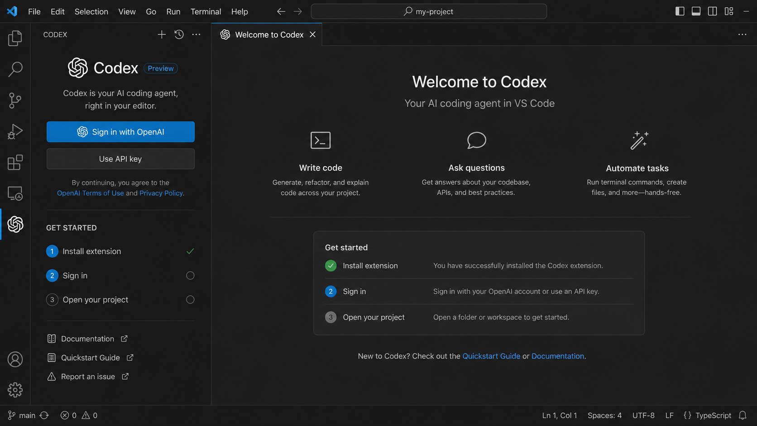
Getting Codex in VS Code
A practical 10 slide walkthrough for installation, sign in, project setup, and first use.
Example Codex welcome interface inside VS Code
Install
Sign in
Open project
Start prompting
AI Professional
21

Slide 22
Step 1: Check the prerequisites
Install the latest version of Visual Studio Code on your computer.
Make sure you can sign in with your OpenAI account, or prepare an API key if needed.
Use a stable internet connection so the sign in flow and extension setup complete smoothly.
Open a sample project folder so you can test Codex right after installation.
Codex welcome page with sign in options
AI Professional
22

Slide 23
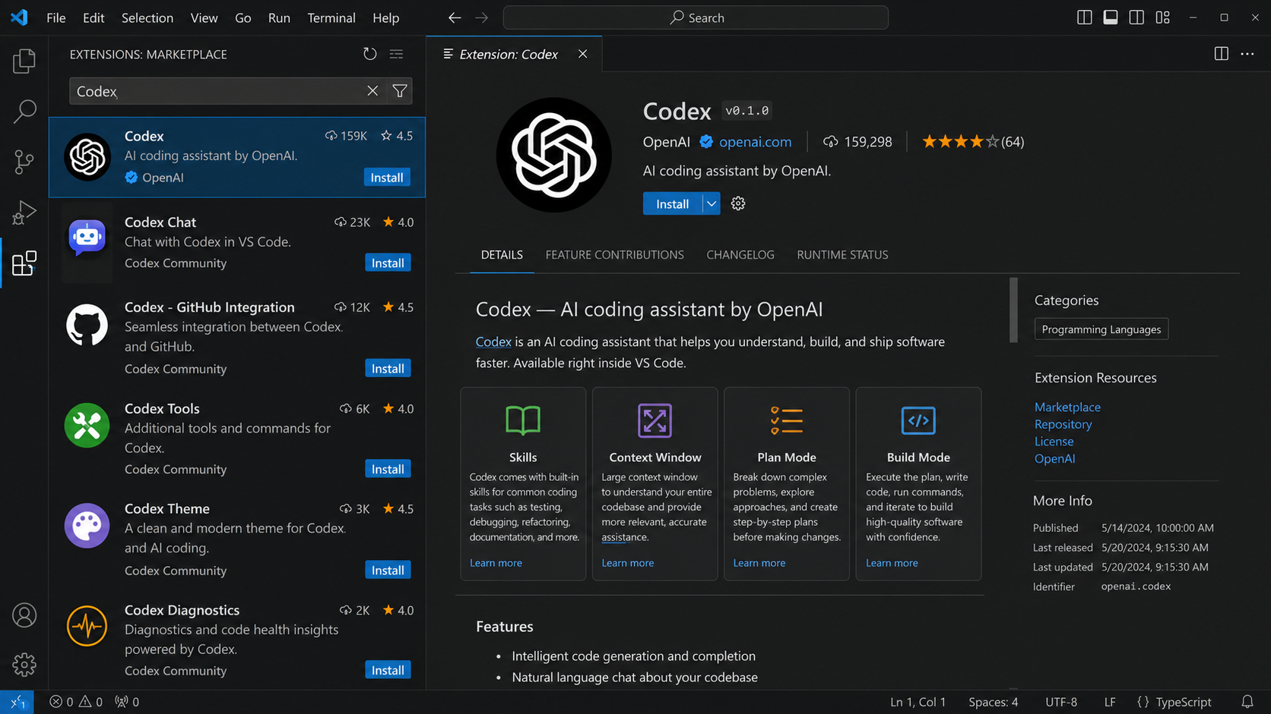
Step 2: Open the Extensions Marketplace
Launch VS Code and click the Extensions icon in the left sidebar.
You can also use the shortcut Ctrl + Shift + X to open the marketplace quickly.
The marketplace lets you search, review, install, and manage editor extensions.
Always review the publisher and extension details before installing any tool.
Extensions Marketplace inside VS Code
AI Professional
23

Slide 24
Step 3: Search for Codex
Type Codex in the marketplace search bar.
Look for the official Codex extension published by OpenAI.
Open the details page to review the main capabilities such as Skills, Context Window, Plan Mode, and Build Mode.
Confirm that you selected the correct extension before proceeding.
Search results showing the Codex extension
AI Professional
24

Slide 25
Step 4: Install the extension
Click Install on the Codex extension page.
Wait for VS Code to finish downloading and enabling the extension.
If VS Code requests a reload, accept it so the new panel appears correctly.
After installation, keep the Codex panel easy to access from the sidebar.
The Codex extension details page
AI Professional
25

Slide 26
Step 5: Sign in and activate Codex
Open the Codex welcome panel after installation.
Choose Sign in with OpenAI, or use the API key option if your setup requires it.
Complete the authentication flow and return to VS Code when it finishes.
Check the get started list to confirm that installation and sign in are complete.
Codex sign in and get started flow
AI Professional
26

Slide 27
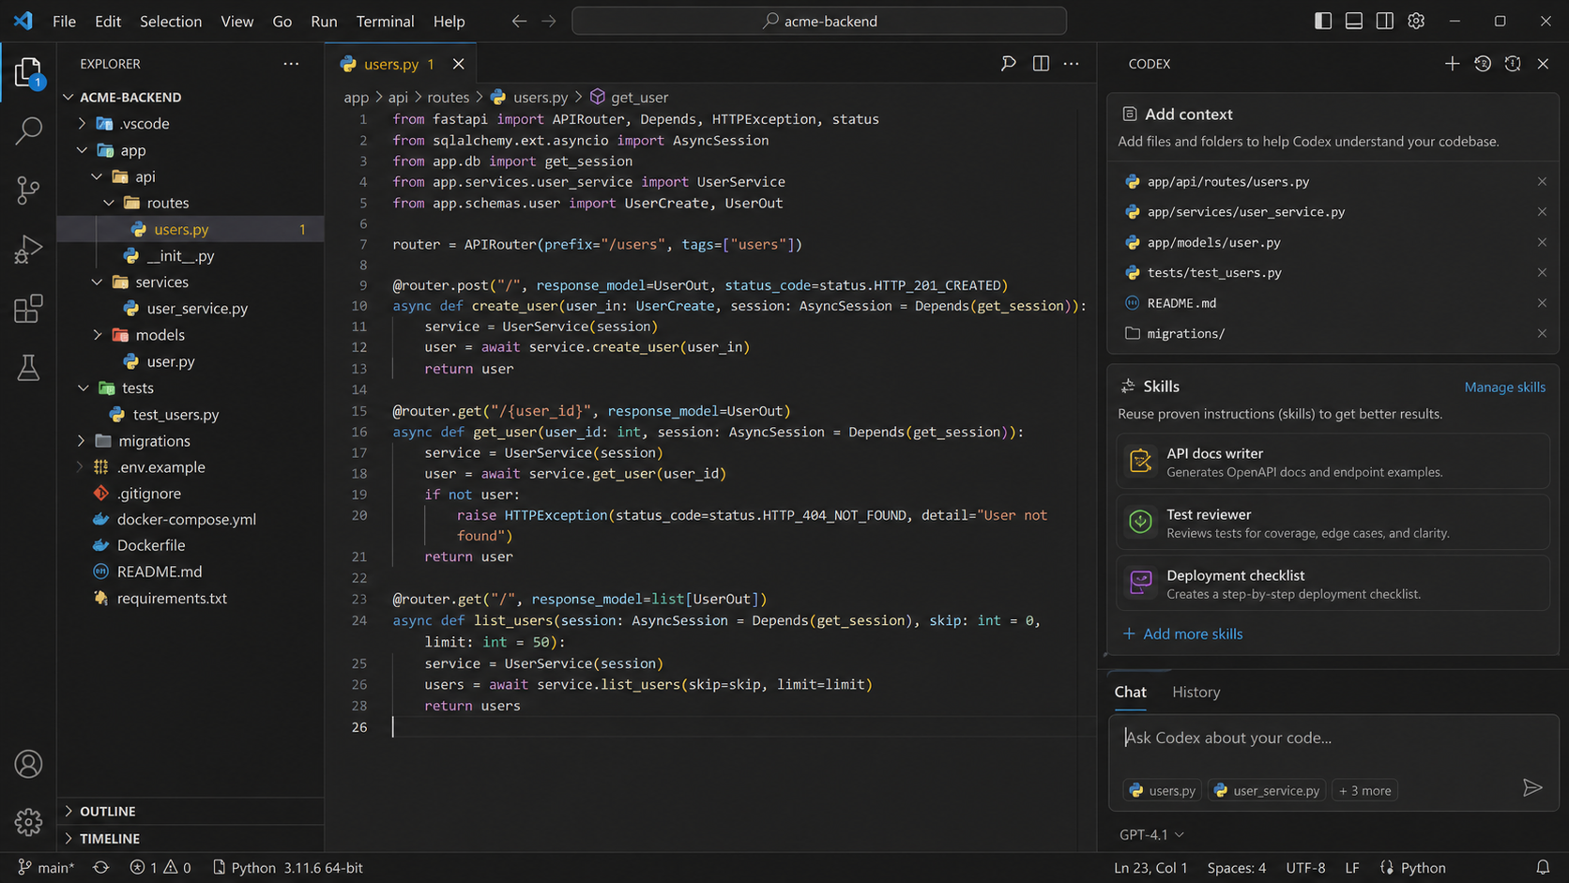
Step 6: Open your project and add context
Open the folder or workspace where you want Codex to help you.
Add relevant files such as README, routes, models, services, or tests.
Use context carefully so Codex understands the architecture and coding conventions.
Keep the context focused on the task to get more relevant answers and changes.
Adding project files and skills to Codex context
AI Professional
27

Slide 28
Step 7: Start with a simple request
Begin with a small and clear prompt, such as explaining a file or reviewing a function.
Refer to selected code or open files instead of pasting too much unrelated text.
Use simple tasks first so students understand how Codex responds.
Review the answer before accepting suggestions or asking for code changes.
Using the Codex chat panel inside a project
AI Professional
28

Slide 29
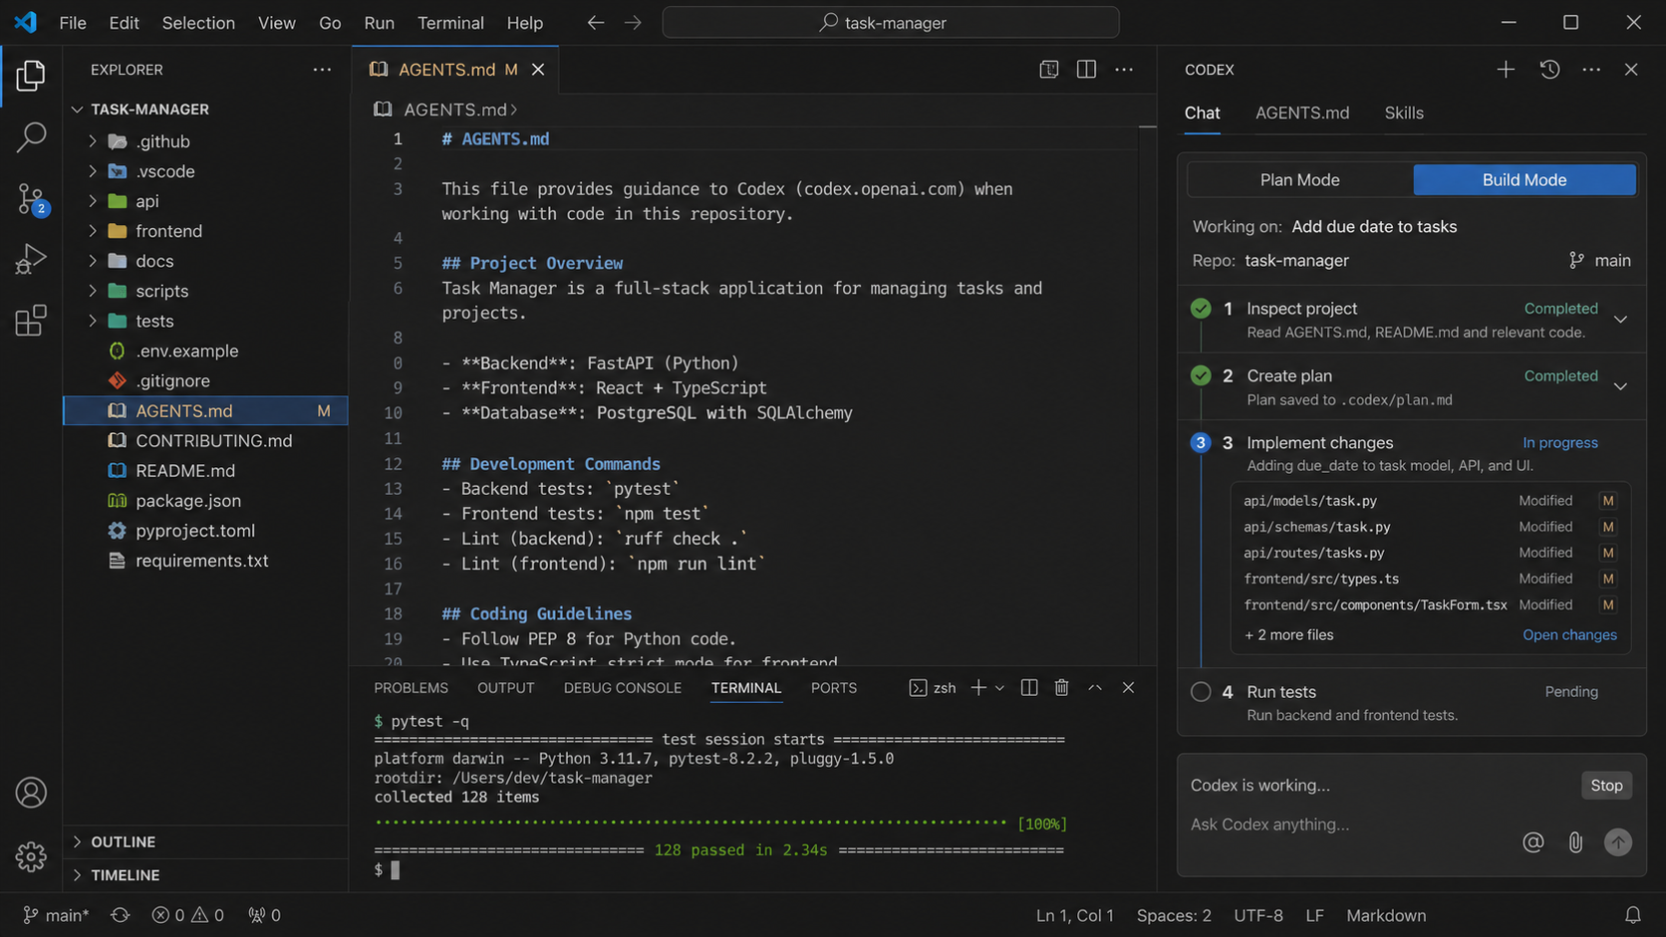
Step 8: Use Plan Mode for larger tasks
For bigger features, ask Codex to inspect the project first.
Request a step by step plan before any implementation begins.
Review which files will change, what tests are needed, and what risks exist.
Approve the plan only after it matches the project structure and requirements.
Plan Mode and Build Mode working flow
AI Professional
29

Slide 30
Step 9: Build, test, and troubleshoot
After the plan is approved, switch to Build Mode so Codex can implement the task.
Let Codex run tests, inspect changed files, and report the result.
If something fails, provide the error message and ask for root cause analysis.
Always review the final code, tests, and project impact before accepting the work.
Codex implementing changes and running tests
AI Professional
30

