Slide 1


Churning while Experimenting: Maximizing User Engagement in a Recommendation System
Michael L. Hamilton and Raghav Singal
Oct 5, 2023
University of Tulsa Seminar

Slide 2

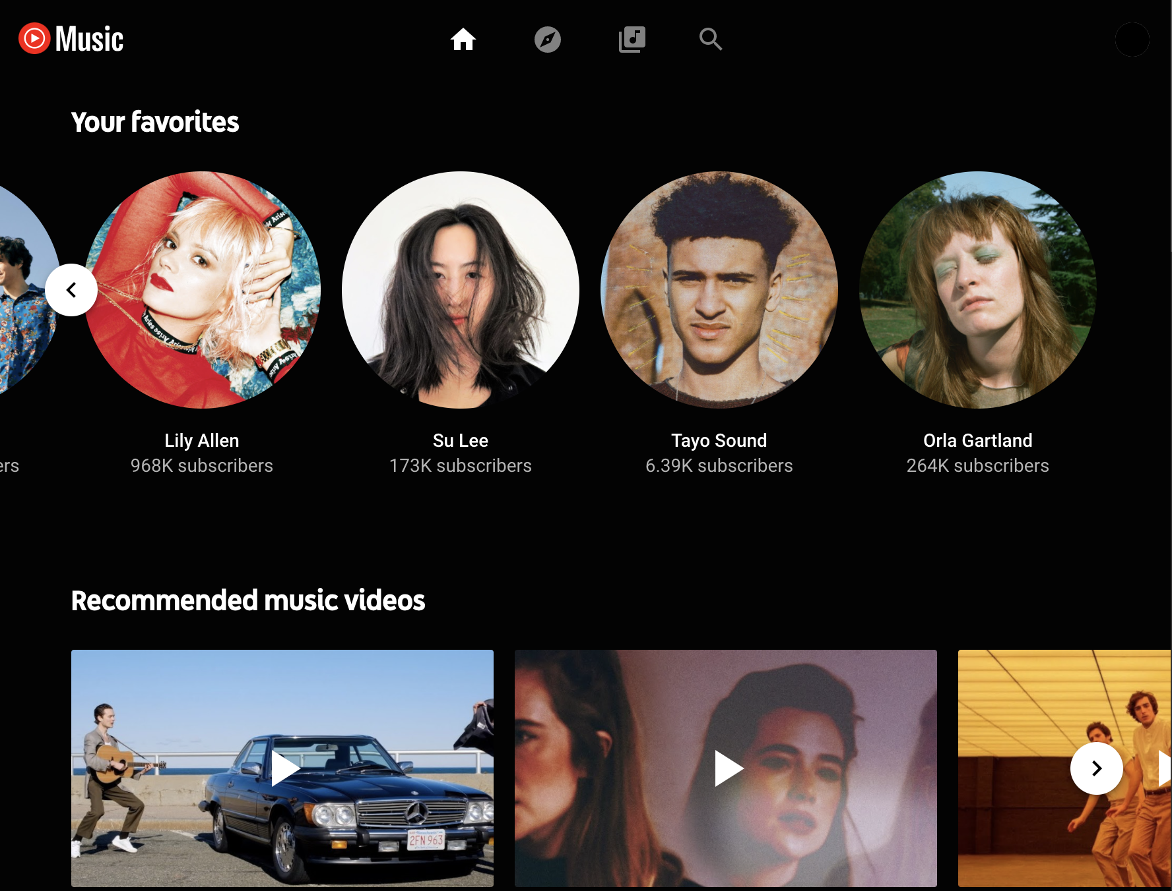

Content Recommendation
We study the platform recommendation problem, in which the platform decides how to recommend new content to users.
Every user sees some recommendations, clicks are tracked
New cards – a pair of music and music video, are released everyday
Card quality is measured via Click-Thru-Rate (CTR)
Personalized Card Recommendations
Notes:
Our model is directly inspired by real-world data. We explored the NetEase Music dataset and found evidence
(a) of heterogeneous card-specific CTRs and them resembling a Beta distribution,
(b) of a first impression effect and heterogeneous churn rates among users (depending on a user's prior engagement with the platform), and
(c) that the platform appears to ignore heterogeneous user behavior and instead opts for a blind randomization policy.
Our model captures the two features in this marketplace: (1) supply-side learning (uncertainty over the CTR of a newly created content) and (2) demand-side heterogeneous churning (e.g., regular vs.\ new users).

Slide 3
Content Recommendation
We study the platform recommendation problem, in which the platform decides how to recommend new content to users.
Goal: Attract and retain users while disseminating new content.
Problem at NetEase, YouTube, Spotify, Netflix, etc.
Personalized Card Recommendations
Notes:
Our model is directly inspired by real-world data. We explored the NetEase Music dataset and found evidence
(a) of heterogeneous card-specific CTRs and them resembling a Beta distribution,
(b) of a first impression effect and heterogeneous churn rates among users (depending on a user's prior engagement with the platform), and
(c) that the platform appears to ignore heterogeneous user behavior and instead opts for a blind randomization policy.
Our model captures the two features in this marketplace: (1) supply-side learning (uncertainty over the CTR of a newly created content) and (2) demand-side heterogeneous churning (e.g., regular vs.\ new users).

Slide 4
Content Recommendation
We study the platform recommendation problem, in which the platform decides how to recommend new content to users.
Goal: Attract and retain users while disseminating new content.
Problem at NetEase, YouTube, Spotify, Netflix, etc.
We focus on two complications of this problem related to the content, user behavior, and the platform.
Need to learn new contents CTR’s via experimentation.
First Impression Effect, new users are more likely to churn (leave the system) as the result of a one bad experience than regular users.
How can the platform maximize user engagement (clicks), while experimenting to learn the CTR of new cards against the heterogeneous churn behavior of users?
Notes:
Our model is directly inspired by real-world data. We explored the NetEase Music dataset and found evidence
(a) of heterogeneous card-specific CTRs and them resembling a Beta distribution,
(b) of a first impression effect and heterogeneous churn rates among users (depending on a user's prior engagement with the platform), and
(c) that the platform appears to ignore heterogeneous user behavior and instead opts for a blind randomization policy.
Our model captures the two features in this marketplace: (1) supply-side learning (uncertainty over the CTR of a newly created content) and (2) demand-side heterogeneous churning (e.g., regular vs.\ new users).

Slide 5
Contributions
Data: We explore the NetEase Music dataset and find:
Cards have varied CTRs.
There’s evidence of a significant first impression effect.
The platform experimentation is likely user-age agnostic.
Model: We propose a fluid MDP model inspired by data insights
Model captures first impression effect, lets us study policies
Analyze two special cases: Binary and Funnel state spaces
Theory: We study a simple greedy algorithm termed Churn Minimization (CM)
We find CM is optimal for NetEase style problems
We find CM is near-optimal for more complicated recommendation problems involving momentum etc.

Slide 6
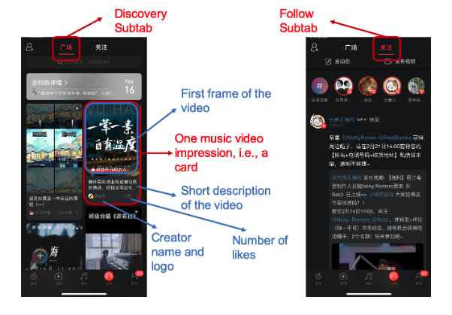
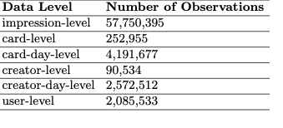
NetEase Cloud Music Dataset
To motivate our study, we have observational data from NetEase
“NetEase Cloud Music is a free music streaming service developed and owned by NetEase, Inc. It was first launched on April 23, 2013, and then became immensely popular in China.”^{[1]}
“The data contains more than 57 million impressions/displays of music content cards recommended to a random sample of 2,085,533 users from November 1st, 2019 to November 30th, 2019.”^{[1]}
[1] NetEase Cloud Music Data - Zhang et al, MSOM.
Notes:
To be done, I don’t know if I need to do this though or what I should include

Slide 7
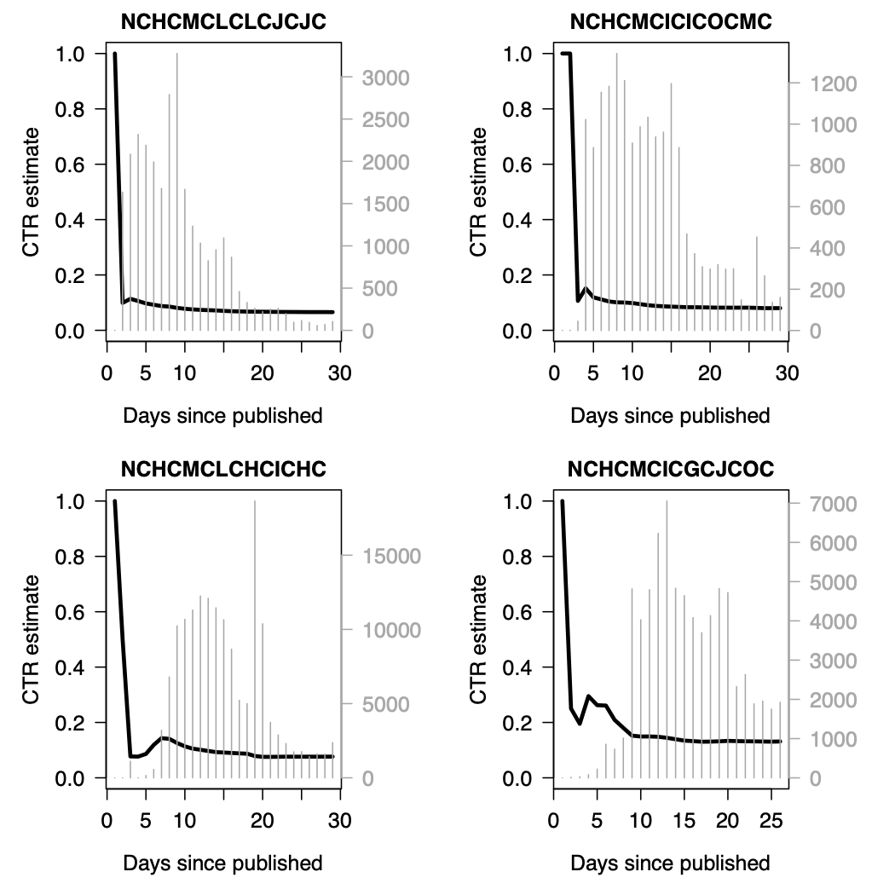
Data Insights: Heterogenous Content
New cards require substantial exploration before stabilizing at their CTR
We internalize unobserved platform matching algorithms, user preference heterogeneity, etc., all into an inherent CTR.

Slide 8
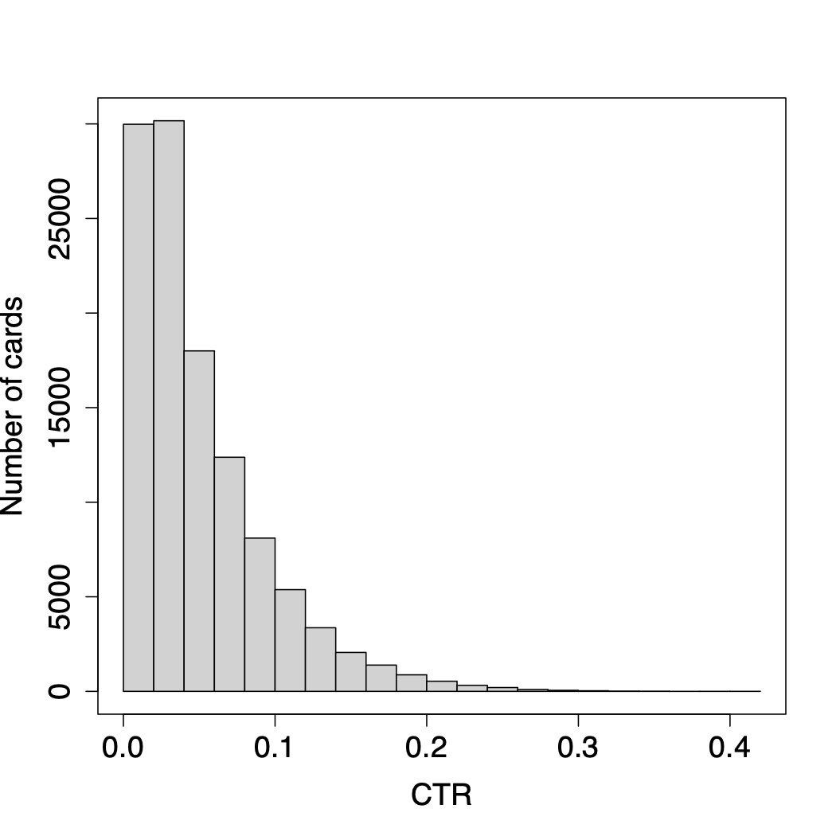
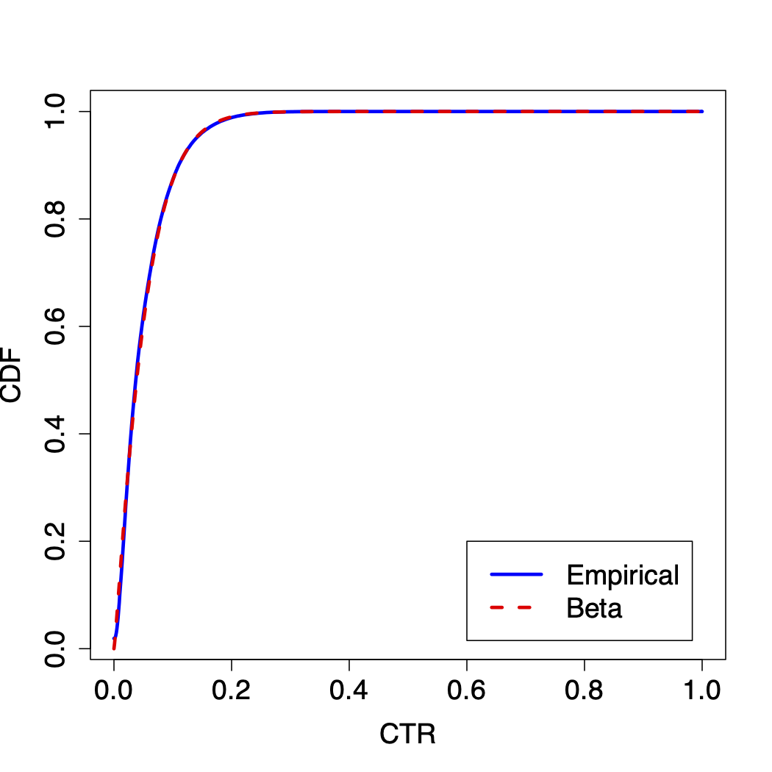
Data Insights: Heterogenous Content
As cards converge to different CTRs, we can fit a distribution over cards to estimate potential of new cards.
Left: Empirical distribution of card’s with >100 impressions (~110,000 such cards).
Right: Empirical CDF vs Beta with mean 0.051, std. dev. 0.044.
Takeaway 1: Cards have heterogenous CTR, distributed as Beta

Slide 9
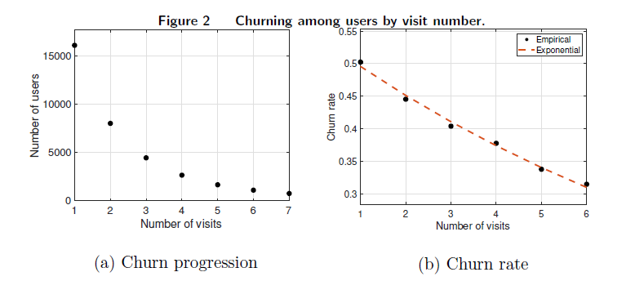
Data Insights: Platform Users
We focus on why new users leave the system, esp. considering on whether they interact with recommended card, i.e., first impression effect.
New users first visit are between day 7 and 10 (16083 obs)
Half of new users never return after first visit!
Users who return once are more likely to return again and again.
Notes:
Out of the 16083 new users plotted in Fig. 4, 2581 clicked on a card during their rst visit whereas
13502 did not. Among the 2581 users who clicked, 1202 churned (i.e., did not return for a second
visit), implying a churn rate of around 46:57%. On the other hand, among the 13502 users who did
not click, around 50:95% of the users churned, suggesting an increase of 4:38 percentage points in
the churn likelihood.

Slide 10
Data Insights: Platform Users
We focus on why new users leave the system, esp. considering on whether they interact with recommended card, i.e., first impression effect.
New users first visit are between day 7 and 10 (16083 obs)
Half of new users never return after first visit!
Users who return once are more likely to return again and again.
Among the 2581 new users who clicked, 1202 churned (46.57%) vs 13502 who did not click, 6875 churned (50.95%). 4% diff in churn rate!
We varied definitions of new user and find these conclusions robust
For regular (10+ visit) users, churn at about 4% regardless of whether they interact with the recommended card (< 2% diff in churn rate).
Takeaway 2: New users leave at high rates and are sensitive
Notes:
Out of the 16083 new users plotted in Fig. 4, 2581 clicked on a card during their rst visit whereas
13502 did not. Among the 2581 users who clicked, 1202 churned (i.e., did not return for a second
visit), implying a churn rate of around 46:57%. On the other hand, among the 13502 users who did
not click, around 50:95% of the users churned, suggesting an increase of 4:38 percentage points in
the churn likelihood.

Slide 11
Data Insights: Platform Users
We focus on why new users leave the system, esp. considering on whether they interact with recommended card, i.e., first impression effect.
New users first visit are between day 7 and 10 (16083 obs)
Half of new users never return after first visit!
Users who return once are more likely to return again and again.
Potential Drawbacks: We conclude this using observational data
Our analysis on the obs. data is not necessarily causal in nature.
Deep literature in Marketing supports these sort of insights ^{[2]}
Takeaway 2: New users leave at high rates and are sensitive
[2] First impressions count: Leveraging acquisition data for customer management- Padilla et al, Mkt Sci.
Notes:
Out of the 16083 new users plotted in Fig. 4, 2581 clicked on a card during their rst visit whereas
13502 did not. Among the 2581 users who clicked, 1202 churned (i.e., did not return for a second
visit), implying a churn rate of around 46:57%. On the other hand, among the 13502 users who did
not click, around 50:95% of the users churned, suggesting an increase of 4:38 percentage points in
the churn likelihood.

Slide 12
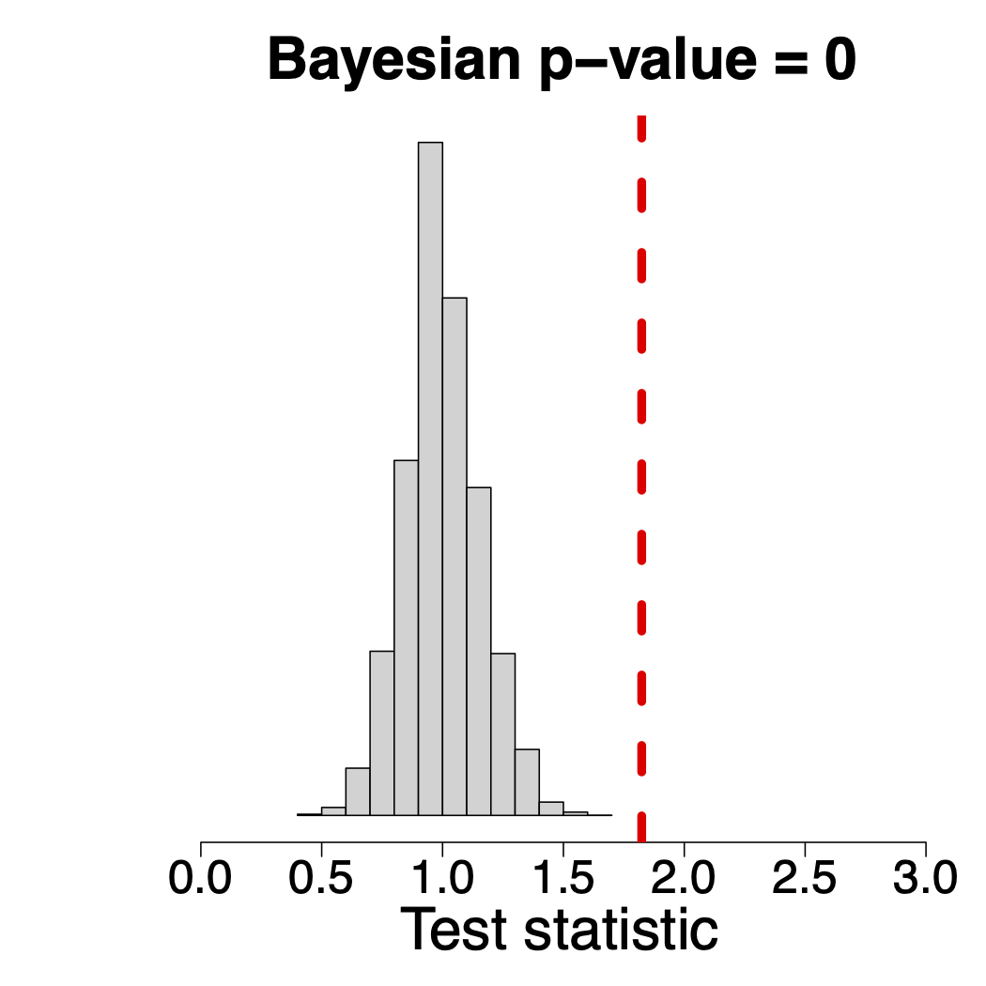
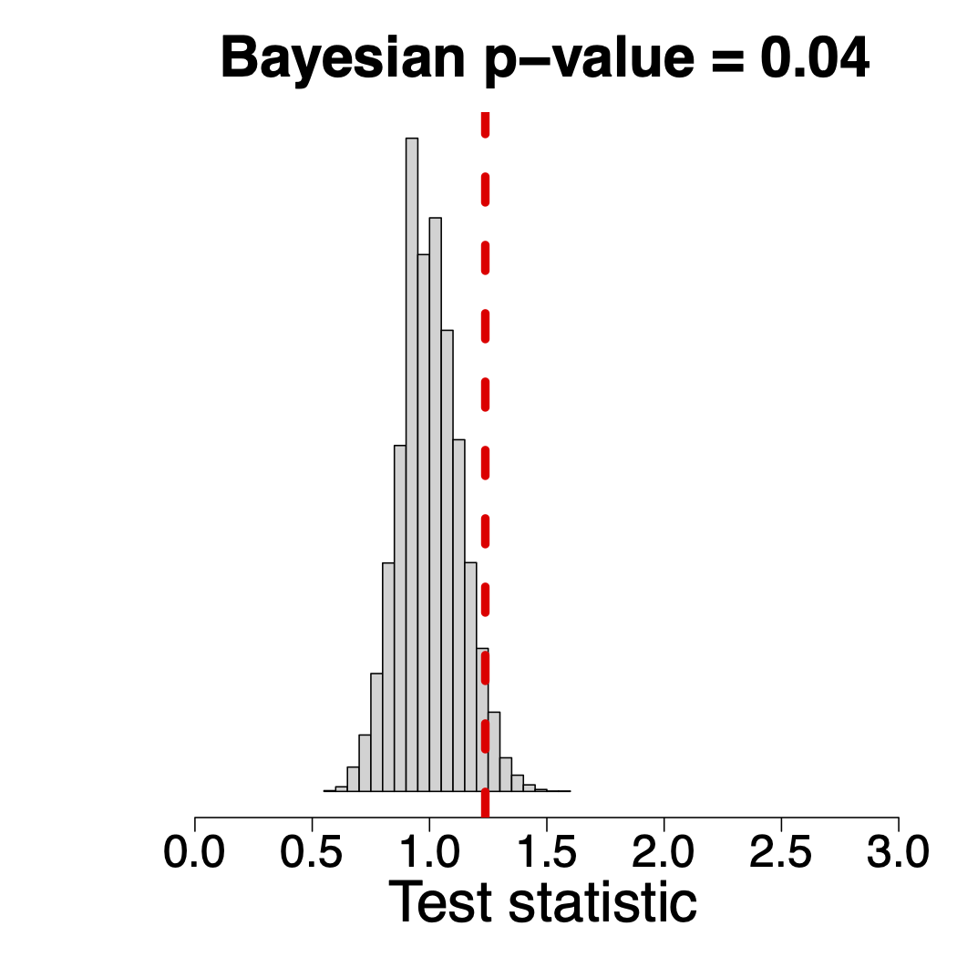
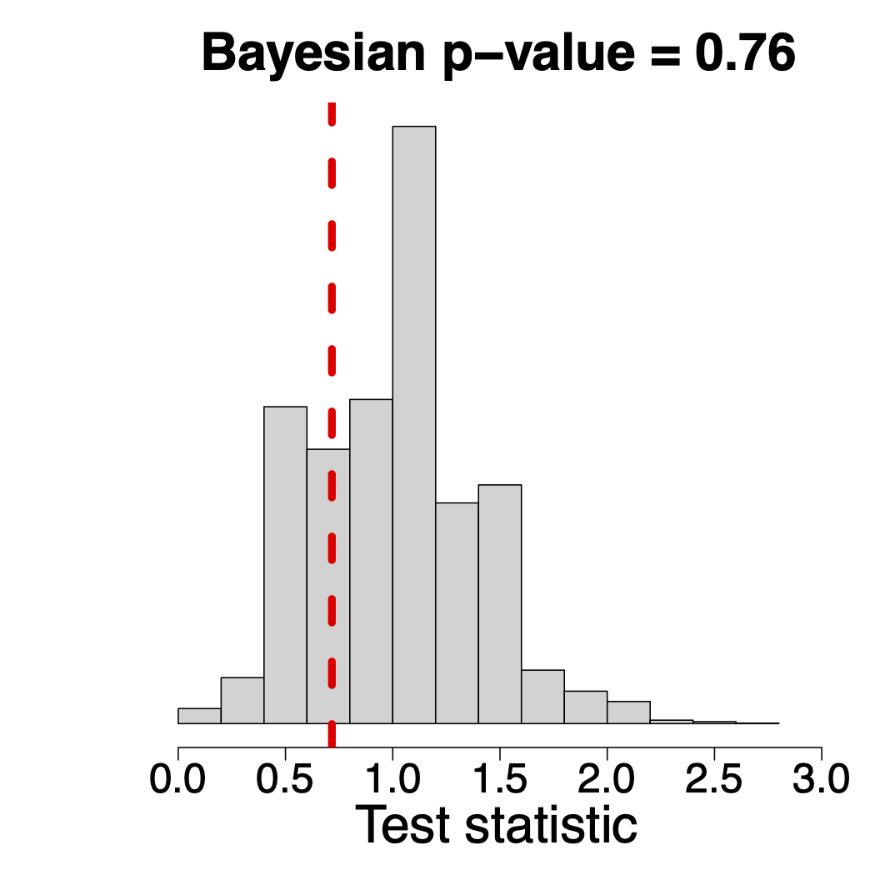
Data Insights: Platform Experimentation
Finally, we look at whether the platform appears to consider user age when experimenting with new cards.
Sample of 1024 cards shown exactly once in the data
Null Hypothesis: Experiment on new and old users at same rate.
Red line to right -> experiment on new more than old!
Register < 1 Month
Register < 2 Month
Register < 3 Month
Takeaway 3: NetEase appears to do age-blind experimentation.
Notes:
Hey Raghav can you write this slide?

Slide 13
Data Insights: Summary
In NetEase Data we find:
Takeaway 1: Cards have heterogenous CTR, distributed as Beta
Need to experiment to find good content in the tail
Takeaway 2: New users leave at high rates and are sensitive
Need to consider user age in recommendation
Takeaway 3: NetEase appears to do age-blind experimentation.
Need to find a better experimentation policy
Notes:
Hey Raghav can you write this slide?

Slide 14
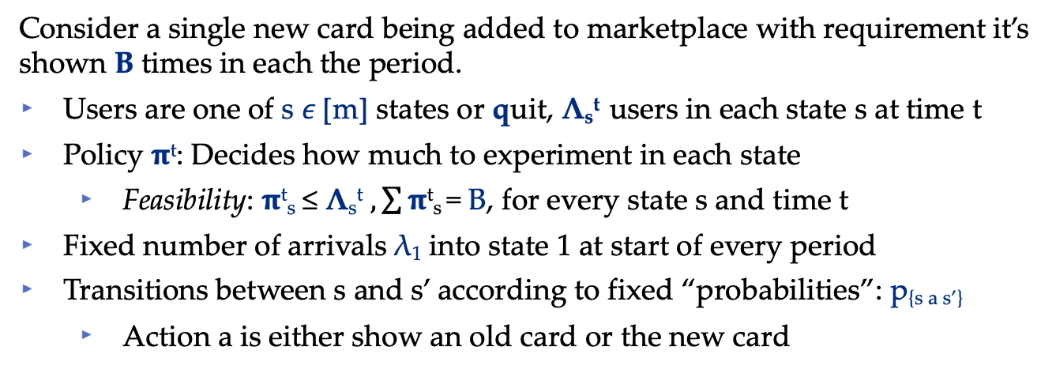
Fluid MDP Model
MDP Model with fluid transitions
Consider a single new card being added to marketplace with requirement it’s shown B times in each the period.
Users are one of s 𝜖 [m] states or quit, Λ_{s}^{t} users in each state s at time t
Policy $π$^{t}: Decides how much to experiment in each state
Feasibility: $π$^{t}_{s} ≤ Λ_{s}^{t} $, \sum{π\text{t}}$_{s} = B, for every state s and time t
Fixed number of arrivals λ₁ into state 1 at start of every period
Transitions between s and s’ according to fixed “probabilities”: p_{{s a s’}}
Action a is either show an old card or the new card
Objective: Maximize steady-state market size
This is equivalent to maximizing sum total user engagement

Slide 15
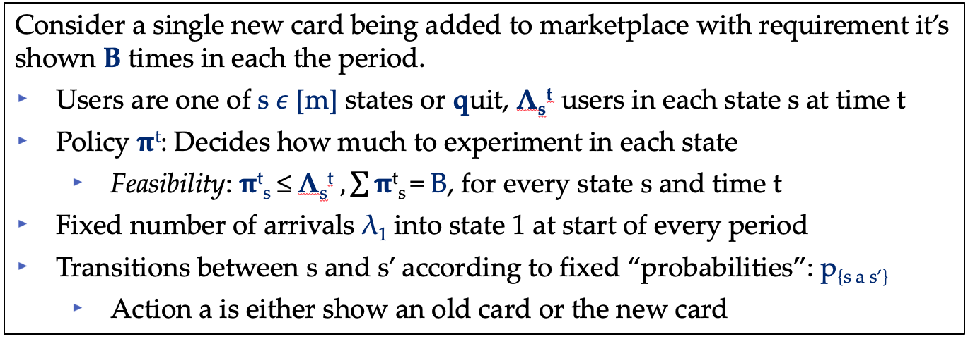
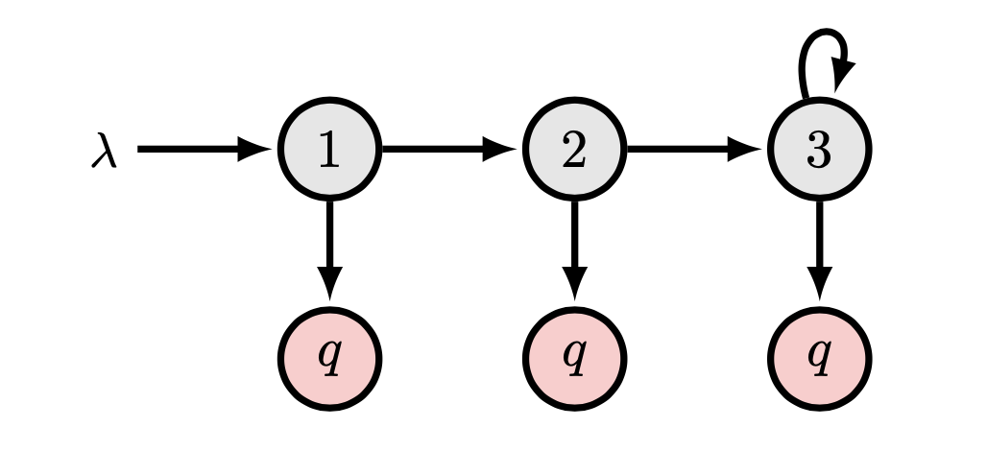
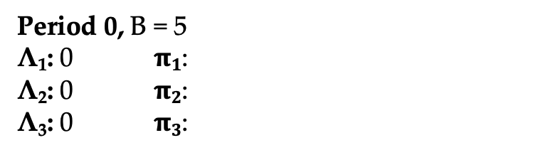
Fluid MDP Model Example
Period 0, B = 5
Λ₁: 0 $π1$:
Λ₂: 0 $π2$:
Λ₃: 0 $π3$:
.95
.8
.8
.9
.6
.75
.4
.2
.25
.1
.2
.05

Slide 16
Fluid MDP Model Example
Period 0, B = 5
Λ₁: 0 $π1$:
Λ₂: 0 $π2$:
Λ₃: 0 $π3$:
.95
.8
.8
.9
.6
.75
.4
.2
.25
.1
.2
.05

Slide 17
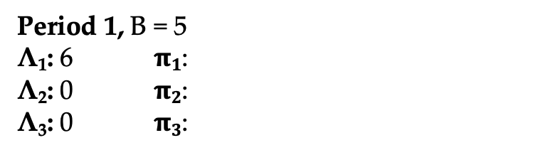
Fluid MDP Model Example
Period 1, B = 5
Λ₁: 6 $π1$:
Λ₂: 0 $π2$:
Λ₃: 0 $π3$:
.95
.8
.8
.9
.6
.75
.4
.2
.25
.1
.2
.05

Slide 18
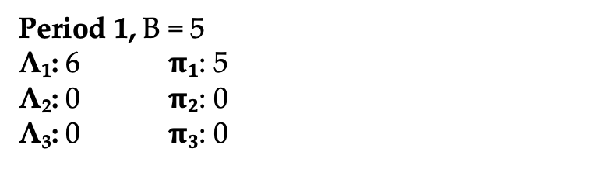
Fluid MDP Model Example
Period 1, B = 5
Λ₁: 6 $π1$: 5
Λ₂: 0 $π2$: 0
Λ₃: 0 $π3$: 0
.95
.8
.8
.9
.6
.75
.4
.2
.25
.1
.2
.05
- User sees old card
- User sees new card

Slide 19
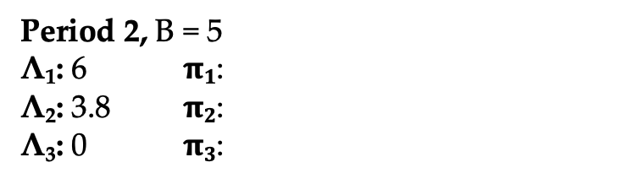
Fluid MDP Model Example
Period 2, B = 5
Λ₁: 6 $π1$:
Λ₂: 3.8 $π2$:
Λ₃: 0 $π3$:
.95
.8
.8
.9
.6
.75
.4
.2
.25
.1
.2
.05
- User saw old card
- User saw new card

Slide 20
Fluid MDP Model Example
Period 2, B = 5
Λ₁: 6 $π1$:
Λ₂: 3.8 $π2$:
Λ₃: 0 $π3$:
.95
.8
.8
.9
.6
.75
.4
.2
.25
.1
.2
.05

Slide 21
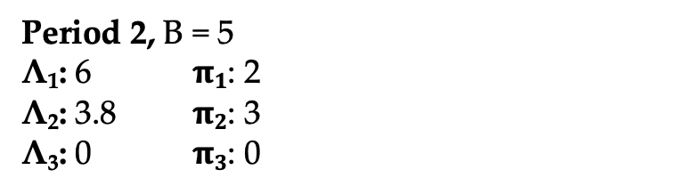
Fluid MDP Model Example
Period 2, B = 5
Λ₁: 6 $π1$: 2
Λ₂: 3.8 $π2$: 3
Λ₃: 0 $π3$: 0
.95
.8
.8
.9
.6
.75
.4
.2
.25
.1
.2
.05
- User sees old card
- User sees new card

Slide 22
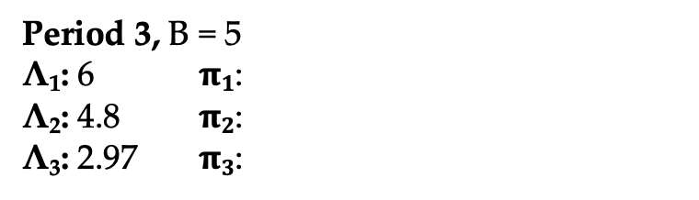
Fluid MDP Model Example
Period 3, B = 5
Λ₁: 6 $π1$:
Λ₂: 4.8 $π2$:
Λ₃: 2.97 $π3$:
.95
.8
.8
.9
.6
.75
.4
.2
.25
.1
.2
.05
- User saw old card
- User saw new card

Slide 23
Fluid MDP Model Example
Period 3, B = 5
Λ₁: 6 $π1$:
Λ₂: 4.8 $π2$:
Λ₃: 2.97 $π3$:
.95
.8
.8
.9
.6
.75
.4
.2
.25
.1
.2
.05

Slide 24
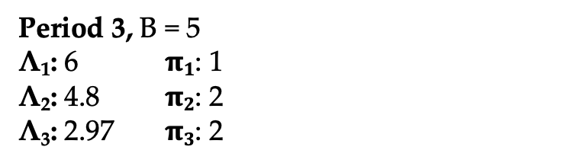
Fluid MDP Model Example
Period 3, B = 5
Λ₁: 6 $π1$: 1
Λ₂: 4.8 $π2$: 2
Λ₃: 2.97 $π3$: 2
.95
.8
.8
.9
.6
.75
…
.4
.2
.25
.1
.2
.05
- User sees old card
- User sees new card

Slide 25
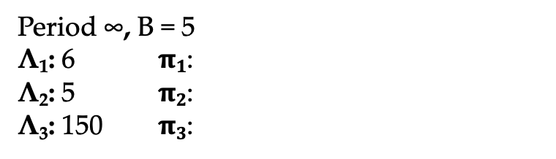
Fluid MDP Model Example
Period ∞, B = 5
Λ₁: 6 $π1$:
Λ₂: 5 $π2$:
Λ₃: 150 $π3$:
.95
.8
.8
.9
.6
.75
.4
.2
.25
.1
.2
.05
Steady-state pile of regular users

Slide 26
Fluid MDP Model
Objective: Maximize steady-state market size
This means deciding where to experiment at each time step
Not clear a steady-state even exists for most policies!
.95
.8
.8
.9
.6
.75
.4
.2
.25
.1
.2
.05

Slide 27
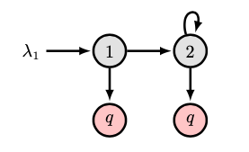
Binary State Model
We focus on two special cases of the model that map to NetEase
Binary State Space - Two states, self-loop only in state 2
Captures our new vs regular user paradigm
Simplest model to study
When viewing chains, keep in mine transitions are action dependent
Remember, some number of users in state 1 and state 2

Slide 28
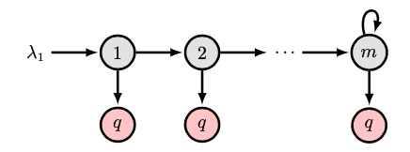
Funnel State Model
We focus on two special cases of the model that map to NetEase
Binary State Space - Two states, self-loop only in state 2
Captures our new vs regular user paradigm
Simplest model to study
Funnel State Space – m states, self-loop only in state m
Extends binary, more granular notion of user age
State number is like user # visits
Regular users have fixed churn prob.
There is some number of users in state 1, 2, 3, …

Slide 29
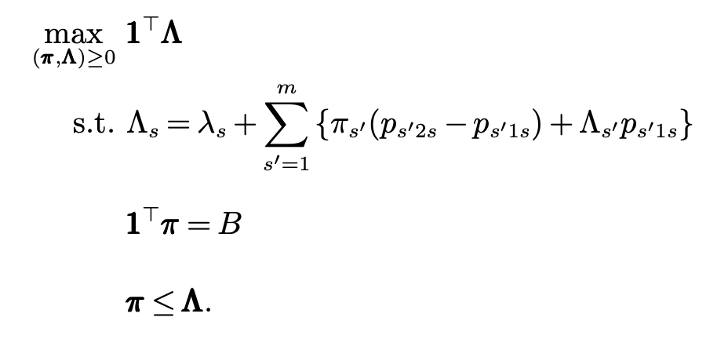
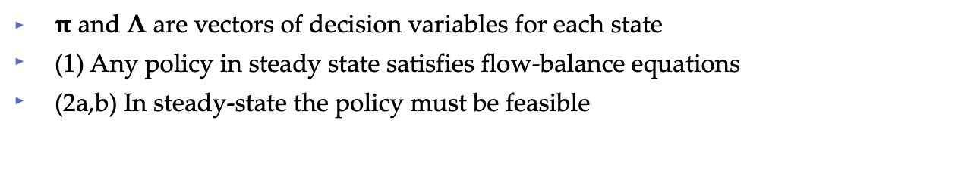
Upper Bounding LP
We are interested in finding policy experimentation policies to maximize market size in steady-state.
Good news! We know what an optimal steady state feasible policy looks like for an input state space + param’s and experimentation budget.
(1)
(2a)
(2b)
$π$ and Λ are vectors of decision variables for each state
(1) Any policy in steady state satisfies flow-balance equations
(2a,b) In steady-state the policy must be feasible
Notes:
type parameters are a function of how the platform decides to separate users into types
Other example: Mobile vs Desktop

Slide 30
Upper Bounding LP
We are interested in finding policy experimentation policies to maximize market size in steady-state.
Good news! We know what an optimal steady state feasible policy looks like for an input state space + param’s and experimentation budget.
(1)
(2a)
(2b)
Bad news
We don’t know what policy reaches this steady-state
The structure of the steady-state optimal policy is sensitive
Notes:
type parameters are a function of how the platform decides to separate users into types
Other example: Mobile vs Desktop

Slide 31
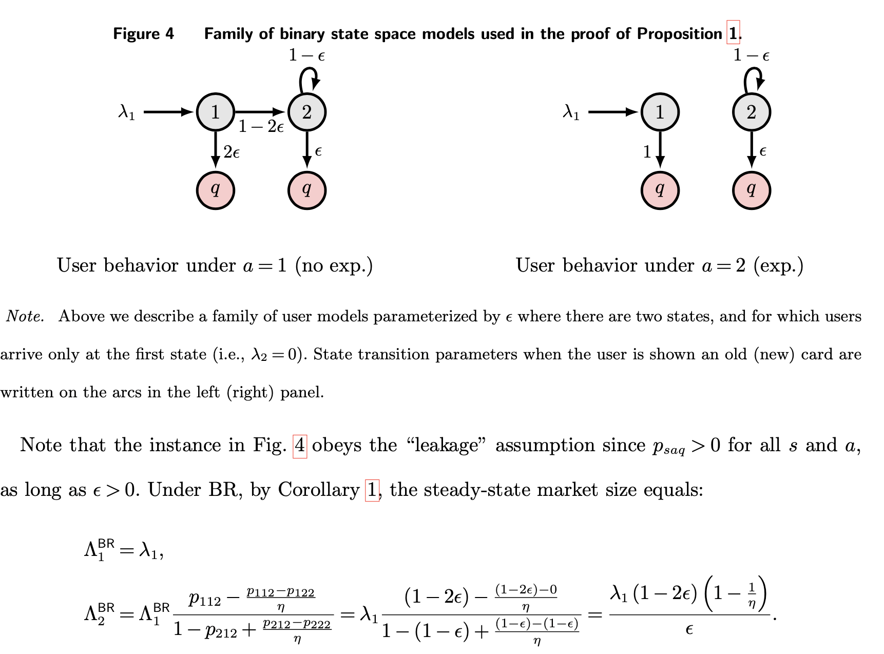
Perils of Blind Randomization
Definition: We call the policy that experiments on each user with equal probability Blind Randomization (BR).
Any policy that ignores user age is BR by definition
Easy to show BR converges and study it’s steady-state
Proposition [BR Performs Arbitrarily Badly].
For the binary state space, BR can guarantee no constant factor of the optimal steady-state reward.
Proof Pic:
Exp. stops flow from 1 to 2
Notes:
Main takeaway is you should evaluate users not just by myopic chance of clicking, but also by incorporating the expected value of that click.

Slide 32
Perils of Blind Randomization
Definition: We call the policy that experiments on each user with equal probability Blind Randomization (BR).
Any policy that ignores user age is BR by definition
Easy to show BR converges and study it’s steady-state
Proposition [BR Performs Arbitrarily Badly].
For the binary state space, BR can guarantee no constant factor of the optimal steady-state reward.
Proof: Lack of flow causes pile up in state 1 for BR, a better policy experiments in state 2!
Notes:
Main takeaway is you should evaluate users not just by myopic chance of clicking, but also by incorporating the expected value of that click.

Slide 33
Churn Minimization (CM)
Qu: What makes a good experimentation policy?
Experiment at random? (No)
Experiment on users with lowest churn probability?
Experiment on oldest users?
Experiment on users with lowest future value to the platform?
Experiment on least sensitive users?
Definition: We define a user in state s’s churn delta as the difference in probability of churning between when they receive experimental content versus when they don’t.
Mathematically: d_{s} := p_{{s (Exp.) q}} - p_{{s (~Exp.) q}}
Captures a notion of sensitivity to new content.
In the funnel, equivalent to oldest, lowest churn rate

Slide 34
Churn Minimization (CM)
Definition: We call the policy that experiments on users in reverse order of churn delta (sensitivity) until feasible Churn Minimization (CM).
This is the myopically optimal one-step policy
Simple, easily implementable
We can show CM converges to a steady-state with effort
Theorem 1 [CM for Binary State Spaces].
For any binary state space model, CM maximizes the steady-state market size.
Remarks
Solves the problem that BR runs into in a simple model
If new users are more sensitive, experiment on them last
Notes:
type parameters are a function of how the platform decides to separate users into types
Other example: Mobile vs Desktop

Slide 35
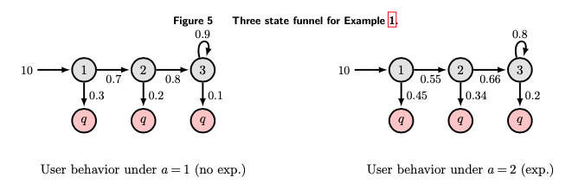
CM Beyond Binary?
Definition: We call the policy that experiments on users in reverse order of state churn delta (sensitivity) until feasible, Churn Minimization (CM).
Qu: Is CM always optimal?
No! Optimality fails even for three state funnel
Remarks
While myopically optimal, there is an interplay between future value which depends on global chain information
Notes:
type parameters are a function of how the platform decides to separate users into types
Other example: Mobile vs Desktop

Slide 36
CM for Funnel State Spaces
Definition: We call the policy that experiments on users in reverse order of churn delta (sensitivity) until feasible Churn Minimization (CM).
Theorem 2 [CM for Funnel State Spaces].
For any funnel state space model, such that:
Churn deltas are decreasing as state number increases
Churn deltas are separated
Then CM maximizes the steady-state market size.
Remarks
When states are differentiated, and later states are always less sensitive, then CM is uniquely optimal.
Global information is basically second order for funnel
Notes:
type parameters are a function of how the platform decides to separate users into types
Other example: Mobile vs Desktop

Slide 37
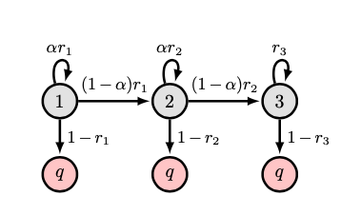
Numerical Results: Funnel + Loops
Numerically we can study CM for general funnel state spaces
We can also add in self loops, ⍺ rate of return to state

Slide 38
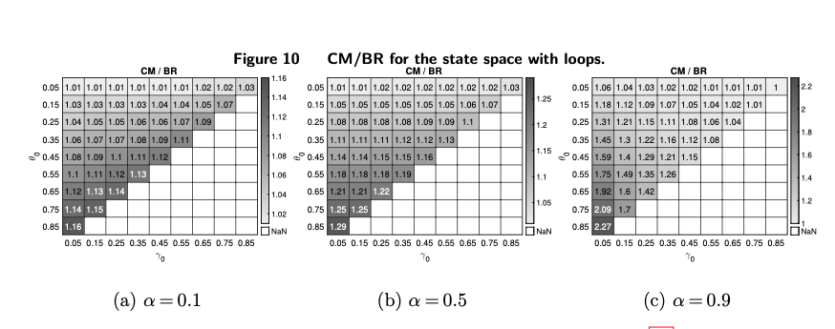
Numerical Results: Funnel + Loops
Numerically we can study CM for general funnel state spaces
We can also add in self loops, ⍺ rate of return to state
Always seems to outperform BR (often significantly)

Slide 39
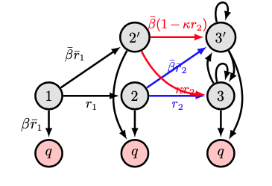
Numerical Results: General States
Numerically we can study CM for general spaces
We can also study CM in general models with complicated transitions between states
Three states, parameters β and 𝜅

Slide 40
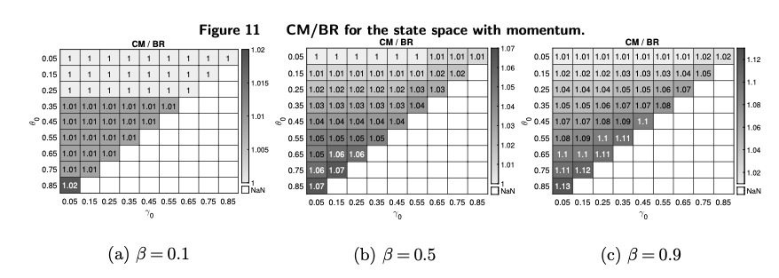
Numerical Results: General States
Numerically we can study CM for general spaces
We can also study CM in general models with complicated transitions between states
Three states, parameters β and 𝜅
Always seems to outperform BR
On average 5% improvement, even for realistic parameters

Slide 41
Conclusions and Future Directions
Recommendation platforms must coordinate interactions between users and content while carefully juggling of challenges corresponding to both sides of this market.
We studied this coordination, balancing the first impression effect against the platform's need to experiment with new creatives.
We give a new model and show that ignoring user age can be very costly in steady state.
We propose a simple algorithm, Churn Minimization, and prove that it is optimal for several realistic models, and numerically near optimal for general and exotic models.
In marketing, literature has proposed CM under a different name ^{[3]}
[3] Managing Churn to Maximize Profits- Lemmens et al, Mkt Sci.

Slide 42
Thank you!
Full paper available at https://mhamilton-pitt.github.io/
Comments, questions, and suggestions are welcome!
Contact: mhamilton@katz.pitt.edu, rs3566@columbia.edu

