Slide 1


Churning while Learning: Maximizing User Engagement in a Recommendation System
Michael L. Hamilton and Raghav Singal
2020 RMP Data-Driven Research Challenge

Slide 2

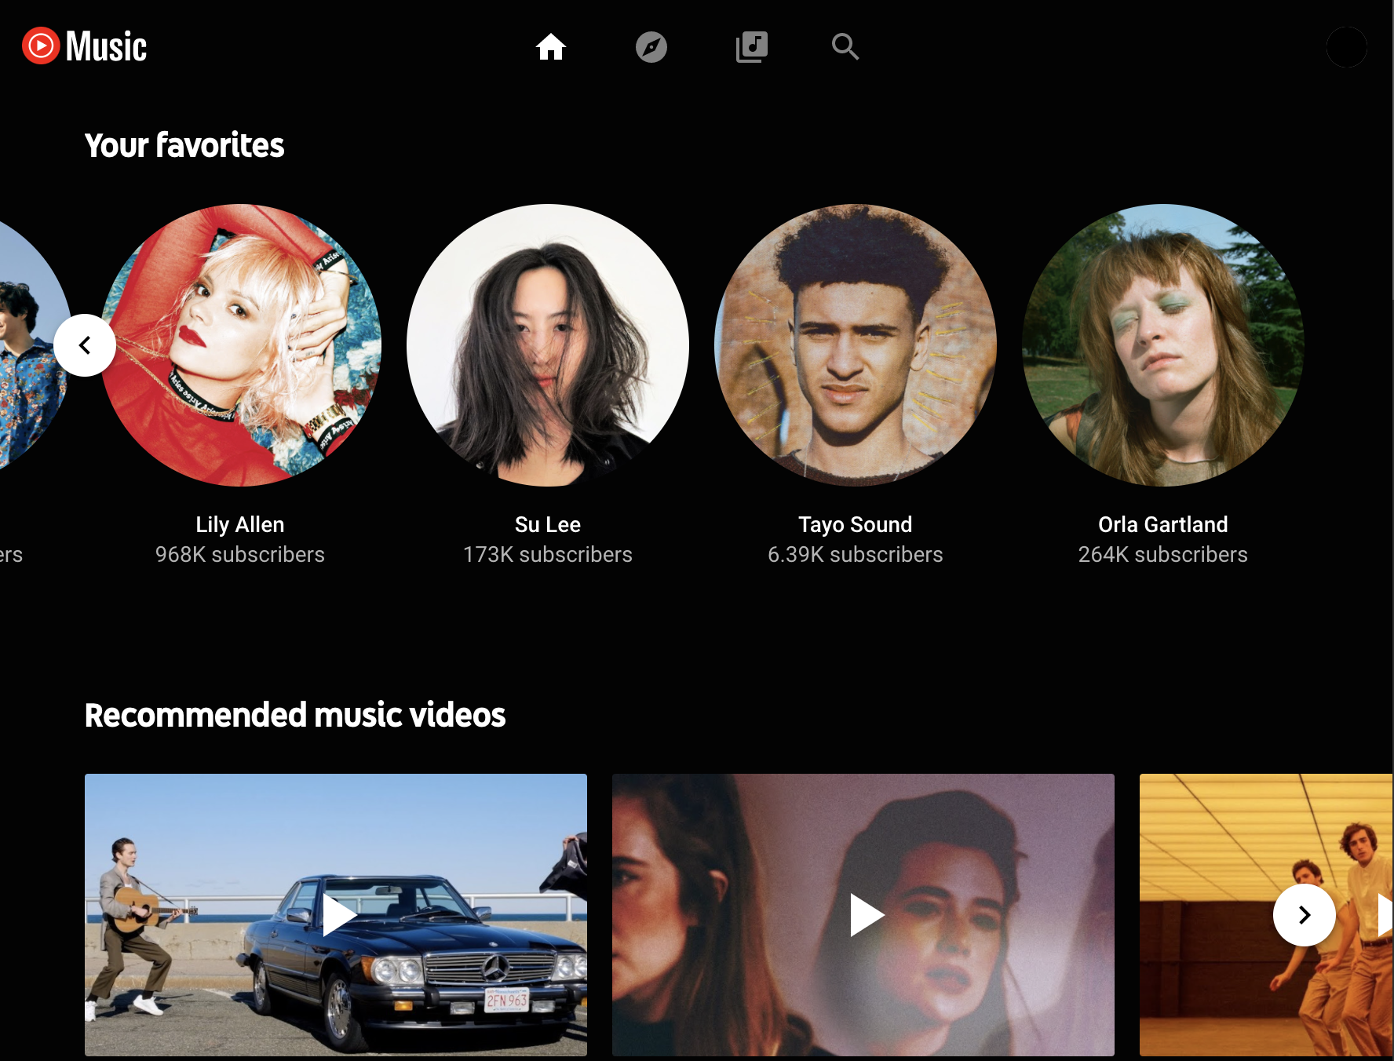

Content Recommendation at NetEase
We study the platform recommendation problem at NetEase Cloud Music, in which the platform decides how to recommend new content to users.
Goal: attract and retain users while disseminating new content.
Problem at NetEase Music, also YouTube, Spotify, Netflix, etc.
Personalized Card Recommendations
Notes:
Our model is directly inspired by real-world data. We explored the NetEase Music dataset and found evidence
(a) of heterogeneous card-specific CTRs and them resembling a Beta distribution,
(b) of a first impression effect and heterogeneous churn rates among users (depending on a user's prior engagement with the platform), and
(c) that the platform appears to ignore heterogeneous user behavior and instead opts for a blind randomization policy.
Our model captures the two features in this marketplace: (1) supply-side learning (uncertainty over the CTR of a newly created content) and (2) demand-side heterogeneous churning (e.g., regular vs.\ new users).

Slide 3
Content Recommendation at NetEase
We study the platform recommendation problem at NetEase Cloud Music, in which the platform decides how to recommend new content to users.
We focus on two complications of this problem using data from NetEase related to the cards, user behavior, and the platform.
Learning new cards Click-Through-Rate (CTR) via experimentation.
First Impression Effect, new users are more likely to Churn (leave the system) as the result of a one bad experience than regular users.
How can the platform maximize user engagement (clicks), while balancing learning the CTR of new cards against the heterogeneous churn behavior of users?
Notes:
Our model is directly inspired by real-world data. We explored the NetEase Music dataset and found evidence
(a) of heterogeneous card-specific CTRs and them resembling a Beta distribution,
(b) of a first impression effect and heterogeneous churn rates among users (depending on a user's prior engagement with the platform), and
(c) that the platform appears to ignore heterogeneous user behavior and instead opts for a blind randomization policy.
The company's long-term goal on the tab is to maximize the daily number of clicks/plays and the
daily number of content created. How could the company create a recommender system that
trades off short-term goals, such as the number of clicks/plays in one day, with this long-term
goal?
The platform recommendation problem (formally defined in \cref{sec:model}) is complicated by a number of factors related to the nature of the content (supply), user behavior (demand), and the platform's information about each. In terms of the supply, the specific catalog of media the platform can recommend is always changing as content creators produce and upload new creatives. Furthermore, there is significant heterogeneity in the quality of such content.
% For example, as we illustrate in our data analysis (\cref{sec:eda}), some creatives have a higher click through rates (CTRs) than others (ranging from $0\%$ to $40\%$.).
For content that has already been widely displayed on the platform, it may be possible to correctly ``estimate'' its click through rate (CTR) and optimize recommendations accordingly. However, such content quickly becomes stale, and with new uploaded content, there's again little information to inform the platform's recommendation decision. Further, gathering information on new content requires care, since showing a low quality creative to too many users can decrease their engagement with the platform.
Adding to the complexity, such user engagement can itself be heterogeneous depending on the ``type'' of the user. For instance, as we demonstrate by analyzing the NetEase dataset (c.f.\ \cref{sec:eda}), new users are more likely to churn (i.e., leave the platform) as a result of one ``poor'' interaction as compared to regular users. How can the platform maximize user engagement (e.g., expected number of clicks) while learning the CTR of new creatives in the presence of heterogeneous churn behavior of users?
Does/can the platform maximize user engagement, while balancing learning the CTR of new cards against the heterogeneous churn behavior of users?

Slide 4
Contributions
We explore the NetEase Music dataset and find evidence that:
Cards have inherent CTRs distributed as a Beta.
A “first impression effect” among users where churn rates depends on a user's prior engagement and the outcome of recommendation.
The platform appears to ignore user-age churn rates when experimenting with new cards.
Based on our exploratory data analysis we propose and solve a two-period model with the goal of maximizing total user engagement.
Optimal policy experiments on users in order of a simple coefficient computable from model params.
We fit our model to NetEase data.
We find potential for increased user retainment and total engagement by switching from user-age agnostic policies to our policy.

Slide 5
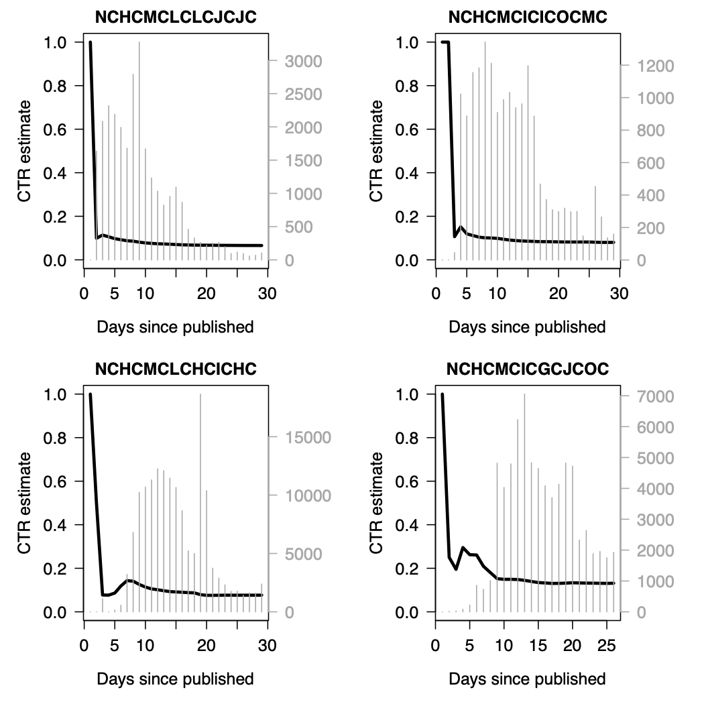
Data Insights: Content Cards
New cards require substantial exploration before stabilizing at their CTR, our measure of card quality.
Two phases: learning of CTR , use of card until phased out.
We internalize unobserved platform matching algorithms, user preference heterogeneity, etc., all into a latent CTR.

Slide 6
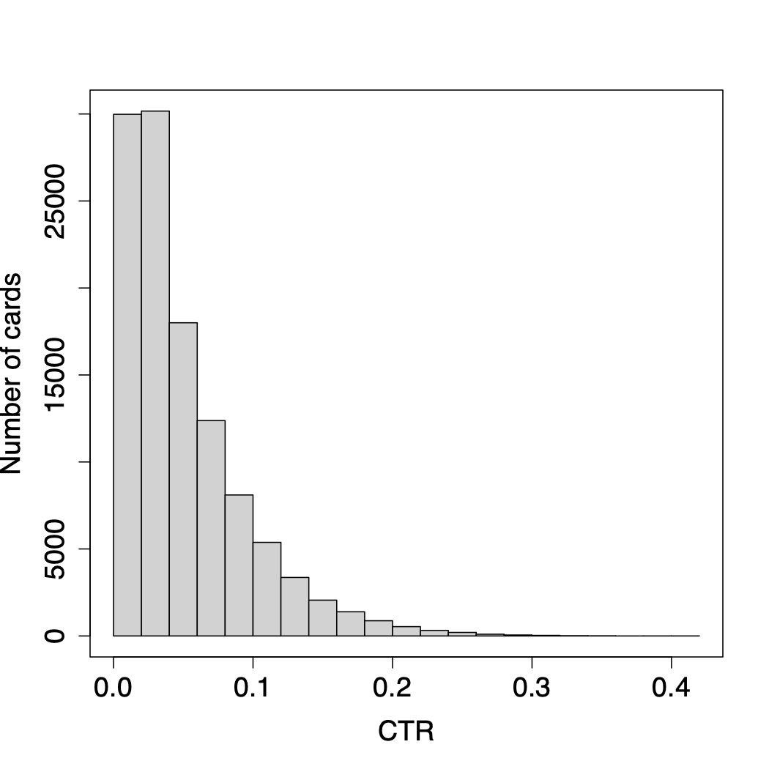
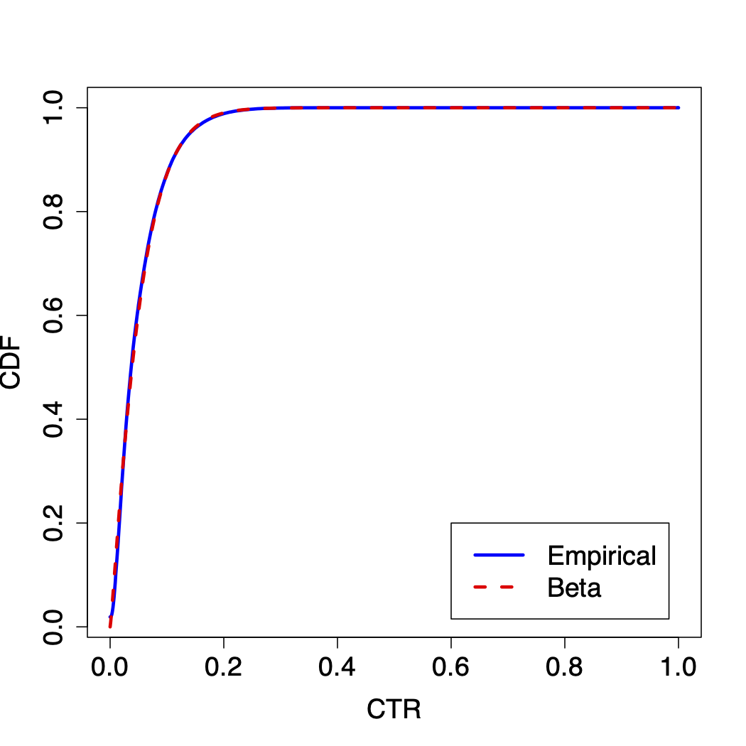
Data Insights: Content Cards
As cards as converge to different CTRs, we can fit a distribution over cards to estimate potential of new cards.
Left: Empirical distribution of cards with >100 impressions (~110,000 such cards).
Right: Empirical CDF vs Beta with mean 0.051, std. dev. 0.044.
Takeaway: Cards have inherent CTR, distributed as Beta

Slide 7
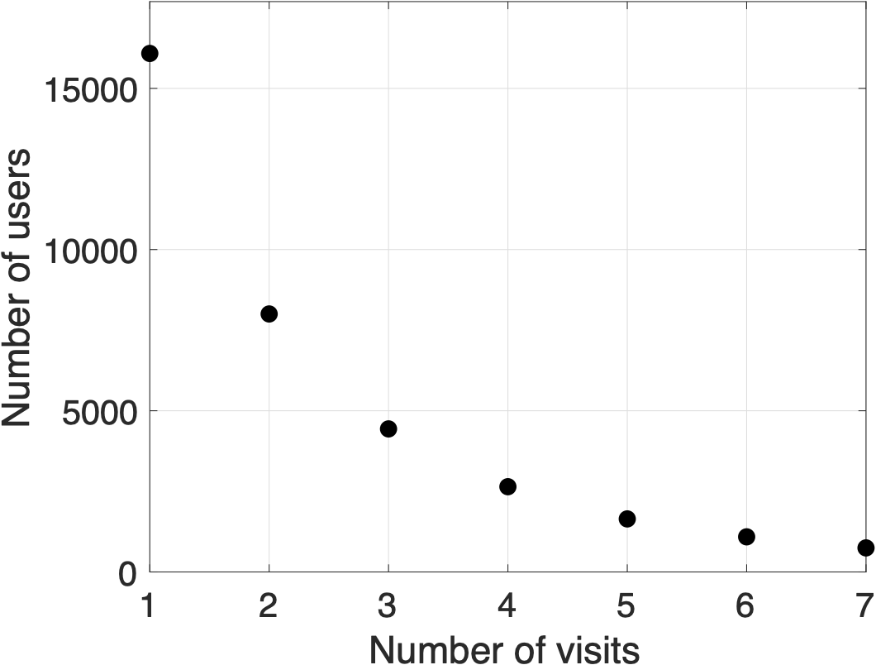
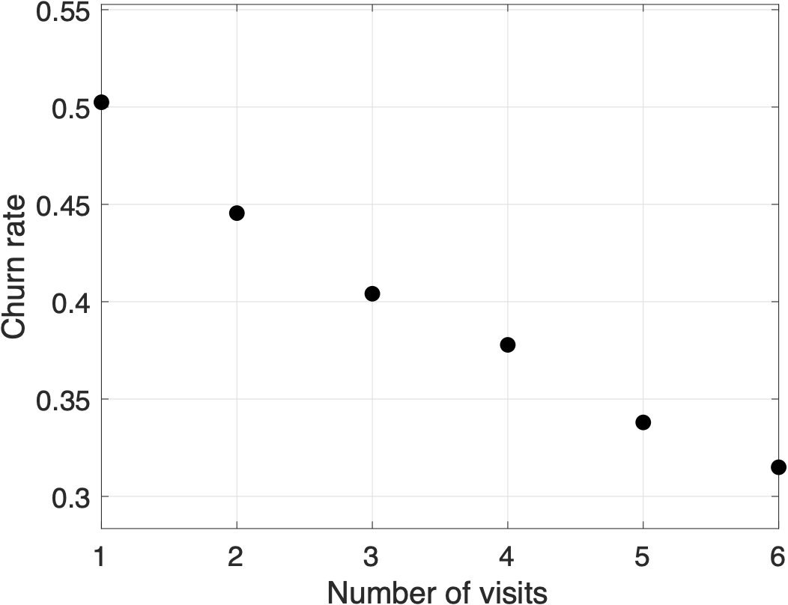
Data Insights: Platform Users
We focus on why new users leave the system, esp. considering on whether they interact with recommended card, i.e., first impression effect.
New users first visit are between day 7 and 10 (16083 obs)
Half of new users never return after first visit!
Users who return are more likely to return again, and again, and again.
Notes:
Out of the 16083 new users plotted in Fig. 4, 2581 clicked on a card during their rst visit whereas
13502 did not. Among the 2581 users who clicked, 1202 churned (i.e., did not return for a second
visit), implying a churn rate of around 46:57%. On the other hand, among the 13502 users who did
not click, around 50:95% of the users churned, suggesting an increase of 4:38 percentage points in
the churn likelihood.

Slide 8
Data Insights: Platform Users
We focus on why new users leave the system, esp. considering on whether they interact with recommended card, i.e., first impression effect.
New users first visit are between day 7 and 10 (16083 obs)
Half of new users never return after first visit!
Users who return are more likely to return again, and again, and again.
Among the 2581 new users who clicked, 1202 churned (46.57%) vs 13502 who did not click, 6875 churned (50.95%). 4% diff in churn rate!
We varied definitions of new user and find these conclusions robust
For regular users (not new), churn at about 5% and are not particularly sensitive to whether they interact with the recommended card
Takeaway: New users leave at high rates and are sensitive
Notes:
Out of the 16083 new users plotted in Fig. 4, 2581 clicked on a card during their rst visit whereas
13502 did not. Among the 2581 users who clicked, 1202 churned (i.e., did not return for a second
visit), implying a churn rate of around 46:57%. On the other hand, among the 13502 users who did
not click, around 50:95% of the users churned, suggesting an increase of 4:38 percentage points in
the churn likelihood.

Slide 9
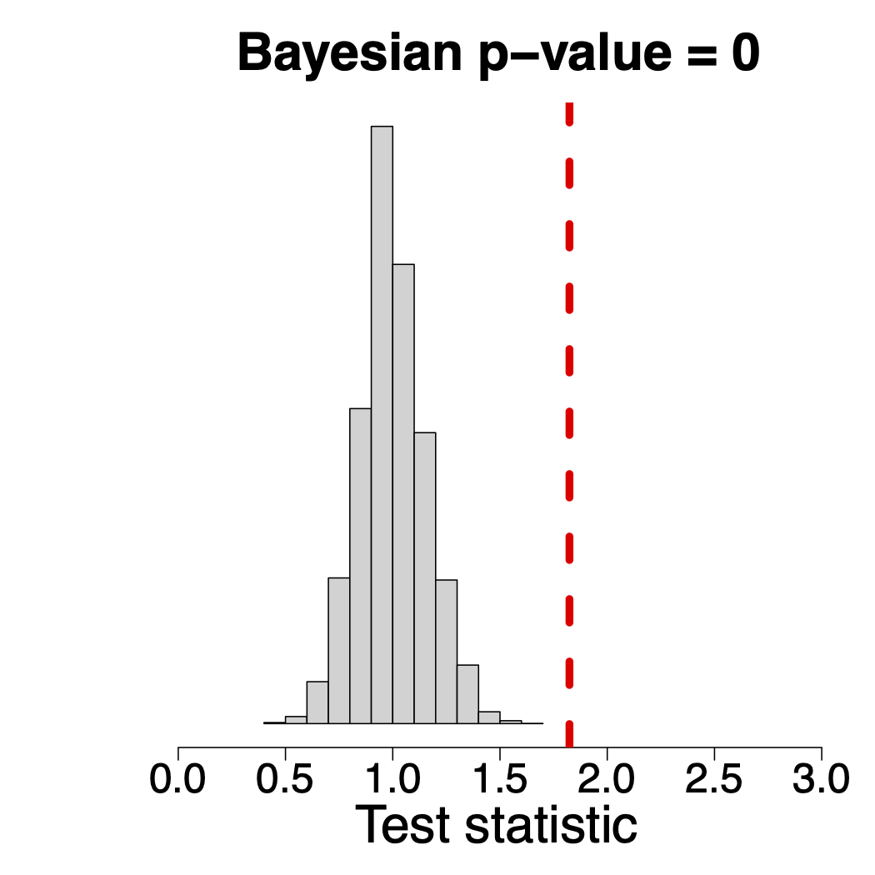
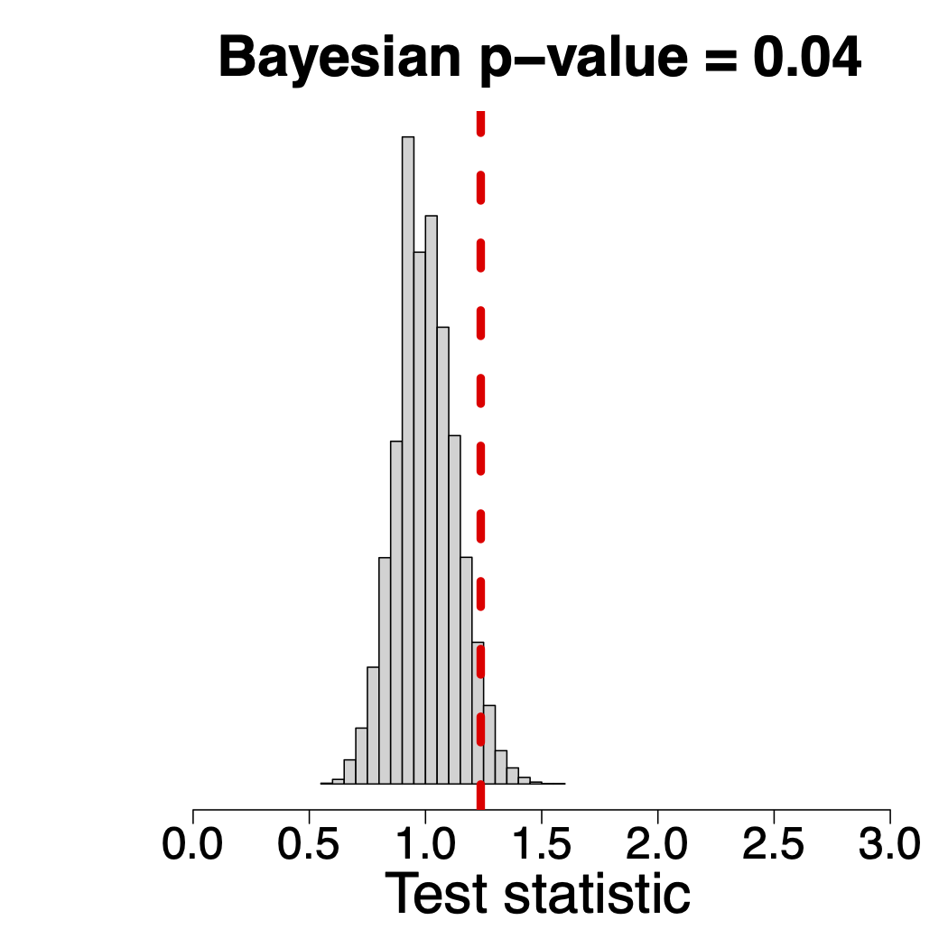
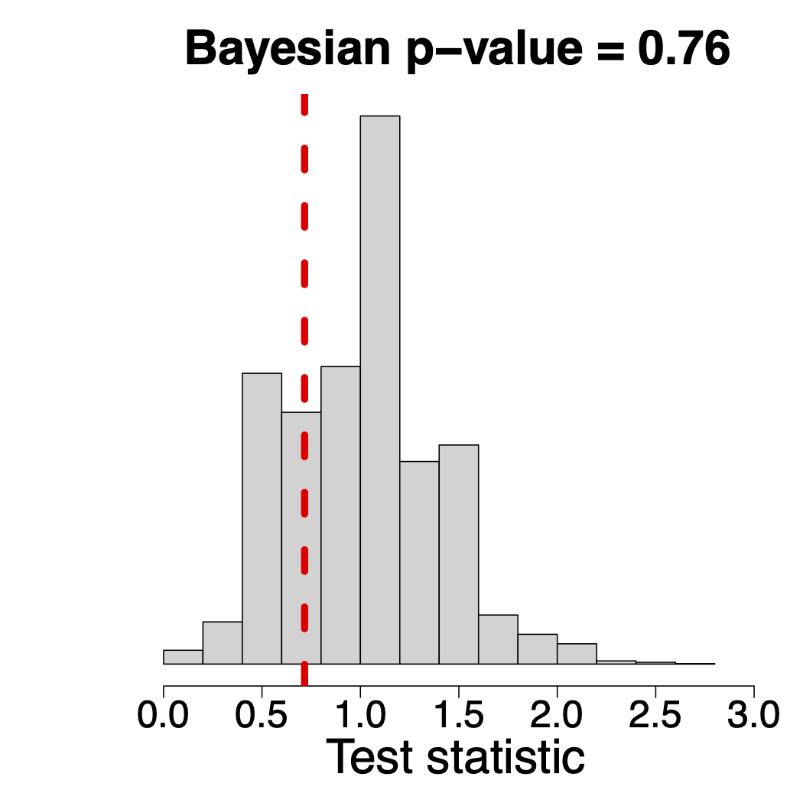
Data Insights: Platform Experimentation
Finally, we look at whether the platform appears to consider user age when experimenting with new cards.
Look at 1024 cards shown exactly once in the data
Null Hypothesis: Experiment on new and old users at same rate.
Red line to right -> experiment on new more than old!
Reg. < 1 Month
Reg. < 2 Month
Reg. < 3 Month
Takeaway: Platform appears to do age-blind experimentation.
Notes:
Hey Raghav can you write this slide?

Slide 10
Two Period Model: Users
Building on our data observations we build a model capturing two key features with the goal of optimizing long-term engagement.
Consider a single new card being added to marketplace with exogenous budget for exploration B.
User of type k is defined by a pair (q_{k} , 𝛿_{k}) where q is base churn rate and 𝛿 is increase in churn rate if they don’t interact with recommendation.
Only two-stages. Obj to maximize clicks in stage 1&2
Platform can show new card or some old one

Slide 11

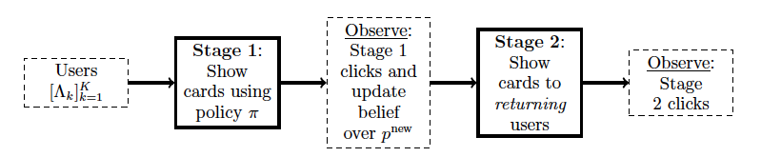
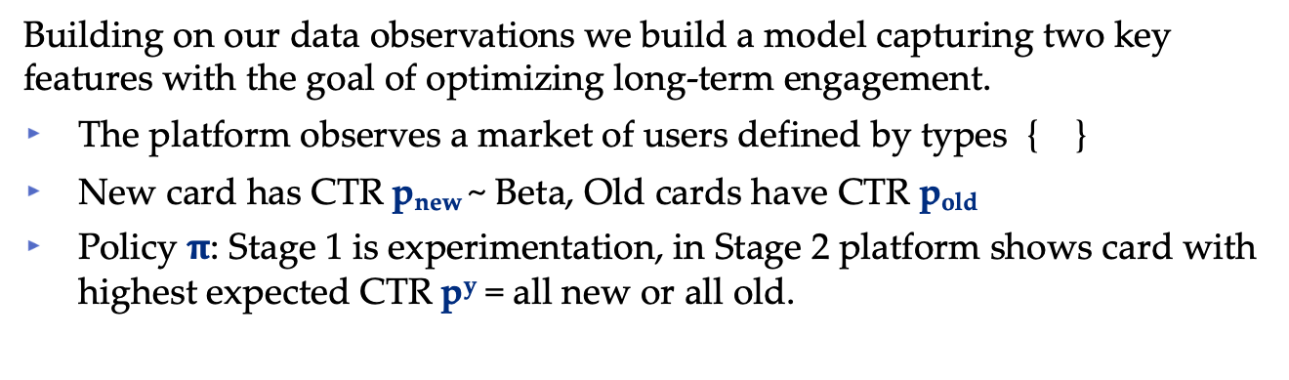
Two Period Model: Platform
Building on our data observations we build a model capturing two key features with the goal of optimizing long-term engagement.
The platform observes a market of users defined by types { }
New card has CTR p_{new} ~ Beta, Old cards have CTR p_{old}
Policy $π$: Stage 1 is experimentation, in Stage 2 platform shows card with highest expected CTR p^{y} = all new or all old.
Remarks
This model is minimal to capture the interaction between experimentation and the first impression effect.
Likely conservative as stage 2 is one click and not whole lifetime.
Notes:
Add in pold, pnew, p^y here

Slide 12
Theoretical Results
Definition: We define a users Experimentation Coefficient (EC) as the expected difference in the probability of a stage 2 click from showing a new card versus an old card to the user in stage 1.
Theorem [Maximizing Engagement via EC].
For any set of model parameters, the policy that shows new cards to users in order of their EC uniquely maximizes total clicks in expectation.
Remarks
ECs are easily computable from model primitives.
Notes:
Main takeaway is you should evaluate users not just by myopic chance of clicking, but also by incorporating the expected value of that click.

Slide 13
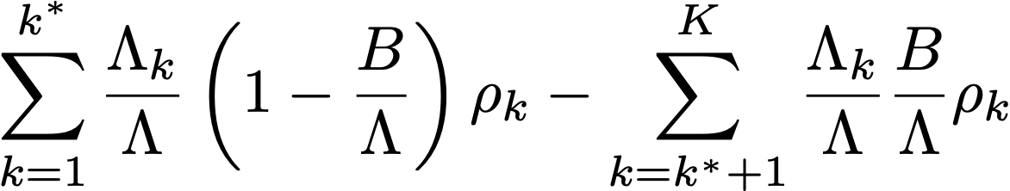
Theoretical Results
Definition: We define a users Experimentation Coefficient (EC) as the expected difference in the probability of a stage 2 click from showing a new card versus an old card to the user in stage 1.
Theorem [Maximizing Engagement via EC].
For any set of model parameters, the policy that shows new cards to users in order of their EC uniquely maximizes total clicks in expectation.
Remarks
Difference between OPT and current practice is a weighted avg of ECs!

Slide 14
Theoretical Results
Definition: We define a users Experimentation Coefficient (EC) as the expected difference in the probability of a stage 2 click from showing a new card versus an old card to the user in stage 1.
Theorem [Maximizing Engagement via EC].
For any set of model parameters, the policy that shows new cards to users in order of their EC uniquely maximizes total clicks in expectation.
Remarks
Takeaway is platform should/can evaluate users by incorporating the expected value of that click over user’s lifetime.
Notes:
type parameters are a function of how the platform decides to separate users into types
Other example: Mobile vs Desktop

Slide 15
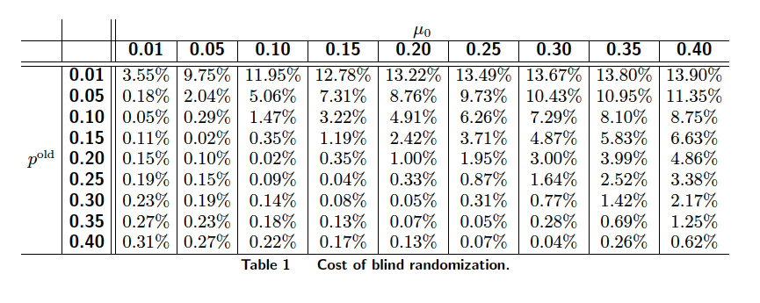
Numerical Results
Finally, we fit our model back to NetEase data and evaluate the cost of type blind experimentation
We set budget for experimentation to be B = 100
Rest of parameters are point estimates
Expected CTR of new card
CTR of old card
Remarks
There’s a modest, uniformly positive impact of applying the opt. policy.
For high yield content, expected value is much higher.

Slide 16
Conclusions and Future Directions
Recommendation platforms must coordinate interactions between users and content while carefully juggling of challenges corresponding to both sides of this market. We numerically studied and modelled this coordination, balancing the first impression effect against the platform's need to experiment with new creatives.
We gave a new framework through which to think about retention of the platform's user-base, via the Experimentation Coefficients, that may guide platform designers in improving user retention/engagement.
Our model is quite conservative, restricting the future lifetime of the user to just one additional period. Extending our results to a multi-period model may substantially strengthen our conclusions.

Slide 17
Thank you!
Full paper available on SSRN
Comments, questions, and suggestions are welcome!
Contact: mhamilton@katz.pitt.edu, rs3566@columbia.edu

Slide 18
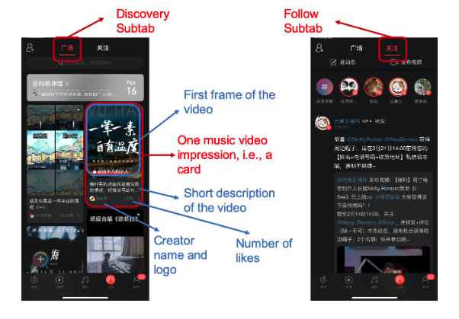
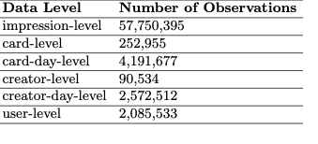
NetEase Cloud Music Dataset
See “NetEase Cloud Music Data” in MSOM
“NetEase Cloud Music is a free music streaming service developed and owned by NetEase, Inc. It was first launched on April 23, 2013, and then became immensely popular in China.”
“The data contains more than 57 million impressions/displays of music content cards recommended to a random sample of 2,085,533 users from November 1st, 2019 to November 30th, 2019.”
Notes:
To be done, I don’t know if I need to do this though or what I should include

