Slide 1

Optimal Feature-Based Market Segmentation and Pricing
Titing Cui and Michael L. Hamilton

Slide 2



Segmented Pricing
A segmented pricing is when the price for a good varies across different segments of the market.
Many markets are segmented
Digital Properties like Adobe, Office, Online Games
Insurance Markets
Geographically segmented infrastructure like Cable, Internet, etc.

Slide 3
Segmented Pricing
A segmented pricing is when the price for a good varies across different segments of the market.
Many markets are segmented
Digital Properties like Adobe, Office, Online Games
Insurance Markets
Geographically segmented infrastructure like Cable, Internet, etc.
In practice, many of these markets are segmented and priced using features of a customer.
Features are used to determine prices by leveraging some regression model that predicts customer willingness-to-pay.

Slide 4
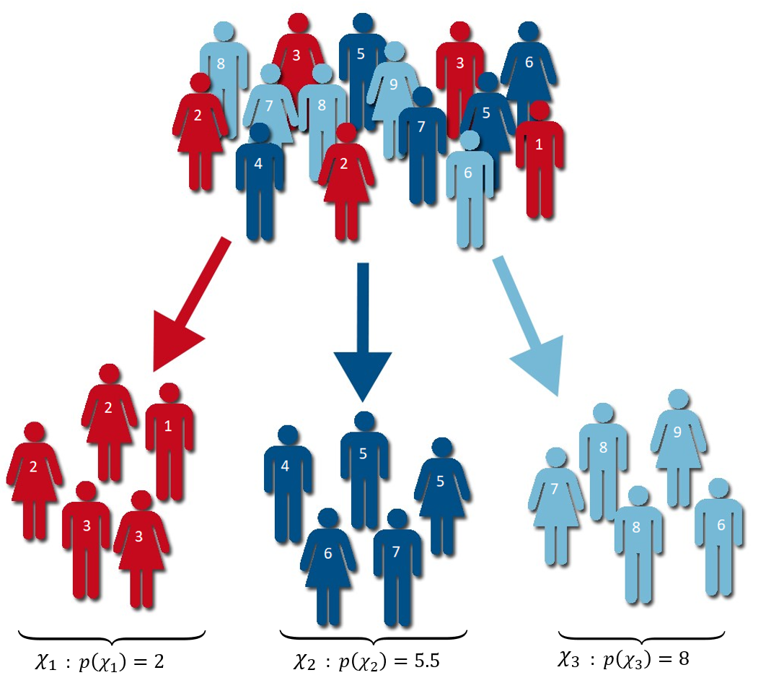


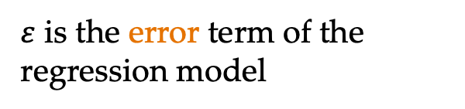

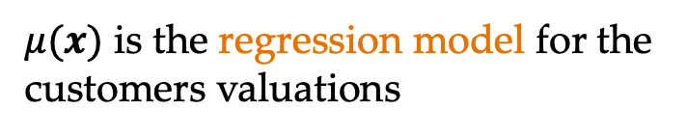
Segmented Pricing in Practice
Objective: Segment and price to maximize revenue
Market of customers with associated features X supported on Ω
V|X = $μ$(X) + 𝜀, $μ$(X) ⫫ 𝜀
$μ(x)$ is the regression model for the customers valuations
$\text{ε}$ is the error term of the regression model
$μ:$Ω ➝ ℝ
$$E\left[\text{ε}\right]=0$$
Notes:
Sigma is all possible contexts
X represents the context of a random customer
Mu(X) is the predicted valuation for a customer

Slide 5
Contributions
C1: Characterize structure of the optimal policy.
Unfortunately, with general errors the optimal segmentation can be quite pathological, i.e., NP-hard to solve. We show when errors are log-concave, the optimal policy becomes is again nice and computable.
C2: Bound approximate model-based policies.
For log-concave errors, we show that the optimal k-segmentation revenue is concave in k. Even though in general the optimal policy is complex, we show that using a segmentation generated by using just the feature-model inherits strong guarantees on the revenue + optimal rates of convergence.
Notes:
We consider a more realistic version of personalized pricing we term feature-based
pricing, and show how to transform our previous bounds into bounds on the value of
feature-based pricing over single price strategies (cf. Lemma 9 and Theorem 5) via a
novel extension theorem. These bounds makes explicit the relationship between the
accuracy of a sellers prediction model, and value of personalized pricing in a market.

Slide 6
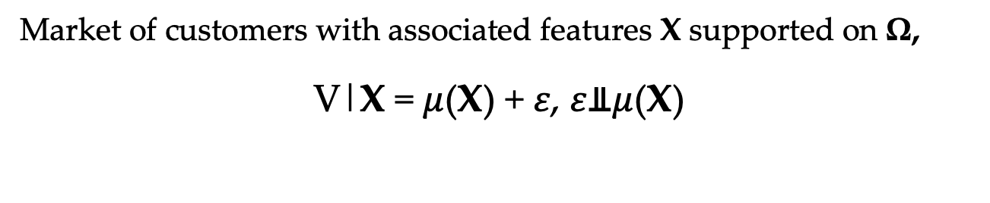
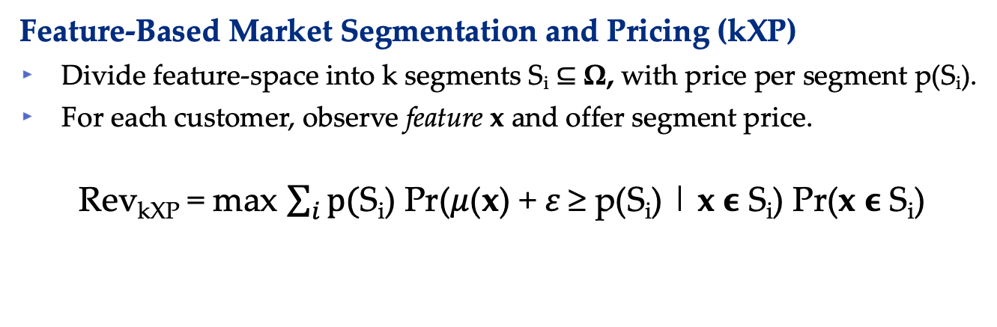
Model: FBMSP
Market of customers with associated features X supported on Ω,
V|X = $μ$(X) + 𝜀, 𝜀⫫$μ$(X)
Feature-Based Market Segmentation and Pricing (kXP)
Divide feature-space into k segments S_{i} ⊆ Ω, with price per segment p(S_{i}).
For each customer, observe feature x and offer segment price.
Rev_{kXP} = max $\sum_{i}{p(}$S_{i}) Pr($μ$(x) + 𝜀 ≥ p(S_{i}) | x ϵ S_{i}) Pr(x ϵ S_{i})
Number of segments, k, is thought to small and exogenously given.
Note p(S_{i}) is an induced price as a function of the segmentation.

Slide 7







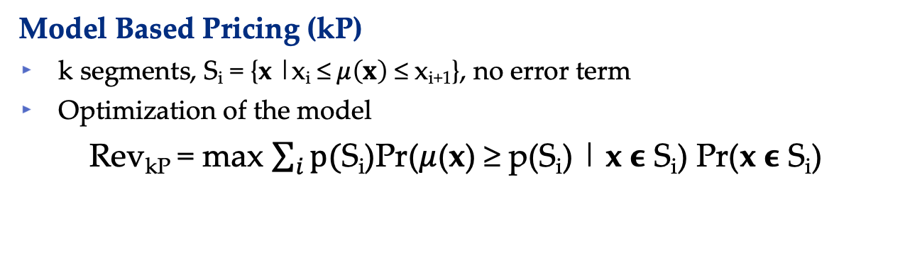
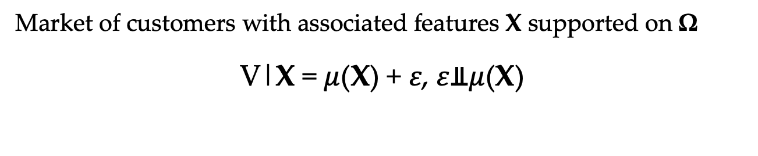
Benchmark: Model Optimization
Market of customers with associated features X supported on Ω
V|X = $μ$(X) + 𝜀, 𝜀⫫$μ$(X)
Model Based Pricing (kP)
k segments, S_{i} = {x |x_{i} ≤$μ\left(x\right)$ ≤ x_{i+1}}, no error term
Optimization of the model
Rev_{kP} = max $\sum_{i}{p(}$S_{i})Pr($μ$(x) ≥ p(S_{i}) | x ϵ S_{i}) Pr(x ϵ S_{i})
p( )
p( )
p( )

Slide 8
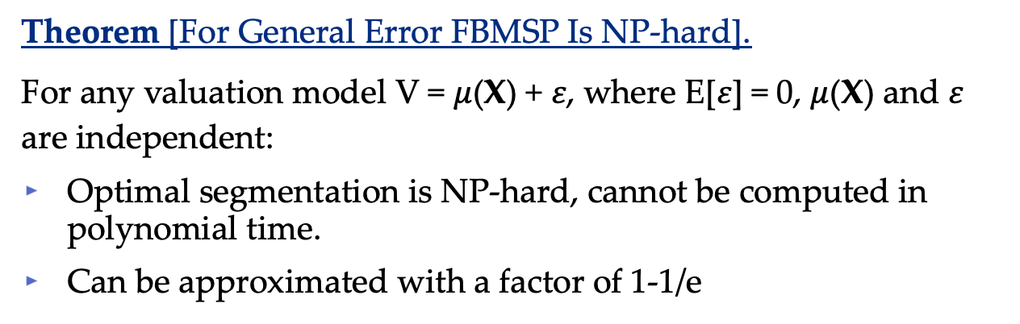
Hardness of FBMSP
Theorem [For General Error FBMSP Is NP-hard].
For any valuation model V = $μ$(X) + 𝜀, where E[𝜀] = 0, $μ$(X) and 𝜀 are independent:
Optimal segmentation is NP-hard, cannot be computed in polynomial time.
Can be approximated with a factor of 1-1/e
Takeaway
For general errors, there is no algorithm can compute the optimal FBMSP in polynomial time.

Slide 9
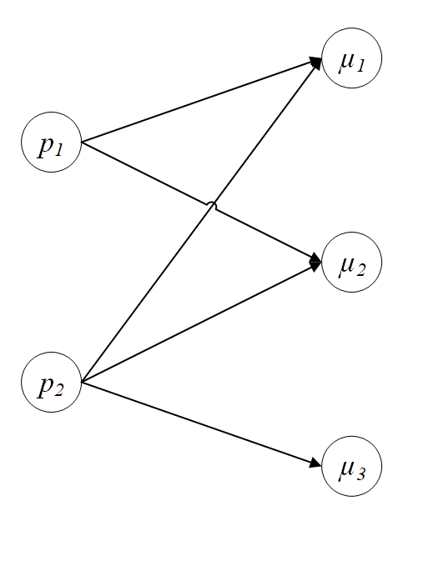
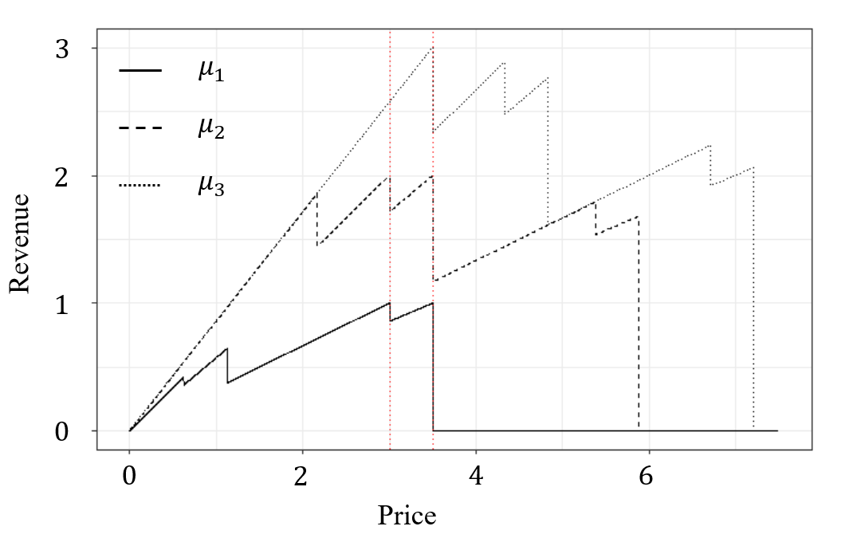
Hardness of FBMSP
Theorem [For General Error FBMSP Is NP-hard].
Takeaway
For general errors, there is no algorithm can compute the optimal FBMSP in polynomial time.
General FBMSP ⬄ Hitting Set

Slide 10
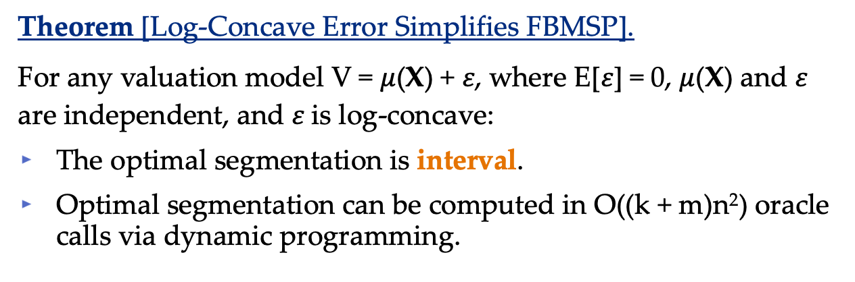
Structure of FBMSP
Theorem [Log-Concave Error Simplifies FBMSP].
For any valuation model V = $μ$(X) + 𝜀, where E[𝜀] = 0, $μ$(X) and 𝜀 are independent, and 𝜀 is log-concave:
The optimal segmentation is interval.
Optimal segmentation can be computed in O((k + m)n²) oracle calls via dynamic programming.
Takeaway
Log-concave error is just as easy to work with as no error at all!
Most common distributions are log-concave, for example Normal, Logistic, Uniform etc.

Slide 11
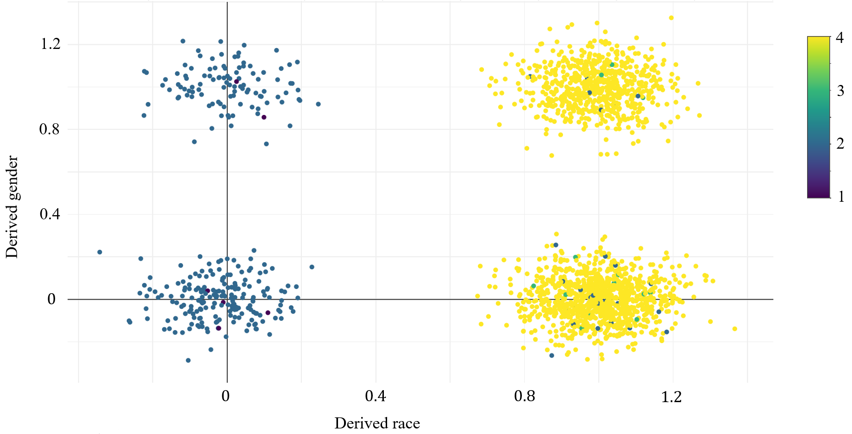
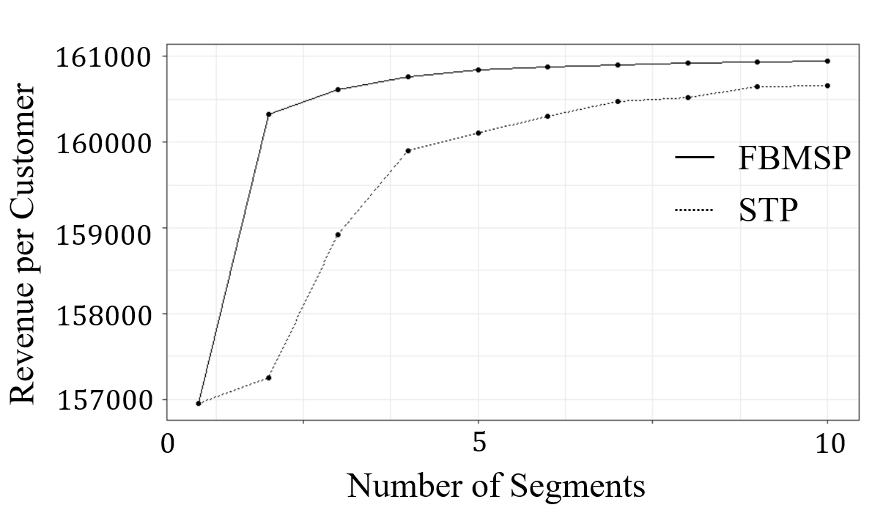
Cut for time!
We prove a number of structural properties that to guide analysts in the implementation and analysis of FBMSP
We do a case study demonstrating our method on real housing loan data from Pennsylvania in 2020. We show our methodology outperforms common segment-then-price paradigms.
More revenue with less segments and less discrimination!

Slide 12
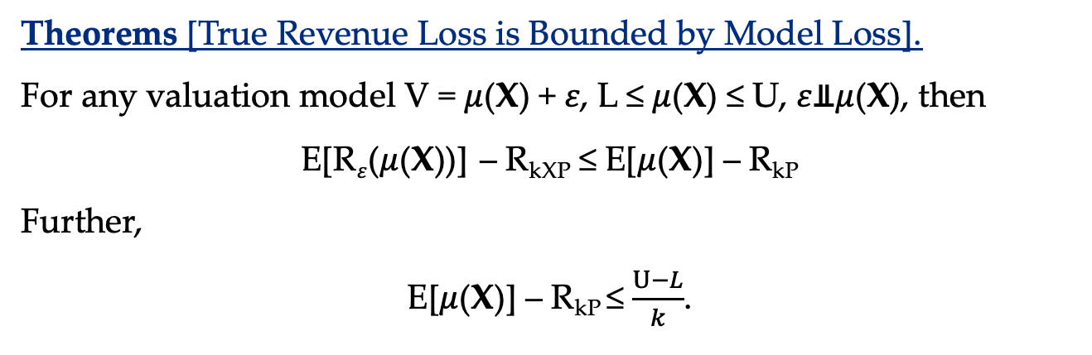
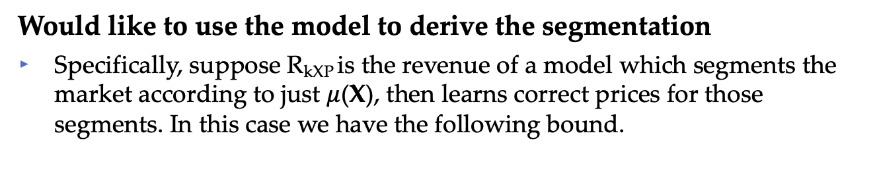
C3: Approximation for FBMSP
Would like to use the model to derive the segmentation
Specifically, suppose R_{kXP} is the revenue of a model which segments the market according to just $μ$(X), then learns correct prices for those segments. In this case we have the following bound.
Theorems [True Revenue Loss is Bounded by Model Loss].
For any valuation model V = $μ$(X) + 𝜀, L ≤ $μ$(X) ≤ U, 𝜀⫫$μ$(X), then
E[R$\text{ε}$($μ$(X))] – R_{kXP} ≤ E[$μ$(X)] – R_{kP}
Further,
E[$μ$(X)] – R_{kP} ≤ $\frac{U−L}{k}$.
True Loss
Model Loss
Both the $U−L$ constant and the rate of O(1/k) can not be improved.

Slide 13
Thank you!
Full paper: https://papers.ssrn.com/sol3/papers.cfm?abstract_id=4151103
Comments, questions @ tic54@pitt.edu
More papers: https://tcui-pitt.github.io/

