Slide 1



The Value of Personalized Pricing
Adam N. Elmachtoub, Michael L. Hamilton, and Vishal Gupta
USC University of
Southern California
Department of IEOR
Data Science Institute
INFORMS 2019
Marshall School of Business

Slide 2
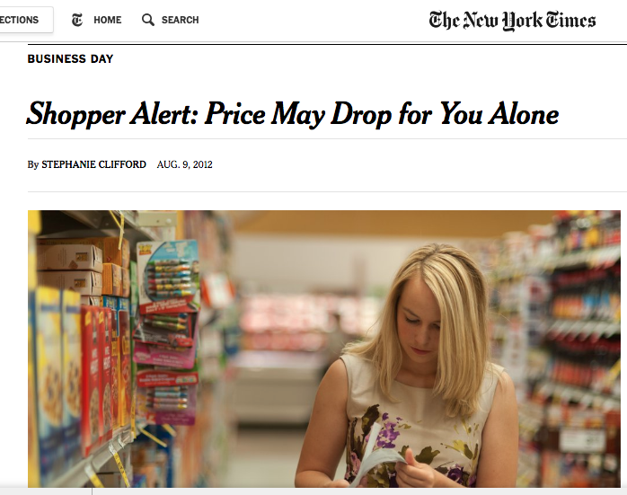



Slide 3
Drawbacks to Personalized Pricing
Investment cost
Customer perception
Legal issues
Extra potential revenue unclear
Research Questions:
When should prices be personalized?

Slide 4







Framework
Market of customers with valuations V ~ F
Customers purchase an item if valuation exceeds offered price.
Idealized Personalize Pricing (PP)
Seller knows the customer’s valuation and offers that price.
v
v
F

Slide 5
Framework
Market of customers with valuations V ~ F
Customers purchase an item if valuation exceeds offered price.
Idealized Personalize Pricing (PP)
Seller knows the customer’s valuation and offers that price.
Single Price Strategy (SP)
Seller offers every customer a fixed price p.
p
F

Slide 6


Framework
Market of customers with valuations V ~ F
Customers purchase an item if valuation exceeds offered price.
Idealized Personalize Pricing (PP)
Seller knows the customer’s valuation and offers that price.
Feature-Based Pricing (XP)
Seller predicts the customer’s valuation and offers a price.
Single Price Strategy (SP)
Seller offers every customer a fixed price p.
p( )
p( )
p( )
F

Slide 7
Contributions
We give tight, closed form upper bounds on the gap between idealized personalized pricing and a single price strategy using natural statistics.
We give novel, closed form lower bounds on the gap between idealized personalized pricing and a single price strategy using natural statistics and a mild shape assumption.
We consider a more realistic version of personalized pricing we term feature-based pricing, and show how to extend our previous bounds to the value of feature-based pricing over single price strategies.
Notes:
We consider a more realistic version of personalized pricing we term feature-based
pricing, and show how to transform our previous bounds into bounds on the value of
feature-based pricing over single price strategies (cf. Lemma 9 and Theorem 5) via a
novel extension theorem. These bounds makes explicit the relationship between the
accuracy of a sellers prediction model, and value of personalized pricing in a market.

Slide 8
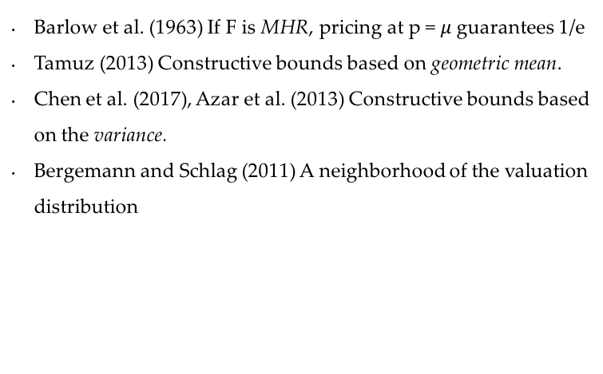
Related Literature
Personalized Pricing
Algorithms for Personalized Pricing
Aydin and Ziya (2009)
Phillips (2013)
Bernstein et al. (2015)
Chen et al. (2015)
Ban and Keskin (2017)
Third Degree Price Discrimination in OM
Intertemporal pricing. Su (2007), Besbes and Lobel (2015)
Rebates/promotions. Chen et al. (2005), Cohen et al. (2017)
Markdown optimization. Caro and Gallien (2012), Ozer and Zheng (2015)
Product differentiation. Moorthy (1984), Choudhary et al. (2005)
Dynamic Pricing and Learning. Cohen et al. (2016), Qiang and Bayati (2016), Javanmard and Nazerzadeh (2016)
Robust Pricing
MHR. Barlow et al. (1963)
Geometric Mean. Tamuz (2013)
Variance. Chen et al. (2017), Azar et al. (2013)
Neighborhood. Bergemann and Schlag (2011)
Support. Cohen, Perakis, Pindyck (2015)

Slide 9
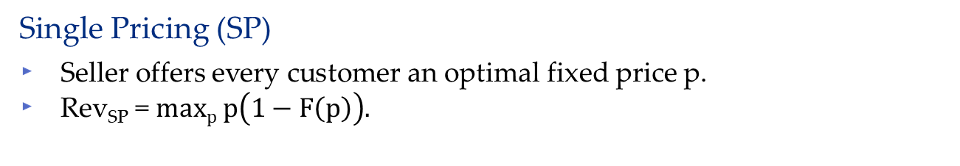
When does a Single Price Suffice?
Idealized Personalize Pricing (PP)
Seller knows the customer's valuation and offers that price.
Rev_{PP} = E[V].
Single Pricing (SP)
Seller offers every customer an optimal fixed price p.
Rev_{SP} = $maxp p\left(1−F\left(p\right)\right).$
The Value of Personalized Pricing := Rev_{PP} / Rev_{SP}
Question: When is the value of personalized pricing low/high?

Slide 10
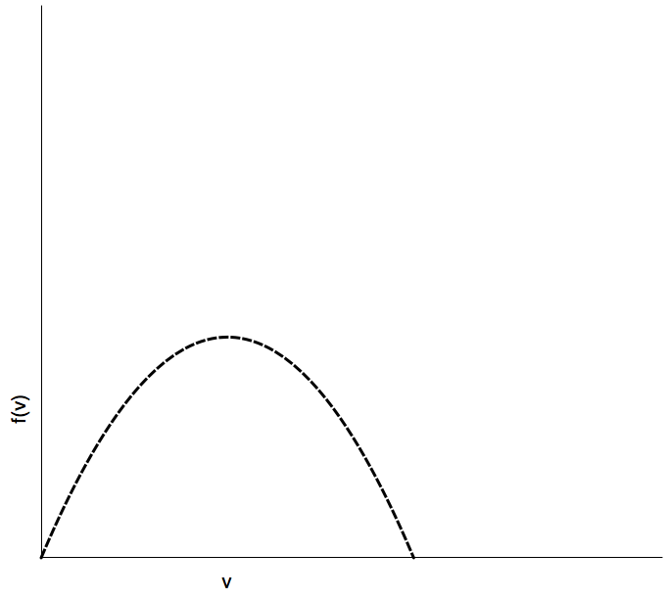

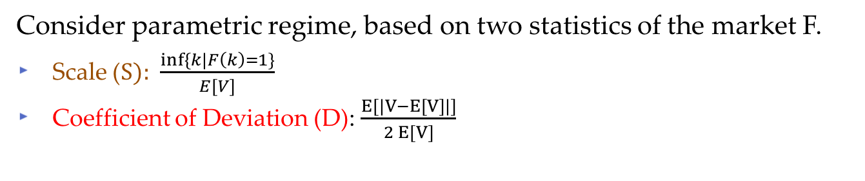
Parametric Regime
Market of customers with valuations V ~ F
If F is known, we can simply compute Rev_{PP} /Rev_{SP}
Consider parametric regime, based on two statistics of the market F.
Scale (S): $\frac{inf⁡\{k|F\left(k\right)=1\}}{E[V]}$
Coefficient of Deviation (D): $\frac{E[|V−E[V]|]}{2 E[V]}$
Probability
$$μ$$
Valuation
F

Slide 11
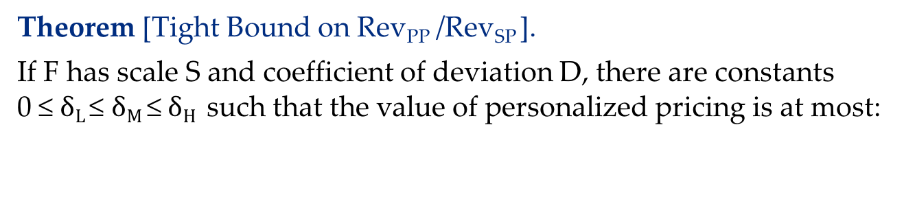

The Value of Personalized Pricing
Theorem [Tight Bound on Rev_{PP} /Rev_{SP} ].
If F has scale S and coefficient of deviation D, there are constants 0 ≤ $δL$≤ $δM \text{≤} δH$ such that the value of personalized pricing is at most:
$\frac{−W_{−1}\left(\frac{D}{e}\right)}{1−D}$ if D ∊ [0, $δL$]
$\frac{log\left(S\right) }{D}$ if D ∊ [$δL$, $δM$]
$W_{−1}\left(\frac{−1}{eS\left(1−D\right)}\right)$ if D ∊ [$δM$, $δH$]
(Low Heterogeneity)
(Medium Heterogeneity)
(High Heterogeneity)

Slide 12
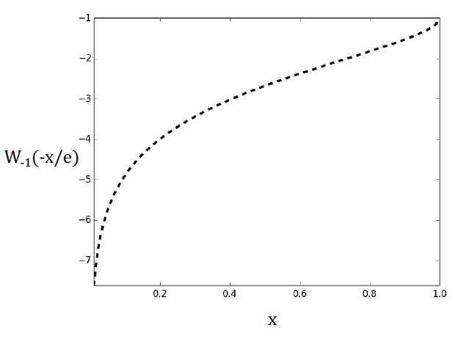
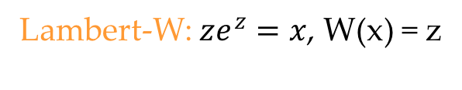

The Value of Personalized Pricing
Theorem [Tight Bound on Rev_{PP} /Rev_{SP} ].
If F has scale S and coefficient of deviation D, there are constants 0 ≤ $δL$≤ $δM \text{≤} δH$ such that the value of personalized pricing is at most:
$\frac{−W_{−1}\left(\frac{D}{e}\right)}{1−D}$ if D ∊ [0, $δL$]
$\frac{log\left(S\right) }{D}$ if D ∊ [$δL$, $δM$]
$W_{−1}\left(\frac{−1}{eS\left(1−D\right)}\right)$ if D ∊ [$δM$, $δH$]
Lambert-W: $ze^{z}=x$, W(x) = z

Slide 13
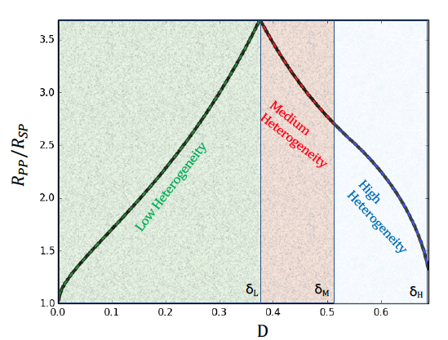
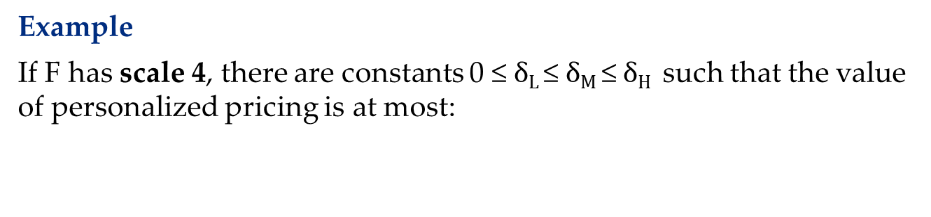
The Value of Personalized Pricing
Example
If F has scale 4, there are constants 0 ≤ $δL$≤ $δM \text{≤} δH$ such that the value of personalized pricing is at most:
e

Slide 14
The Value of Personalized Pricing
Non-monotonicity of the value of personalized pricing
Note as the coefficient of deviation increases past a certain point, a single price strategy begins to improve.

Slide 15
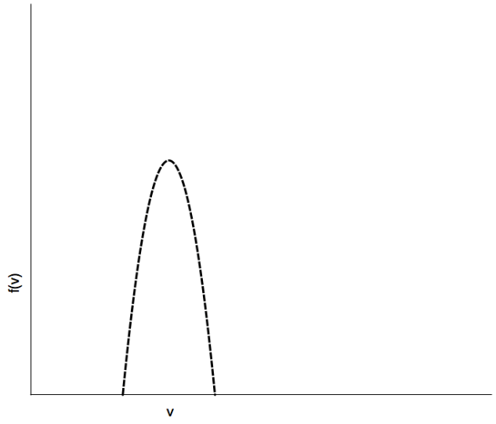
The Value of Personalized Pricing
Non-monotonicity of the value of personalized pricing
Note as the coefficient of deviation increases past a certain point, a single price strategy begins to improve.
Low Deviation
Probability
p*
Valuation

Slide 16
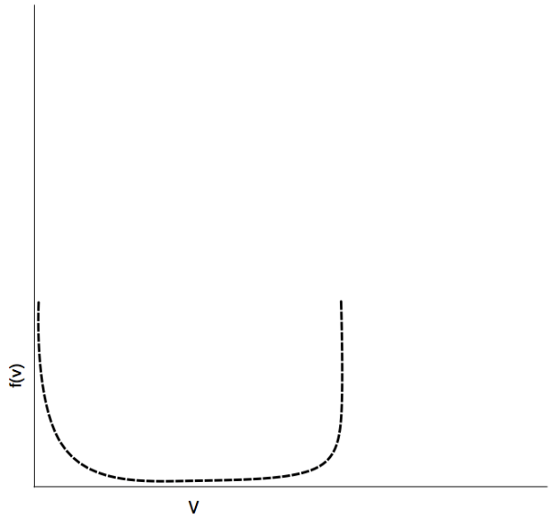
The Value of Personalized Pricing
Non-monotonicity of the value of personalized pricing
Note as the coefficient of deviation increases past a certain point, a single price strategy begins to improve.
High Deviation
Probability
p*
Valuation

Slide 17
The Value of Personalized Pricing
Does high heterogeneity ever imply high VoPP?
Can we prove lower bounds on the value of personalized pricing?
Need to restrict the distribution class to bar Bernoulli Distributions.
Probability
p*
Valuation

Slide 18

The Value of Personalized Pricing
Theorem [Lower Bound on Rev_{PP} /Rev_{SP} ].
If F is unimodal, and has coefficient of deviation D, the value of personalized pricing is at least :
$\frac{1}{1−D}$ if D ∊ [0, 1/3]
$\frac{8D }{\left(1+D\right)2}$ if D ∊ [1/3 , 1]
High Heterogeneity ⇒ High Value of Personalized Pricing

Slide 19
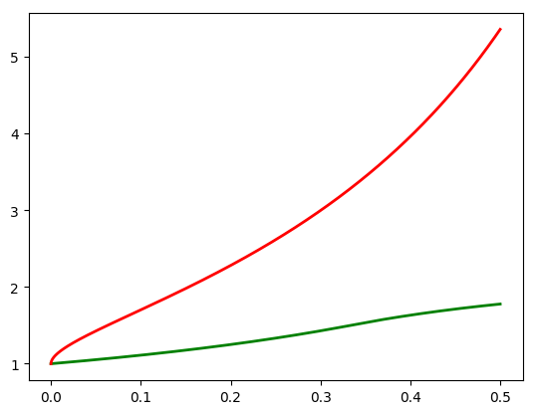
The Value of Personalized Pricing
Theorem [Lower Bound on Rev_{PP} /Rev_{SP} ].
If F is unimodal, and has coefficient of deviation D, the value of personalized pricing is at least :
$\frac{1}{1−D}$ if D ∊ [0, 1/3]
$\frac{8D }{\left(1+D\right)2}$ if D ∊ [1/3 , 1]
Rev_{PP} /Rev_{SP}
Upper Bound
Lower Bound
D

Slide 20
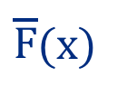
Lower Bound Intuition
Proof Intuition
(E[V] = α = 1)
Concave
$\overline{F}$(x)
Convex
α
p*

Slide 21
Lower Bound Intuition
Proof Intuition
(E[V] = α = 1)
Rev_{SP} = R₁ + R₂
$\overline{F}$(x)
R₁
R₂
α
p*

Slide 22

Lower Bound Intuition
Proof Intuition
(E[V] = α = 1)
Rev_{SP} = R₁ + R₂
Rev_{PP} ≥ R + T
$\overline{F}$(x)
R
T
α
p*

Slide 23

Lower Bound Intuition
Proof Intuition
(E[V] = α = 1)
Rev_{SP} = R₁ + R₂
Rev_{PP} ≥ R + T
Area of ≅ 1-D
$\overline{F}$(x)
α
p*

Slide 24
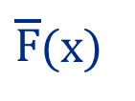
Lower Bound Intuition
Proof Intuition
(E[V] = α = 1)
Rev_{SP} = R₁ + R₂
Rev_{PP} ≥ R + T
Area of = 1-D
Area of = D
$\overline{F}$(x)
α
p*

Slide 25
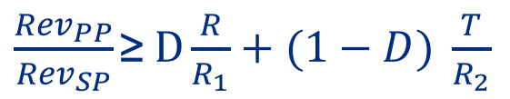

Lower Bound Intuition
Proof Intuition
(E[V] = α = 1)
Rev_{SP} = R₁ + R₂
Rev_{PP} ≥ R + T
Area of ≅ 1-D
Area of ≅ D
$\overline{F}$(x)
$\frac{{Rev}_{PP}}{{Rev}_{SP}}\text{≥}$ $D\frac{R}{R_{1}}+(1−D) \frac{T}{R_{2}}$
R
R₂
R₁
T
α
p*

Slide 26
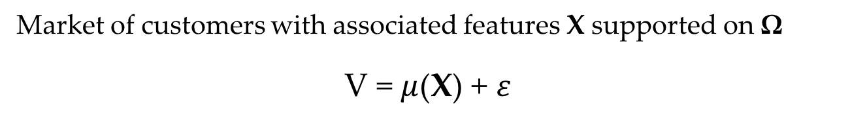


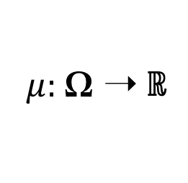

Personalized Pricing in Practice
Market of customers with associated features X supported on Ω
V = $μ$(X) + 𝜀
$μ(⋅)$ is the prediction model
$\text{ε}$ is the error term of the model
$μ:$Ω ➝ ℝ
$$E\left[\text{ε}\right]=0$$
Notes:
Sigma is all possible contexts
X represents the context of a random customer
Mu(X) is the predicted valuation for a customer

Slide 27
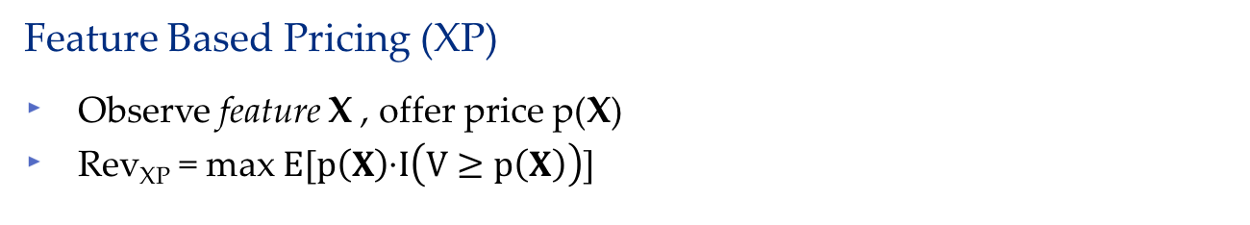
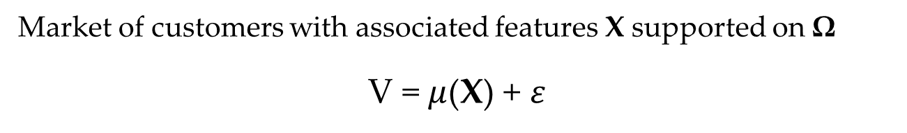
Personalized Pricing in Practice
Market of customers with associated features X supported on Ω
V = $μ$(X) + 𝜀
Feature Based Pricing (XP)
Observe feature X , offer price p(X)
Rev_{XP} = max $E[p\left(X\right)\text{·}I\left(V≥p\left(X\right)\right)]$
p(·)
p( )
p( )
p( )

Slide 28
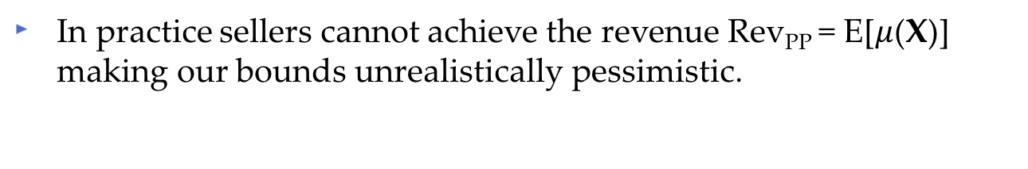
Personalized Pricing in Practice
V = $μ$(X) + 𝜀
In practice sellers cannot achieve the revenue Rev_{PP} = E[$μ$(X)] making our bounds unrealistically pessimistic.
The Value of Personalized Pricing in Practice := Rev_{XP} / Rev_{SP}
Captures loss due to prediction inaccuracy
Bounds should be stronger for more accurate models
When 𝜀 = 0 a.s., Rev_{XP} / Rev_{SP} = Rev_{PP} / Rev_{SP}

Slide 29
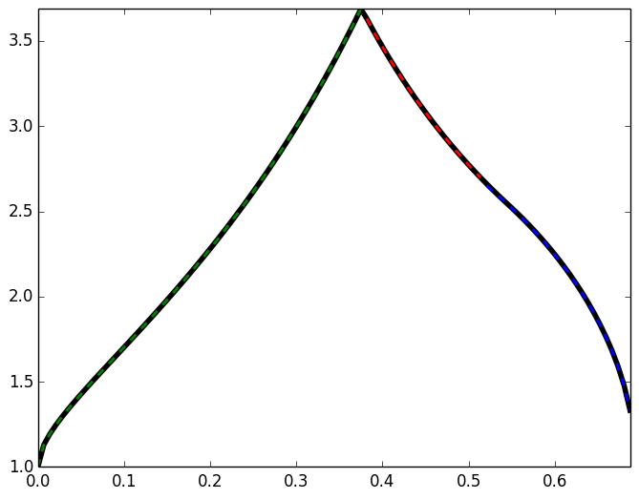

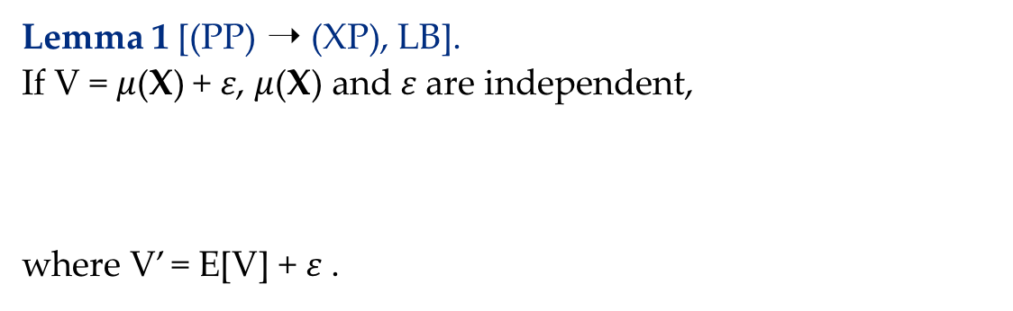




Isolated Error Convergence
Lemma 1 [(PP) ➝ (XP), LB].
If V = $μ$(X) + 𝜀, $μ$(X) and 𝜀 are independent,
where V’ = E[V] + 𝜀 .
$$\frac{R_{PP}}{R_{XP}} ≤ \frac{R_{PP}}{R_{SP}^{V′}}$$
$$R_{PP}/{R_{SP}^{V′}}_{}$$
Lemma 2 [(PP) ➝ (XP), UB].
If V = $μ$(X) + 𝜀, $μ$(X) and 𝜀 are independent,
where D_{𝜀} = E[| 𝜀 |]/2$μ$
E[|𝜀|]/2$μ$
$R_{XP}$ $≤$ $\frac{{2−D}_{\text{ε}}}{2}$ $R_{PP}$

Slide 30






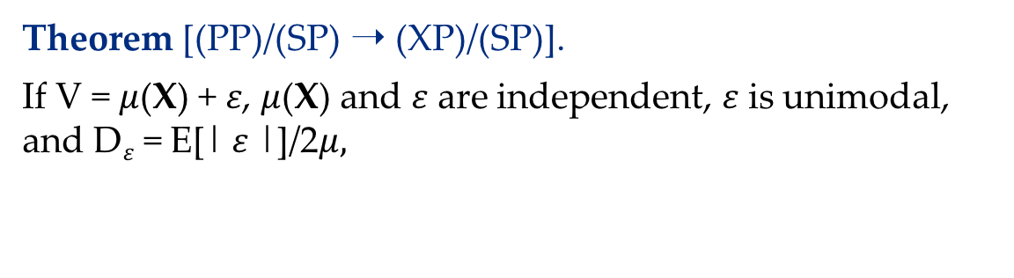

The Value of Feature Based Pricing
Theorem [(PP)/(SP) ➝ (XP)/(SP)].
If V = $μ$(X) + 𝜀, $μ$(X) and 𝜀 are independent, 𝜀 is unimodal, and D_{𝜀} = E[| 𝜀 |]/2$μ,$
$$\frac{1−D\text{ε}}{−W_{−1}\left(\frac{D\text{ε}}{e}\right)}$$
$$\frac{R_{PP}}{R_{SP}}$$
$$\frac{R_{XP}}{R_{SP}}$$
$$\frac{{2−D}_{\text{ε}}}{2}$$
$$\frac{R_{PP}}{R_{SP}}$$
$$≤$$
$$≤$$
Lemma 1 + Upper Bound
Lemma 2
Equality when 𝜀 = 0

Slide 31
Conclusions
We exactly characterized the value of personalized pricing over single pricing in terms of natural market statistics.
We proved parametric lower bounds on the value of personalized pricing for unimodal distributions that codified our intuition that as markets are increasingly heterogeneous, the value of personalized pricing increases.
We showed how to transform our bounds between single pricing strategies and idealized personalized pricing into bounds between single pricing and more realistic feature based personalized pricing.

Slide 32
Thank you
Full paper is available at https://mhamilton-pitt.github.io/, forthcoming in Management Science

