Slide 1

Feature-Based Market Segmentation and Pricing
Michael L. Hamilton
CORS 2021

Slide 2

Segmented Pricing
A segmented pricing is when the price for a good varies across different segments of the market.
Many markets are segmented
Digital properties like Adobe, Microsoft Office, online games
Insurance Markets
Infrastructure like cable, internet, etc.
Very well studied and fundamental problem in RMP, sometimes referred to as third-degree price discrimination.
“Third-degree price discrimination means that different purchasers are charged different prices, […] This is perhaps the most common form of price discrimination” – Varian, 1989

Slide 3
Segmented Pricing
A segmented pricing is when the price for a good varies across different segments of the market.
Many markets are segmented
Digital Properties like Adobe, Office, Online Games
Insurance Markets
Infrastructure like Cable, Internet, etc.
In practice, many of these markets are segmented and priced using features of a customer. These features are used to determine prices, often by leveraging some regression model that predicts customer willingness-to-pay.

Slide 4









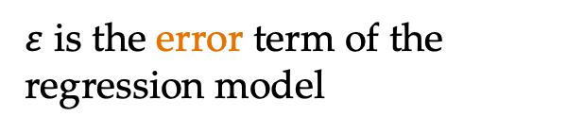

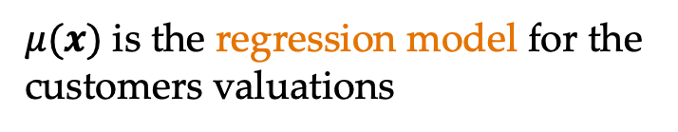
Segmented Pricing in Practice
Market of customers with associated features X supported on Ω
V|X = $μ$(X) + 𝜀, 𝜀⫫$μ$(X)
$μ(x)$ is the regression model for the customers valuations
$\text{ε}$ is the error term of the regression model
$μ:$Ω ➝ ℝ
$$E\left[\text{ε}\right]=0$$
Objective: Segment and price to maximize revenue
p( )
p( )
p( )
Notes:
Sigma is all possible contexts
X represents the context of a random customer
Mu(X) is the predicted valuation for a customer

Slide 5
Contributions
C1: Characterize structure of the optimal policy.
When valuations are exact, the optimal segmentation and pricing has a simple, computable form. Unfortunately, with general errors the optimal segmentation can be quite pathological. We show when errors are log-concave, the optimal policy becomes is again nice and computable.
C2: Bound approximate model-based policies.
Even though in general the optimal policy is complex, we show that using a segmentation generated by using just the feature-model inherits strong guarantees on the revenue + optimal rates of convergence.
C3: Fine-grained analysis in the number of segments.
When both the valuation model and the error are log-concave, we show the optimal segmentations evolve in a controlled way that can be leveraged to prove novel upper and lower bounds on the revenue of another segment.
Notes:
We consider a more realistic version of personalized pricing we term feature-based
pricing, and show how to transform our previous bounds into bounds on the value of
feature-based pricing over single price strategies (cf. Lemma 9 and Theorem 5) via a
novel extension theorem. These bounds makes explicit the relationship between the
accuracy of a sellers prediction model, and value of personalized pricing in a market.

Slide 6
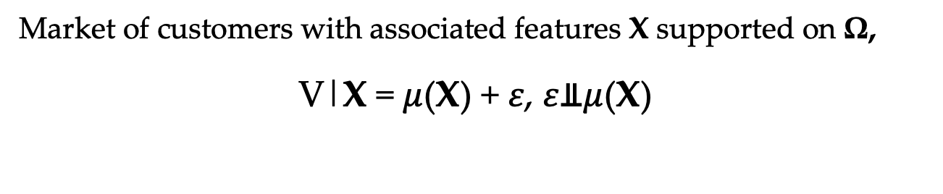
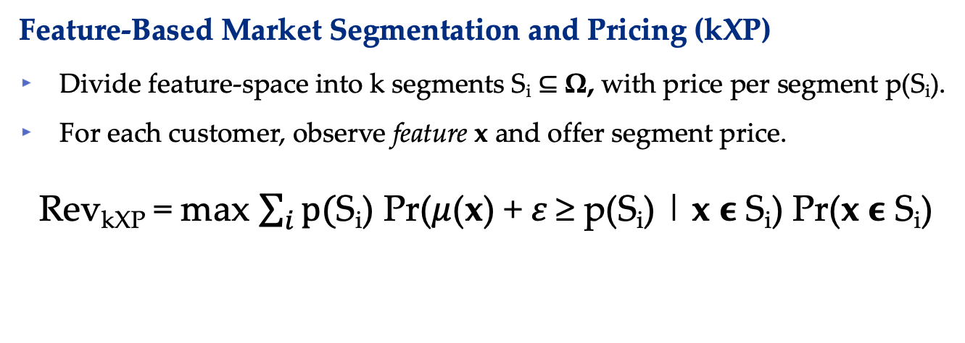
Model: FBMSP
Market of customers with associated features X supported on Ω,
V|X = $μ$(X) + 𝜀, 𝜀⫫$μ$(X)
Feature-Based Market Segmentation and Pricing (kXP)
Divide feature-space into k segments S_{i} ⊆ Ω, with price per segment p(S_{i}).
For each customer, observe feature x and offer segment price.
Rev_{kXP} = max $\sum_{i}{p(}$S_{i}) Pr($μ$(x) + 𝜀 ≥ p(S_{i}) | x ϵ S_{i}) Pr(x ϵ S_{i})
Number of segments, k, is thought to small and exogenously given.
Note p(S_{i}) is an induced price as a function of the segmentation.

Slide 7


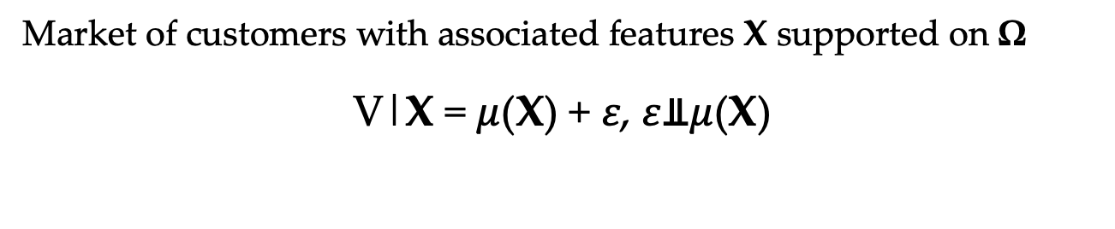
Two Benchmark Strategies
Market of customers with associated features X supported on Ω
V|X = $μ$(X) + 𝜀, 𝜀⫫$μ$(X)
Feature-Based Pricing (XP)
Observe feature X , offer price p(X)
Rev_{XP} = max $E[p\left(X\right)\text{·}I\left(V≥p\left(X\right)\right)]$
No k.
Model Based Pricing (kP)
k segments, S_{i} = {x |x_{i} ≤$μ\left(x\right)$ ≤ x_{i+1}}.
Rev_{kP} = max $\sum_{i}{p(}$S_{i})Pr($μ$(x) ≥ p(S_{i}) | x ϵ S_{i}) Pr(x ϵ S_{i})
No error term.
p(·)
p( )
p( )
p( )

Slide 8
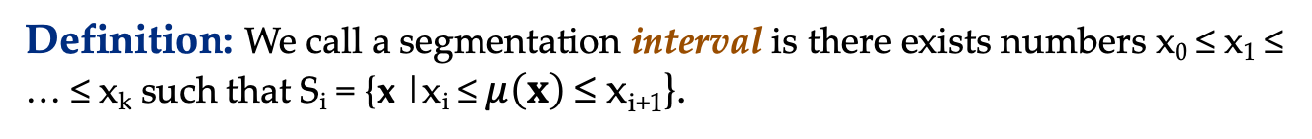
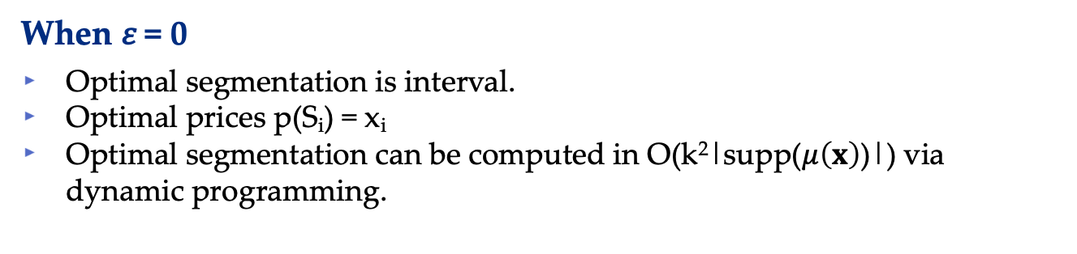

C1: Structure of FBMSP
Definition: We call a segmentation interval is there exists numbers x₀ ≤ x₁ ≤ … ≤ x_{k} such that S_{i} = {x |x_{i} ≤$μ\left(x\right)$ ≤ x_{i+1}}.
$μ\left(x\right)$
x₁
x₂
x₃
x₄
S₁
S₂
S₃
S₄
When 𝜀 = 0
Optimal segmentation is interval.
Optimal prices p(S_{i}) = x_{i}
Optimal segmentation can be computed in O(k²|supp($μ\left(x\right)$)|) via dynamic programming.

Slide 9

C1: Structure of FBMSP
Example: A non-interval segmentation
$μ\left(x\right)$ + 𝜀
x₁
x₂
x₃
x₄
S₁
S₂
S₁
S₂
When 𝜀 arbitrary
Optimal segmentation is not necessarily interval!
Optimal prices are not necessarily increasing in the segment
Optimal segmentation can be an arbitrary number of segments, depends on the support of the error distribution.

Slide 10
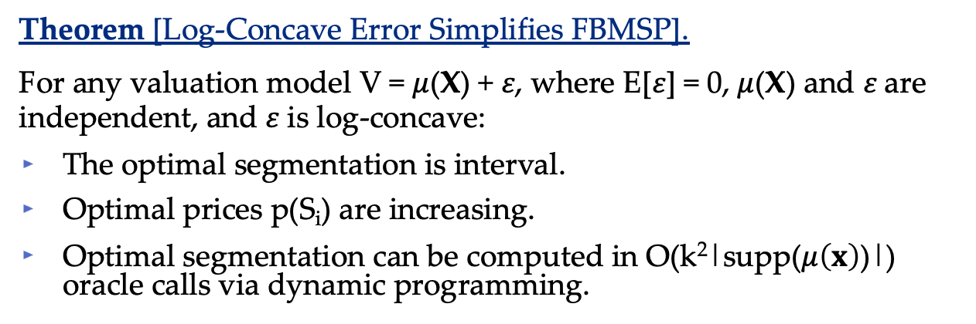
C1: Structure of FBMSP
Theorem [Log-Concave Error Simplifies FBMSP].
For any valuation model V = $μ$(X) + 𝜀, where E[𝜀] = 0, $μ$(X) and 𝜀 are independent, and 𝜀 is log-concave:
The optimal segmentation is interval.
Optimal prices p(S_{i}) are increasing.
Optimal segmentation can be computed in O(k²|supp($μ\left(x\right)$)|) oracle calls via dynamic programming.
Takeaway
Log-concave error is just as easy to work with as no error at all.
Most common distributions are log-concave, for example Normal, Logistic, Uniform etc.

Slide 11



C2: Approximation for FBMSP
What if the error isn’t log-concave or it’s unknown?
Quite often the error distribution is not known.
Further, typically optimal prices can be discovered only after committing to a segmentation!
Would be great if the using just the regression model itself could guide a segmentation and then pricing with provable guarantees.
To get there we’re going to take a slight detour and study the revenue function R$\text{ε}$(v) and price function p$\text{ε}$(v).
R$\text{ε}$(v) = $\max{pPr(}v+\text{ε}≥p)$
p$\text{ε}$(v) = arg$\max{pPr(}v+\text{ε}≥p)$

Slide 12
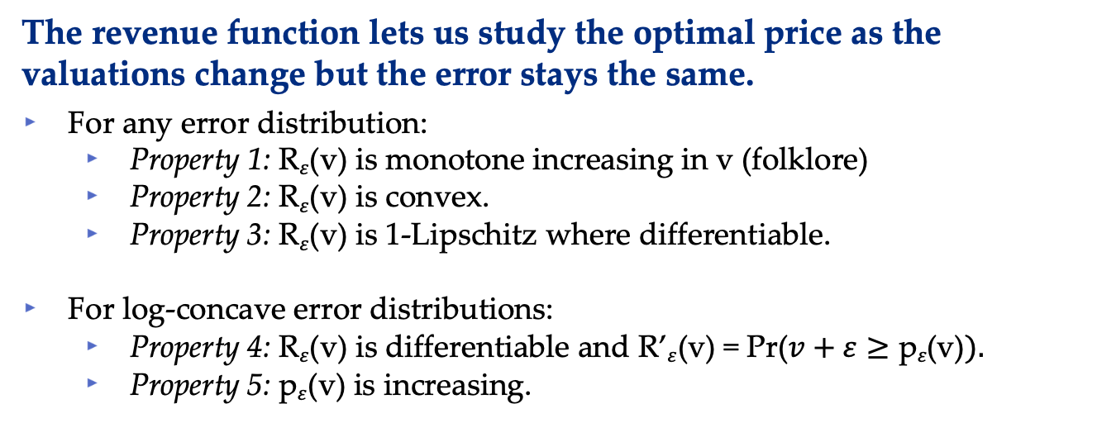
C2: Approximation for FBMSP
The revenue function lets us study the optimal price as the valuations change but the error stays the same.
For any error distribution:
Property 1: R$\text{ε}$(v) is monotone increasing in v (folklore)
Property 2: R$\text{ε}$(v) is convex.
Property 3: R$\text{ε}$(v) is 1-Lipschitz where differentiable.
For log-concave error distributions:
Property 4: R$\text{ε}$(v) is differentiable and R’$\text{ε}$(v) = Pr($v+\text{ε}≥\text{p}\text{ε}\text{(}\text{v}\text{)}).$
Property 5: p$\text{ε}$(v) is increasing.
R$\text{ε}$(v) = $\max{pPr(}v+\text{ε}≥p)$
p$\text{ε}$(v) = arg$\max{pPr(}v+\text{ε}≥p)$

Slide 13
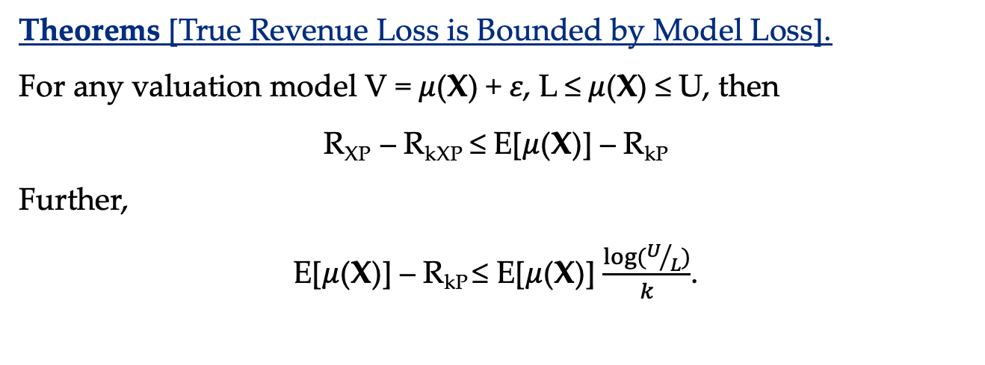
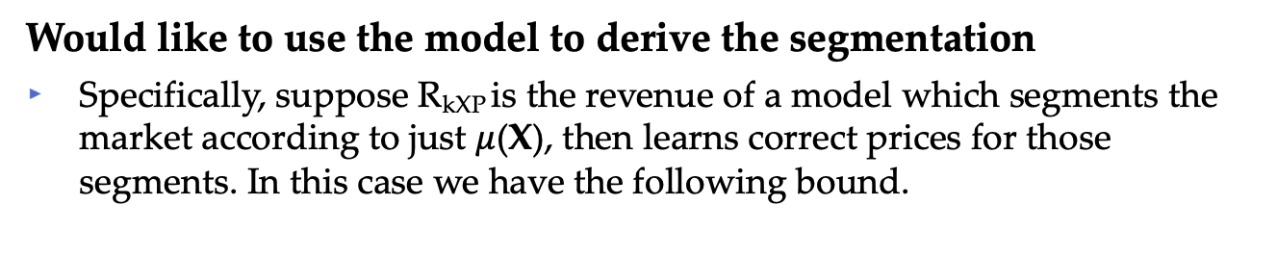
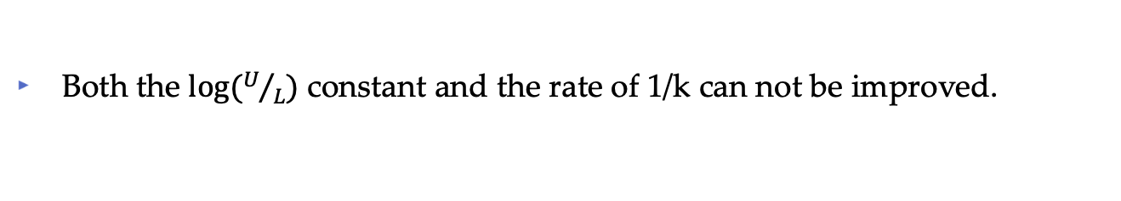
C2: Approximation for FBMSP
Would like to use the model to derive the segmentation
Specifically, suppose R_{kXP} is the revenue of a model which segments the market according to just $μ$(X), then learns correct prices for those segments. In this case we have the following bound.
Theorems [True Revenue Loss is Bounded by Model Loss].
For any valuation model V = $μ$(X) + 𝜀, L ≤ $μ$(X) ≤ U, then
R_{XP} – R_{kXP} ≤ E[$μ$(X)] – R_{kP}
Further,
E[$μ$(X)] – R_{kP} ≤ E[$μ$(X)] $\frac{log⁡(U/L)}{k}$.
True Loss
Model Loss
Both the $log⁡(U/L)$ constant and the rate of 1/k can not be improved.

Slide 14

C3: Fine-grained Analysis of FBMSP
When to increase the number of segmentations?
Would like to understand how beneficial it would be to open another segmentation before committing to doing so.
Can we use the regression model itself to see if there’s value?
Hard to understand how models change from k to k+1…
Definition: We say segmentations weave if there exists numbers x₀ ≤ x₁ ≤ … ≤ x_{k} and x’₀ ≤ x’₁ ≤ … ≤ x’_{k} ≤ x’_{k+1} such that {x_{i}} and {x_{i}’} are optimal interval segmentations, and x’₀ ≤ x₀ ≤ x’₁ ≤ x₁ … ≤ x_{k} ≤ x’_{k+1}.
$μ\left(x\right)$
x’₁
x₁
x’₂
x₂
x'₃
x₃
x'₄
x₄
x’₅
S₁
S₂
S₃
S₄

Slide 15
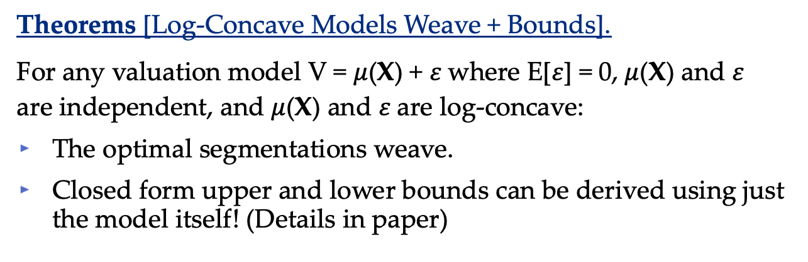
C3: Fine-grained Analysis of FBMSP
Theorems [Log-Concave Models Weave + Bounds].
For any valuation model V = $μ$(X) + 𝜀 where E[𝜀] = 0, $μ$(X) and 𝜀 are independent, and $μ$(X) and 𝜀 are log-concave:
The optimal segmentations weave.
Closed form upper and lower bounds can be derived using just the model itself! (Details in paper)
Takeaway
With some structural assumptions, we can use the model to not just guide the segmentations but also to determine when to open new segments!

Slide 16
Conclusions
We characterized the structure of optimal feature-based market segmentation and pricing when errors are features independent.
We showed how to use a regression model to guide feature-based market segmentation and pricing.
We also showed how to use the model to judge and guide new expansions of the segmentation and pricing.
Along the way we proved some nice results about segmenting markets when errors are log-concave that may be of independent interest.

Slide 17
Thank you!
Full paper to be available soon
Comments, questions @ mhamilton@katz.pitt.edu
More papers: https://mhamilton-pitt.github.io/

