Slide 1

Pricing Strategies for Online Dating Platforms
Titing Cui, Michael L. Hamilton
Informs 2022

Slide 2
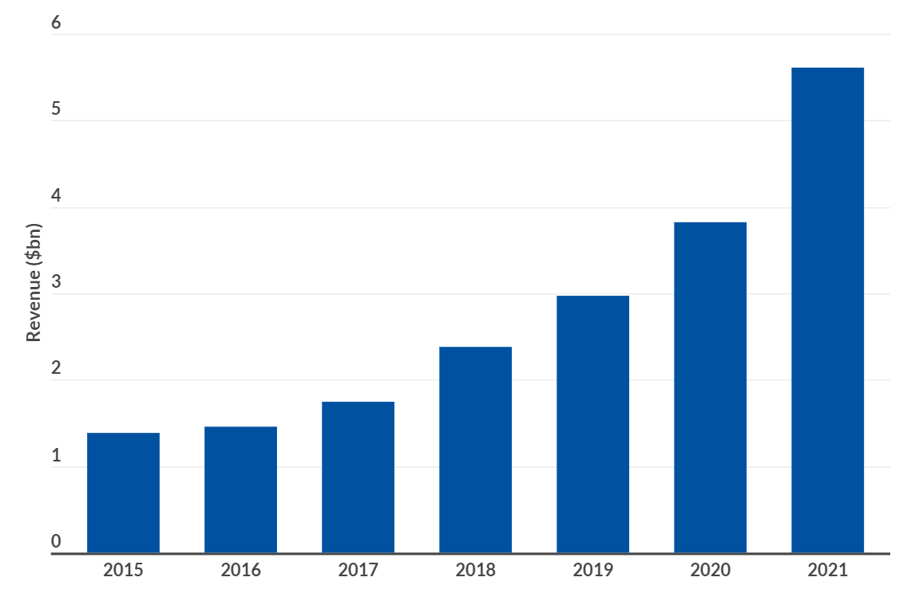

Online Dating
Online dating platforms revenues have swelled over the last five years, with an annual growth rate of 12.9%, rising to $5.3 billion as mobile services expand.
Notes:
We can also see the significant growth in revenue for the last six years.
We can also see the growth from other apps, like the global download of Hinge. And the ARPU (average revenue per user) keeps the same, meaning the increasing subscribers bring a big amount money in total.
Replace the graph with revenue.

Slide 3
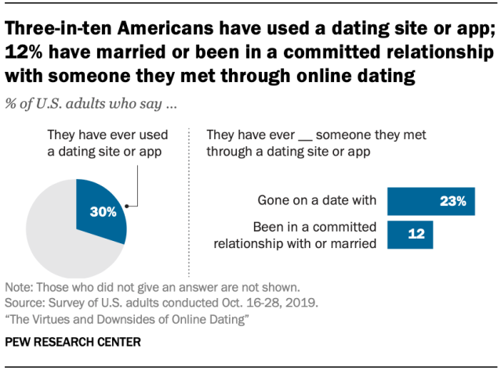
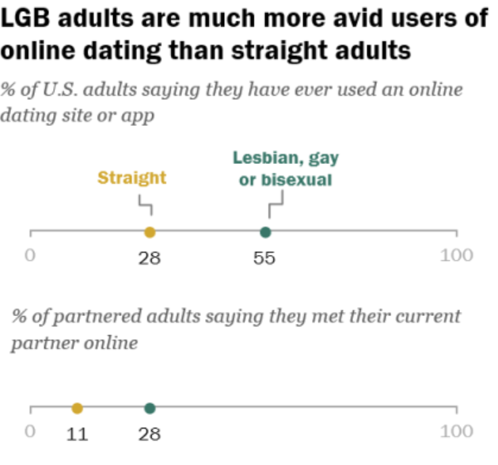
Online Dating
Online dating platforms have displaced conventional mediums such as family, school, or the workplace, to become the most common way for new couples to meet.
Notes:
Nowadays, online dating platform has become more and more popular, and replaced the conventional mediums, such as family, school, or the workplace, to be the most common way for new couples to meet each other, especially during the pandemic.
According to the research conducted by Pew Research Center in 2019, about 30% U.S. adults say they have used a dating site or app before.
The percentage goes even higher for the LGBT people, a full two-thirds of lesbian, gay, or bisexual Americans report using dating apps

Slide 4
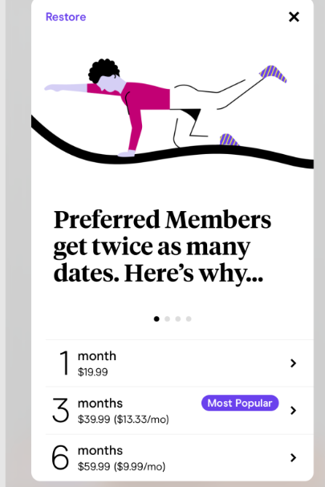
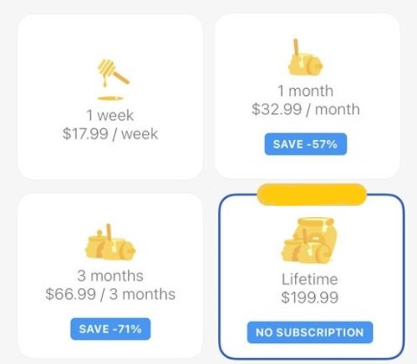
Online Dating in Practice
Hinge
Bumble
Notes:
Let’s talk about the price of online dating apps. In practice, The majority of dating apps earn revenue by subscription-based pricing, where subscriptions for access to the app are sold at a fixed price.
Subscription based pricing is a ubiquitous way to monetize mobile apps, however in the context of online dating is controversial as it potentially misaligns the incentives of the platform and its users. The platform wants its users to stay on the platform as long as possible, while the users want to get a match as soon as possible, especially for short subscription periods. For most of platforms, they offer different subscription periods, one month, 3 months, even 6 month.
Another, less popular is the contract based model, in which the dating app is contracted by the user to facilitate a search for a partner at some agreed upon one time price. Like selective search, users will pay for once, the platform will provide complex search service for one year. In this paper, we want to compare these strategies. Contracted pricing can also be viewed as a long subscription period.
Free, (SP), lifetime (Bumble lifetime plan)

Slide 5
Outline/Expectations
Qu: What is the right subscription set-up for online dating apps?
What maximizes revenue? What maximizes welfare?
Simplifying Assumption: We focus on swipe apps
Users swipe left or right on candidate partners. No searching.
Dominant paradigm: Tinder, Bumble, Hinge etc.
Simplifying Assumption : Users are looking for love
A match will be a permanent pairing after which users leave the site
No short term or casual dating in our model.
Simplifying Assumption : One subscription option
Strategy space is a subscription period length and price pair
Notes:
First, we give a novel model to describe the pricing for online dating platforms and prove bounds on the profit ratio of (FP) to the optimal achievable profits.
Next, We study the impact of marginal operating cost. when the marginal operating cost, c, is small, and show larger payment periods are better for both profit and welfare.
Finally, we look at heterogenous matching rates. But today, I’m only going to discuss the first two results.

Slide 6
Contributions
C1: Derive revenue bounds for subscription models (Thm. 1).
We give a novel model to describe the pricing for online dating platforms and prove bounds on the profit ratio of freemium pricing to the optimal achievable profits.
C2: Fine-grained analysis for cost and matching proportion (Thm. 2 & 3).
When the marginal operating cost, c, is small, we show longer subscription periods are better for profit and increase the match rate!
C3: Extensions to heterogenous matching rate (Thm 4).
When the platform strategically varies the match rate, (FP) has the incentive to offer users the worst matches while (CP)’s incentive is to match the user as quickly as possible.
Notes:
First, we give a novel model to describe the pricing for online dating platforms and prove bounds on the profit ratio of (FP) to the optimal achievable profits.
Next, We study the impact of marginal operating cost. when the marginal operating cost, c, is small, and show larger payment periods are better for both profit and welfare.
Finally, we look at heterogenous matching rates. But today, I’m only going to discuss the first two results.

Slide 7
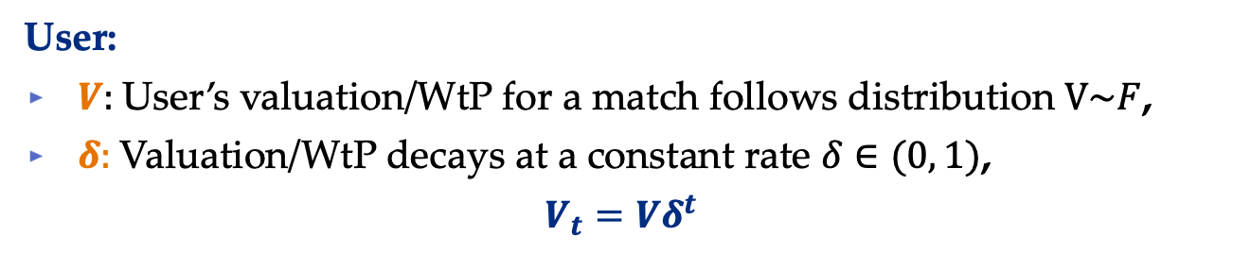
Model: ODP
User:
$V:$User’s valuation/WtP for a match follows distribution $V\sim F$,
$δ:$Valuation/WtP decays at a constant rate $δ∈(0, 1)$,
$$V_{t}=Vδ^{t}$$
Note: This is valuation of app service.
61% of Hinge users feel “overwhelmed by modern dating process”
Four in five report some degree of burnout
Notes:
First of all, let’s look at the model for online dating pricing. In our model, we assume the users are looking long-term relationship. If they get matched, they will leave the platform forever
We assume user’s valuation for a successful match follows a distribution F, and decays at a constant rate delta. The platform offers price for using the platform for a period of length $L$. Users will pay price $p$ if their expected valuation of successful matches in the period is greater or equal than the price $p.$ For each period, users match with probability $1−e^{−qL}$, the success of matching follows an exponential distribution. They can stay on the platform at most $T$. $T$ denotes the size of candidate pool. The marginal cost for providing the services is c. The platform’s expected profit equals to price times how many periods customers will pay minus the total operating cost.

Slide 8
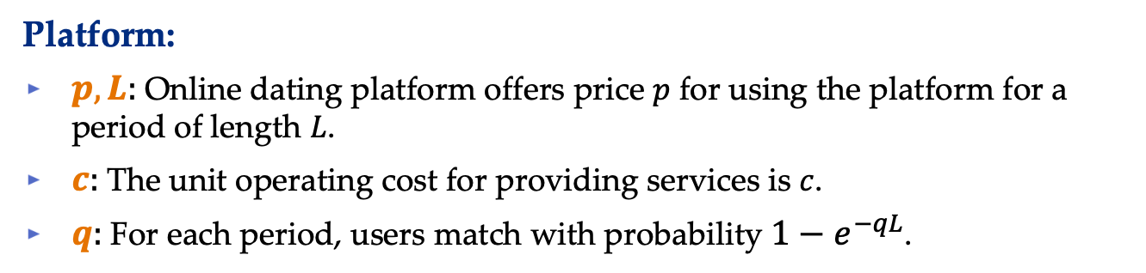
Model: ODP
User:
$V:$User’s valuation/WtP for a match follows distribution $V\sim F$,
$δ:$Valuation/WtP decays at a constant rate $δ∈(0, 1)$,
$$V_{t}=Vδ^{t}$$
Platform:
$p,L:$Online dating platform offers price $p$ for using the platform for a period of length $L$.
$c:$The unit operating cost for providing services is $c$.
$q:$For each period, users match with probability $1−e^{−qL}$.
Note: Swipe apps are discrete.
Match with small probability ~q, see T(L) people a period
Should be geometric, we smooth it to trunc. exponential
Notes:
First of all, let’s look at the model for online dating pricing. In our model, we assume the users are looking long-term relationship. If they get matched, they will leave the platform forever
We assume user’s valuation for a successful match follows a distribution F, and decays at a constant rate delta. The platform offers price for using the platform for a period of length $L$. Users will pay price $p$ if their expected valuation of successful matches in the period is greater or equal than the price $p.$ For each period, users match with probability $1−e^{−qL}$, the success of matching follows an exponential distribution. They can stay on the platform at most $T$. $T$ denotes the size of candidate pool. The marginal cost for providing the services is c. The platform’s expected profit equals to price times how many periods customers will pay minus the total operating cost.

Slide 9

Model: ODP
User:
$V:$User’s valuation/WtP for a match follows distribution $V\sim F$,
$δ:$Valuation/WtP decays at a constant rate $δ∈(0, 1)$,
$$V_{t}=Vδ^{t}$$
Platform:
$p,L:$Online dating platform offers price $p$ for using the platform for a period of length $L$.
$c:$The unit operating cost for providing services is $c$.
$q:$For each period, users match with probability $1−e^{−qL}$.
$$R\left(p, L\right)=pE\left[Periods on platform\right]−cE[Time on platform]$$
$$R\left(L\right)=max_{p} R\left(p, L\right)$$
Notes:
First of all, let’s look at the model for online dating pricing. In our model, we assume the users are looking long-term relationship. If they get matched, they will leave the platform forever
We assume user’s valuation for a successful match follows a distribution F, and decays at a constant rate delta. The platform offers price for using the platform for a period of length $L$. Users will pay price $p$ if their expected valuation of successful matches in the period is greater or equal than the price $p.$ For each period, users match with probability $1−e^{−qL}$, the success of matching follows an exponential distribution. They can stay on the platform at most $T$. $T$ denotes the size of candidate pool. The marginal cost for providing the services is c. The platform’s expected profit equals to price times how many periods customers will pay minus the total operating cost.

Slide 10

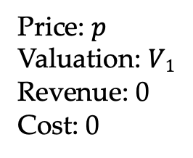
Online Dating Platform Example
1
2
Price: $p$
Valuation: $V1$
Revenue: 0
Cost: 0
Notes:
We use the Bumble as an example to demonstrate the operations of dating platform. Suppose Mr. Smith on the left side is a user of Bumble. Bumble will show possible dates for Mr. Smith. If Mr. Smith doesn’t like the recommendation, he swipe left or right to see other recommendations. Otherwise, Mr. Smith can initiate a conversation. We focus on swipe app, only recommendations by the platform, no active search.

Slide 11

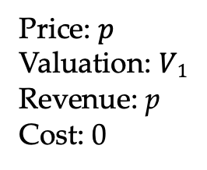
Online Dating Platform Example
1
2
Price: $p$
Valuation: $V1$
Revenue: p
Cost: 0
Notes:
Suppose Mr. Smith on the left side is a user of Bumble. Bumble will show possible dates for Mr. Smith. If Mr. Smith doesn’t like the recommendation, he swipe left or right to see other recommendations. Otherwise, Mr. Smith can initiate a conversation. We focus on swipe app, only recommendations by the platform, no active search.

Slide 12

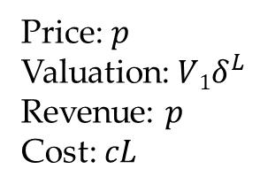
Online Dating Platform Example
1
2
Price: $p$
Valuation:$V1δ^{L}$
Revenue: $p$
Cost: $cL$
Prob: $1−e^{−qL}$
Notes:
Suppose Mr. Smith on the left side is a user of Bumble. Bumble will show possible dates for Mr. Smith. If Mr. Smith doesn’t like the recommendation, he swipe left or right to see other recommendations. Otherwise, Mr. Smith can initiate a conversation. We focus on swipe app, only recommendations by the platform, no active search.

Slide 13

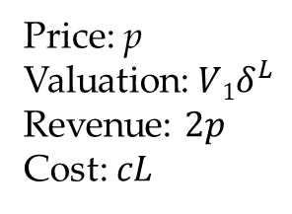
Online Dating Platform Example
1
2
Price: p
Valuation:$V1δ^{L}$
Revenue: $2p$
Cost: $cL$
Notes:
Suppose Mr. Smith on the left side is a user of Bumble. Bumble will show possible dates for Mr. Smith. If Mr. Smith doesn’t like the recommendation, he swipe left or right to see other recommendations. Otherwise, Mr. Smith can initiate a conversation. We focus on swipe app, only recommendations by the platform, no active search.

Slide 14
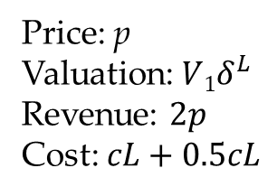
Online Dating Platform Example
1
2
Price: p
Valuation:$V1δ^{L}$
Revenue: $2p$
Cost: $cL+0.5cL$
Notes:
Suppose Mr. Smith on the left side is a user of Bumble. Bumble will show possible dates for Mr. Smith. If Mr. Smith doesn’t like the recommendation, he swipe left or right to see other recommendations. Otherwise, Mr. Smith can initiate a conversation. We focus on swipe app, only recommendations by the platform, no active search.

Slide 15
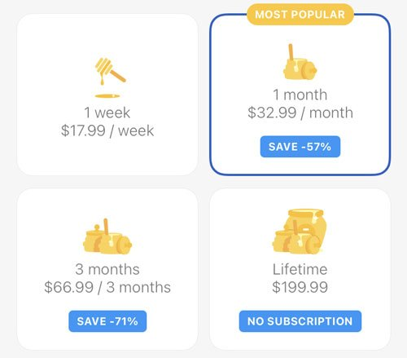
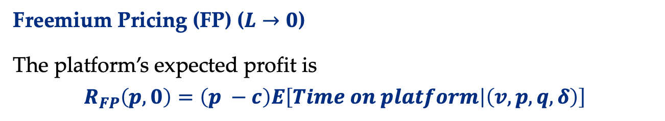
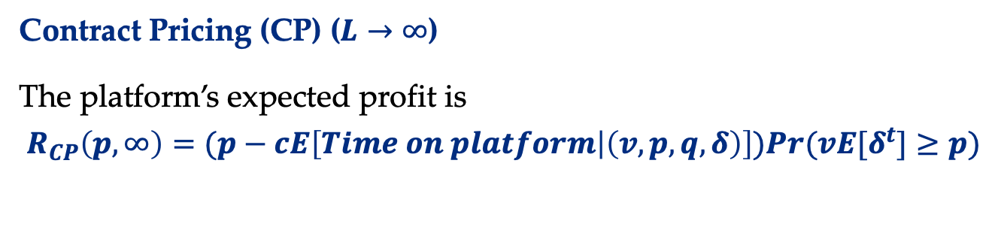
Special Cases of ODP
Freemium Pricing (FP) ($L→0$)
The platform’s expected profit is
$$R_{FP}\left(p, 0\right)=\left(p −c\right)E\left[Time on platform | \left(v, p, q, δ\right)\right]$$
Free
Note: Monetization here can be thought of as from ads, selling metadata, etc. Price is intensity at which ads are shown.
Contract Pricing (CP) ($L→∞$)
The platform’s expected profit is
$$R_{CP}\left(p,∞\right)=(p−cE\left[Time on platform | \left(v, p, q, δ\right)\right])Pr(vE[δ^{t}]≥p)$$
Notes:
In this paper, we emphasize two pricing strategies, (SP) and (CP). (SP) and (CP) represents two ends of the pricing spectrum. For the (SP)

Slide 16

Q1: Why Short Subscriptions?
Theorem 1 [$Freemium Pricing is$Approximately Optimal].
For all positive valued distributions $F,$parameters $c, q> 0$, and $δ∈ (0,1)$, then:
$$\frac{RFP}{\max_{L}{R(L)}}≥\frac{1}{1+e}$$
Takeaway
No other period length achieves constant factor for all market params.
Freemium pricing is robust + easy to implement
Often more than 1/(1+e)! Close to 1 when 𝛿 is close 1
Notes:
The first questions, why short period? We show that (SP) is approximately optimal. The ratio between (SP) and the optimal achievable revenue is bounded by a factor of q over log(delta). If we take the minimum -q/log(delta), the ratio is actually bounded by 1/e. No other subscription period can achieve a constant bound like (SP).

Slide 17
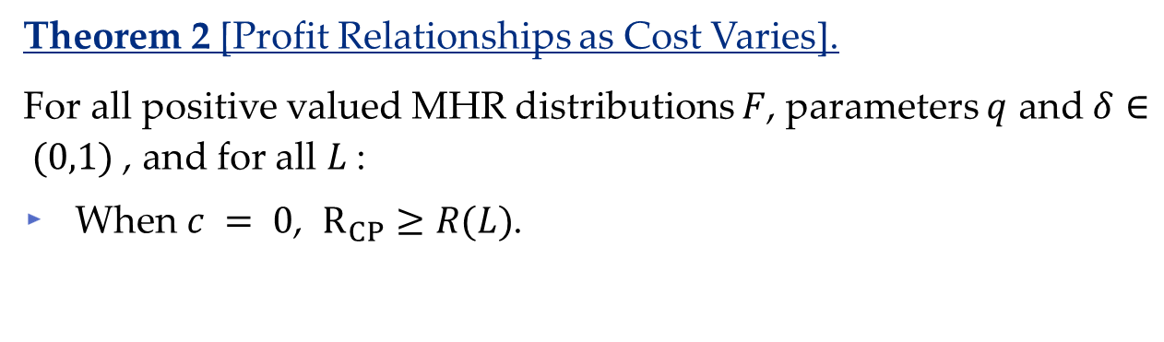
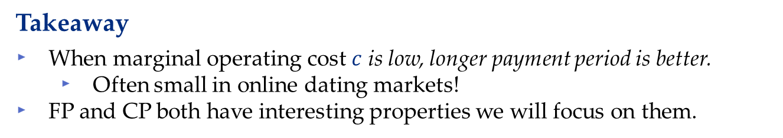
Q2: Impacts of Costs?
Theorem 2 [Profit Relationships as Cost Varies].
For all positive valued MHR distributions $F$, parameters $q$ and $δ∈ (0,1)$, and for all $L$:
When $c = 0$, $R_{CP}≥R(L)$.
Takeaway
When marginal operating cost $c$ is low, longer payment period is better.
Often small in online dating markets!
FP and CP both have interesting properties we will focus on them.
Notes:
Next, we consider the impacts of marginal operating cost. For MHR distribution F, we show that when c = 0, the revenue for larger periods is always better than smaller periods. While when the marginal operating cost is high, the revenue for larger periods becomes always less than smaller periods.

Slide 18
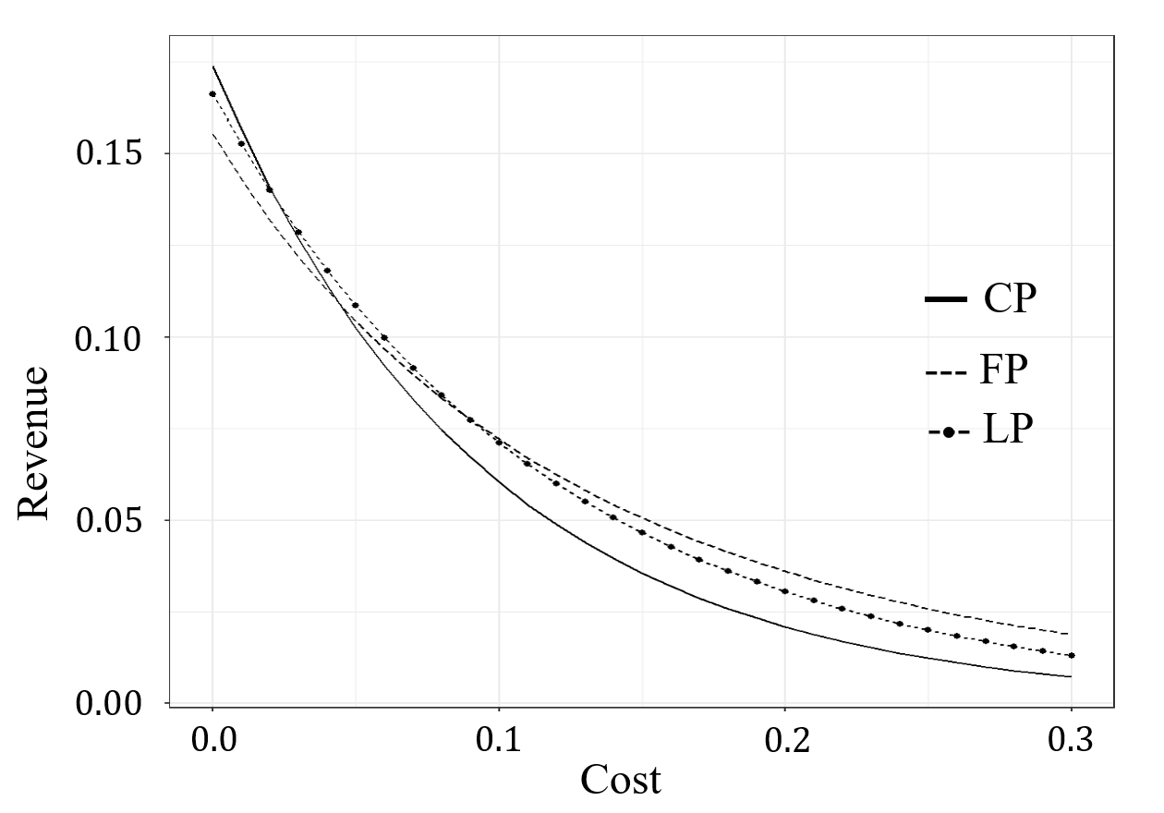
Q2: Impacts of Costs?
Example of Theorem 2 [Profit Relationships as Cost Varies].
$$δ=0.8, q=0.2, L=7, F=Exp(1)$$
Notes:
We also use the exponential distribution with mean 100 to do the simulation. Consider the case when T = infinity, customer’s valuation decays at delta = 0.8, and the match rate is 0.2, When, c is less than 4, (CP) is better than (SP).

Slide 19

Special Cases of ODP
Freemium Pricing (FP) ($L→0$)
Ads!
Great initial policy
Easy to implement, just run ads
Pro: Robust
Contract Pricing (CP) ($L→∞$)
Requires commitment from users to implement
Pro: Optimal when costs are low!
Notes:
In this paper, we emphasize two pricing strategies, (SP) and (CP). (SP) and (CP) represents two ends of the pricing spectrum. For the (SP)

Slide 20
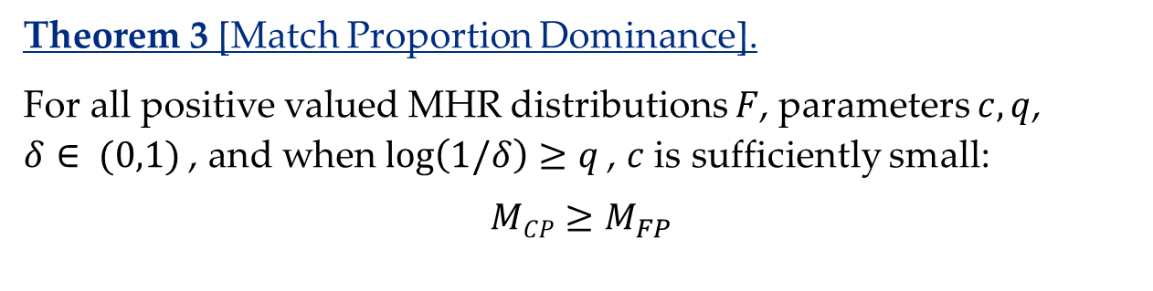
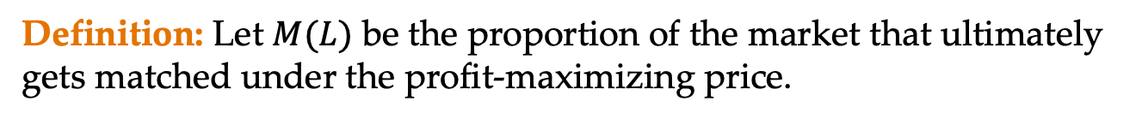
Q3: Matching Proportion?
Definition: Let $M(L)$ be the proportion of the market that ultimately gets matched under the profit-maximizing price.
Theorem 3 [Match Proportion Dominance].
For all positive valued MHR distributions $F$, parameters $c, q$, $δ∈ (0,1)$, and when $\log\left(1/δ\right)≥q$, $c$is sufficiently small:
$$MCP≥M_{FP}$$
Takeaway
When marginal cost is low, longer payment period also benefits users.
Low cost means more profit AND more welfare (match proportion) from longer payment periods
Notes:
The dominance is not only for revenue, but also for user’s welfare. Now consider the matching proportion, the percentage of users leave the platform getting matched, is also going to be larger for longer periods.
$c^{∗}\left(L_{1},L_{2}\right)$ is the cost such that the profit of payment period $L_{1}$ is the same as the profit of $L_{2}$.
$,$ there exists $c^{∗}\left(L_{1},L_{2}\right)$ such that when $c≤$ $c^{∗}\left(L_{1},L_{2}\right)$

Slide 21
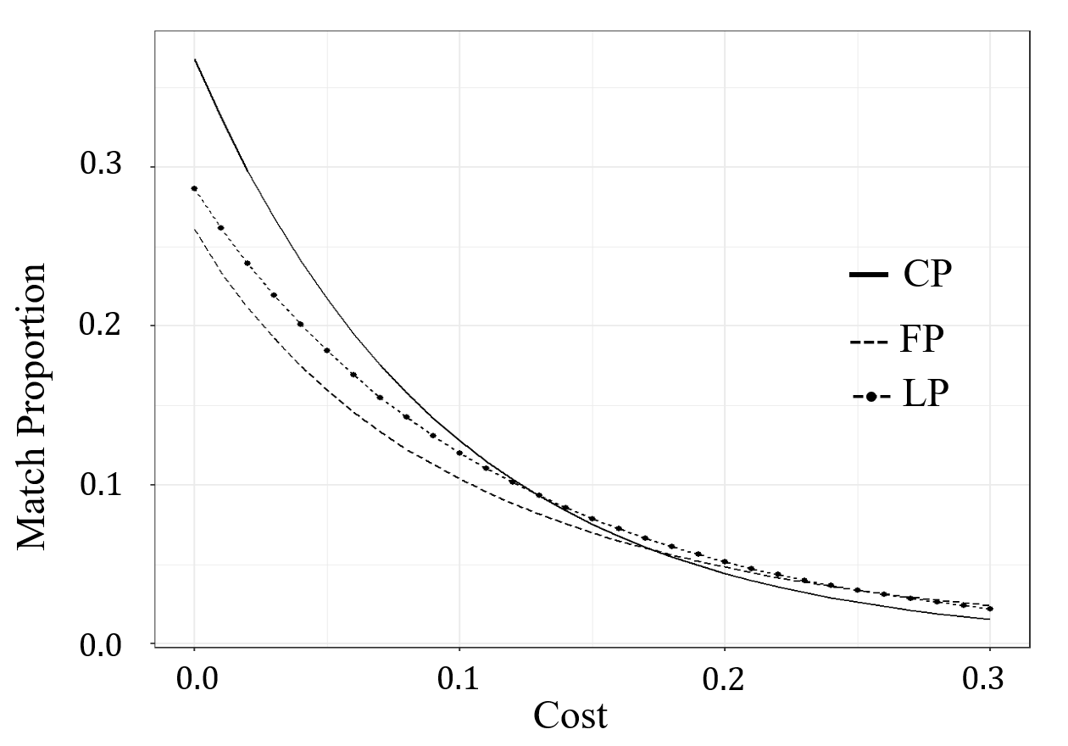
Q3: Matching Proportion?
Example of Theorem 3 [Match Proportion Dominance]
$$δ=0.8, q=0.2, L=7, F=Exp(1)$$
Notes:
We also use the same parameters to do the simulation for matching proportion. When, c is less than 15 , (CP) is better than (SP) in terms of matching proportion.

Slide 22
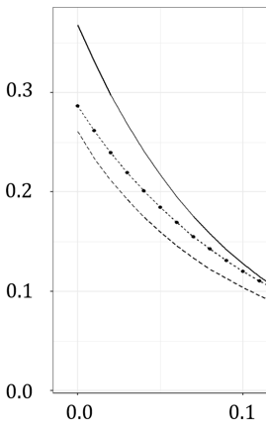
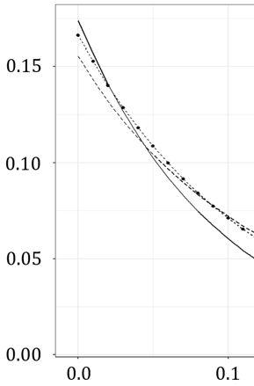
Thm. 2 + Thm. 3
Revenue and Match Proportion Dominance
--- (FP)
(CP)
Match Proportion (M)
Revenue (R)
Cost (c)
$$δ=0.8, q=0.2, L=7, F=Exp(1)$$
Notes:
We also use the same parameters to do the simulation for matching proportion. When, c is less than 15 , (CP) is better than (SP) in terms of matching proportion.

Slide 23
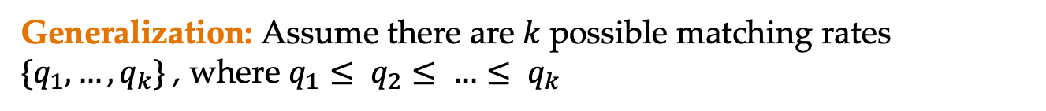
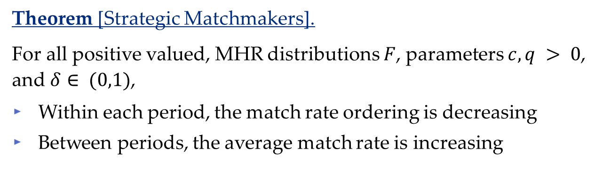
Q4: Heterogenous Matching Rates?
Generalization: Assume there are $k$possible matching rates $\{q_{1},…, q_{k}\}$, where $q_{1}≤ q_{2}≤ …≤ q_{k}$
Theorem [Strategic Matchmakers].
For all positive valued, MHR distributions $F$, parameters $c, q > 0$, and $δ∈ (0,1)$,
Within each period, the match rate ordering is decreasing
Between periods, the average match rate is increasing
Takeaway
(CP) aligns the incentives of platforms and users.
(FP) misaligns the incentives of platforms and users.

Slide 24
Conclusions ODP
Freemium Pricing (FP) ($L→0$)
Ads!
Great initial policy
Easy to implement!
Pro: Robust
Contract Pricing (CP) ($L→∞$)
Pro: Optimal when costs are low!
Pro: Matches a higher proportion of the users!
Pro: Users are incentivized to provide information, translates to lower prices, higher profit, better served market!
Notes:
In this paper, we emphasize two pricing strategies, (SP) and (CP). (SP) and (CP) represents two ends of the pricing spectrum. For the (SP)

Slide 25
Thank you!
https://papers.ssrn.com/sol3/papers.cfm?abstract_id=4032735
New version coming soon!
Comments, questions tic54@pitt.edu
More papers: https://tcui-pitt.github.io/, https://mhamilton-pitt.github.io/
Notes:
Thank you all for listening. Here are my contact information, more papers can be found in my and my advisor’s website. The paper is also available online. You can download it on ssrn for more details. Do you have any questions?

