Slide 1


Hicksian Unit-Demand Pricing
Michael L. Hamilton¹, Jourdain Lamperski², Kasra Tari¹
¹ Katz Graduate School of Business, University of Pittsburgh,
² Department of Industrial Engineering, University of Pittsburgh

Slide 2
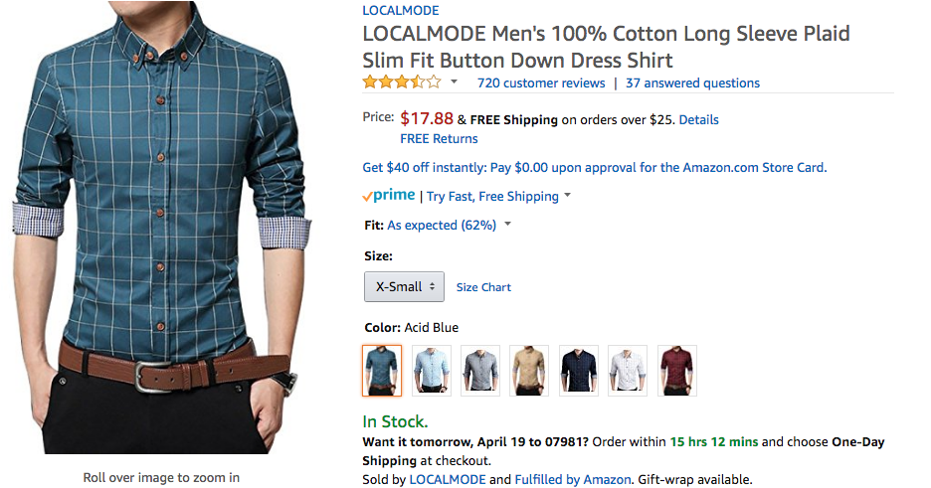
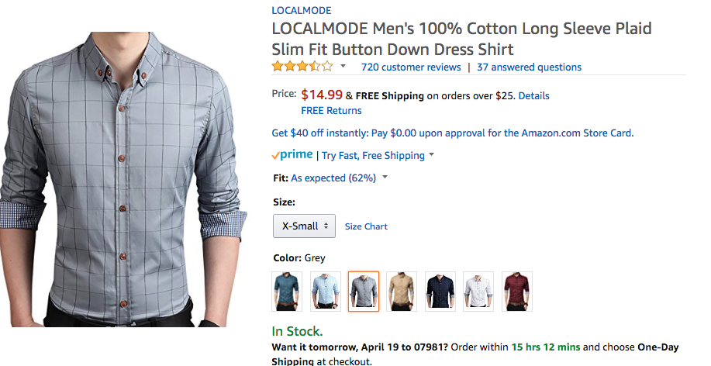

Unit Demand Pricing Problem
A discriminatory pricing charges different prices for equivalent versions of a good.
Often occurs for substitutable goods
Ex. Products that are the same up to choice of color, cut, etc.
Common way to rebalance inventory
14.99 $
17.99 $

Slide 3

Unit Demand Pricing Problem
A discriminatory pricing charges different prices for equivalent versions of a good.
Often occurs for substitutable goods
A differentiated pricing charges different prices for non-equivalent versions of a good.
749 $
549 $
309 $

Slide 4
Discriminatory Pricing (DP)
Can increase seller revenue.
Even when product valuations are drawn symmetrically (i.e. i.i.d.).
Even without reference to inventory
Discriminates against particular segment of customers.
Since goods are of equal quality, some goods are arbitrarily higher priced.
Notes:
It may seem sort of counter initutive that we’d offer substitutable goods are differing prices.
As it turns out in theory non-convex here, don’t stress fairness.
On a gut level though I believe this feels sort of wrong.
Be sure to emphasize in words why I give a shit
OPQ selling sides steps these and has a nice properties!

Slide 5







Bayesian Unit-Demand Pricing
Bayesian Unit Demand Pricing (BUDP) for N different products
Customers draw valuations (V₁, V₂, .., V_{N}) ~ F
Purchase item that maximizes utility (or nothing!): V_{i} - p_{i}
Objective: Set prices to maximize revenue
$ p₁
$ p₂
$ p₃
V₁ , V₂ ,V₃
F
Notes:
We’re going to imagine every customer as having some valuations for the N products, i.e. different colors of the same good.
We will assume these valuations are drawn from some distribution that discribes the market, F

Slide 6

Bayesian Unit-Demand Pricing
Bayesian Unit Demand Pricing (BUDP) for N different products
Customers draw valuations (V₁, V₂, .., V_{N}) ~ F
Purchase item that maximizes utility (or nothing!): V_{i} - p_{i}
Objective: Set prices to maximize revenue
$ 5.99
$ 2
$ 5
5 , 3 , 7
F
Notes:
And customers will purchase the item that maximizes their utility, or no item if all utilities are negative

Slide 7
Bayesian Unit-Demand Pricing
2 different products
Customers draw valuations i.i.d. according to:
1 w.p. 2/3
$ 1
$ 1
V_{i} =
2 w.p. 1/3
(1 , 2)
(2 , 1)
(2 , 2)
(1 , 1)
E[Revenue(1,1)] = 1
Notes:
In this model, the measure we’re interested in is expected revenue earned where the expectation is taken with respect to the valuation distribution.
Suppose the prices for the two shirts were (1,1). Then every customer would purchase, two such customers being totally indifferent to which shirt they obtain

Slide 8
Bayesian Unit-Demand Pricing
2 different products
Customers draw valuations i.i.d. according to:
1 w.p. 2/3
$ 1.99
$ 1.99
V_{i} =
2 w.p. 1/3
(1 , 2)
(2 , 1)
(2 , 2)
(1 , 1)
E[Revenue(1,1)] = 1
E[Revenue(2,2)] = 1.99・(1-4/9) ≅ 10/9
Notes:
As it turns out, 1 dollar isn’t the optimal single price for these shirts. A better price would be to set the shirts at 1.99.
10/9 is the best revenue you can achieve when constrained to price the shirts the same

Slide 9
Bayesian Unit-Demand Pricing
2 different products
Customers draw valuations i.i.d. according to:
1 w.p. 2/3
$ 1.99
$ 1
V_{i} =
2 w.p. 1/3
(1 , 2)
(2 , 1)
(2 , 2)
(1 , 1)
E[Revenue(1,1)] = 1
!
E[Revenue(2,2)] = 1.99・(1-4/9) ≅ 10/9
E[Revenue(2,1)] = 1.99・2/9 + 7/9 ≅ 11/9
Discriminatory Pricing Helps!
Notes:
As it turns out, a seller can earn more revenue by offering different prices for the two shirts (even though valuations are i.i.d.)
1 Minute

Slide 10
Hicksian Unit-Demand Pricing
Hicksian Unit Demand Pricing (HUDP) for N different products
Customers draw valuations (V₁, V₂, .., V_{N}) ~ F
Purchase item that minimizes expenditure (or nothing!): min_{i} p_{i} s.t. V_{i} ≥ p_{i}
Objective: Set prices to maximize revenue
Second most common objective, often referred to as min-buying^{[1,2]}
Often defined with a minimum level of utility, WLOG 0 for us
Research Questions:
What’s the difference between BUDP and HUDP?
How effective is a single price for HUDP?
[1] Aggarwal et al, 2004. Algorithms for Multi-Product Pricing.
[2] Rusmevichiting et al, 2006. A Non-Parametric Approach to Multi-Product Pricing.
[3] Briest and Krysta., 2007. Buying Cheap is Expensive: Hardness of Non-Parametric Multi-Product Pricing.

Slide 11
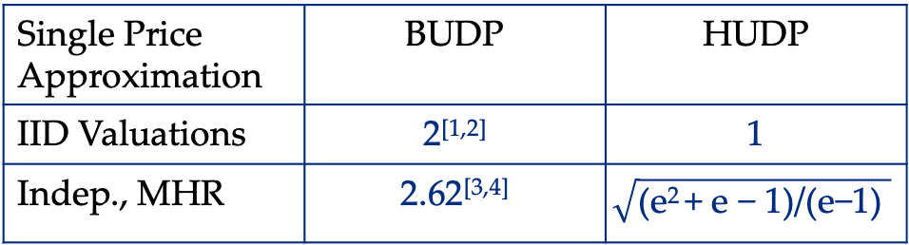
Contributions
C1: When valuations are independent and identical
A single price is optimal for HUDP. Value of discrimination in BUDP IID settings is due solely to quasi-linear utility maximizing effects.
C2: When valuations are independent but not identical
Single price approximates the optimal when indep. and MHR.
C3: When valuations are dependent but identical
Single price is not optimal, but approximates optimal
Single Price Approximation | BUDP | HUDP
IID Valuations | 2^{[1,2]} | 1
Indep., MHR | 2.62^{[3,4]} | $$\sqrt{\text{(}\text{e}\text{2 }\text{+ }\text{e}\text{ − 1)/(}\text{e}\text{−1) }}$$
[1] Chawla et al, 2007. Algorithmic Pricing via Virtual Valuations.
[2]Chawla et al., 2010. Multi-parameter Mechanism Design and Sequential Posted Pricing
[3] Alaei et al., 2015. Optimal Auctions vs. Anonymous Pricing.
[4] Jin et al.,, 2019. Tight Approximation Ratio of Anonymous Pricing

Slide 12
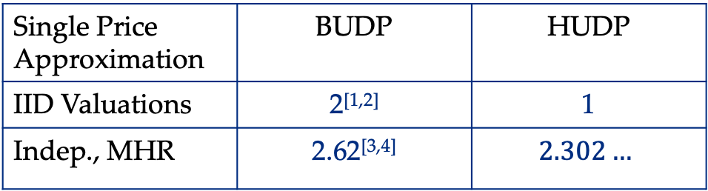
Contributions
C1: When valuations are independent and identical
A single price is optimal for HUDP. Value of discrimination in BUDP IID settings is due solely to quasi-linear utility maximizing effects.
C2: When valuations are independent but not identical
Single price approximates the optimal when indep. and MHR.
C3: When valuations are dependent but identical
Single price is not optimal, but approximates optimal
Single Price Approximation | BUDP | HUDP
IID Valuations | 2^{[1,2]} | 1
Indep., MHR | 2.62^{[3,4]} | $$2.302…$$
[1] Chawla et al, 2007. Algorithmic Pricing via Virtual Valuations.
[2]Chawla et al., 2010. Multi-parameter Mechanism Design and Sequential Posted Pricing
[3] Alaei et al., 2015. Optimal Auctions vs. Anonymous Pricing.
[4] Jin et al.,, 2019. Tight Approximation Ratio of Anonymous Pricing

Slide 13
HUPD, IID Valuations
Theorem [Single Price is Optimal for IID Valuations].
For any positive valued distribution V ~ F such that valuations are for drawn N items are drawn IID, a single price for all items maximizes Hicksian revenue.
Remarks
For Hicksian demand, there is no value in discriminatory pricing!
The BUPD discrimination is fully driven by the quasi-linear utility maximizing assumption
Over-estimates the effect in practice?

Slide 14
HUPD, IID Valuations
Theorem [Single Price is Optimal for IID Valuations].
For any positive valued distribution V ~ F such that valuations are for drawn N items are drawn IID, a single price for all items maximizes Hicksian revenue.
Proof Sketch
Direct proof follows from a nice inductive argument
No detour through auction theory, prophet inequalities
Polynomial time whereas BUDP is NP-Hard^{[1,2]}
Easy proof when N = 2
[1] Chen et al, 2014. The Complexity of Optimal Multidimensional Pricing.
[2] Cai and Daskalakis, 2015. Extreme Value Theorems for Optimal Multidimensional Pricing.

Slide 15
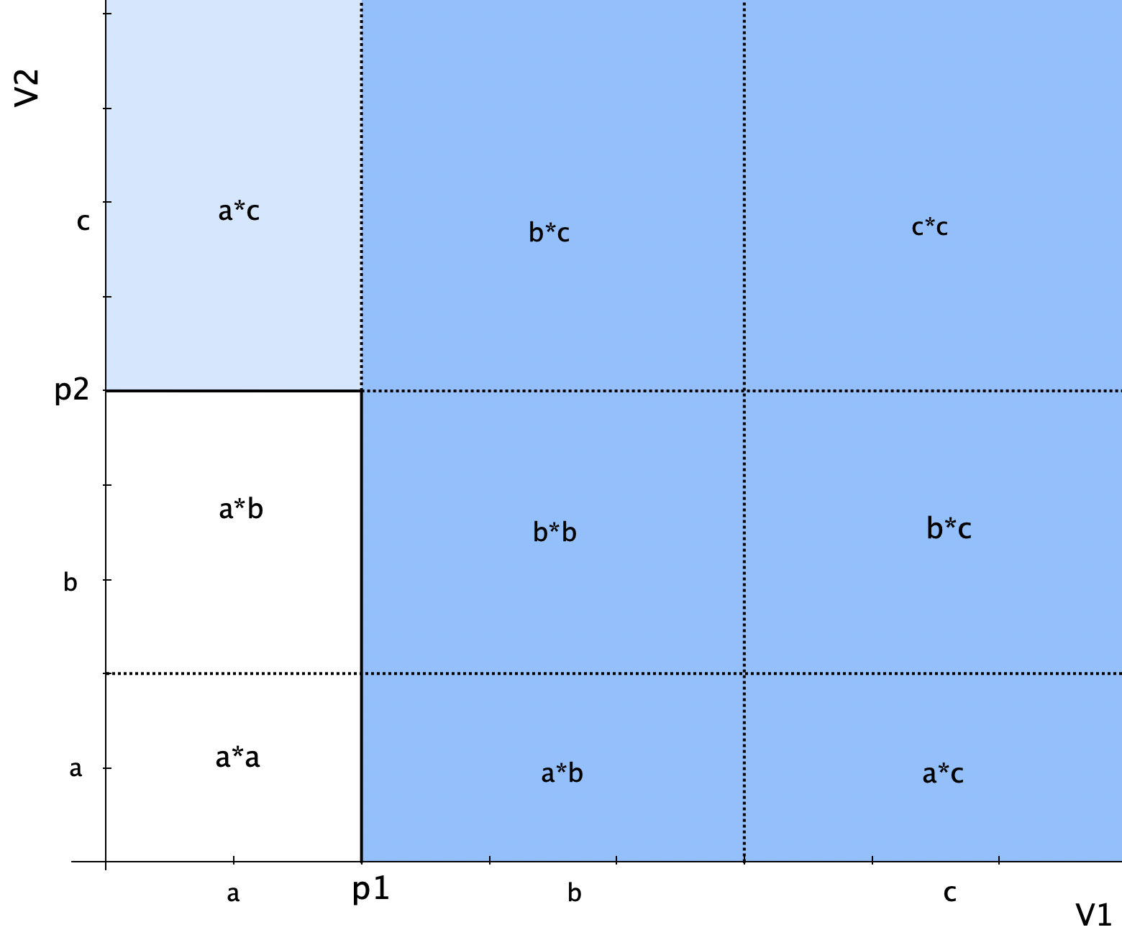
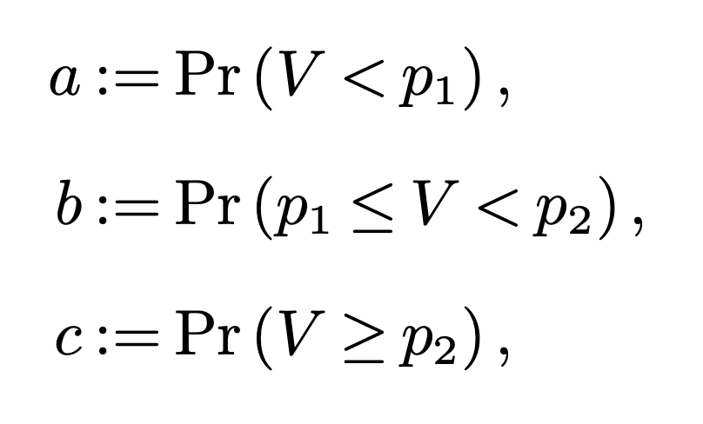
HUPD, IID Valuations N = 2
Theorem [Single Price is Optimal for IID Valuations].
For any positive valued distribution V ~ F such that valuations are for drawn N items are drawn IID, a single price for all items maximizes Hicksian revenue.
Proof N = 2
Draw out the valuation space.
Nine events to consider.

Slide 16
HUPD, IID Valuations N = 2
Theorem [Single Price is Optimal for IID Valuations].
For any positive valued distribution V ~ F such that valuations are for drawn N items are drawn IID, a single price for all items maximizes Hicksian revenue.
Proof N = 2
Draw out the valuation space.
Nine events to consider.
Two conditions:
SP(p₁) < DP(p₁, p₂)
SP(p₂) < DP(p₁, p₂)
Algebra gives the contradiction

Slide 17
Independent, Non-Identical Valuations
Theorem [Single Price is Nearly Optimal for Indep., MHR].
For any positive valued, MHR distributions {V_{i}} such that valuations are for drawn N items are independently IID, a single price is a 2.302.. approximation of the optimal Hicksian differentiated pricing revenue.

Slide 18
Independent, Non-Identical Valuations
Theorem [Single Price is Nearly Optimal for Indep., MHR].
For any positive valued, MHR distributions {V_{i}} such that valuations are for drawn N items are independently IID, a single price is a 2.302.. approximation of the optimal Hicksian differentiated pricing revenue.
Remarks
Monotone-hazard rate distributions have non-decreasing hazard rates
Light-tailed distributions which include uniform, exponential etc.
Without MHR no constant approx. is possible in HUDP or BUDP

Slide 19
Independent, Non-Identical Valuations
Theorem [Single Price is Nearly Optimal for Indep., MHR].
For any positive valued, MHR distributions {V_{i}} such that valuations are for drawn N items are independently IID, a single price is a 2.302.. approximation of the optimal Hicksian differentiated pricing revenue.
Remarks
Monotone-hazard rate distributions have non-decreasing hazard rates
This approximation is improved over BUDP case
Direct proof, no detour through auctions, prophet inequalities

Slide 20
Independent, Non-Identical Valuations
Theorem [Single Price is Nearly Optimal for Indep., MHR].
For any positive valued, MHR distributions {V_{i}} such that valuations are for drawn N items are independently IID, a single price is a 2.302.. approximation of the optimal Hicksian differentiated pricing revenue.
Remarks
Monotone-hazard rate distributions have non-decreasing hazard rates
This approximation is improved over BUDP case
Lower bound construction of 2, valued based differentiated pricing

Slide 21
Cut for time!
Exchangeable distributions! These are the most general symmetric environments, identical but not independent
There is value of discriminatory pricing in this case!
Prove the efficacy of a single price.
Shift distributions!
These are shifted distributions that are otherwise IID
Model of regression outputs

Slide 22
Thank you!
Full paper is Coming Soon
Comments, questions @ mhamilton@katz.pitt.edu
More papers: https://mhamilton-pitt.github.io/

