Slide 1

Fududeeye Management System
Global Science University (GSU)
Prepared By:
• Abdiqani Maxamed Cabdi
• Abshir Shaani
• Aadan Abdirahman Aadan
Lecturer: ENG-MAXAMED CABDULQADIR XIRSI

Slide 2



Technologies Used
Frontend: HTML, CSS, Bootstrap, JavaScript
Backend: PHP
Database: MySQL
Server Environment: XAMPP

Slide 3
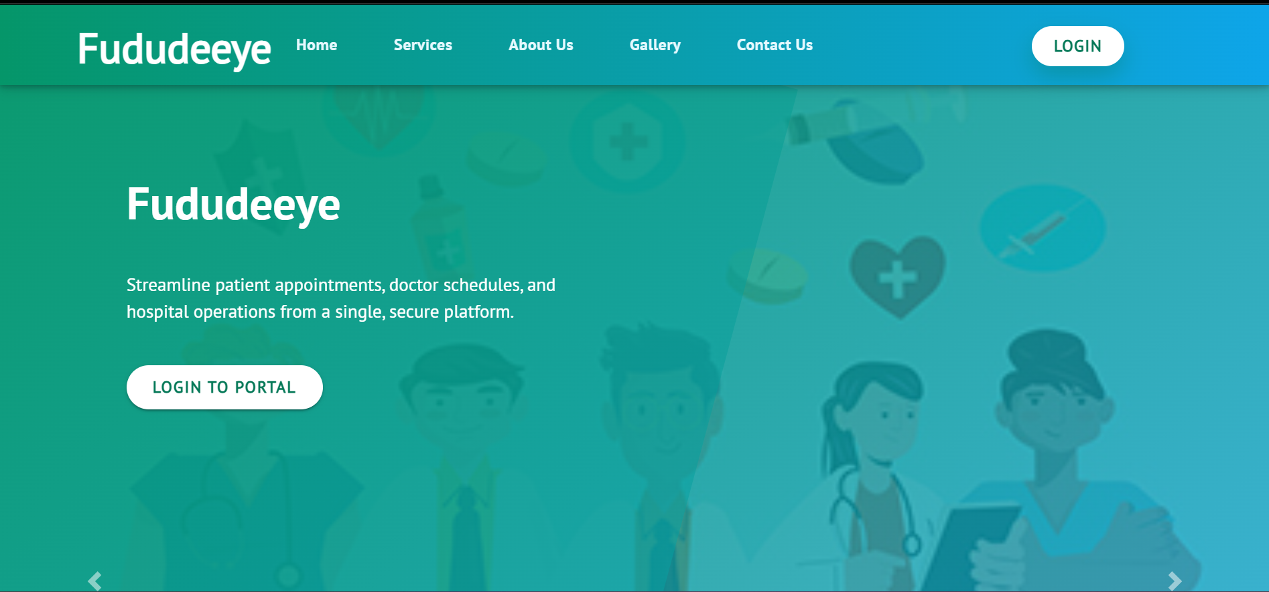
Front Website
Fududeeye Management System is a system for managing hospitals.

Slide 4
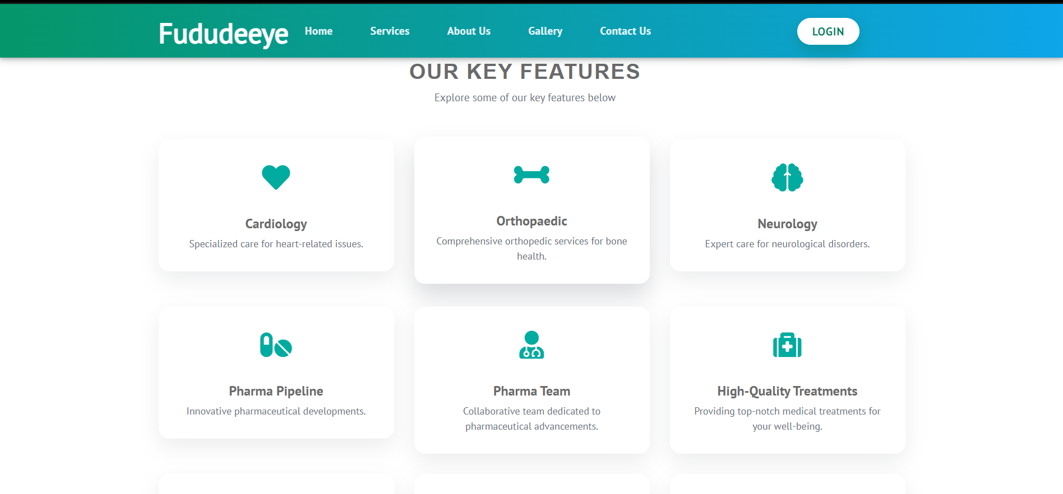
OUR KEY FEATURES

Slide 5
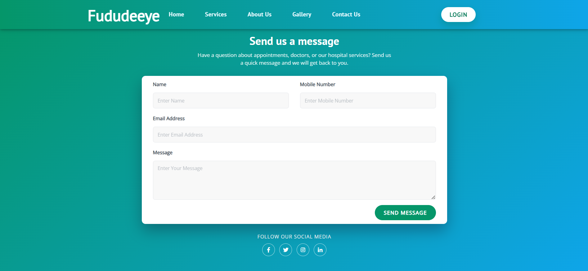
Send us a message
The user has the ability to send messages to the admin directly, and the admin can see and react to them.

Slide 6
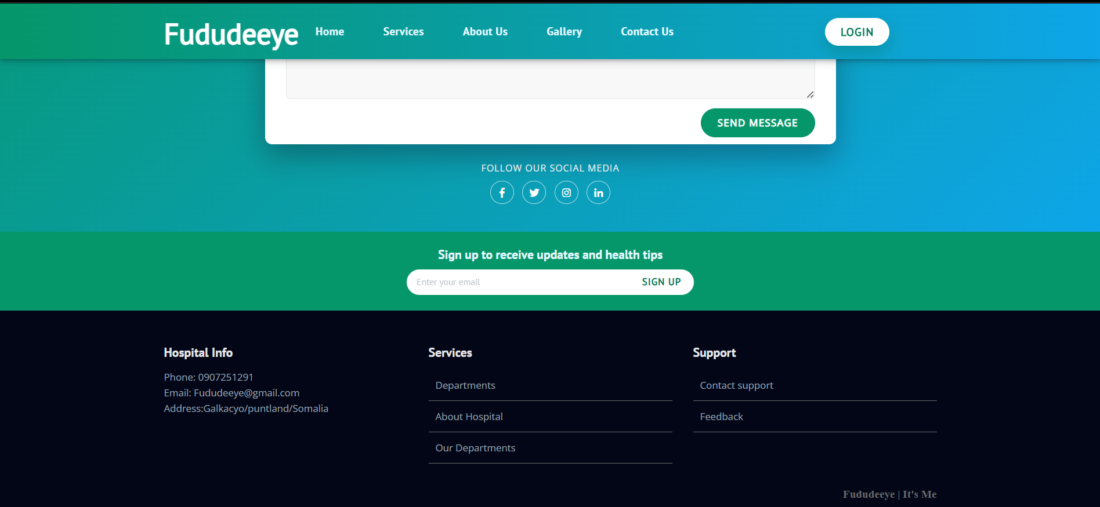
Footer
The footer of the system contains the actual address of the hospital and the hospital's contact information.

Slide 7
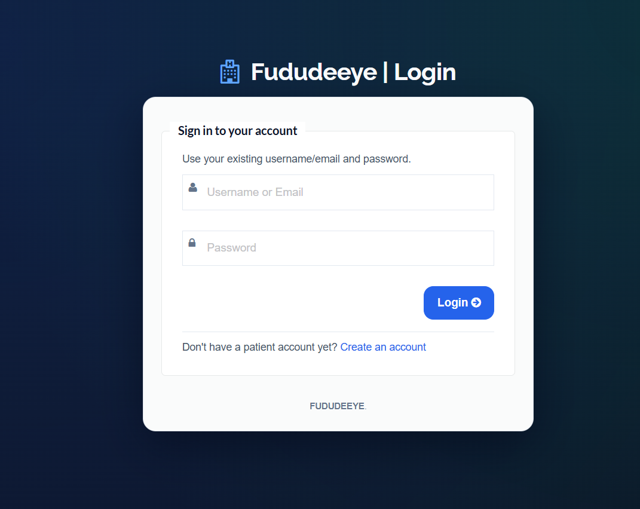
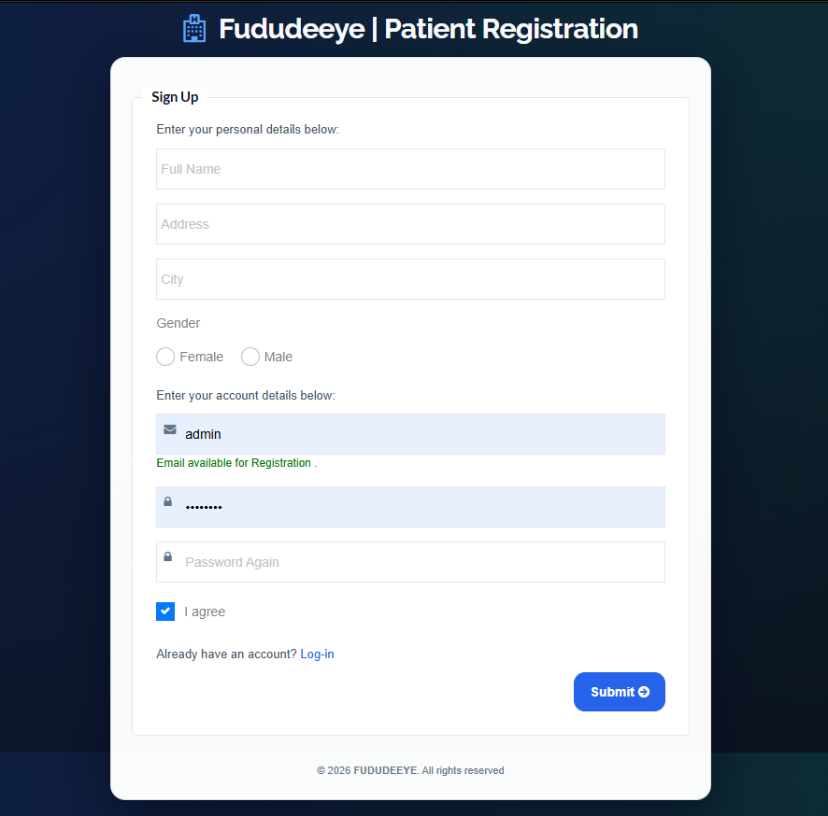
The system connects Admin, Doctor & Patient.
Login
Registration

Slide 8
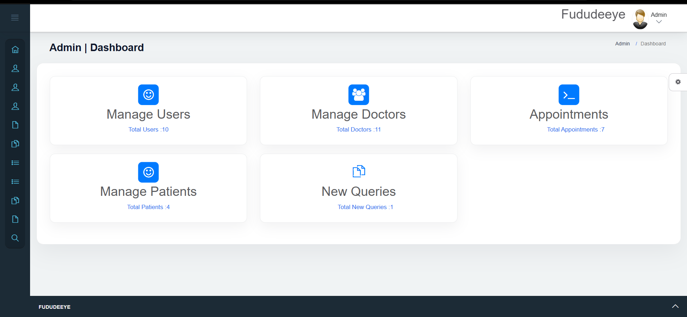
Admin Modules
Admin Dashboard
This is the admin dashboard which consists of various advanced sections.

Slide 9
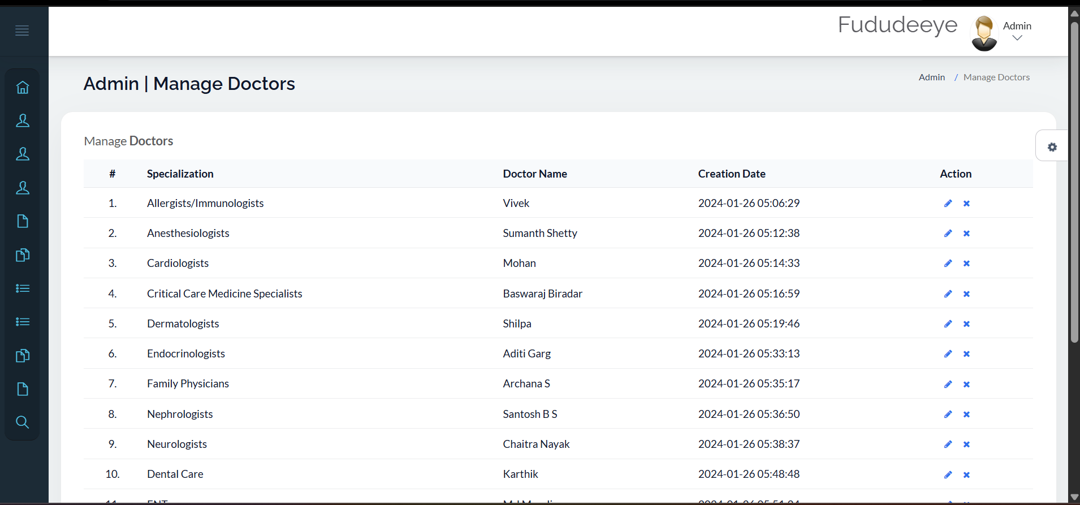
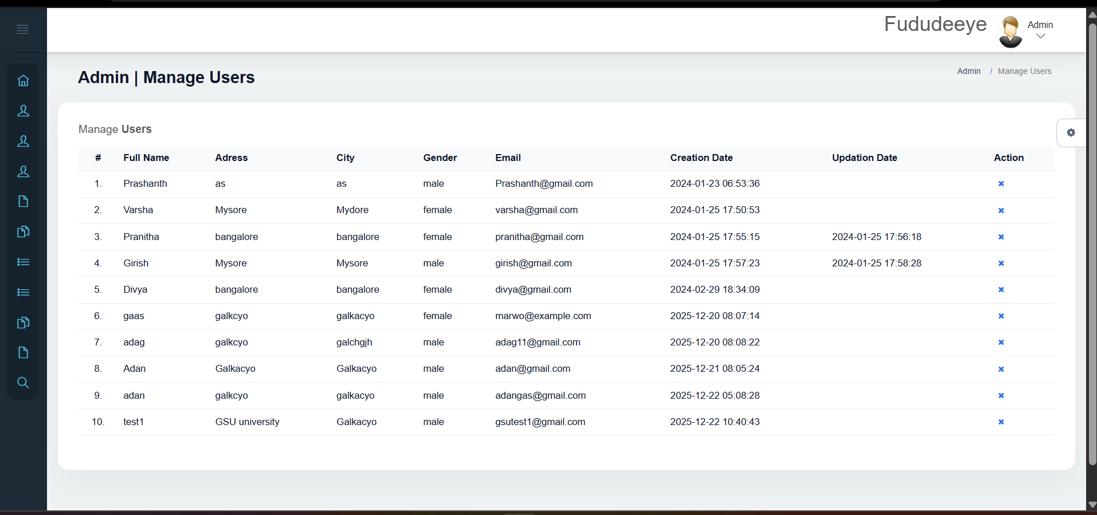
Admin Modules
Manage Doctors & Users
This is the Manage Doctors and Manage Users sections, the Admin has the ability to manage both of these.
Manage Doctors
Manage Users

Slide 10
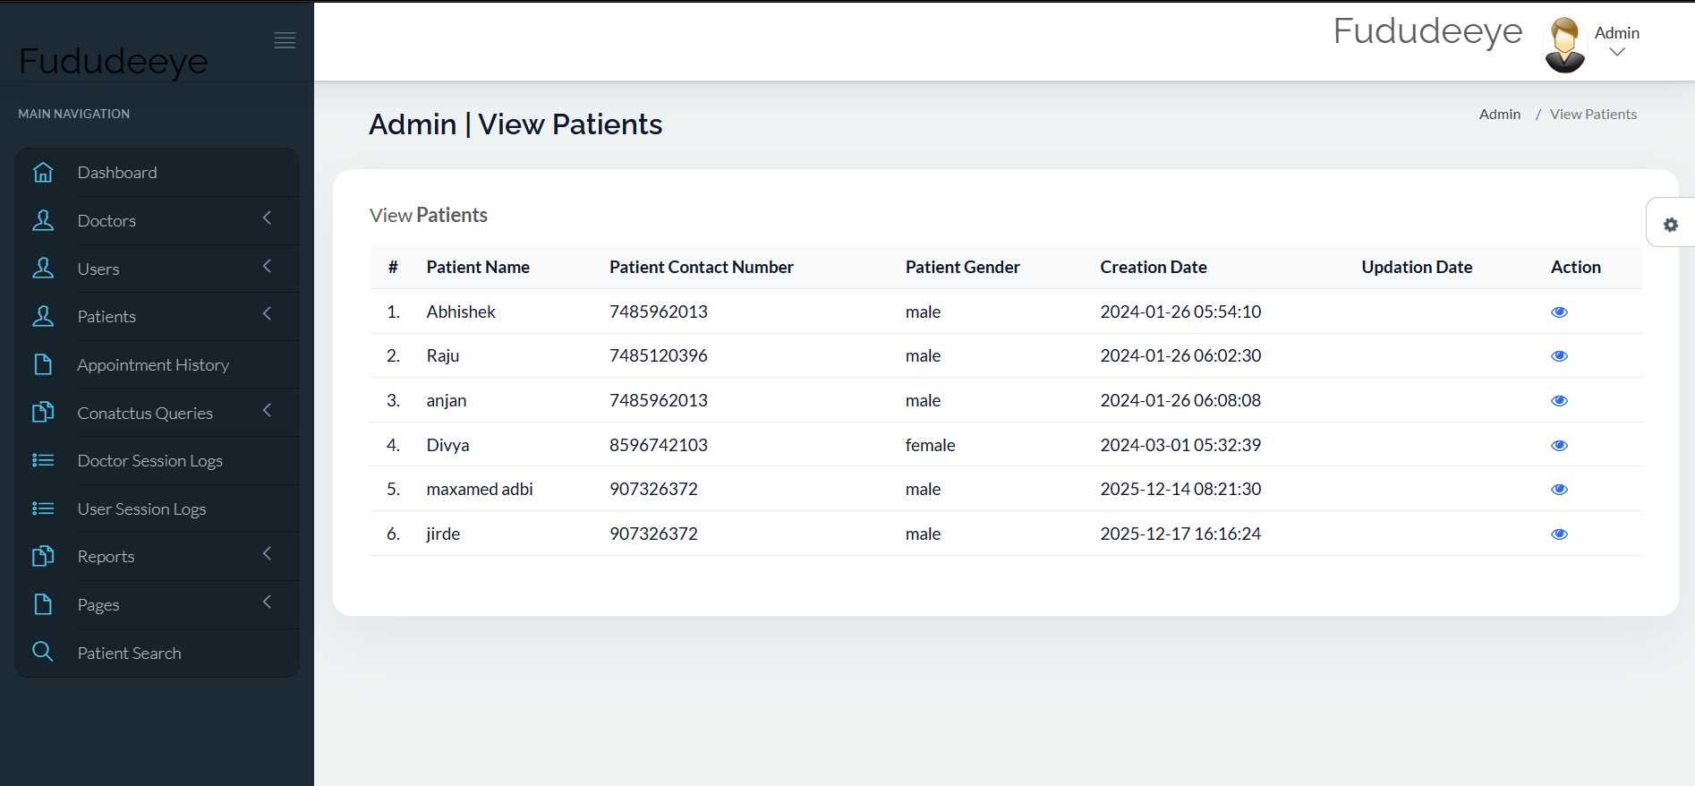
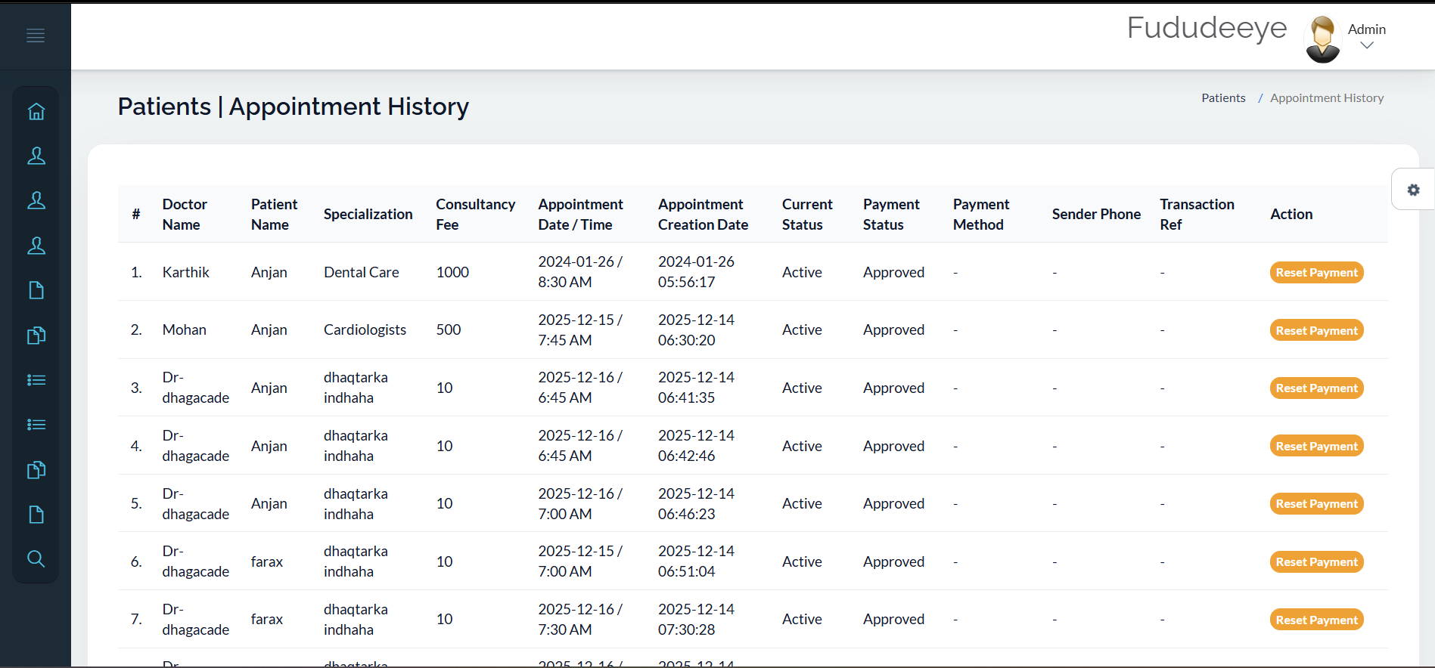
Admin Modules
Manage Patients & Appointment
These two sections are Manage Patients & Appointment admin has the ability to manage these two
Manage Patients
Manage Appointment

Slide 11
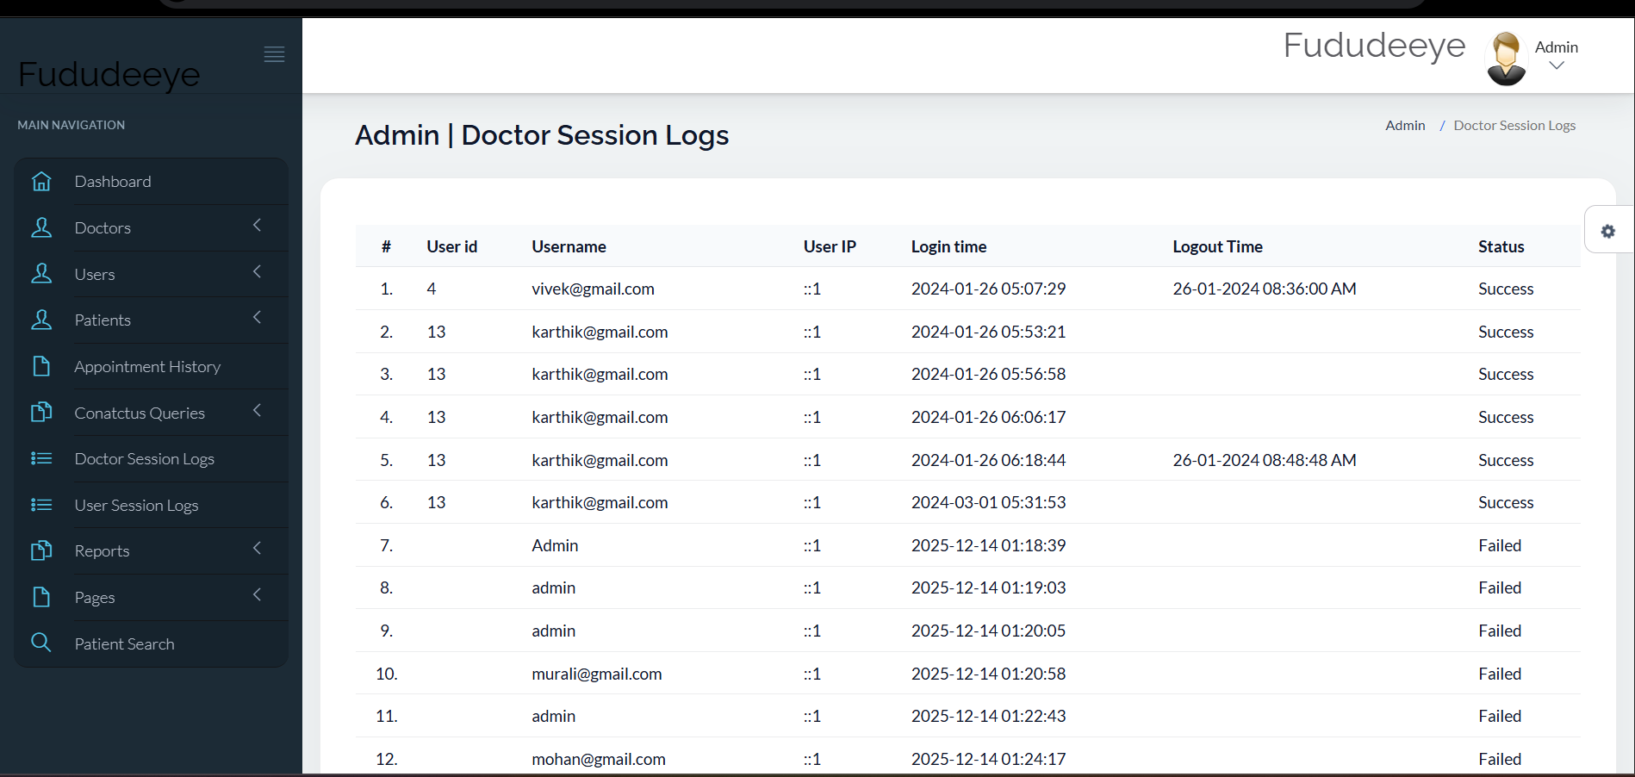
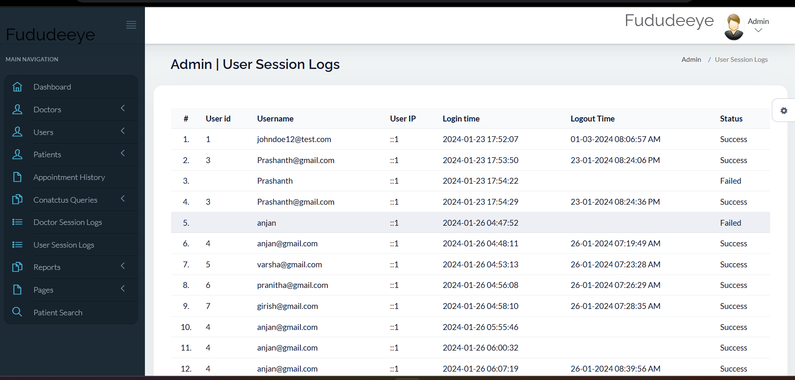
Admin Modules
Manage Session Logs
The admin has the ability to track (Session Logs) users using the system in two ways: Doctor Session Logs User Session Logs
Doctor Session Logs
User Session Logs

Slide 12
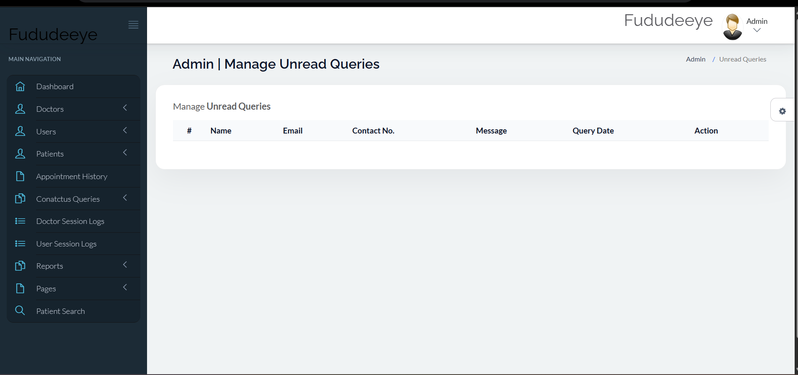
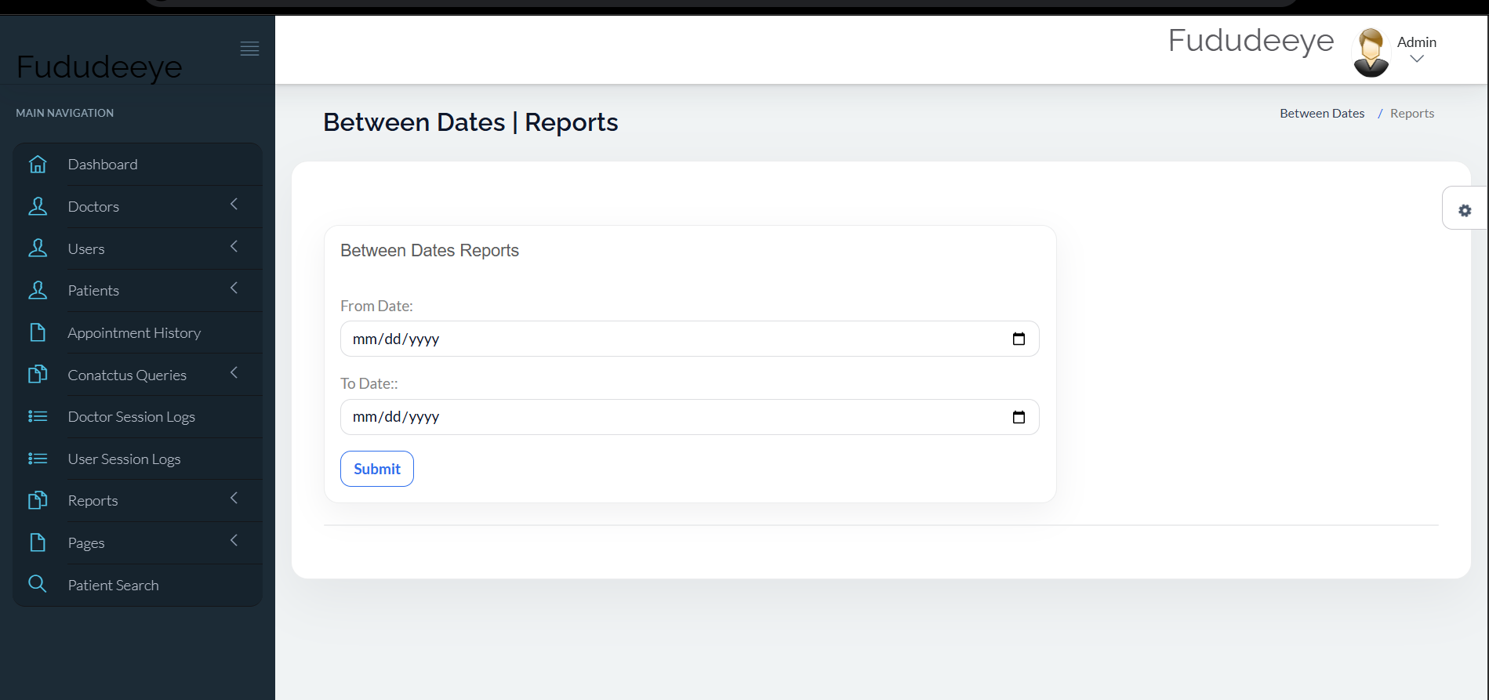
Admin Modules
Manage Queries & Reports
These sections enable the Admin to manage Queries & Reports,
Manage Queries
Manage Reports

Slide 13
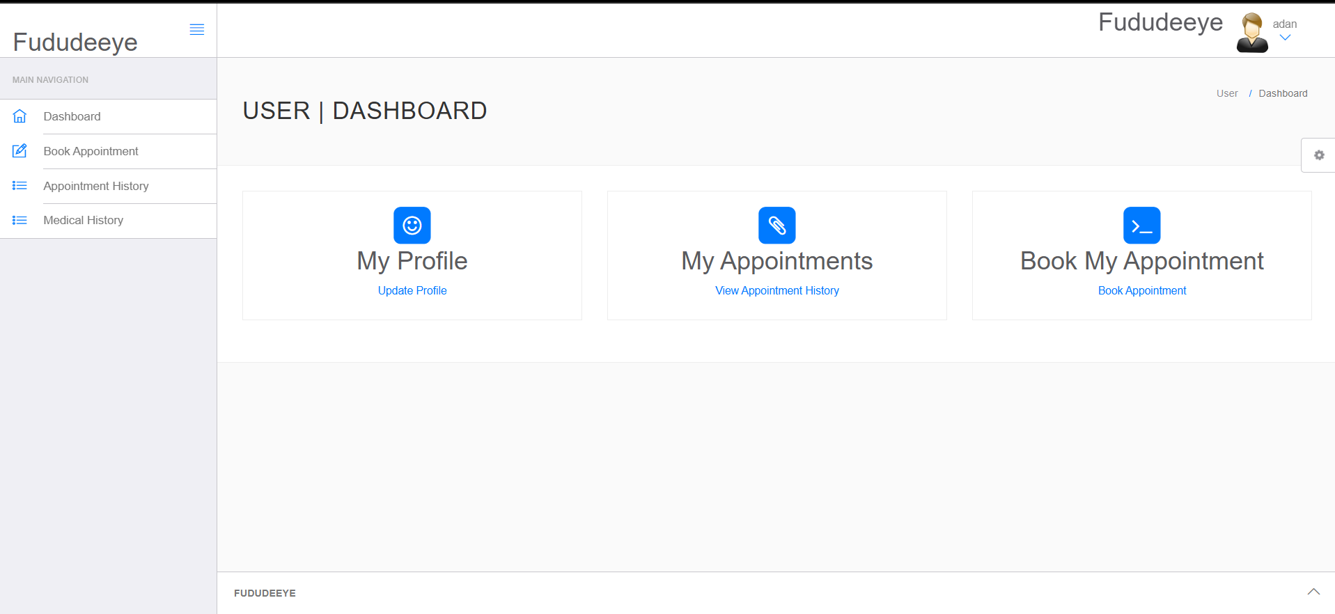
Patient Dashboard
The patient can only view this dashboard, book an appointment, and contact the doctor.

