Slide 1
Topic: Bluetooth based Smartphone controlling led

Slide 2
Bluetooth specifications
Frequency: 2.4GHz ISM band.
Modulation: GFSK(Gaussian Frequency Shift Keying)
Emission power: ≤4dBm, Class 2.
Sensitivity: ≤-84dBm at 0.1% BER.
Speed: Asynchronous: 2.1Mbps(Max) / 160 kbps, Synchronous: 1Mbps/1Mbps.

Slide 3
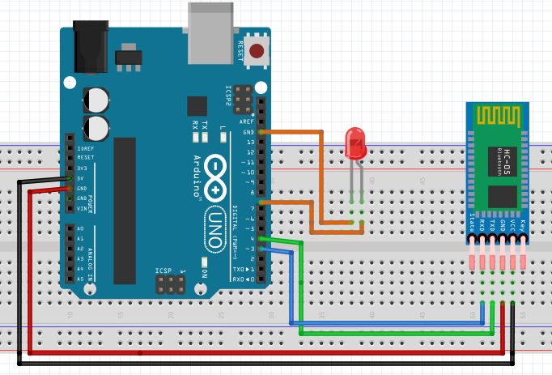
CIRCUIT CONNECTION

Slide 4
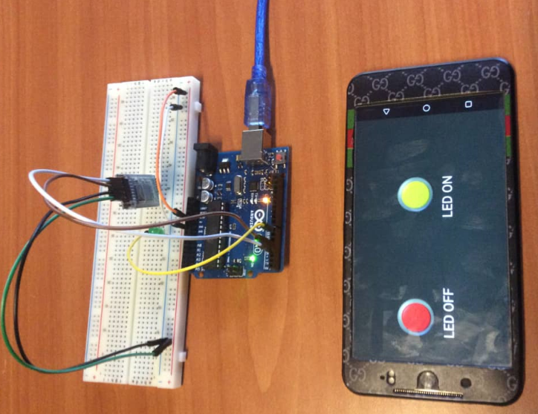
Project implementation

Slide 5
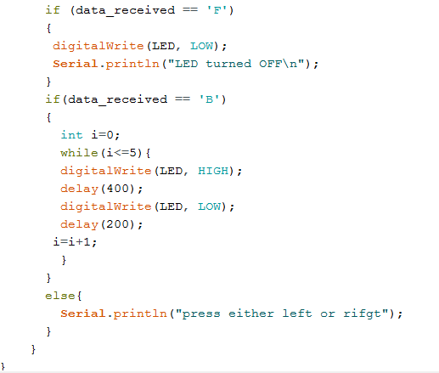

Slide 6
Bluetooth application
Open google playstore
Search for bluetooth electronics app
Download and install app
Configure the interface of your project the application

Slide 7

Questions and Discussions
Thank you

