Slide 1
Air Quality Monitoring System Supervised by: Dr. Ramasamy Kingdom of Saudi Arabia | King Faisal University College of Computer science & Information Technology
Student Name and ID:
Nasser Alhamdan – 222411198
Abdulqader Almusallam – 223045603
Mahdi Alhamdan - 223004127

Slide 2
Project Overview
Distributed IoT-based system using ESP32
Monitors gases and PM in real-time
Data sent to cloud dashboard

Slide 3



Problem Statement
Air pollution is dangerous
Traditional systems are expensive
Need low-cost, real-time monitoring solution

Slide 4
System Architecture
2 Sensor Nodes (ESP32 + MQ + PM)
Wi-Fi communication (MQTT/HTTP)
Cloud dashboard for visualization

Slide 5

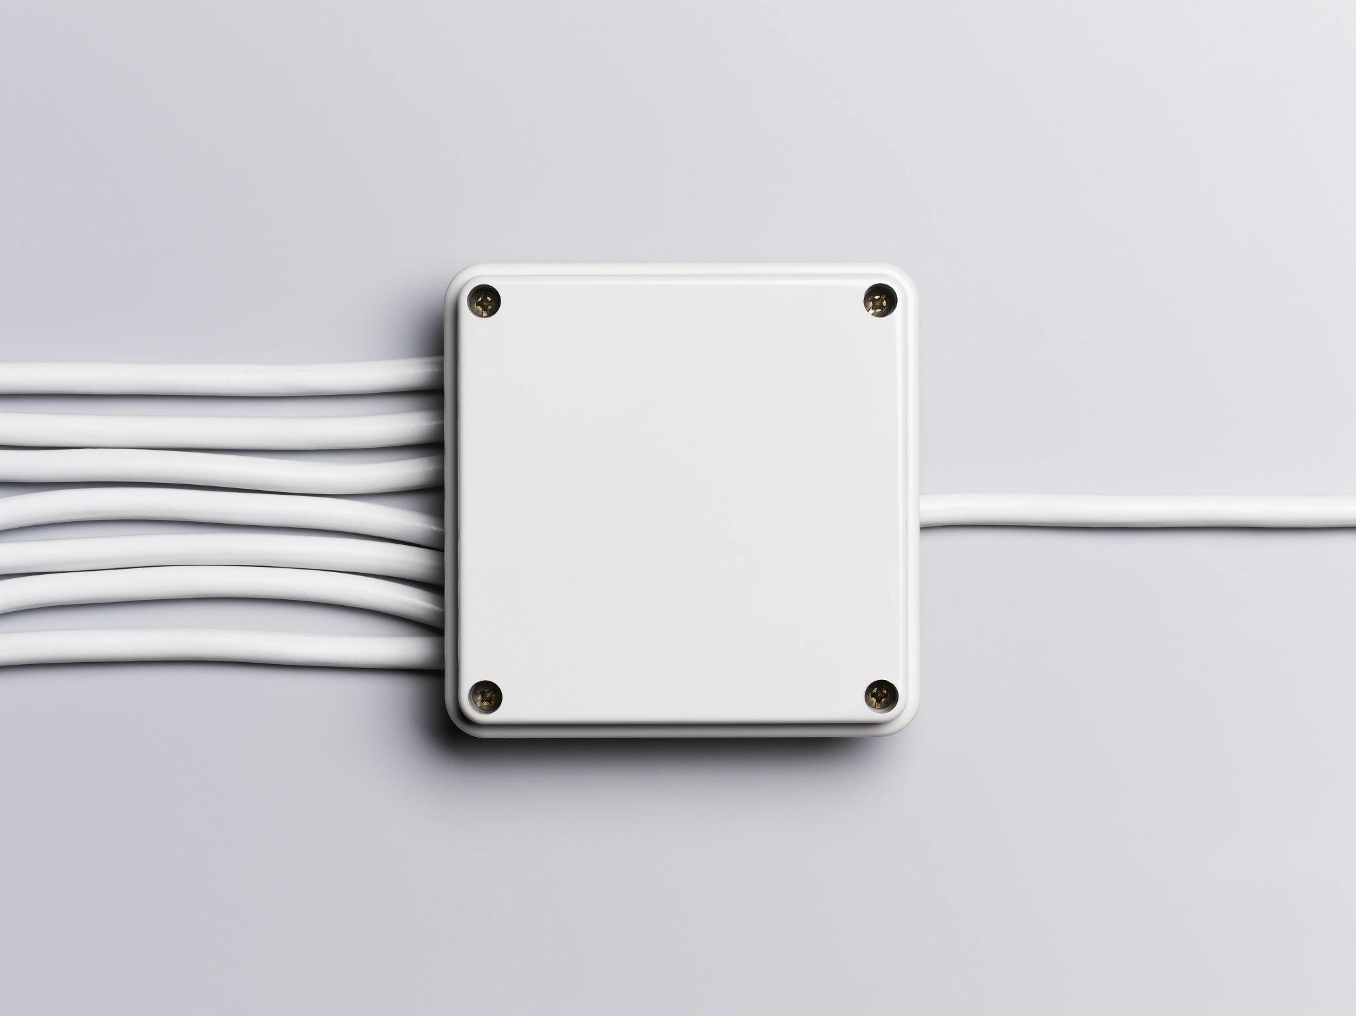
Hardware Design
ESP32 microcontroller
MQ-135 gas sensor
PM2.5 sensor (SDS011)
5V power supply

Slide 6

Software Design
Embedded C/C++ (Arduino)
Initialize sensors & Wi-Fi
Read data and calibrate
Send JSON to cloud

Slide 7
Results & Discussion
Successful real-time monitoring
Stable data transmission
Good Wi-Fi reconnection performance

Slide 8

Conclusion
Low-cost and scalable system
Real-time monitoring achieved
Future: add GPS for mapping

Slide 9

Any questions?
Thank you for your attention!

