Slide 1
GRPC
By google

Slide 2
OUTLINE
http/2 vs http/1.1
Client/server communication
protocol buffers
An introduction to gRPC and protocol buffers
HOW grpc works
How stubs are generated
Why gRPC users protocol buffer?
What languages are supported by grpc?
WHAT makes grpc efficient?
HOW http/2 works under the hood
gRPC modes
coding
Pros and cons

Slide 3
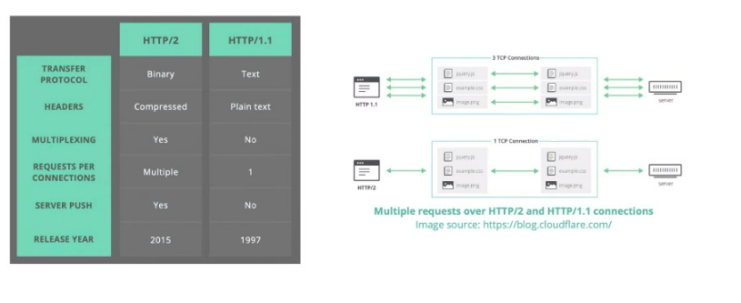
http/2 vs http/1.1
http://www.http2demo.io/

Slide 4
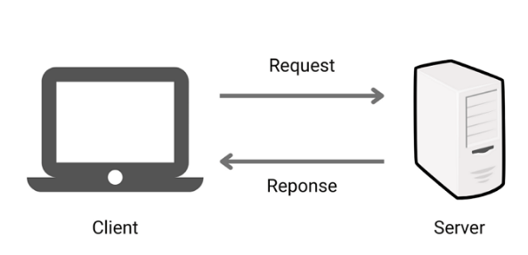
Client/server communication
SOAP, REST, GraphQL, RPC
SSE(Server-Sent Events), WebSocket
Raw TCP

Slide 5
Client/server communication
REST
[ xml, JSON, HTML, Plain text]
Large community
Public apis, simple resources
In security(tls, ssl)
Client --> server request only
RPC
[JSON, XML, Protobuf, Thrift, FlatBuffers]
Large community
Command and action oriented Apis, internal high performance communication in massive micro-services systems.
In security(tls, ssl)
Bidirectional streaming
Use protocol buffer

Slide 6
protocol buffers
Protocol buffers provide a language-neutral
platform-neutral
extensible mechanism for serializing structured data in a forward-compatible and backward-compatible way.
It’s like JSON, except it's smaller and faster, and it generates native language bindings.
Protocol buffers are the most commonly-used data format at Google.
Protocol buffer messages and services are described by engineer-authored .proto file.

Slide 7
protocol buffers (Syntax)
ProtoBuf
Int32
Int64
String
Float
Double
Bool
bytes
Java
int
Long
String
Float
Double
Bool
byte
protocol-buffers/docs/proto3

Slide 8
protocol buffers (Syntax)
message: converted to public final class class_name , contain defined filed , setters and getters.
message Person {
//data type, variable name, serialization sequence string name = 1; int32 id = 2; string email = 3; }
Person john = Person.newBuilder() .setId(1234) .setName("John Doe") .setEmail("jdoe@example.com") .build();
Build
enum
As you can see, the enum's first constant maps to zero: every enum definition must contain a constant that maps to zero as its first element.
This is because:
There must be a zero value, so that we can use 0 as a numeric default value.
The zero value needs to be the first element, for compatibility with the proto2 semantics where the first enum value is always the default
enum Gender {
MALE = 0;
FEMALE = 1; }

Slide 9
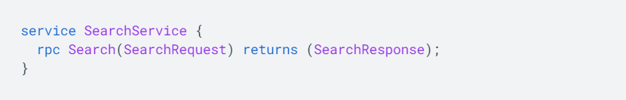
protocol buffers (Syntax)
Defining Services

Slide 10
What are the Benefits of Using Protocol Buffers?
Compact data storage
Fast parsing
Availability in many programming languages
Optimized functionality through automatically-generated classes

Slide 11
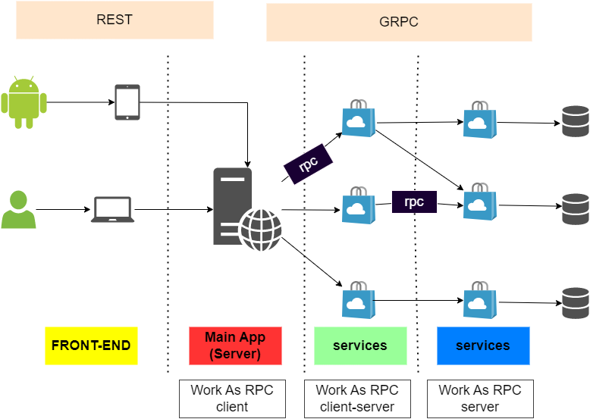
An introduction to gRPC And protopuf protocol

Slide 12
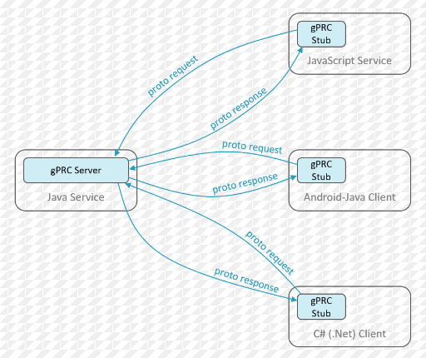
An introduction to gRPC And protopuf protocol
What is gRPC?
gRPC is a modern, open source remote procedure call (RPC) framework that can run anywhere. It enables client and server applications to communicate transparently, and makes it easier to build connected systems.

Slide 13
An introduction to gRPC And protopuf protocol
COMMUNOCATION SHOULD BE EFFICIENT
Huge amount of exchange message between micro-services
Mobile network can be slow with limited bandwidth
COMMUNICATION SHOULD BE SIMPLE
Client and server should focus on their core service logic
Let the framework handle the rest

Slide 14
HOW grpc works
Client has a generated stub that provides the same methods as the server
The stub calls grpc framework under the hood to exchange information over network
Client and server use stubs to interact with each other, they only need to implement their core service logic.

Slide 15
How stubs are generated
Api Contract description
The service and payload messages are define using protocol buffer
Server and client stubs are generated by the
Protocol Buffer compiler
gPRC plugins of each language

Slide 16
Why gRPC uses protocol buffer?
Human-readable interface definition language(IDL)
Code generators for many languages
Binary data representation
Strong typed contract

Slide 17
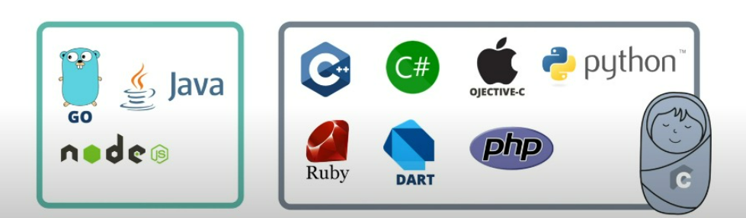
What languages are supported by grpc?
10 officially supported languages
Pure implementation Go, Java, Nodejs
Wrap C-grpc core: c/c++, c#, objective-c, python, dart, php

Slide 18
WHAT makes grpc efficient?
GRPC USES HTTP/2 AS ITS TRANSFER PROTOCOL
Binary framing
Header compression using HPACK
Reduce overhead and improve performance
multiplexing
Server push
One client request, multiple response
Reduce round-trip latency

Slide 19
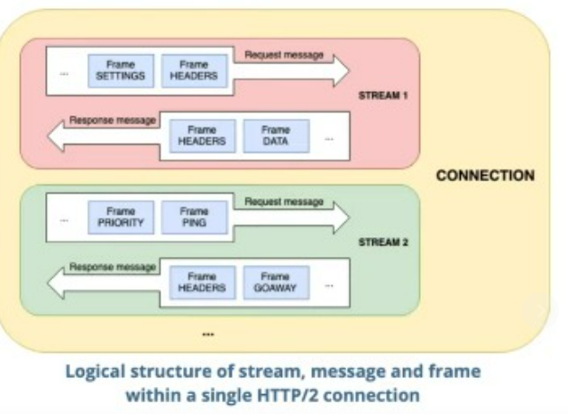
HOW http/2 works under the hood
Single TCP connection carries multiple bidirectional streams
Each stream has a unique ID and caries multiple bidirectional messages
Each message (request/ response) is broken down into multiple binary frames
Frame is the smallest unit that carries different types pf data : HEADERS, SETTINGS, PRIORITY, DATA, etc.

Slide 20
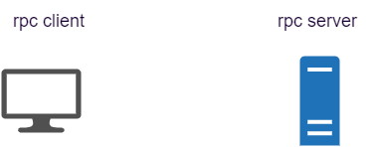
gRPC modes
Unary rpc
Server streaming rpc
Client streaming rpc
Bidirectional rpc

Slide 21
gRPC modes
Unary rpc
Server streaming rpc
Client streaming rpc
Bidirectional rpc

Slide 22

gRPC modes
Unary rpc
Server streaming rpc
Client streaming rpc
Bidirectional rpc

Slide 23
gRPC modes
Unary rpc
Server streaming rpc
Client streaming rpc
Bidirectional rpc

Slide 24
gRPC modes
Unary rpc
Server streaming rpc
Client streaming rpc
Bidirectional rpc

