Slide 1
BinX Tech · AI & ML Internship · Capstone Project
Melanoma
Classification
Binary skin lesion classification — from CNN experimentation to a publicly deployed web application
Nadeen Shadeed
ISIC Melanoma Dataset
TensorFlow · FastAPI · Streamlit
2026

Slide 2
THE PROBLEM
Can a CNN distinguish a benign lesion
from a malignant one?
Melanoma is one of the most dangerous forms of skin cancer, but early visual detection is possible from dermoscopic images. Benign and malignant lesions can look similar even to trained observers — making automated classification meaningful and non-trivial.
2
11,888
Binary
Classes: Benign / Malignant
Total dermoscopic images
Image classification task
⚠ Disclaimer: this project was built for educational purposes and is not intended for clinical diagnosis.

Slide 3
THE DATA
Split
Images
Batches
ISIC Melanoma
Dataset
Training (70%)
8,322
261
Validation (15%)
1,783
56
Test (15%)
1,783
56
11,888 dermoscopic images across two classes. A 70/15/15 split maximizes training data while maintaining reliable evaluation sets.
Preprocessing
Detail
Convert to RGB
3-channel input
Resize
112 × 112 pixels
ISIC Archive
RGB Images
112×112 px
Normalize
Pixel values ÷ 255.0
Augmentation (train)
Flip, rotation, zoom, brightness

Slide 4
EDA HIGHLIGHTS
What the data tells us before training
6,289
5,601
Balanced
Benign images (52.9%)
Malignant images (47.1%)
Class distribution
1
Visually subtle differences: malignant lesions show irregular borders and uneven colors. A CNN needs deep features — simple rules are insufficient.
2
Pixel range 0–255: normalization required before training. Applied consistently so raw images stay compatible throughout the pipeline.
3
Near-balanced classes: accuracy is a meaningful metric here. AUC was tracked alongside to measure separation across all thresholds.

Slide 5
METHODOLOGY
Three approaches. One winner.
Input
112×112×3
Conv2D × 4
+ BatchNorm
GlobalAvg
Pooling
Dense 256
+ Dropout
Sigmoid
→
→
→
→
1
CNN from Scratch— baseline without augmentation. Overfitting appeared after Epoch 8; training accuracy climbed while validation plateaued.
2
CNN + Data Augmentation— same architecture with random flips, rotations, zoom, and brightness. Training/validation gap narrowed. Selected model.
3
MobileNetV2 (frozen)— ImageNet pretrained, frozen base, new classification head. Lower test performance; fine-tuning identified as future work.

Slide 6
RESULTS
CNN + Augmentation outperformed across all metrics
Model
Test Accuracy
Test AUC
Test Loss
CNN from Scratch
88.11%
0.9514
0.2826
✦ CNN + Augmentation
88.95%
0.9579
0.2632
MobileNetV2 (frozen)
86.47%
0.9383
0.3165
CNN from Scratch
88.11%
CNN + Augmentation ✦
88.95%
MobileNetV2 (frozen)
86.47%
AUC 0.9579 = the model correctly ranks a malignant image above a benign one 95.8% of the time — across all thresholds.

Slide 7
MODEL BEHAVIOR
What drove the model's decisions?
0.5
89.39%
0.9597
Classification threshold
Best val accuracy (retraining)
Best val AUC (retraining)
1
Augmentation reduced overfitting: the training/validation accuracy gap was smaller than the scratch baseline — the model learned patterns, not image positions.
2
Confidence is not certainty: borderline cases (~61% confidence) reflect genuine visual ambiguity in the lesion — the model uncertainty mirrors the task difficulty.
3
MobileNetV2 limitation: frozen pretrained layers could not adapt to dermoscopic characteristics. Fine-tuning the deeper layers is the identified next step.

Slide 8
DEPLOYMENT PIPELINE
From serialized model to public web app
Train
melanoma_cnn
.keras
FastAPI
/predict
Streamlit
UI
Streamlit
Cloud
Public
URL
→
→
→
→
→
D1
melanoma_cnn.keras (5.3 MB) — loads in any environment without retraining.
D2
FastAPI POST /predict — accepts image uploads, validates file type, returns JSON with prediction + confidence.
D3
Streamlit dashboard — image uploader, probability bars, @st.cache_resource ensures model loads once per session.
D4
Streamlit Community Cloud — 4-package requirements.txt, deployed from GitHub, no GPU required.
binxaimlinternship-ahm9zn2cc7ebk8gzw7fzhh.streamlit.app

Slide 9
LIVE DEMO
Deployed predictions match local — exactly
3 test images run on both local app and deployed URL. All three matched to 4 decimal places — confirming no training/serving skew.
3.jpg
22.jpg
64.jpg
Benign
Benign
Malignant
61.05%
91.12%
99.91%
✓ Match
✓ Match
✓ Match
Key rule: inference preprocessing must match training exactly. Resize → 112×112, normalize ÷ 255.0, add batch dimension — applied identically in training, FastAPI, and Streamlit.
Live app → binxaimlinternship-ahm9zn2cc7ebk8gzw7fzhh.streamlit.app

Slide 10
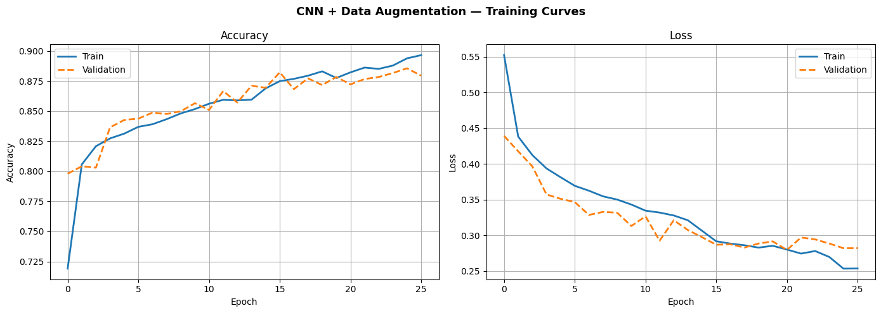
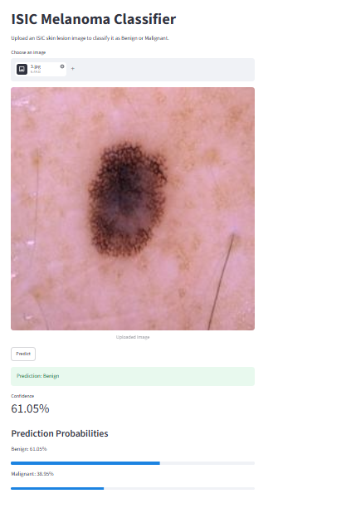
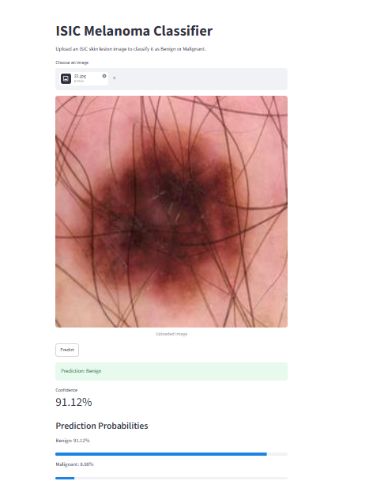
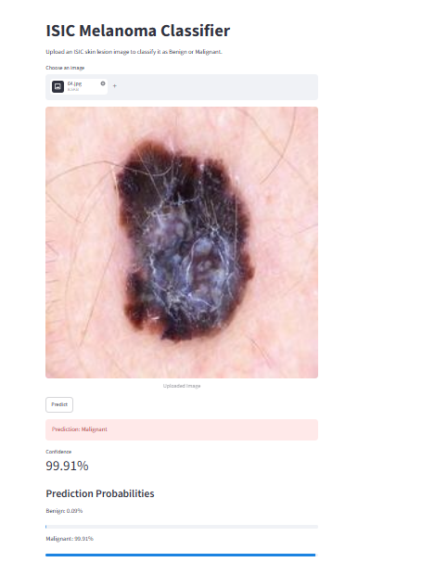
VISUAL RESULTS
Training curves & live predictions
CNN + DATA AUGMENTATION — TRAINING CURVES (25 EPOCHS)
3.jpg — BENIGN · 61.05%
22.jpg — BENIGN · 91.12%
64.jpg — MALIGNANT · 99.91% ⚠

Slide 11
LIMITATIONS & FUTURE WORK
Honest assessment and next steps
Current Limitations
Identified Next Steps
Evaluated on one dataset — generalization unverified
Fine-tune MobileNetV2 pretrained layers on melanoma data
Images resized to 112×112 — some detail lost
Evaluate at higher resolutions (224×224)
MobileNetV2 frozen layers only — fine-tuning not tested
Add SHAP / Grad-CAM for visual explainability
3 test images for live verification — not statistical
Expand automated API and UI test coverage
No clinical validation — not a diagnostic tool
Add confidence threshold warning for borderline cases

Slide 12
Thank
You
Melanoma Classification · CNN + Data Augmentation
val AUC 0.9597 · val Accuracy 89.39%
🔗 binxaimlinternship-ahm9zn2cc7ebk8gzw7fzhh.streamlit.app
BinX Tech · AI & ML Internship · 2026
Questions?

