Slide 1
PVT Simulator PE251_V12
By Mansoor Hussain
Dedicated to:
Raphael Babar
who will beat
Raphael Nadal’s record
Presentation Draft: 2
27-August-2020

Slide 2
Contents:
Summary
Technical Background
Features
Step By Step Guide for Oil
Step By Step Guide for Gas

Slide 3
SUMMARY
I have developed a PVT Simulator; which can be used if a Commercial Simulator is not available to the User.
The Programme has been written in Python and is very straight forward to use and produces Output which after minor editing can be used with the Eclipse Simulator.
The results have been compared to PVTi and PVTSIM and fall within the Error Margin.

Slide 4
Technical Background
Uses Peng Robinson (2-Parameter) Equation of State and Flash Equation to determine, the Liquid and Vapour Mole Fractions and Compositions and Volumes
Uses Lohrenz Bray Clark to determine Viscosity (Does not Psudoize C7+)
The Simulator is written in Python and can be executed on Jupyter Notebook OR in batch mode using the Python Command

Slide 5
Work Flow:
Input:
i) Composition of the Reservoir Fluid in Mole Fraction (Up to C16)
ii) Reservoir Temperature (Degree F)
iii) List of Pressures for which Experiment needs to be conducted
iv) Separator Pressure and Temperature ( Two Stages are allowed)
2. Output:
Oil:
Rs, Bo, viscosity vs Pressure for Oil
Bg, viscosity vs Pressure for Gas
PVTO and PVDG Tables (in Excel Format)
Composition of Oil and Gas at Separator (and all intermediate stages)
Gas Condensates:
Rv, Bg, Viscosity vs Pressure for Gas
Rs, Bo, Viscosity vs Pressure (Saturated Only)
PVTG and PVTO (Saturated values only) (in Excel Format)
Composition of Oil and Gas at Separator (and all intermediate stages)
3. All Plots can be viewed in Jupyter Notebook

Slide 6
Step by Step Guide: OIL

Slide 7
User Input
User is required to provide:
Reservoir Fluid Composition in Mole Fractions: (User must ensure they add up to 1.0)
Reservoir Temperature in Degree Fahrenheit
List of Reservoir Pressures in psia
Fluid Type i.e. Oil or Gas
Number of Separator Stages i.e. 1 or 2
Pressure and Temperature of Each Separator Stage:

Slide 8
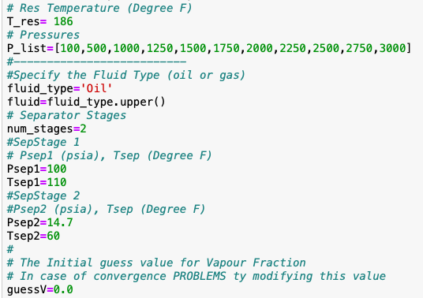
User Input (Example)

Slide 9
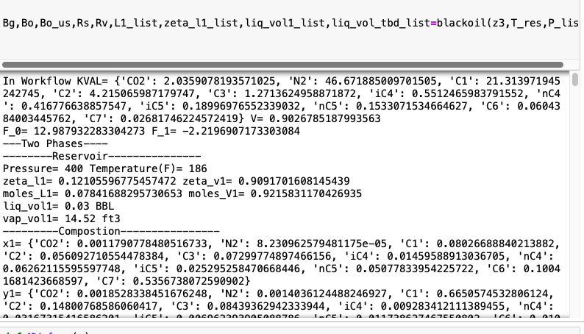
Execution

Slide 10
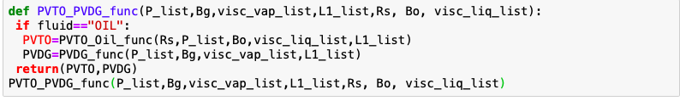
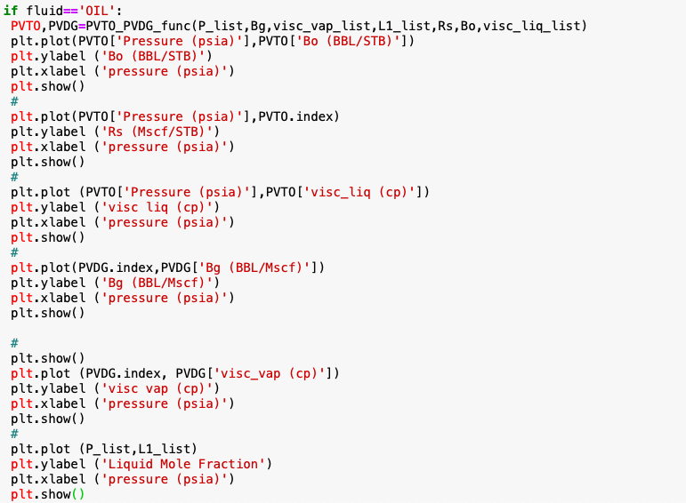
Execution

Slide 11
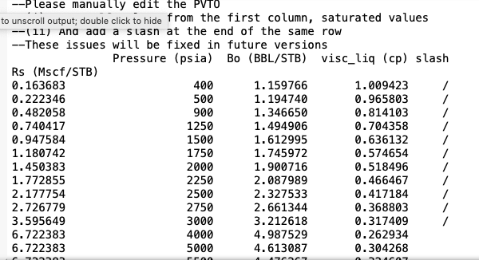
Output
Caution:
1.The PVTO Tables need to manually formatted as per the Eclipse Manual

Slide 12
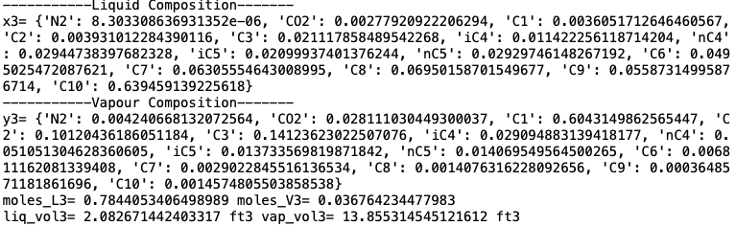
Liquid Composition(x3) and Vapour Composition(y3)
Note: Shall improve the presentation in the next Version

Slide 13
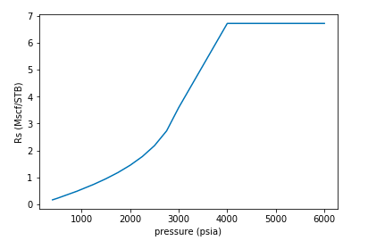
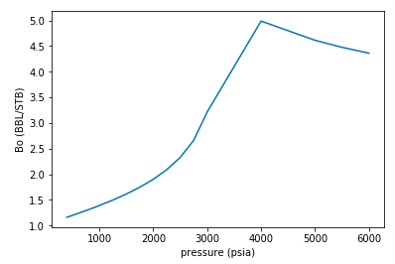
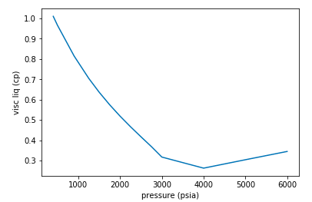
Output Plots (PVTO)
Bo vs Pressure
Rs vs Pressure
Visco vs Pressure
PVTO

Slide 14
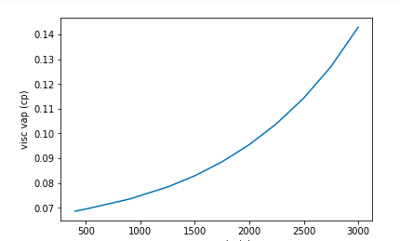
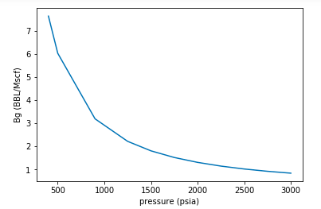
Output Plots (PVDG)
Visc vap vs Pressure
Bg vs Pressure

Slide 15
Step by Step Guide: GAS

Slide 16
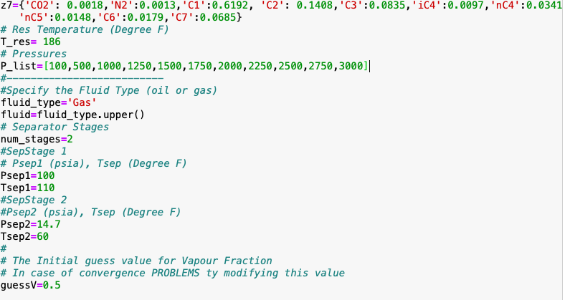
User Input

Slide 17
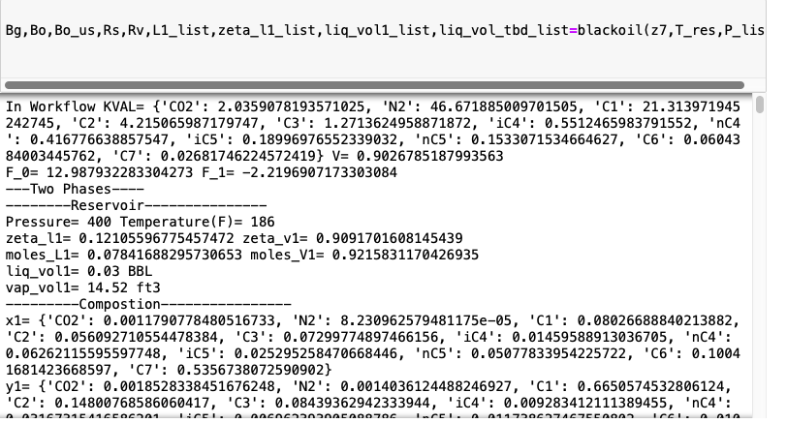
Execution

Slide 18
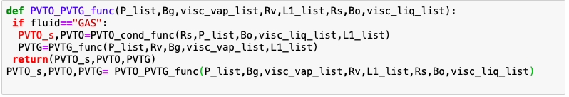
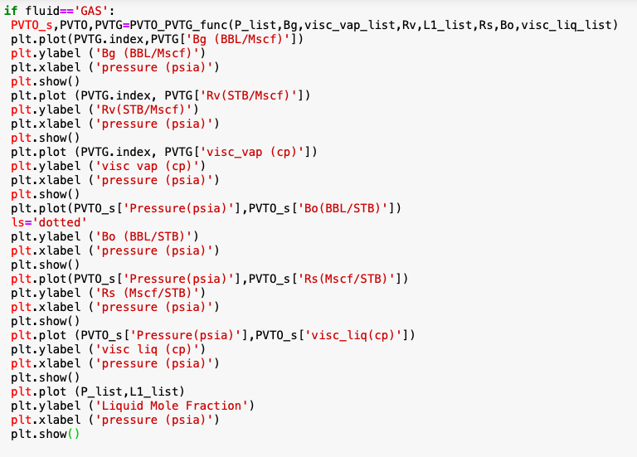
Execution

Slide 19
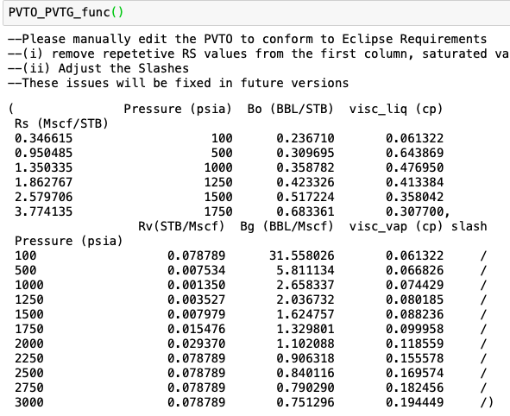
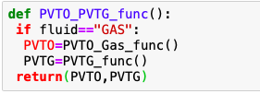
Output Functions
Caution:
1. The PVTO Tables need to manually formatted as per the Eclipse Manual
3. PVTG Table is as per Eclipse Input

Slide 20
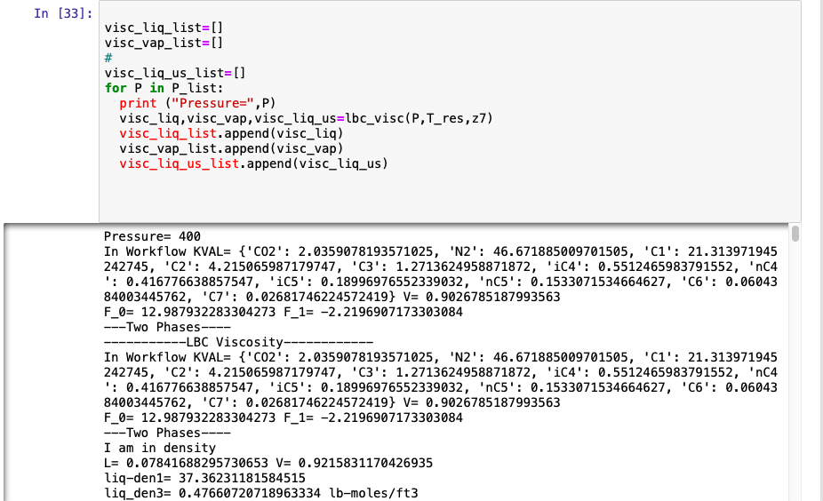
Output Functions

Slide 21
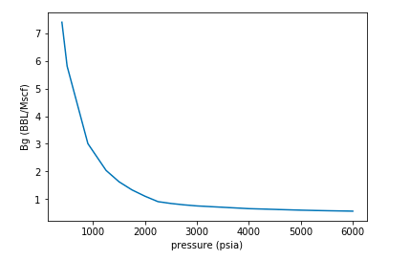
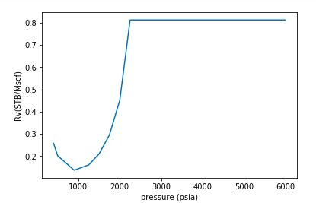
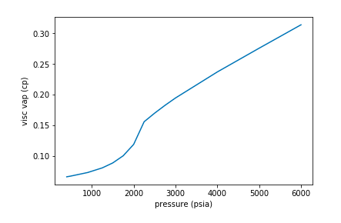
Output Plots (PVTG)
Bg vs Pressure
Rv vs Pressure
Viscg vs Pressure

Slide 22
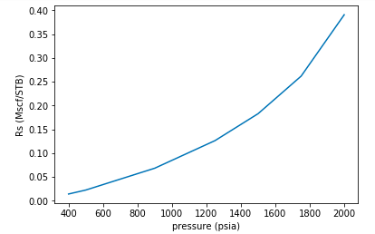
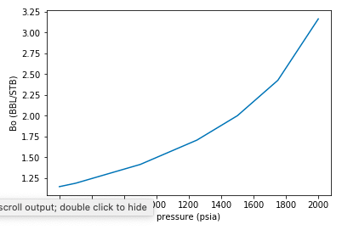
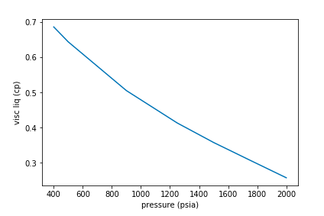
Output Plots (PVTO)
Bo vs Pressure
Rs vs Pressure
Visc liq vs Pressure
Note:
Undersaturated Lines are generated but not shown for
condensate

Slide 23
Future Work
In the Upcoming Versions:
Include Corresponding States Model (PEDERSEN) for Viscosity Calculation (Work In Progress)
More flexibility with the design of the Separators.
Develop the ability to produce more than one Undersaturated Lines.
Develop the ability to calculate First Contact Miscibility Pressure (FCMP)
Develop the ability to calculate Multiple Contact Miscibility Pressures MCMP and Ternary Diagrams
Develop the ability to carry out REGRESSION on Pc and Tc of the Heaviest Fraction to match the Experimental Data

