Slide 1







Exploring Global Trends in Programming Languages and Databases: Insights and Implications for the Tech Industry
Rania ElBarbary
December- 04 -2024

Slide 2



OUTLINE
Executive Summary
Introduction
Methodology
Results
Visualization – Charts
Dashboard
Discussion
Findings & Implications
Conclusion
Appendix

Slide 3

EXECUTIVE SUMMARY
Project Objective:
Analyze programming language and database trends based on global developer survey data.
Provide actionable insights for developers, organizations, and educators.
Key Insights:
Programming Languages: Highlighted the most popular languages, such as Python and JavaScript, alongside emerging trends like Go and Rust.
Databases: Identified widespread use of relational databases like MySQL and PostgreSQL and increasing interest in NoSQL solutions like MongoDB.
Developer Preferences:
Developers are increasingly drawn to scalable, developer-friendly, and future-proof technologies.
The desire to upskill in modern programming and database systems is evident.
Implications for Stakeholders:
Organizations can use these trends to align hiring and training strategies.
Developers can prioritize learning in-demand skills to remain competitive.
Conclusions:
The analysis underscores the dynamic nature of technology trends and the importance of continuous learning and adaptation.

Slide 4

INTRODUCTION
Background:
The technology industry is evolving rapidly, with new programming languages, tools, and databases emerging to meet growing demands for scalability and efficiency.
Understanding current trends and future preferences is essential for developers, organizations, and educators to stay competitive.
Purpose of the Analysis:
To explore global trends in programming languages and databases.To identify shifts in developer preferences and highlight areas of growth and opportunity.
Scope:
The analysis covers a wide range of topics, including demographic factors, current technology usage, and future aspirations.
Focused on two datasets:
one capturing developer demographics and the other their technology preferences.
Significance:
Provides actionable insights for stakeholders in the tech industry to align strategies with emerging trends.Helps developers and organizations understand how technological advancements influence skills and tool adoption.

Slide 5

METHODOLOGY
Data Collection:
Data was sourced from a global developer survey, capturing responses from diverse demographics and professional backgrounds.
Two key datasets were used: one focusing on demographics and another on technology preferences.
Data Cleaning and Preparation:
Removed incomplete or invalid entries to ensure data quality.
Normalized data formats and consolidated multi-response fields for easier analysis (e.g., combining multiple language preferences).
Analysis Techniques:
Descriptive Statistics:
Used to summarize the data (e.g., counts, percentages) for programming languages and databases.
Visualization: Created bar charts and other graphical representations to illustrate key trends.
Comparative Analysis:
Compared current preferences with future aspirations to identify shifts in trends.
Tools and Technologies:
Python was used for data analysis, leveraging libraries like Pandas and Matplotlib for data manipulation and visualization.
Microsoft Excel was utilized for initial data exploration and validation.
Key Metrics:
Focused on frequency counts for languages and databases, respondent demographics, and cross-tabulations to identify relationships between variables.
Limitations:
Some data entries were incomplete, which may have led to slight variations in overall trends.
Results are based on self-reported data and may reflect personal biases or regional influences.

Slide 6
RESULTS
Key results include:
- Most popular programming languages: JavaScript, HTML/CSS, SQL.
- Most desired programming languages: JavaScript, HTML/CSS, Python.
- Most popular databases: MySQL, Microsoft SQL Server, PostgreSQL.
- Most desired databases: PostgreSQL, MongoDB, Redis.

Slide 7
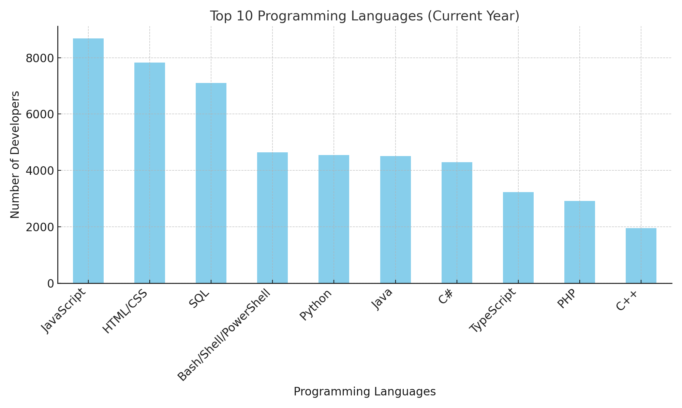
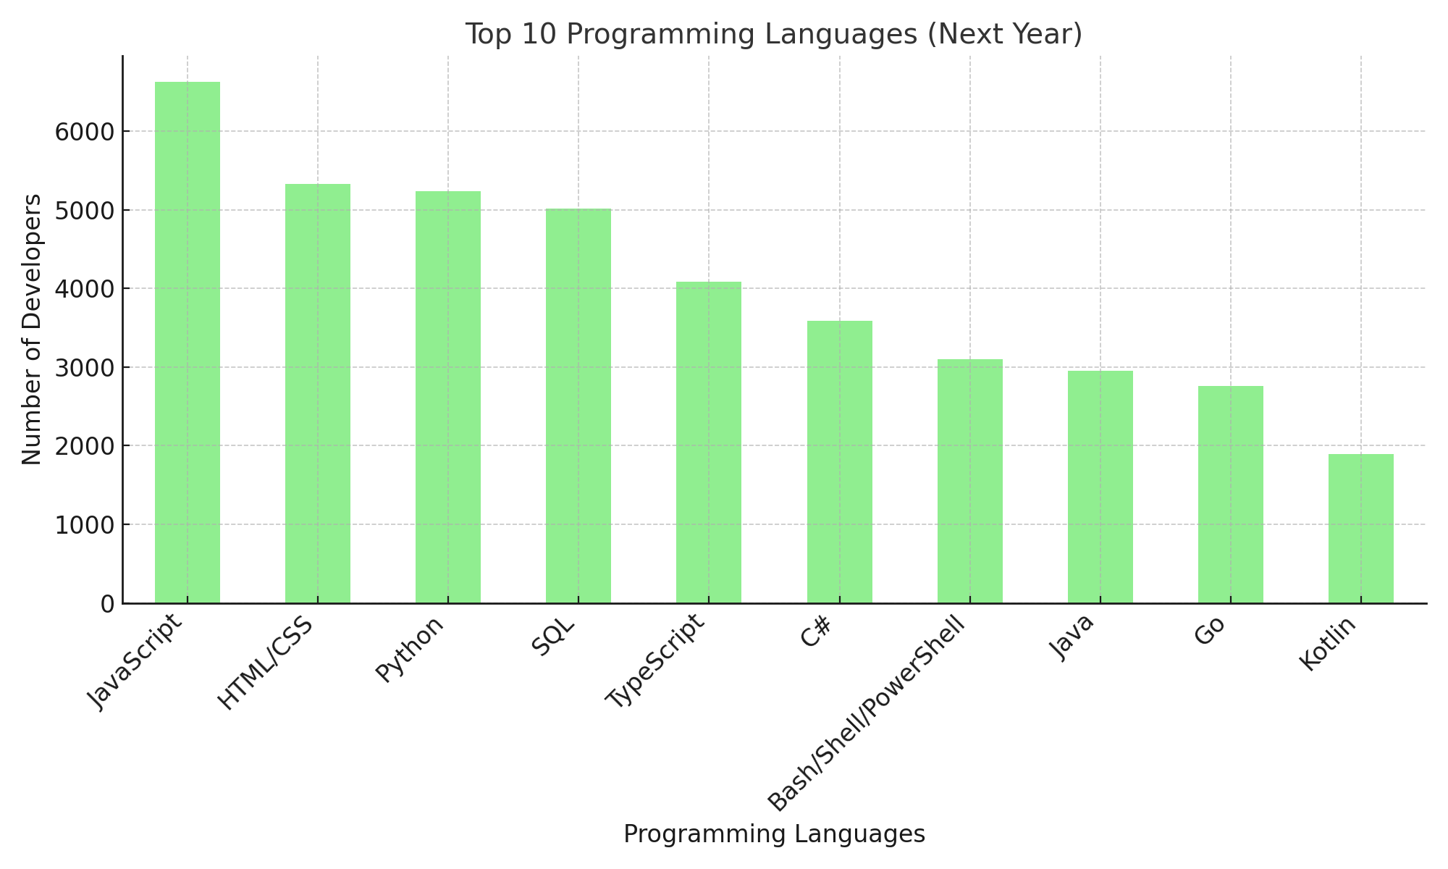
PROGRAMMING LANGUAGE TRENDS
Current Year
Next Year

Slide 8
PROGRAMMING LANGUAGE TRENDS - FINDINGS & IMPLICATIONS
Findings:
Dominance of Established Languages:
Languages like Python, JavaScript, and Java continue to dominate due to their versatility and widespread use.
Emerging Technologies:
Newer languages like Go and Rust show steady growth, driven by performance and modern application needs.
Developer Transition:
Many developers express interest in learning new languages, reflecting a focus on staying competitive and adapting to industry shifts.
Implications:
Industry Adoption:
Organizations should invest in training for emerging languages to future-proof their development teams.
Education and Upskilling:
Academic institutions and training providers should prioritize teaching modern languages alongside traditional ones.
Tooling and Ecosystem Growth:
Growth in newer languages may lead to an expanded ecosystem of libraries, tools, and community support.

Slide 9
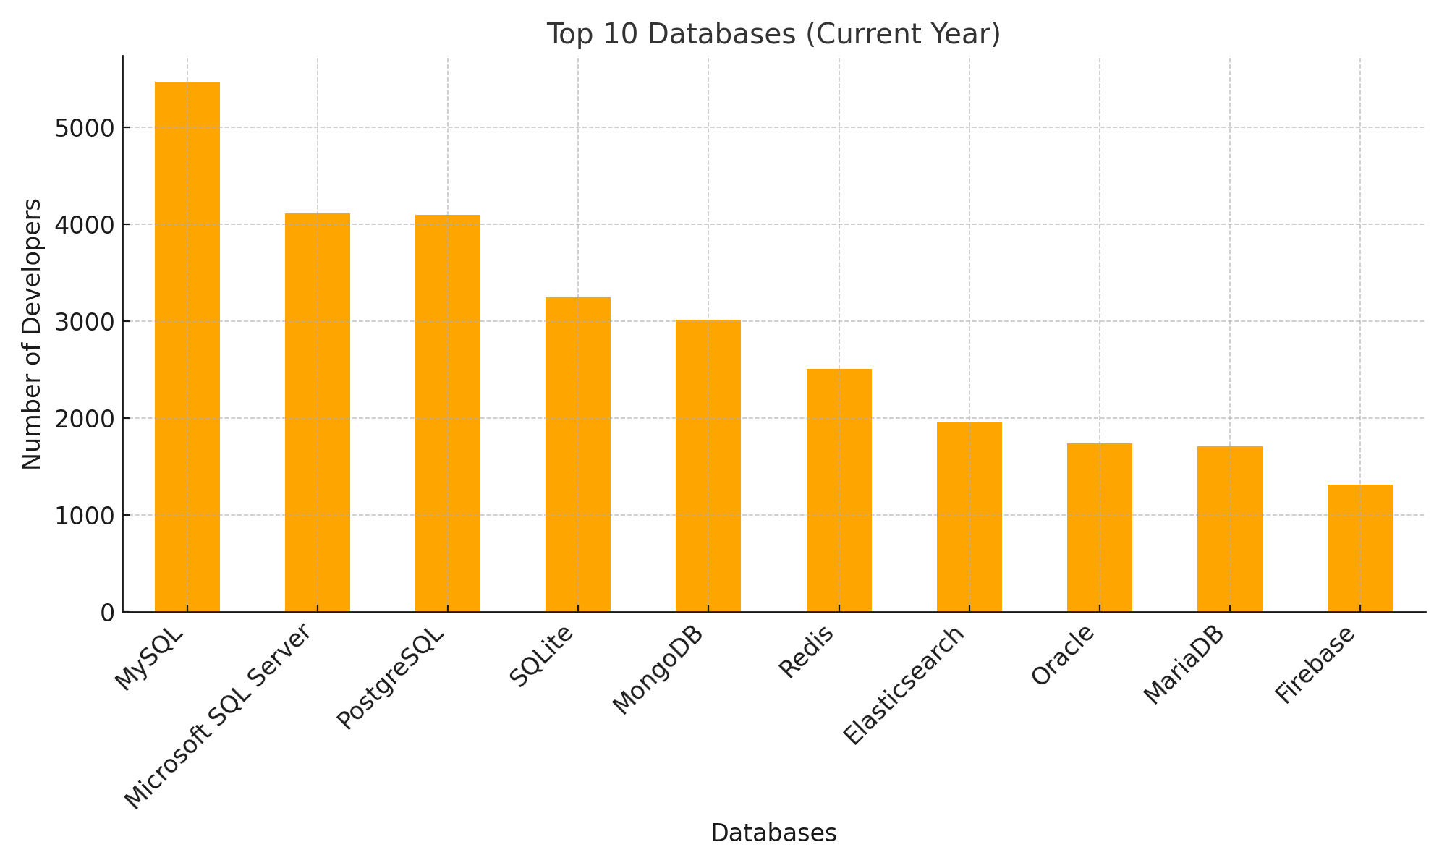
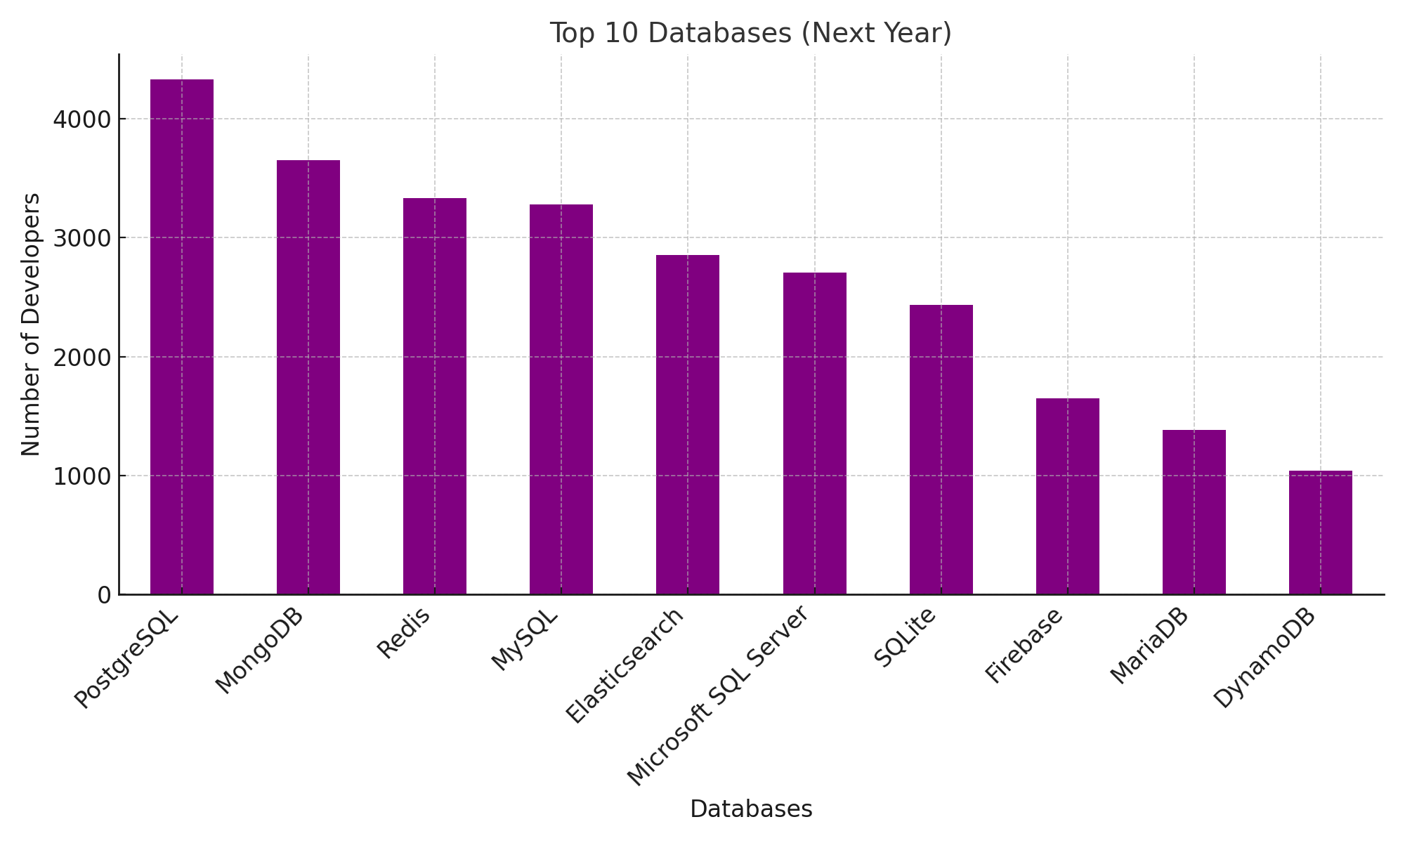
DATABASE TRENDS
Current Year
Next Year

Slide 10
DATABASE TRENDS - FINDINGS & IMPLICATIONS
Findings
Dominance of Relational Databases:
MySQL, PostgreSQL, and SQLite are the most widely used databases, reflecting their reliability and performance.
Emergence of NoSQL Databases:
MongoDB and Firebase show increasing popularity due to their scalability and suitability for real-time applications.
Shifting Preferences:
Developers express growing interest in learning NoSQL and cloud-based database solutions.
Implications
Strategic Focus on Modern Databases:
Organizations should consider adopting scalable database solutions to meet the growing demand for real-time applications.
Upskilling Opportunities:
Developers need to prioritize learning about NoSQL databases and cloud-native technologies to stay competitive.
Future-Proofing Technology Stacks:
Businesses can enhance operational efficiency by incorporating newer database technologies into their infrastructure.

Slide 11

DASHBOARD
<https://github.com/Eng-Raniabarabary/testrepo>

Slide 12
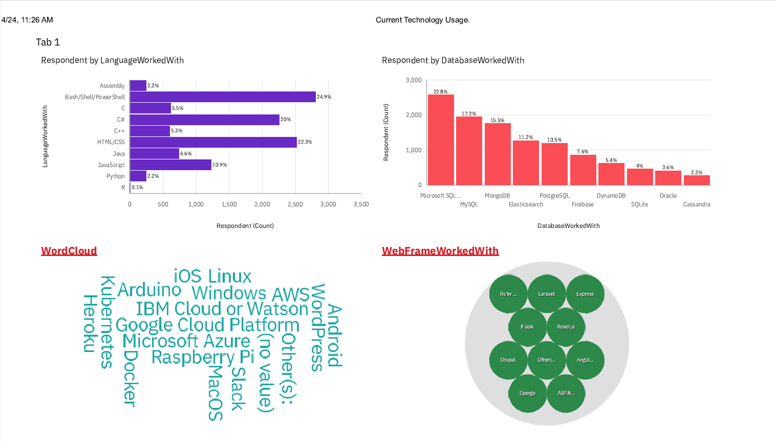
DASHBOARD TAB 1

Slide 13
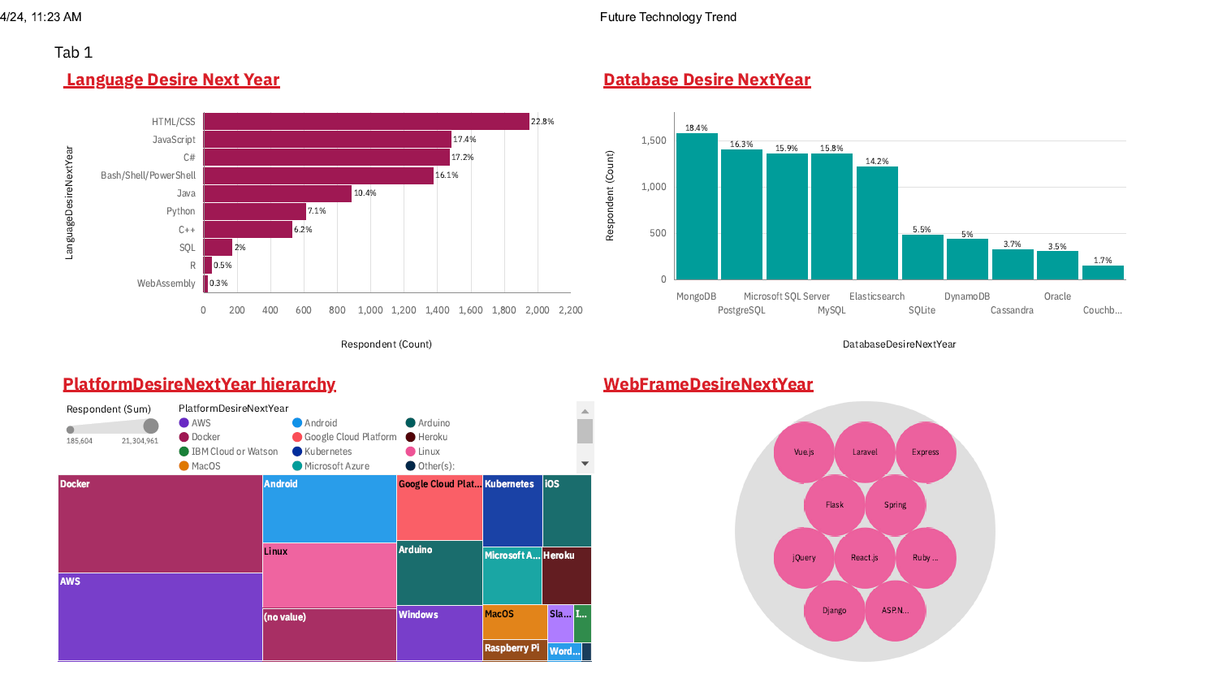
DASHBOARD TAB 2

Slide 14
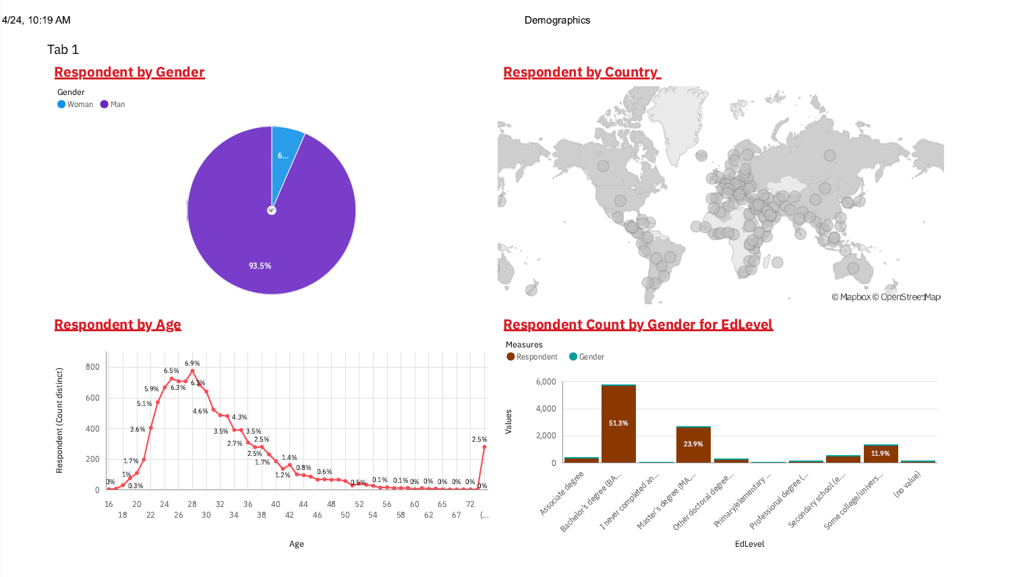
DASHBOARD TAB 3

Slide 15
DISCUSSION
1. What factors influence programming language preferences?
2. How do industry trends affect database choices?
3. What skills should developers focus on for the future?

Slide 16
OVERALL FINDINGS & IMPLICATIONS
Findings
Programming Languages:
Python, JavaScript, and Java remain dominant, with increased interest in emerging languages like Go and Rust.
Databases:
Relational databases like MySQL and PostgreSQL are widely used, with growing attention to NoSQL options like MongoDB.
Developer Focus:
Clear trends in upskilling indicate a strong focus on cloud-based and scalable technologies.
Implications
Industry Growth:
Businesses should invest in modern programming languages and databases to maintain competitive advantages.
Skill Development:
Developers need to stay agile, learning in-demand technologies to align with market demands.
Strategic Planning:
Organizations can optimize their technology stacks by balancing current tools with emerging trends.

Slide 17

CONCLUSION
Key Insights:
The analysis highlights significant trends in programming languages and databases, emphasizing the importance of continuous learning and adaptation in the tech industry.
Python, JavaScript, and Java dominate current programming preferences, while emerging languages like Go and Rust gain traction.
Developer and Industry Alignment:
Developers are proactively focusing on upskilling in cloud-based and scalable technologies.
Businesses are shifting toward modern database solutions like NoSQL to meet evolving application demands.
Actionable Recommendations:
Organizations should strategically align training and recruitment efforts to adopt modern technologies.
Developers should prioritize learning in-demand programming languages and database systems to remain competitive.
Closing Thoughts:
The dynamic nature of the tech industry requires adaptability, collaboration, and a forward-looking approach to technology adoption.

Slide 18

APPENDIX
Additional Charts:
Include bar charts showcasing:
Full distribution of programming languages used by respondents.
Complete breakdown of desired databases for the next year.
Comparative visualizations of usage trends between current and future technologies.
Tables:
Summarized data tables showing:
Frequency counts of the most popular programming languages and databases.
Regional or demographic-specific trends, if relevant (e.g., preferences by age group or employment status).
Raw Data Insights:
Highlight any interesting outliers or unique findings from the data, such as rare languages or databases with niche but strong followings.
Supplementary Materials:
References to methodology steps, such as cleaning, processing, or visualizing the data.
Links to resources or datasets used in the analysis for further exploration.

Slide 19
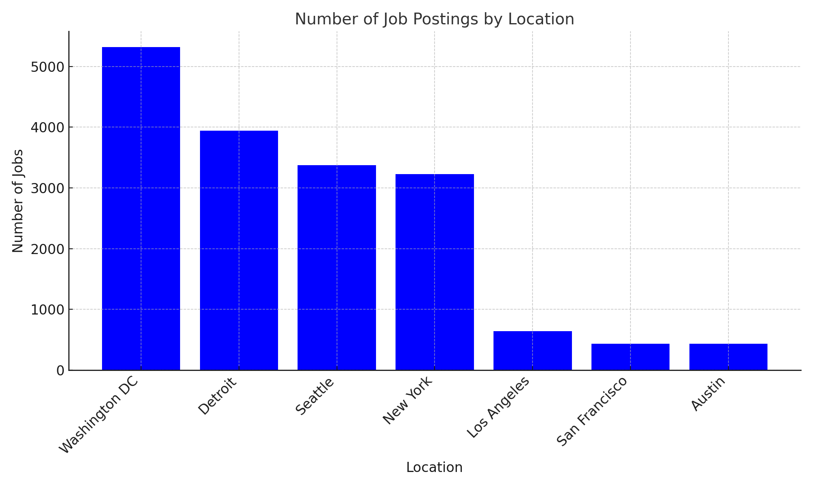
JOB POSTINGS

Slide 20
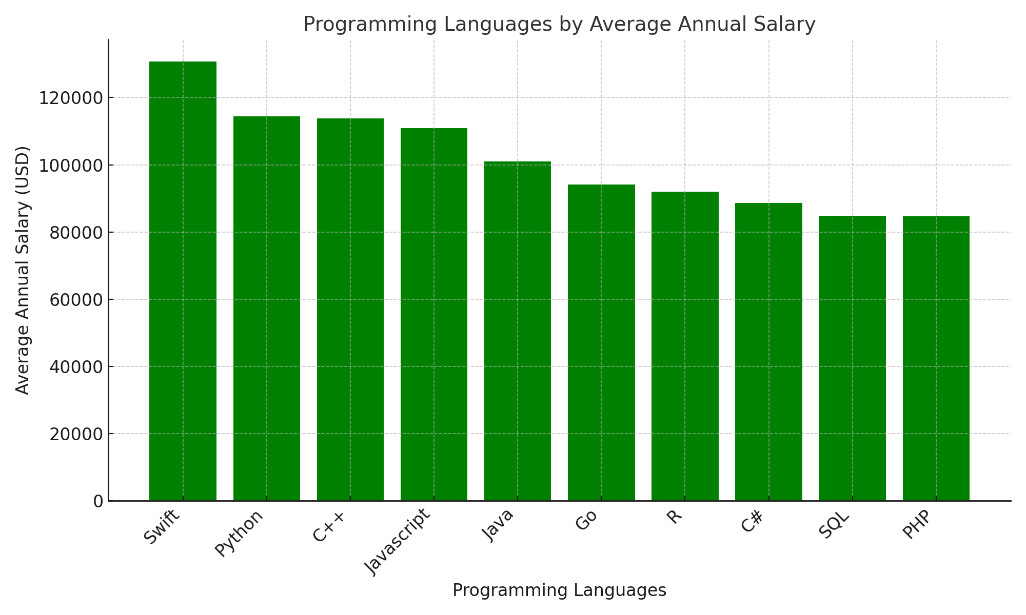
POPULAR LANGUAGES

