Slide 1

Information Networks
GROUP K

Slide 2
Outline
Computer Networks
Topologies of LAN
Models of LAN
Routers, Bridges, & Gateways
Internet

Slide 3
Computer Networks
– A computer network is a group of computers linked to each other that enables
the computer to communicate with another computer and share their
resources, data, and applications.
– A computer network can be categorized by their size. A computer network is
mainly of four types:
PAN (Personal Area Network)
LAN (Local Area Network)
MAN (Metropolitan Area Network)
WAN (Wide Area Network)

Slide 4
Personal Area Network
Personal Area Network is a network arranged within a person, typically within a
range of 10 meters.
Personal Area Network is used for connecting the computer devices of personal use
is known as Personal Area Network.
Personal computer devices that are used to develop the personal area network are
the laptop, mobile phones, media player and play stations.
There are two types of Personal Area Network:
Wired Personal Area Network
Wireless Personal Area Network
Examples: Body Area Network (Hotspot), Offline Network (Devices), Small Home Office (VPN)

Slide 5
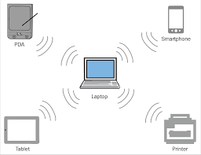
Personal Area Network

Slide 6
Local Area Network
– Local Area Network is a group of computers connected in a small area such as
building, office.
– LAN is used for connecting two or more personal computers through a
communication medium such as twisted pair, coaxial cable, etc.
It is less costly as it is built with inexpensive hardware such as hubs, network adapters, and ethernet cables.
The data is transferred at an extremely faster rate in Local Area Network.
Local Area Network provides higher security.

Slide 7
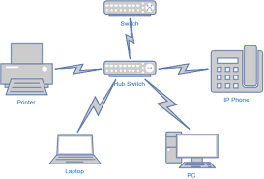
Local Area Network

Slide 8
Metropolitan Area Network
A metropolitan area network is a network that covers a larger geographic area by
interconnecting a different LAN to form a larger network.
Government agencies use MAN to connect to the citizens and private industries.
In MAN, various LANs are connected through a telephone exchange line.
It has a higher range than the Local Area Network (LAN).
Uses of Metropolitan Area Network:
MAN is used in communication between the banks in a city.
It can be used in an Airline Reservation.
It can be used in a college within a city.
It can also be used for communication in the military.

Slide 9
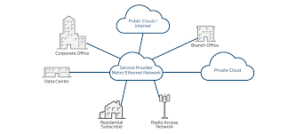
Metropolitan Area Network

Slide 10
Wide Area Network
A Wide Area Network is a network that extends over a large geographical area
such as states or countries.
A Wide Area Network is quite a bigger network than the LAN.
A Wide Area Network is not limited to a single location, but it spans over a large geographical area through a telephone line, fiber optic cable or satellite links.
The internet is one of the biggest WAN in the world.
A Wide Area Network is widely used in the field of Business, government, and
education.

Slide 11
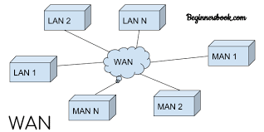
Wide Area Network

Slide 12
Topologies of LAN
Topology defines the structure of the network of how all the components are interconnected to each other.
There are various types of Topologies, some are listed below:
Bus
Ring
Star
Mesh
Hybrid

Slide 13
Bus Topology
The bus topology is designed in such a way that all the stations are connected
through a single cable known as a backbone cable.
Each node is either connected to the backbone cable by drop cable or directly
connected to the backbone cable.
When a node wants to send a message over the network, it puts a message over the
network.
All the stations available in the network will receive the message whether it has
been addressed or not.
The bus topology is mainly used in 802.3 (ethernet) and 802.4 standard networks.
The configuration of a bus topology is quite simpler as compared to other topologies.

Slide 14
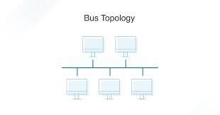
Bus Topology

Slide 15
Ring Topology
Ring topology is like a bus topology, but with connected ends.
The node that receives the message from the previous computer will retransmit
to the next node.
The data flows in one direction, i.e., it is unidirectional.
The data flows in a single loop continuously known as an endless loop.
It has no terminated ends, i.e., each node is connected to other node and
having no termination point.
The data in a ring topology flow in a clockwise direction.

Slide 16
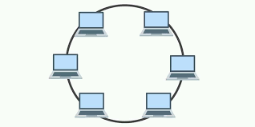
Ring Topology

Slide 17
Star Topology
Star topology is an arrangement of the network in which every node is
connected to the central hub, switch or a central computer.
The central computer is known as a server, and the peripheral devices attached
to the server are known as clients.
Coaxial cable or RJ-45 cables are used to connect the computers.
Hubs or Switches are mainly used as connected devices in a physical star
topology.
Star topology is the most popular topology in network implementation.

Slide 18
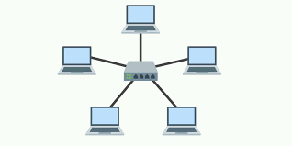
Star Topology

Slide 19
Mesh Topology
Mesh technology is an arrangement of the network in which computers are interconnected with each other through various redundant connections.
There are multiple paths from one computer to another computer.
It does not contain the switch, hub or any central computer which acts as a
central point of communication.
The Internet is an example of the mesh topology.
Mesh topology is mainly used for WAN implementations where communication failures are a critical concern.
Mesh topology is mainly used for wireless networks.

Slide 20
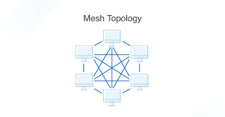
Mesh Topology

Slide 21
Hybrid Topology
The combination of various topologies is known as Hybrid topology.
A hybrid topology is a connection between different links and nodes to transfer
the data.
When two or more different topologies are combined is termed as Hybrid topology and if similar topologies are connected will not result in Hybrid topology.

Slide 22
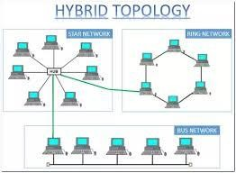
Hybrid Topology

Slide 23
Models of LAN
There are two types of model in LAN:
Client-Server
Main Computer is known as Server whereas computer on networks are called clients.
Server provides that resources need by the client to preform its duties.
Peer-to-Peer
In peer-to-peer all computers are connected to each other directly.
They share their resources with each other without the middle man.

Slide 24
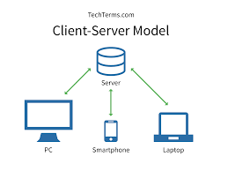
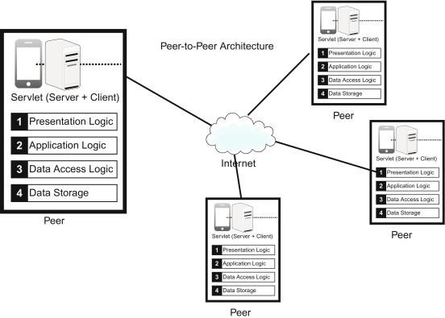
Client-Sever & Peer-to-Peer Network Architecture

Slide 25
Routers, Bridges, & Gateways
Router
It is a special computer that oversees the communication between several networks
connected together.
Bridge
It is a combination of hardware and software that connect same types of networks.
Gateway
It enables communication between different networks having different structures
and standards.

Slide 26
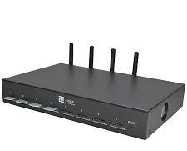
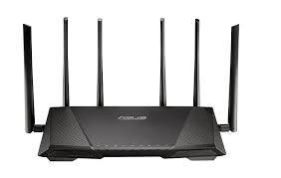
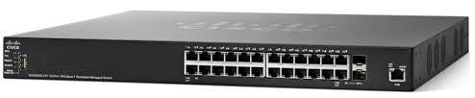
Router, Bridge, & Gateway

