Slide 1

MITRE ATT&CK T1566
NIST SP 800-61
SANS IH
INCIDENT RESPONSE
& PLAYBOOK
Phishing Attack Detection, Containment & Recovery
Team: Mohamed Abbasy | Mohamed Hesham | Marvel Ghobrial
Supervisor: Eng. Mohamed | Course: Incident Response | 2026

Slide 2
TEAM CONTRIBUTIONS
M
M
M
PRESENTER
RESEARCH LEAD
DESIGN LEAD
Mohamed Ahmed Abbasy
Mohamed Hesham Farouk
Marvel Ghobrial
Project Manager & Team Lead
Security Specialist & Researcher
Design Lead & Documentation
› Project planning, timeline & GitHub management
› Literature review — NIST 800-61, SANS, MITRE
› Detection, Containment & Recovery from Cyber Threats
› Presentation delivery & project overview
› 6-Phase IR Playbook detailed content
› Phishing Project Playbook
› Simulation scenario & Final Report

Slide 3
PROJECT OVERVIEW
OBJECTIVE
STANDARDS ALIGNMENT
Design a structured and practical Incident Response Playbook to effectively detect, contain, eradicate, and recover from phishing attacks within small-to-medium organizations.
✦ MITRE ATT&CK — Technique T1566
✦ NIST SP 800-61 Rev. 2
✦ SANS Incident Handler's Handbook
6
10+
4
5h
Playbook Phases
Functional Req.
UML Diagrams
Containment Time
⚠ SCOPE NOTE: This project focuses on the Design Phase of the SDLC. Implementation and testing phases are out of scope per project requirements.

Slide 4

Incident Response
Detection, Containment & Recovery from Cyber Threats
Presented by : Marvel Ghobrial
Cybersecurity Incident Response | 2026
Notes:
Welcome slide. Introduce your names, university/course, and date. The presentation covers both the theoretical IR lifecycle and a practical phishing-to-ransomware scenario.

Slide 5
Agenda
Introduction to Incident Response
Phase-by-Phase Walkthrough
01
04
Definition, objectives, and importance
Detection, containment, eradication & recovery
IR Lifecycle
Post-Incident Analysis (PIA)
02
05
Six phases: Preparation → Lessons Learned
Findings, business impact, and improvements
Real-World Scenario
Key Takeaways
03
06
Phishing attack leading to ransomware
Lessons learned and recommendations
Notes:
Walk through the agenda briefly. This presentation is split into theory and practice — first the lifecycle model, then a live scenario.

Slide 6




What is Incident Response?
"A structured and organized approach to detect, analyze, contain, eradicate, and recover from cybersecurity incidents — protecting operations, data, and reputation."
Stop Attacks
Protect Data
Business Continuity
Ensure Compliance
Quickly detect and halt active threats before major damage occurs.
Safeguard sensitive information and preserve digital evidence.
Minimize downtime and restore normal operations swiftly.
Meet regulatory and cybersecurity standard requirements.
Growing Threats: Phishing • Ransomware • Malware • Data Breaches
Notes:
Emphasize that IR is not just a technical process — it is a business-critical function. Organizations that lack a formal IR plan suffer longer downtime and greater financial loss.

Slide 7






Incident Response Lifecycle
1
2
3
4
5
6
Preparation
Detection & Analysis
Containment
Eradication
Recovery
Lessons Learned
"A continuous cycle — each incident strengthens future security posture."
Notes:
This is the NIST-aligned IR lifecycle. Emphasize that it is cyclical — Lessons Learned feeds back into Preparation. The six phases will each be covered in detail on the following slides.

Slide 8
Phase 1: Preparation | Phase 2: Detection & Analysis
1. Preparation
2. Detection & Analysis
Building readiness before any incident occurs
Monitor and analyze suspicious activities to identify threats
Firewalls & Antivirus solutions
SIEM monitoring systems
Backup & recovery strategies
Security awareness training
Incident Response Playbook
Antivirus & EDR alerts
Email security flagging
Event logs review
Network monitoring tools
SOC triage: true vs. false positive
Goal: Ensure the organization is ready to respond effectively to any cyber threat.
SOC team determines severity and classifies: High / Medium / Low incident.
Notes:
Preparation is the most impactful phase — organizations with mature IR plans recover 3x faster. Detection quality depends on tooling AND trained analysts.

Slide 9
Phase 3: Containment | Phase 4: Eradication
3. Containment
4. Eradication
Prevent the attack from spreading further across the network
Completely remove the root cause from the environment
Isolate infected systems from network
Disable compromised user accounts
Block malicious domains & IP addresses
Enforce MFA on critical accounts
Block SMB lateral movement paths
Delete malware and malicious files
Remove malicious registry entries
Disable PowerShell persistence
Apply security patches & updates
Terminate unauthorized sessions
Goal: Minimize organizational impact and prevent lateral movement.
Goal: Ensure the threat no longer exists anywhere in the environment.
Notes:
Containment is time-critical — every minute of delay risks lateral movement. Eradication must be thorough; partial removal leads to reinfection.

Slide 10

Phase 5: Recovery | Phase 6: Lessons Learned
5. Recovery
6. Lessons Learned
Restore systems and services safely to normal operations
Post-incident review to strengthen future readiness
Restore systems from clean backups
Gradually reconnect workstations
Verify critical business services
Monitor for reinfection attempts
Confirm business operations resume
What happened and how the attack succeeded
Identify weaknesses in security controls
Review SOC response effectiveness
Update playbooks and detection rules
Plan targeted training and improvements
Goal: Resume normal operations with no active threats remaining.
Goal: Improve future IR readiness and overall security posture.
Notes:
Recovery must include validation — not just restoration. Lessons Learned is the most neglected phase but delivers the highest long-term ROI in security improvements.

Slide 11



Real-World Scenario: Phishing → Ransomware Attack
Phishing Email
Employee Opens
Malware Runs
C2 Contact
Credential Theft
Ransomware
HR impersonation
.pdf.exe attachment
Endpoint compromised
External malicious IP
Attempted password grab
Encryption initiated
Phishing Email Details
SOC Alerts Triggered
Target: Finance Department employees
Sender: Impersonated HR Department
Subject: "Updated Salary Adjustment Report 2026"
Attachment: Salary_Adjustment_2026.pdf.exe
Used company branding to appear legitimate
Antivirus: suspicious PowerShell activity
SIEM: unusual outbound traffic alert
Email GW: malicious attachment flagged
Multiple failed login attempts detected
Classification: HIGH SEVERITY INCIDENT
Notes:
This scenario is realistic — double-extension filenames (.pdf.exe) are a common social engineering tactic. The email spoofed internal HR branding to maximize trust.

Slide 12

Initial Triage → Containment Actions
Initial Triage — SOC Analysis
Containment Actions
Analyze email headers & SPF/DKIM
Endpoint
Isolated from network
Removed from AD communication
SMB blocked
Review malicious attachment behavior
Confirm if user executed the file
Account
User account disabled
Forced password reset
MFA enforced
Identify affected systems & scope
Finding: Malware executed · Malicious C2 contact confirmed · Credential theft detected
Review EDR & antivirus alerts
Network
Malicious IPs blocked on firewall
Domains blacklisted
Phishing email removed from all inboxes
Notes:
Triage quality determines response speed. The containment was three-pronged: endpoint, account, and network — covering all possible propagation vectors.

Slide 13



Eradication → Recovery → Monitoring
Eradication
Recovery
Post-Recovery Monitoring
Delete malware & malicious files
Remove registry persistence entries
Disable PowerShell persistence
Full AV & EDR scans performed
Patch vulnerabilities identified
Restore from clean verified backups
Reconnect workstations gradually
Verify all critical services
Resume business operations carefully
Confirm no active malware remains
SIEM monitoring intensified
Endpoint behavior analysis enabled
Network traffic watched continuously
IOC detection rules updated
Extra phishing rules deployed
Notes:
Eradication must be verified before recovery begins — restoring infected systems defeats the purpose. Post-recovery monitoring is critical in the first 72 hours.

Slide 14

Post-Incident Analysis (PIA) & Lessons Learned
Findings | Recommendations
Phishing email bypassed user trust | Conduct advanced phishing awareness training
MFA was not fully enforced | Implement organization-wide MFA immediately
Detection occurred after malware executed | Deploy pre-execution endpoint protection
User awareness needed improvement | Strengthen email filtering and simulation drills
Lateral movement paths were open | Enhance endpoint monitoring & network segmentation
Business Impact:
Finance dept. disruption • Limited downtime • Risk of data exposure • Increased SOC workload — contained without major data loss.
Notes:
The PIA should be conducted within 72 hours post-incident while details are fresh. Present findings to management with concrete remediation timelines.

Slide 15






Key Takeaways
IR is a Business Function
Process Matters
Early Detection is Critical
Not just technical — protects reputation, operations, and regulatory standing.
A structured 6-phase lifecycle ensures faster, more effective incident resolution.
The sooner an incident is detected, the less damage and cost it causes.
Team Coordination
Continuous Improvement
People Are the Perimeter
SOC, IT, management, and legal must work together during and after an incident.
Every incident is a learning opportunity to strengthen future defenses.
Security awareness training is the most cost-effective defense against phishing.
Notes:
Summarize the presentation here. Reiterate that IR is both proactive and reactive — the scenario demonstrated how every phase of the lifecycle played out in a real attack.

Slide 16
"Incident Response is not only a technical process,
but a critical business function that protects operations,
data, and reputation against evolving cyber threats."
Questions & Discussion Welcome
Notes:
End with the closing quote and invite questions. Be prepared to discuss the PIA findings and any specific technical details from the phishing scenario.

Slide 17
MITRE ATT&CK T1566
NIST SP 800-61
SANS PICERL
🛡
PLAYBOOK
Bank Notification Phishing — SILVER PHANTOM Simulation
SEVERITY: HIGH
APT: SILVER PHANTOM
Target: Sarah Chen — Junior Accountant @ FinServe Corp.
Duration: 09:00–14:00 | Attack: T1566.002 Spearphishing Link
Supervisor: Eng. Mohamed | Incident Response Course — 2026

Slide 18
SIMULATION SCENARIO
Real-world phishing attack walkthrough — Bank Notification Impersonation
SCENARIO: An employee at a mid-size financial firm receives an email impersonating their bank, urging them to verify account details via a malicious link. The email bypasses the spam filter due to a spoofed legitimate domain.
09:00
Detection
10:30
Containment
Phishing email received
Domain blocked, endpoint isolated, account suspended
09:15
Compromised
12:00
Eradication
Employee clicks link — credentials entered
Malware removed, credentials reset, patches applied
09:30
Report
14:00
Recovery
Employee reports suspicious activity to IT
Systems restored, monitoring initiated (72 hrs)
09:45
Identification
Next Day
Closure
SOC Analyst confirms phishing — IoCs identified
Lessons learned meeting — Playbook updated
10:00
Phase 2 Start
Playbook activated — Incident ticket created

Slide 19
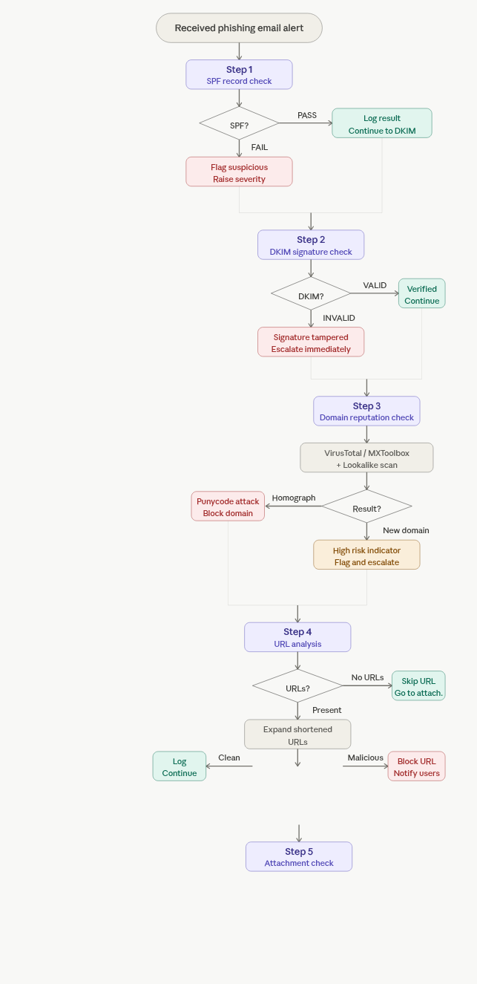

Slide 21
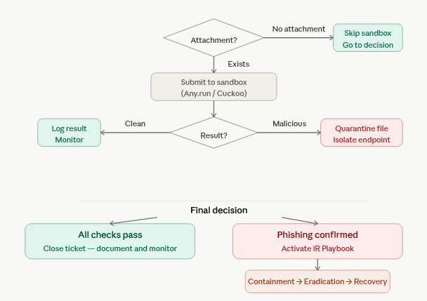

Slide 22
LITERATURE REVIEW
NIST SP 800-61 Rev.2
Computer Security Incident Handling Guide
› 4-phase lifecycle: Preparation → Detection → Containment → Recovery
› Standardized incident categorization & priority levels
› Evidence handling and documentation requirements
› Foundation for our playbook structure

Slide 23
LITERATURE REVIEW
SANS Institute
Incident Handler's Handbook
› Extended 6-phase PICERL model adopted in this project
› Forensic preservation best practices
› Communication protocols during active incidents
› Post-incident lessons learned methodology

Slide 24
LITERATURE REVIEW
MITRE ATT&CK T1566
Phishing — Tactics, Techniques & Procedures
› Sub-techniques: T1566.001 (Spear), .002 (Link), .003 (Service)
› Adversary behavioral mapping to defensive controls
› Detection logic: email gateway alerts & user reports
› Mitigation: MFA, email filtering, security awareness

Slide 25
01 SCENARIO OVERVIEW
Organization: FinServe Corp. — Banking & Financial Services
Organization
FinServe Corp. (Mid-Size Financial Firm)
TECHNICAL DECEPTION INDICATORS
Domain
✗ securebänk.com (Punycode)
Target
Sarah Chen — Junior Accountant
SPF
✗ FAIL
Attack Vector
Spear Phishing Email (T1566.002)
DKIM
✗ INVALID
Threat Actor
APT Group SILVER PHANTOM (Assumed)
DMARC
✗ MISALIGN
Duration
09:00 – 14:00 (5 Hours Total)
IP
✗ 185.220.101.47 (Bulletproof)
Impact
Credential Compromise + Potential Wire Fraud
SSL
✗ Self-Signed / No SSL

Slide 26
02 THE BAIT — PHISHING EMAIL
Spearphishing Link Technique — MITRE T1566.002
📧 EMAIL CLIENT — sarah.chen@finserve.com
RED FLAGS IDENTIFIED
From:
security@securebänk.com ⚠ (securebxnk.com)
Homograph domain: ä vs a
(Punycode attack)
To:
sarah.chen@finserve.com
Subject:
⚠️ Urgent: Account Verification Required
Urgency language:
"24 hours" pressure
Date:
Mon, 19 May 2026 08:58:23 +0200
SPF / DKIM / DMARC
all FAIL on header check
Dear Valued Customer,
HTTP link — no SSL
certificate
We have detected unusual login activity on your
business account. Your account has been temporarily
restricted pending verification.
Sender IP on
Bulletproof hosting
Please verify your account within 24 hours to
VERIFY ACCOUNT NOW →
avoid service disruption.

Slide 27
03 ATTACK TIMELINE
Full timeline from email delivery to 72-hour recovery monitoring
08:58
Initial Access
T1566.002
09:45
Identification
—
Phishing email delivered to inbox
SOC Analyst confirms phishing
09:00
Execution
T1204.001
10:00
Preparation
—
Sarah opens email
IR Playbook activated
09:02
Execution
T1204.001
10:30
Containment
T1485
Clicks malicious link
Domain blocked, endpoint isolated
09:05
Credential Access
T1003
12:00
Eradication
T1205
Enters credentials on fake page
Malware removed, creds reset
09:06
Exfiltration
T1041
13:00
Recovery
—
Credentials sent to C2 server
Systems restored from backup
09:15
Lateral Movement
T1021
14:00
Recovery
—
Attacker logs in with stolen creds
72-hour monitoring initiated
09:30
Detection
—
Sarah reports suspicious activity

Slide 28
04 PHASE 1 & 2 — PREPARATION + IDENTIFICATION
SANS PICERL Model — Phases 1 and 2
1 PREPARATION
2 IDENTIFICATION
🎓
Security Awareness
🔔
SIEM Alert Triggered
Quarterly phishing simulations & training for all employees
Rule: Suspicious login from foreign IP 185.220.101.47
📧
Email Gateway Controls
🔎
Email Header Analysis
SPF / DKIM / DMARC enforced — alerts on failure
SPF FAIL • DKIM INVALID • Punycode domain detected
📊
SIEM Monitoring
🧪
URL Sandbox
Splunk with correlation rules for suspicious logins
securebänk-verify.com → credential harvester confirmed
👥
IR Team & Roles
📝
IoC Documentation
SOC Analyst, IR Lead, IT Admin, Legal — pre-defined
Domain + IP + MD5 hash logged in incident ticket
🎫
Incident Ticketing
⚠️
Severity: HIGH
ServiceNow integration — auto-ticket on SIEM alert
Confirmed compromise — IR Playbook activation triggered

Slide 29
05 PHASE 3 & 4 — CONTAINMENT + ERADICATION
Stopping the threat and removing all malicious artifacts
3 CONTAINMENT
4 ERADICATION
🚫
Block Malicious Domain
🔬
Full AV / EDR Scan
securebänk-verify.com blocked at DNS + firewall
Endpoint scanned — update.exe (MD5 d41d8c…) removed
🔌
Isolate Endpoint
🗑️
Clear Malicious Artifacts
WS-ACCT-042 removed from network — VLAN quarantine
AppData\Temp cleared, browser cache wiped
🔒
Disable Account
🔑
Reset All Credentials
sarah.chen account suspended — all sessions revoked
Sarah + shared accounts — force password + MFA reset
🔥
Block C2 IP
📨
Recall Phishing Email
185.220.101.47 blocked on perimeter firewall
Email recalled from all FinServe recipients
📢
Notify Stakeholders
🔍
Verify Clean State
IR Lead, Legal, and affected department notified
Re-scan confirms no persistence — IOCs absent

Slide 30
06 PHASE 5 & 6 — RECOVERY + LESSONS LEARNED
Restoring operations and improving future defenses
5 RECOVERY
6 LESSONS LEARNED
💾
Reimage Endpoint
🔍
Root Cause
WS-ACCT-042 reimaged from clean gold image
Homograph / Punycode attack bypassed visual inspection
✅
Re-enable Account
⚠️
Gap Identified
sarah.chen restored — MFA enforced on login
No Punycode detection in email gateway — critical gap
👁️
72-hr Enhanced Monitoring
🔧
Fix Applied
SIEM watchlist active — any IoC triggers alert
Internationalized domain filtering deployed
🏢
Verify Business Ops
🛡️
MFA Would Have Stopped
Finance confirmed — no wire transfers initiated
Account takeover prevented even with stolen password
📋
Status Communication
📊
KPIs All Met
Management briefed — incident closed at 14:00
MTTD 45min ✅ | MTTC 90min ✅ | MTTR 5hrs ✅

Slide 31
07 FORENSIC ARTIFACTS
Evidence collected during investigation — Email · Network · Endpoint
EMAIL ARTIFACTS
NETWORK INDICATORS
ENDPOINT ARTIFACTS
› Message-ID: <a1b2c3d4@securebxnk.com>
Malicious Domain
Malware Path
securebänk-verify.com
AppData\Local\Temp\update.exe
› X-Mailer: PHPMailer 6.5.0 (spoofed)
IP Address
MD5 Hash
185.220.101.47
d41d8cd98f00b204e9800998ecf8427e
› Received from: mail.securebxnk.com
POST Request
Browser History
POST /api/collect HTTP/1.1
securebänk-verify.com @ 09:02
› HELO: mx-01.bullet-host.net [185.220.101.47]
C2 Beacon
Event ID 4624
Every 300s → 185.220.101.47:443
Suspicious login @ 09:15
MITRE ATT&CK MAPPING
Initial Access
T1566.002
Spearphishing Link
Malicious email with fake bank URL
Execution
T1204.001
User Execution
Sarah clicked the link
Credential Access
T1003
OS Credential Dumping
Credentials harvested via fake login
Exfiltration
T1041
Exfil Over C2
Credentials sent to 185.220.101.47
Defense Evasion
T1036
Masquerading
Fake page mimicked real bank site

Slide 32
08 KPIs & KEY TAKEAWAYS
All response targets met — Incident closed at 14:00
MTTD
MTTC
MTTE
MTTR
Mean Time to Detect
Mean Time to Contain
Mean Time to Eradicate
Mean Time to Recover
45 min
90 min
2.5 hrs
5 hrs
Target: < 60 min
Target: < 2 hrs
Target: < 4 hrs
Target: < 8 hrs
✓ MET
✓ MET
✓ MET
✓ MET
KEY TAKEAWAYS
01
Homograph (Punycode) attacks are highly effective against visual inspection — deploy IDN filtering
02
SPF / DKIM / DMARC must be enforced, not just monitored — misconfiguration allowed delivery
03
User reporting was the critical detection mechanism — automated tools alone were insufficient
04
Rapid containment (90 min) prevented financial loss — lateral movement was already in progress
05
MFA would have prevented account takeover even with stolen credentials — enforce immediately

Slide 33
CONCLUSION
Incident closed. All 6 phases executed. All KPIs met.
✦ Complete 6-Phase Response
✦ Homograph Attack Contained
All SANS PICERL phases executed successfully within the 5-hour window — from detection to recovery.
Punycode domain attack by APT SILVER PHANTOM was detected, contained, and eradicated without financial loss.
✦ Standards-Aligned
✦ Playbook Validated
Every action mapped to MITRE ATT&CK T1566, NIST SP 800-61, and SANS — fully compliant and documented.
Simulation confirmed the playbook works under real-world conditions — gaps identified and patched immediately.
Thank You — Questions Welcome

