Slide 1

Data Base
With Oracle

Slide 2
Definitions
Data Base : A collection of related data.
Data: Known facts that can be recorded and have an implicit meaning.
Mini-world: Some part of the real world about which data is stored in a database.
Database Management System (DBMS): A software package/ system to facilitate the creation and maintenance of a computerized database.
Database System: The DBMS software together with the data itself. Sometimes, the applications are also included.

Slide 3
Typical DBMS Functionality
Define a particular database in terms of its data types, structures, and constraints
Constructor Load the initial database contents on a secondary storage medium
Manipulating the database:
Retrieval: Querying, generating reports
Modification: Insertions, deletions and updates to its content
Accessing the database through Web applications
Processing and Sharing by a set of concurrent users and application programs –yet, keeping all data valid and consistent
Other features:
Protection or Security measures to prevent unauthorized access
“Active” processing to take internal actions on data
Presentation and Visualization of data
Maintaining the database and associated programs over the lifetime of the database application

Slide 4
Main Characteristics of the Database Approach
Self-describing nature of a database system:
A DBMS catalog stores the description of a particular database (e.g. data structures, types, and constraints)
The description is called meta-data.
This allows the DBMS software to work with different database applications.
Insulation between programs and data:
Called program-data independence.
Allows changing data structures and storage organization without having to change the DBMS access programs.
Data Abstraction:
A data model is used to hide storage details and present the users with a conceptual view of the database.
Programs refer to the data model constructs rather than data storage details
Support of multiple views of the data:
Each user may see a different view of the database, which describes only the data of interest to that user.
Sharing of data and multi-user transaction processing:
Allowing a set of concurrent users to retrieve from and to update the database.
Concurrency control within the DBMS guarantees that each transaction is correctly executed or aborted
Recovery subsystem ensures each completed transaction has its effect permanently recorded in the database
OLTP(Online Transaction Processing) is a major part of database applications. This allows hundreds of concurrent transactions to execute per second.

Slide 5
DB users
System Users (Admin): These are users who are created automatically by Oracle during the installation process, and they are used to perform administrative tasks within the database.
Those who use and control the database content, and those who design, develop and maintain database applications (called “Actors on sence )
Application Users: These are users who are created specifically to access an application that uses the database. Application users are created using the CREATE USER command, and they are typically associated with a set of privileges that allow them to access and manipulate data within the database. Application users can be granted privileges such as SELECT, INSERT, UPDATE, and DELETE, depending on the requirements of the application.

Slide 6
Advantages of Using the Database Approach
Controlling redundancy in data storage and in development and maintenance efforts.
Sharing of data among multiple users.
Restricting unauthorized access to data.
Providing persistent storage for program Objects
Providing Storage Structures (e.g. indexes) for efficient Query Processing
Providing backup and recovery services.
Providing multiple interfaces to different classes of users.
Representing complex relationships among data.
Enforcing integrity constraints on the database.
Drawing inferences and actions from the stored data using deductive and active rules

Slide 7
Some DB concepts
Data Model:
A set of concepts to describe the structure of a database, the operations for manipulating these structures, and certain constraints that the database should obey.
Schemas versus Instances :
Database Schema:
The description of a database.
includes descriptions of the database structure, data types, and the constraints on the database.
Schema Diagram:
An illustrative display of (most aspects of) a database schema.
Schema Construct:
A component of the schema or an object within the schema, e.g., STUDENT, COURSE.
Database State:
The actual data stored in a database at a particular moment in time. This includes the collection of all the data in the database.
Also called database instance (or occurrence or snapshot).

Slide 8
Database Schema vs. Database State
Database State:
Refers to the content of a database at a moment in time.
Initial Database State:
Refers to the database state when it is initially loaded into the system.
Valid State:
A state that satisfies the structure and constraints of the database.
Distinction
The database schema changes very infrequently.
The database state changes every time the database is updated.
Schema is also called intension.
State is also called extension.

Slide 9
Schema Architecture
Defines DBMS schemas at three levels:
Internal schema at the internal level to describe physical storage structures and access paths (e.g indexes).
Typically uses a physical data model.
Conceptual schema at the conceptual level to describe the structure and constraints for the whole database for a community of users.
Uses a conceptual or an implementation data model.
External schemas at the external level to describe the various user views.
Usually uses the same data model as the conceptual schema.
Mappings among schema levels are needed to transform requests and data.

Slide 10
Data Independence
Logical Data Independence:
The capacity to change the conceptual schema without having to change the external schemas and their associated application programs.
Physical Data Independence:
The capacity to change the internal schema without having to change the conceptual schema.

Slide 11
DBMS Languages
Data Definition Language (DDL) : commands for create and define database.
Data Manipulation Language (DML) : commands for dealing with the data and records in the database.
Data Control Language (DCL) : commands used by DB admins to protect the database and generate users' permissions.
Transition Control Language (TCL) : commands used to get backups of data or undo actions.

Slide 12
Entity Relationship (ER) Model
Entity : are specific objects or things in the mini-world that are represented in DB
Attributes : are properties used to describe an entity.
Entity : Tables , Relation
Attributes : Columns
Relationship : Constraints
Row : Tuple,record

Slide 13
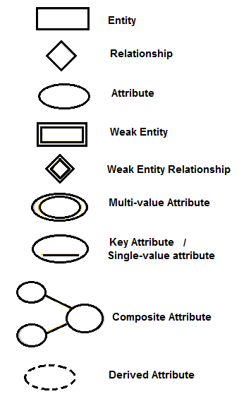
Entity Relationship Diagram (ERD)

Slide 14
ERD
The attribute could be composed and multivalued at the same time.
Entities with the same basic attributes are grouped or typed into an entity type.
Entity type can have more than key.
An attribute of an entity type for which each entity must has a unique value called a key attributes and could be composed.
Each key is underlined.
Each entity type will have a collection of entities stored in DB called Entity set.
Entity Set is the current State of the entities of that type that are stored in DB.
Each Entity Type displayed in a box as the past image symbols where attributes are displayed in ovals and each attribute is connected to its entity type.

Slide 15
Relationship
Relationship relates two or more distinct entities with a specific meaning.
Relationship of the same type are grouped or typed into a relationship type.
The degree of a relationship type is the number of participating entity types.
Relationship type:
Is the schema description of a relationship.
Identifies the relationship name and the participating entity types.
Identifies certain relationship constraints.
Relationship set :
The current set of relationship instance represented in db.
The current state of a relationship type.
Each instance in the set relates individual participating entities.
Represent the relationship type as a diamond shaped box and connected to the participating entities via straight lines.

Slide 16

Relationship ratio Constraints
Cardinality :
One to one : don’t forget to get total-participation
One to many
Many to many
A relationship type who's with the same participating entity type in distinct roles.
Weak entity doesn’t have a key attribute , must be participate in an identifying relationship with an owner or identifying entity.
Existence Dependency
Zero (optional participation)
One or more

Slide 17
Notes
Entities are identified by the combination of:
A partial key of the weak entity.
The particular entity they are related to in the identifying entity type.
In recursive relationship type both participation are the same entity type in different roles
In ERD , need to display role name to distinguish participations.
Relationship type can have attributes and most of them are used with m:m relationship.
There is a UML representation for DB called schema.
There are different degrees for relationship types and generally n-ary relationship isn’t equivalent to n-binary relationship and constraints be more difficult for n-ary.

Slide 18
ER to Relational Mapping Algorithm
Mapping of a regular entity
يتم تفريغ كل attributes في مصفوفة عدا multivalued , كما انه لل composed يتم تفريغ الأبناء النهائيين عوضا عن الاب.
Mapping of a weak entity
يتم عمل مصفوفة يكون pk فيها هو الخاص ب weak مع الخاص ب entity المتصلة بها
Mapping of a Binary (1:M) Relation
يتم إضافة attribute جديد (خانة جديدة) في المصفوفة التي تمثل M وتحتوي على pk لل entity الاخر وتشير اليه بسهم (أي تكونfk (

Slide 19
Cont.
Mapping of Binary (1:1) Relation
يتم إضافة خانة جديدة ك 1:M ولكن ناحية total-participation
إذا ظهرت attribute جديدة متولده عن العلاقة يتم اضافتها مع الخانات الإضافية
Mapping of Binary (M:M) Relation
يتم انشاء جدول جديد يكون فيه pk هو pk الخاص بالمصفوفات المشتق منها الجدول معا وكل key فيهم على حده يكون fk
Mapping of Multi-Valued Attributes
يتم انشاء جدول جديد يكون فيه pk هو pk لل entityالمنبثق عنها مع قيم multi-valued
بفرض ان id هو pkفي entityالاصلية فان قيم multi value تكون مرتبطة ارتباط وثيق بكل idوحيث انه يمكن تكرارid لان كل record يمثل قيمة وبالتالي لا يصح كون id pk في ذاته ولذا يكون الناتج من ارتباطه معvalue يمثل pk
Mapping of N-ary Relationship
في حال تعدد العلاقات يتم انشاء جدول يضم كل pkالخاص ب entities المنبثق عنها

Slide 20
Keys
Each row has a value of a data item that uniquely identifies that row in the table called the key.
Sometimes rows-id or sequential number (auto generated) are assigned as keys to identify the rows in a table called artificial key or surrogate key.
Key = unique constraint and not null.
Primary key (PK) must be only one in each relation.
Reference or Foreign key (FK) is a PK in another table. (it’s points to a PK and must use the same domain also use the same PK values)

Slide 21
Notes.
The schema is description of a relation , denoted by R(A1,A2,..) where R the relation's name and A the Attributes of the relation.
Each attributes has a domain or set for valid values.
A tuple is an ordered set of values enclosed in <-> each value is derived from an appropriate domain.
We will use 3 main Data Types (Number , date , Varchar2) and we use ‘’ with any nonnumeric datatype. (use Varchar2 for any Numeric that won’t used by arithmetic operation)
A relation is a set of tuples.
The domain has a logical definition (length) and a data type, and a format defined for it.
The relation state is a subset of the Cartesian product of the domains of it’s attributes.
Each domain contains the set of all possible values the attribute can take.

Slide 22
Cont.
Each value in a tuple must be form the domain of the attribute for that column.
A special null value is used to represent values that are unknown or inapplicable to certain tuples.
Data Dictionary Form for each Entity (Relation)
Reference | FK | PK | Constraints | Description | Data Type (length) | Attribute name | no

Slide 23
Structured Query Language (SQL)
DCL
Create user ---- identified by *****;
Grant DBA to ----;
Connect ----
Password: *****

Slide 24
Cont. SQL
DDL
Create table table_name (attributes_name Datatype(length) constraints,…);
Ex:
Create table t(t1 number(2,0) ,
y2 varchar2(15) not null unique ,
x3 number(3,0) references y, primary key(t1));
Create table t(t1 number(2,0) primary key ,
y2 varchar2(15) not null ,
x3 number(3,0), unique(y2) ,
foreign key(x3) references y);

Slide 25
Cont. SQL
Alter table table_name operation (-----); : edit table’s structure
Operations on columns : add , modify , drop , rename.
Ex: Alter table x add (a varchar2(3) not null);
ALTER TABLE table_name MODIFY column_name datatype;
ALTER TABLE table_name RENAME COLUMN old_name to new_name;
ALTER TABLE table_name DROP COLUMN column_name;
When we define a FK we could use the following constraints:
On Delete set Default on Update Cascade.
Could use null.

Slide 26
Cont. SQL
for deleting a table:
Drop Table table_name;
Each DDL Command is committed by default.

Slide 27
Cont. SQL
DML
Insert into table_name values(v1,v2,….);
Insert into table_name (col1,col3,col2,col5) values(v1,v3,….);
Insert into table_name (id,dname) select xid,xname from x;
Ex:
Insert into dept (depno,dname) values(50,’sce’);

Slide 28
Cont. SQL
Update table_name set col_name = value;
Update an attribute with an operation:
Update table_name set attribute_name = arithmetic operation; (Derived)
Exs:
Update students set total = m1+m2+m3;
Update employees set sal = 5000 where department = ‘sales’;
Update employees set job = ‘eng’ , sal = sal*10 , where name =‘abdo’;
Update dept d set empno = select * from emp where emp.dept = d.dept;

Slide 29
Cont. SQL
Delete col value -> update to null
Update table_name set col_name is null;
Delete a record (row)
Delete from table_name where condition;
If no condition it will delete all records
Describe a table:
Desc table_name;

Slide 30
CONT. SQL
SELECT <attribute list> from <table list> where <conditions>;
Incase there is more than table in the table list then it should be at least one condition (pk = fk) for each two tables
You can use operator and , or with conditions.
Ex:
select t1.name, t2.name from emp t1,dep t2 where t1.dept = t2.dept;
select emp.name, dep.name from emp, dep where emp.dept = dep.dept;
Use * with select to select all;
See all tables :
Select * from tab;

Slide 31
functions available to manipulate data
In Oracle, there are many functions available to manipulate data. Here are some examples:
LOWER() function is used to convert a string to lowercase.
SELECT LOWER(column_name) FROM table_name;
UPPER() - This function converts a string to uppercase. The syntax is UPPER(string).
SUBSTR() - This function extracts a substring from a string. The syntax is SUBSTR(string, start_position, length).
LENGTH() - This function returns the length of a string. The syntax is LENGTH(string).
CONCAT() or || operator - These are used to concatenate two or more strings. The syntax of the CONCAT() function is CONCAT(string1, string2).
LTRIM() - This function removes leading spaces from a string. The syntax is LTRIM(string).

Slide 32
Cont.
RTRIM() - This function removes trailing spaces from a string. The syntax is RTRIM(string).
TRIM() - This function removes leading and trailing spaces from a string. The syntax is TRIM(string).
INITCAP() - This function capitalizes the first letter of each word in a string. The syntax is INITCAP(string).
REPLACE() - This function replaces a substring within a string with another substring. The syntax is REPLACE(string, old_substring, new_substring).
TRANSLATE() function, which is used to replace characters in a string with other characters or remove them. The

Slide 33
Cont.
TRANSLATE() function is often used to replace non-alphanumeric characters or to perform character set conversions.
The syntax for the TRANSLATE() function in Oracle is as follows:
TRANSLATE(string, from_string, to_string)
Note that the TRANSLATE() function is different from the REPLACE() function, which replaces all occurrences of a specific substring in a string with another substring. The TRANSLATE() function replaces individual characters in a string and can be used to replace multiple characters at once.
INSTR() - This function returns the position of a substring within a string. The syntax is INSTR(string, substring).
LPAD() - This function pads a string with a specified character on the left side. The syntax is LPAD(string, length, character).
RPAD() - This function pads a string with a specified character on the right side. The syntax is RPAD(string, length, character).

Slide 34
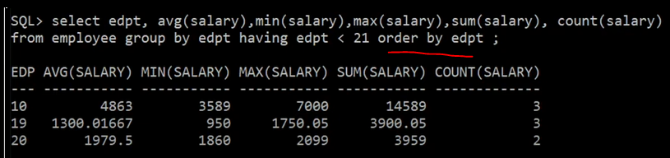
Cont.
aggregate function:
Max(attribute) : returns the maximum value in a set of values. For example, if you have a table of products and want to find the highest price, you will use the MAX() function on the price column.
Min(attribute) : returns the minimum value in a set of values. For example, if you have a table of salaries and want to find the lowest salary, you will use the MIN() function on the salary column.
Avg(attribute) : returns the average value in a set of values. For example, if you have a table of students and their grades, you can use the AVG() function to calculate the average grade.
Sum(attribute) : returns the sum of all the values in a set of values. For example, if you have a table of sales and want to find the total sales for a particular product, you will use the SUM() function on the sales column.
Count(attribute) : (or could use * to count all) The COUNT() function returns the number of rows that match a specified condition. For example, if you have a table of customers and want to find the number of customers who have placed an order, you will use the COUNT() function on the customer_id column.
Could use them with group by and a condition using having : When you want to use aggregate functions in combination with grouping, you can use the GROUP BY clause in your SQL query. The GROUP BY clause groups the rows in a table based on the values in one or more columns and applies the aggregate function to each group.

Slide 35
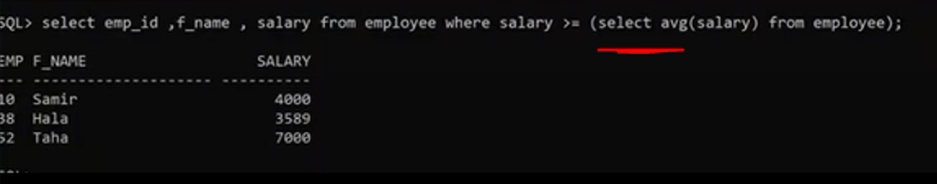
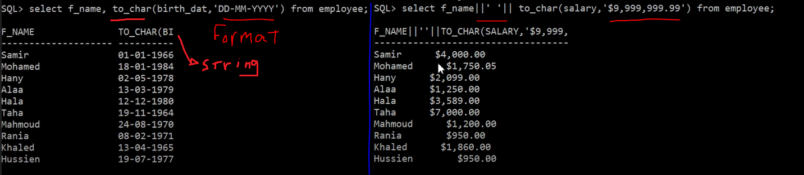
Cont.
For example, let's say you have a table called "orders" that contains order information for a company, including the customer ID, order date, and order amount. You want to find the total order amount for each customer who has placed an order, but you only want to include customers who have placed orders totaling more than $1,000.
Here's an example SQL query that uses the SUM() function as a group with a HAVING condition:
When we use ag functions use it with select to get the value that we can use it with conditions
To_char(attribute,’format’)
SELECT customer_id, SUM(order_amount) as total_order_amount FROM orders GROUP BY customer_id HAVING SUM(order_amount) > 1000;

Slide 36
Cont.
ROUND(): The ROUND() function is used to round a numeric value to a specified number of decimal places. The syntax for the ROUND() function is as follows:
Where "numeric_expression" is the value to be rounded, "length" is the number of decimal places to round to, and "function" is an optional parameter that specifies the rounding method to use (e.g. "0" for round to nearest, "-1" for round down, "1" for round up). If the "function" parameter is not specified, the default behavior is to round to the nearest value.
Ex: SELECT ROUND(3.141592653589793, 2) as rounded_value; -> 3.14
TRUNC(): The TRUNC() function is used to truncate a numeric value to a specified number of decimal places. The syntax for the TRUNC() function is as follows:
Where "numeric_expression" is the value to be truncated, and "length" is the number of decimal places to truncate to.
Ex : SELECT TRUNC(3.141592653589793, 2) as truncated_value; -> 3.14
ROUND(numeric_expression, length [, function])
TRUNC(numeric_expression, length)

Slide 37
PL/SQL Procedural Language Extension to SQL
There are two types of blocks in PL/SQL:
Anonymous Blocks:
have no name (like scripts)can be written and executed immediately in SQLPLUS
can be used in a trigger
Named Blocks:
Procedures
Functions
Allows using general programming tools with SQL, for example: loops, conditions, functions, etc.
We write PL/SQL code in a regular file, for example PL.sql, and load it with @PL in the sqlplus console.
To edit file or create use edit path:\pl.sql

Slide 38
Anonymous Block Structure:
DECLARE (optional)
/* Here you declare the variables you will use in this block */
BEGIN (mandatory)
/* Here you define the executable statements (what the block DOES!)*/
EXCEPTION (optional)
/* Here you define the actions that take place if an exception is thrown during the run of this block */
END;(mandatory)
/
Always put a new line with only a / at the end of a block! (This tells Oracle to run the block)
A correct completion of a block will generate the following message:
PL/SQL procedure successfully completed

Slide 39
DECLARE
Syntax:
Identifier [CONSTANT] datatype [NOT NULL] [:= | DEFAULT expr];
Examples:
birthday DATE;
Age NUMBER(2) NOT NULL := 27;
Name VARCHAR2(13) := 'Levi';
Magic CONSTANT NUMBER := 77;
Valid BOOLEAN NOT NULL := TRUE;
Declare section contains definitions of PL/SQL identifiers such as variables, constants, cursors and so on.
Declaring Variables with the %TYPE Attribute (dynamic declaration by set a variable depends on another in type and length)
It makes the changes of the linked variable affected on the declared variable.
sname Sailors.sname%TYPE; // depends on an attribute on a table Sailors
fav_boat VARCHAR2(30);
my_fav_boat fav_boat%TYPE := 'Pinta’; // depends on another variable
Declaring Variables with the %ROWTYPE Attribute (a datatype that represents an entire row of a database table)
emp_rec employees%ROWTYPE; // create object of rows (like arr)
emp_rec.sid:=9; // access attributes of row

Slide 40
Record
A record is a type of variable which we can define (like ‘struct’ in C or ‘object’ in Java)
DECLARE TYPE sailor_record_type IS RECORD
(snameVARCHAR2(10),
sid VARCHAR2(9),
Age NUMBER(3),
rating NUMBER(3));
sailor_record sailor_record_type; // create object of the declared record
...
BEGIN
Sailor_record.sname:=‘peter’;
Sailor_record.age:=45;
…

Slide 41
Creating a Cursor
We create a Cursor when we want to go over a result of a query (like ResultSet in JDBC)
DECLARE
cursor c is select * from sailors; // array of rows
sailorData sailors%ROWTYPE; // sailorData is a variable that can hold a ROW from the sailors table Here the first
BEGIN
open c;
fetch c into sailorData; // Here the first row of sailors is inserted into sailorData
close c;
To get the other rows in sailorData you need to use a loop.
Notes:
DECLARE
Pi constant NUMBER(8,7) := 3.1415926;
area NUMBER(14,2);
cursorrad_cursor isselect * from RAD_VALS;
rad_value rad_cursor%ROWTYPE;
BEGIN
open rad_cursor;
fetch rad_cursorinto rad_val;
area:=pi*power(rad_val.radius,2);
insert into AREAS values (rad_val.radius, area);
close rad_cursor;
END;
/

Slide 42
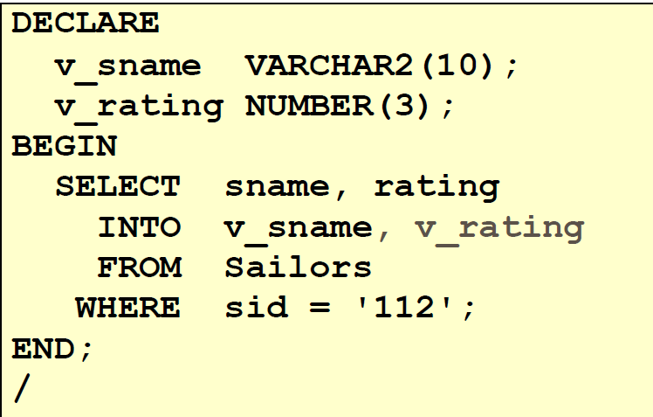
SELECT Statements
INTO clause is required.
Query must return exactly one row.
Otherwise, a NO_DATA_FOUND or TOO_MANY_ROWS exception is thrown

Slide 43
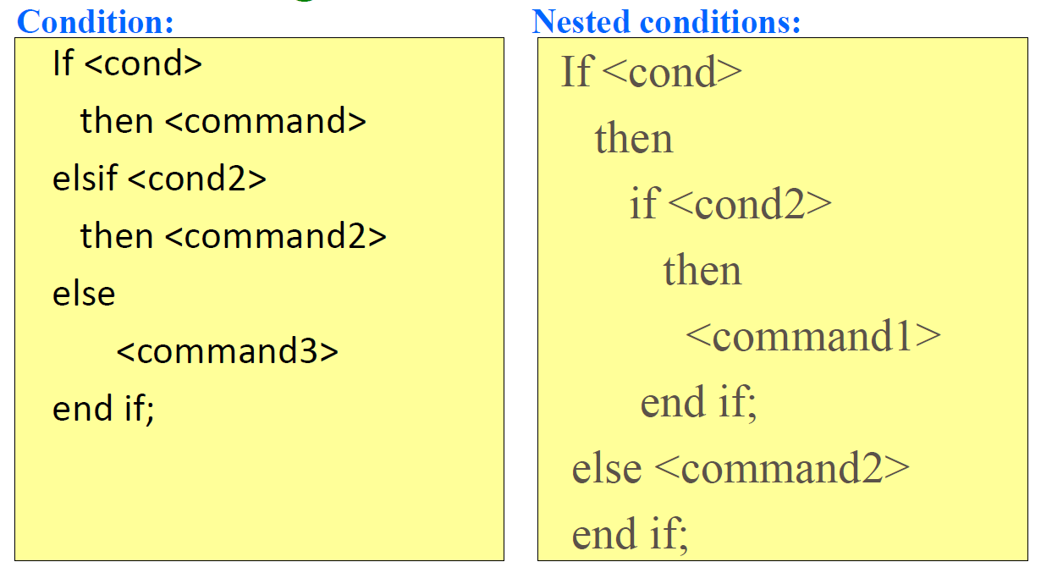
Conditional logic

Slide 44
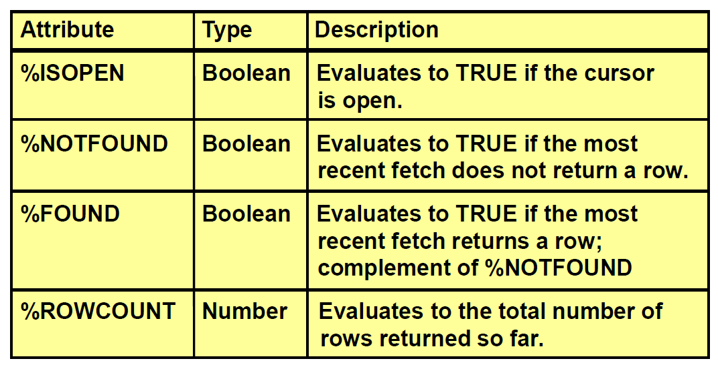
Explicit Cursor Attributes

Slide 45
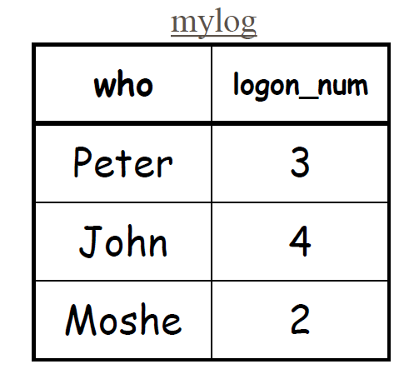
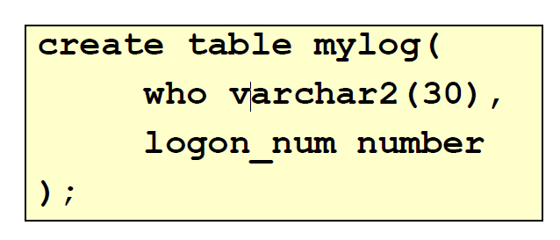
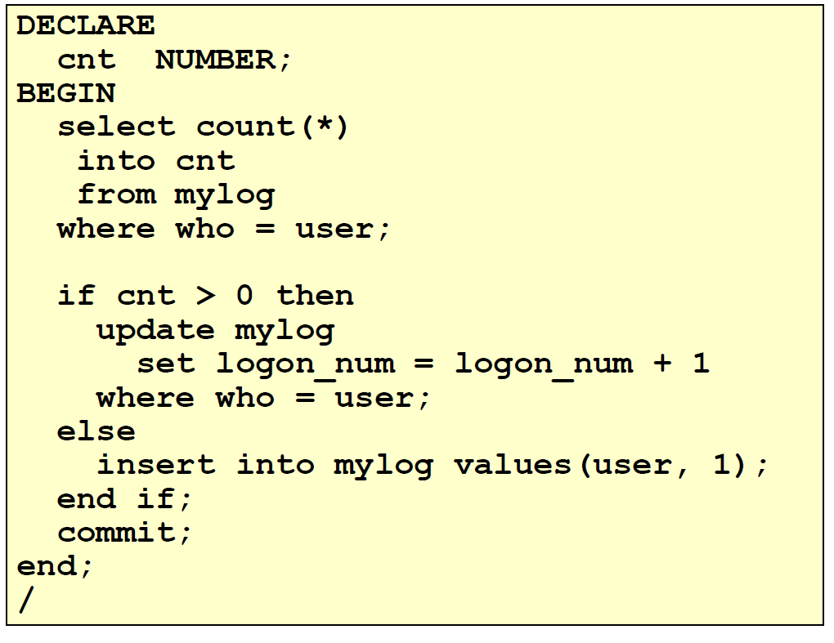
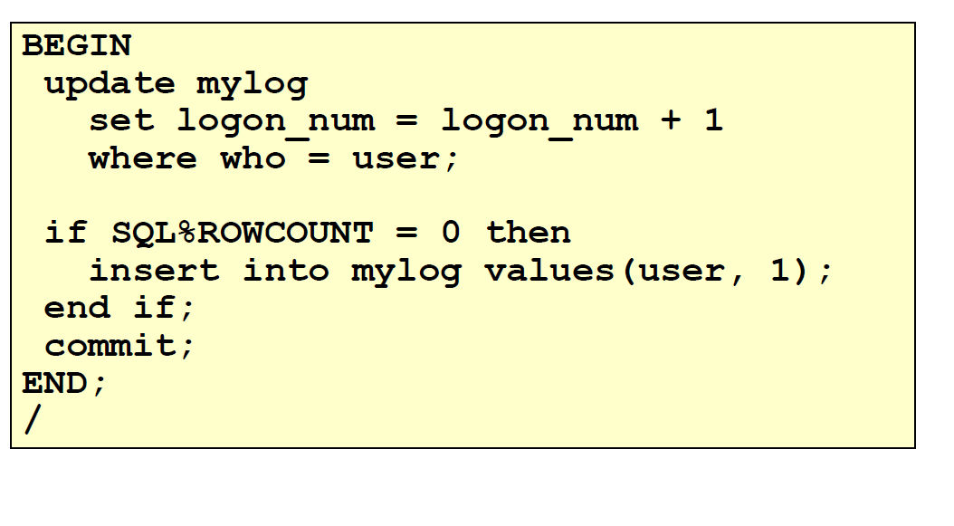
Suppose we have the following table:
Want to keep track of how many times someone logged on to the DB
When running, if user is already in table, increment logon_num. Otherwise, insert user into table
Solution 2
Solution 1

Slide 46
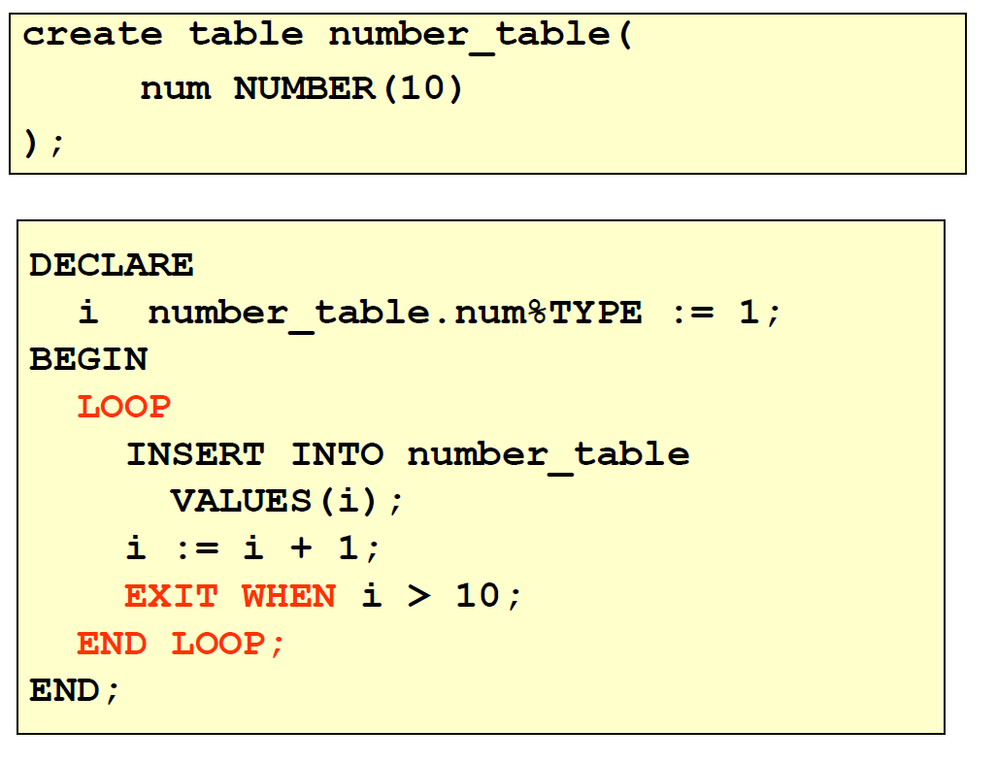
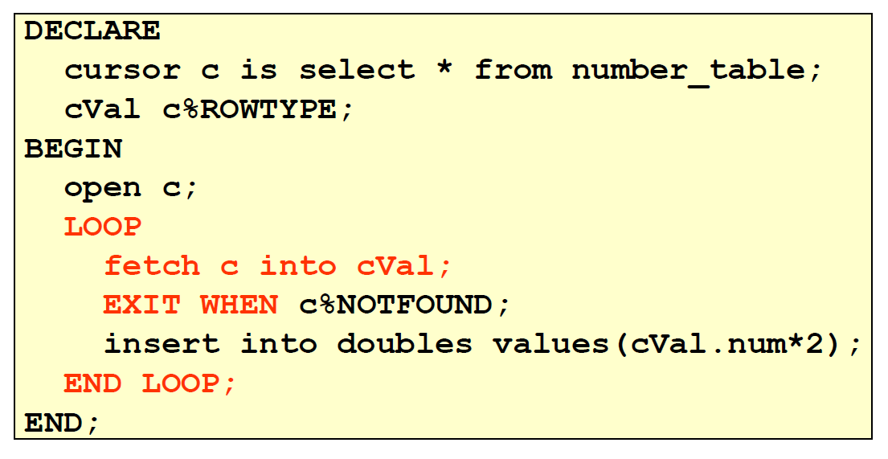
Loops: Simple Loop
With cursor

Slide 47
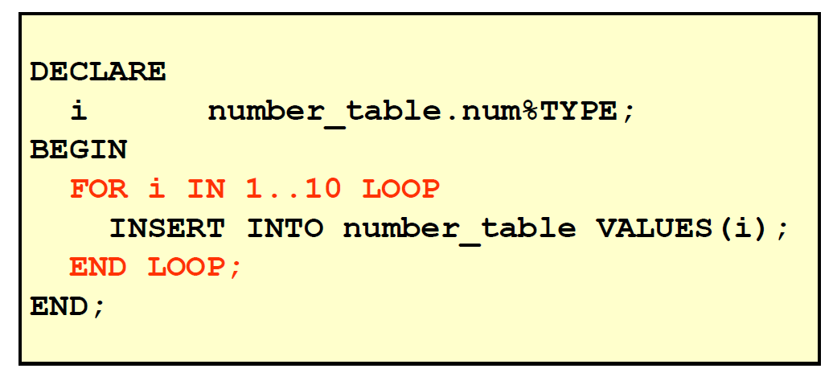
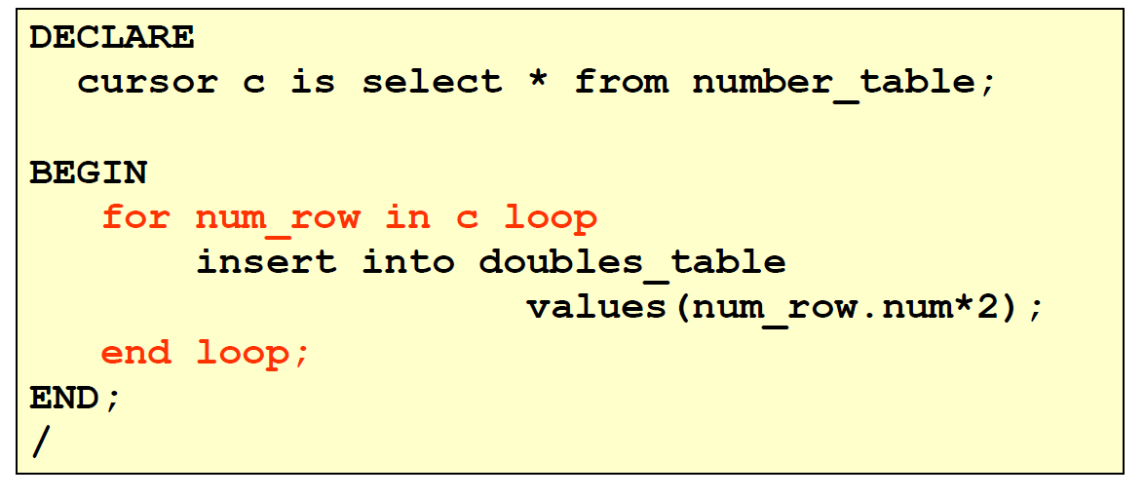
Loops: FOR Loop
With cursor

Slide 48
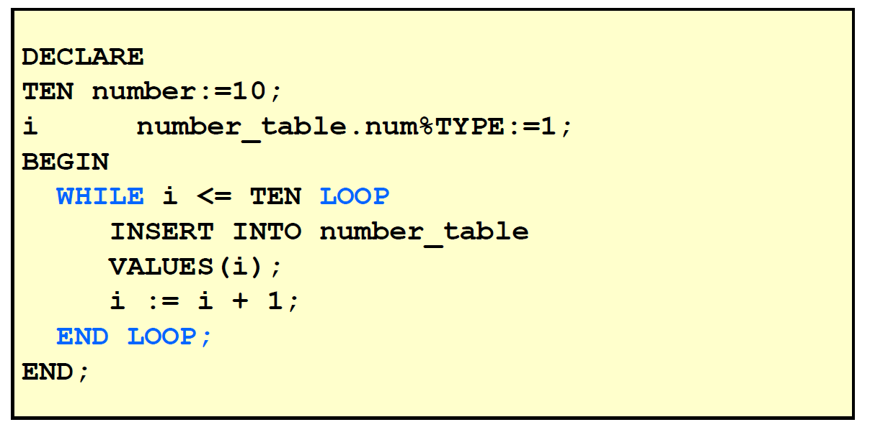
Loops: WHILE Loop

Slide 49
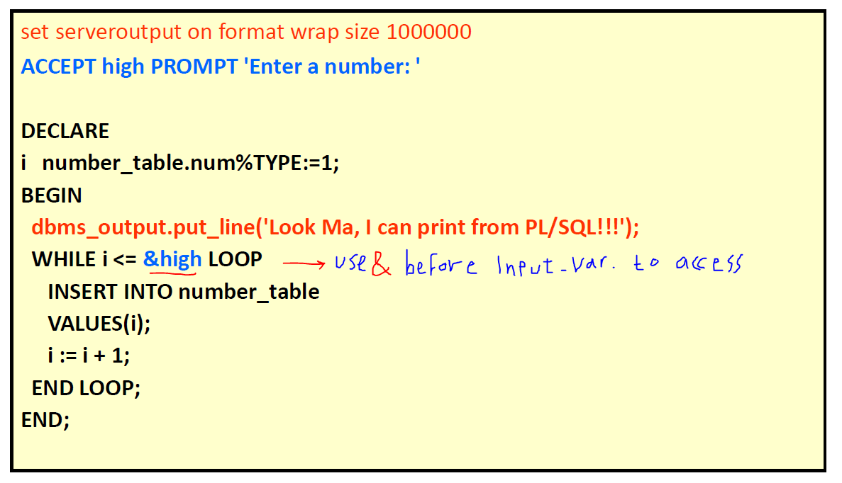
I/O
Print:
You need to use a function in the DBMS_OUTPUT package in order to print to the output
If you want to see the output on the screen, you must type the following (before starting):
set serveroutput on format wrapped size 1000000
Then print using
dbms_output. put_line(your_string);
dbms_output.put(your_string);
Input :
Use the following command for each input you want to get
ACCEPT input_name PROMPT ‘message shown for entering the input '

Slide 50
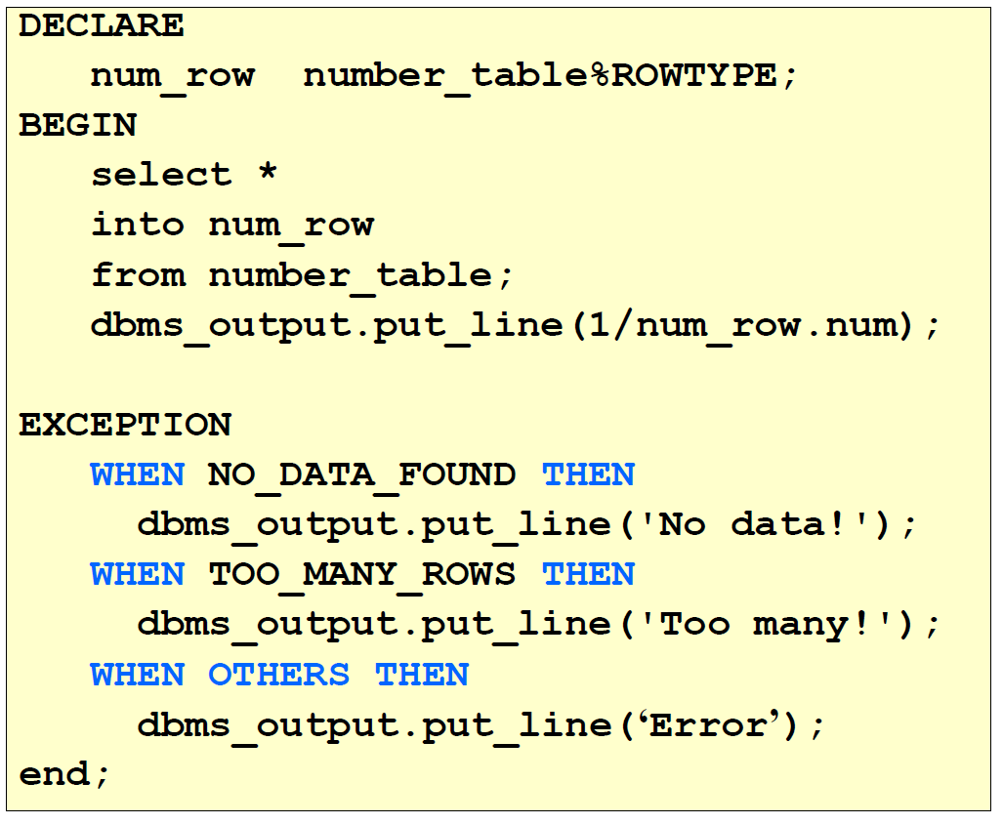
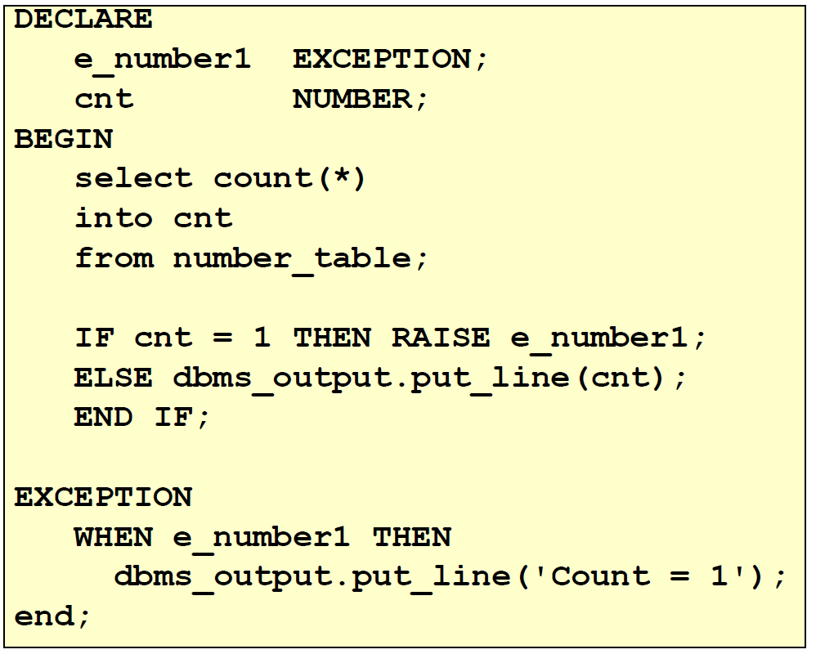
Trapping Exceptions
User-Defined Exception

Slide 51
Functions and Procedures
Up until now, our code was in an anonymous block
It was run immediately
It is useful to put code in a function or procedure so it can be called several times
Once we create a procedure or function in a Database, it will remain until deleted (like a table).
Procedure doesn’t have a return type , on the other hand functions have a return type.
Modes:
IN: procedure must be called with a value for the parameter. Value cannot be changed
OUT: procedure must be called with a variable for the parameter. Changes to the parameter are seen by the user (i.e., call by reference)
IN OUT: value can be sent, and changes to the parameter are seen by the user
Default Mode is: IN

Slide 52
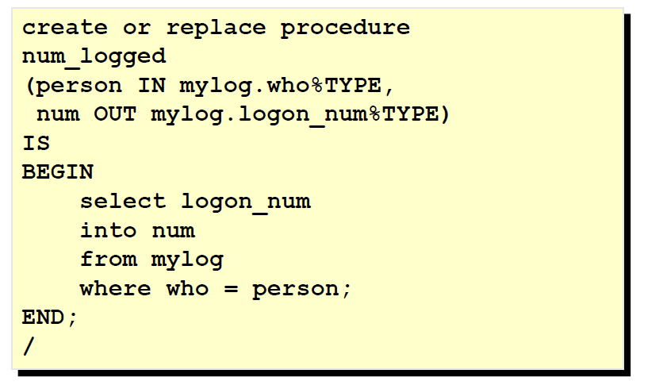
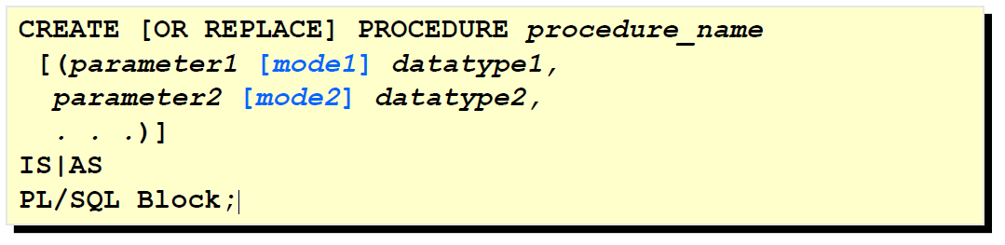
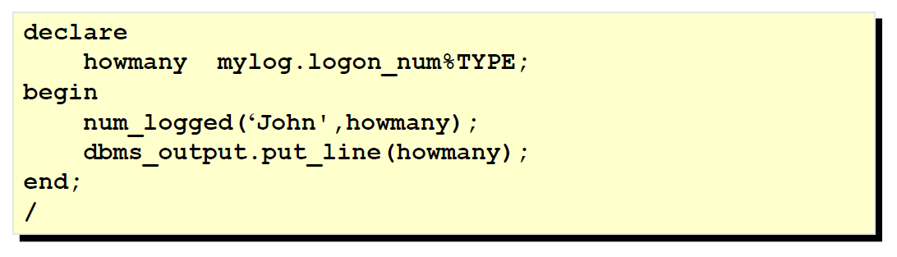
Producer
Calling

Slide 53
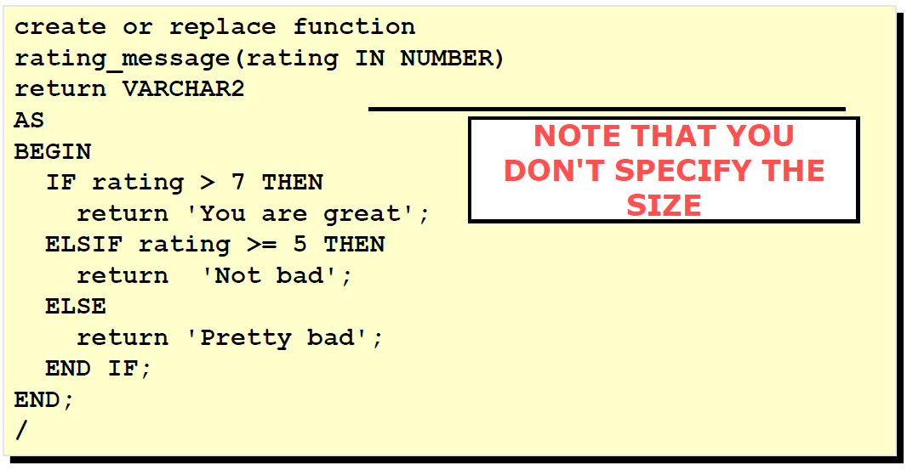
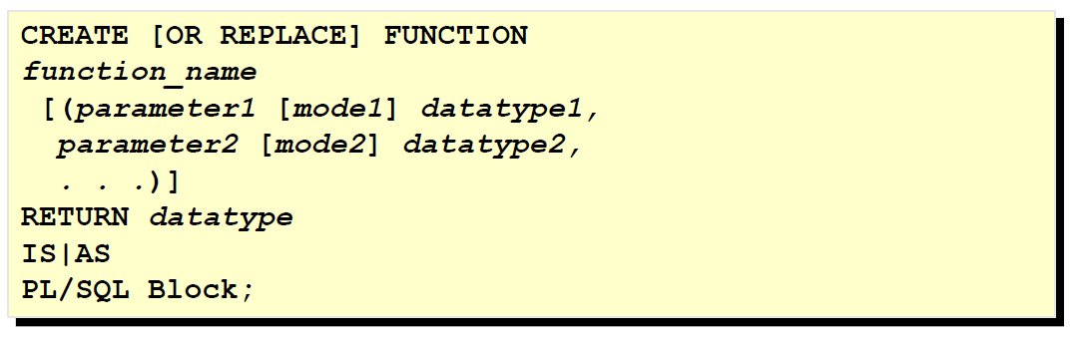
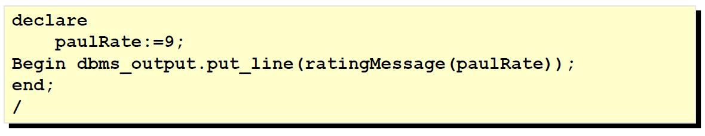
Functions
Calling

Slide 54
Notes
Errors in a Procedure :
To see the errors of a procedure called myProcedure , type:
SHOW ERRORS PROCEDURE myProcedure
For functions, type:
SHOW ERRORS FUNCTION myFunction
Preferred to use is with procedure and as for functions

Slide 55
Packages
Functions, Procedures, Variables can be put together in a package
In a package, you can allow some of the members to be "public" and
some to be "private"
There are also many predefined Oracle packages
Won't discuss packages in this course
Triggers:
Triggers are special procedures which we want activated when someone has performed some action on the DB.
For example, we might define a trigger that is executed when someone attempts to insert a row into a table, and the trigger checks that the inserted data is valid.

