Slide 1
PROGRAMMING
With JAVA
Files

Slide 2
CONTENTS OF THIS LECUTURE
Here’s what you’ll find in this Lecuture:
Files
Exception handle
Assignment.

Slide 3
Exception Handling

Slide 4
Exception Handling
The most common used way is try and catch method.
General Syntax :
Try {statements want to implement}
Catch (ExceptionType variable)
{statements will be done if there is an exception}
Finally{statements will be done in all cases} // may ignore.

Slide 5

Files

Slide 6
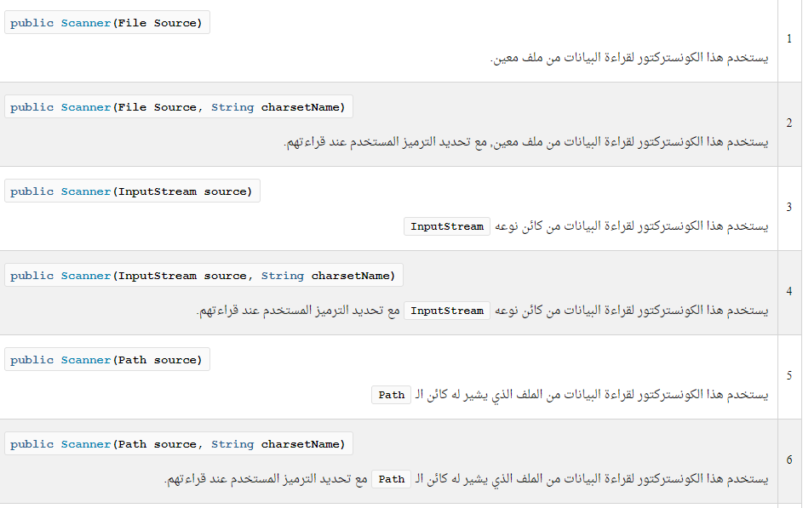
Files
Java can handle files with many ways , java has package java.io that deals with inputs and outputs.
To take an input you can use many sources , do remember class Scanner?
Scanner class deals with input, and we have used System.in as a parameter to mention the console but we can also use it to read a file as input.

Slide 7
Read with Scanner
// Java Program to illustrate // reading from Text File // using Scanner Class import java.io.File;
import java.util.Scanner;
public class ReadFromFileUsingScanner {
public static void main(String[] args) throws Exception {
// pass the path to the file as a parameter
File file = new File(“path");
Scanner sc = new Scanner(file);
while (sc.hasNextLine()) System.out.println(sc.nextLine());
}
}
Scanner can't be used for writing purposes, only reading.

Slide 8
File class
Used in:
Create a new file or folder
Delete a file or folder
Search for a file or folder
View a folder or read file
The object represents a file or folder in the device (new or already exist).
Main constructor : File (String path)
Use separator with path from File.separator in java.nio package.
There are many methods for file class.

Slide 9
Streams Classes
There are 2 kinds of files , char based and byte based in char based each char take 2 bytes of memory and the result file is text that we can use with strings while in byte based each data take it’s datatype in a binary format and we can use that method with images and videos.
Stream classes :
Input stream
Output stream
Steps should notice while dealing with files :
Create object represent the file
Use exception handling
Determine the path and the extinction
Handle the file (R/W)
Close after finish.

Slide 10

Char Stream
The most common classes
FileReader and FileWriter

Slide 11

ASSIGNMENT
Write a program that read a file called azsencs and then rewrite it in a file called copy.
___

Slide 12



THANKS!
Do you have any questions?
amabdo30@gmail.com

