Slide 1
Internet Protocol V6
Number | Name
70 | Abdalrhman Mostafa Mahmoud
18 | Ahmed Abdelkader
74 | Abdallah Mohy
 | Alhasan Amir
 | Abdelrhman Magdy

Slide 2
What is IP?
An IP address is a string of numbers separated by periods.
An Internet Protocol address (IP address) is a numerical label that is connected to a computer network that uses the Internet Protocol for communication.An IP address serves two main functions: network interface identification and location addressing.
Notes:
IP addresses are not random. They are mathematically produced and allocated by the Internet Assigned Numbers Authority (IANA), a division of the Internet Corporation for Assigned Names and Numbers (ICANN). ICANN is a non-profit organization that was established in the United States in 1998 to help maintain the security of the internet and allow it to be usable by all. Each time anyone registers a domain on the internet, they go through a domain name registrar, who pays a small fee to ICANN to register the domain.
Internet Protocol works the same way as any other language, by communicating using set guidelines to pass information. All devices find, send, and exchange information with other connected devices using this protocol. By speaking the same language, any computer in any location can talk to one another.

Slide 3
The Need OF IP6
Firstly, each device connects to a network needs a specific IP address to represent the device as a logical address, the problem In IP4 was it is limited 32 bit (4 octet) and to solve it initially the made LANs inside the internet connects to global network with one IP address in other words we can connect all home devices with one IP address (Adsl IP address) and inside the LANs each device take a private IP address.
Then we find there are a lot of devices are made everyday and we still needing more IP addresses (a lot of IOT devices also needs to take IP address).

Slide 4
Cont. The Need OF IP6
hence the IP6 Was Developed to Contains the Whole devices in the world in other words it can give each sand an IP address.
It consists of 128 bit (8 octet) each octet consists of 16 bit with 4 hexadecimal numbers , each 16-bit (4 numbers) are separated with colon “:”.
The usage of IP6 increasing everyday.

Slide 5
Tips and Tricks
The IP6 could be shorten if the LSB in the octet is Zeros we could remove those Zeros.
2001:0db8:34cd:0012:0000:0000:00a9:1234 ->
2001:db8:34cd:12:0:0:a9:1234
And if there Zero Octets in series we could skip them with “::” but you could use it once;
2001:db8:34cd:12::a9:1234
We know there are 8 octet so in the last IP there are only 6 so :: represents 2 Zero octets in series.

Slide 6
Cont.
We can use prefix mask to represent the fixed bits in the IP
2001:db8:34cd:12::a9:1234/4 means that 2 in 2001 is fixed
There isn’t BroadCast in IPV6 (no one to all at all)
We can Convert IP4 to IP6
The instead broadcast in IP6 has IP starts with ff02:01 and known as Link Local Scope all nodes multicasting.

Slide 7
A brief summary between IP4 & IP6
IP6 | IP4
Global | Public(Real IP)
Site Local | Private(Virtual IP)
LINK LOCAL | APIPA
::1 | Loop Back (127.0.0.1)
FFOO::/8 | Multicasting (224.0.0.0)

Slide 8
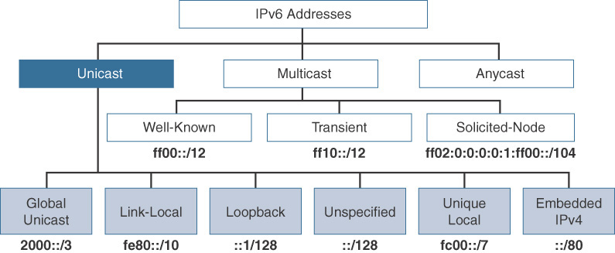

Slide 9
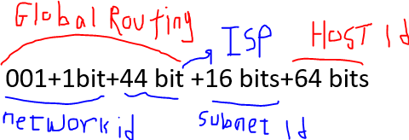
Global IP
For now, the term 001 is fixed for the first 3 bits(binary) in the first octet
That means the Form of Global IP is:
001+1bit+44 bit +16 bits+64 bits
HOST ID CALLED INTERFACE ID TOO.
Global Routing Prefix represents first 3 octets.

Slide 10
Link Local
Starts with FE80/10
Represents the IP which is given automatic to devices.
Site Local
Starts with FEC0/10
Represents the Private IP Which given by user to device.

