Slide 1
Queueing System
Consists of :
Arrival
Server
Service time
Components :
Input Process
Size of arriving (finite/infinite)
Arriving pattern (Deterministic / Stochastic)
Behavior of arriving customers (BLOCK / STORE AND FORWARD)
System Structure
Number of servers (SINGLE / MULTIPLE)
System capacity
Output process
Serving discipline (FCFS / LCFS ..ETC)
Service time distribution (service pattern)

Slide 2
Kendall Notation
A/B/X/Y/Z
A : Inter-arrival time distribution : arriving pattern
B : Service Time distribution : service pattern
X : Number of parallel servers : can be single or multiple c
Y : System Capacity : default ∞ and can be finite k
Z : Queueing Discipline : default FCFS
Deterministic when the arriving and service rate are constant.
Stochastic when the arriving and service rate are random.
Arrival rate = λ , arrival time = 1/ λ .
Service rate = μ, service time = 1/ μ.

Slide 3
Case 1: λ > μ or 1/λ < 1/μ
Deterministic Models D/D/1/K-1
period (0 < t < t_{i}) corresponds to a transient state.
steady state N(t) = (k-1) or (k-2).
Assume n(t) at t< (1/ λ) = 0, Wq(0) , Wq(1) = Zero
Wq(n) = (1/μ - 1/λ)(n-1)
n >= λt_{i} -> Wq(n) = (1/μ - 1/λ)(λt_{i} -2) or Wq(n) = (1/μ - 1/λ)(λt_{i} -3)
Special Case
When (1/ μ) = m (1/ λ), At steady state ( t >= t_{i})
n(t) is constant, n(t) = k-1
Wq(n) is constant, Wq(n) = (1/μ - 1/λ)(λt_{i} -2)

Slide 4
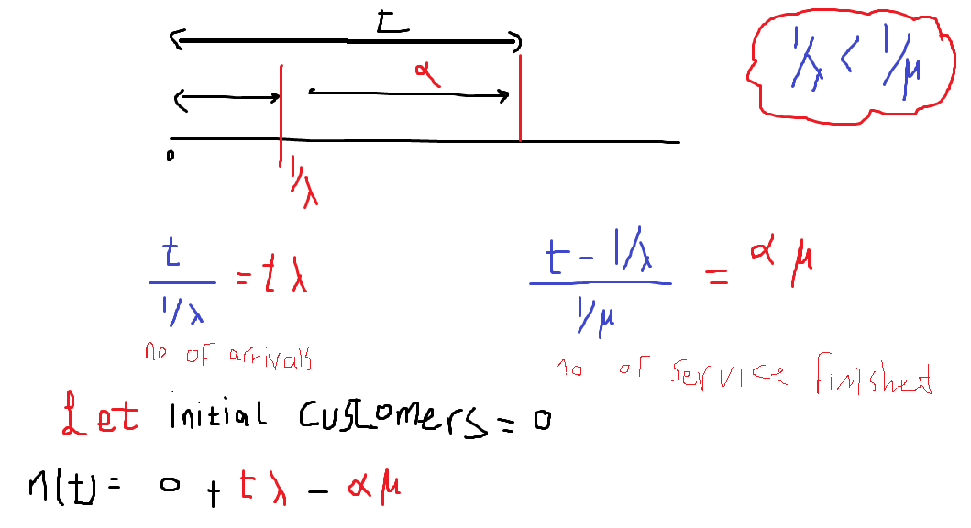

Slide 5
Case 2: λ ≤ μ or 1/λ ≥ 1/μ
At steady state (n ≥ ⎣λt_{i} ⎦) n(t) is either one or zero.
Wq(n) = 0 for all n.
Wq(n) = (M-1)(1/ μ)
At λ = μ
For λ < μ,
n(t) = M
For λ = μ,
At steady state , λ<μ
Average waiting time for init. M customers
Wq(n) = ( M + n - 1) (1/μ) – n(1/ λ)
For n < ⎣λt_{i} ⎦

Slide 6
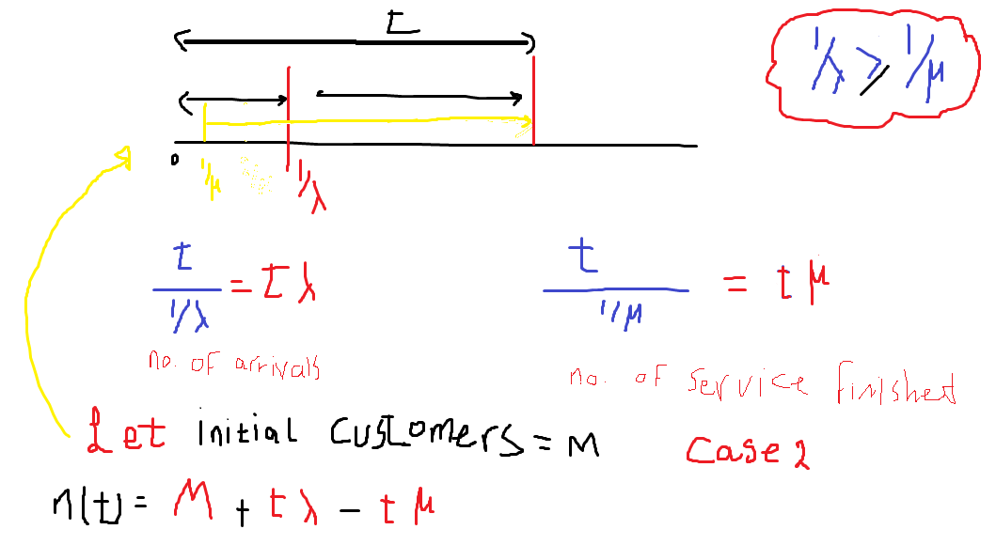

Slide 7
Stochastic Process
Continuous Time and Discrete Parameter stochastic processes
(set T is Finite - > discrete time otherwise continuous)
Continuous State and Discrete State stochastic processes
(x(t) is defined over a countable set -> discrete state otherwise continuous)
Classification of Random Process :
Discrete-parameter (or time), Discrete-state random process.
Like x(n) represents the outcome of the nth toss of a dice (T int , s = {1,2,3,4,5,6})
Discrete-parameter (or time), Continuous-state random process.
like x(n) represents the temp. at the end of the nth hour of the day (T int hour ,s cont.)
Continuous-parameter (or time), Discrete-state random process.
Like x(t) represents the number of phone calls received in interval time (0,t) (T cont. , s = int)
Continuous-parameter (or time), Continuous-state random process.
like x(t) represents the temp. at any time of the day (T cont. ,s cont.)

Slide 8

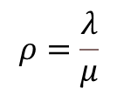
M / M / 1
Stochastic Models
At steady state
$$ρ=\frac{λ}{μ}$$

Slide 9
M / M / 1 / K

Slide 10
M / M / c
( )
( )
Average number of idle server

Slide 11
M / M / c / K
( )
( )

Slide 12
simulation
A simulation is the imitation (reproduction) of the operation of a real-world process or system over time.
This model is represented by set of assumptions concerning the operation of the system.
These assumptions are expressed in mathematical, logical, and symbolic relationships between the entities, or objects of interest, of the system.
Potential changes to the system can first be simulated in order to predict their impact on system performance.
Simulation can also be used to study systems in the design stage, before such systems are built.

Slide 13
Simulation Benefits
Simulation enables the study of the internal interactions of a complex system, or of a subsystem within a complex system.
The knowledge gained in designing a simulation model may be of great value toward suggesting improvement in the system under investigation.
By changing simulation inputs and observing the resulting outputs, valuable insight may be obtained into which variables are most important and how variables interact.
Simulation can be used as an educational device to support analytic solution methodologies.
Simulation can be used to experiment with new designs or policies prior to implementation, to prepare for what may happen.
The modern system (factory, wafer fabrication plant, service organization, etc.) is so complex that the interactions can be treated only through simulation.

Slide 14
When Simulation Is Not Appropriate
when the problem can be solved using common sense.
if the problem can be solved analytically.
if it is easier to perform direct experiments.
The costs should not exceed the savings.
if the resources or time are not available.

Slide 15
Simulation pros and cons
Advantages of Simulation
New hardware designs, physical layouts, transportation systems, and so on, can be tested without placing resources for their acquisition.
Time is controllable which it can be compressed or expanded allowing for a speedup or slowdown of the phenomena under investigation.
A simulation study can help in understanding how the system operates rather than how individuals think the system operates.
Disadvantages of Simulation
Model building requires special training.
Simulation results may be difficult to interpret. Since most simulation outputs are essentially random variables.
Simulation modeling and analysis can be time consuming and expensive.

Slide 16
System
A system is defined as a group of objects that are joined together in some regular interaction or interdependence toward the accomplishment of some purpose.
Components
Entity : an object of interest in the system
Attribute : a property of an entity.
Activity : represents a time period of specified length.
State of variable : the collection of variables necessary to describe the system at any time, relative to the objectives of the study.
Event : an immediate occurrence that may change the state of the system.

Slide 17
System
Types:
discrete system : the state variable(s) change only at a discrete set of points in time.
continuous system : the state variable(s) change continuously over time.
Model :
Mathematical : uses symbolic notation and mathematical equations to represent a system.
Physical
simulation model :
static or dynamic
static : represents a system at a particular point in time.
dynamic : represents systems as they change over time.
deterministic or stochastic
Deterministic model has a known set of inputs which will cause a unique set of outputs.
stochastic model has one or more random variables as inputs. Random inputs lead to random outputs.
discrete or continuous

Slide 18
Steps in discrete-event simulation study
Problem formulation : Every simulation study should begin with a statement of the problem.
Setting of objectives and overall project plan : Is the simulation appropriate for the problem formulated?
Model conceptualization : It is best to start with a simple model and build toward greater complexity.
Data collection
Model translation : The model must be entered into a computer-recognizable format.
Verification : Is the computer program performing properly?
Validation : Is a model an accurate representation of the real system?
Experimental design
Production runs and analysis
Additional runs if needed
Documentation and reporting
Implementation
Phases of simulation model-building process :
The first phase, consisting of steps 1 and 2.
The second phase is related to model building and data collection and includes steps 3, 4 , 5, 6, and 7.
The third phase concerns running the model. It involves steps 8 ,9, and 10.
The fourth phase, implementation, involves steps 11 and 12.

Slide 19
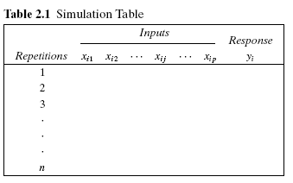
Simulation steps
Determine the characteristics of each of the inputs to the simulation. These may be modeled as probability distributions.
Construct a simulation table
For each repetition i, generate a value for each of the inputs.

Slide 20
Assumptions
to simulate a single-channel queueing system:
Let the calling population is infinite.
Arrivals occur one at a time in a random fashion.
Service times are of some random length according to a probability distribution which does not change over time.
Units are served in the order of their arrival (often called FIFO) by a single server or channel
the arrival rate must be less than the total service rate, or the waiting line will grow without bound.
Simulation Components:
Events
The arrival event
The departure event
State Variables
The number of units in the system
The status of the server, busy or idle
Simulation Clock
is used to track simulated time.

Slide 21
Steps to simulate system using tables
Get the distribution of time between arrivals table and for service table , using the probability generate random digits (the range of random, the probability divisor) and calculate the cumulative probability to determine the range of each clock.
Then make a simulation table for n customers and generate the random digits for each customer to get the arrival and service time for each using the tables created before.
There are some column added to get performance of the system such as waiting in the queue , server idle time .. Etc.

Slide 22
Steps to simulate system using tables for single server
Assume first customer arrive at clock time 0, there is no random digit arrival for the first customer
Simulation table fields:
Customer number
Random Digit Arrival
Time since last arrival (minutes) = time-between-arrivals
Arrival time (accumulative time-between-arrivals times (clock))
Random Service digit
Service time (minutes)
Time service begins
Time service ends
Time customer waits in queue (minutes)
Time customer spends in the system (minutes)
Idle time of server (minutes)

Slide 23
Calculate the table elements for single server
G_{k}= Max ( D_{k}, H_{k-1})
G_{k} : Time Service Begins for customer k
D_{k} : Arrival time of customer k (CLOCK)
H_{k-1} : Time service ends for customer k - 1
H_{k} = G_{k} + F_{k}
H_{k} : Time service ends for customer k
F_{k} : Service time for customer k
I_{k} = G_{k} - D_{k}
I_{k} : Time customer waits in the queue for customer k
J_{k} = H_{k} – D_{k} = I_{k} + F_{k}
J_{k} : Time customer spends in the system for customer k
K_{k} = Max (D_{k} – H_{k-1} , 0) = G_{k} – H_{k -1}
I_{k} : Idle Time of server for customer k

Slide 24
Some important functions in Excel
ALL FUNCTION UPPERCASE AND USE = BEFORE IT.
MAX(A1,B5): Compare the value of A1 and B5 then return the bigger.
USE ‘:’ Instead of ‘,’ to compare Range of cells
Use $X to make X cell fixed within the range or in the normal compare.
IF(CONDITION,TRUE STATEMENT,FALSE STATEMENT)
COULD BE NESTED
RAND() : GENERATES a number between 0 ,1
To get bigger number you can multiply the range to it
ROUND(NUMBER,DECIMAL PLACE): to get integer round then the dec =0.

Slide 25
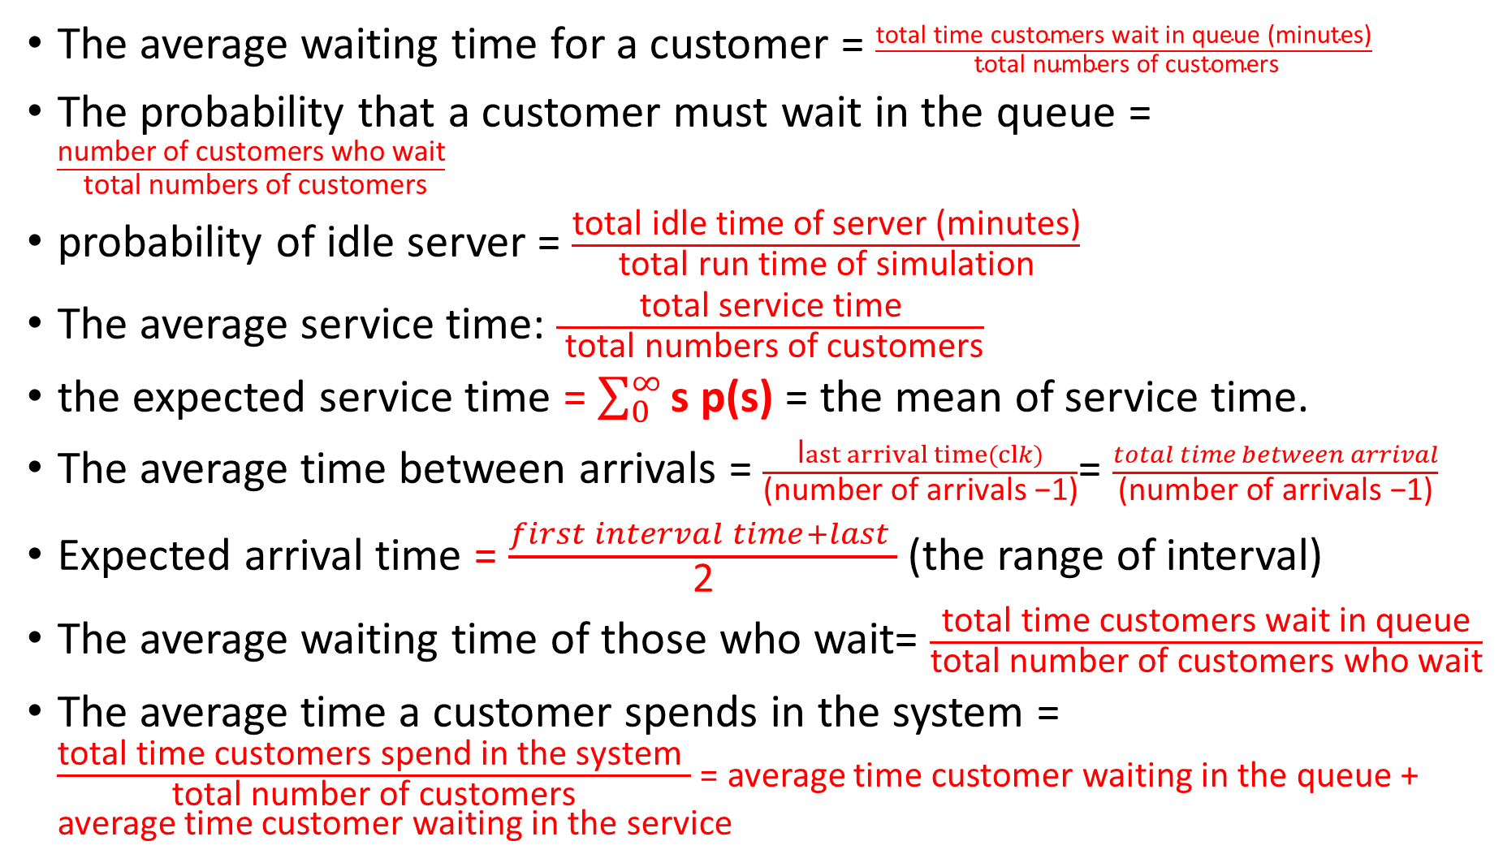
Performance metrics
The average waiting time for a customer = $\frac{\text{total} \text{time} \text{customers} \text{wait} \text{in} \text{queue}\text{ (}\text{minutes}\text{)}}{ \text{total} \text{numbers} \text{of} \text{customers}}$
The probability that a customer must wait in the queue = $\frac{\text{number} \text{of} \text{customers} \text{who} \text{wait}}{ \text{total} \text{numbers} \text{of} \text{customers}}$
probability of idle server = $\frac{\text{total} \text{idle} \text{time} \text{of} \text{server}\text{ (}\text{minutes}\text{)}}{\text{total} \text{run} \text{time} \text{of} \text{simulation}}$
The average service time: $\frac{\text{total} \text{service} \text{time}}{ \text{total} \text{numbers} \text{of} \text{customers}}$
the expected service time = $\sum_{0}^{∞}{\text{s} \text{p}\text{(}\text{s}\text{)}}$ = the mean of service time.
The average time between arrivals = $\frac{\text{l}ast arrival time(clk)}{\text{(}\text{number} \text{of} \text{arrivals} \text{−}\text{1}\text{)}}$= $\frac{total time between arrival}{\text{(}\text{number} \text{of} \text{arrivals} \text{−}\text{1}\text{)}}$
Expected arrival time = $\frac{first interval time+last }{\text{2}}$ (the range of interval)
The average waiting time of those who wait= $\frac{\text{total} \text{time} \text{customers} \text{wait} \text{in} \text{queue}}{\text{total} \text{number} \text{of} \text{customers} \text{who} \text{wait}}$
The average time a customer spends in the system = $\frac{\text{total} \text{time} \text{customers} \text{spend} \text{in} \text{the} \text{system} }{\text{total} \text{number} \text{of} \text{customers}}$ = average time customer waiting in the queue + average time customer waiting in the service
Notes:
All times In (minutes)

