Slide 1

Networks
Introduction to

Slide 2
Intro.
Communication is based on transfer of information having a wider scope
Topology of a Computer Network Consists of:
End Systems: sources and sinks of information
Subnetwork : Interconnecting end systems and they communicate through a transit system.
Each end system has an interconnection point through which it is physically connected to the transmission medium. The interconnection point has an address by which the end system is identified.
Each end system hosts one or more application entities.
The subnetwork, (without any application entity), performs all transmission and switching activities required for transporting messages between the end systems.
Subnetwork consists of nodes (Servers) that process the messages for routing them towards their destination.
Nodes are interconnected to the end systems at the edges of the sub network through a transmission medium that carries electrical signals.

Slide 3
Communication Establish
Elements of Meaningful Communication
Common theme/subject
Common language
an orderly session (i.e. disciplined dialogue exchange which required flow control, error control, and synchronization).
Transport- Oriented Functions (End System Functions)
Interaction with the subnetwork.
Quality of transport service.
Conversion of signals.
Error control.

Slide 4
Components of a Computer Network
Authentication and login.
Common syntax.
Establishment of an orderly exchange of messages with markers for forward and backward synchronization.
Establishing transport connection of required quality, flow control.
Interacting with the subnetwork.
Error control.
Conversion of bits into electrical signals and vice versa.

Slide 5
Architecture of a Computer Network
The architecture of a computer network, describes how the computer network has been assembled using its various components. It defines the specifications of the components and their interrelationship.
The architecture of a computer network specifies a complete set of rules for the connections and interactions of its physical and logical components for providing and utilizing communication services.
The architecture of a computer network is layered architecture. A computer network is portioned into end systems interconnected using a subnetwork and communication process is decomposed into hierarchical functional layers
Standardization of network architecture makes us move from "closed systems" to "open systems“
Some of the important network architectures are:
IBM's System network Architecture (SNA).
Digital's Digital Network Architecture (DNA).
Open System Interconnection (OSI)
Internet architecture.

Slide 6
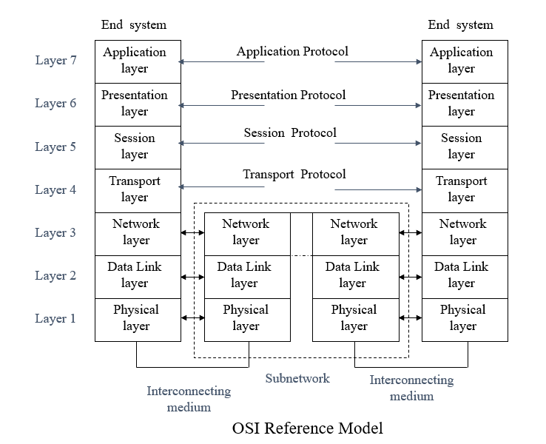
OSI
Notice that we don’t need in subnetwork the layers from 4 to 7 where the main idea of subnetwork is only to transmitting the data not to understand it.
Each layer in transmitting add its header to the data before passing it to the next layer starting from layer 6 to layer 2 and in receiving the designated layer remove its header before passing to the upper layers.

Slide 7
OSI Layers
Application Layer
is the interface for the distributed applications
services as:
Identification of the intended communication partner (s) by name or by address.
Establishment of authority to communicate.
Agreement on privacy (encryption) mechanisms.
Authentication of an intended communication partner.
Agreement on responsibility for error recovery.
Presentation Layer
The purpose of the presentation layer is to present the information to the communicating application entities in a way that preserves the meaning while resolving the syntax (code and data format) differences.
syntactic versions of data being transferred:
syntax used by the application entity of the originator of the data
syntax used the application entity of the recipient of data
the "transfer" syntax used to transfer the data between the presentation entities.
When syntax are not same, the presentation layer contains functions necessary to transform the transfer syntax to the required syntax used by the application entities preserving the meaning.

Slide 8
Cont.
Session Layer:
The session layer provides the necessary means for the two cooperating application layer protocol entities to:
Organize their dialogue (session)
the session layer provides functions which are necessary for setting up (opening) and clearing (terminating) the session (dialogue).
Synchronize their dialogue (data exchange)
The session layer provides a check pointing mechanism, so that if a failure of some sort occurs between checkpoints, the session entity can retransmit all data since the last checkpoint.
Mange their data exchange (interaction management).
The data exchange associated with a dialogue may be full duplex (two-way simultaneous) or half duplex (two-way alternate).

Slide 9
Cont.
Transport Layer:
provide transport service of the quality required by the session entities in a cost-effective manner.
The basic function of the transport layer is to:
Accept data from the session layer
Split it up into smaller units if need be
Pass these units to the network layer
Ensure that the pieces (the small units) all arrive correctly at the session layer of the other end system.
creates a distinct network connection for each transport connection required by the session layer.
If the transport connection requires a high throughput, however, the transport layer might create multiple network connections, dividing the data among the network connections to improve throughput.
the transport layer might multiplex several transport connections onto the same network connection to reduce the cost.
types of transport service (determined when Connection established)
Connection-oriented transport service: which ensures that data are delivered error free, in sequence, with no loss or duplications.
Connectionless transport service: where the transported messages have no guarantee about the order of delivery.
The transport layer is a true end-to-end layer, from source to destination.
the transport layer provides a mechanism to regulate the flow of information, so that a fast end system can not overrun a slow one. Such a mechanism is called flow control.

Slide 10
Cont.
Network Layer:
provides the means to access the subnetwork for routing the message to the destination end system
The network layer of an end system interacts with the network layer of the access node of the subnetwork. This interaction represents the dialogue between an end system and the subnetwork to specify the destination address and to request certain network facilities, such as priority.
Routing decisions at each node are taken by the network layer.
It is up to the network layer to overcome all problems to allow heterogeneous networks to be interconnected.

Slide 11
Cont.
Data Link Layer:
The main task of the data link layer is to take a stream of bits transmission facility, from the physical layer, and transform it into a frame that appears free of undetected errors to the network layer.
It accomplishes this task having the data link layer, at the sender breaks the incoming data packet, from the network layer, into up data frames, and transmits the frames sequentially using the physical layer.
Another important function of the data link layer is error detection & correction, and flow control mechanism.
In local area networks, end systems are having a common transmission medium. Medium Access Control (MAC) function is carried out by the data link layer. MAC determines which user can use the media for its transmission.
Physical Layer:
Conversion of the bits into electrical signals having characteristics suitable for transmission over the medium.
Signal encoding, if required.
Relaying of the digital signals using intermediary devices, like modems.

Slide 12
Need for Data Link Layer
The basic service provided by the physical layer is transportation of bits over the physical connection. This service is unreliable in the sense that disturbed line conditions of the transmission medium may introduce errors which are not taken care of by the physical layer.
Error control, flow control and other associated functions are carried out by the Data Link Layer, which ensures error-free transfer of bits from one device to the other.
Data link layer together with the physical layer and the interconnecting medium provide a data link connection for reliable transfer of data bits over an imperfect physical connection.
Data link layer receives the data to be sent to the other device from the next higher layer (network layer) and adds some control bits to a block of data bits. The data block along with the control bits is called frame. The frame is handed over to the physical layer. The physical layer converts bits of the frame into an electrical signal for transmission over interconnecting transmission medium.
At the receiving end, the incoming electrical signal is converted back to bits by the physical layer and the frame is handed over to the data link layer. It removes the control bits and checks for error. If there is no error, it hands over the received data bits to the next .

Slide 13
Service Provided by the Data Link Layer
Data link layer receives service from the physical layer and provides service to the network layer, which is the user of these services.
the user data unit received from the network layer is called a Data Link Service Data Unit (DL-SDU)/ Packet, and the frame formed by adding control bits to the DL-SDU is called a Data Link Protocol Data Unit (DL-PDU). The control bits constitute a header and a trailer.
The basic service provided by the data link layer to the network layer is reliable transfer of DL-SDU over the data link connection which is established, maintained, and released by the data link layer on the request of the network layer. And it has the following features:
Sequencing: The sequence integrity of the DL-SDUs is maintained.
Error notification: If the data link layer detects an unrecoverable error, it notifies the network layer.
Flow control: The network layer can control the rate at which it receives the DL-SDUs from the data link layer. This control may be reflected in the rate at which the data link layer will accept DL-SDUs at the other end.
Quality of service parameters: The data link layer provides selectable quality of service parameters which include residual error rate, transit delay, throughput, etc. The selected quality of service is maintained during data link connection.

Slide 14
Data Link Protocols
data link protocol: The specified set of rules and procedures for carrying out data link control function.
It specifies the following:
Frame format, i.e., locations and sizes of the various fields.
Contents of various fields.
Sequence of messages to be exchanged to carry out the error control, flow control, and data link management functions.
Examples of data link protocols are:
Binary Synchronous Data Link Control (BISYNC, BSC).
Synchronous Data Link Control (SDLC).
High- Level Data Link Control (HDLC).
Advanced Data Communication Control Procedure (ADCCP).
Point-to Point Protocol (PPP).

Slide 15
Frame Design Considerations
Frame
A frame contains user data and control fields. Each frame is processed as one entity, for error control, i.e. if an error is detected the whole frame is retransmitted.
The format of a frame, in general, consists of three components, Header, Data, and Trailer. The header and the trailer consists of one or more fields containing data link protocol control information.
Header
Data
Trailer
HDLC frame
Flag
Address
Control bits
Data
FCS
Flag
Header
Trailer

Slide 16
Types of Frame Format
The frame format is so designed that the receiver is always able to locate the beginning of the frame and its various field and can separate the data field. There are several types possibilities:
Variable format-variable length
Fixed format-fixed length
Fixed format-variable length.
X A B C Y
X
X B C Y

Slide 17
Transparency
Transparency refers to providing a service to the users wherein no restriction is placed on the contents of the user data. Since any bit pattern can be sent by the user, problems may arise if the data field contains bit patterns like the field identifiers/delimiters.
Bit-Oriented and Byte-Oriented Data Link Protocols:
Bit-Oriented Data Link Protocol: in which, control information is coded at bit level and the length of the data field may not to be a multiple of bytes, ( e.g. HLDL).
Byte-Oriented Data Link Protocol: in which, control information is coded at byte level, at least one byte long. The size of data field is also a multiple of bytes, (e.g. BISYNC).

Slide 18
Types of Error Control
Content Errors Control
Stop and Wait ARQ (Idle RQ)
The stop-and-wait error control scheme is concerned with reliable transfer of data (Information) frames, (I- frame) between a sender (primary) and a receiver (secondary) across a serial data link.
operates in a half-duplex mode. Since the primary after sending an I-frame, must wait until it receives and indication from the secondary as to whether the frame was correctly received or not. The primary then either sands the next frame, if the previous frame was correctly received, or retransmits a copy of the previous frame if it was not.
Continuous ARQ
Selective Repeat
Go- Back-N
Flow Integrity Errors Control

Slide 19
implementing stop-and –wait mechanism:
Implicit retransmission: In implicit retransmission, the receiver (secondary-S) acknowledges only correctly received frames and the sender (primary-P) interprets the absence of an acknowledgment as an indication that the previous frame was corrupted.
Timer started
Timer stopped
Timer started
Timer expires/started
Timer started
Timer started
Timer stopped
Timer stopped
Primary P
I(N)
I(N+1)
I(N+2)
Primary P
I(N)
I(N)
I(N+1)
ACK(N)
ACK(N+1)
ACK(N)
Time
Secondary S
I(N)
I(N+1)
Time
Secondary S
I(N)
Timer started
Timer expires/started
Timer started
Timer stopped
Primary P
I(N)
I(N)
I(N+1)
ACK(N)
ACK(N)
Time
Secondary S
I(N)
I(N)
Duplicated detected/discarded

Slide 20
Cont.
Explicit retransmission: In explicit retransmission when the receiver (secondary-S) detects that a frame has been corrupted, it returns a negative acknowledgment to request that another copy of the frame is transmitted, explicit request.
Timer started
Timer stopped
Timer started
Timer stopped
Timer stopped
Timer started
Timer started
Timer stopped
Primary P
I(N)
I(N+1)
I(N+2)
Primary P
I(N)
I(N)
I(N+1)
ACK(N)
ACK(N+1)
NAK(N)
ACK(N)
Time
Time
Secondary S
I(N)
I(N+1)
Secondary S
I(N)
Timer started
Timer expires/started
Timer started
Timer stopped
Primary P
I(N)
I(N)
I(N+1)
ACK(N)
ACK(N)
Time
Secondary S
I(N)
I(N)
Duplicated detected/discarded

Slide 21
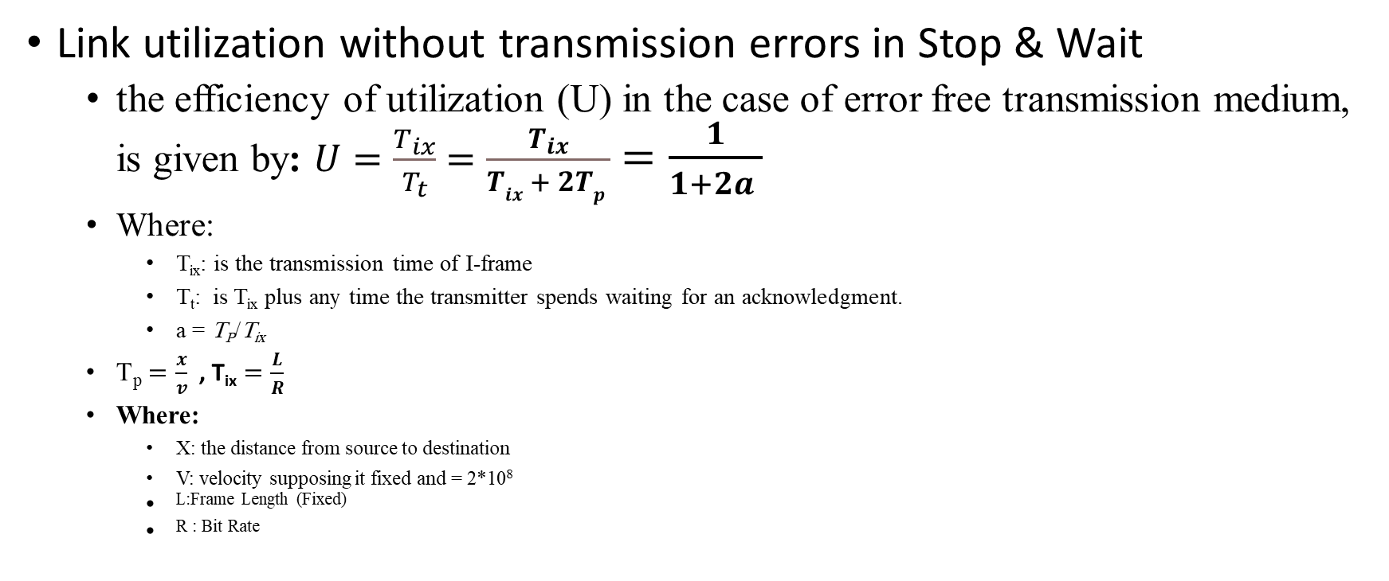
Link Utilization
Link utilization without transmission errors in Stop & Wait
the efficiency of utilization (U) in the case of error free transmission medium, is given by: $U=\frac{T_{ix}}{T_{t}}$ $=\frac{T_{ix}}{Tix + 2Tp }$ $=\frac{1}{{1+2a}_{ }}$
Where:
T_{ix}: is the transmission time of I-frame
T_{t}: is T_{ix} plus any time the transmitter spends waiting for an acknowledgment.
a = T_{P}/T_{ix}
T_{p} $=\frac{x}{v}$ , T_{ix} $=\frac{L}{R}$
Where:
X: the distance from source to destination
V: velocity supposing it fixed and = 2*10⁸
^{L:Frame Length (Fixed)}
^{R : Bit Rate}
T_{t}
T_{ix}
T_{p}
T_{p}
I-frame
ACK
I-frame
P
S
I-frame

Slide 22
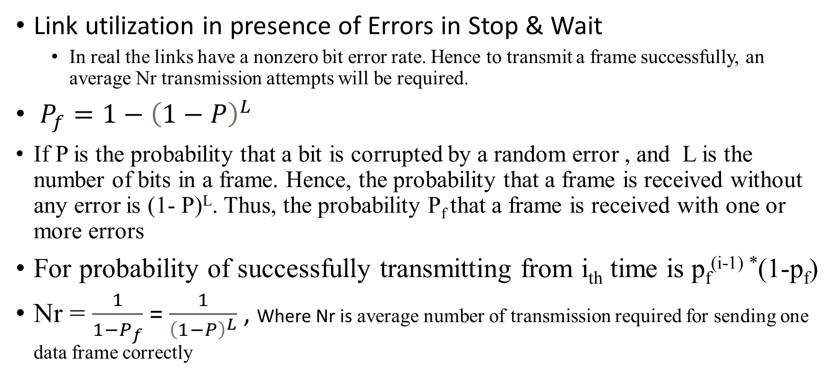
Cont.
Link utilization in presence of Errors in Stop & Wait
In real the links have a nonzero bit error rate. Hence to transmit a frame successfully, an average Nr transmission attempts will be required.
$P_{f}=1−{\left(1−P\right)}^{L}$
If P is the probability that a bit is corrupted by a random error , and L is the number of bits in a frame. Hence, the probability that a frame is received without any error is (1- P)^{L}. Thus, the probability P_{f} that a frame is received with one or more errors
For probability of successfully transmitting from i_{th} time is p_{f}^{(i-1) *}(1-p_{f})
Nr = $\frac{1}{1−P_{f}}$ = $\frac{1}{{\left(1−P\right)}^{L}}$, Where Nr is average number of transmission required for sending one data frame correctly

Slide 23
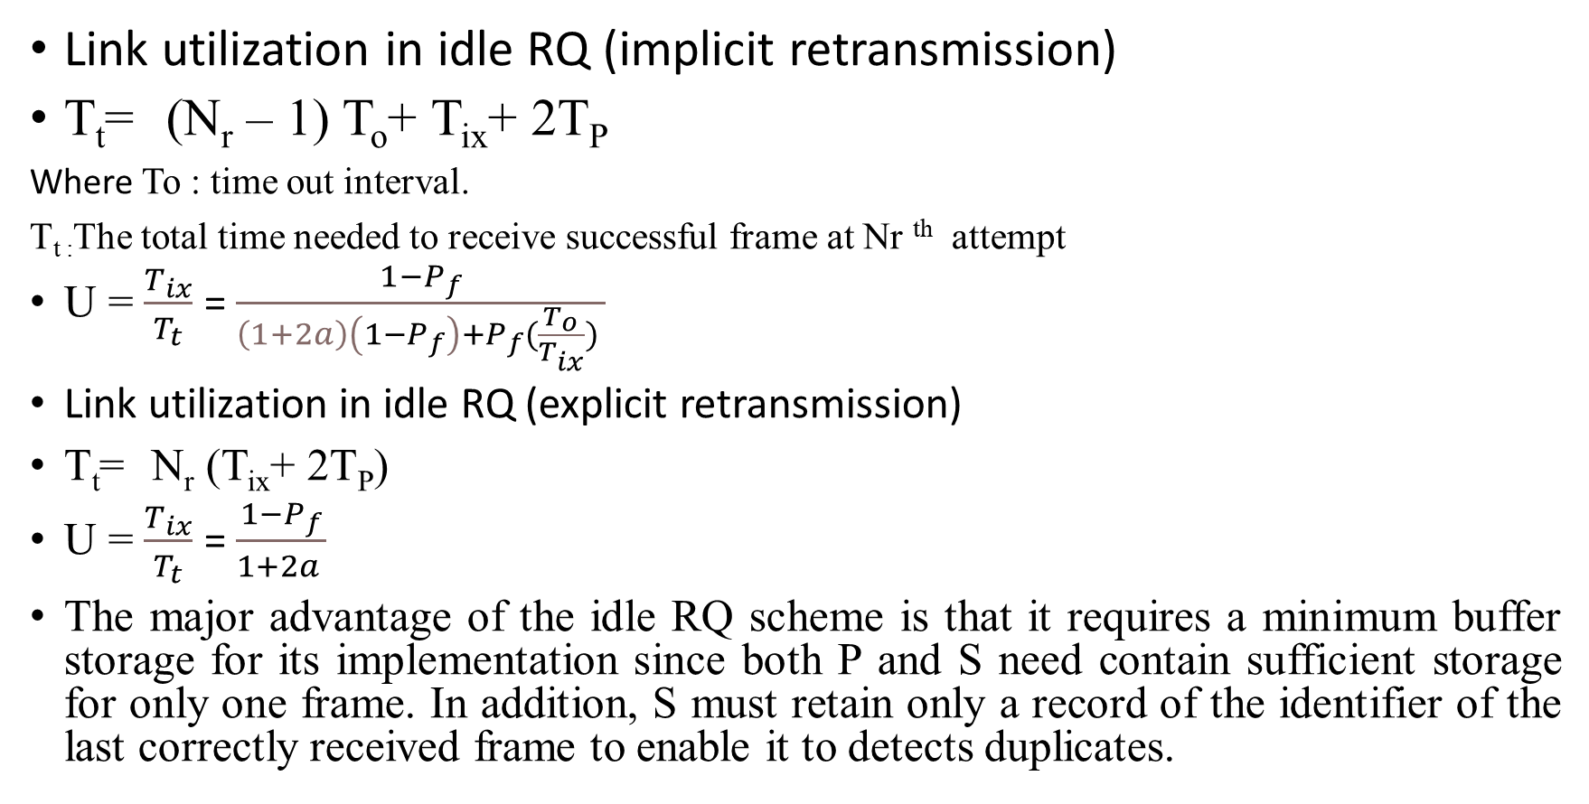
Cont.
Link utilization in idle RQ (implicit retransmission)
T_{t} =(N_{r} – 1) T_{o}+ T_{ix}+ 2T_{P}
Where To : time out interval.
T_{t :}The total time needed to receive successful frame at Nr ^{th} attempt
U = $\frac{T_{ix}}{T_{t}}$ = $\frac{1−P_{f}}{{\left(1+2a\right)\left(1−P_{f}\right)+P_{f}(\frac{T_{o}}{T_{ix}})}_{ }}$
Link utilization in idle RQ (explicit retransmission)
T_{t} =N_{r} (T_{ix}+ 2T_{P})
U = $\frac{T_{ix}}{T_{t}}$ = $\frac{1−P_{f}}{{1+2a}_{ }}$
The major advantage of the idle RQ scheme is that it requires a minimum buffer storage for its implementation since both P and S need contain sufficient storage for only one frame. In addition, S must retain only a record of the identifier of the last correctly received frame to enable it to detects duplicates.

Slide 24
implementing Continuous RQ mechanism:
link utilization is much improved at the expense of increased buffer storage requirements. A duplex link is required for continuous RQ error control scheme implementation.
V(S)
N+2
N+3
N+4
Retransmission
List
N+1
N+1
N+2
N+3
N
N
N
N+1
N+2
Primary P
I(N)
I(N+1)
I(N+2)
I(N+3)
ACK(N)
ACK(N+1)
ACK(N+2)
Time
Secondary S
I(N)
I(N+1)
I(N+2)
I(N+3)
N
N+1
N+2
N+3
Receive
List
V(R)
Error Free –continuous RQ-Transmission

Slide 25
Cont.
When an error does occur, one of two retransmission strategies may be followed:
Selective Repeat
On detecting corrupted frames, the receiving end, S sends requests to the transmitting end, for retransmission of just those frames in the sequence that are corrupted. Selective repeat can be implemented in one of the following two ways:
Implicit retransmission
Explicit retransmission.
In both schemes, in the event of frames being received out of sequence, S retains these in the link receive list until the next in-sequence frame is received.
Go-Back-N
Developed to solve overflow problem is the selective repeat.
When the secondary (receiver) detects an out of sequence frame, it informs the primary (transmitter) to start to retransmit frames from a specified frame number.

Slide 26
Implicit Selective Repeat
P enter retransmission state P leaves retransmission state
V(S)
N+4
V(S)
N+3
N+2
N+3
N+3
N+1
N+5
Retransmission
List
N+2
N+2
N
Retransmission
List
N+1
N+1
N+2
N+2
N+4
N+1
N+1
N+1
N+1
N+3
N
N
N
N
N+1
N+1
N+3
N+4
N
N
N
N
N+2
N+3
P
I(N)
I(N+1)
I(N+2)
I(N+3)
I(N+4)
I(N+1)
I(N+5)
P
I(N)
I(N+1)
I(N+2)
I(N+3)
I(N)
ACK(N)
ACK(N+2)
ACK(N+3)
ACK(N+4)
ACK(N+1)
ACK(N)
ACK(N+1)
ACK(N+2)
ACK(N+3)
ACK(N)
Time
Time
S
I(N)
I(N+2)
I(N+3)
I(N+4)
I(N+1)
I(N+5)
S
I(N)
I(N+1)
I(N+2)
I(N+3)
I(N)
N
N+1
N+2
N+3
Receive
List
N
N+2
N+2
N+2
N+2
N+5
Receive
List
N+3
N+3
N+3
N+4
N+4
N+1
Corrupted ACK- Frame
V(R)
N N+1 N+1 N+1 N+1 N+1 N+5
V(R)
Corrupted I- Frame

Slide 27
Explicit Selective Repeat
V(S)
P enter retransmission state P leaves retransmission state
N+5
N+4
N+4
Retransmission
List
V(S)
N+2
N+3
N+3
N+3
N+6
N+5
N+1
N+1
N+2
N+2
N+2
N+5
N+4
N+1
N+1
Retransmission
List
N
N
N
N+1
N+1
N+1
N+4
N+2
N+3
N+3
N+4
N+4
N+1
N+1
N+2
N+2
N+3
N+3
P
I(N)
I(N+1)
I(N+2)
I(N+3)
I(N+4)
I(N+5)
I(N+6)
N
N
N
N+1
N+1
N+2
N+2
N+5
P
I(N)
I(N+1)
I(N+2)
I(N+3)
I(N+4)
I(N+1)
I(N+5)
ACK(N)
NAK(N+1)
ACK(N+3)
ACK(N+4)
Time
ACK(N)
NAK(N+1)
ACK(N+4)
S
I(N)
I(N+2)
I(N+3)
I(N+4)
I(N+5)
I(N+6)
Time
S
I(N)
I(N+2)
I(N+3)
I(N+4)
I(N+1)
I(N+5)
N
N+2
N+2
N+2
N+2
N
N+2
N+2
N+2
N+2
N+5
Receive
List
N+3
N+3
N+3
Receive
List
N+3
N+3
N+3
N+4
N+4
N+4
N+4
N+5
N+1
V(R)
N N+1 N+1 N+1 N+1 N+1 N+5 N+6
V(R)
Corrupted I-Frame and NAK-Frame
Corrupted I- Frame
Notes:
use an explicit negative acknowledgment frame to request for a specific frame to be retransmitted.
* When S receives corrupted frame it returns a NAK –frame to P, containing the identifier of this corrupted I –frame.
* When S returns a NAK –frame, it enters the retransmission state. When S in the retransmission state, the return of ACK- frames is suspended.
* On receipt of the uncorrupted I–frame, S leaves the retransmission state and resumes returning ACK frames.
* An ACK – frame acknowledges all frames in the retransmission list up to and including the I–frame with the Sequence number the ACK contains.

Slide 28
Go – Back – N
V(S)
P enter retransmission state P leaves retransmission state
N+4
N+3
N+3
V(S)
N+2
N+2
N+2
N+5
Retransmission
List
N+1
N+1
N+1
N+1
N+4
N+4
N+4
Retransmission
List
N
N
N
N
N
N+3
N+2
N+3
N+3
N+3
N+1
N+1
N+2
N+2
N+2
P
I(N)
I(N+1)
I(N+2)
I(N+3)
I(N+4)
N
N
N
N+1
N+1
N+1
ACK(N)
ACK(N+1)
ACK(N+2)
ACK(N+3)
P
I(N)
I(N+1)
I(N+2)
I(N+3)
I(N+4)
I(N+1)
I(N+2)
I(N+4)
Time
ACK(N)
NAK(N+1)
S
I(N)
I(N+1)
I(N+2)
I(N+3)
I(N+4)
Time
S
I(N)
I(N+2)
I(N+3)
I(N+4)
I(N+1)
N
N+1
N+2
N+3
N+4
Receive
List
N
N+2
N+3
N+4
N+1
Receive
List
V(R)
V(R)
N N+1 N+1 N+1 N+1 N+1 N+2
N N+1 N+2 N+3 N+4 N+5
Frame discarded
Corrupted ACK- Frames
Corrupted I- Frame

Slide 29
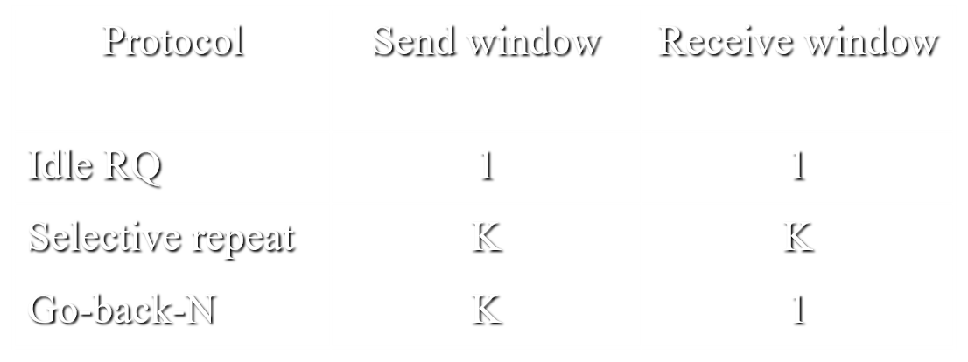
Sliding Window Flow Control mechanism
Recall that an idle RQ error control scheme, although inefficient in its use of transmission bandwidth, requires a minimum of buffer storage capacity. The flow of I–frames across the link is therefore automatically tightly controlled.
With a continuous RQ error control scheme, however, P may send I–frames continuously before receiving any acknowledgments. With this type of scheme, it is possible for the destination to run out of available buffer storage.
If the destination (S) is unable to pass on the frames sent to it, to the network layer, S stops returning acknowledgment frames, the retransmission list at P builds up and this in turn can be interpreted as a signal for P to stop transmitting further frames until acknowledgment stat to flow again.
To implement this scheme, a maximum limit is set on the number of I-frames that can be awaiting acknowledgment and hence outstanding in the retransmission list. This limit is the “send window, K”.
Factors such as the maximum frame size, available buffer storage, link propagation delay, and transmission bit rate must all be considered when selecting the send window size, K.
The Window K is equal to the Frames waiting to be acknowledged.
The maximum number of frame buffers required
At error – free transmission

Slide 30
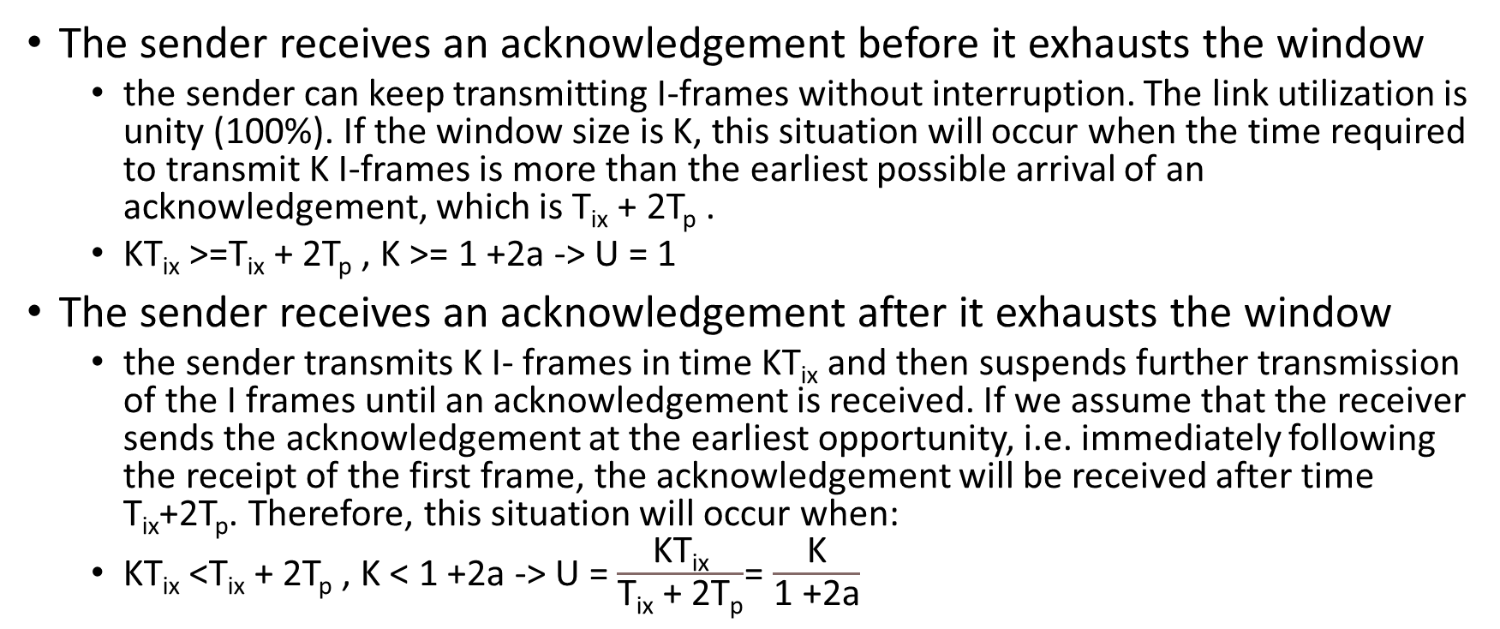
Link Utilization Continuous RQ (Error Free)
The sender receives an acknowledgement before it exhausts the window
the sender can keep transmitting I-frames without interruption. The link utilization is unity (100%). If the window size is K, this situation will occur when the time required to transmit K I-frames is more than the earliest possible arrival of an acknowledgement, which is T_{ix} + 2T_{p} .
KT_{ix} >=T_{ix} + 2T_{p} , K >= 1 +2a -> U = 1
The sender receives an acknowledgement after it exhausts the window
the sender transmits K I- frames in time KT_{ix} and then suspends further transmission of the I frames until an acknowledgement is received. If we assume that the receiver sends the acknowledgement at the earliest opportunity, i.e. immediately following the receipt of the first frame, the acknowledgement will be received after time T_{ix}+2T_{p}. Therefore, this situation will occur when:
KT_{ix} <T_{ix} + 2T_{p} , K < 1 +2a -> U = $\frac{\text{KT}\text{ix}}{\text{T}\text{ix}\text{ + }\text{2}\text{Tp}}$= $\frac{\text{K}}{\text{1 }\text{+}\text{2}\text{a}}$

Slide 31
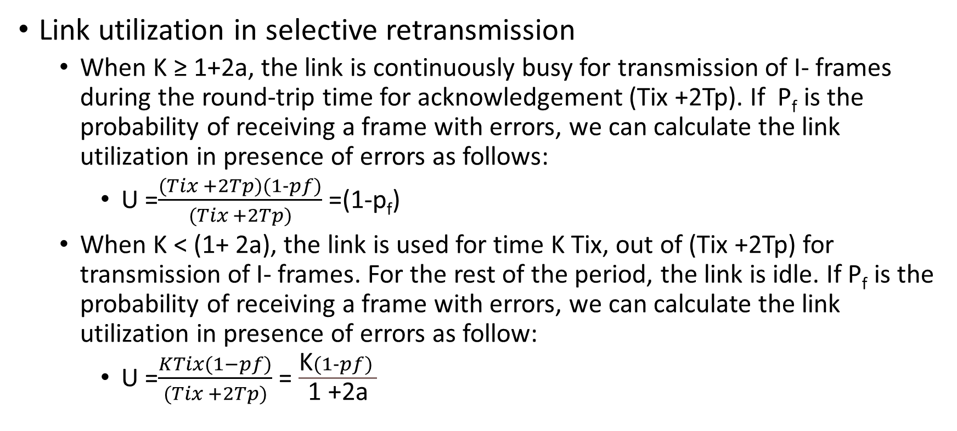
Link utilization in Presence of Errors Continuous RQ
Link utilization in selective retransmission
When K ≥ 1+2a, the link is continuously busy for transmission of I- frames during the round-trip time for acknowledgement (Tix +2Tp). If P_{f} is the probability of receiving a frame with errors, we can calculate the link utilization in presence of errors as follows:
U =$\frac{(Tix +2Tp)(1−pf)}{(Tix +2Tp)}$ =(1-p_{f})
When K < (1+ 2a), the link is used for time K Tix, out of (Tix +2Tp) for transmission of I- frames. For the rest of the period, the link is idle. If P_{f} is the probability of receiving a frame with errors, we can calculate the link utilization in presence of errors as follow:
U =$\frac{KTix(1−pf)}{(Tix +2Tp)}$ = $\frac{\text{K}(1−pf) }{\text{1 }\text{+}\text{2}\text{a}}$

Slide 32
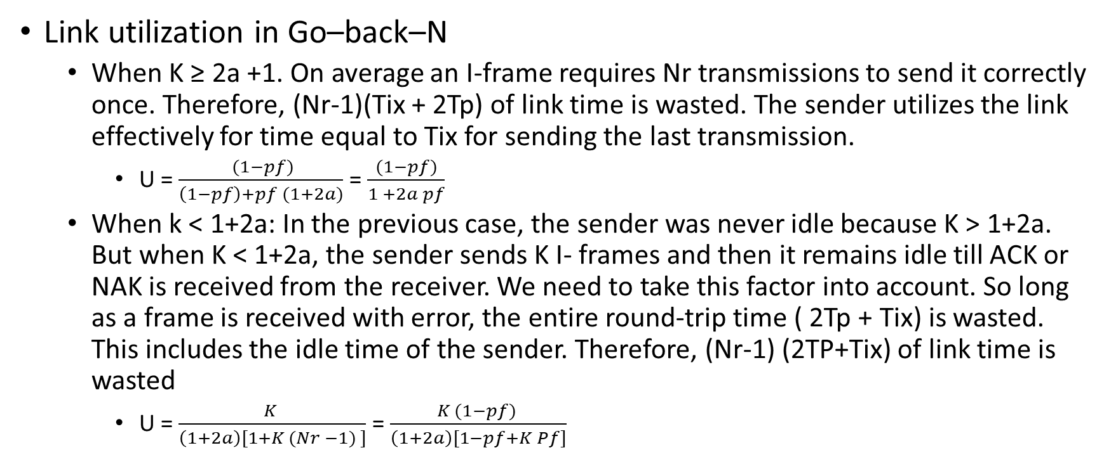
Cont.
Link utilization in Go–back–N
When K ≥ 2a +1. On average an I-frame requires Nr transmissions to send it correctly once. Therefore, (Nr-1)(Tix + 2Tp) of link time is wasted. The sender utilizes the link effectively for time equal to Tix for sending the last transmission.
U = $\frac{ (1−pf)}{\left(1−pf\right)+pf (1+2a)}$ = $\frac{ (1−pf) }{1 +2a pf}$
When k < 1+2a: In the previous case, the sender was never idle because K > 1+2a. But when K < 1+2a, the sender sends K I- frames and then it remains idle till ACK or NAK is received from the receiver. We need to take this factor into account. So long as a frame is received with error, the entire round-trip time ( 2Tp + Tix) is wasted. This includes the idle time of the sender. Therefore, (Nr-1) (2TP+Tix) of link time is wasted
U = $\frac{K }{\left(1+2a\right)[1+K (Nr −1) ]}$ = $\frac{K (1−pf) }{\left(1+2a\right)[1−pf+K Pf]}$

Slide 33




Medium Access Control (MAC)
an access method is needed and imposed on all the stations connected to the network to ensure that the transmission medium is accessed and used in a fair way. the needed access method should ensure one and only one station can access the transmission medium at a time. This access method is called medium access control, MAC, mechanism.

Slide 34
Carrier Sense Multiple Access (CSMA)
a station wishing to transmit listens to the medium (carrier sense) and obeys the following roles:
If the medium is in use (busy), the station must wait.
If the medium is idle, the station may transmit.
If may happen that two or more stations attempt to transmit at about the same time, there will be collision. the data will not be received successfully.
To account for this, a station waits a reasonable amount of time (round trip propagation delay) after transmitting for an acknowledgment.
if there is no acknowledgment, the station assumes that a collision has occurred and retransmits.
Collisions can occur only when more than one user begins transmitting within a short time (the period of the propagation delay).
If a station begins to transmit a frame and there are no collisions during the time it takes for the leading edge of the frame to propagate to the farthest station, then there will be no collision for this frame because all other station are now a ware of the transmission.
The maximum utilization depends on the length of the frame and on the propagation time; the longer the frames or shorter the propagation time, the higher the utilization.

Slide 35
CSMA approaches
non persistent CSMA
If the medium is idle, transmit; otherwise, go to step 2.
If the medium is busy, wait an amount of time drawn from a probability distribution (the retransmission delay) and repeat step 1.
The use of random delays reduces the probability of collisions.
1- persistent CSMA
If the medium is idle, transmit; otherwise, go to step 2.
If the medium is busy, continue to listen until the channel is sensed idle; then transmit immediately.
P- persistent CSMA
If the medium is idle, transmit with probability P and delay one time unit with probability (1-P). The time unit is typically equal to the maximum propagation delay.
If the medium is busy, continue to listen until the channel is sensed idle and repeat step 1.
If transmission is delayed one time unit, repeat step 1.

Slide 36
Carrier Sense Multiple Access Collision Detection ( CSMA/CD )
Made to solve CSMA Issues
if the medium is sidle, transmit; otherwise, go to step 2
if the medium is busy, continue to listen until the channel is idle, then transmit immediately.
if a collision is detected during transmission, the station ceases transmission of the frame, and transmits a brief jamming signal to ensure that all stations know that there has been a collision.
after transmitting the jamming signal, wait a random amount of time, referred to as the back off, then attempt to transmit again (repeat from step1)

Slide 37
MAC Frame Format
Field size
7
1
6
6
2
46 – 1500
4
bytes
Preamble
SFD
DA
SA
Length
Data
Pad
FCS
Preamble: Used for synchronization between the sending and receiving devices. It consists of a repeating pattern of 10101010.
Start of Frame Delimiter (SFD):Marks the end of the preamble and the start of the frame. It has a pattern of 10101011
Destination MAC Address: Specifies the MAC address of the intended recipient of the frame. This address can be unicast, multicast, or broadcast.
Source MAC Address: Specifies the MAC address of the sender of the frame.
Length: Indicates either the type of payload protocol (e.g., IPv4, IPv6, ARP) or the size of the payload if it is less than 1500 bytes.
Payload (Data Field): Contains the encapsulated data from a higher layer. This field must be at least 46 bytes to ensure a minimum frame size of 64 bytes; if the data is less than 46 bytes, padding is used.
Frame Check Sequence (FCS): Contains a 32-bit Cyclic Redundancy Check (CRC) used to detect errors in the transmitted frame.
Leftmost bit, (I/G) bit, of DA, indicates whether the address is individual or group address. If it is group address, the frame is accepted by all the members of the group. The second bit from the left, (U/L) bit, indicates whether the address pertains to universal addressing scheme administered by IEEE or it has locally administered address. Destination address containing all 1s is broadcast address.
The frame should be long enough (i.e. frame transmission time ≥ 2Tp) to allow collision detection prior to the end of transmission. If shorter frames are used, then collision detection does not occur, and CSMA/CD exhibits the same performance as the less efficient CSMA protocol.
Notes:
the maximum length of cable segment to 500m for 10 base 5 and 200m for 10 base 2.

Slide 38
Motivation for Using LAN Bridges
A local area network is the stand-alone network with capability to provide communication services to the end systems. There is however, always need to communicate with the stations connected on the other local area networks. LAN Bridge, Layer-2 Switch, and Router are the devices required to interconnect two or more local area networks.
Bridge is intermediary device that interconnect two or more local area networks.
Bridge partitions the collision domain and therefore the performance improves.
We don’t use bigger LANs and we separate LANs
There is limit on the maximum number of stations that can be connected on a single LAN.
The maximum physical size of a LAN is limited.
Upgrading the existing infrastructure can be very costly and the investments already made are wasted.

Slide 39
Devices
Bridge
Hup
A repeater merely regenerates electrical signals and extends the physical medium domain of a LAN. It works at the physical layer level. Thus a network having repeaters still constitutes one single LAN and single collision domain.
Router is a packet switch implemented at the layer-3. The packets are routed and forwarded at layer-3.Thus all physical layers and data link layer protocol differences are taken care of. The addressing scheme at the layer-3 is structured address. A layer-3 address is composed of two parts: - network part and host (end-system) part.
A
B
C
D
A
B
C
D
A
B
Repeater
C
D
Shared Medium Bus
A
B
C
D

Slide 40
LAN Bridge
Bridge is the device that is attached to two or more local area networks. It takes MAC frames from one LAN and sends them across to the other LAN. Note the difference between a bridge and a repeater. A repeater does not look at the address field and regenerates all the frames.
Due to the differences in the LAN technologies make it impractical to use the bridge to interconnect two dissimilar local area networks for the following reasons:
Each type of LAN has its own MAC protocol and MAC frame format.
The maximum size of MAC frame is different in LAN technologies.
The data rates are different
LAN management and priority management functions are different.
Therefore, Bridges generally interconnect LANs of the same MAC protocol type. Interconnection of dissimilar LAN types is nowadays dealt with using Router.

Slide 41
Bridge Architecture
LLC
Sub layer
LLC
Sub layer
R & R: Relay and Routing functions
The two physical layers and MAC sub layers are matched (similar) with those of two LANs. The two MAC sub layers of the bridge have relay and routing functions between them.
When a MAC frame is received by the bridge at its one port, it examines its destination address. If the bridge decides that the frame should be transferred across, it forwards the frame to the other port using relay and routing function.
The decision whether to forward the frame or not is either taken by the bridge (transparent bridge) or alternatively, the MAC frame itself contains the routing instruction (source routing bridge). It is to be noted that:
The bridged LANs maintain their identity although the user may not perceive so.
A bridge does not extend the collision domain of one Ethernet to the other interconnected Ethernet.
MAC
Sub layer
MAC
Sublayer
R&R
MAC
Sublayer
MAC
Sub layer
Physical
Layer
Physical
Layer
Physical
Layer
Physical
Layer
Port A
MAC Bridge
Port B

Slide 42
Types of Bridges
Transparent bridges
Transparent bridges are also known as spanning tree bridges. They are used in Ethernet environment.
A transparent bridge is invisible to the stations in the network. The stations perceive the network as an extended network. The routing decisions are made by the bridge. A transparent bridge creates and maintains a comprehensive forwarding table of all destination stations.
Source routing bridges
Source routing bridges are used for Token Ring LANs. Source routing is part of IEEE 802.5 token ring specifications.
the routing is decided by the station sending a frame .The sending station incorporates the route to be followed to the destination in the frame. The bridge merely follows the routing instructions incorporated by the source. The source routing bridges, therefore, do not require any routing table for forwarding frames.
Notes:
Transparent bridges, therefore, are more complex than source routing bridges.

Slide 43
Transparent Bridges
A transparent bridge works in "Plug and Play" mode
when the bridge is attached to two Ethernet LANs it starts working. The network software configurations of the station need not be altered in any way. The bridge achieves this result by operating in promiscuous mode, i.e., it receives all the frames whether they are addressed to it. It builds a forwarding table by looking at the source address of the frame that hits its port. Based on the table, the bridge can, then, forward the frames from one Ethernet to the other. Thus the description of the operation the transparent bridge as consisting of the following two basic functions:
Frame filtering and forwarding the frames based on the forwarding table.
Learning the addresses of the stations and creating forwarding table.

Slide 44
Frame Filtering and Forwarding
As Ethernet LANs operate in broadcast mode, all the frames, irrespective of their destination, appear at the port of the bridge connect to the LAN, The bridge maintains a table of the MAC address of the all stations on the extended bridge network. The table is maintained port-wise. In other words, by looking at the table, it is possible to find out the port on which a particular destination address is available. When a bridge receives a frame at any of its ports, it takes one of the following actions:
1. Filtering: If the destination address is available on the same port through which it received the frame, the bridge filters the frame.
2. Forwarding: If the bridge determines that the destination address is available on the different physical port than the one through which the frame was received, it forwards the frame onto that port. If the destination address on the frame is global address or multicast address, the bridge sends the frame on all its ports except the one from which it received the frame.
3. Flooding: If the bridge does not find the address in its forwarding table, it floods (sends) the frame on to all the physical ports except the one from which it received the frame.
SA
Bridge

Slide 45
Learning Address
When a bridge comes up for the first time, its forwarding table is empty. It builds up the address database by examining the source address field of the MAC frames that hits its ports. Whenever the bridge finds that the source address is not in its forwarding table, it updates the forwarding table with the source address and the identity of the port at which the frame was seen. Thus, as the stations exchange the frames, the bridge gradually builds up its forwarding table.
Multiple Paths Learning:
If the topology of the interconnected Ethernet LANs has loops, there will be more than one path interconnecting two segments of a network. Multiple interconnecting paths can affect network operations in three ways:
Confusion during address learning.
Endless circulation of frames with unknown destination.
Broadcast storm.
A
L₁
P₁
P₁
B1
B2
L₂
P₂
P₂
B

Slide 46
spanning tree protocol.
Multiple paths are built into the network to improve network resilience against failure of segment or a bridge of a network. When one path fails, the alternative path takes over. But multiple paths can not be allowed to coexist. Therefore, what we need to ensure is that there is only one path interconnecting any two segments of network at any point of time in the network. If there is a failure in any section of the network, an alternative path is automatically built through the redundant network resources. This is achieved through the spanning tree protocol.
A spanning tree is a graph structure that includes all the bridges and stations on an extended network, but it never has more than one active path connecting any two stations. Therefore, the complication of multiple path never occur.
we need an algorithm by which the bridges will be able to drive the spanning tree automatically. The algorithm must be such that topological changes in the network due to additions, deletions of stations or faults are automatically discovered and spanning tree is reworked dynamically.

Slide 47
Some Concepts
Root Bridge: the bridge with the lowest identifier is called the root bridge.
Port cost: each port of a bridge has an associated cost parameter, which is the cost of transmitting a frame through the particular port. The default value of the port cost is 1000/ (bit rate-Mbs). The port cost is associated with the bits transmission through a port. Reception of bits through a port has no cost attached to it.
Root path cost: Root path cost is the cost associated with a path to a root bridge from a port of another bridge. It is the sum of all the intervening port cost parameters. Note that cost of the transmitting ports only is added to arrive at the root path cost.
Root port: A bridge may have several paths emanating from its ports to the root bridge. The port having the least root path cost is called “Root Port.” If there are more than such ports, the port with the lowest port identification number is chosen as the root port.
Designated bridge: If there are several bridges connected to a LAN segment, one of the bridges is designated bridge for forwarding the data frames from that LAN segment. Selection of the designated bridge is based on the root path cost. The bridge that offers least root path cost from the LAN segment is selected as the designated bridge for that LAN segment. If more than one bridge have the same root path cost, the bridge with lower identifier number is chosen as the designated bridge.
Designated Port: the port of the designated bridge that connects to the LAN segment is called designated port.

Slide 48
Bridge Protocol Data Unit (BPDU)
To construct the spanning tree and for other management functions, a control frame called configuration Bridge Protocol Data Unit (BPDU) is exchanged by the bridges. Configuration BPDUs are generated by the bridges and have MAC multicast address. A configuration BPDU generated by a bridge contains the following fields:
Bridge Identifier (B-ID).
Root Identifier (R-ID) as perceived by bridge.
Root Path Cost (RPC) of the bridge.
Port Identifier (P-ID).
Any other information.
2
1
1
1
8
4
8
2
8
Protocol
Id
Port
ver
BPDU type
other
R-Id
RPC
B-Id
P-Id
other

Slide 49
Constructing the Spanning Tree
Constructing the spanning tree involves the following steps:
Identification of the root bridge,
Identification of the root ports, and
Selecting of the designated bridges for every LAN.
After the above steps are carried out, the root ports and the designated ports of the bridges are set in forwarding mode ( i.e. they become active for the data frames) and all other ports are retained in blocked mode. Once this is done, the goal of spanning tree algorithm is achieved and there will be only one path from any station in the network.
To begin with, all the ports of all the bridges are in blocked mode. A port in blocked mode does not accept any data frame but it accepts BPDUs.

Slide 50
Selection of the root bridge
The bridge with the lowest bridge identifier (B-Id) is selected as Root Bridge. Root Bridge is identified as follows:
Each bridge asserts that it is the root bridge by sending configuration BPDU on all its ports, Figure 2. It indicates its identity (B-Id), root bridge identity (R-Id) which is its own identity, root path cost (RPC) which is zero and port identity (P-Id) in the BPDUs.
If a bridge receives a configuration BPDU with lower root bridge identity than its own identity (R-Id < B-Id) on any of its ports, it stops sending its configuration BPDU and forwards the received BPDU on its other ports. When forwarded by a bridge, a BPDU undergoes the following changes:
The bridge puts its own identity in the (B-Id) field.
The bridge puts its own port identity in the (P-Id) field.
The root path cost is incremented by the cost of the port through which the BPDU is received because later it will be transmitting through this port. The root bridge identity (R-Id) is retained as it is.
If a bridge receives a configuration BPDU with higher root bridge identity (R-Id) than its own identity (B-Id) on a port, it continues sending its configuration BPDUs.

Slide 51
Identification of the root ports
Every bridge other than the root bridge determines its root port, which is the port with the lowest root path cost. It involves the following steps:
The configuration BPDUs generated by the root bridge are forwarded by all the other bridges on their ports. After making the necessary changes in the B-Id, P-Id, and RPC fields, Figure 3. The root path cost is incremented by the cost of the port through which the BPDU is received.
Each bridge determines which of its ports has the lowest root path cost and that port is selected as the root port. If there is a tie, the port with the lower port identifier is selected as root port.
The root ports are put in the forwarding mode. Other ports remain in the blocked mode.

Slide 52
Selection of the designated bridges and the designated ports
A bridge is designated for each LAN segment to carry its data frame to the other LAN segments. If there are several bridges connected to a LAN, the bridge that has the lowest RPC is selected as the designated bridge.
The decision of selecting the designated bridge is made by the bridges themselves.
Note that the root bridge is the designated bridge for all the LANs connected to it directly. From this moment onwards, normal network operation is possible. Every station will have only one path to any other station on the network.

Slide 53
Layer 2 Ethernet Switches
We have seen three types of Ethernet devices so far-repeater, hub, and transparent bridge. These devices are required when there is need to expand a local area network in terms of the number of stations and their geographic distribution. these Ethernet devices replaced by Ethernet switches, also called layer-2 switches.
in case of repeater or a hub, there is one Ethernet and one collision domain. As the numbers of stations and transmission rate increases, so does the collisions and eventually a stage comes the throughput performance deteriorates. At this stage it becomes necessary to partition the local area network using a bridge.
A bridge has buffer, and it uses a store and forward mechanisms to send the frames. Store and forward mechanism does not allow frames on one segment of the network to collide with the frames on the other segment of the network. Therefore, a bridge effectively partitions the network into separate Ethernets, each having its own collision domain. Thus, the constraint of supporting large number of stations on one local area network is overcome. But a bridge has limitations of number of ports. It can partition a LAN in a few segments, say two or four, which does not meet the requirement.
Layer-2 switch is functionally a multi-port bridge. It can have a number of ports ranging from 12 to a few hundreds. With such large number of ports, it is possible to create big collision free network. Each station is connected to the switch on point-to-point full duplex Ethernet link.
Repeaters and hub do not support different speeds at their ports, A transparent bridge can do this because it has buffer to store the frames temporarily. But this capability is fully made use of in layer-2 switches.

Slide 54
Latency in Ethernet Layer-2 Switch
When a frame is received on a port of a switch , the source address is added to the forwarding table, if it is not already there. The destination address in the frame is searched in the forwarding table for determining the output port of the switch. The frame is put in the queue for subsequent transmission on that port. Such layer2 switch is categorized as store and forward switch.
In a store and forward switch, the latency time is the time taken from ingress of the frame to its egress from switch. Minimum latency will be when there are no frames in the queue. For a 1500 octets frame at 10 Mbps the latency comes to over 1ms. Latency of the switch can be reduced by starting to forward the frame on the output port as soon as the source and the destination address have been received. Such layer-2 switch is called cut-through switch and it reduces the switch latency to less than 50µs.
However, there are several situations where cut-through switching will not work or may not be desirable. For example:
If the destination port is busy, the frame must put in the queue, so there is no advantage gained.
The source and the destination ports must be operating at the same data rate for cut-through to work.
If an error is detected in a frame, a store and forward switch will filter the frame, but a cut-through switch will not. Therefore, if error rate is above a defined threshold, the cut-through switches are designed to change over to store and forward mode.

Slide 55
Basic Features of Ethernet Layer-2 Switch
layer-2 switch is functionally similar to a multiple port bridge, so the basic features of layer-2 switch can be summarized as follows:
Layer -2 switches operate in the same way as transparent bridges for functions like address learning, filtering, and forwarding frames. They also have forwarding tables like bridges.
Spanning tree protocol is used to remove multiple paths between two stations.
Most of the stations are connected to switches on full duplex point to point links.
They support rate adaptation, i.e., a switch can send with the transmission rate at 100 Mbps on a port to another port of rate 10 Mbps.
The network is collision free if only point-to-point full duplex links are used.
a switch can have large number of ports. Several switches can be interconnected to meet the port requirements.
As compared to a bridge, a switch is faster because several of its functions are implemented in hardware. The current implementation of layer-2 networks use switches instead of bridges.

