Slide 1
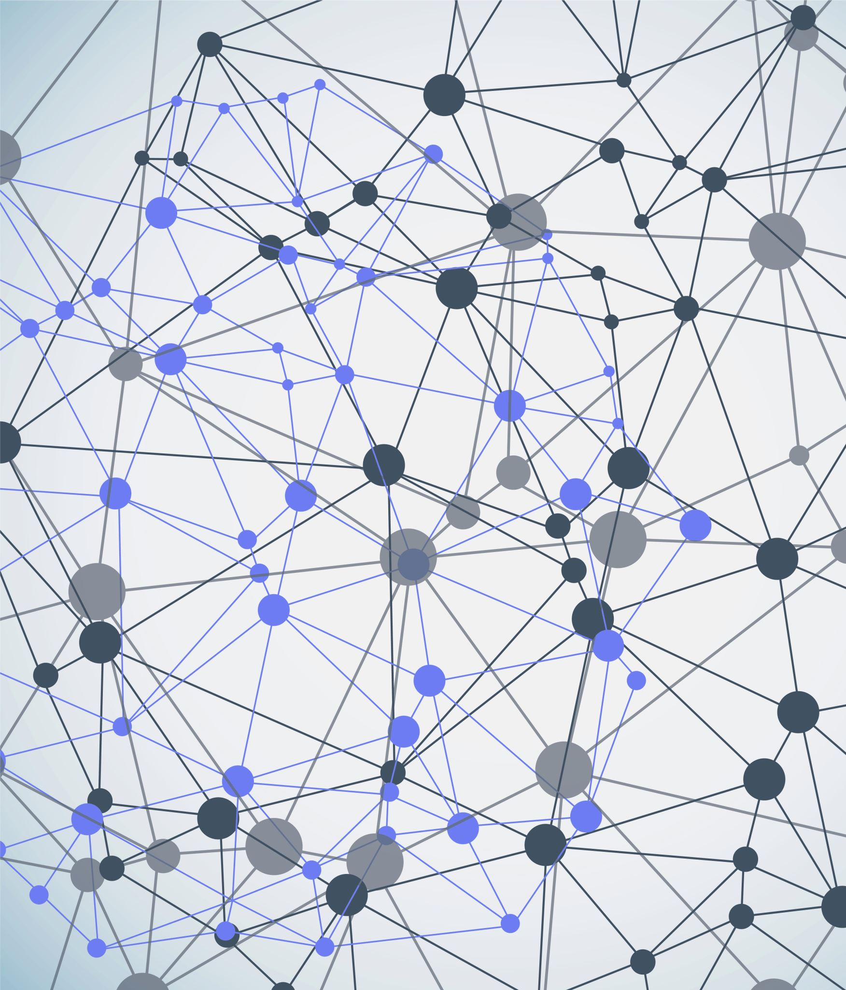
PhageMatch
Revolutionizing Phage Therapy Selection
Saarland University | Bioinfromatics

Slide 2
The Challenge We Face
The Big Problem: Antibiotic-resistant bacterial infections are a major and growing threat to global public health. Traditional antibiotics are becoming less effective.
A Promising Alternative: Phage therapy, which uses viruses called bacteriophages (phages) to specifically target and destroy bacteria, offers a powerful alternative.
The Bottleneck: However, finding the right phage for a specific infection is currently slow, difficult, and uncertain. This is due to the complex ways phages interact with bacteria.

Slide 3
The Difficulty of Current Phage Selection
Existing methods for matching phages to bacterial infections are time-consuming and labor-intensive.
They rely on empirical selection methods that lack the necessary speed and precision, especially for critical clinical settings.
The process is often uncertain because single types of data don't capture the full picture of complex phage-host interactions

Slide 4
Introducing PhageMatch
Our Solution: PhageMatch is a next-generation machine learning platform designed to solve the challenge of phage selection.
Our Goal: We optimize the process of finding the most effective phages for specific bacterial infections.
PhageMatch provides a faster, more precise solution for discovering suitable phages.

Slide 5
How PhageMatch Works
PhageMatch takes information about a bacterial infection as input.
Think of it like a powerful AI that analyzes vast amounts of data to understand how phages and bacteria interact.
The platform then provides a ranked list of recommended phages that are predicted to be most effective against the targeted bacteria, even quantifying the predicted effectiveness.

Slide 6
Why PhageMatch is Unique
Data Integration: PhageMatch is unique because it combines biological data which current approaches often miss. This gives us a more complete understanding and enhances accuracy.
Advanced AI: We leverage cutting-edge machine learning techniques like Graph Neural Networks and Self-Supervised Learning to predict interactions with high precision. This allows us to learn from large amounts of data and even generalize to new phages or bacteria.
Efficiency: By using this data-driven approach, PhageMatch significantly reduces the time and cost typically needed for phage selection.

Slide 7
Applications and Impact
Healthcare: PhageMatch helps hospitals and clinics fight multi-drug-resistant infections with personalized, precision phage therapy. This can improve patient outcomes and potentially reduce healthcare costs.
Agriculture & Veterinary Medicine: It assists in managing bacterial outbreaks in crops and livestock, contributing to food safety and productivity while reducing economic losses.
Research & Industry: We accelerate the discovery and development of new phage therapies and products.
Overall Impact: PhageMatch is a transformative step towards precision medicine and offers a scalable, cost-effective solution to the global antibiotic resistance crisis

Slide 8
How We Generate Value & Revenue
The Problem We Solve: Current methods for finding the right phage for an infection are slow, costly, and uncertain. PhageMatch provides a faster, more precise, data-driven solution.
Our Customers:
Healthcare
Agriculture & Veterinary Medicine
Research & Biotechnology Industry

