Slide 1
TITLE: Aviation Risk Assessment for Aircraft Acquisition
SUB-TITLE: Strategic Insights for Safe and Sustainable Aviation Portfolio Expansion
NAME: BRIAN KIPYEGON
DATE: 27TH MARCH 2025

Slide 2
Business problem
Company is expanding into aviation but lacks risk knowledge.
Need to determine safest aircraft to minimize financial and reputational risks

Slide 3
Objective
Identify the safest aircraft by analyzing safety records, accident history, locations, and engine performance.
Support decision-making for aircraft purchases.

Slide 4
Data & methodology
Data Source: NTSB (1962–2023, U.S. and international waters).
Tools: Python (Pandas, NumPy, Matplotlib), Tableau.
Key Variables: Aircraft make, engine type, engine count, flight phase.

Slide 5
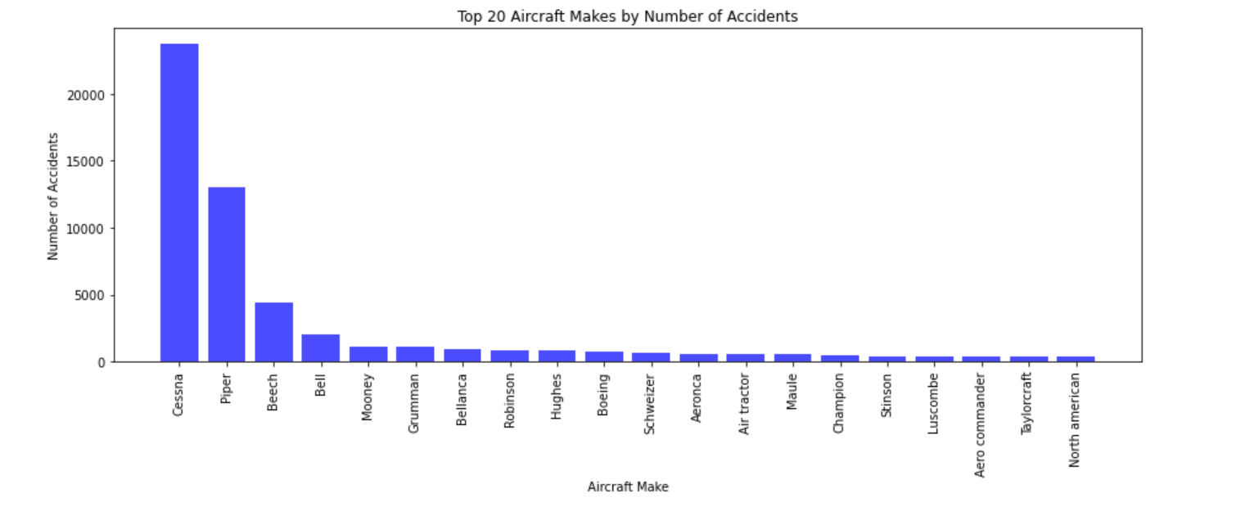
Aircraft make analysis
High Accident Makes: Cessna, Piper, Beech (>5,000 accidents each)
Implication: Avoid high-risk manufacturers.

Slide 6
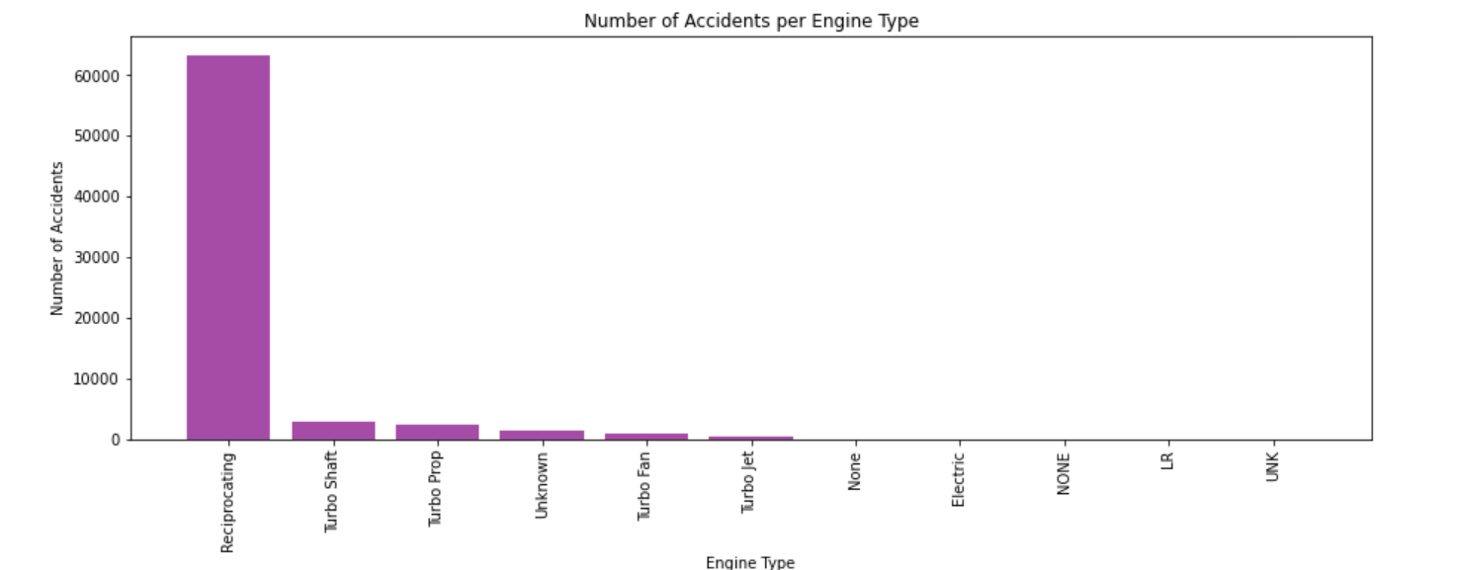
Engine type risk analysis
High Risk: Reciprocating engines have the most accidents.
Low Risk: UNK engines show the least accidents.
Implication: Prioritize aircrafts with UNK engines

Slide 7
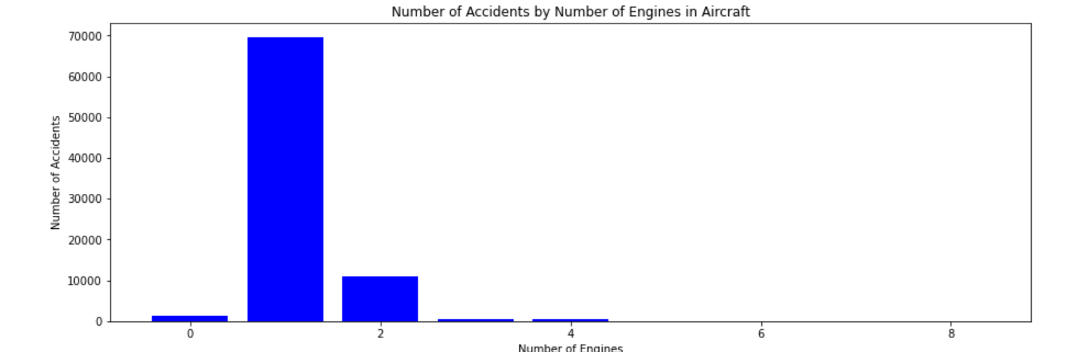
Engine count risk analysis
High Risk: Single-engine aircraft have the highest accident rates.
Low Risk: Multi-engine aircraft demonstrate better safety records.
Insight: Multi-engine configurations reduce the likelihood of complete power failure, increasing overall safety.

Slide 8
Link to tableau visualizations
https://public.tableau.com/app/profile/brian.kipyegon8353/viz/Aviation_Data_Vizzes/AnalysisofAviationAccidentsImpactofLocationFlightPhaseandEngineTypeonAccidentFrequency

Slide 9
Recommendations
Select Low-Risk Aircraft Makes: Avoid Cessna, Piper, Beech. Consider safer manufacturers.
Choose Multi-Engine Aircraft: Reduces failure risks, enhances safety.
Prioritize Safer Engine Types: Avoid reciprocating engines; prefer UNK engines

Slide 10
Next steps
Shortlist low-risk aircraft vendors.
Audit engine types.

Slide 11


Slide 12
Thank you

