Slide 1
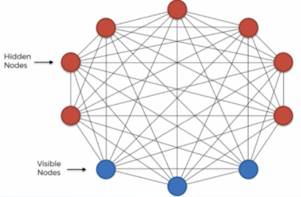
Deep Boltzmann Machine

Slide 2
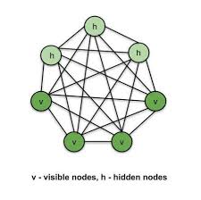
Boltzmann Machine
We will briefly cover Boltzmann Machines and their evolution into Deep Boltzmann Machines (DBMs).
A Boltzmann Machine is a network of symmetrically connected neurons like units that make stochastic decisions about whether to be on or off.

Slide 3
Boltzmann Machine
This definition means the network decides whether the network will be ON or Off position by the random probability distribution.
It belongs to the family of unsupervised learning; therefore, the model is solely responsible for decision-making when some input features are provided.
In Boltzmann Machine, the model does not give any output.
In contrast, it is responsible for finding the relationship between the input features.
Boltzmann Machines have an undirected model connection, they have connected both ways.

Slide 4
Objective of Boltzmann Machine
The fundamental goal of a Boltzmann Machine is to optimize a problem solution.
The Boltzmann Machine's job is to optimize the weights and quantities associated with that particular challenge.

Slide 5
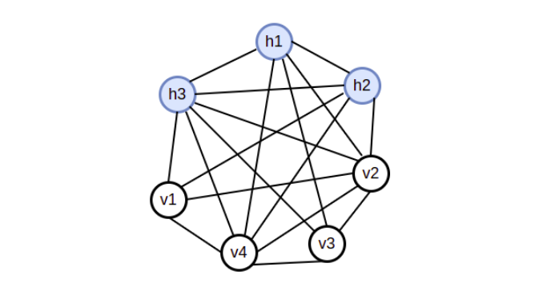
Architecture of Boltzmann Machine
Boltzmann Machines consist :
Visible units:
Represent the observed data.
Hidden units:
Capture complex dependencies between the visible units.
Visible neurons are nothing but the input layer.
Each neuron is connected to every neuron, and even the input neurons are connected.
The weights of neurons are used to represent the cost function of neurons.
For example, the weight between v₁ and v₄, namely W_{1,4} will define the cost function of V₁ and V₄ neurons.
Remember, Boltzmann Machine is only accountable for finding the relation between the input layers using the features, not the output.
Hidden layer
Visible layer

Slide 6
Boltzmann Machine
Boltzmann Machines : (Generative Models )
Generative Models vs. Discriminative Models:
- Generative Models:
Learn a joint probability distribution P(X, Y) and can generate new data instances.
Examples :- include Boltzmann Machines and GANs.
- Discriminative Models:
Learn the conditional probability P(Y | X) and are used for classification tasks.
Examples :- include logistic regression and SVMs.

Slide 7
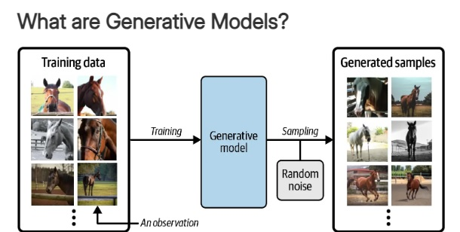

Slide 8
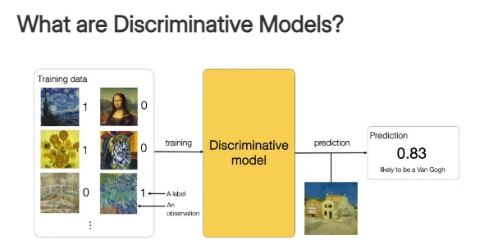

Slide 9
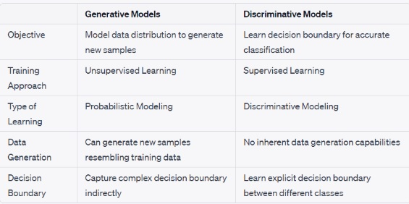

Slide 10
Types of Boltzmann machines
Restricted Boltzmann machine (RBM)
Deep Belief Network (DBN)
Deep Boltzmann machine (DBM)

Slide 11
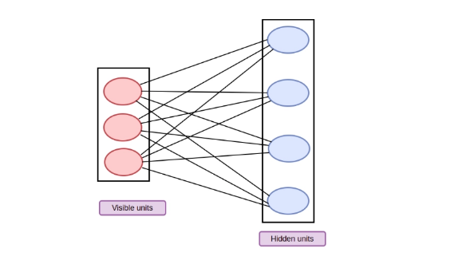
Restricted Boltzmann machine (RBM)
Restricted term means we cannot connect the same type of layer. In other words, the two neurons in the input or hidden layer cannot communicate even though the hidden and visible layers can be linked !?
Because there is no output layer in this machine, the question of how we will identify, update the weights, and measure whether our prediction is correct or not arises.
All of the questions have a single answer: Restricted Boltzmann Machine.
Geoffrey Hinton (2007) proposed the RBM algorithm, which learns probability distributions from sample training data inputs.
It has widespread use in supervised and unsupervised Machine learning applications such as feature learning, dimensionality reduction, classification, collaborative filtering, and topic modeling.

Slide 12
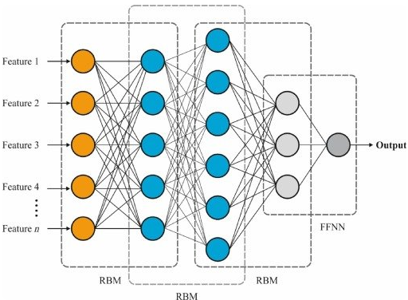
Deep Belief Network(DBN)
It is a generative model which uses multiple stacks of the deep architecture of the Restricted Boltzmann Machine.
Each restricted Boltzmann machine performs a non-linear transformation on the input neurons and produces the outputs that serve as the input for the consecutive model.
Deep Belief Networks can act supervised or unsupervised as they have a generative model.
Due to it, Deep Belief Networks has a lot of flexibility, and it is easier to expand.

Slide 13
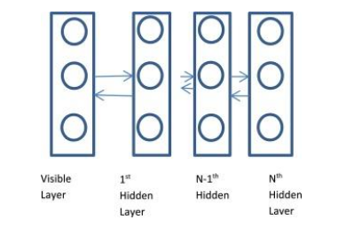
Deep Boltzmann machine (DBM)
Deep Boltzmann machine is a model with additional hidden layers and directionless connections between the nodes.
DBM learns features from raw data in a hierarchical manner, and the features recovered in one layer are applied as hidden variables as input to the subsequent layer.
To define the training information, weight initialization, and adjustment parameters, the DBM training method must be modified.
According to the DBM, temporal complexity limitations will occur when the parameters are set to ideal.
Montavon et al presented a centering optimization strategy to make the learning process more robust and for midsized DBM to construct a generative, quicker, and discriminative model.

Slide 14
Deep Boltzmann machines
In general, we will rarely be interested in learning a complex, fully connected Boltzmann machine.
Instead, consider learning a deep multilayer Boltzmann machine
Deep Boltzmann machines are interesting for several reasons:
First, like deep belief networks, DBM’s have the potential of learning internal representations that become increasingly complex, which is considered to be a promising way of solving object and speech recognition problems.
Second, high-level representations can be built from a large supply of unlabeled sensory inputs and very limited labeled data can then be used to only slightly ﬁne-tune the model for a speciﬁc task at hand.
Finally, unlike deep belief networks, the approximate inference procedure, in addition to an initial bottom up pass, can incorporate top-down feedback, allowing deep Boltzmann machines to better propagate uncertainty about, and hence deal more robustly with, ambiguous inputs.

Slide 15
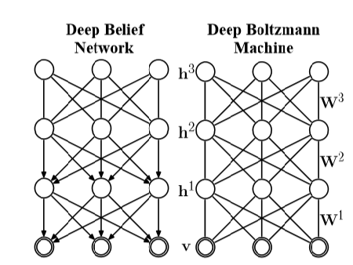
Deep Boltzmann machine (DBM)
A three-layer Deep Belief Network and a three-layer Deep Boltzmann Machine

Slide 16
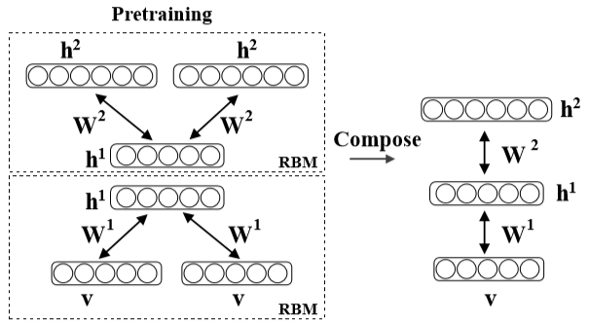

Deep Boltzmann machine (DBM)
Pretraining consists of learning a stack of modiﬁed RBM’s, that are then composed to create a deep Boltzmann machine.
Consider a two-layer Boltzmann machine with no within-layer connections.
The energy of the state {v,h1,h2} is deﬁned as:
where θ = {W1,W2} are the model parameters, representing visible-to-hidden and hidden-to-hidden symmetric interaction terms.

Slide 17

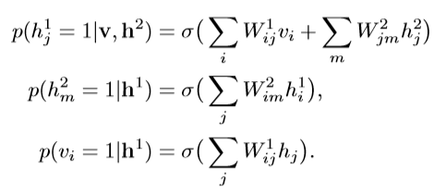
Deep Boltzmann machine (DBM)
The probability that the model assigns to a visible vector v is:
The conditional distributions over the visible and the two sets of hidden units are given by logistic functions:

Slide 18
Deep Boltzmann machine (DBM)
For approximate maximum likelihood learning, we could still apply the learning procedure for general Boltzmann machines described above, but it would be rather slow, particularly when the hidden units form layers which become increasingly remote from the visible units.
There is, however, a fast way to initialize the model parameters to sensible values as we describe in the next section

Slide 19
Greedy Layerwise Pretraining of DBM’s
is a technique used in training Deep Boltzmann Machines (DBMs) where the model is trained one layer at a time in a greedy, unsupervised manner.
Hinton et al. (2006) introduced a greedy, layer-by-layer unsupervised learning algorithm that consists of learning a stack of RBM’s one layer at a time.
After the stack of RBM’s has been learned, the whole stack can be viewed as a single probabilistic model, called a “deep belief network”.
Surprisingly, this model is not a deep Boltzmann machine.
The top two layers form a restricted Boltzmann machine which is an undirected graphical model, but the lower layers form a directed generative model

Slide 20


Greedy Layerwise Pretraining of DBM’s
After learning the ﬁrst RBM in the stack, the generative model can be written as:
Where is an implicit prior over h1 deﬁned by the parameters.
The second RBM in the stack replaces :

Slide 21
Greedy Layerwise Pretraining of DBM’s
To initialize model parameters of a DBM, we propose greedy, layer-by-layer pretraining by learning a stack of RBM’s, but with a small change that is introduced to eliminate the double-counting problem when top-down and bottom-up inﬂuences are subsequently combined.
For the lower-level RBM, we double the input and tie the visible-to-hidden weights.

Slide 22
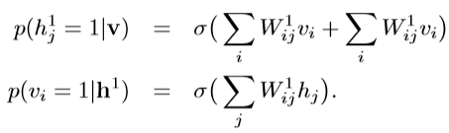
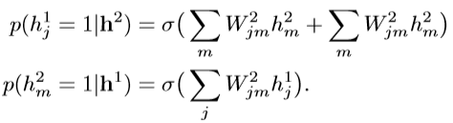
Greedy Layerwise Pretraining of DBM’s
In this modiﬁed RBM with tied parameters, the conditional distributions over the hidden and visible states are deﬁned as:
Contrastive divergence learning works well and the modiﬁed RBM is good at reconstructing its training data.
Conversely, for the top-level RBM we double the number of hidden units.
The conditional distributions for this model take the form:

Slide 23

Greedy Layerwise Pretraining of DBM’s
When these two modules are composed to form a single system, the total input coming into the ﬁrst hidden layer is halved which leads to the following conditional distribution over h1:
The conditional distributions over v and h2 stay consistent.
The composed model's conditional distributions match those of the DBM.
Greedy pretraining of modified RBMs forms a symmetric-weighted deep Boltzmann machine.
When training a stack of more than two RBMs, modify the first and last RBMs and halve the weights for intermediate ones.
Pretraining DBM weights speeds up inference and initializes sensible values, leading to faster convergence than random initialization.

Slide 24
Evaluating DBM’s
Recently, Salakhutdinov and Murray (2008) showed that a Monte Carlo based method, Annealed Importance Sampling (AIS) (Neal, 2001), can be used to efﬁciently estimate the partition function of an RBM.
In this section we show how AIS can be used to estimate the partition functions of deep Boltzmann machines.
Together with variational inference this will allow us obtain good estimates of the lower bound on the log-probability of the test data.
Suppose we have two distributions deﬁned on some space X with probability density functions: p A(x) = p*A(x)/ZA and p*B(x) = p*B(x)/ZB.
Typically p A(x) is deﬁned to be some simple distribution with known ZA and from which we can easily draw i.i.d. samples. AIS estimates the ratio ZB/ZA by deﬁning a sequence of intermediate probability distributions: p0,...,pK, with p0 = pA and pK=pB.
For each intermediate distribution we must be able to easily evaluate the unnormalized probability p∗ k(x), and we must also be able to sample x′ given x using a Markov chain transition operator Tk(x′;x) that leaves pk(x) invariant
Using the special layer-by-layer structure of deep Boltzmann machines, we can derive a more efﬁcient AIS scheme for estimating the model’s partition function

Slide 25
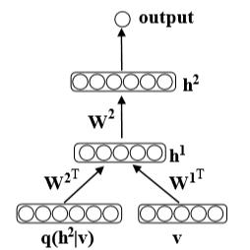
Discriminative Fine-tuning of DBM’s
After learning, the stochastic activities of the binary features in each layer can be replaced by deterministic, real valued probabilities, and a deep Boltzmann machine can be used to initialize a deterministic multilayer neural network in the following way.
For each input vector v, the mean ﬁeld inference is used to obtain an approximate posterior distribution q(h | v).
The marginals q(h2 j = 1|v) of this approximate posterior, together with the data, are used to create an “augmented” input for this deep multilayer neural network as shown in Fig.

Slide 26
Discriminative Fine-tuning of DBM’s
Standard backpropagation can then be used to discriminatively ﬁne-tune the model.
The unusual representation of the input is a by-product of converting a DBM into a deterministic neural network.
In general, the gradient-based ﬁne-tuning may choose to ignore q(h2|v), i.e. drive the ﬁrst-layer connections W2 to zero, which will result in a standard neural network net.
Conversely, the network may choose to ignore the input by driving the ﬁrst-layer W1 to zero.
In all of our experiments, however, the network uses the entire augmented input for making predictions.

Slide 27
Discriminative Fine-tuning of DBM’s
mini-batches, each containing 100 cases, and updated the weights after each mini-batch.
The number of fantasy particles used for tracking the model’s statistics was also set to 1002.
For the stochastic approximation algorithm, we always used 5 Gibbs updates of the fantasy particles.
The initial learning rate was set 0.005 and was gradually decreased to 0.
For discriminative ﬁne-tuning of DBM’s we used the method of conjugate gradients on larger mini-batches of 5000 with three line searches performed for each minibatch in each epoch

Slide 28
Experimental Results
In our experiments we used the MNIST and NORB datasets.
mini-batches, each containing 100 cases, and updated the weights after each mini-batch.
The number of fantasy particles used for tracking the model’s statistics was also set to 1002.
For the stochastic approximation algorithm, we always used 5 Gibbs updates of the fantasy particles.
The initial learning rate was set 0.005 and was gradually decreased to 0.
For discriminative ﬁne-tuning of DBM’s we used the method of conjugate gradients on larger mini-batches of 5000 with three line searches performed for each minibatch in each epoch.

Slide 29
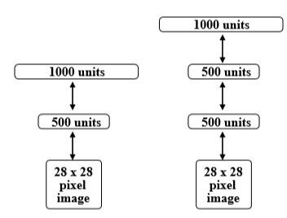
MNIST
The MNIST digit dataset contains 60,000 training and 10,000 test images of ten handwritten digits (0 to 9), with 28×28 pixels
In our ﬁrst experiment, we trained two deep Boltzmann machines: one with two hidden layers (500 and 1000 hidden units), and the other with three hidden layers (500, 500, and 1000 hidden units).

Slide 30
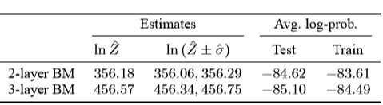
MNIST
To estimate the model’s partition function we used 20,000 βk spaced uniformly from 0 to 1.0.
Table 1 shows that the estimates of the lower bound on the average test log probability were −84.62 and −85.18 for the 2- and 3-layer BM’s respectively.
This result is slightly better compared to the lower boundof−85.97, achieved by a two-layer deep belief network (Salakhutdinov and Murray, 2008)

Slide 31
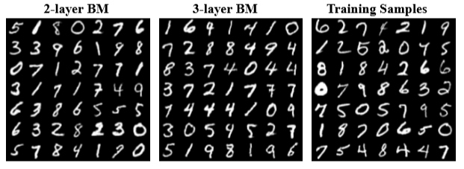
MNIST
Observe that the two DBM’s, that contain over 0.9 and 1.15 million parameters, do not appear to suffer much from overﬁtting.
The difference between the estimates of the training and test log-probabilities was about 1 nat. Fig. 4 shows samples generated from the two DBM’s by randomly initializing all binary states and running the Gibbs sampler for 100,000 steps.
Certainly, all samples look like the real handwritten digits.
We also note that without greedy pretraining, we could not successfully learn good DBM models of MNIST digits.

Slide 32
NORB
Results on MNIST show that DBM’s can signiﬁcantly outperform many other models on the well-studied but relatively simple task of handwritten digit recognition.
In this section we present results on NORB, which is considerably more difﬁcult dataset than MNIST.
NORB (LeCun et al., 2004) contains images of 50 different 3D toy objects with 10 objects in each of ﬁve generic classes: cars, trucks, planes, animals, and humans.
Each object is captured from different viewpoints and under various lighting conditions.
The training set contains 24,300 stereo image pairs of 25 objects, 5 per class, while the test set contains 24,300 stereo pairs of the remaining, different 25 objects.
The goal is to classify each previously unseen object into its generic class.
From the training data, 4,300 were set aside for validation.

Slide 33
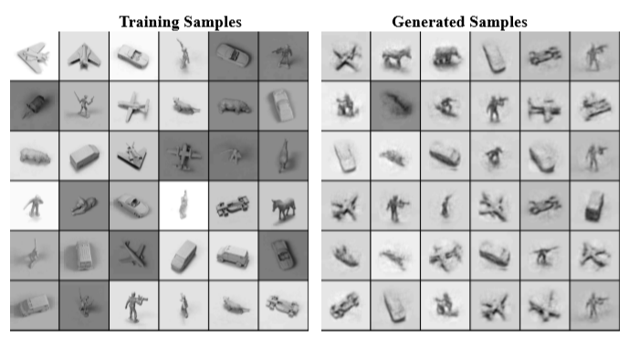
NORB
Each image has 96×96 pixels with integer greyscale values in the range [0,255].
To speed-up experiments, we reduced the dimensionality of each image from 9216 down to 4488 by using larger pixels around the edge of the image4.
A random sample from the training data used in our experiments .

Slide 34
NORB
To model raw pixel data, we use an RBM with Gaussian visible and binary hidden units. Gaussian-binary RBM’s have been previously successfully applied for modeling greyscale images, such as images of faces (Hinton and Salakhutdinov, 2006).
However, learning an RBM with Gaussian units can be slow, particularly when the input dimensionality is quite large.
Here we follow the approach of (Nair and Hinton, 2008) by ﬁrst learning a Gaussian-binary RBM and then treating the activities of its hidden layer as “preprocessed” data.
Effectively, the learned low-level RBM acts as a preprocessor that converts greyscale pixels into binary representation which we then use for learning a deep Boltzmann machine.

Slide 35
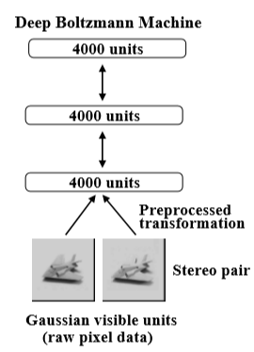
NORB
The number of hidden units for the preprocessing RBM was set to 4000 and the model was trained using contrastive divergence learning for 500 epochs.
We then trained a two layer DBM with each layer containing 4000 hidden units.

Slide 36
NORB
Note that the entire model was trained in a completely unsupervised way.
After the subsequent discriminative ﬁne-tuning the “unrolled” DBM achieves a misclassiﬁcation error rate of 10.8% on the full test set.
This is compared to 11.6% achieved by SVM’s (Bengio and LeCun, 2007), 22.5% achieved by logistic regression, and 18.4% achieved by the K-nearest neighbours (LeCun et al., 2004).
To show that DBM’s can beneﬁt from additional unlabeled training data, we augmented the training data with additional unlabeled data by applying simple pixel translations, creating a total of 1,166,400 training instances.

Slide 37
NORB
After learning a good generative model, the discriminative ﬁne-tuning(using only the 24300labeled training examples without any translation) reduces the misclassiﬁcation error down to 7.2%.
Figure shows samples generated from the model by running prolonged Gibbs sampling.

Slide 38
NORB
Note that the model was able to capture a lot of regularities in this high dimensional highly-structured data, including different object classes, various viewpoints and lighting conditions.
Although the DBM model contains about 68 million parameters, it signiﬁcantly outperforms many of the competing methods.
Clearly, unsupervised learning helps generalization because it ensures that most of the information in the model parameters comes from modeling the input data.
The very limited information in the labels is used only to slightly adjust the layers of features already discovered by the deep Boltzmann machine

Slide 39
References
Author : Anju Jaiswal link : https://www.naukri.com/code360/library/boltzmann-machine---introduction
Ruslan Salakhutdinov Department of Computer Science University of Toronto rsalakhu@cs.toronto.edu
Geoffrey Hinton Department of Computer Science University of Toronto hinton@cs.toronto.ed

