Slide 1

Machine Learning Based
IoT Network Intrusion Detection Classification
Harshil Patel & Yuesheng Chen
Ohio State University, USA
4-23-2020
Notes:
Introduce your sel

Slide 2
Motivation
Traditional Security Solutions
IoT traditional network security solutions may not be directly applicable due to the differences in IoT structure and behavior.
Low Operating Energy
Low operating energy and minimal computational capabilities.
Therefore security mechanism such as encryption protocols and authentication can not be directly applied.
IoT Architecture
The lack of a single standard for IoT architecture.
IoT systems may have different policies, and connectivity domains.
IoT networks have become an increasingly valuable target of malicious attacks due to the increased amount of valuable user data they contain. In response, network intrusion detection systems have been developed to detect suspicious network activity.

Slide 3
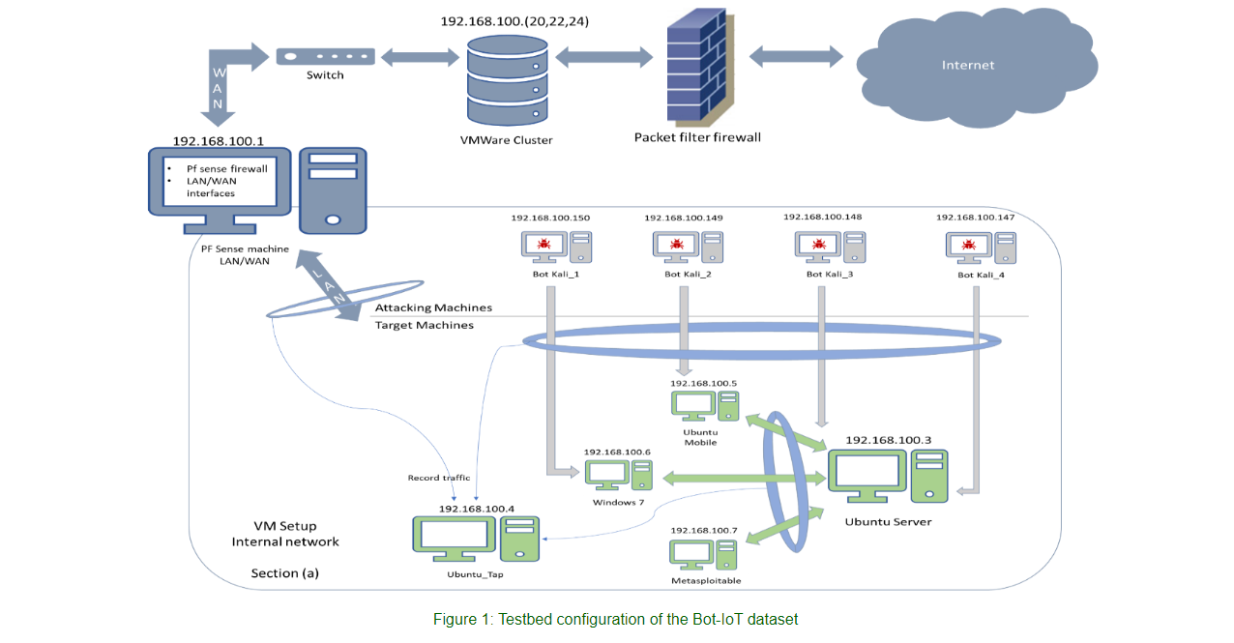
UNSW-NB15 Dataset
UNSW-NB15 is an IoT-based network traffic data set with different categories for normal activities and malicious attack behaviors.
Network data set included 2.5 million data points with 47 features and two target labels: Is the data point attack (referred as "attack or not") and the category of attack.

Slide 4
Literature Review
Moustafa, Nour, and Jill Slay. "UNSW-NB15: a comprehensive data set for network intrusion detection systems (UNSW-NB15 network data set)." Military Communications and Information Systems Conference (MilCIS), 2015. IEEE, 2015.
Moustafa, Nour, and Jill Slay. "The evaluation of Network Anomaly Detection Systems: Statistical analysis of the UNSW-NB15 dataset and the comparison with the KDD99 dataset." Information Security Journal: A Global Perspective (2016): 1-14.
M. Stevanovic and J. M. Pedersen, "An efficient flow-based botnet detection using supervised machine learning," 2014 International Conference on Computing, Networking and Communications (ICNC), Honolulu, HI, 2014, pp. 797-801.

Slide 5
Previous Methodology
Data Preprocessing
Response Features
CSV processed with:
1-Pandas, NumPy, skitLearn
2-Remove NaN`s
3-Training & Testing 4-Encoding Transformation
1 -Attack or Normal
2 –Attack Classification
1
2
3
4
Model Selection
ML algorithms:
1-Logistic Regression
2-Descion Trees
3-Random Forests 4-Multi-Layer Perceptron Classifier
Model Comparison & Inspection
Determine which model should be used to classify category attacks and network intrusions on IoT networks. Also discover relevant features for model inspection.

Slide 6
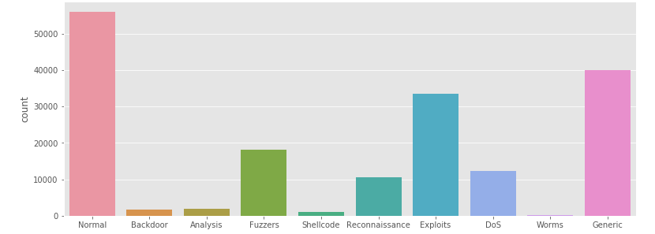
Attack Category Classifier
Attack Type Classification
This dataset has nine types of attacks: Fuzzers, Analysis, Backdoors, DoS, Exploits, Generic, Reconnaissance, Shellcode and Worms.
The methodology of previously to use ML algorithm as a primary classifier likely reduces accuracy as malicious types of attacks in classification process are likely to be missed.

Slide 7
New Methodology: Feed-Forward Classifier
Testing Data
Random Forest Classifier
Testing Data
Neural Network
+
Attack or Normal
Category
Attack or Normal
Prediction
Final Prediction
Using a random forest and feed-forward neural network.
The model uses the random forest that classifies data to normal or malicious data.
This information is then used to train a neural network to further classify the attack data to different attack categories using the previous classification as a feature.

Slide 8
Feed-Forward Classifier Python Notebook
Train the random forest to predict “attack or normal” label with training data.
Use the random forest to generate new “attack or normal” feature to the testing data.
Train the neural network to predict attack categories with training data including “attack or not” feature.
Predict attack category with the testing data (with generated ”attack or not” feature).
Apply performance metrics to measure how well the model generalizes the data

Slide 9
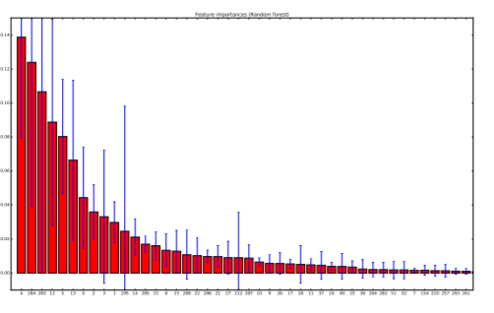
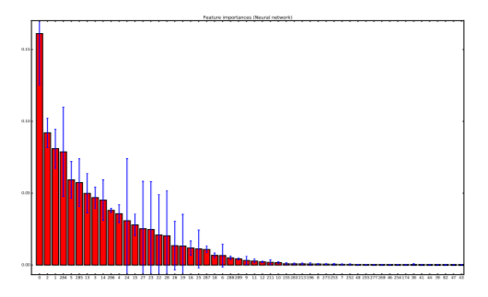
Feed-Forward Classifier: Importance Plots
Feature importance's for ”attack or not” (random forest) classifier.
Feature importance's for category (neural network) classifier.
The feature is the ”attack or not” label has much greater importance in attack classification neural network.
Thus, it makes sense that to separate normal network data from other attack categories.

Slide 10
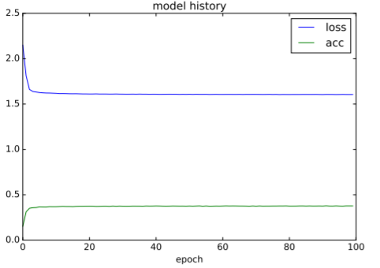
Feed-Forward Classifier
Random Forest Classifier:
For the attack detection case Scikit-Learn ExtraTreesClassifier was used with 31 estimators (decision trees).
Neural Network Classifier:
Layer | Neurons (Dimensions) | Activation | Dropout | Epoch
Dense | 1250 | Sigmoid | 0.75 | 100
The neural network architecture was refined by trial and error.
Different activation functions: sigmoid had always the best results.
Dense layers are fully connected layers and larger number of neurons resulted to better classification results.
Loss Function: categorical cross-entropy

Slide 11
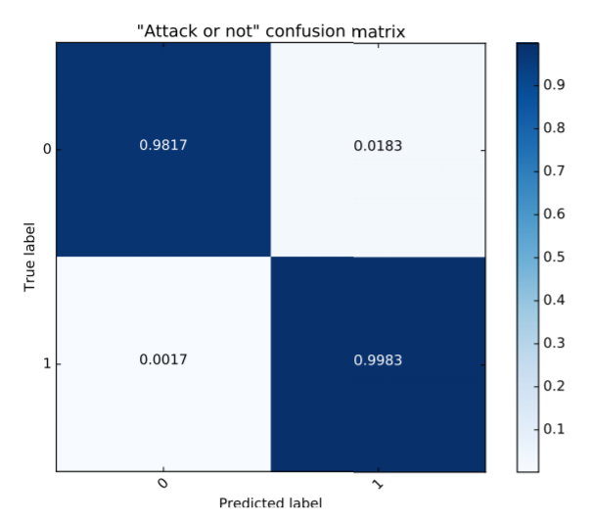
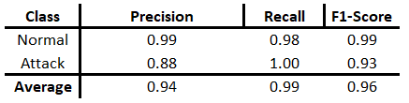
Results: Feed-Forward Classifier
”Attack or Normal” Classification:

Slide 12
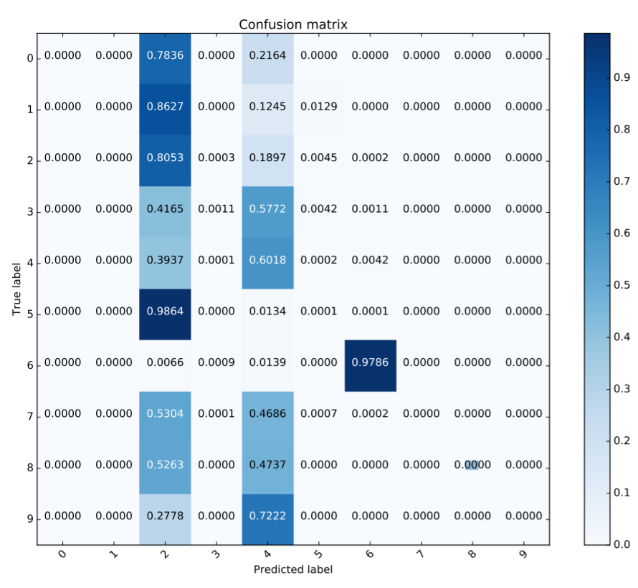
Results: Feed-Forward Classifier
Attack Category Classification
Nine types of attacks: Fuzzers, Analysis, Backdoors, DoS, Exploits, Generic, Reconnaissance, Shellcode and Worms.
The attack classes are represented with numbers 0–9.
The neural network seemed to learn to classify attack instances always to two classes.

Slide 13
Conclusions
The results for attack detection were very good with approx. 0.88 precision for attacks and nearly 1.0 precision for normal data samples.
Attack categorization had problems in differentiating between attack classes and could mostly classify the attacks to two different classes. However, it could accurately classify normal network data.
Development had many common problems in machine learning: large data amount, lack of memory and unbalance between class sizes. Especially unbalanced data made it difficult to generalize data classes.
Most development time was spent on fixing these problems.
Further experimenting could have been done on tuning the hyper parameters automatically.
Final experimentation showed that the results of developed method were equally as good or slightly better than the ones that could be achieved with just a random forest on the overall attack type classification.

Slide 14
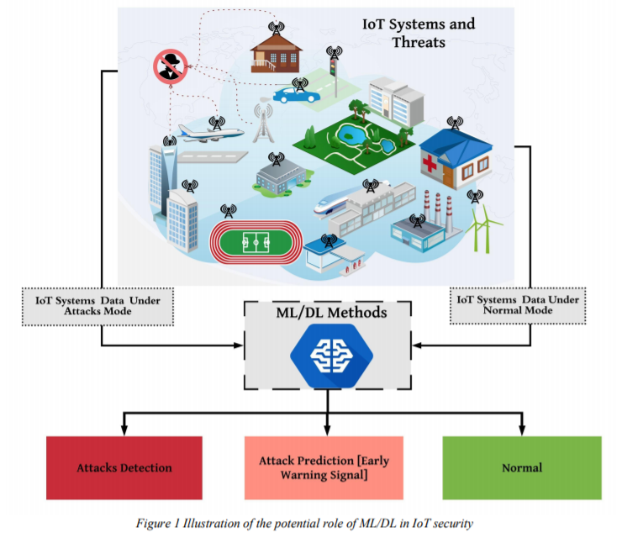
Control Schemes
From the large transportation system to the small smart devices in everyone's home are all links in the Internet of Things, and all face a certain risk of being attacked.
Apply control scheme models for decision making for
cyber-physical systems
autonomous intrusion detection techniques
Multi-agent RL
Defense strategies against cyber attacks

Slide 15
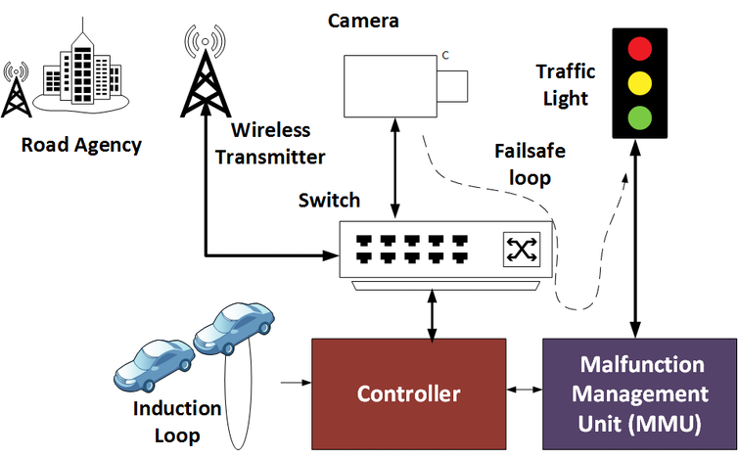
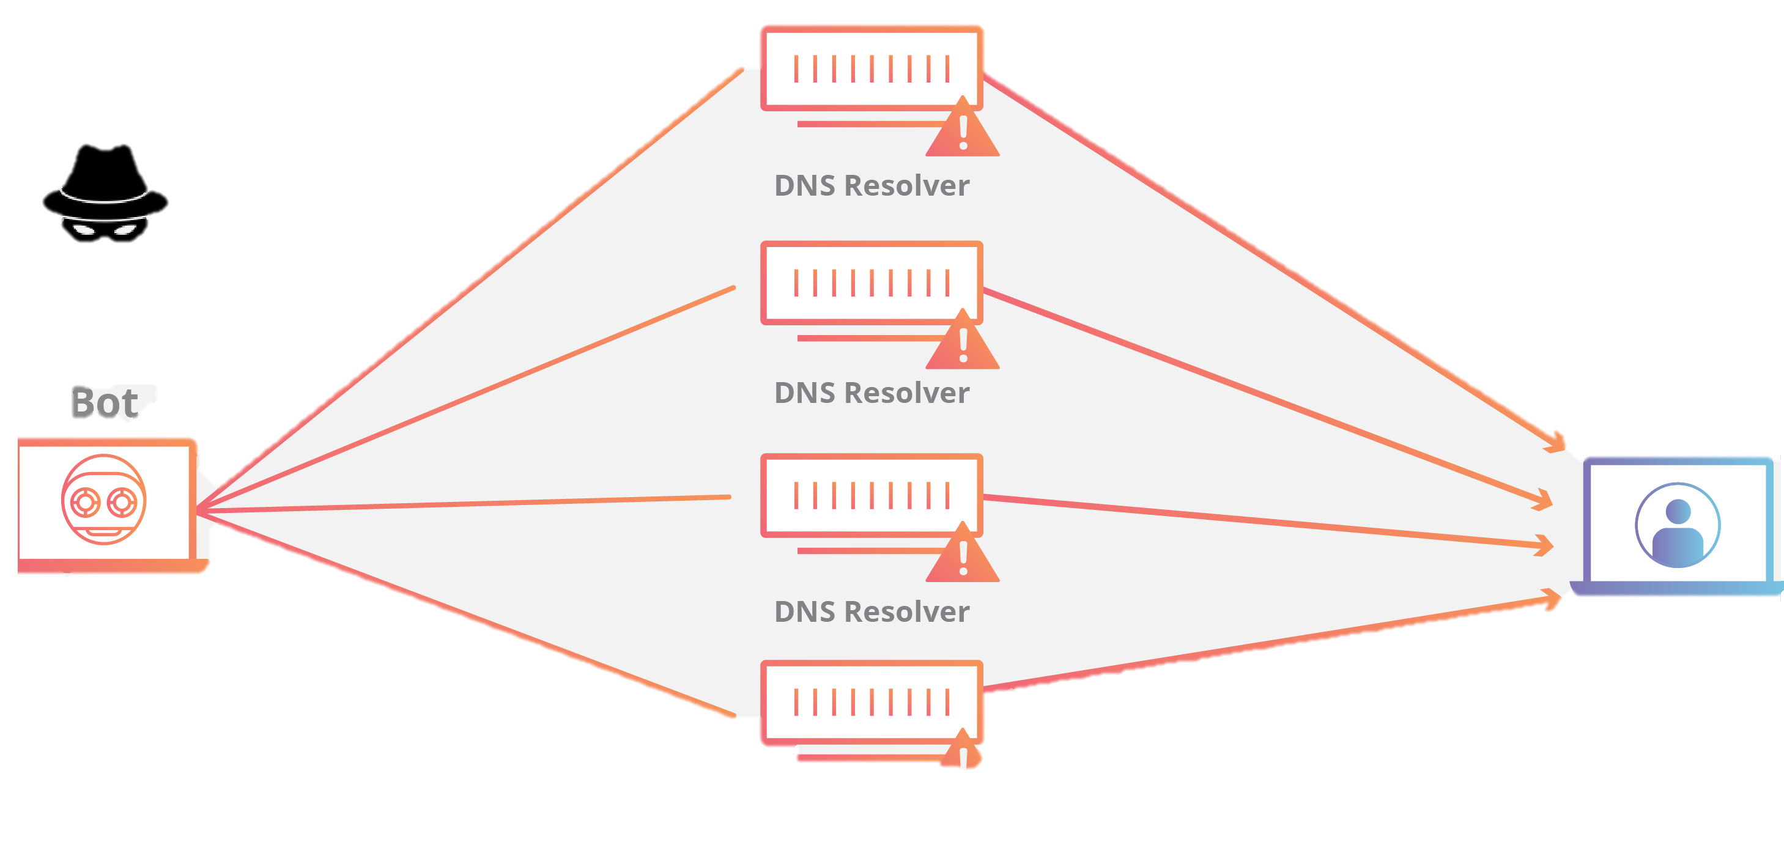
Control Schemes: Traffic Light Example
In complex road conditions, traffic lights are the only way to control the flow of cars.
However, once the control system of the traffic lights is attacked or hijacked, the driver is given the wrong signal indication, ranging from traffic jams to serious traffic accidents.

Slide 16
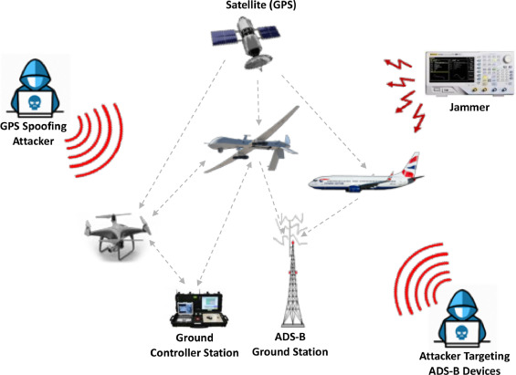
Control Schemes: Air Traffic
If an attack on the dispatch control system occurs at this time, it may cause the train to enter the wrong route at the wrong time, resulting in a collision accident between objects.
But if a hacker attacks the aviation command system, there will be an uncountable number of aircraft affected.
Therefore, the control scheme plans for large bot network traffic systems is important cyber security.

Slide 17
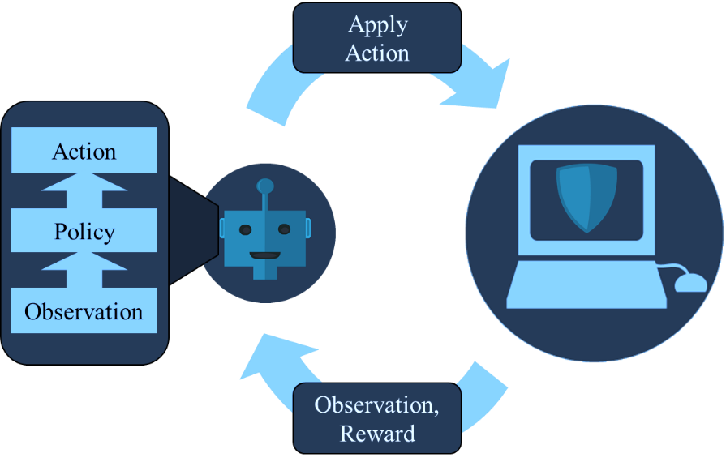
Control Schemes for IoT Cybersecurity
Future research directions may also include how to dynamically change the protection strategy, because when we detect an attack and successfully prevent the attack, hackers will not easily give up the attack after they are dropped from networks
They may change the form of the attack or improve the concealment, Subsequent solutions for such activities are worth studying.

