Slide 1

Machine Learning Based
IoT Network Intrusion Detection Classification
Harshil Patel & Yuesheng Chen
Ohio State University, USA
4-2-2020
Notes:
Introduce your self

Slide 2

Motivation
Traditional Security Solutions
IoT traditional network security solutions may not be directly applicable due to the differences in IoT structure and behavior.
Low Operating Energy
Low operating energy and minimal computational capabilities.
Therefore security mechanism such as encryption protocols and authentication can not be directly applied.
IoT Architecture
The lack of a single standard for IoT architecture.
IoT systems may have different policies, and connectivity domains.
IoT networks have become an increasingly valuable target of malicious attacks due to the increased amount of valuable user data they contain. In response, network intrusion detection systems have been developed to detect suspicious network activity.

Slide 3
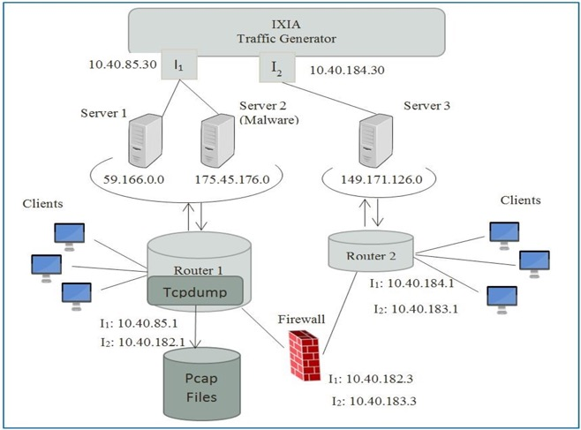
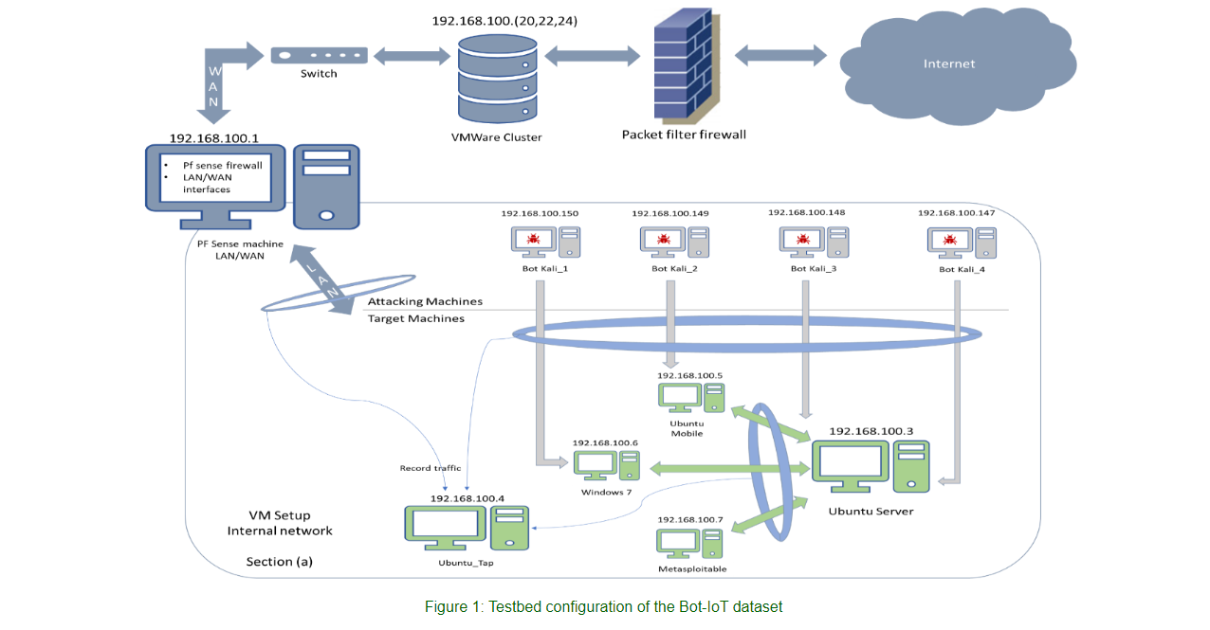
UNSW-NB15 DATASET
UNSW-NB15 is an IoT-based network traffic data set with different categories for normal activities and malicious attack behaviors.

Slide 4
Methodology
Data Preprocessing
Response Features
CSV processed with:
1-Pandas, NumPy, skitLearn
2-Remove NaN`s
3-Training & Testing 4-Encoding Transformation
1 -Attack or Normal
2 –Attack Classification
1
2
3
4
Model Selection
ML algorithms:
1-Logistic Regression
2-Descion Trees
3-Random Forests 4-Multi-Layer Perceptron Classifier
Model Comparison & Inspection
Determine which model should be used to classify category attacks and network intrusions on IoT networks. Also discover relevant features for model inspection.

Slide 5
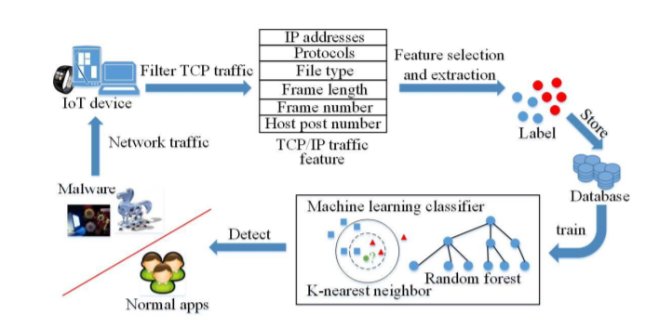
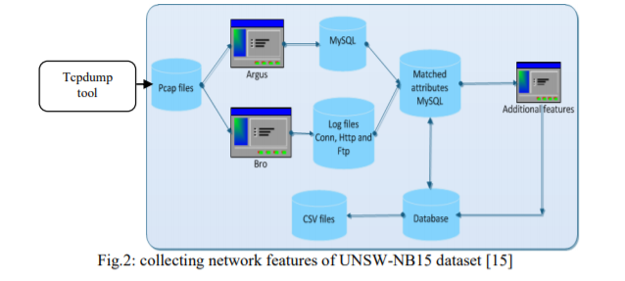
Overall Architecture
Training
Data
Model
Hyperparameters
Model
Training
Testing Data
Model
Evaluation & Metrics
Model Selection
Collecting features of botnet data

Slide 6
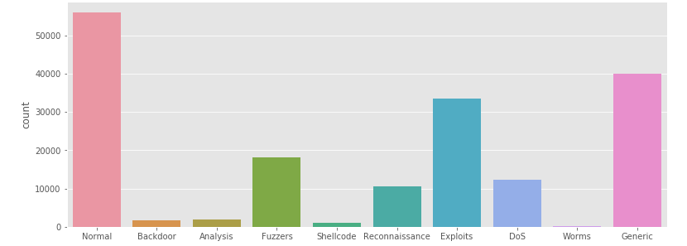
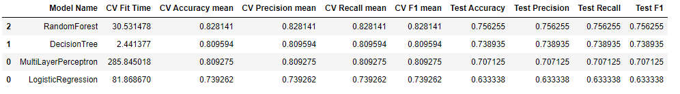
Model Comparison
Attack Type Classification
This dataset has nine types of attacks: Fuzzers, Analysis, Backdoors, DoS, Exploits, Generic, Reconnaissance, Shellcode and Worms.
F1 score (weighted average of the precision and recall) is the primary evaluation metric on testing data to show the performance of the trained model. The Random Forest model marginally outperformed the other model.
Additionally, through tuning hyperparameters of Multi-Layer Perceptron and Decision Tree models, they could also perform better.

Slide 7
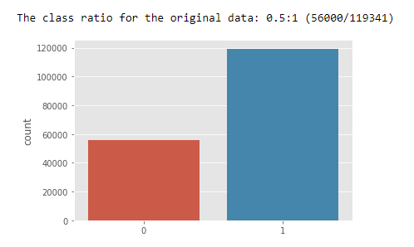
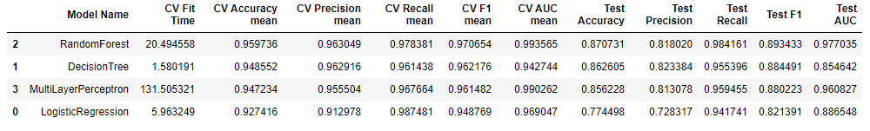
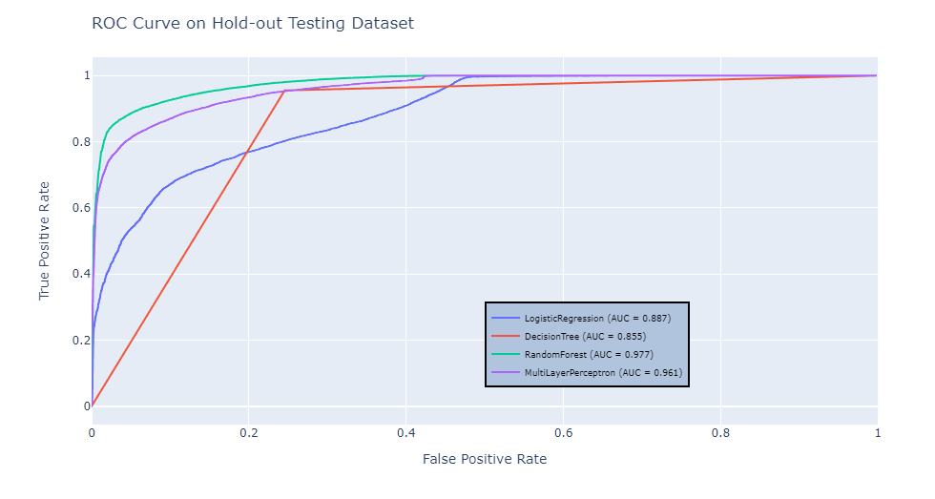
Model Comparison
Attack (1) or Normal (0) Classification (Binary)
F1 score (weighted average of the precision and recall) is the primary evaluation metric on testing data to show the performance of the trained model.
The Random Forest model marginally outperformed the other model.

Slide 8
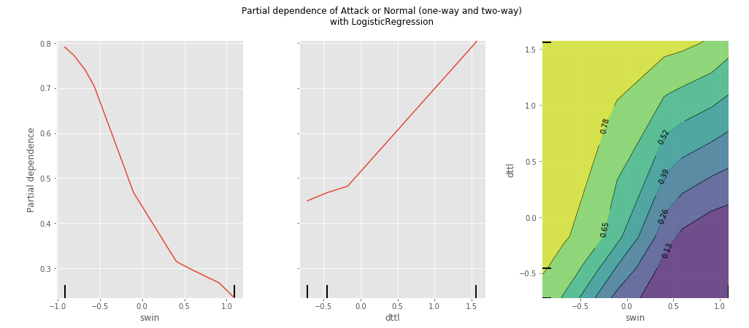
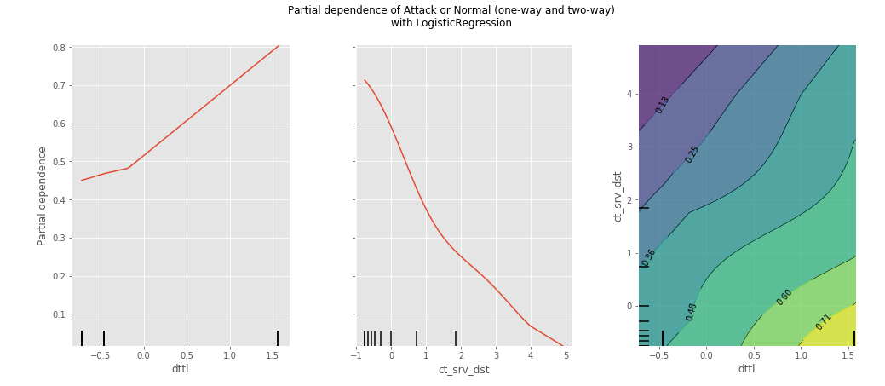
Model Inspection
Attack (1) or Normal (0) Classification (Binary)
Created partial dependence plots (PDPs) for all 'target' features, that show the dependence between the target response of 1 and target' feature.
Features including ‘swin’, ‘dttl’, and ‘ct_srv_dst’ were of high dependence. The last set of plots represents paired PDPs that conveys the dependence relationship together among 'target' features.

Slide 9
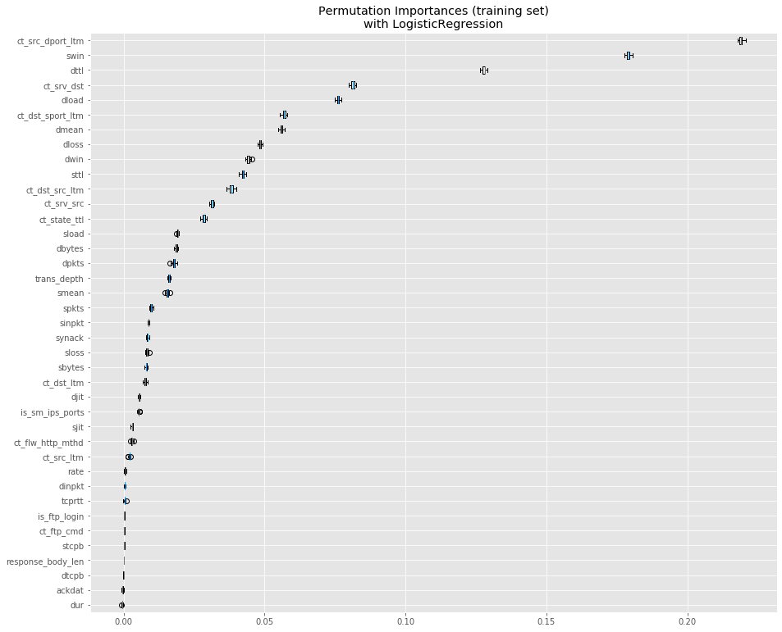
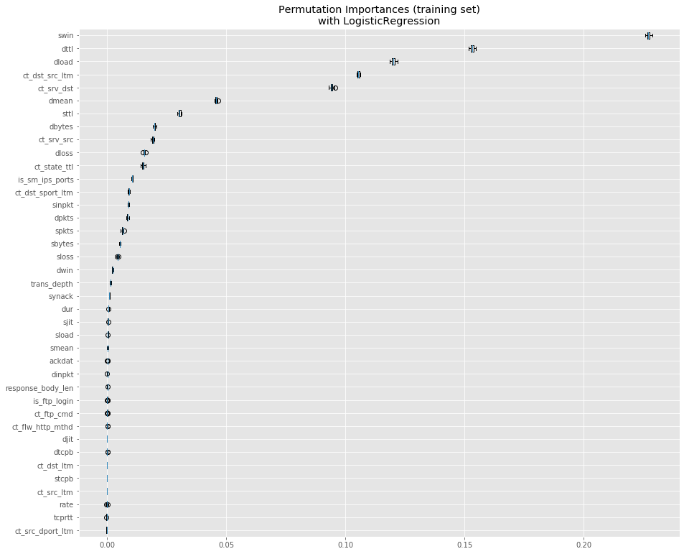
Feature Importance
Attack Type Classification
Attack (1) or Normal (0) Classification
The plot shows that ‘swin’ and ‘ct_src_dport_itm’ are very most important feature in the model because once we shuffle the ‘swin’ and ‘ct_src_dport_itm’ column of the training data, leaving the target and all other columns in place, the decrease of the accuracy score of predictions is around 0.24 for both, which is a significant finding.

Slide 10
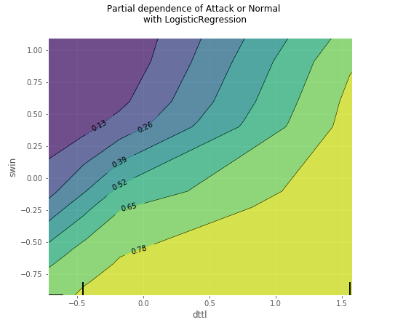
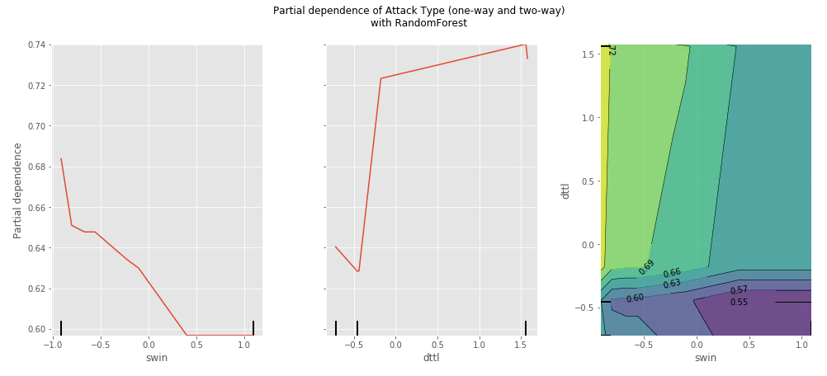
Further Inspection
Attack (1) or Normal (0) Classification (Binary)
Name | Type | Description
swin | integer | Source TCP window advertisement value
dttl | Integer | Destination to source time to live value
ct_src_dport_ltm | integer | No. of connections of the same source address (1) and the destination port (4) in 100 connections according to the last time.
dloss | Integer | Destination packets retransmitted or dropped
ct_dst_sport_ltm | integer | No. of connections of the same destination address (3) and the source port (2) in 100 connections according to the last time.
ct_dst_src_ltm | integer | No. of connections of the same source (1) and the destination (3) address in in 100 connections according to the last time.
ct_srv_dst | integer | No. of connections that contain the same service (14) and destination address (3) in 100 connections according to the last time.

Slide 11
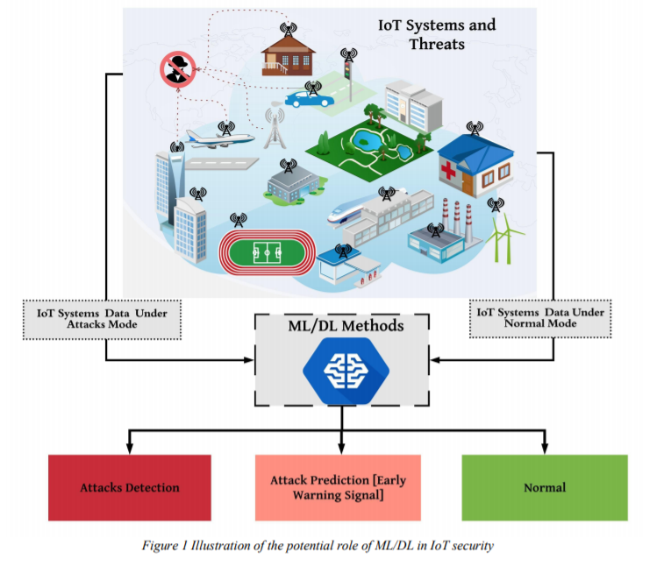
Discussion
UNSW-NB15 botnet datasets with IoT sensors' data are used to obtain results that show that the proposed features have the potential characteristics of identifying and classifying normal and malicious activity .
Role of ML algorithms is for developing a network forensic system based on network flow identifiers and features that can track suspicious activities of botnets is possible.
Furthermore, Random Forests provides a higher detection rate, accuracy and a lower false positive rate compared with both classification responses.
The ML model metrics using the UNSW-NB15 dataset revealed that ML techniques with flow identifiers can effectively and efficiently detect botnets’ attacks and their tracks.

Slide 12
References
Moustafa, Nour, and Jill Slay. "UNSW-NB15: a comprehensive data set for network intrusion detection systems (UNSW-NB15 network data set)." Military Communications and Information Systems Conference (MilCIS), 2015. IEEE, 2015.
Moustafa, Nour, and Jill Slay. "The evaluation of Network Anomaly Detection Systems: Statistical analysis of the UNSW-NB15 dataset and the comparison with the KDD99 dataset." Information Security Journal: A Global Perspective (2016): 1-14.
Moustafa, Nour, et al. . "Novel geometric area analysis technique for anomaly detection using trapezoidal area estimation on large-scale networks." IEEE Transactions on Big Data (2017).
Moustafa, Nour, et al. "Big data analytics for intrusion detection system: statistical decision-making using finite dirichlet mixture models." Data Analytics and Decision Support for Cybersecurity. Springer, Cham, 2017. 127-156.

