Slide 1

Title
Continued Title
Event details
Presenter, Role @

Slide 2
Title
Continued Title
Event details
Presenter, Role @

Slide 3
Title
Continued Title
Event details
Presenter, Role @

Slide 4

Faster builds and tests

Slide 5
Title

Slide 6
Subtitle:
Title

Slide 7
Title: free-form
Text

Slide 8
Title: three columns
column 1
column 2
column 3

Slide 9
Title: single card
How has the
size of code
at your company
changed in the
past 10 years?
Footnote, e.g. for credits

Slide 10
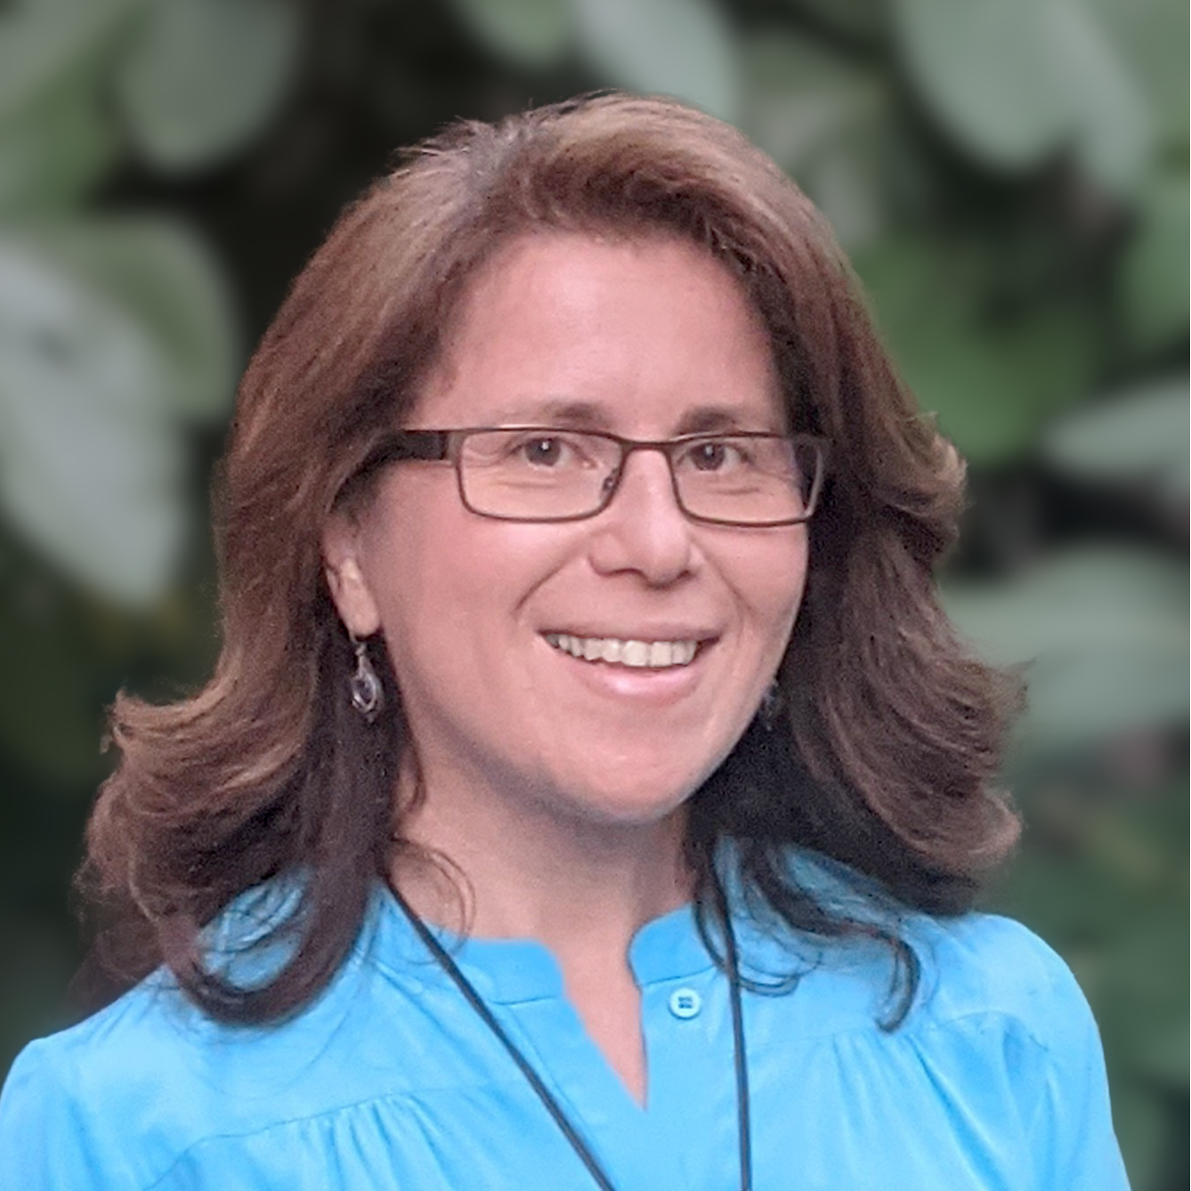






Title: two cards
Name Surname
Role
Name Surname
Role
Short bio
Short bio

Slide 11
Title: text and 3x3 grid
Text

Slide 12
Title: 5 x 6 grid

Slide 13
















Title: 4x4 grid

Slide 14

Quotation
Name, Role @ Company

Slide 15
Title: stacked ordered list
01
Item 1
Text
04
Item 1
Text
02
Item 1
Text
05
Item 1
Text
03
Item 1
Text

Slide 16
Problem statement multiple lines
THE PROBLEM
Text
THE SOLUTION
Text

Slide 17






Performance slide
Blue River Technology
From 3 hrs
down to 20 mins
9x faster
Top-5 automaker
From 1.5 hrs
down to 19 mins
5x faster
Brave Software
From 2 hrs
down to 15 mins
8x faster
Faster
Releases
Better
Collaboration
More Effective
Companies
Notes:
[Non-image version of the slide before]
And Brave, whose Chromium builds are now 8 times faster.
And Blue River Technology, who are saving over 2 and a half hours on every commit.
The effect: faster releases, better collaboration and more effective companies.

Slide 18
Example Code
public main void (String[] args) throws Exception {
// Comment
System.out.println("Hello presentation!");
}

Slide 19





























Graphics

Slide 20













Company Logos: customers (listed on website)

Slide 21









Company Logos: customers (internal)

