Slide 1
Nursery in Cairo

Slide 2
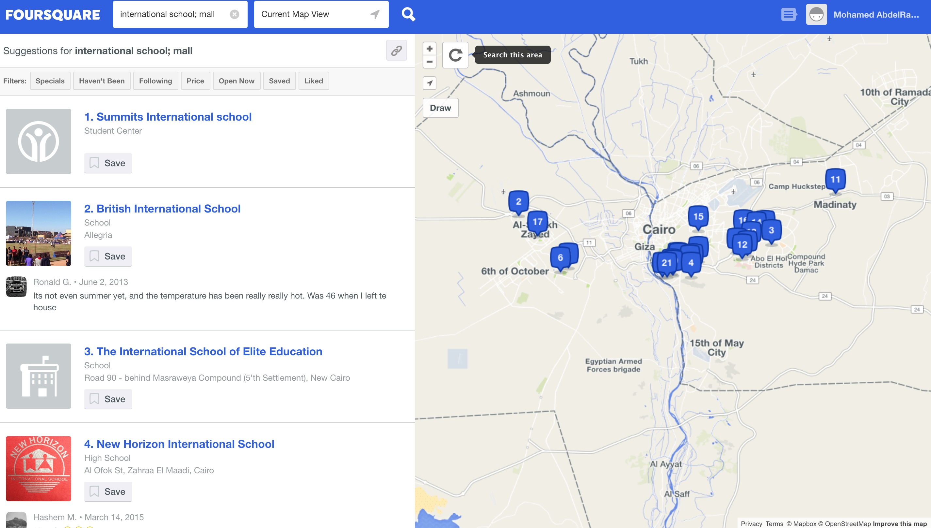
Aim
Find potential area to look for a location to start a Nursery project

Slide 3
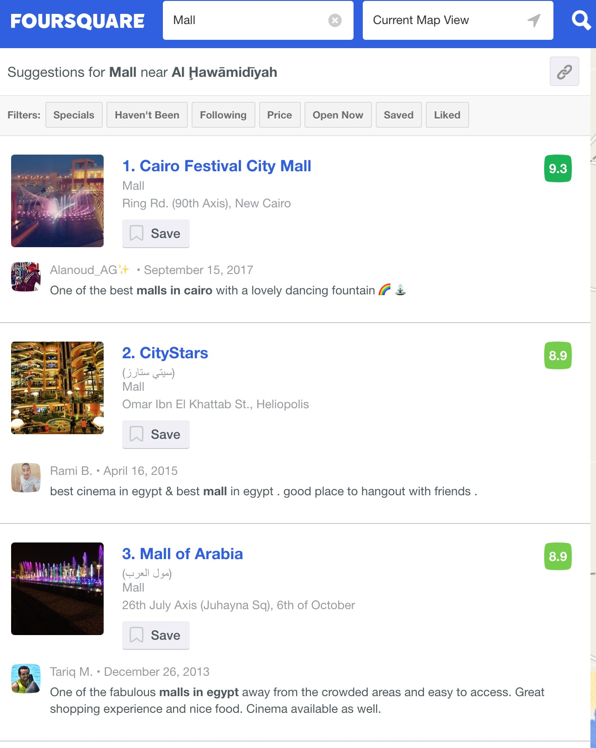
Method
Find the density of related venues in each major district in Cairo
Maadi, Heliopolis and Giza were selected to choose from

Slide 4
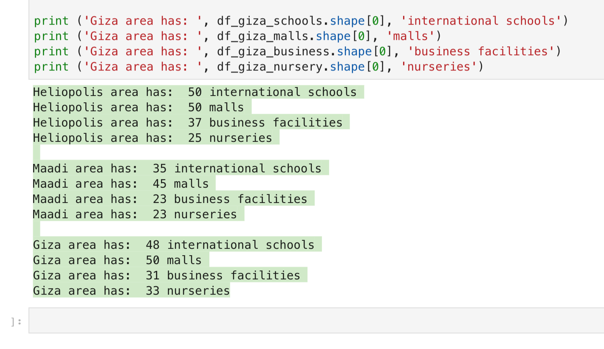
And the result is …
Maadi has potential more than other areas

