Slide 1

Notes:
ReelSpy pitch deck. Render to PDF/PPTX/HTML with Marp: npx @marp-team/marp-cli docs/product/03-pitch-deck.md -o reelspy.pdf npx @marp-team/marp-cli docs/product/03-pitch-deck.md -o reelspy.pptx npx @marp-team/marp-cli docs/product/03-pitch-deck.md -o reelspy.html Or open in VS Code with the "Marp for VS Code" extension and Export.

Slide 2


Slide 3


Slide 4


Slide 5


Slide 6


Slide 7


Slide 8


Slide 9


Slide 10
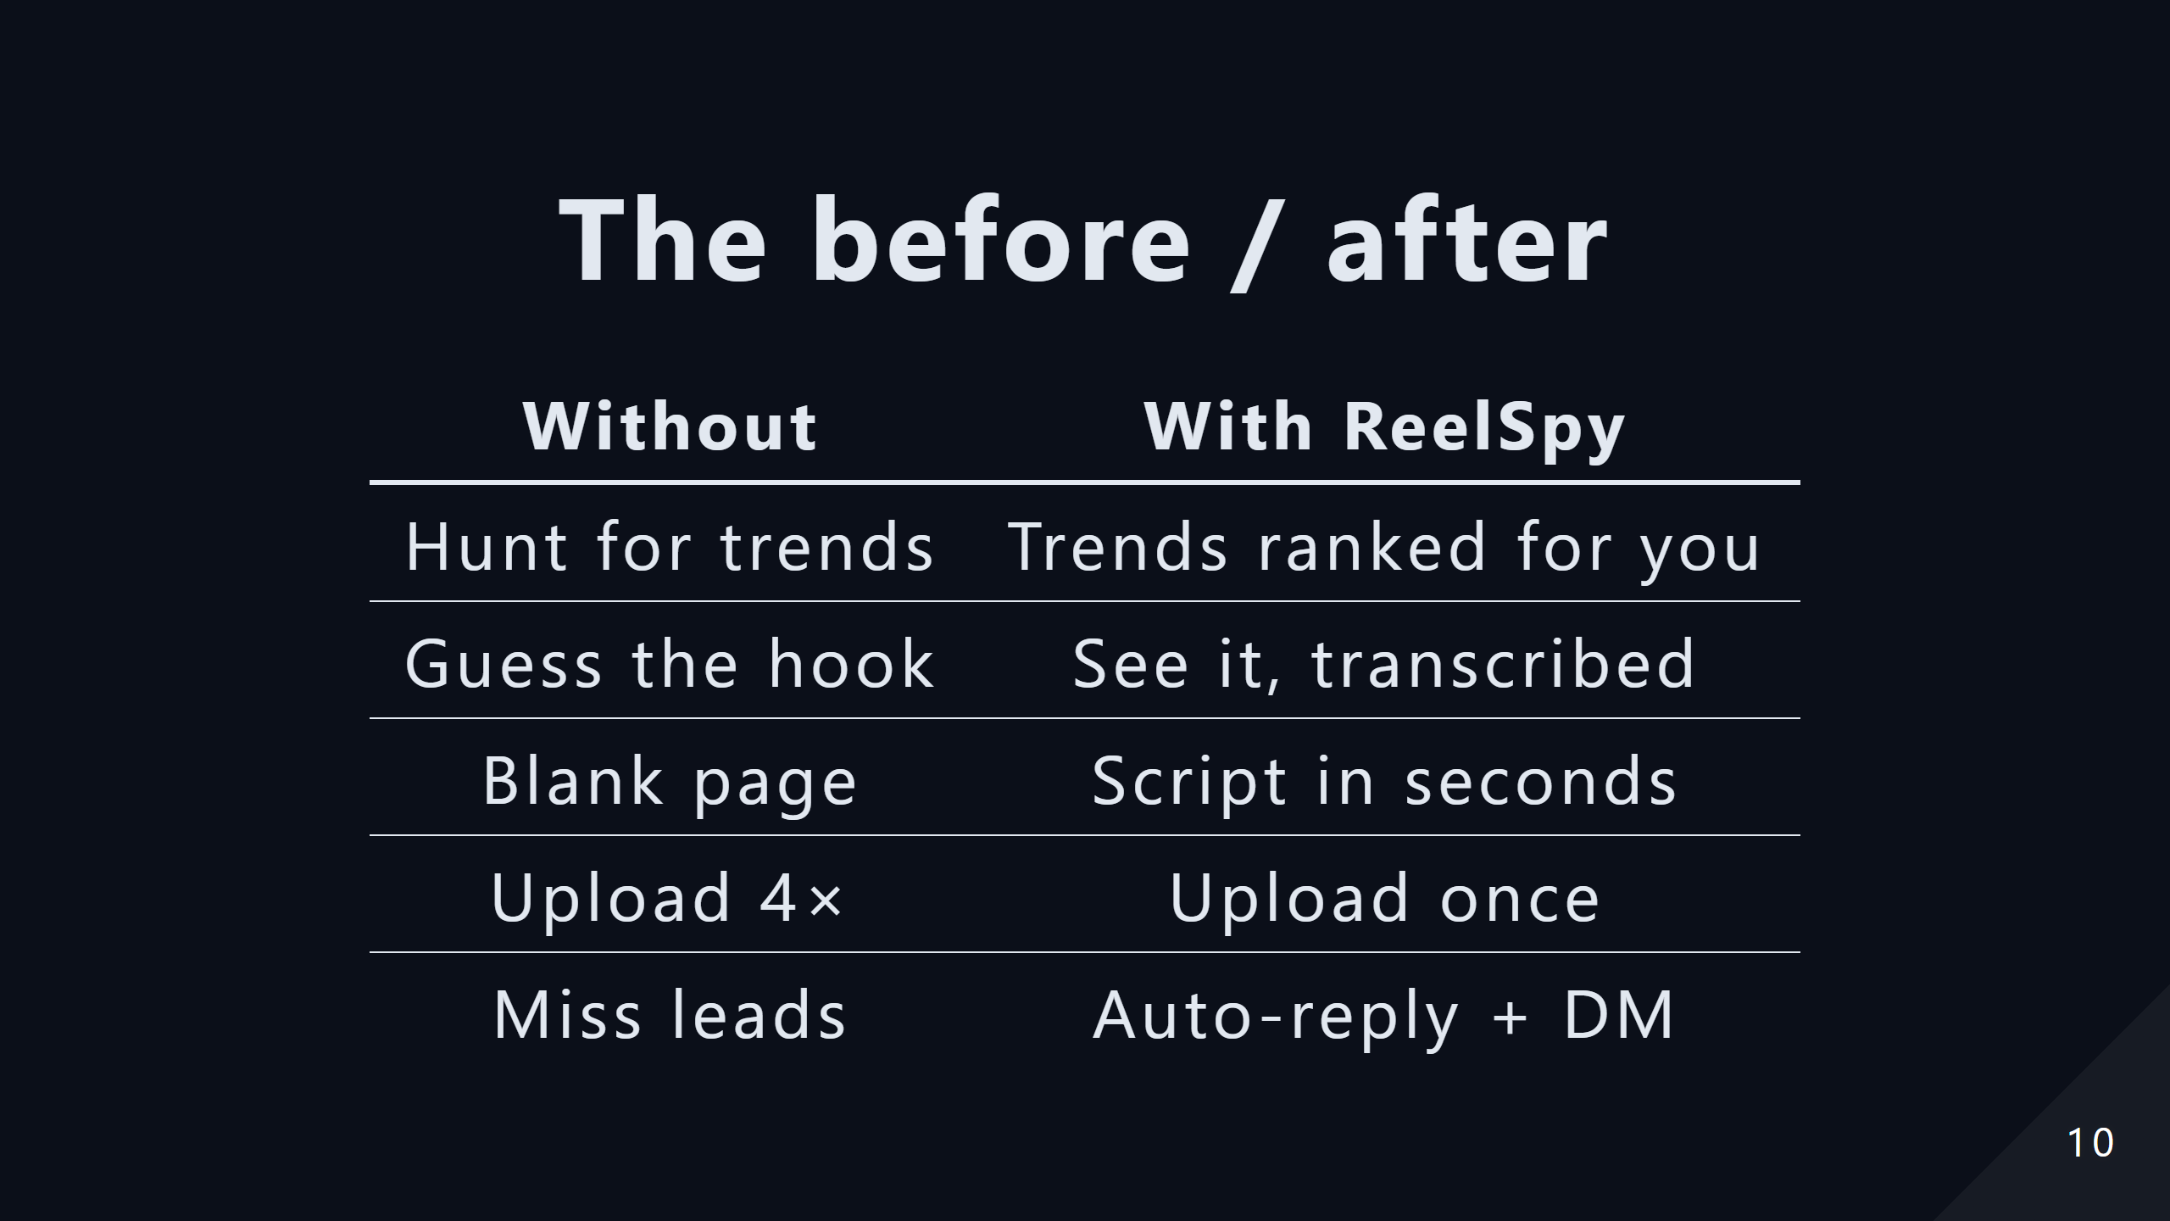

Slide 11


