Slide 1
Presentation of 3 RDBMS : MySQL, PostgreSQL and SQL SERVER And a comparison between them
Prepared by : Meriem AYED

Slide 2
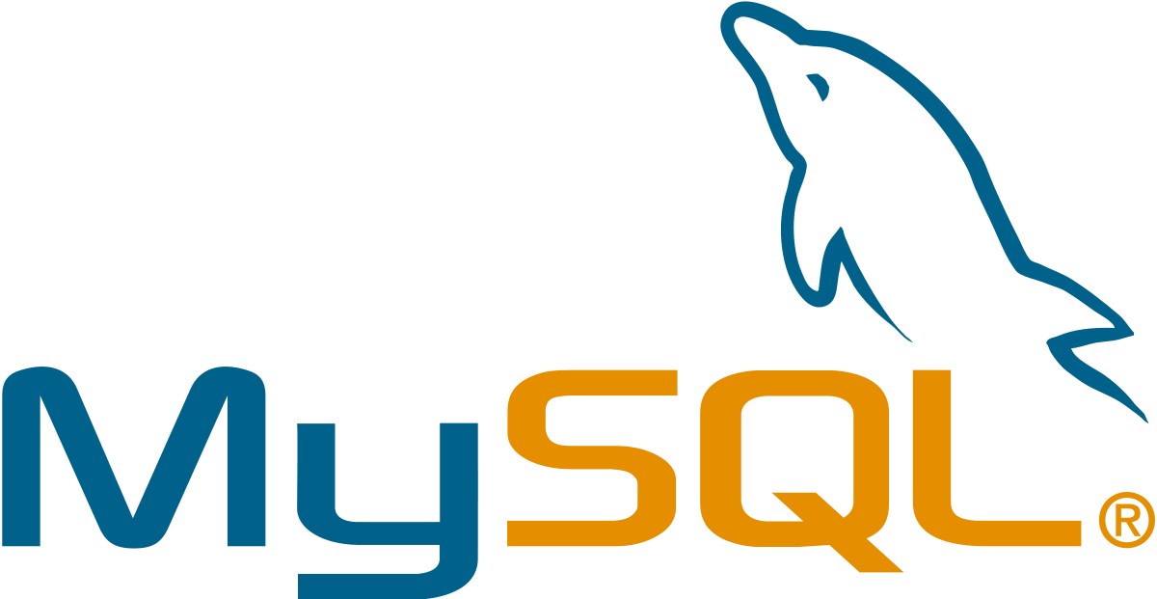
I

Slide 3
What is MySQL ?

Slide 4
Its name is a combination of "My", the name of co-founder Michael Widenius's daughter, and "SQL", the abbreviation for Structured Query Language,
Relational database management system (RDBMS),
Free and open-source software under the terms of the GNU General Public License,
Was created by a Swedish company, MySQL AB, founded by Swedes David Axmark, Allan Larsson and Finland Swede Michael "Monty" Widenius,
The first version of MySQL appeared on 23 May 1995,
Is written in C and C++.

Slide 5
Features

Slide 6
MySQL stores data efficiently in the memory ensuring that data is consistent, and not redundant. Hence, data access and manipulation using MySQL is quick.
2- Quick and Reliable

Slide 7
MySQL is open-source, which means this software can be downloaded, used and modified by anyone. It is free-to-use and easy-to-understand. The source code of MySQL can be studied, and changed based on the requirements. It uses GPL, i.e. GNU General Public license which defines rules and regulations regarding what can and can’t be done using the application.
1- Open Source

Slide 8
Scalability refers to the ability of systems to work easily with small amounts of data, large amounts of data, clusters of machines, and so on. MySQL server was developed to work with large databases.
3- Scalable

Slide 9
It contains multiple data types such as unsigned integers, signed integers, float (FLOAT), double (DOUBLE), character (CHAR), variable character (VARCHAR), text, blob, date, time, datetime, timestamp, year, and so on.
4- Data Types

Slide 10
It supports different character sets, and this includes latin1 (cp1252 character encoding), German, Ujis, other Unicode character sets and so on.
5- Character Sets

Slide 11
It provides a secure interface since it has a password system which is flexible, and ensures that it is verified based on the host before accessing the database. The password is encrypted while connecting to the server.
6- Secure

Slide 12
It comes with support for large databases, which could contain about 40 to 50 million records, 150,000 to 200,000 tables and up to 5,000,000,000 rows.
7- Support for large databases

Slide 13
MySQL server also comes with many client and utility programs. This includes Command line programs such as ‘mysqladmin’ and graphical programs such as ‘MySQL Workbench’. MySQL client programs are written in a variety of languages. Client library (code encapsulated in a module) can be written in C or C++ and would be available for clients that have C bindings.
8- Client and Utility Programs

Slide 14
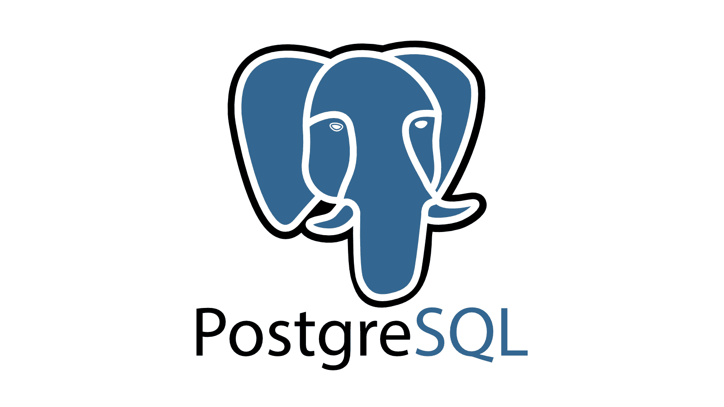
II

Slide 15

What is PostgreSQL ?

Slide 16
Is a free and open-source relational database management system (RDBMS) emphasizing extensibility and SQL compliance,
PostgreSQL (initially called Postgres) was created by a computer science professor Michael Stonebraker and his team,
It is a highly used and tested solution having started in 1981 as the Ingres project at the University of California.
The project was later named Postgres as it became "post Ingres", and then in 1996 the online presence at the website PostgreSQL.org was launched while the project was renamed PostgreSQL to reflect its support for SQL.

Slide 17
Features

Slide 18
Helps developers to build applications.
It allows administrators to build fault-tolerant environment by protecting data integrity.
Compatible with various platforms using all major languages and middleware.
It offers a most sophisticated locking mechanism.
Support for multi-version concurrency control.
Mature Server-Side Programming Functionality.

Slide 19
Compliant with the ANSI SQL standard.
Full support for client-server network architecture.
Log-based and trigger-based replication SSL.
Standby server and high availability.
Object-oriented and ANSI-SQL2008 compatible.
Support for JSON allows linking with other data stores like NoSQL which act as a federated hub for polyglot databases.

Slide 20
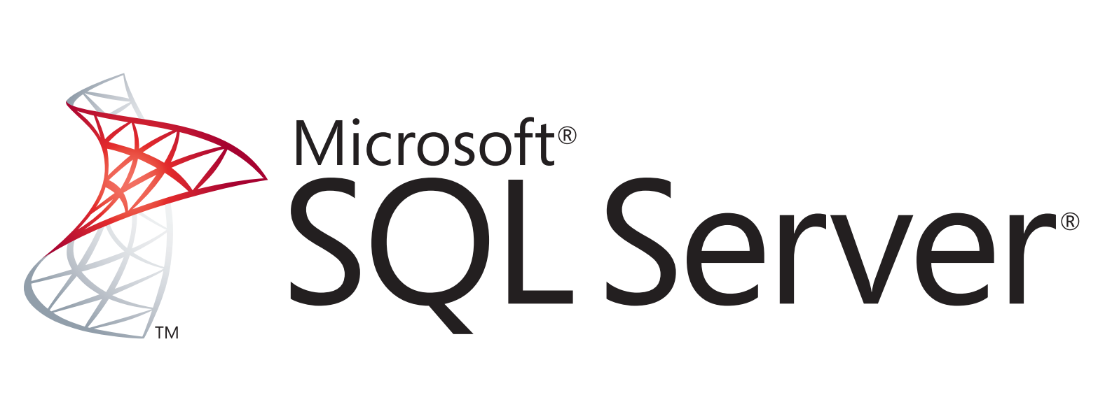
III

Slide 21
What is SQL Server ?

Slide 22
Is a relational database management system (RDBMS) developed by Microsoft,
Is a Microsoft software product mainly used to store and retrieve data for the same or other applications.,
We can run these applications on the same computer or a different one,
It is also called MS SQL Server, which is an ORDBMS, platform-dependent, and can work on GUI and command-based software.
Originally released in 1989 as version 1.0 by Microsoft, in conjunction with Sybase, SQL Server and its early versions were very similar to Sybase.

Slide 23
Features

Slide 24
Break down data silos Gain insights from all your data by querying across your entire data estate—SQL Server, Azure SQL Database, Azure SQL Data Warehouse, Azure Cosmos DB, MySQL, PostgreSQL, MongoDB, Oracle, Teradata, and others—without moving or replicating the data.
Run SQL Server anywhere
Use SQL Server with Windows and Linux containers, plus deploy and manage your deployments using Kubernetes.

Slide 25
#1 in performance Get record-breaking performance on Windows and Linux. SQL Server consistently leads across the TPC-E OLTP workload, TPC-H data warehousing workload, and real-world application performance benchmarks. Intelligent database capabilities Upgrade and modernize your SQL Server database on-premises, in the cloud, and at the edge. Database compatibility certification eliminates the risk of application incompatibility. Use in-memory database capabilities such as persistent memory support and memory-optimized tempdb to improve performance for your mission critical workloads.

Slide 26
Fewest vulnerabilities for nine years Protect data at rest and in motion with a database that has the fewest vulnerabilities of any major platform for nine years running in the National Institute of Standards and Technologies National Vulnerabilities Database. Built-in security and compliance Use built-in features for data classification, data protection, and monitoring and alerts. SQL Server 2019 monitors, identifies, and provides alerts on suspicious activity—even identifying and remediating security gaps and misconfigurations. Always encrypted data enclaves Encrypt sensitive data and execute rich computations on encrypted data, plus enable customized data access based on role with complex row filtering.

Slide 27
Maximum availability Gain mission-critical uptime, fast failover, and improved TCO using cloud disaster recovery replicas and always on availability groups. Accelerated database recovery Greatly improves database availability by enabling fast and consistent database recovery regardless of the number or size of active transactions.

Slide 28
Self-service BI on any device Explore visual data and quickly discover patterns to make better, faster decisions with Power BI Report Server, which is included with your SQL Server Software Assurance license. Connect all your data Combine data from almost any source using the extensive connector library and new transformations in SSAS tabular models. Visual data exploration Find the answers behind the data with visual data exploration and interactive analysis of data lakes data using SQL Server BI tools.

Slide 29
Highly scalable cloud services Build highly scalable cloud services on Azure, and get a unified SQL platform built on the industry-leading performance of SQL Server—for limitless scalability, intelligent performance, and built-in security. Migrate to Azure without redesigning your apps and improve the performance of your existing applications.

Slide 30
MySQL vs PostgreSQL vs SQL server
IV

Slide 31
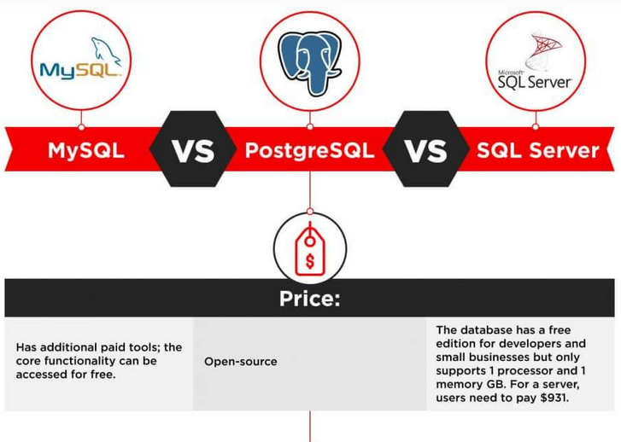

Slide 32
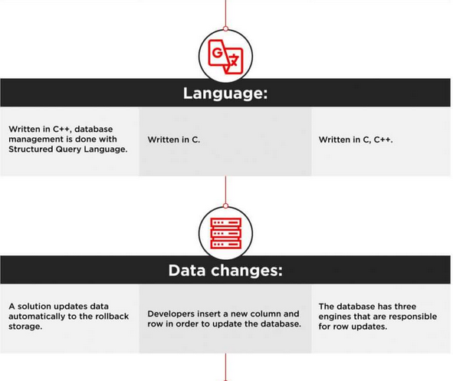

Slide 33
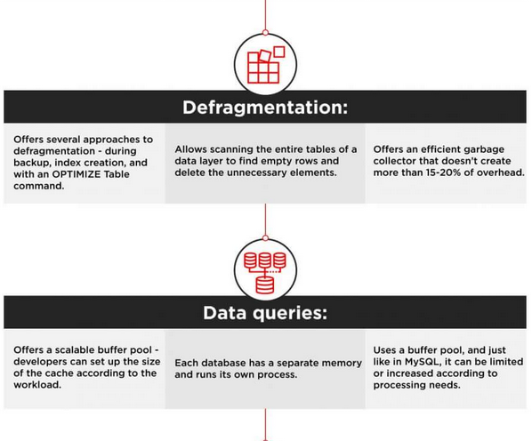

Slide 34
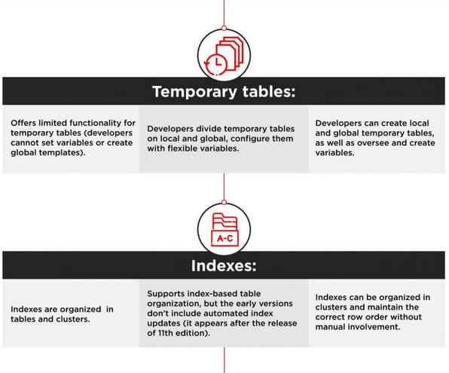

Slide 35
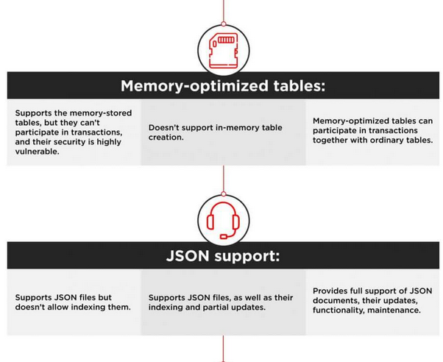

Slide 36
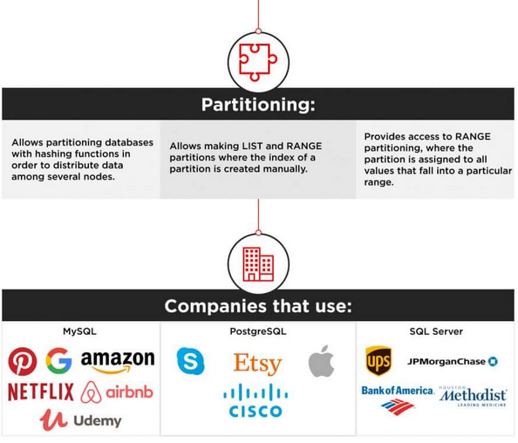

Slide 37
VI
Conclusion

Slide 38
The choice between the three most popular databases ultimately boils down to the comparison of the functionality, use cases, and ecosystems. Companies that prioritize flexibility, cost-efficiency, and innovation usually choose open-source solutions. They can be integrated with multiple free add-ons, have active user communities, and are continuously updated.
For corporations that prefer traditional commercial solutions, software like SQL Server backed up by a big corporation and compatible with an extensive infrastructure, is a better bet. They have access to constant technical support, personalized assistance, and professional management tools.

