Slide 1
COMMUNICATION & ARGUMENTATION
Nicoletta Di Blas - Introduction

Slide 2
People
Teacher: Nicoletta Di Blas (HOC-LAB)
Assistant: Giacomo Cassano

Slide 3
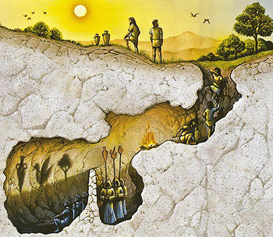
Plato’s cave

Slide 4
Course goal(s)
Equip students with basic & advanced communication skills, on:
How to be clear
How to be persuasive
… with a focus on the relevance of the audience/addressee

Slide 5
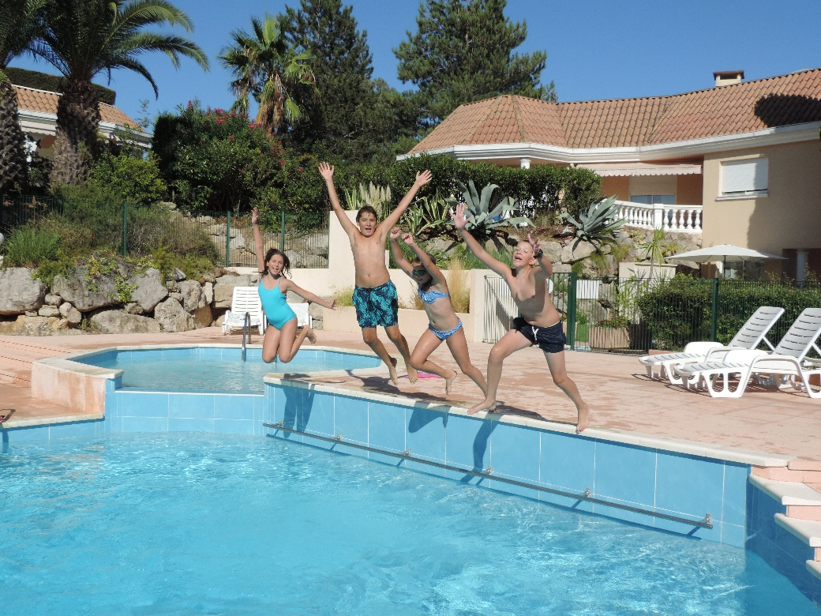
Learning to communicate
Theory
Imitation
Find gurus/examples…
Practice
Gradual challenges

Slide 6
What this course is about
Linguistics (basic elements)
Rhetoric
Presentation skills
Argumentation
… and manipulation
Grant-writing

Slide 7
Methodology
CLASSES: on campus, synchronous
LABS: on campus, synchronous
MOOC on communication
Massive Online Open Course (POK- COURSERA)
TUTORING on the final project
All the above mixed: see calendar in WEBEEP

Slide 8
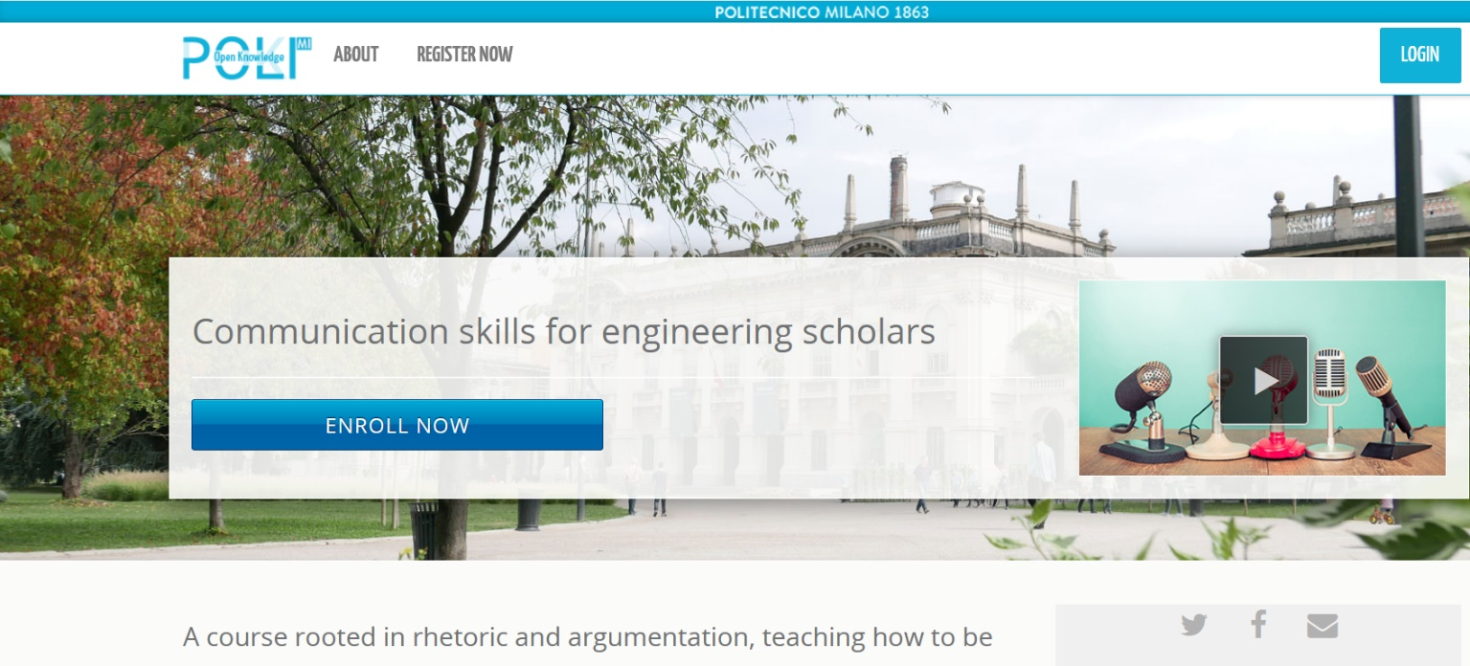
MOOC on communication
Organized into weeks; includes quizzes
~3 hours of videos

Slide 9
Materials
Slides
MOOCs (videos, transcripts)
Background readings
Papers, excerpts from books…
Additional resources (optional)
All materials in WEBEEP

Slide 10
Exam
MOOC: final certificate required
TEST: 6 open-ended questions
60% of the final score
PROJECT: project proposal simulation
40% of the final score

Slide 11
Exam – the test
6 open-ended questions
based on the course’s materials (the compulsory ones)
required to show understanding of the issues and to re-phrase concepts in their own words

Slide 12
Exam – the project
Simulation of a project proposal
A proposal to Switch2Product (start-up)
Output: a document (4-5 pages)
Groupwork: 4-5 people at most
Topic: to be agreed upon with the teacher
Something that at least one person in the group knows well

Slide 13
Exam – practical rules
MOOC certificate: required
TEST and PROJECT:
students need to score a sufficient grade in both, in order to pass
they can be done in different exam’s sessionS
REMEMBER TO ENROLL when you are ready to get the final score!

Slide 14
The 3 credits version
3 credits version of the course:
MOOC=yes
6 open-ended questions = yes
Project = NO

Slide 15
Contacts
Mail:
nicoletta.diblas@polimi.it
giacomo.cassano@polimi.it
Communications:
During the lessons’ breaks
After the lesson
please send an e-mail the day before
Subject: C&A_[whatever the topic is]
…any other time, if you ask in advance

Slide 16
END

