Slide 1
COMMUNICATION SKILLS COURSE - ARGUMENTATION
Nicoletta Di Blas - Introduction

Slide 2
Definition
Argumentation is a verbal, social, and rational activity aimed at convincing a reasonable critic of the acceptability of a standpoint by putting forward a constellation of one or more propositions to justify this standpoint
[F. van Eemeren]
Notes:
People often disagree.
They try to reach an agreement through an argumentative discussion.

Slide 3
Two main ways
Use rhetorical strategies
“Technical” proofs (rhetoric is a “techne”)
Find facts, figures, data…
(no rhetorical technique needed; “extra-technical” proofs)
Notes:
Aristotle says that there are two main sources of arguments: the technical proofs and the extra-technical proofs. This latter are data facts figures testimonials… anything objective, factual. these you only need to FIND, not to elaborate with the rhetorical art (TECHNE). So they are called extra-techne proofs.

Slide 4
Demonstrate
Main form of reasoning: the syllogism:
Major premise: All men are mortal Minor premise: Socrates is a man Conclusion: Socrates is mortal
Scientific syllogism: both premises must be valid
The conclusion is therefore valid as well
There is NO DISCUSSION about this

Slide 5
Convince
An «enthymeme» is a syllogism based on a generally valid proposition
All mothers love their children
Mary is a mother
Mary loves her children
Counter-facts do not invalidate the major premise

Slide 6
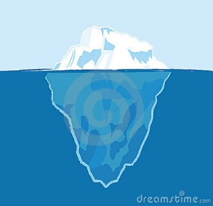
Enthymeme/1
Usually, enthymemes in a discussion are introduced in INCOMPLETE form
“Mary is John’s mother, she must love him!”
(The major premise is implicit)
“Mary is John’s mother!”
(Both the major premise and the conclusion are implicit)

Slide 7
Enthymeme/2
Why are some parts left implicit?
To speed the talk up (no manipulation meant)
But it may help “reaching a goal”:
Implicit premises
they are more «acceptable»
the addressee hardly takes notice of them
Implicit conclusions:
To draw conclusions is gratifying
The effort of drawing conclusions distracts from the validity of the conclusions
Letting the addressee draw conclusions is generally more effective

Slide 8
Topoi
Argumentation schemas

Slide 9
Contradiction
A position may be refuted by demonstrating that the opposite is false
EXAMPLE:
You are against nuclear since you think it is bad for people’s health. But also fossil fuels are bad for the health, and you accept them!
[I do not accept things that are bad for the health – fossil fuels are bad – I accept fossil fuels]

Slide 10
Analogy
The validity of a position is proved by means of an irrefutable and striking similarity (…AS IF…)
EXAMPLE:
Radiations are used to treat cancer. Like drugs: sure, they can be poisonous at times, but they help us treat conditions. Would we do without drugs?

Slide 11
Reductio ad absurdum/1.1
String theory [is…] an example of “non-empirical theory assessment”. By this he means that to select a good theory, its ability to describe observation isn’t’ the only criterion. He claims that certain criteria that are not based on observations are also philosophically sound, and he concludes that the scientific method must be amended so that hypothesis can be evaluated on purely theoretical ground

Slide 12
Reductio ad absurdum/1.2
[BUT] if we accept a new philosophy that promotes selecting theories based on something other than facts, why stop at physics? I envision a future in which climate scientists choose models according to criteria some philosopher dreamed up. The thought makes me sweat…
S. Hossenfelder, (2018). Lost in math. How beauty led physics astray. Basic Books, New York

Slide 13
Irreparable direction
Example: “The freedom speech”
If you choose something, there will be consequences you do not want – and you won’t be able to repair
“Now or never”; “This is the last time I ask you…”

Slide 14
Quasi-logic arguments

Slide 15
Quasi-logic arguments
The speakers trying to convince their audience, or their opponents often design their arguments, in such ways as to resemble logical or mathematical demonstrations
Their persuasiveness derives from their resemblance to formal logic
(1958, Chaim Perelman and Lucie Olbrechts-Tyteca)
Notes:
The Role of Quasi-Logical Arguments, Iva Svačinová, Informal Logic, Vol. 37, No. 1 (2017), pp. 42-69

Slide 16
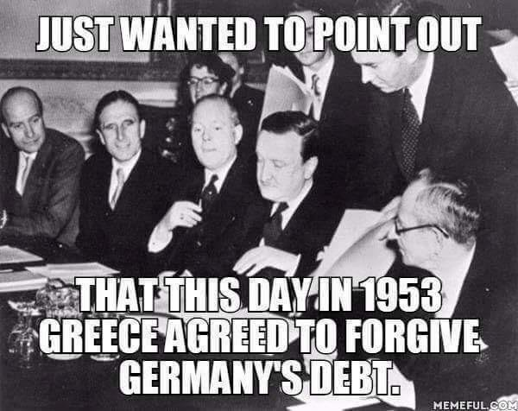
Quasi-logic arguments/1
Reciprocity (A:B=B:A)
“If they bully you at school, just hit them back”
“Is it justice of Germany to refuse debt relief to Greece when the country was itself given debt relief by Greece in 1953?”
Notes:
PERELMAN says: “the problem is to know in what case it is rational or just to treat in the same way two beings or situations which differ but which can be likened to each other. It is thus a question of partial, not complete identification, which is justified by the fact that the differences are considered negligible but the likeness essential. What is or is not essential depends upon the desired end.”
The saying is: “one good turn deserves another”
A:B=B:A
How to refute this argument?
Show inapplicability by showing that the symmetry is only apparent
Demonstrate the two terms are NOT essentially similar, but different
((http://intelligenceofpersuasion.blogspot.com/2015/09/a-beginners-guide-to-perelmans-quasi.html – for this and the successive slides on quasi-logic arguments)

Slide 17
Quasi-logic arguments/2
RULE OF JUSTICE:
Beings in the same essential category should be treated in the same way
“Siblings should be treated the same way”

Slide 18
Quasi-logic arguments/3
Of sacrifice
In the absence of an objective standard, things are judged only by the value people attach to them
“We don’t know what the purpose of the Stonehenge was, but we can tell from the effort it took to bring these stones all the way here that this was important for whoever built this.”
“We have come too far to give up now.”

Slide 19
Sophisms or Fallacies
Arguments apparently correct in form but actually invalid

Slide 20
Argument from ignorance
Appeal to ignorance, in the sense of «lack of evidence»
“If a proposition has not been disproven, then it cannot be considered false and must therefore be considered true.”
“If a proposition has not been proven, then it cannot be considered true and must therefore be considered false.”
In LAW: You are innocent until it’s proven that you are guilty
It’s an argument from ignorance, adopted for the reason that it’s a worse mistake to consider guilty someone who is innocent than the opposite (to consider innocent someone who is guilty).
Notes:
Ad Ignorantiam
The argument from ignorance represents a type of false dichotomy in that it excludes a third option, which is that there is insufficient investigation and therefore insufficient information to prove the proposition satisfactorily to be either true or false. Nor does it allow the admission that the choices may in fact not be two (true or false), but may be as many as four, (1) true, (2) false, (3) unknown between true or false, and (4) being unknowable (among the first three).
An ignorance fallacy occurs when a person mistakenly believes something to be true because she does not know enough about the subject to know otherwise. For example, an argument based on stereotype or hasty generalization is an example of ignorance fallacy. Such an argument is persuasive because the audience is ignorant.

Slide 21
Argument from ignorance/example
She didn't say that I couldn't borrow her car, so I figured it was just fine if I borrowed it for the weekend.

Slide 22
Argument from authority/1
The opinion of an authority on a topic is used as evidence to support an argument.
This approach is based on the assumption that if an expert or authoritative figure believes or states something, it must therefore be true.
The validity of this argument depends heavily on the credibility, expertise, and relevance of the authority in question.
The fallacy occurs when:
the argument relies solely on the authority's status or reputation, rather than on the evidence or reasoning behind their claim
when the authority is not actually an expert in the specific subject matter of the argument.
Notes:
In Latin: «Argumentum ad verecundiam»

Slide 23
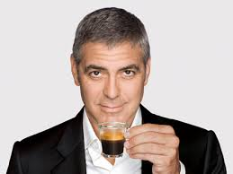
Argument from authority/2
Many advertising campaigns are built on this fallacy.
Popular sports figures, musicians, or actors endorse products of which they have no special expertise, and, in this context, this fact is offered as a mistaken reason we should use those products.

Slide 24
Argument «to the person»
The fallacy of attacking the character or circumstances of an individual who is advancing a statement or an argument instead of trying to disprove the truth of the statement or the soundness of the argument
The assumption is that what the locutor is saying is entirely or partially dictated by his character or special circumstances and so should be disregarded
… even if you win, it is a bitter win
Notes:
Latin name: Argumentum ad hominem or Argumentum ad personam
Informal Structure
Person L says argument A. Person L's circumstance or character is not satisfactory. Argument A is not a good argument.
BIG ISSUE: do you need to be perfect in order to be allowed to criticize someone?
Carere debet omni vitio qui dicere in alterum paratus est: those who want to criticize must have no faults.

Slide 25

Argument «to the person»/example
Context: Alfie Evans case (April, 2018). Alfie has an undiagnosed brain condition and UK wants to to stop life-support treatment and thus terminate his life
TWITTER POST (by a man on the street): “Who’s more knowledge [= knowledgeable] when it comes to Alfie Evans’ well-being? Doctors with decades of experience and lawyers, judges who know every letter of the law to the point where they rule over an entire continent or Alfie’s dad who went to prison for stabbing someone?.”
Notes:
Not all attacks on the person are problematic (though they are usually considered “bad” moves in a debate). It is possible to discredit the arguer in a way that effectively undercuts his argument. For example, one could challenge a speaker's credibility by showing that it is based on intentional deception: the person is “dishonest” or “a liar”.

Slide 26
Argument from pity
Irrelevant appeal to emotions to get a conclusion accepted
Example:
You should do as your mother says: you know how sorry she would be otherwise!
Notes:
Argumentum ad misericordiam
Schema:
Person L argues statement p or argument A. L deserves pity because of circumstance y. Circumstance y is irrelevant to p or A. Statement p is true or argument A is good.

Slide 27
The complex question
The fallacy of phrasing a question that, by the way it is worded, assumes something not contextually granted, assumes something not true, or assumes a false dichotomy.
EXAMPLE: “How many school shootings should we tolerate before we change the gun laws?”
Notes:
Explanation: The presupposition is that changing the gun laws will decrease the number of school shootings. This may be the case, but it is a claim that is implied in the statement and hidden by a more complex question. Reactively, when one hears a question such as this, one's mind will attempt to search for an answer to the question—which is actually a distraction from rejecting the implicit claim being made. It is quite brilliant, but still fallacious.
Complex (or assumptive) questions are designed to take for granted the very question at issue. As a former police interrogator and fraud examiner states, "Regardless of the questioner's surety of … guilt, it would be most sensible to start with [a] question [that] … assumes guilt, which makes the job of denial more difficult than issuing a simple ‘no.’
Counselors, psychologists, and related professionals use complex question as an investigative technique.

Slide 28
The false cause
The fallacy committed when an argument mistakenly attempts to establish a causal connection.
Post hoc ergo propter hoc (after this – so because of this)
The fallacy of arguing that one event was caused by another merely because it occurred after that event.
«We never had a problem with this elevator until you moved into the building”
«You were such a good boy before you made friendship with Louis»
Notes:
Informal structure: Event x is related to (or is followed by) event y. Event x caused event y. or
Events of kind x are followed by events of kind y. Events of kind x cause events of kind y.
Establishing causality in science is difficult. Usually if all A's are followed by B's then one suspect that A caused B. But even this generalization could be a coincidence. For the most part, causality is no longer used in science; correlation is sought instead.
Physiognomy: «the assessment of a person's character or personality from his or her outer appearance, especially the face» (wikipedia). Finding a correlation between someone’s looks and her (criminal) behaviour… looks a quite debatable scientific position!

Slide 29
Straw man
Modify the interlocutor’s thesis turning it from A to B and then into answering to B instead of to A. This happens if A is too hard a bite and if the B is similar enough to A to deceive
“I’m actually in favor of renewable sources. I think they can contribute to a nation’s energy demand”
“Oh, but if we were to use renewable sources only, we could not do all the things that we do now, they are not constant and moreover they don’t generate enough energy!”

Slide 30
END
CREDITS:
http://philosophy.lander.edu/logic
http://www.logicallyfallacious.com/
http://intelligenceofpersuasion.blogspot.it/2015/04/philosophical-rhetoric-beginners-guide.html
van Eemeren, F.H., Grootendorst, R., Snoeck Henkemans, A.F. (2002). Argumentation: Analysis, Evaluation, Presentation. Mahwah, NJ: Lawrence Erlbaum Associates
Perelman, C., & Olbrechts-Tyteca, L. (1952). Rhétorique et philosophie pour une théorie de l'argumentation en philosophie.
Cantoni, L., Di Blas, N., Rubinelli, S., Tardini, S. (2008). Pensare e comunicare, Apogeo, Milano

