Slide 1
Etching

Slide 2
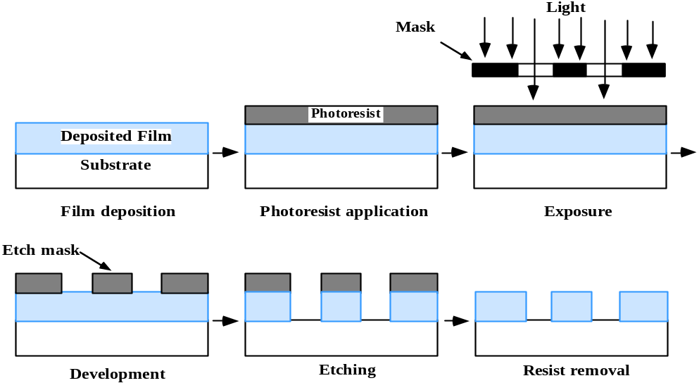
Introduction
After thin films are deposited, they are usually removed from the wafer surface to form the desired pattern.
Sometimes the silicon substrates is patterned too
After patterning photo resist and/or hard masks are etched away form the entire wafer
Etching can be performed in wet or dry (plasma) environment

Slide 3
Etch parameters/requirements
Etch rate
  Amount of material removed per unit time
Selectivity
  Ratio of the etch rates of different materials
  Mask and materials underneath the film to be patterned must be preserved
Anisotropy
  Vertical etch rate/horizontal etch rate
  A certain degree of anisotropy is often needed: features patterned on photo resist must be reproduced into the underlying film
  Structures profile shape must be accurately controlled.
Uniformity

Slide 4
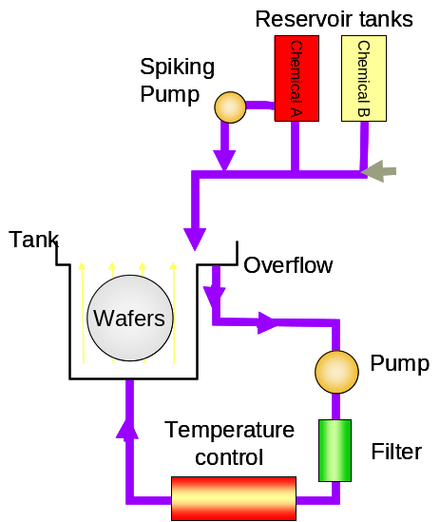
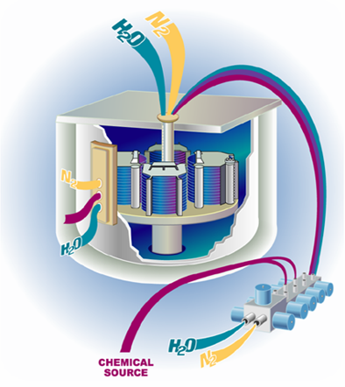
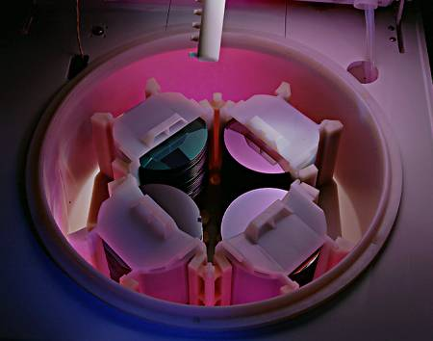
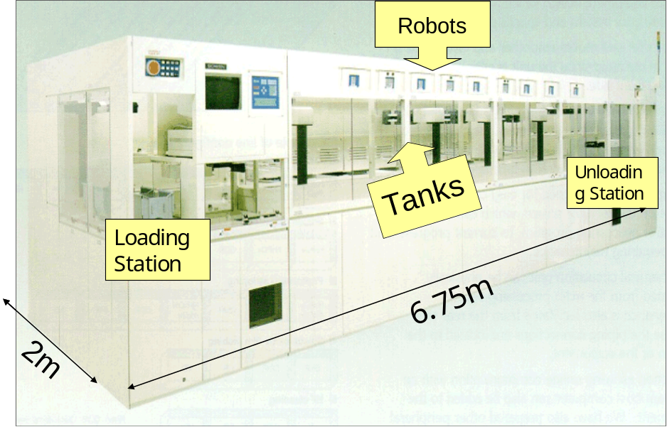
Wet etching
Wet chemical etchants are used
Wafers are immersed into baths or sprayed with chemicals

Slide 5
Wet etching
First method used in microelectronics, now widely used especially to remove hard masks, photo resist and dry etching by products.
Pros
  Very high selectivity
  High uniformity and etch rate control
Cons
  No anisotropy (except for crystalline orientation dependent silicon etch)

Slide 6
Etching Chemistries
 | Designation | Chemical Constituent
SiO₂ | Hydrofluoric acid | HF:H₂O
 | BOE,BHF | HF:NH₄F:H₂O
 | SC1 | NH₄OH:H₂O₂H₂O
Si₃N₄ | Hydrofluoric acid | HF:H₂O
 | (orto-)phosphoric acid | H₃PO₄
Organics | Piranha,SPM | H₂SO₄:H₂O₂
 | SOM | H₂SO₄:O₃
 | Ozonized DIW | DIW:O₃
Si | Nitric:HF | HF:HNO₃
 | Silicon etch | HF:HNO₃: H₂SO₄: H₃PO₄
 | Tetramethylammonium-hydroxide | TMAH
 | Ammonium hydroxide | NH₄OH
 | Potassium hydroxide | KOH
 | Hydrazine/water | N₂H₄:H₂O
W | Peroxide | H₂O₂
 | SC1 | NH₄OH:H₂O₂H₂O
 | SC2 | HCl:H₂O₂:H₂O
Al | SC2 | HCl:H₂O₂:H₂O
 | SC1 | NH₄OH:H₂O₂H₂O
 | Designation | Chemical Constituent
Cu | Ozonized water | O₃:H₂O
 | SC2 | HCl:H₂O₂:H₂O
Ti | SC1 | NH₄OH:H₂O₂H₂O
 | SC2 | HCl:H₂O₂:H₂O
 | Hydrofluoric acid | HF:H₂O
Co | SC2 | HCl:H₂O₂:H₂O
 | Piranha,SPM | H₂SO₄:H₂O₂
Ni | Piranha,SPM | H₂SO₄:H₂O₂
Ta | Hydrofluoric acid | HF:H₂O
 | Nitric:HF | HF:HNO₃
TaN | Nitric:HF | HF:HNO₃
Al₂O₃ | (orto-)phosphoric acid | H₃PO₄
 | Hydrofluoric acid | HF:H₂O
HfO₂ | Hydrofluoric acid | HF:H₂O
 | Nitric:HF | HF:HNO₃
ZrO₂ | Hydrofluoric acid | HF:H₂O
 | (orto-)phosphoric acid | H₃PO₄
 | Piranha,SPM | H₂SO₄:H₂O₂
 | Nitric:HF | HF:HNO₃
Notes:
Questo e’ un elenco di chimiche che si possono utilizzare per attaccare vari materiali. Ad esempio, si vede che l’ossido di silicio puo’ essere attaccato dall’acido fluoridrico, oppure da acido fluoridrico tamponato con ammonio fluoruro. Il nitruro puo’ attaccare con l’acido fluoridrico oppure con l’acido fosforico.

Slide 7
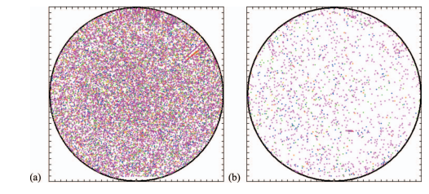
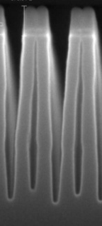
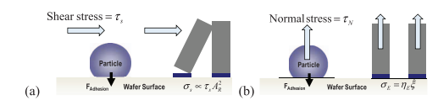
Advanced celaning/wet etching
Advanced wet processes challenges:
  Particle removal efficiency
    Foam and bubble cleaning (CO2 or Nitrogen)
    Nozzle spray celaning
    Laser generated bubbles
    Non newtonian fluids [0 shear stress]
    Micro machined nano-tweezers (mask fabrication)
  Pattern collapse
    HF vapor
    Plasma + sublimation
    Cryogenic aerosol (N2)
    Super-critical CO2 [0 surface tension]

Slide 8
Plasma etching
A plasma is used to etch the desired material:
  Both chemical reactions and ionic bombardment contribute to film removal.
Pros
  High anisotropy
  Profile shape controllability
Cons
  Contamination
  Damage
  Loading and memory effects
  Etch by-products to be removed

Slide 9
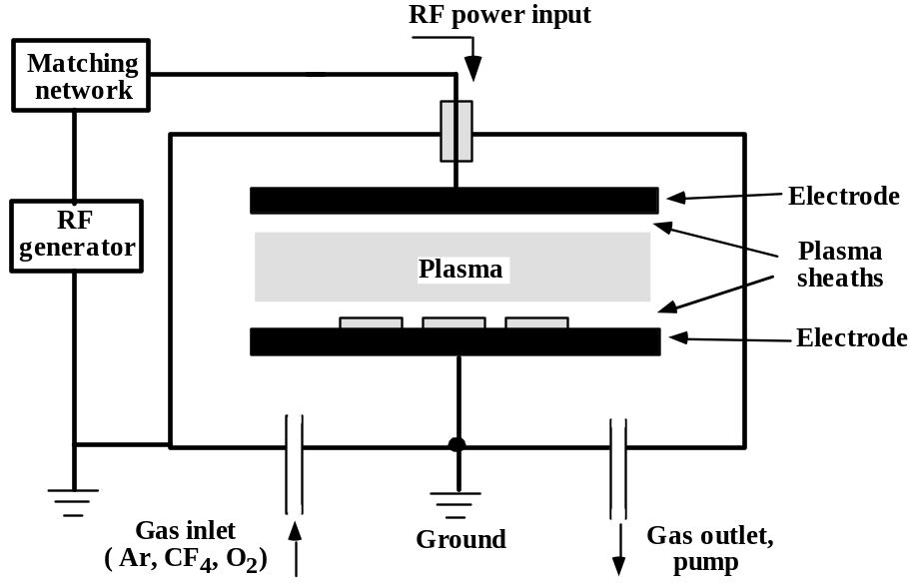
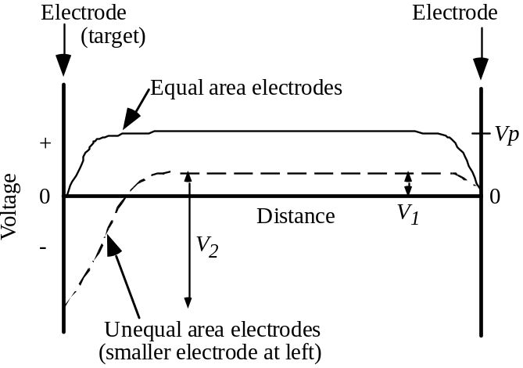
Plasma etching
Typical RF-powered plasma etch systems look just like PECVD or sputtering systems.
Both chemical (highly reactive) species and ionic (very directional) species typically play a role.
V_{P} is positive to equalize electron and ion fluxes.
Smaller electrode has higher fields to maintain current continuity (higher RF current density).

Slide 10
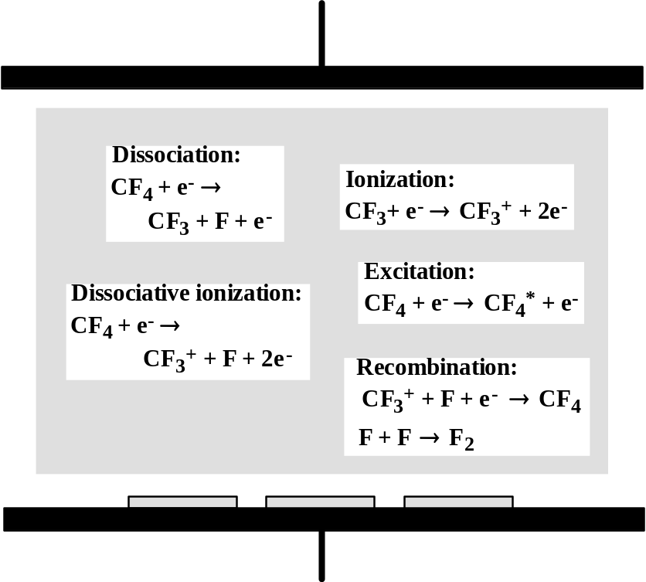
Plasma etching basic mechanisms
Etching gases include halide-containing species such as CF4, SiF6, Cl2, and HBr, plus additives such as O2, H2 and Ar. O2 by itself is used to etch photoresist.
Pressure = 1 mtorr to 1 torr.
Typically there are about 10¹⁵ cm-3 neutral species (1 to 10% of which may be free radicals) and 10⁸-10¹² cm⁻³ ions and electrons.
In standard plasma systems, the plasma density is closely coupled to the ion energy (as determined by the sheath voltage). Increasing the power increases both.

Slide 11
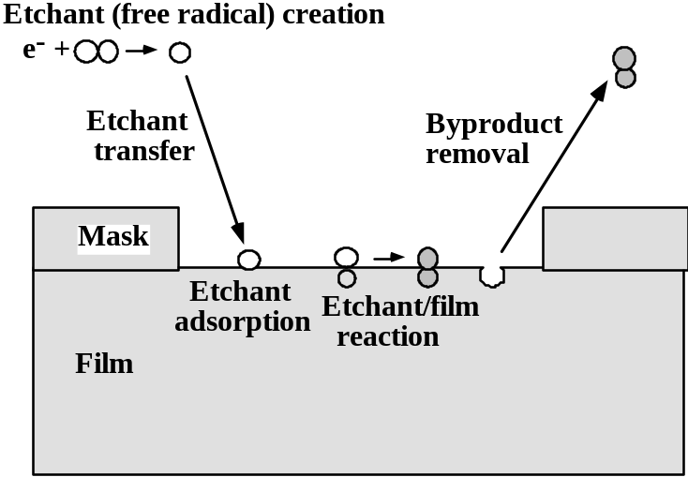
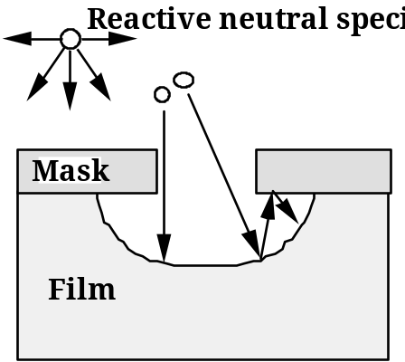
Plasma etching basic mechanisms
Chemical etching
Gas phase etchants are formed in the plasma (often, very reactive radicals)
Arrival angle distribution is uniform (cos^{n}θ with n=1)
Low sticking coefficient S_{s}
Since the etch is purely chemical, it’s also isotropic
High selectivity
Es.
e⁻+CF₄ → CF₃+F+e⁻
4F+Si(s) → SiF₄

Slide 12
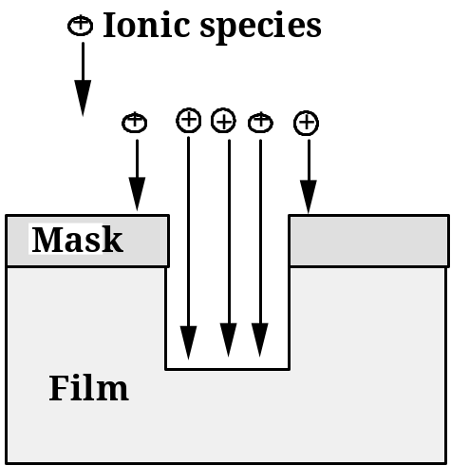
Plasma etching basic mechanisms
Physical etching (sputtering)
Sputtering yields are usually low ( one atom/incident ion)
Sputtering yield also depends on arrival angle (see figure) → faceting
Directional arrival angle distribution, S_{c}=1 → anisotropic etching
Note: some chemical reaction can also occur during ion bombardment if ionized species are reactive.
3
3
2
2
Normalized Sputtering yield, Y
1
1
0
0
1
0
2
0
3
0
4
0
5
0
6
0
7
0
8
0
9
0
0
Incident angle

Slide 13
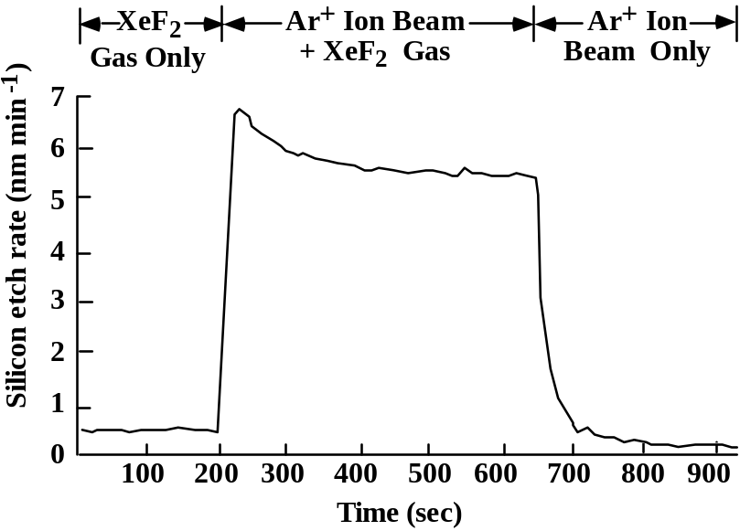
Plasma etching basic mechanisms
Ion enhanced etching
Ion bombardment and chemical etching seem to work in a synergetic way:
Resulting etch rate is higher than the sum of single etch rates
Anisotropy is very high
Unexplained mechanism:
  Chemical reaction enhancement (e.g. bonds breaking)
  Inhibitor removal (see next slide)

Slide 14
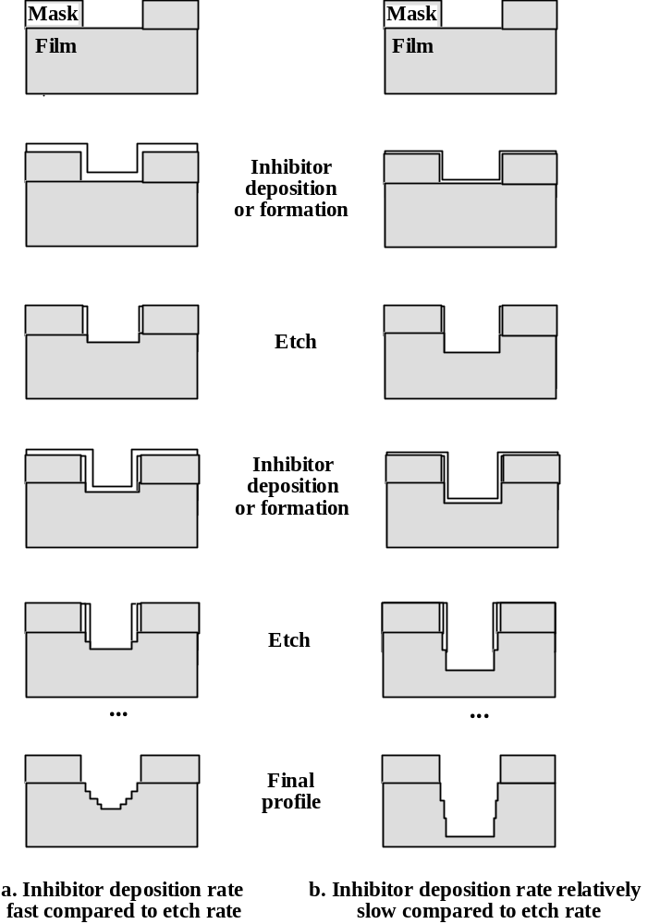
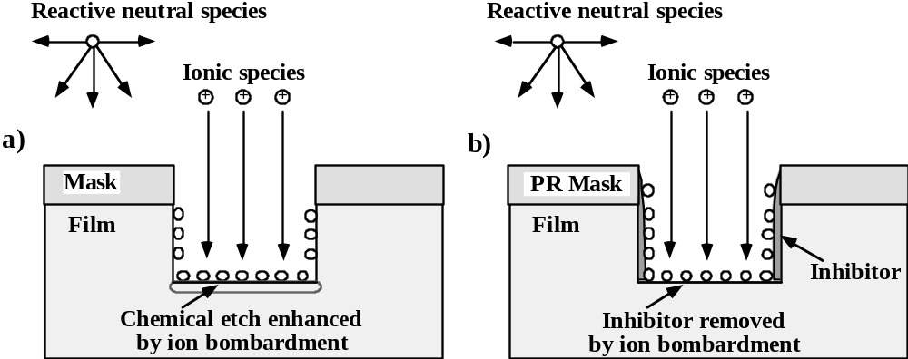
Plasma etching basic mechanisms
Ion enhanced inhibitor etching
A inhibitor or a “passivation” layer is formed and removed by ion bombardment (but stays on structures sidewalls)

Slide 15
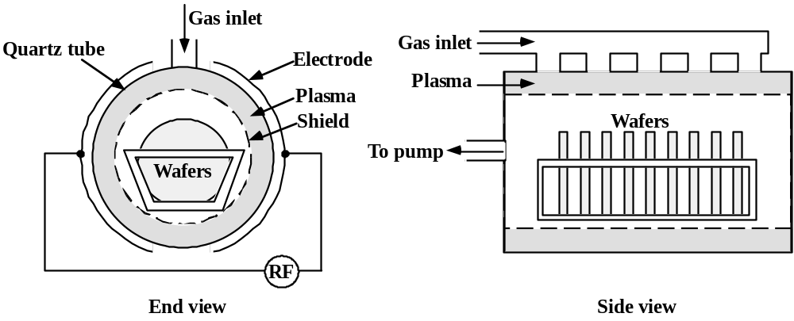
Etching tools
Barrel etcher
  Plasma is kept separated by wafers → no ion bombardment
    High selectivity
    No anisotropy
  Not used in modern IC manufacturing
  Downstream plasma concept still used for resist ashing

Slide 16
Etching tools
NOTE: All the etching systems in modern IC manufacturing are SINGLE WAFER TOOLS
Parallel plate etcher
  Very similar to PE-CVD chambers we already described.
  Can be operated in:
    Plasma mode: symmetrical electrodes lead to poor ion bombardment, small sheath voltage drop at wafer surface.
    RIE (Reactive Ion Etching) mode: asymmetric electrodes guarantee enhanced ion bombardment

Slide 17
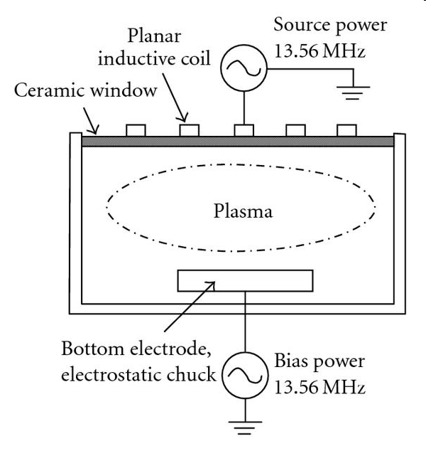
Etching tools
High density plasma systems
  Plasma density and ion energy control are “decoupled”
    Bottom (wafer holding) electrode is controlled by an RF source
    Plasma is ignited by ECR (Electron Cyclotron Resonance) or ICP (Inductively Coupled Plasma) systems
    Can be operated in th 1-10 mTorr range
    High ion density and relatively low ion bombardment can be achieved simultaneously

Slide 18
Etching tools
Sputter etching and Ion milling
  In sputter etching, only the sputtering component is exploited.
  In Ion Milling a confined plasma is used to generate ions (es. Ar⁺), grids are then used to accelerate ions toward the target (electron are eventually used to neutralize the beam). The Ar beam can also be focused ( used for mask repairing and TEM sample preparation).

Slide 19
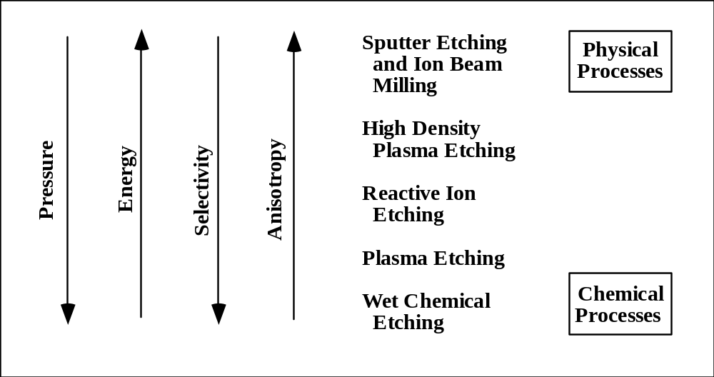
Summary of etching tools/techniques

Slide 20
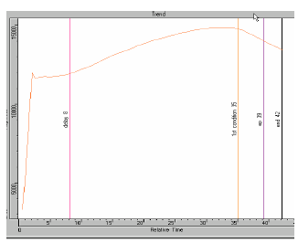
End point detection
Species in plasma are excited and emit photons at specific wavelengths.
Using Optical Emission Spectroscopy, a specific wavelength relative to a reactant or to a reaction product can be tracked.

Slide 21
Plasma etching process “knobs”
Power.
  RIE: 0.1/5 Wcm⁻² , ion energy =10/700 eV
  HDP: 0.1/3 Wcm⁻², ion energy = 10/500 eV
Pressure
  RIE: 10/100 mTorr
  HDP: 1/10 mTorr
Gas species, flow rate and distribution
Wafer and chamber temperature

Slide 22
Etch rate dependence on “knobs”
Etch rate dependence on power, pressure, flow rate an T is quite complicated, and can strongly depend on etch systems design. Generally speaking:
  Etch rate obviously depends on gas species
  Increasing power increases etch rate (in HDP systems ion bombardment can also be independently controlled)
  Increasing pressure decreases ion density, but increases chemical flux → etch rate dependence on pressure is not easily predictable
  Flow rate has a minor impact on etch rate ( can be increased to supply more reactant species, but high flow rate can decrease too much the residence time)

Slide 23
Etch profile dependence on “knobs”
Etch profile can be controlled by:
  Increasing/decreasing ion bombardment ( power )
  Using different etchant gases, to control by-product formation and passivation layers deposition/removal process

Slide 24
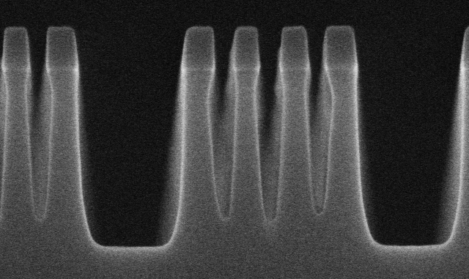
Plasma etching issues
Loading effects
  Etch rate dependence on local plasma density
Micro-loading effect
  Structures with different mask openings or aspect ratios are etched with different etch rates
Can be due to:
Depletion or trapping of reactant species
Distortion of ion paths due to charging
Shadowing effects

Slide 25
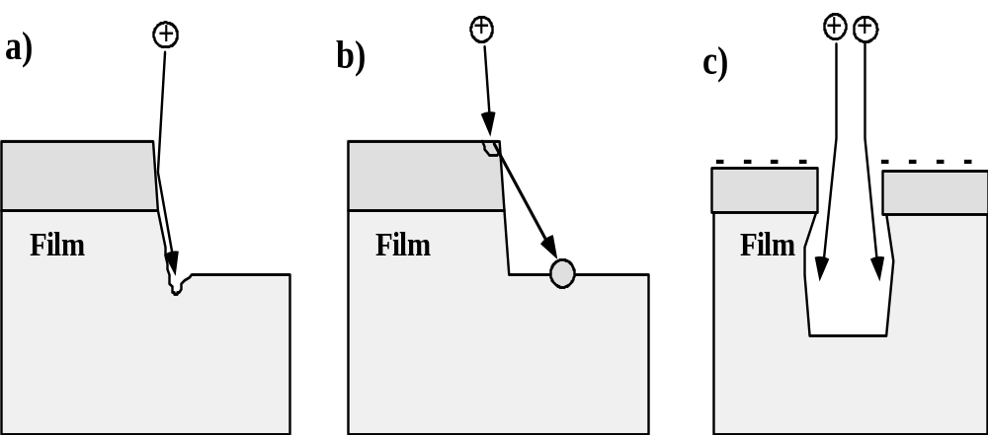
Plasma etching issues
Micro trenching (ion physical deflection)
Resist re-sputtering
Ion trajectory distortion due to resist charging

Slide 26
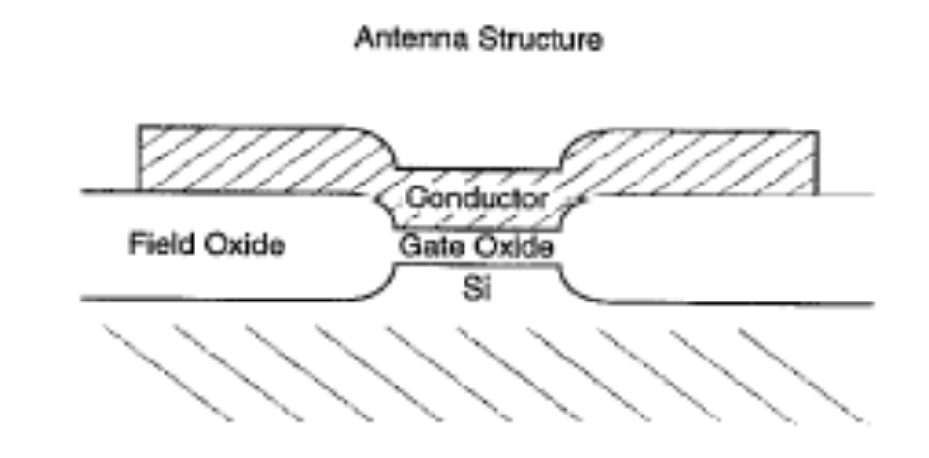
Plasma etching issues
Radiation damage
  Wafer surface can suffer from displaced atoms and implanted species such as H and C.
Active oxides plasma damage (antenna effect)
Substrate doping dependence

Slide 27
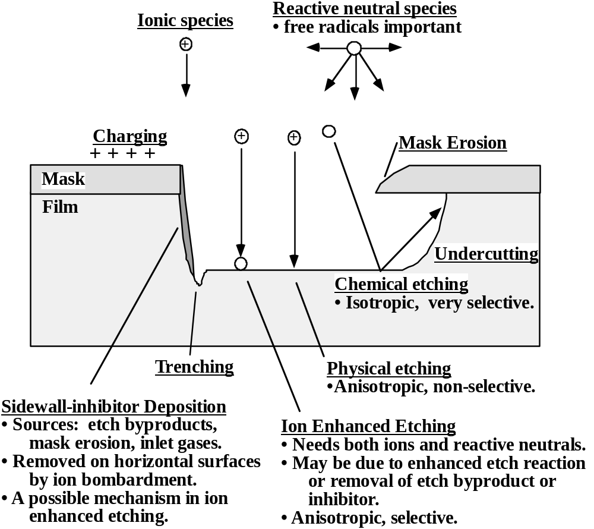

Slide 28
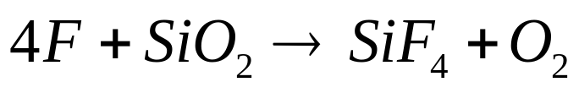
Plasma etching chemistries
Silicon oxide
Fluorine based chemistries are used; F radicals are very reactive
Gases like NF₃,SF₆,CF₄ result in very isotropic etching, silicon selectivity is also poor.
Adding O₂ to CF₄ increases the density of F radicals ( reducing recombination of C and F).
Fluorine-poor chemistries like CHF₃, C₃F₈ or C₂F₆ can be used to reduce isotropy . Increasing C/F ratio also increases polymer deposition and profile control

Slide 29
Plasma etching chemistries
Silicon and poly-silicon
Due to SiF4 volatility, F-based chemistries can be used to etch Si as well.
Problems:
SiO2 selectivity
Anisotropy
Adding O₂ to CF₄ can increase oxide selectivity ( Si etch is enhanced much more than SiO₂ etch)
Halogen gases are used to increase both selectivity and anisotropy (less chemical component)
Cl₂ and HBr are the most commonly used gases. Adding O₂ can activate inhibitor deposition, allowing profile control

Slide 30
Plasma etching chemistries
Aluminum
  Ion bombardment/sputtering to get rid of native Al₂O₃
  Cl based chemistries to increase volatility of by-products
  Strong inhibitor usage to avoid lateral erosion
  Higher temperatures to allow for evaporation of Cu based by-products.
  Post etch treatments needed to avoid Cl reacting with atmosphere H₂O → HCl formation and Al corrosion,

Slide 31
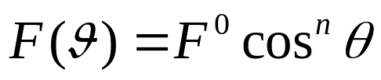
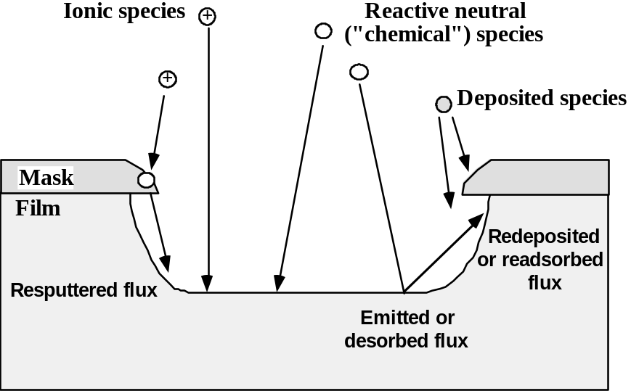
Etching models
Simple empirical models have to be derived for dry etching, since most of basic mechanisms are still not understood.
As usual, we should model the arrival angle distribution for each point of the wafer.
n=1 for neutral chemical species, n=10 to 80 for ions
We will also use the sticking coefficient concept. With S_{c}=1 for ionic species, and very low for neutral chemicals, that “bounce” around

Slide 32
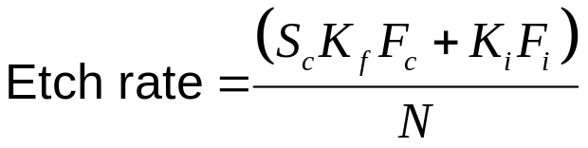
Etching models
Simple linear model
The simplest way to proceed is to imagine that sputtering and chemical reaction act independently. We can thus write
K_{f} is a reaction rate constant, K_{i} is the effective sputtering yield, depending both on incident angle and ion energy.
N is the density of the film to be etched.
Micro-loading effects can be, for example, simulated

Slide 33
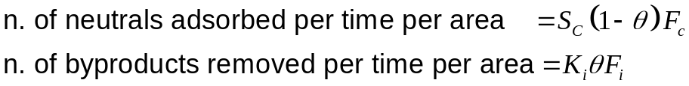
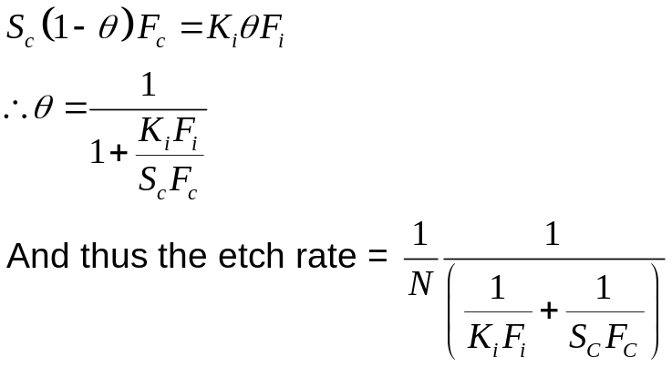
Etching models
Ion enhanced etching model:
  Neutral species are adsorbed to the surface to chemically react with the film
  Byproducts are removed by ion bombardment
  Number of species adsorbed is proportional to number of sites available (i.e. how many sites are free from by-products)
  Number of by-products removed is proportional to ion flux
Where 1-θ is the fraction of available sites. Assuming steady state condition:

Slide 34
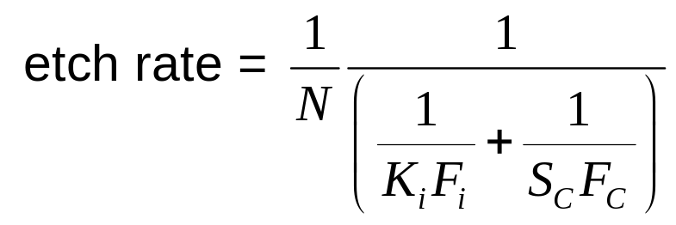
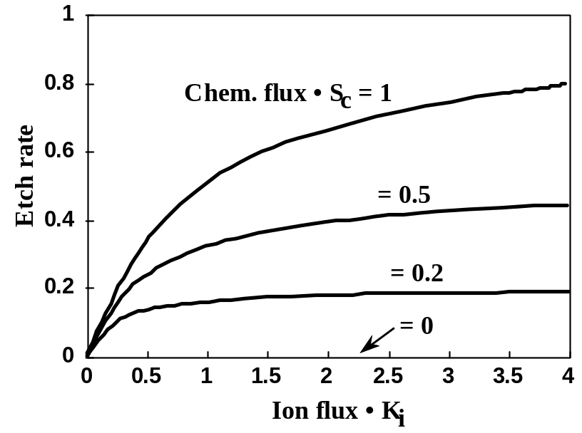
Etching models
If either flux is zero, the overall etch rate is zero since both are required to etch the material.
Etch rate saturates when one component gets too large relative to the other (limited by slower of two series processes).
General approach with broad applicability. (But does not account for independently formed inhibitor layer mechanism, and does not model excess inhibitor formation.)

