Slide 1
Interconnections

Slide 2
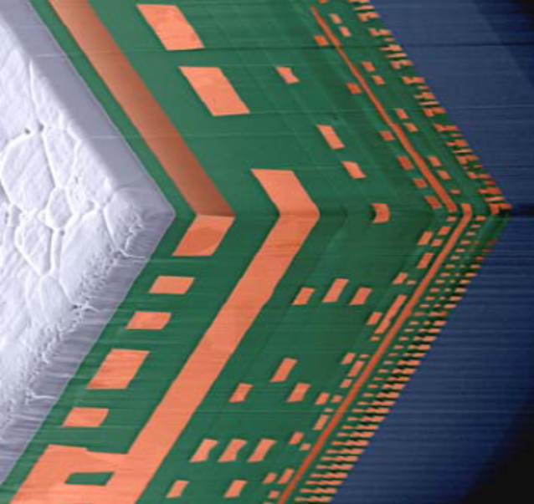
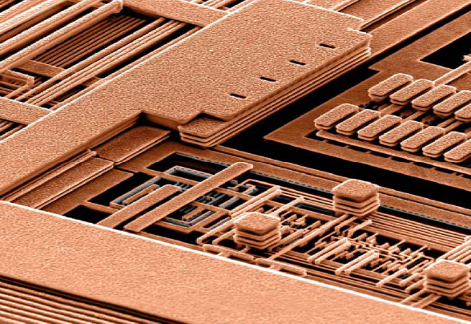
Introduction
Back end or Back end of the line (BEOL):
  Interconnect layers
  Contacts
  Vias
  Insulating dielectric layers
Needed to wire the active devices into specific circuit configuration

Slide 3
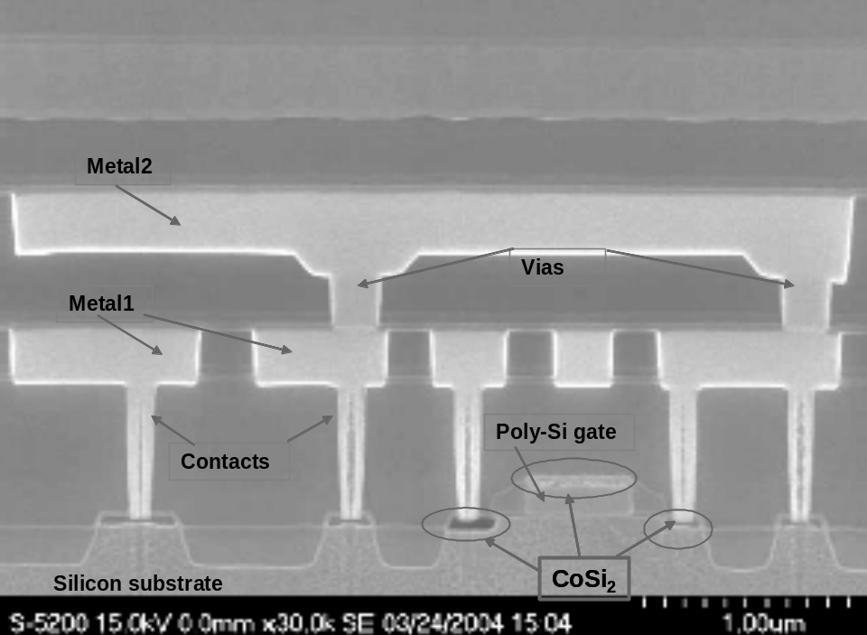
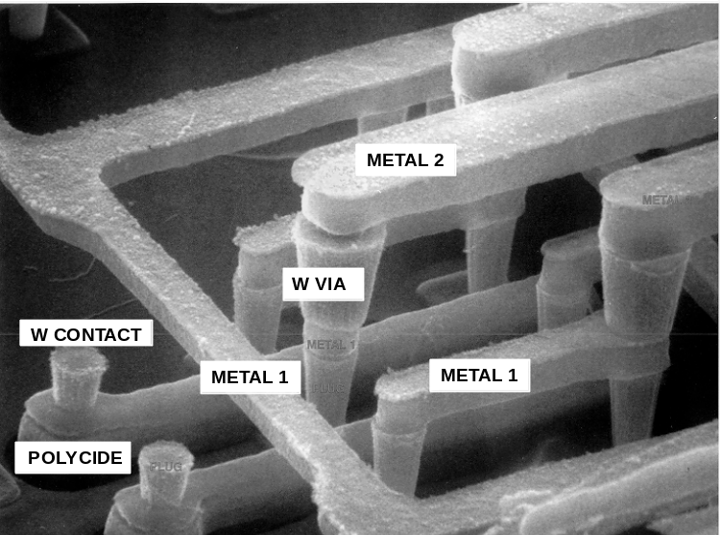
Back end elements
Local interconnects
  Silicided transistor gates
  Silicided active areas ( source and drain regions)
Contacts
  Connecting local interconnects/active devices to first metal level
Intermediate/Global interconnects
  Metal lines wiring active elements into circuits
Dielectrics
  Insulating different metal levels and lines
Vias
  Connecting different metal lines

Slide 4
Local interconnects
Silicides are used as or with local interconnects in three ways:
  Reduce sheet resistance of poly gates (and keep the poly/SiO₂ interface unchanged)
  Strap source/drain regions to allow for low resistance contacts
  (Local interconnects below the lowest metal level)

Slide 5
Silicides properties
Low resistivity (10/50 Ωcm)
High temperature stability
Good compatibility with silicon
Easy to plasma etch
Good compatibility/interface with other materials
No electromigration

Slide 6
Silicides formation methods
Direct deposition
  The silicide is directly deposited on the wafer by PVD or CVD techniques ( CVD actually used only for WSi₂) .
Reaction
  Simple reaction
    Metal and amorphous Si are deposited by sputtering, Si is deposited and patterned before metal deposition.
    An annealing allow for the reaction between metal and Si.
    Unreacted metal is selectively stripped off.
  Self aligned silicide (salicide)
    Metal is deposited (by sputtering) directly on exposed gates and source/drain regions
    The wafer is annealed and the metal reacts with Si → no reaction occurs on field oxide zones
    Unreacted metal is stripped off.

Slide 7
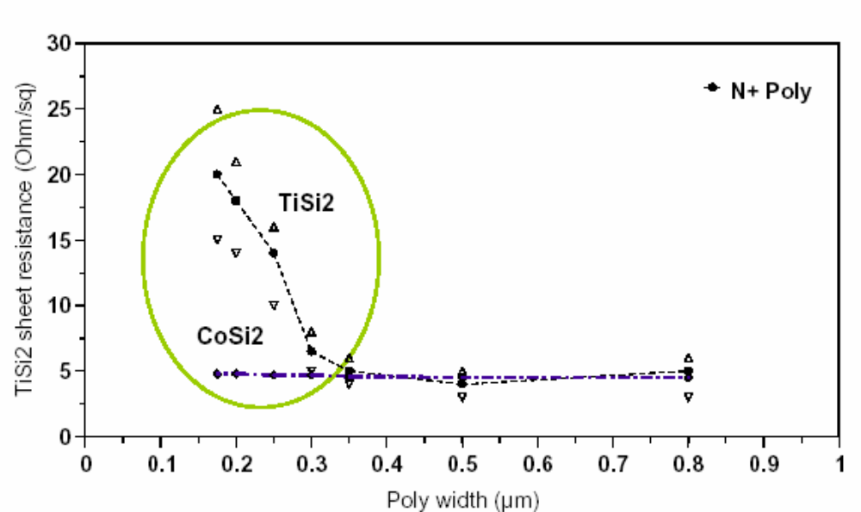
An example: SA-TiSi₂
Native or screen SiO₂ is removed from the wafer (HF wet etch and/or sputter etch)
Ti sputtering deposition (50/100nm)
600/700 °C, 15/60 s N₂ anneal
  Ti reacts with Si at the bottom, to form TiSi₂ (no reaction on silicon oxide)
  Ti reacts with Nat the top, to form TiN
  Low temperature prevents excess lateral growth ( but TiSi₂ is in C49 phase)
TiN and unreacted Ti are stripped off ( NH₄OH:H₂O₂:H₂O wet etch)
An 800 °C converts the TiSi₂ from into C54 low resistivity phase (temperature and time must be kept as low as possible to avoid agglomeration and dopant diffusion into metal layer)

Slide 8
Silicides materials
Silicide | Resisitivity (μΩcm) | Sintering temperature (°C) | Stable on Si up to (°C) | nm of Si consumed per nm of metal | Nm of silicide per nm of metal | Barrier height to n-Si (eV)
PtSi | 28-35 | 250-400 | 750 | 1.12 | 1.97 | 0.84
TiSi₂(C54) | 13-16 | 700-900 | 900 | 2.27 | 2.51 | 0.58
TiSi₂(C49) | 60-70 | 500-700 |  | 2.27 | 2.51
WSi₂ | 30-70 | 1000 | 1000 | 2.53 | 2.58 | 0.67
CoSi | 100-150 | 400-600 |  | 1.82 | 2.02
CoSi₂ | 14-20 | 600-800 | 950 | 3.64 | 3.52 | 0.65
NiSi | 14-20 | 400-600 | 650 | 1.83 | 2.34
NiSi₂ | 40-50 | 600-800 |  | 3.65 | 3.63 | 0.66
MoSi₂ | 40-100 | 800-1000 | 1000 | 2.56 | 2.59 | 0.64
TaSi₂ | 35-55 | 800-1000 | 1000 | 2.21 | 2.41 | 0.59

Slide 9
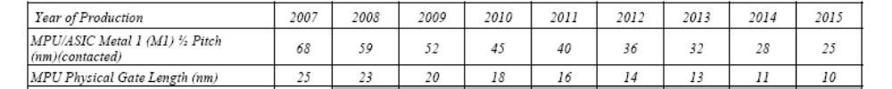
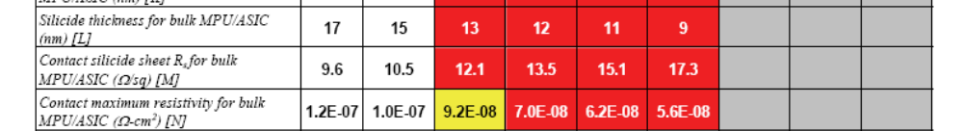
ITRS predictions for silicides
Narrow lines salicidation and compatibility with shallow junctions are the main issues in salicidation processes
Ni(+Pt) silicides are the current mainstream for advanced ICs

Slide 10
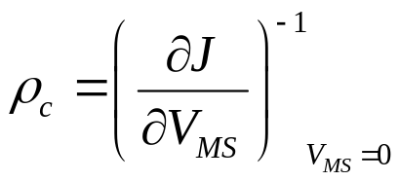
Contacts
Contacts provide low resistance connections between active devices and the first metal layer.
Metal/semiconductor contacts behaviour can vary from rectifying to Ohmic
Φ_{b} is n principle strongly dependent on metal work function ( but interface states tend to pin the Fermi level deep in the band gap)
High Φ_{b} contacts to n-silicon, relatively low Φ_{b} to p-silicon.
Specific contact resistivity is an usual figure of merit for contacts:
φ_{b}
semiconductor
E_{c}
E_{f}
metal
E_{v}

Slide 11
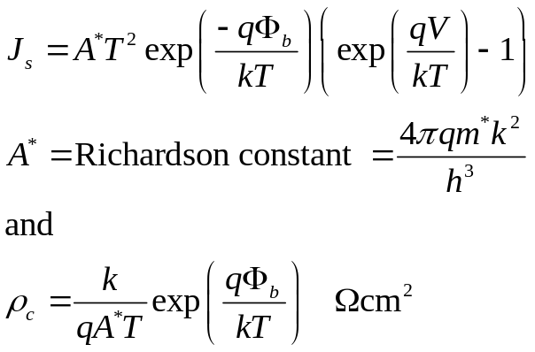
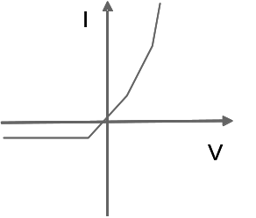
Contacts
For a contact dominated by thermoionic emission current:
Contact ρ_{s} depends only on barrier height
For most metals barrier is too high, and rectifying behaviour is observed.
φ_{b}
semiconductor
E_{c}
E_{f}
metal
E_{v}

Slide 12
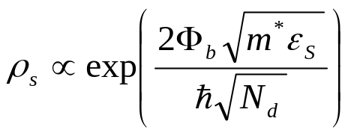
Contacts
Ohmic behaviour can be obtained if operating in tunnelling regimes; it can be demonstrated that:
Increasing surface doping lowers ρ_{s}, since the tunnelling barrier shrinks
Heavily doped substrates are needed to obtain an ohmic contact
I
I
V
V
φ_{b}
semiconductor
E_{c}
E_{f}
metal
E_{v}

Slide 13
Contact resistance
Contact resistance can be roughly estimated by dividing ρ_{s} by the contact area (→ contact resistance is one of the technology scaling issues)
Other effects must also be taken into account, e.g. current crowding.

Slide 14
Contacts
Contacts materials must guarantee:
  Ohmic electrical contact
  Low resistivity
  Thermal stability during the process flow

Slide 15
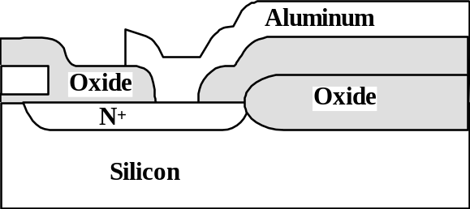
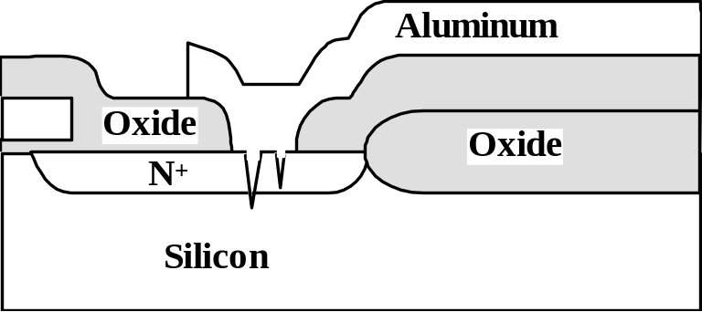
Contacts
In early devices, contact/interconnects were made of Al in direct contact with Si.
Al reduces SiO₂ (H₂ anneal at 450°C)
Good adhesion to Si
But…
Si is soluble in Al (1% at 500 °C)→ Al spiking into Si substrate and junction depth limitation.
  Al +Si metal material
  Barrier layers (e.g., Ti, TiN)
Planarity is an issue
Notes:
Ricorda: nel caso dell’Al Ti e’ barriera chimica, reagisce con Al e Si per formare siliciuri e alluminati e impedire reazioni fra Al e Si.
TiN e’ barriera inerte: blocca la diffusione del Si.

Slide 16
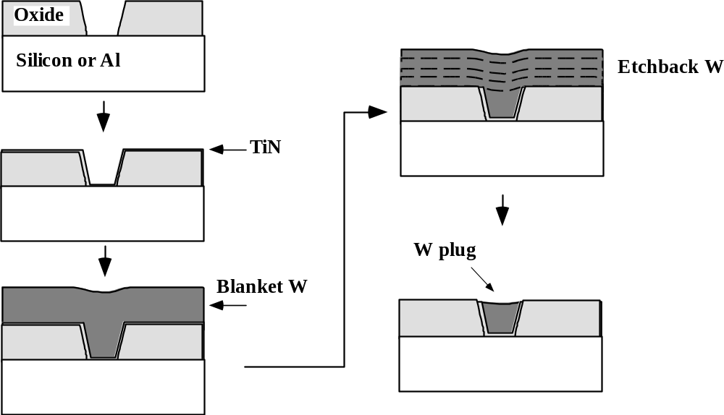
Contacts process flow
Contacts are now typically realized as W plugs:
  Pre metal dielectric is deposited ( and planarized)
  Contact plug is etched into the dielectric
  Ti and TiN layers are deposited:
    Ti improves adhesion
    TiN acts as a barrier to prevent WF₆ diffusion into silicon during W deposition
  W is deposited by CVD and/or PVD techniques
  A W etch-back or CMP guarantees the appropriate degree of planarity.

Slide 17
Interconnects: general properties
Requirements on interconnects are:
Low resistivity
Good adhesion to underlying films
Stability during processing and circuit operation
Ability of being deposited and etched

Slide 18
Interconnects materials
Material | Resistivity (μΩcm) | Melting point (°C)
Al | 2.7/3.0 | 660
W | 8/15 | 3410
Cu | 1.7/2.0 | 1084
Ti | 40/70 | 1670
TiN | 50/150 | ~2950

Slide 19
Al interconnects
Al has been the mainstream material for interconnects:
  Relatively low resistivity
  Good adhesion
  Relatively easy deposition and etching
BUT…
Thermal expansion coefficient for Al: 23 10⁻⁶ °C⁻¹
Thermal expansion coefficient for Si: 2.6 10⁻⁶ °C⁻¹

Slide 20
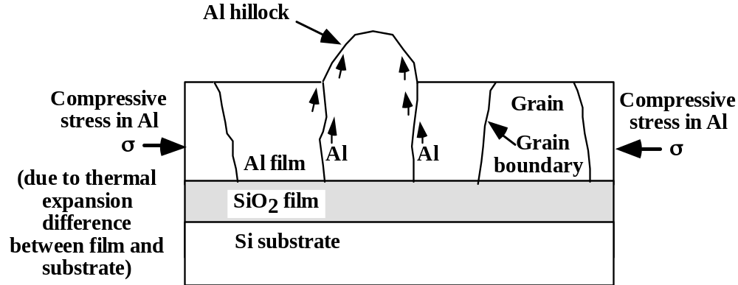
Al Interconnects: hillocks and voids
Hillocks and voids form because of stress and diffusion in Al films.
Heating places Al under compression causing hillocks.
Cooling back down can place Al under tension ⇒ voids.
Adding a few % Cu stabilizes grain boundaries and minimizes hillock formation.

Slide 21
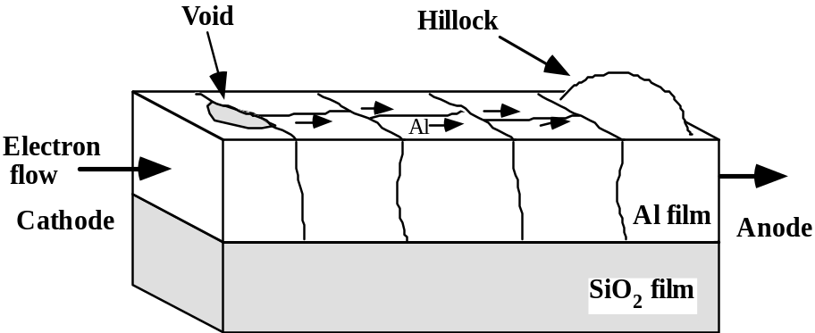
Al interconnects: electromigration
High current density(0.1-0.5 MA/cm2) causes movement of Al atoms in direction of electron flow.
Can cause hillocks and voids, leading to shorts or opens in the circuit.
Adding Cu (0.5-4 weight %) can also inhibit electromigration.
Thus Al is commonly deposited with 1-2 wt % Si and 0.5-4 wt % Cu.
Multi-layer stacks like Ti +TiN + Al(Cu) + TiN are used :
Ti helps controlling the Al grain texture (reduces electromigration effects)
TiN acts as a barrier for WF₆ during via processing
Ti or TiN can shunt the metal line in case of voids or cracks formation.
They can prevent electromigration by containing stress induced deformation of Al lines.

Slide 22
Dielectrics
General requirements for back end dielectrics:
  Good electrical isolation
  Low dielectric constant
  High breakdown electric field (>5 MV/cm)
  Good adhesion
  Good stability
  Good structural density
  No contaminants
  Permeable to hydrogen

Slide 23
Dielectrics
Material class | Material | K | Deposition technique
Inorganic | SiO₂ (including PSG, BPSG) | 3.9/5.0 | CVD, HDP
 | FSG |  | CVD, HDP
 | Spin on glass | 3.9/5.0 | SOD
 | Si₃N₄ (only in multi-layer structures) | 5.8/6.1 | CVD/PE-CVD
Organic | Polymides | 2.9/3.9 | SOD/CVD
Hybrids | Si-O-C polymers | 2.0/3.8 | SOD/CVD
Aerogels | Porous SiO₂ | 1.2/1.8 | SOD
Air bridge |  | 1.0/1.2
Dielectric planarization is needed before contacts/metal lines/vias patterning:
  Formerly obtained by reflow (BPSG, PSG) or etch back
  Now CMP is the mainstream approach

Slide 24
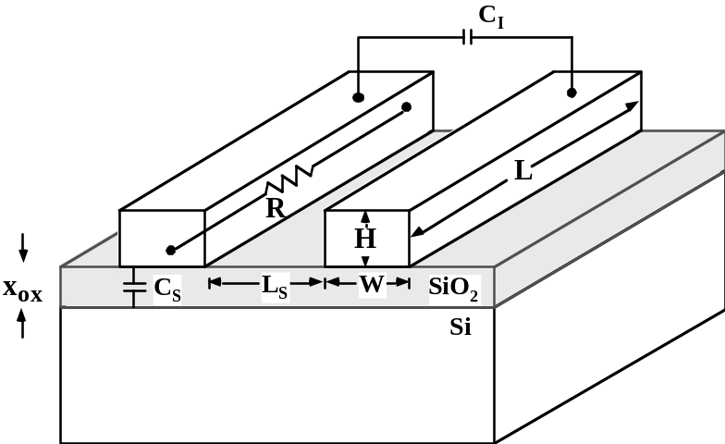

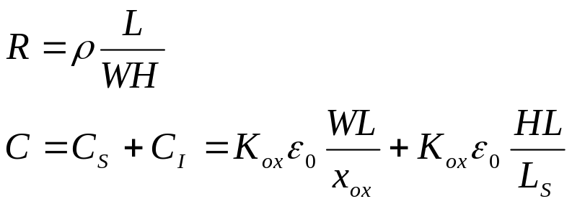
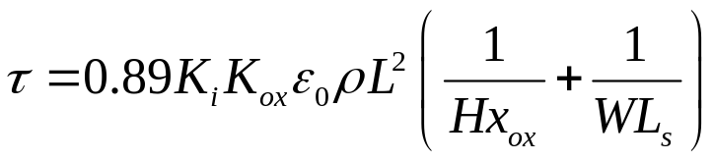
Back end features vs technology scaling
The time delay of a signal transmitted over a metal line can be estimated as:
Let’s express τ as a function of back end features
With ρ=metal resistivity, K_{ox}= oxide dielectric constant
K_{i}≈2 takes into account fringing fields effect and other metal layers

Slide 25
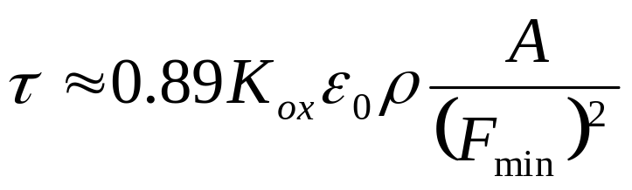
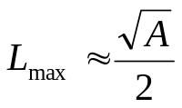
Back end features vs technology scaling
As technology scales down:
H,W,x_{ox} and L_{s} all scale down as F_{min}
,A= chip area, usually increases with scaling
Need to act on material properties to keep τ under control

Slide 26
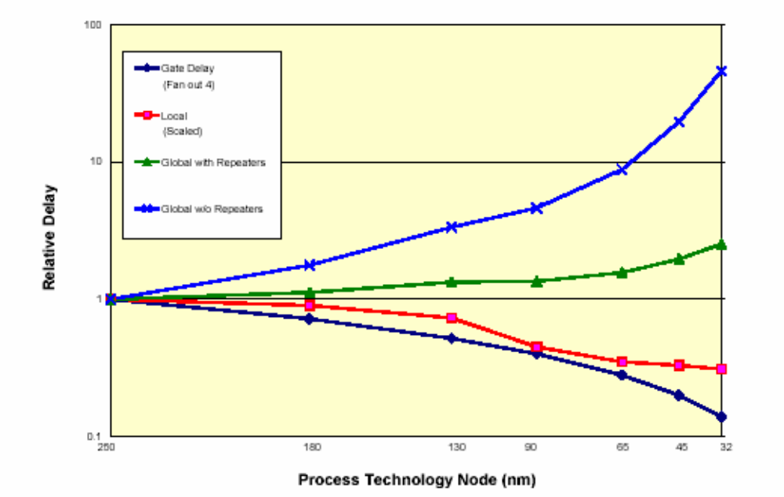
Back end features vs technology scaling

Slide 27
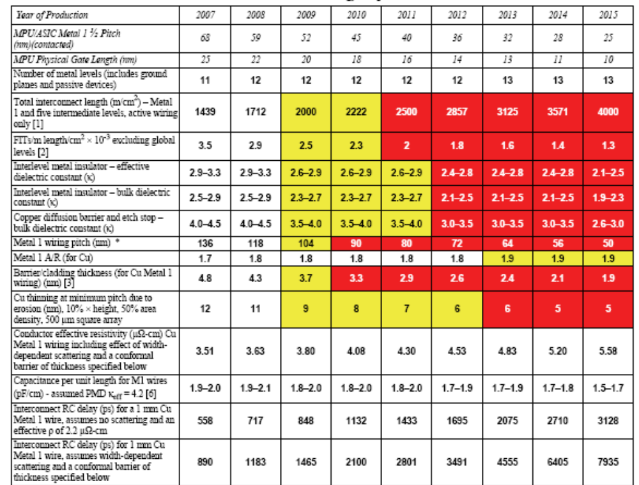
Back end features vs technology scaling

Slide 28
Copper process
Cu is now widely used in most of advanced ICs
Low K dielectrics have also been introduced in MC, ASICS and DRAMs to minimize RC.
Copper cannot be dry etched (etch by-products are not volatile) : it requires a damascene approach!

Slide 29
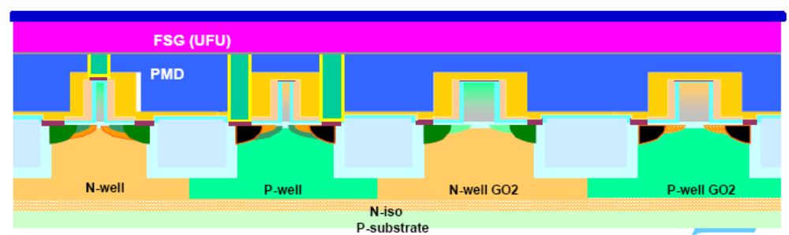
Copper process
After standard contact formation:
Nitride or low-K SiCN deposition (PE-CVD/CVD) [etch stopping layer]
Low K dielectric deposition (FSG or SiOC)

Slide 30
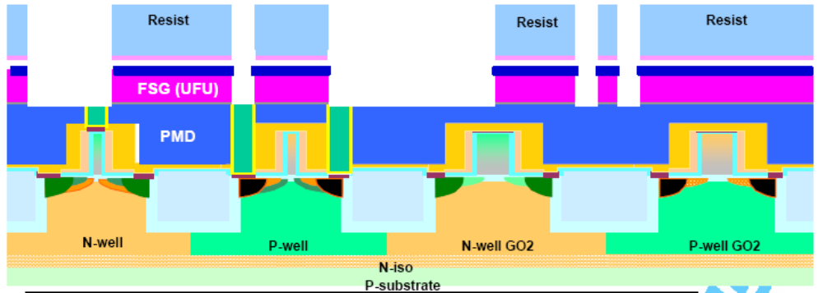
Copper process
Line 1 lithography
Line1 etching

Slide 31
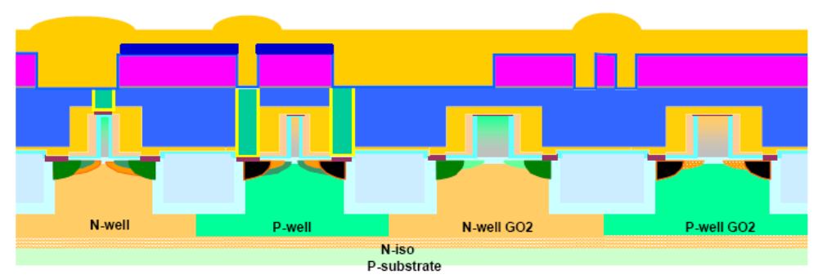
Copper process
Reactive pre clean (sputter etch) to reduce native oxide
Barrier deposition: TaN/Ta (effective in preventing Cu contamination in front end structures)
Cu seed deposition
Cu electroplating

Slide 32
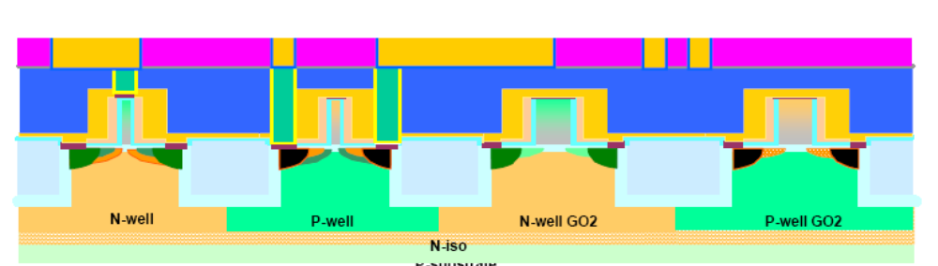
Copper process
Cu-CMP

Slide 33
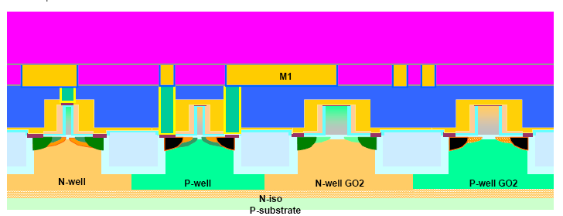
Copper process
Stopping nitride (or SiCN) deposition
Low K dielectric (FSG or SiOC) deposition

Slide 34
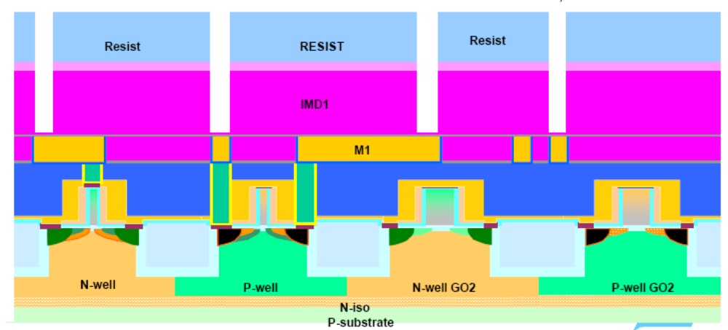
Copper process
VIAS litho and etching

Slide 35
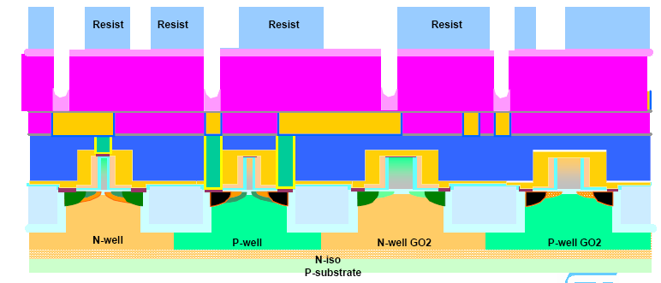
Copper process
Line 2 lithography ( BARC protects vias from Line etchin)

Slide 36
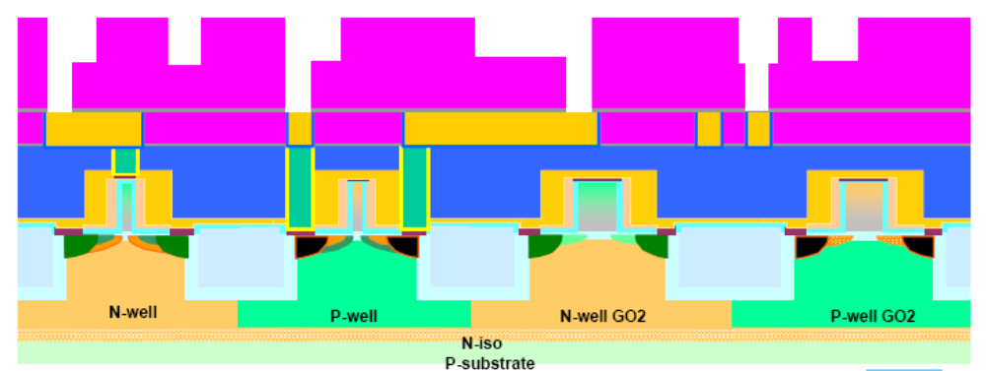
Copper process
Line 2 etching

Slide 37
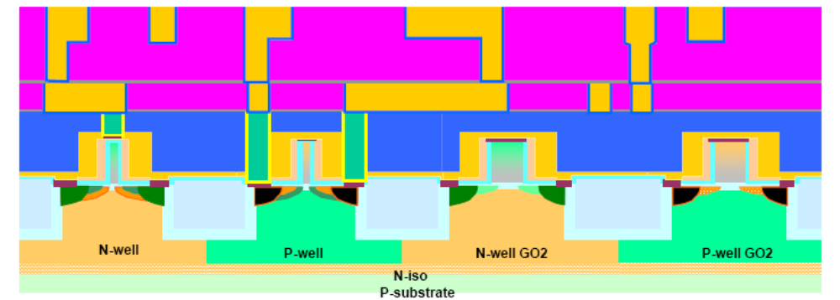
Copper process
Barrier deposition (TaN/Ta)
Cu seed deposition + electroplating
Cu-CMP

Slide 38
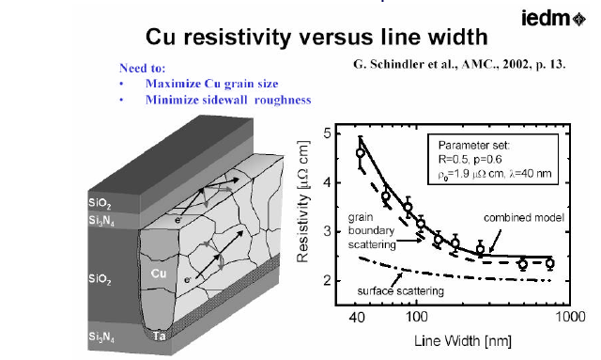
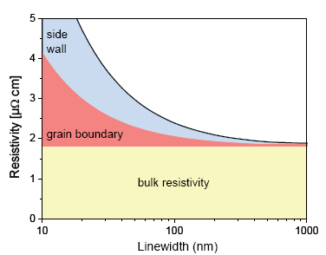
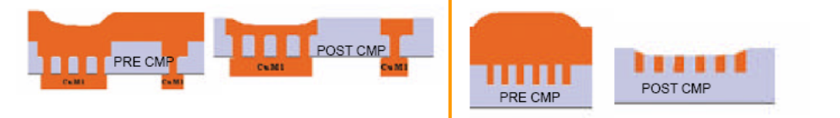
Cu main issues
CMP effects

Slide 39
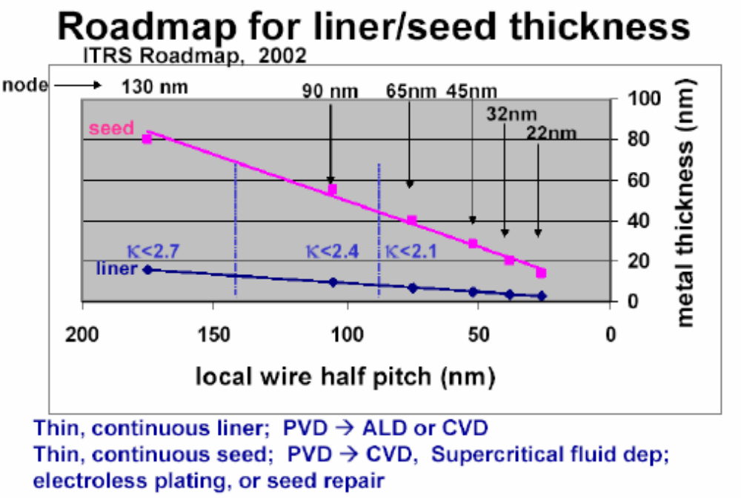
Cu main issues
Barrier and seed thickness scaling

Slide 40
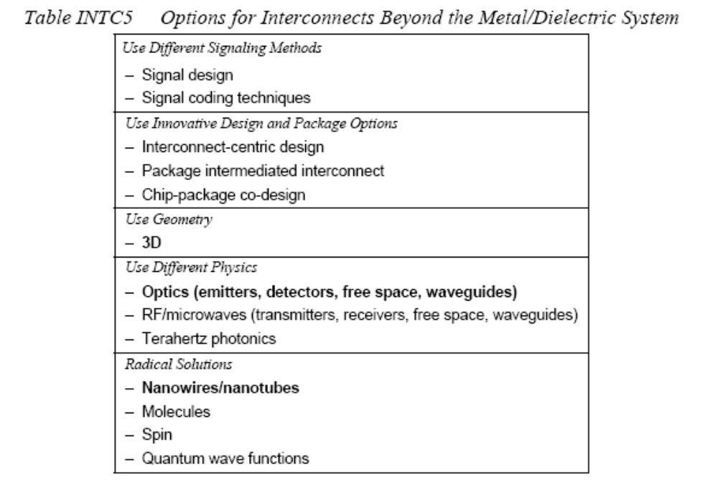
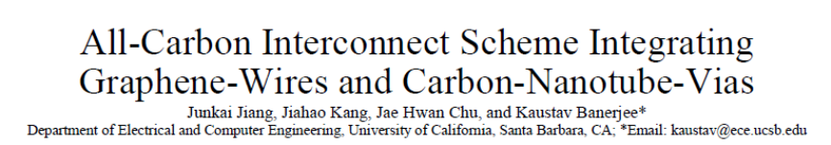
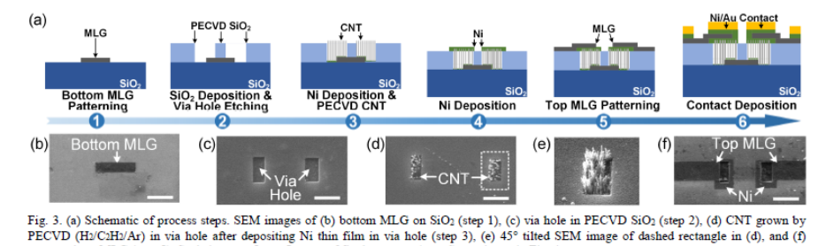
Future
Attending to ITRS considerations, in the future more than 80% of power in a chip will be dissipated by interconnects
New radical solution might be required to overcome this problem.
IEDM 2017

Slide 41

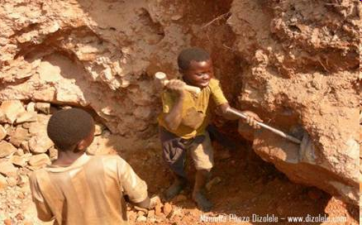
Ta and COLTAN…
http://www.peacelink.it/kimbau/a/10997.html
Quando le nuove tecnologie grondano sangue
Il Congo e la drammatica corsa al Coltan
http://sitemaker.umich.edu/section002group3/coltan_mining_in_democratic_republic_of_the_congo
Computer Industry Impacts on the Environment and Society
La guerra del coltan
http://it.peacereporter.net/articolo/12650/La+guerra+del+coltan
http://pace-sviluppo.megablog.it/item/africa-dopo-i-diamanti-insanguinati-il-coltan
Africa: dopo i diamanti insanguinati il coltan

Slide 42
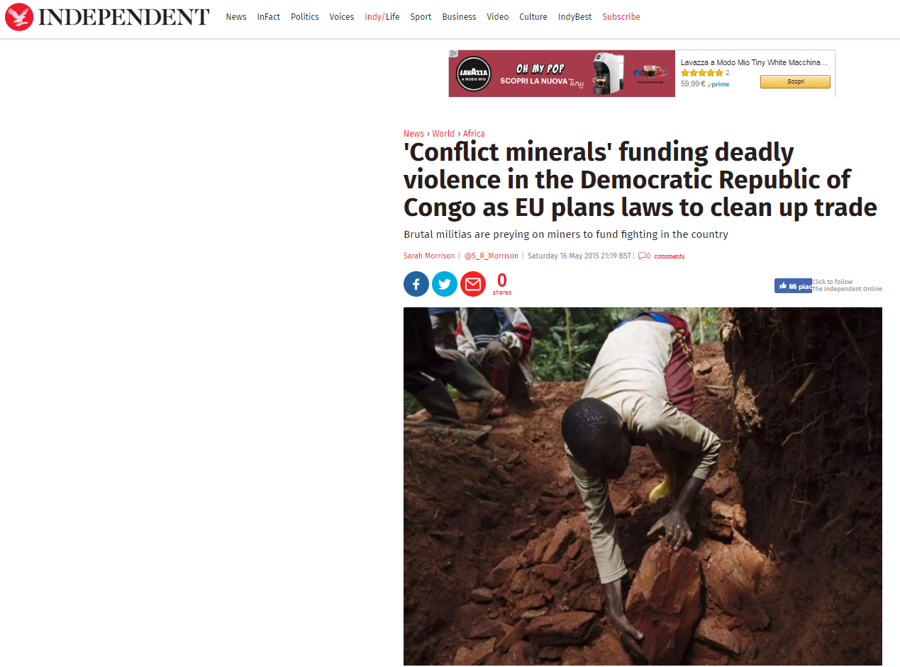

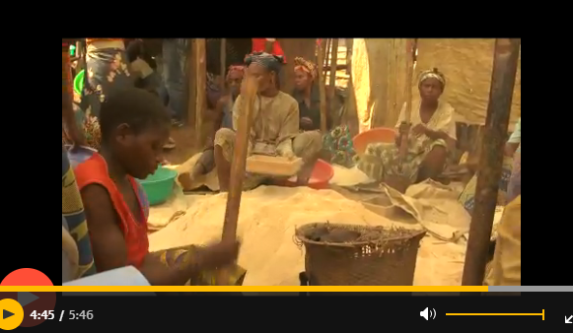
Sn and Cassiterite, W and Wolframite, gold…

Slide 43
Bibliography for this lesson
J.D. Plummer, “Silicon VLSI technology. Fundamentals, practice and modeling” , Prentice Hall 2000
V. Cusi, “Thin films”; ST Microelectronics internal course, unpublished
C. Cupeta, “Back end and metal reliability”, ST Microelectronics internal course, unpublished
S.M. Sze, K.K. Ng, “Physics of Semiconductor Devices", Wiley 2007
“ITRS 2007, Front End Processes”, available at http://www.itrs.net/Links/2007ITRS/2007_Chapters/2007_FEP.pdf
“ITRS 2007, Interconnect”, available at http://www.itrs.net/Links/2007ITRS/2007_Chapters/2007_Interconnect.pdf

