Slide 1
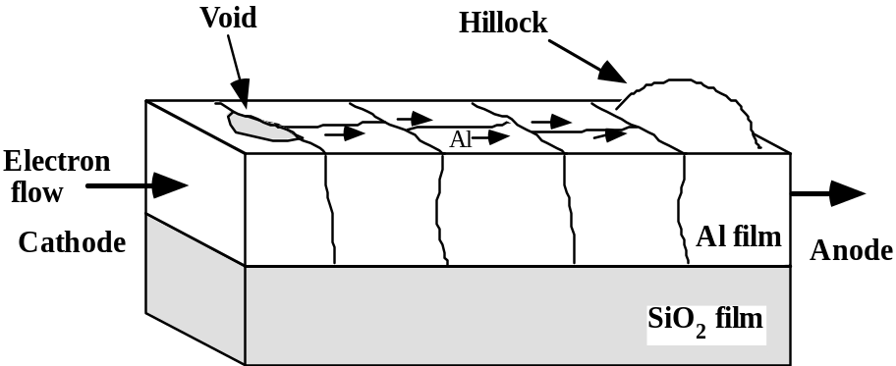
Al interconnects: electromigration
High current density(0.1-0.5 MA/cm2) causes movement of Al atoms in direction of electron flow.
Can cause hillocks and voids, leading to shorts or opens in the circuit.
Adding Cu (0.5-4 weight %) can also inhibit electromigration.
Thus Al is commonly deposited with 1-2 wt % Si and 0.5-4 wt % Cu.
Multi-layer stacks like Ti +TiN + Al(Cu) + TiN are used :
Ti helps controlling the Al grain texture (reduces electromigration effects)
TiN acts as a barrier for WF₆ during via processing
Ti or TiN can shunt the metal line in case of voids or cracks formation.
They can prevent electromigration by containing stress induced deformation of Al lines.

Slide 2
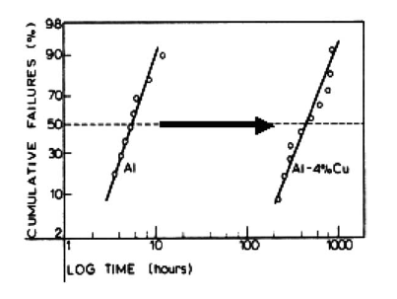
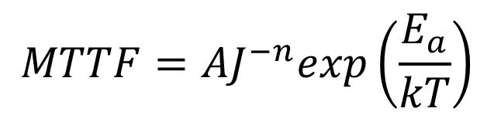
Electromigration and reliability
Accumulation or depletion of Al atoms in flux divergence points can lead to hillocks or voids in a metal intecronnection line → failure of the interconnection on field, during device operation
Failure of lines is measured statistacally; the cumulative probability of failures is ususally lpoltted vs time lognormal plot
Median time to failure is usually found to be dependent on current and T as:

Slide 3
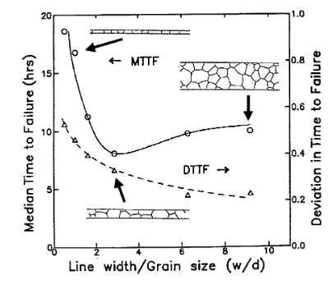
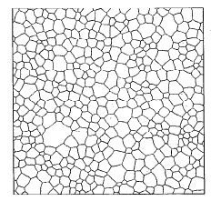
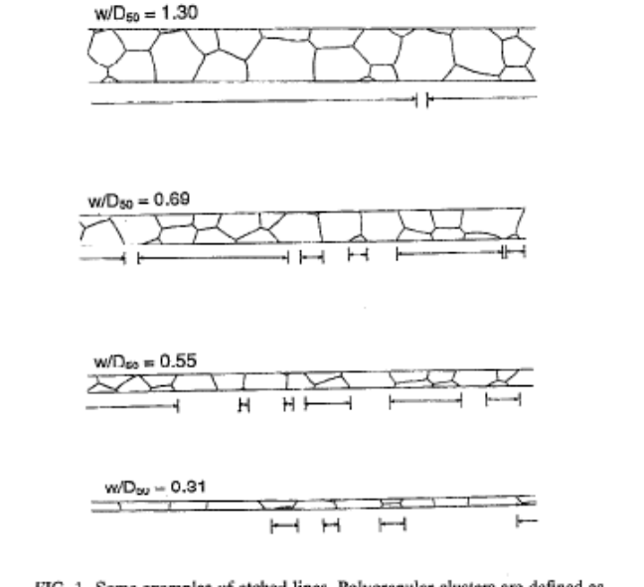
MTTF vs line width (and grain size)
Why is MTTF not depending monotonically on w/d ?

Slide 4
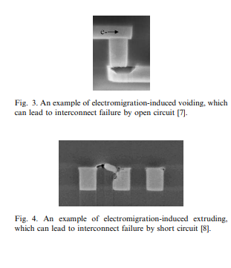
An electromigration model
Little/no diffusion happens at spanning grains
As electrons flow in the line, electro-migrating atoms are depleting at one spanning grain at accumulating at another
A stress field builds up (compressive @ accumulation point, tensile @ depletion) → Al atoms flow backward due to stress field
At steady state the electromigration and stress-induced fluxes balance out
But… if stress overcome a critical level, the line can undergo irriversible deformation (voids, hillocks,etc.)

Slide 5
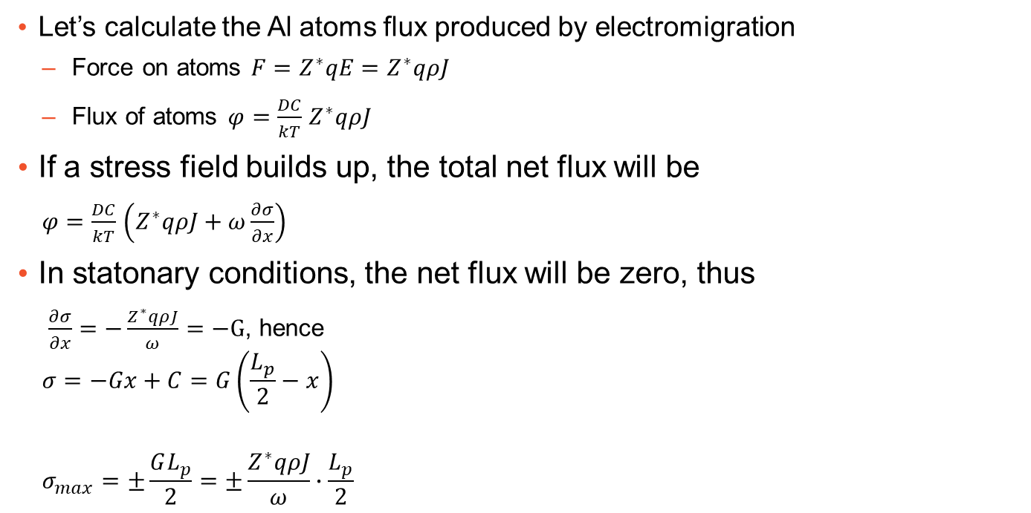
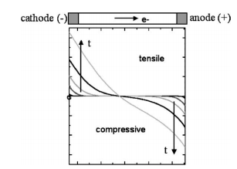
An electromigration model

Slide 6
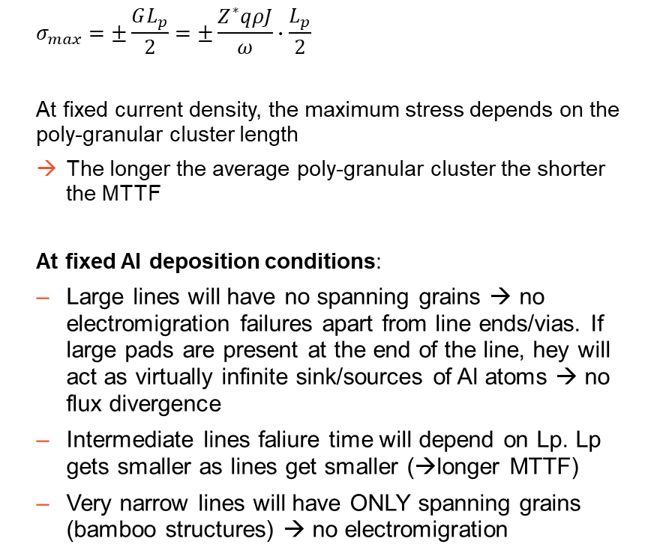
An electromigration model

Slide 7
Bibliogrpahy
All picture in these slides are from
  C.S. Hau-Riege / Microelectronics Reliability 44 (2004) 195–205
  Your textbook

