Slide 1


University of Hafr Al-Batin
SET 212: Fire Prevention and Protection Methods
Lecturer
FIRE SAFETY IN THE WORKPLACE

Slide 2
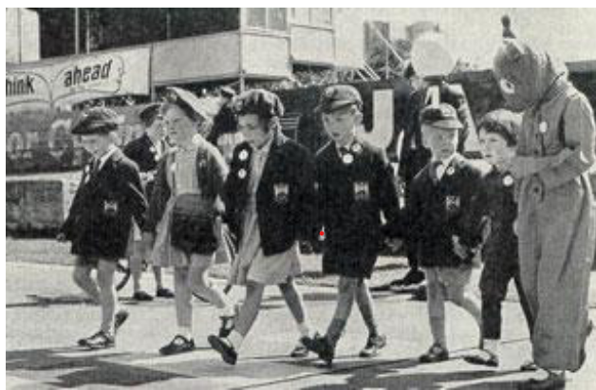
Fire Prevention and Protection Methods –SET 212
HSE HISTORY
This was further strengthened by my parents’ Health & Safety guidance.
“Watch where you’re going or you’ll hurt yourself”.
“If you fall off that wall that’ll teach you”.
“Don’t come running to me if you break your leg”

Slide 3
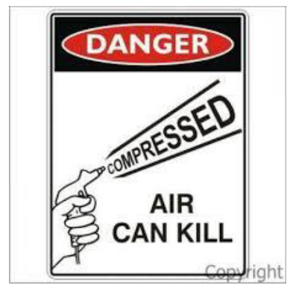
Fire Prevention and Protection Methods –SET 212
And at 16yrs of age as I began my engineering apprenticeship, I learnt that if you took air & compressed it became very dangerous if abused.

Slide 4
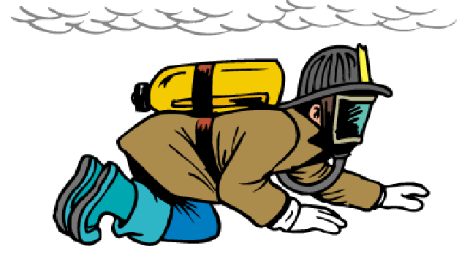
Fire Prevention and Protection Methods –SET 212
And when I joined the fire service in 1991, “smoke” was something we crawled under; & if our ears started dripping it was too hot & we should get out.

Slide 5
Fire Prevention and Protection Methods –SET 212
Fortunately, health & safety has moved on from there.
What is Health & Safety?.
Surely, it is COMMON SENSE?
“Common sense is your natural ability to make good judgement & to behave in a practical & sensible way”.
Unfortunately, history tells us that common sense is not so common, which is why, historically, a lot of our health & safety has been retrospective.

Slide 6
Fire Prevention and Protection Methods –SET 212
WHY DO WE SHY AWAY FROM FRA?
Risk Assessment
Dynamic Risk Assessment
Fire Risk Assessment ?
What is a fire risk assessment?
And what is a risk assessment for?
Why do you even need this bit of paper anyway?

Slide 7
Fire Prevention and Protection Methods –SET 212
A fire risk assessment is designed to minimise the probability of the event of a fire by identifying the potential hazards and fire risks within a building.
However, it doesn’t just examine the structure of the building itself, but the contents of the building, the layout, and the use of the building.
How does the use of the building affect the fire risk?
How many people are in the building?
How will they escape?
What steps should be taken to minimise the dangers?

Slide 8
Fire Prevention and Protection Methods –SET 212
WHO'S RESPONSIBLE?
• An employer
• The owner
• The landlord
• An occupier.
Anyone else with control of the premises, e.g. a facilities manager, building manager, managing agent or risk assessor.
You’re known as the ‘responsible person’. If there’s more than one responsible person, you have to work together to meet your responsibilities.

Slide 9
Fire Prevention and Protection Methods –SET 212
RESPONSIBILITIES
As the responsible person you must:
Carry out a fire risk assessment of the premises and review it regularly
Tell staff or their representatives about the risks you’ve identified.
Put in place, and maintain, appropriate fire safety measures.
Plan for an emergency.
Provide staff information, fire safety instruction and training.

Slide 10
Fire Prevention and Protection Methods –SET 212
FIRE RISK ASSESSMENTS
As the responsible person you must carry out and regularly review a fire risk assessment of the premises. This will identify what you need to do to prevent fire and keep people safe.
Identify the fire hazards.
Identify people at risk.
Evaluate, remove or reduce the risks
Record your findings, prepare an emergency plan and provide training.
Review and update the fire risk assessment regularly.

Slide 11
Fire Prevention and Protection Methods –SET 212
FIRE SAFETY RISK ASSESSMENT
You’ll need to consider:
emergency routes and exits
fire detection and warning systems
fire fighting equipment
the removal or safe storage of dangerous substances
an emergency fire evacuation plan
the needs of vulnerable people, e.g. the elderly, young children or those with disabilities.
providing information to employees and other people on the premises
staff fire safety training

Slide 12
Fire Prevention and Protection Methods –SET 212
HELP WITH THE ASSESSMENT
You can do the fire risk assessment yourself with the help of standard fire safety risk assessment guides.
If you don’t have the expertise or time to do the fire risk assessment yourself you need to appoint a ‘competent person’ to help, e.g. a professional risk assessor.
Your local fire and rescue authority might be able to give you advice if you’re not sure your risk assessment’s been carried out properly. However, they can’t carry out risk assessments for you.

Slide 13
Fire Prevention and Protection Methods –SET 212
FIRE SAFETY AND EVACUATION PLANS
Your plan must show how you have:
A clear passageway to all escape routes clearly marked escape routes that are as short and direct as possible.
enough exits and routes for all people to escape
emergency doors that open easily
emergency lighting where needed
training for all employees to know and use the escape routes
a safe meeting point for staff.

Slide 14
Fire Prevention and Protection Methods –SET 212
FIRE SAFETY EQUIPMENT, DRILLS AND TRAINING.
Fire detection and warning systems.
You must have a fire detection and warning system. You may need different types of detectors, depending on the type of building and the work carried out in it.
Fire fighting equipment
The types of equipment you need depend on your business premises. You’ll need to have any equipment properly installed, tested and maintained and train your staff to use them if necessary.

Slide 15
Fire Prevention and Protection Methods –SET 212
Maintenance and testing
You must carry out regular checks to make sure that:
All fire alarm systems are working the emergency lighting is working you record any faults in systems and equipment all escape routes are clear and the floor is in good condition all fire escapes can be opened easily automatic fire doors close correctly fire exit signs are in the right place.

Slide 16
Fire Prevention and Protection Methods –SET 212
Fire drills and training
You need to train new staff when they start work and tell all employees about any new fire risks.
You should carry out at least one fire drill per year and record the results. You must keep the results as part of your fire safety and evacuation plan.

