Slide 1
F1TENTH • GRADUATION PROJECT
Mapping, Localization
and Planning
From separate modules to an integrated simulation workflow
Progress, lessons learned and next steps
Supervisor progress review | 31 October 2026
Notes:
Introduce the project as an autonomous small-scale vehicle developed first in F1TENTH Gym ROS. Today’s scope is exploration, mapping, localization and route planning. Racing is excluded from the demonstration. The presentation distinguishes recorded successes from work that still needs validation. No claim of hardware readiness is being made.
Evidence sources:

Slide 2
PROJECT PROGRESS
What we are building
01
02
03
Mapping
Localization
Planning
What does the track look like?
Where is the car on the map?
Where should the car go?
Explore an unknown track and save a usable map.
Combine motion estimates with live LiDAR and the saved map.
Extract a centreline and check a route against the vehicle geometry.
Demonstrated: mapping + planning. Localization startup passes; moving accuracy needs work.
F1TENTH • Mechatronics graduation project
02
Notes:
Explain the three questions rather than starting with ROS package names. Mapping and planning completed in the mapping-only mission. AMCL initialized successfully and passed a fresh-pose readiness check in a separate test. These are separate pieces of evidence: there is not yet a fully validated combined mapping–localization–planning mission with reliable moving localization.
Evidence sources:
run_evidence_131817/mission_status.json
upload/localization_ready.json
upload/localization_truth_audit(5).csv

Slide 3
PROJECT PROGRESS
How we reached this stage
1. Build the simulation
4. Add localization
Set up the custom track and check LiDAR and ROS topics.
Introduce sensor fusion, EKF and saved-map AMCL.
2. Explore without a map
5. Generate a route
Use live LiDAR to choose steering and forward speed.
Extract the centreline, smooth it and audit the full vehicle body.
3. Generate the map
6. Connect and record
Combine scans and estimated motion using SLAM.
Automate stage transitions, add guards and save mission evidence.
F1TENTH • Mechatronics graduation project
03
Notes:
The work began with exploration, map generation and centreline following as separate modules. We then added synthetic wheel-speed and gyro measurements, an EKF motion estimate, a scan relay, and AMCL saved-map localization. Later work addressed reference-frame consistency, isolated initialization messages, route feasibility and automated stage handoff. Offline tests support the software checks; recorded simulator runs provide the evidence for today’s results.
Evidence sources:
https://github.com/EngZaq/f1tenth_uj_sim/tree/engineering/autonomous-mission-20261029
Visible project development history and recorded mission logs

Slide 4
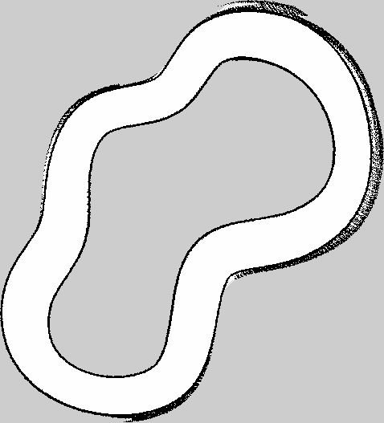
DEMONSTRATED IN SIMULATION
Mapping: the car builds its own track map
Explore → collect → combine
LiDAR measures the walls. Estimated motion lets SLAM combine scans into one map.
Saved, reusable output
A map image and its YAML settings are generated automatically.
Map resolution: 2.5 cm per cell
White: free • Black: occupied • Grey: unknown
F1TENTH • Mechatronics graduation project
04
Notes:
This is the generated map from the 13:18 run, not the simulator’s preloaded environment map. SLAM means simultaneous localization and mapping: it estimates movement while constructing the map. The files are new_track.pgm and new_track.yaml, at 0.025 m per cell. The software found an enclosed free corridor. Return-to-start evidence is estimated; SLAM graph closure and absolute map accuracy have not been independently certified. Boundary speckling is visible and motivates more map-quality checks.
Evidence sources:
run_evidence_131817/new_track.pgm
run_evidence_131817/new_track.yaml
run_evidence_131817/mission_status.json
run_evidence_131817/lap_pose.json

Slide 5
RECORDED COMPARISON • 31 OCTOBER
Faster exploration shortened the workflow
67%
less total time
261 s → 87 s
Speed adapts to turns and available clearance.
One run per setting. The 1.0 m/s setting is a command ceiling, not a constant measured speed.
F1TENTH • Mechatronics graduation project
05
Notes:
The baseline mission took 260.6008 s in total, with 230.1788 s in exploration. The faster run took 86.9569 s in total, with 55.0725 s in exploration. This is a 66.63% reduction in total duration, or approximately three times faster. The ceiling was increased from 0.18 to 1.0 m/s; corner, clearance and acceleration limits remain active. The largest sampled command was 0.97 m/s. Do not call this an actual measured peak or claim repeatability from these two runs. Both mission status files report completed mapping and planning.
Evidence sources:
run_evidence_124702/mission_status.json
run_evidence_124702/commands.jsonl
run_evidence_131817/mission_status.json
run_evidence_131817/commands.jsonl

Slide 6
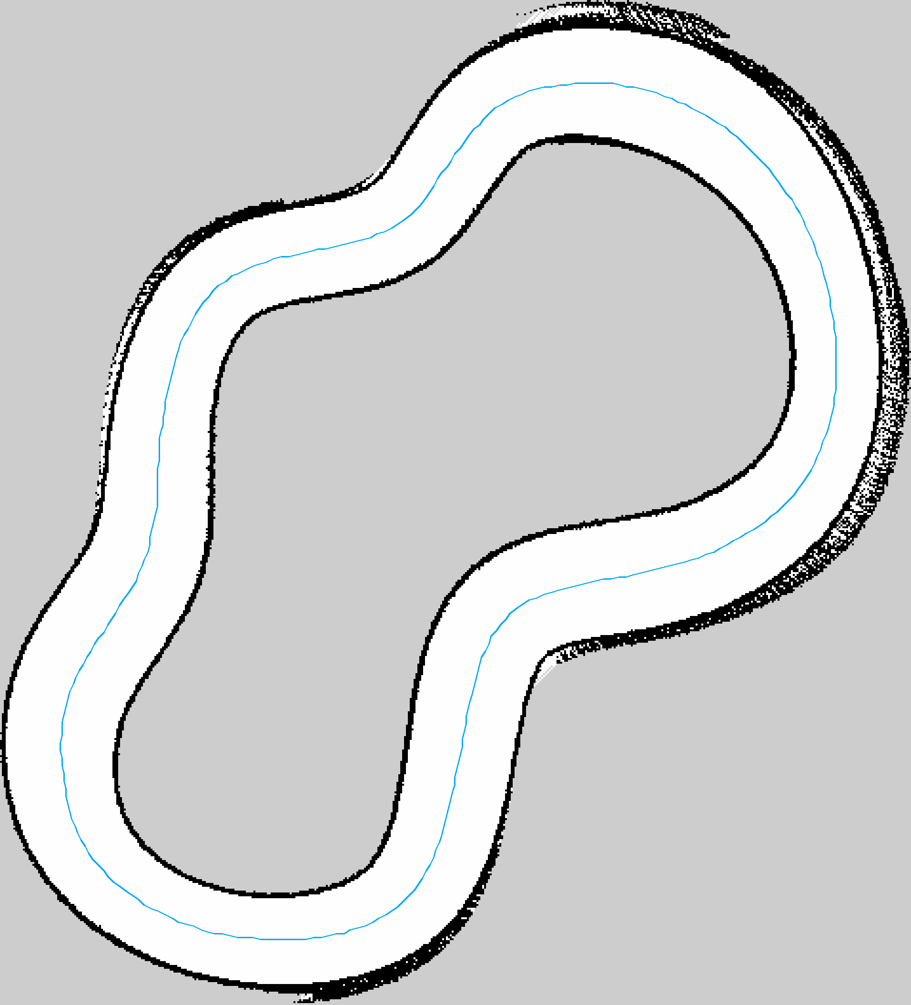
DEMONSTRATED NOMINAL GEOMETRY
Planning: turn the map into a feasible route
33.86 m
route length • 339 waypoints
Centreline → smooth → check
The route is checked for full-body clearance and required steering.
0.358 m
23.88° / 24°
minimum nominal
body clearance
required steering / limit
Very little steering reserve
F1TENTH • Mechatronics graduation project
06
Notes:
The blue line is the extracted centreline preview, shown to explain how a map becomes a route. The final body-optimized CSV is then smoothed and audited. In the faster run the first candidate required 28.19 degrees of steering and was rejected. Smoothing produced a candidate requiring 23.88 degrees, just under the 24-degree limit. The final route has 339 waypoints and a closed length of about 33.8588 m. The conservative minimum body clearance is about 0.358 m in the saved map. This is nominal geometry only: localization error and future tracking error must also fit within the clearance. A speed profile is generated, but profile execution is outside today’s demonstrated scope. The current CSV contains a 0.4 m/s cap; the original preparation report records a higher envelope, so do not present either as executed speed.
Evidence sources:
run_evidence_131817/new_track_preview.png
run_evidence_131817/new_track_body_optimized.csv
run_evidence_131817/route_preparation.json
run_evidence_131817/new_track_speed_profile.csv

Slide 7
PROJECT PROGRESS
Localization: estimate where the car is
1. Predict movement with EKF
2. Correct with AMCL
Combine wheel-speed and gyro measurements to estimate local motion.
Match live LiDAR against the saved map to estimate position and heading.
3. Initialize automatically
4. Validate independently
Find a scan-matched pose hypothesis, then confirm fresh AMCL estimates.
Use simulator reference data only to measure estimation errors.
EKF = sensor-fusion filter | AMCL = map-based particle localization
F1TENTH • Mechatronics graduation project
07
Notes:
The EKF, or extended Kalman filter, combines motion measurements. AMCL, adaptive Monte Carlo localization, estimates pose by comparing the laser scan with a known map. In this simulator, wheel-speed and gyro-like measurements are emulated from simulator velocity; hardware sensors are not yet validated. Global simulator pose is used by a passive audit, not as localization input. The latest initialization passed four fresh confidence checks. A small reported covariance describes the estimator’s own uncertainty; it does not prove that the pose is correct.
Evidence sources:
upload/sensor_emulator(2).log
upload/ekf(4).log
upload/live_scan_seed(3).json
upload/localization_ready.json
upload/localization_truth_audit(5).csv

Slide 8
CURRENT VALIDATION LIMITATION
Localization: startup passes, drift remains
0.44 m
AMCL RMS error
0.85 m
maximum observed
AMCL relative error
Errors are measured after initial alignment; this is not an absolute map-accuracy measurement.
F1TENTH • Mechatronics graduation project
08
Notes:
This chart uses 50 uniformly sampled observations for readability; the statistics use all 412 paired observations in localization_truth_audit(5).csv. RMS summarizes the typical magnitude of error. AMCL relative position RMS error is 0.4402 m, with maximum 0.8480 m. EKF relative position RMS error is 0.0222 m, with maximum 0.0407 m, over this short test. Each estimate is aligned to the simulator reference at its first sample, so the graph shows relative drift rather than absolute map accuracy. The estimates use different frames and alignment references; this is not a controlled ranking of the two algorithms. Initialization succeeded, but moving localization is still a blocking validation issue. Investigate scan-to-map agreement, reference transforms, map distortion, timing and noise assumptions before claiming reliable global pose.
Evidence sources:
upload/localization_truth_audit(5).csv
upload/localization_ready.json
upload/localization_audit(3).log

Slide 9
PROJECT PROGRESS
Engineering improvements already completed
Consistent sensor geometry
Corrected the laser offset and reference frames used by mapping and localization.
Safer initialization and handoff
Separated the AMCL seed from simulator reset and checked that old nodes had stopped.
Checks before accepting a route
Added full-body clearance and steering checks; rejected infeasible candidates.
Evidence for each stage
Saved maps, routes, commands, status files and logs in a mission bundle.
F1TENTH • Mechatronics graduation project
09
Notes:
These are concrete integration improvements rather than new algorithms. The raw simulator pose is referenced at the centre of gravity, while the engineering motion frame uses the rear axle. Consistent offsets include 0.100 m from centre of gravity to laser and 0.27145 m from rear axle to laser. AMCL seeding uses /fusion/initialpose to avoid resetting the Gym simulator through /initialpose. The handoff checks that the previous stack is absent in fresh graph observations. Planning rejects candidates that violate body geometry or steering limits. Mission bundles make failures inspectable. These checks improve diagnosis but do not establish completed moving-localization validation.
Evidence sources:
https://github.com/EngZaq/f1tenth_uj_sim/tree/engineering/autonomous-mission-20261029
run_evidence_131817/route_preparation.json
upload/localization_handoff.json
upload/amcl_initial_pose(1).json
upload/guard_stop_context.json

Slide 10
PROJECT PROGRESS
What needs improvement next
Localization accuracy
Map quality and repeatability
Reduce moving scan-to-map drift and verify time stamps, frames and sensor assumptions.
Repeat from different starting poses and quantify boundary and closure consistency.
Route steering margin
Reliable stage transitions
Smooth tight curvature while preserving clearance; avoid operating at the steering limit.
Resolve dropped-scan warnings and clean up the SLAM shutdown exception.
F1TENTH • Mechatronics graduation project
10
Notes:
Prioritize moving localization because the recorded AMCL error grows despite apparently acceptable reported confidence. For map quality, compare repeated generated maps after alignment and inspect wall consistency rather than judging only the image. In the faster run, the feasible route has only about 0.12 degrees of steering reserve. A dropped scan was logged and SLAM reported a karto exception during deliberate shutdown after the map was saved. Map and planning outputs were produced, but this is not a clean shutdown and should be fixed. These observations identify work; they do not establish a single root cause.
Evidence sources:
upload/localization_truth_audit(5).csv
run_evidence_131817/route_preparation.json
run_evidence_131817/slam.log
run_evidence_131817/mission_status.json

Slide 11
PROJECT PROGRESS
Next steps: validate, combine, then transfer
01
Validate each stage
Repeat mapping, assess moving localization, then audit the resulting route.
02
Combine the three stages
Automate map → localization → planning and report a clear pass/fail result.
03
Add stronger measurements
Measure repeatability, scan-to-map error, map consistency and steering reserve.
04
Prepare the physical car
Calibrate wheel/IMU/LiDAR geometry, check timing and test supervised low-speed mapping.
Today: mapping and planning demonstrated; moving localization still under validation.
F1TENTH • Mechatronics graduation project
11
Notes:
Close by describing an achievable next milestone: repeatable mapping, measured reliable localization and a feasible plan, each independently verified and then connected. This combined three-stage milestone has not yet been demonstrated with reliable moving localization. Hardware transfer remains future work: real sensor drivers, scale and bias calibration, laser extrinsics, synchronized time stamps and a controlled low-speed test are needed. Keep path execution and racing outside today’s scope. The repository has not been modified or pushed as part of preparing this presentation.
Evidence sources:
Visible user project requirements and latest test evidence
https://github.com/EngZaq/f1tenth_uj_sim
https://github.com/EngZaq/f1tenth_uj

