Slide 1
Caesar Cipher Program Encryption and Decryption
Prepared By :
Mahmoud Youssef Mahmoud
20043261
Supervised By :
Prof. Shawkat K. Guirguis
Professor of Computer Science & Informatics
Information Technology Department
Institute of Graduate Studies & Research
Alexandria University

Slide 2
Contents
Program Workflow
Encryption Functions
Automatic Decryption function
Program Samples

Slide 3
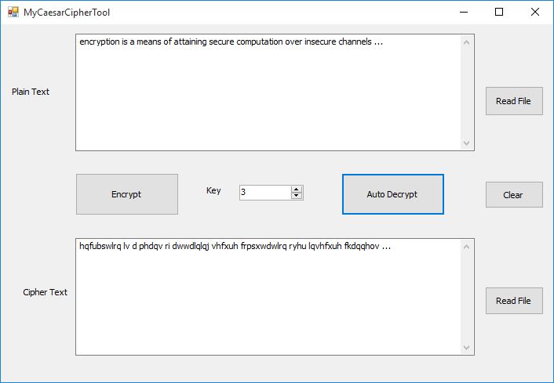
Program Workflow
Encrypt
Auto Decrypt
Plain Text
Read text from file
Cracking Cipher text
Cipher Key
Encrypt with key
Empty text area
Cipher Text
Read cipher text from file

Slide 4
Program Workflow
Encryption Workflow:
Click Read File beside plain text area to read text file or type plain text in text box
Enter cipher Key
Press Encrypt button

Slide 5
Program Workflow
Decryption Workflow:
Click Read File beside cipher text area to read text file or type plain text in text box
Press Auto Decrypt button
The program automatically detect key and write it in key number box
The program automatically decrypt message and write Plain message

Slide 6
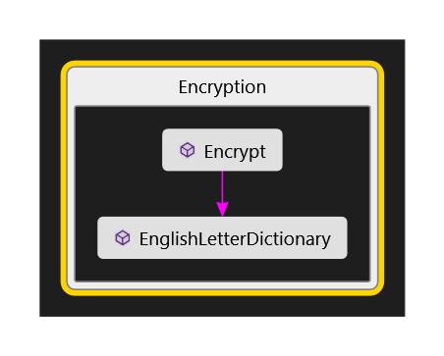
Encryption Function

Slide 7
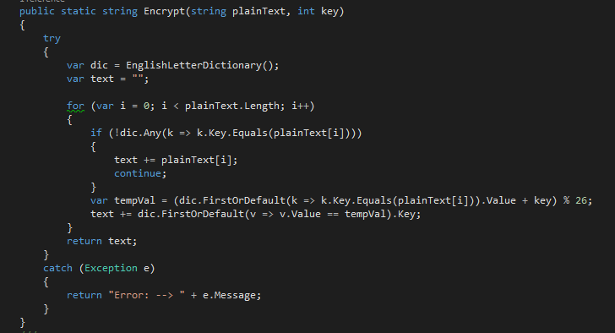
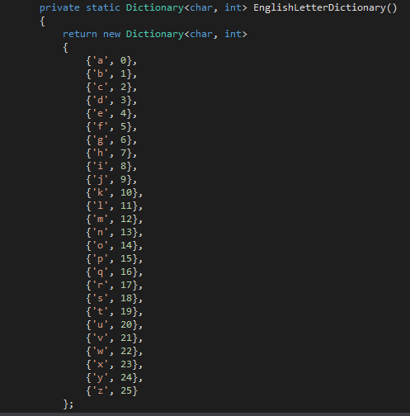
Encryption Function

Slide 8
Encryption Function
This function take plain text and encryption key
Initialize English Dictionary that contains all English letters and its equivalent numbers
Search for each letter of the message in English Dictionary and get its equivalent number
Sum letter number with given Key then take its modulus to 26
Return equivalent latter for this number
If message letter not found in dictionary its return same letter such as any special letters (?,!,1,2,…)
Return Cipher message

Slide 9
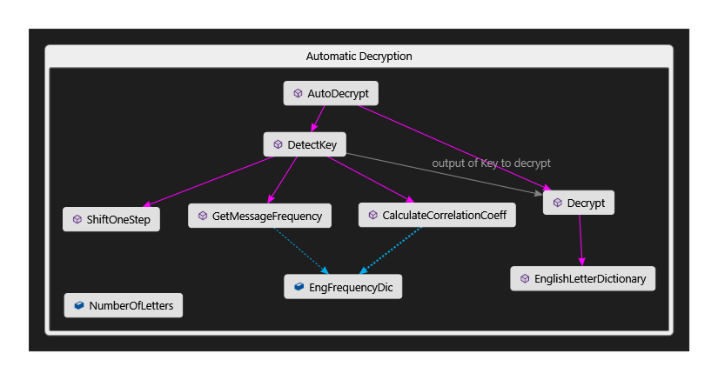
Decryption Function

Slide 10
Decryption Function
Cracking cipher text by Caesar Cipher Algorithm using Correlation Coefficient Method by:
calculation message letter frequency distribution
calculate Correlation between message letter frequency
List and English letter frequency distribution
shift message frequency list by one step and calculate Correlation again
repeat this steps for 26 time number of English letters
find max Correlation Coefficient
get index of max Correlation Coefficient this is the KEY
use the KEY to Decrypt cipher message

Slide 11
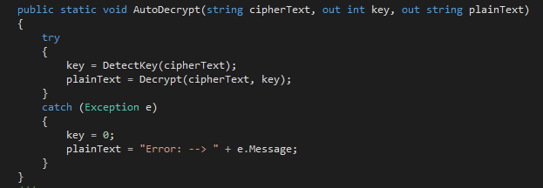
Decryption Function
To Crack cipher text first you have to detect Key
DetectKey function use sub functions
GetMessageFrequency()
ShiftOneStep()
CalculateCorrelationCoeff()
Then use this key to decipher() message

Slide 12
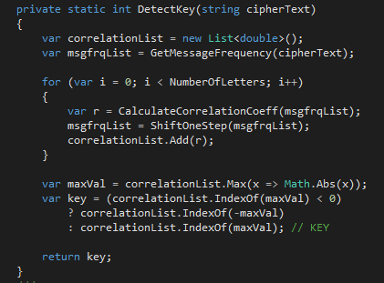
Decryption Function
Detect cipher key by calculation message letter frequency distribution
calculate Correlation between message letter frequency List and English letter frequency distribution
shift message frequency list by one step and calculate Correlation again
repeat it for 26 time number of English letters
find max Correlation Coefficient
get index of max Correlation Coefficient this is the KEY

Slide 13
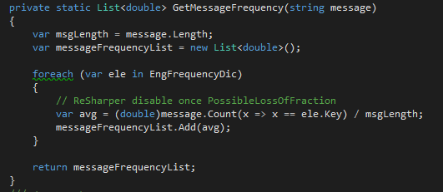
Decryption Function
GetMessageFrequency
Calculate message letters frequency distribution
By counting each letter in message and divide it with message length

Slide 14
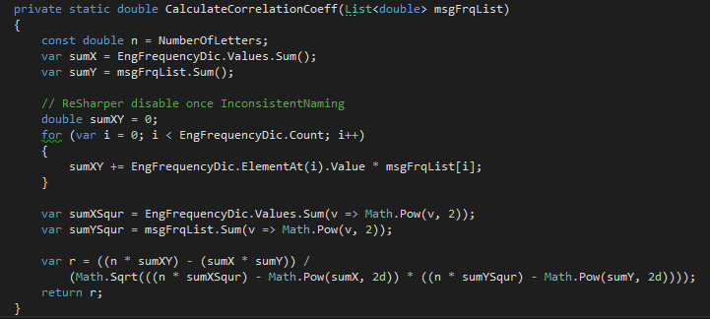
Decryption Function
Calculate Correlation Coefficient function

Slide 15
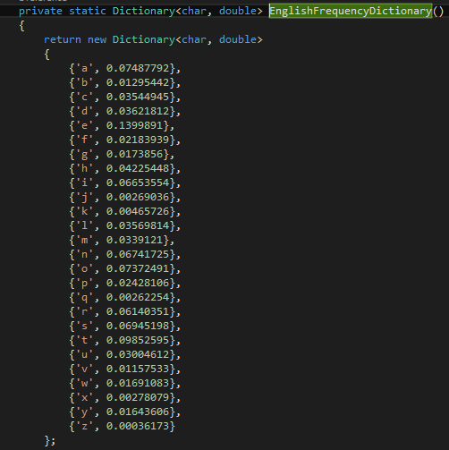
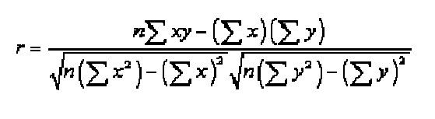
Decryption Function
Calculate Correlation Coefficient function
Calculate Correlation Coefficient function between each character frequency in message and its equivalent English letter frequency
According to this Equation

Slide 16
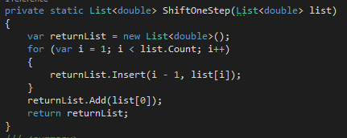
Decryption Function
ShiftOneStep
shift list of message frequencies by one step

Slide 17
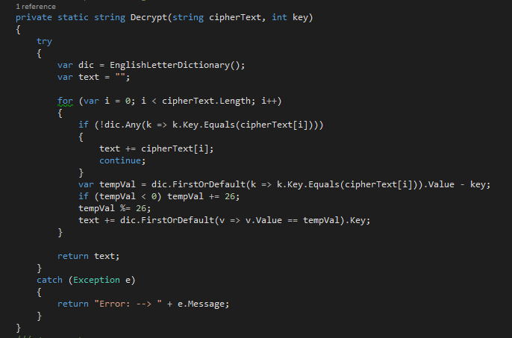
Decryption Function
Search for each letter of the message in English Dictionary and get its equivalent number
Subtract letter number with given Key if number was negative then add 26 to it
take its modulus to 26
Return equivalent latter for this number
If message letter not found in dictionary its return same letter such as any special letters (?,!,1,2,…)
Return Plain message

Slide 18
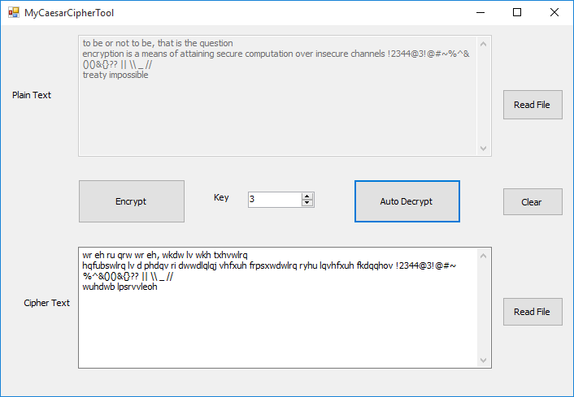
Test Program

Slide 19
Thank You

