Slide 1
A380 – The Biggest failure in Project management history
MAN471
Group LETTER

Slide 2

Outline
Project summary
Project team and staffing
Project deliverables (Planned vs Actual)
Transition to operations
Project costs
Project schedule
Recommendations

Slide 3
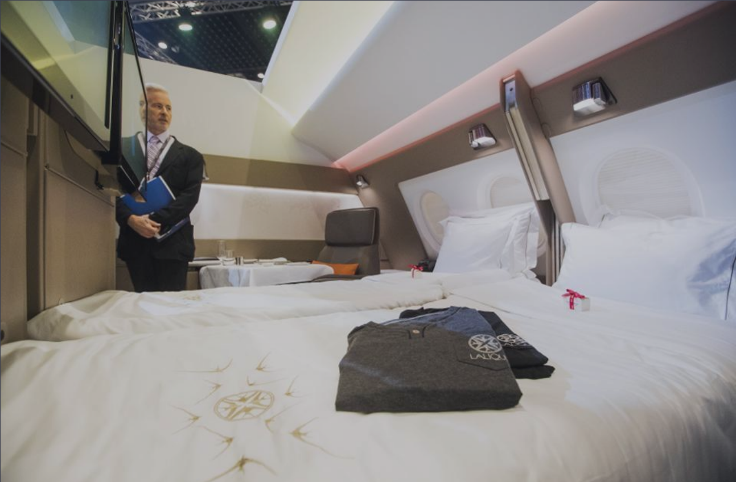
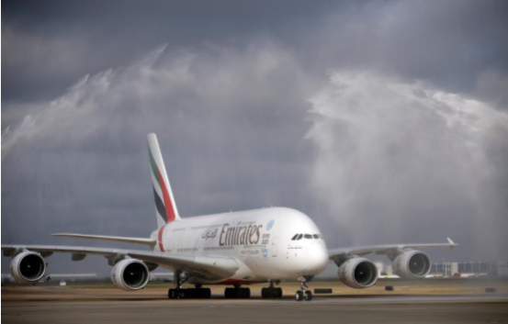
Project summary
As the world's largest commercial aircraft the Airbus A380 is a feat of engineering.
It has two full-length decks with widebody dimensions and more seats than any other aircraft.
While the aircraft has now been in operational service for 6 years, the aircraft's entry into service was delayed by almost 2 years and the project was several billion dollars over budget mostly due to the version incompatibility of CAD.
Airbus announced that it will stop making the A380 airplane (failure to achieve economies of scale).

Slide 4
Project team and Staffing
Airbus, as an independent organization, is a consortium of European countries.It has the strength to compete with Boeing.
The highest ranks of the organization are co-CEO of France and Germany.
The development of the aircraft was a collaboration between 16 sites spread across 4 different countries(German, Spanish, British and French).
Thousands of engineers are based in Luxembourg, Germany.

Slide 5
Project deliverables (Planned vs Actual)
Planned Deliverable | Actual Deliverable | Summary
The A380 is designed to be the world's largest and most complex aircraft, while ensuring passenger comfort | The A380 is designed to be the world's largest and most complex aircraft, while ensuring passenger comfort | This deliverable was completed as planned
700+ Complete Aircraft | 253 complete aircraft | Only 35% of the aircraft were completed
Ensure that relatively aggressive plans are met on schedule | Planned completion time is seriously behind schedule | Key issues were ignored early in the project lifecycle
Different countries can use different versions of cad to complete the design | The actual product is not compatible | Theory and practice are not always the same thing.

Slide 6
Transition to operations
During operations the Engineers found that there were many problems concerning the lengths of the wires in the aircraft. This was due to the corporation using different versions of the CAD software. Operational costs snowballed out of control and it led to developmental mishaps and a lot of time lost.
Amazingly, the Engineers were able to work through the project with these mishaps and eventually finished the project and completed the aircraft. This goes to show that no matter what you do to mess something up, an Engineer will be there to fix it.

Slide 7
Project costs
Scheduled for delivery in 2006, the aircraft’s entry into service was delayed by
almost 2 years and the project was several billion dollars over budget.

Slide 8
Project Schedule
The root of the problem can be traced back to a single decision: the decision to proceed with the project despite the fact that two CAD systems were in use. That decision resulted in design inconsistencies, mismatched calculations and configuration management failures.
For the configuration management failure. During the initiation and planning phases there was concern the complex organizational.
Overly complex organizational structure that attempted to keep different parts of the organization happy rather than focusing on how best to build the aircraft. Failure to form a single project team across the multiple design centres in use. Overly aggressive schedule leading to schedule pressure such that key issues were ignored early in the project lifecycle. Failure to address issues when they were first identified resulted in snowballing costs and significantly higher costs once the problems were finally faced up to.

Slide 9
Recommendations
Problems concerning the project:
CAD software versions
National pride among CEOs
Planning to keep offices happy instead of building the best aircraft possible
Good practices during the project:
Good Engineering
Teams worked together
Multiple countries can come together and create a huge feat of engineering
Overall comments:
Overall, ambitious projects such as these require a level of unmatched transparency. The project itself was a good venture, but Having multiple CEOs govern one project can create problems, as seen in this project.

Slide 10
THANK YOU
Notes:
Title: Uppercase, Calibri size 60, XJTLU Navy

