Slide 1
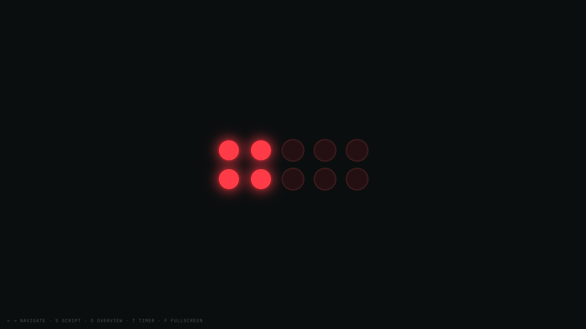
Notes:
FIONA · Title slide. Warm, confident open.
Good afternoon, everyone. We are the Pit-Stop Racer Pro team, and for the next fifteen minutes we want to show you a little racing car that thinks for itself. It is a one-tenth-scale autonomous racer, and here is the one thing that makes it special: it manages its own battery, its own tires and its own fuel, and it decides, entirely on its own, when to come in for a pit stop. No driver. No remote control. Just the car, watching its own resources, and making the call.

Slide 2
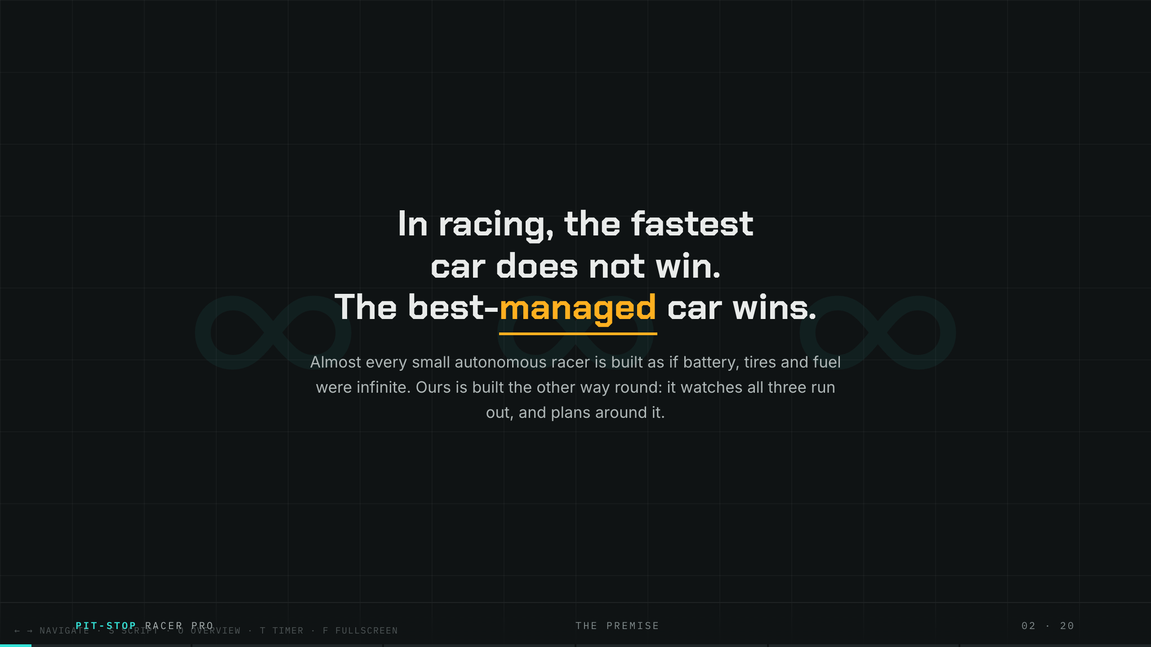
Notes:
FIONA · The premise. Land the first line, then pause.
Let me start with the idea that the whole project is built on. Most small self-driving cars pretend their hardware lasts forever. Infinite battery. Infinite grip. Infinite fuel. They just drive until someone unplugs them. Ours does the opposite. Our car assumes everything is running out, all the time, exactly like a real race car. And once you accept that, the interesting question stops being "how fast can it go", and becomes "how long can it stay out before it has to stop". That single question is the entire talk.

Slide 3
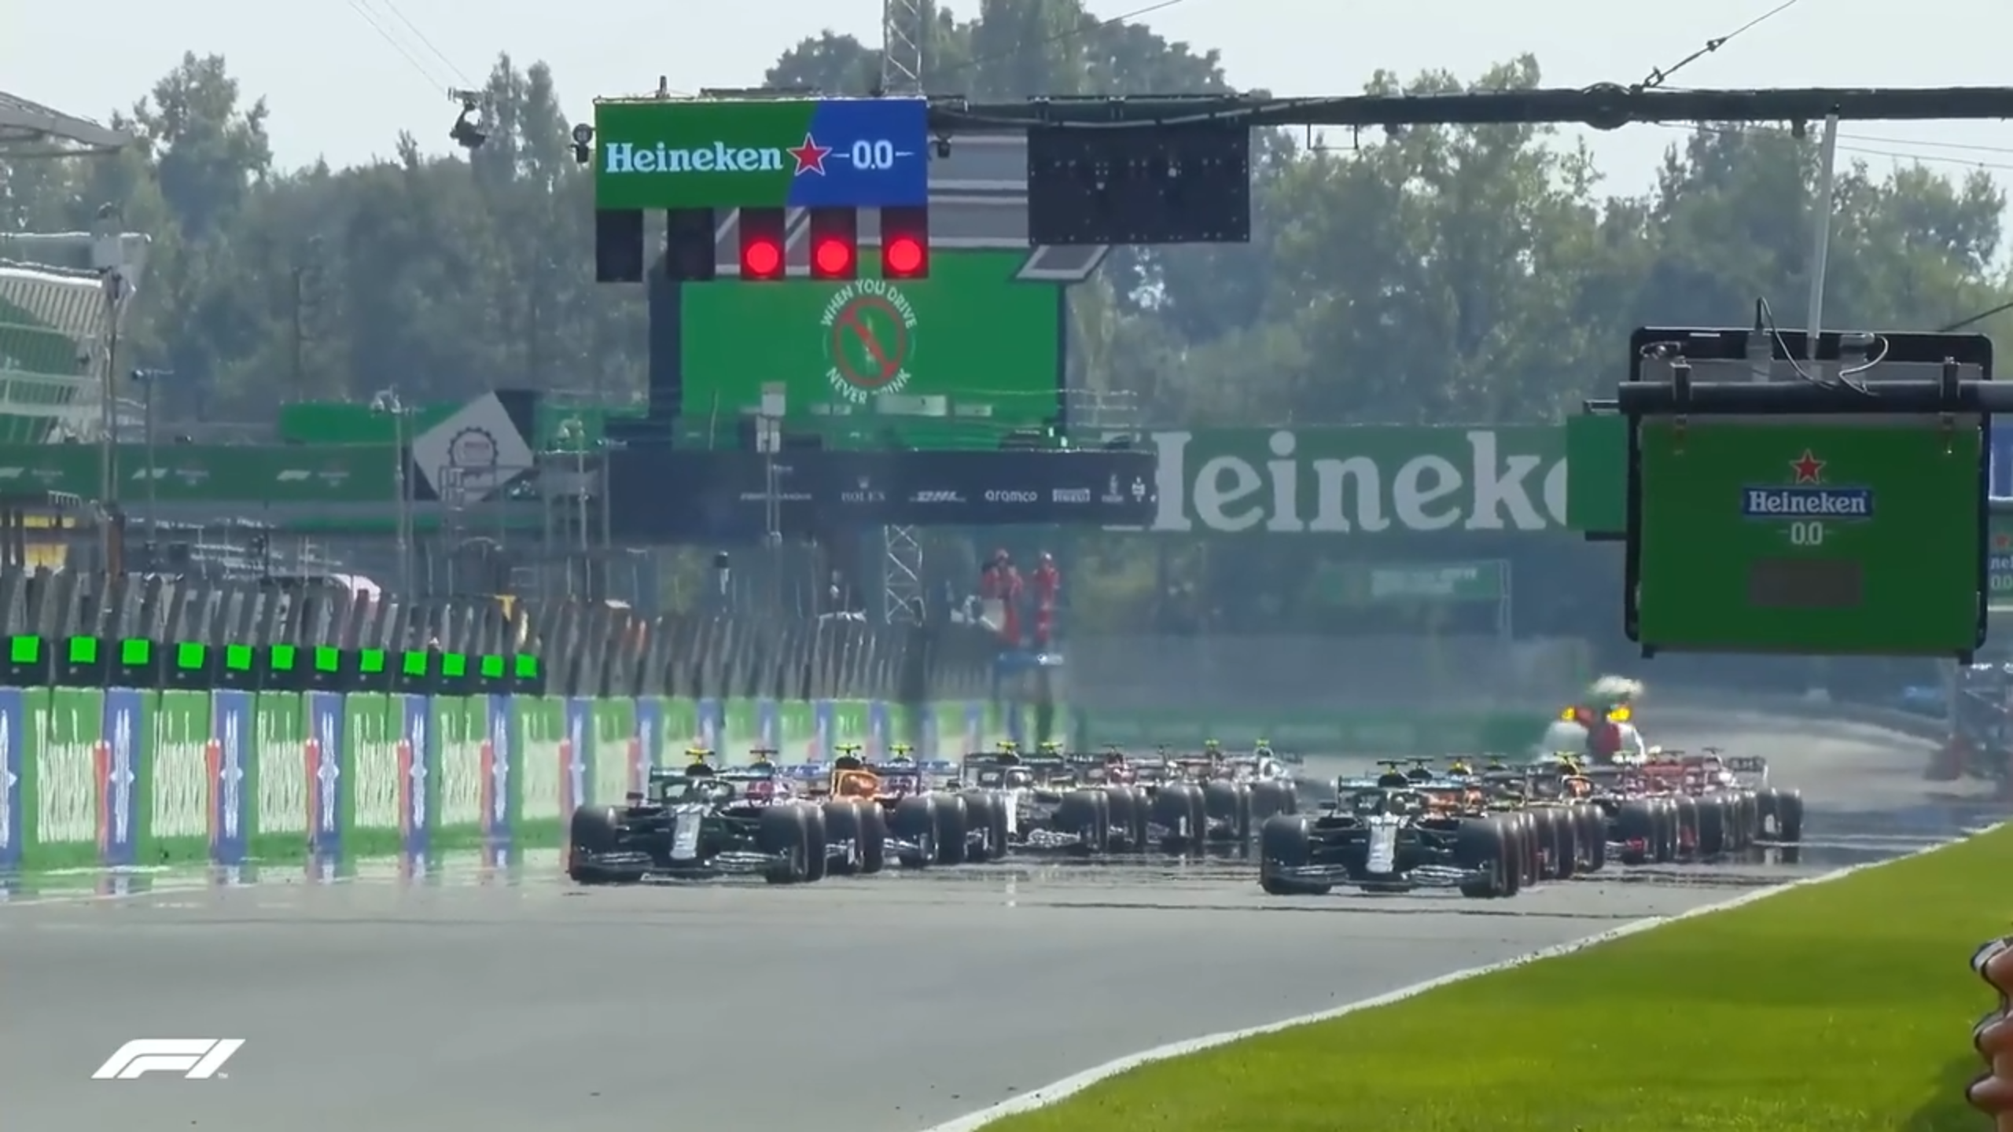
Notes:
FIONA · Monza video plays with sound. Stay quiet ~10s, then speak over the end.
Watch this for a second. This is the start of a real Formula One race at Monza. Twenty cars, all ridiculously fast, all within a tenth of a second of each other. And here is the secret that television never tells you: not one of these cars can finish without stopping. Every single one of them will come into the pit lane at least once. So the race you are watching is not really won by the fastest car. It is won by the team that picks the best moment to stop. That is the game we taught our little car to play.

Slide 4
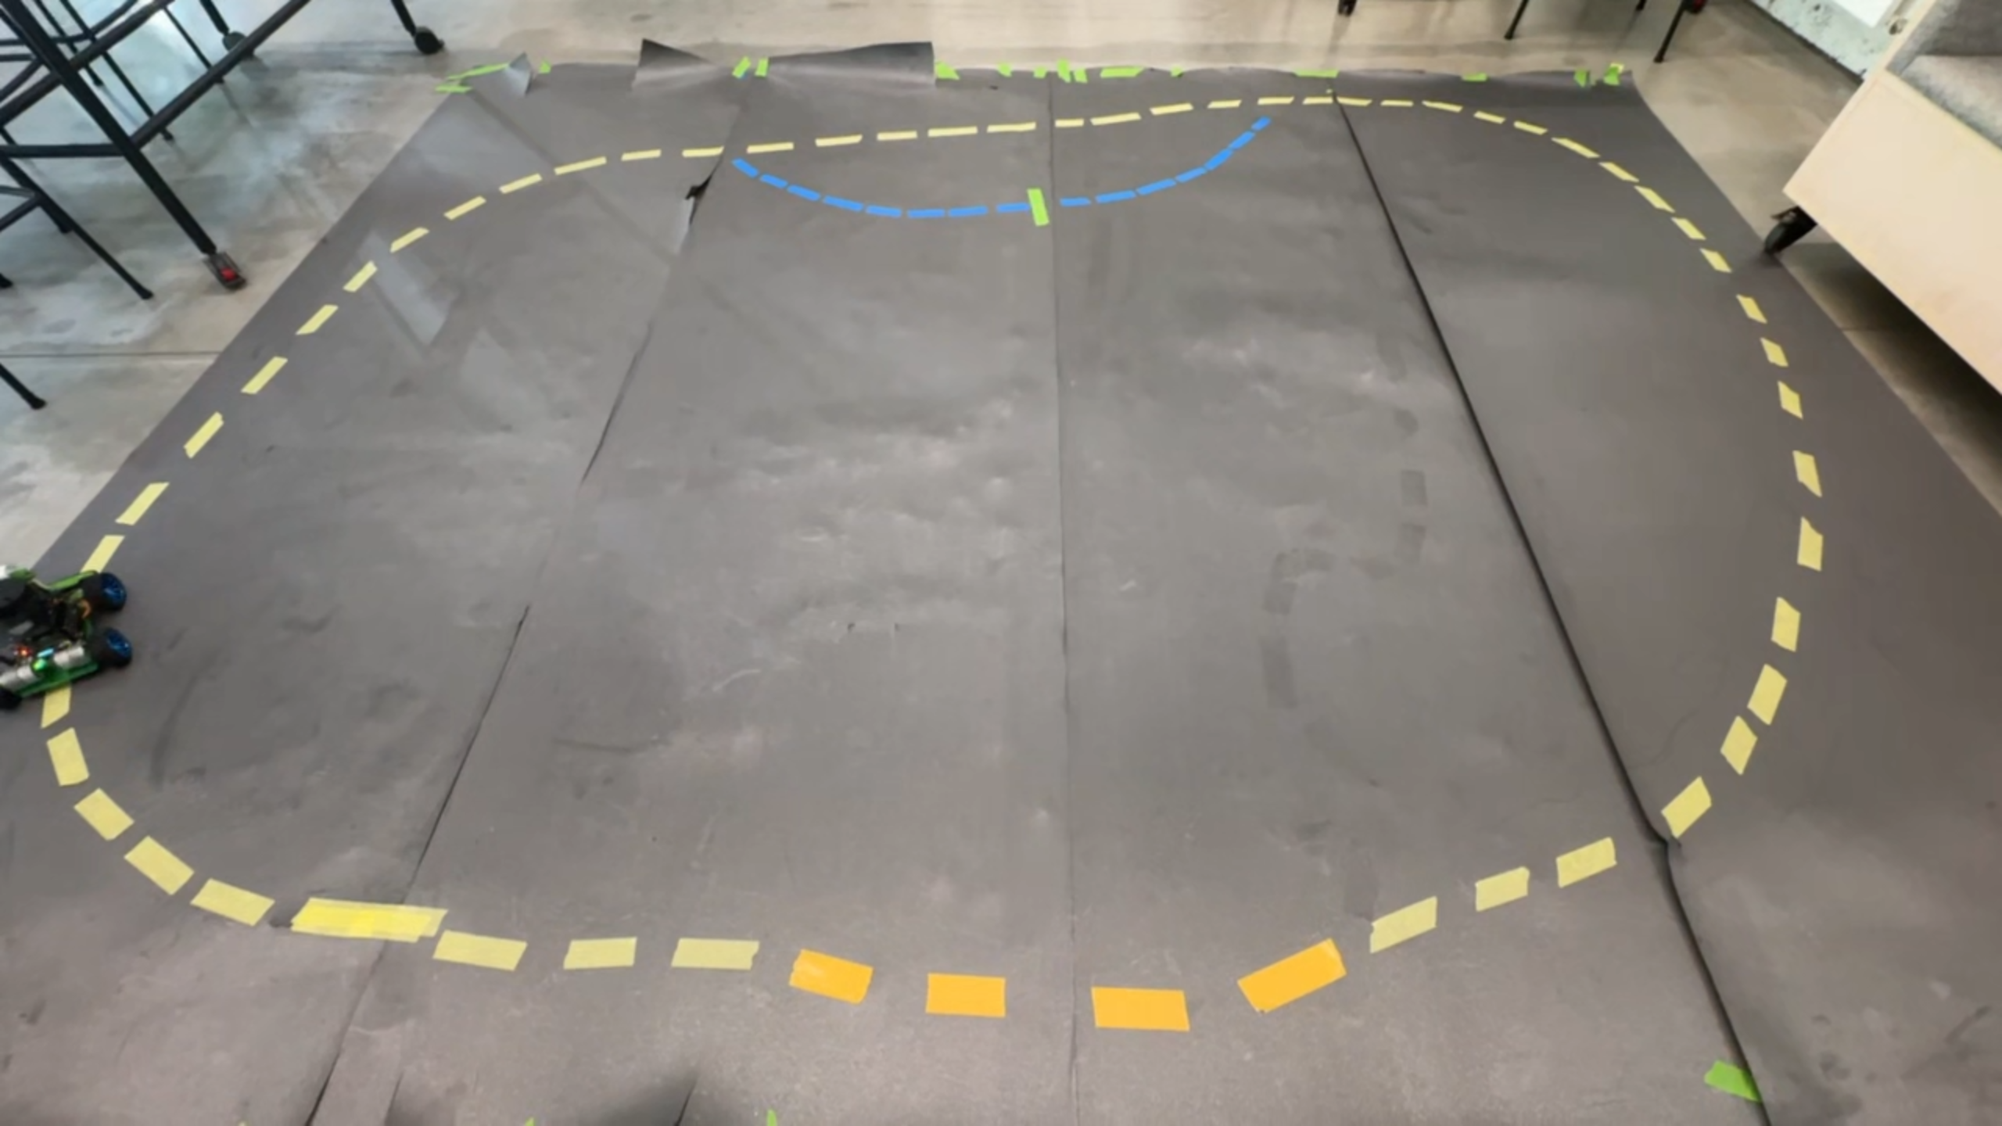
Notes:
FIONA · Cut to our own car (hero lap). Let it drive ~4s, then speak.
And this is ours. No cuts, no help, this is the actual car on a track we taped down ourselves on the floor. The camera on the front finds the racing line, and the car just drives it. Same problem as Monza, one-tenth the size. It is quick, it is smooth, and every second it is out there, it is quietly burning through the three things it needs to keep going. So let me show you those three things.

Slide 5
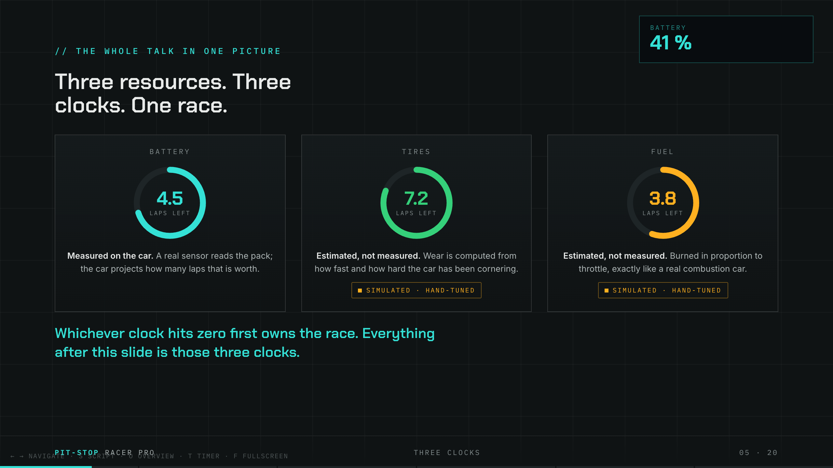
Notes:
FIONA · Three clocks slide. Point at each ring as you name it.
Think of the car as running three countdown clocks at once. The first is the battery, and this one is special, because it is the only clock we can actually measure with a real sensor on the car. The second is the tires, which slowly wear out as it corners. The third is the fuel, which burns as it drives. Now, be honest with a technical audience: the tires and the fuel are computed models, not physical sensors, and you will see us label them clearly as we go. Whichever of these three clocks hits zero first is the one that forces the car into the pits. The rest of this talk is simply those three clocks, one at a time.

Slide 6
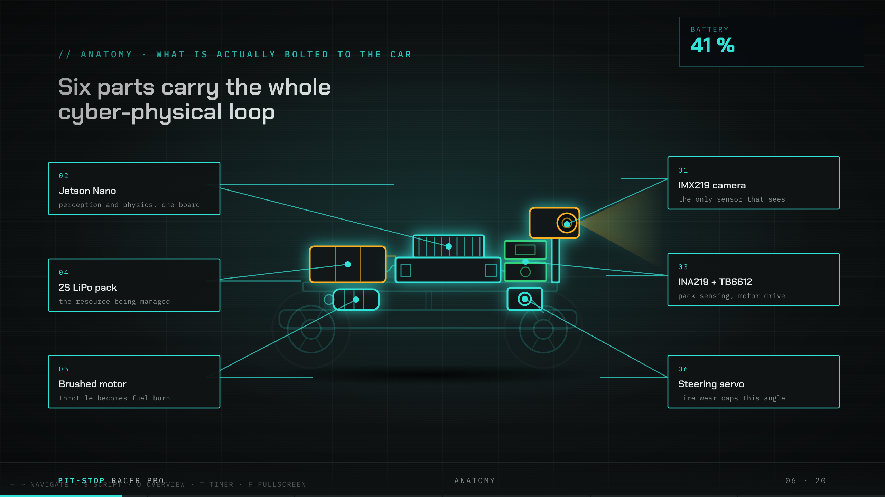
Notes:
FIONA · Anatomy slide. The car diagram draws itself; gesture along it.
Before the strategy, thirty seconds on what is actually bolted to this thing, because it is a surprisingly small amount of hardware. There is one camera on the nose, and that single camera does everything: it finds the track, it spots the pit markers, and it sees people. There is a small computer, an Nvidia Jetson, doing all the thinking. There is one sensor on the power line that reads the real battery. And there are two little chips that turn all of that into steering and throttle. That is basically it. One camera, one brain, one battery, and every decision you are about to see happens right here on the car while it is moving.

Slide 7
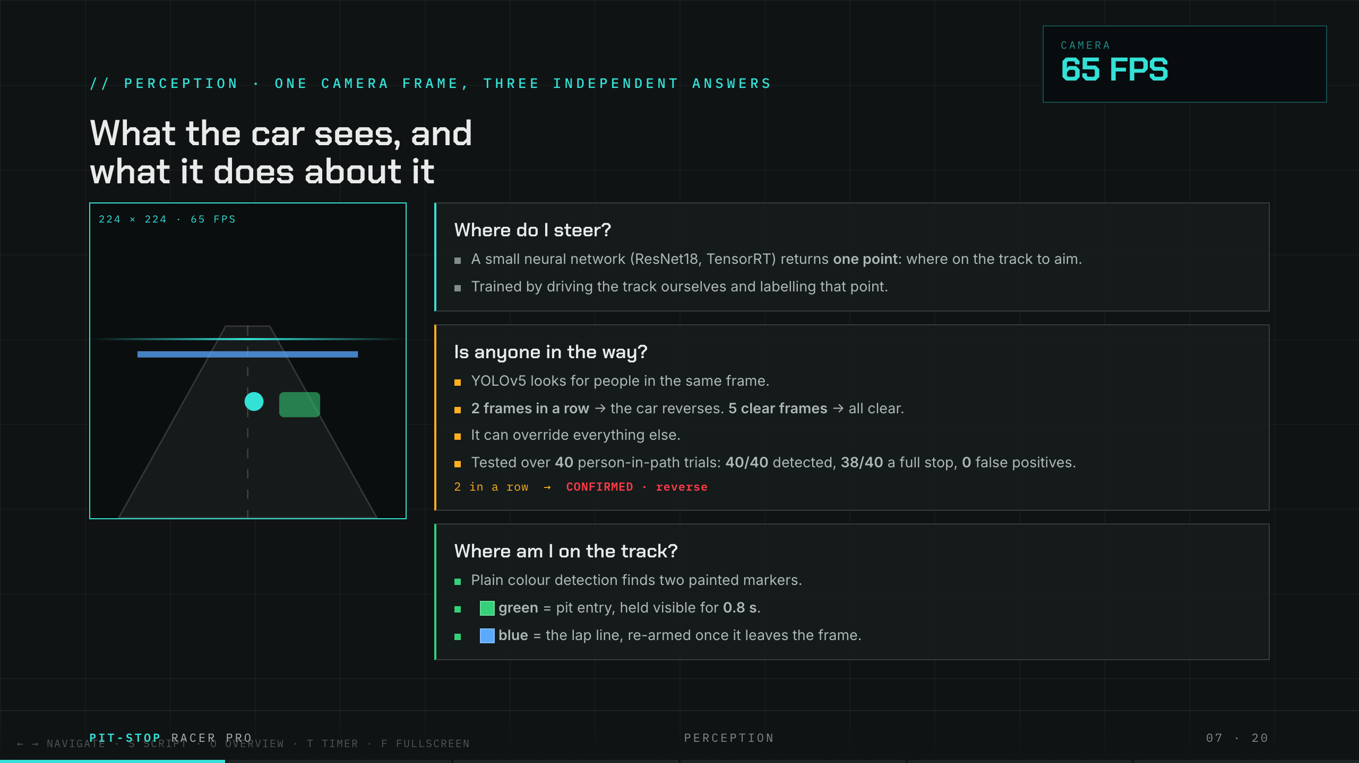
Notes:
FIONA · Perception slide. Three boxes appear one by one.
So what does that one camera frame actually become? Three completely separate answers, sixty-five times a second. First: where do I steer? A small neural network looks at the track ahead and picks one point, the spot to aim for. We trained it the fun way, by driving the track ourselves and showing it where we would look. Second: is anyone in the way? A detector called YOLO scans the very same frame for people. If it sees a person two frames in a row, the car stops and reverses, and this rule beats every other rule on the car. We tested it forty times, walking into its path, and it caught the person all forty times. And third: where am I on the lap? For that we just look for two coloured strips of tape, green for the pit entry, blue for the start-finish line. Simple, and it never gets confused.

Slide 8
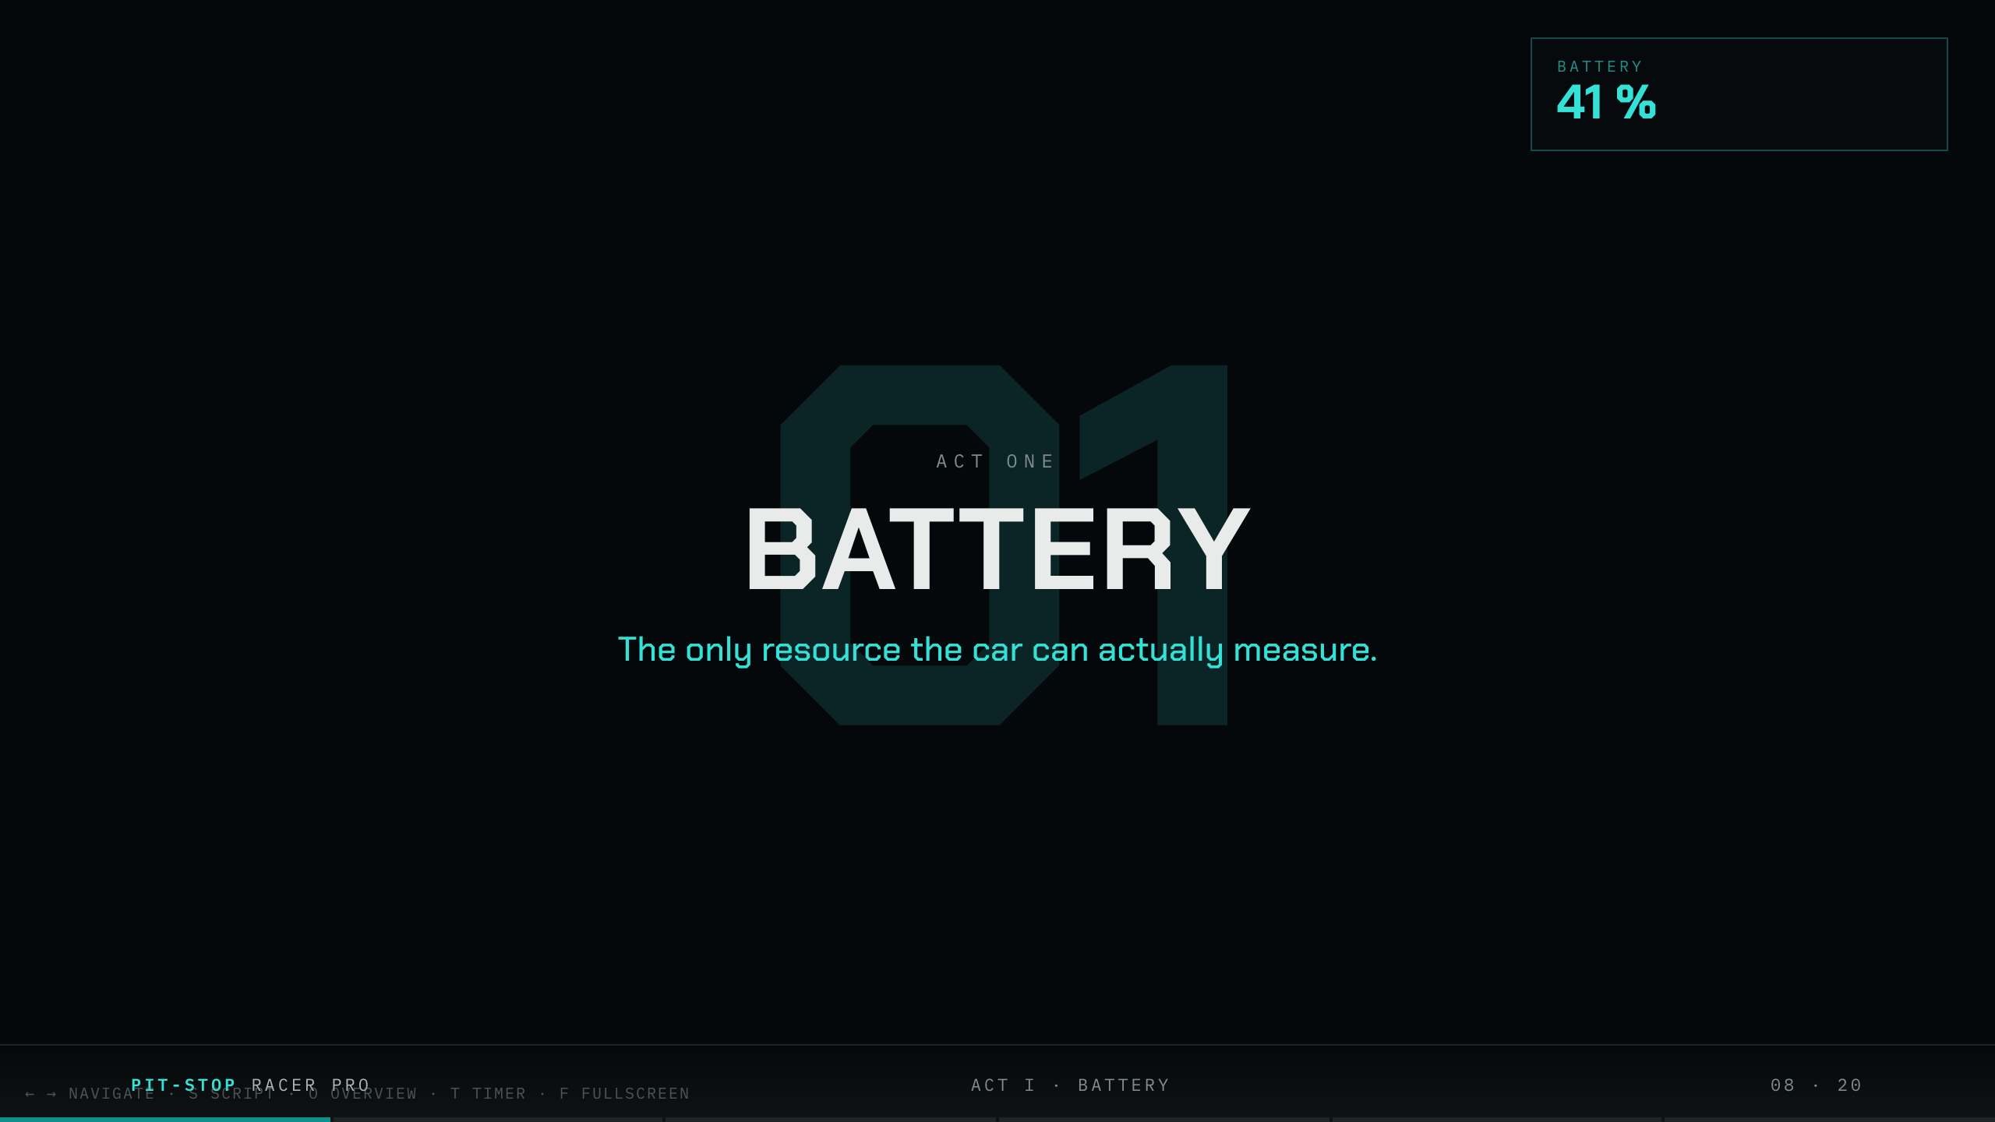
Notes:
GANG-YUN · Act I card: BATTERY. Take the handover clearly.
Thank you, Fiona. I am going to take the first clock, the battery, and this is my favourite one, because the battery is the only resource we do not have to guess. There is a real sensor on the car reading it. So here, the strategy is not a simulation. It is the real thing.

Slide 9
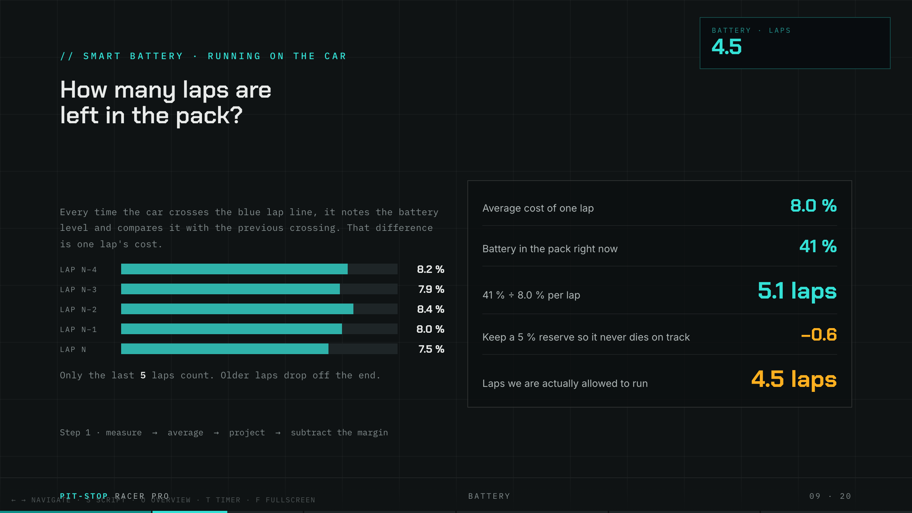
Notes:
GANG-YUN · Battery math slide. Walk the four numbers slowly.
Here is exactly how the car works out how many laps it has left, and it is beautifully simple. Every time it crosses the start-finish line, it checks the battery and asks, "how much did that last lap cost me?" Then it takes the average of the last five laps, so one weird lap does not throw it off. Say each lap costs about eight percent. If the pack is sitting at forty-one percent, then forty-one divided by eight is about five laps. But we never run it to zero, that would leave the car dead in the middle of the track, so we hold back a five-percent safety cushion. And that gives us the real number: about four and a half laps left. Measure, average, project, keep a little in reserve. That is the whole method.

Slide 10
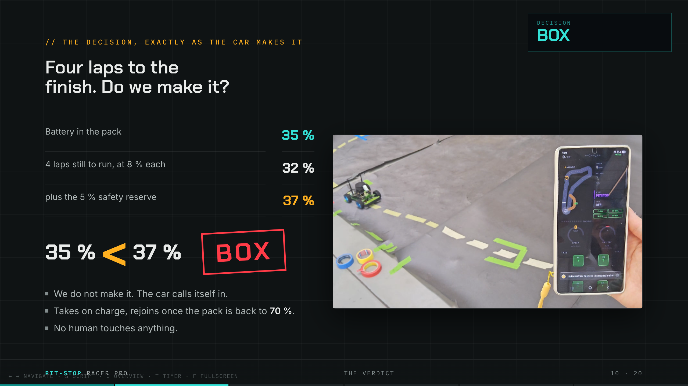
Notes:
GANG-YUN · The verdict + pit video. Deliver the decision, then point at the clip.
Now the moment of truth. Let us say there are four laps to the finish, and the pack is down to thirty-five percent. Four laps at eight percent each is thirty-two percent, plus our five-percent cushion, that is thirty-seven percent we would need. But we only have thirty-five. Thirty-five is less than thirty-seven. So the car says, out loud, in its own logic: box. Come in. And look, on the right, that is it actually happening. The car decided by itself, drove itself into the pit box, parked on the green marker, and started charging. The app shows the mode flip to CHARGING and the battery climbing back up. Nobody touched it. It made the call and it acted on it.

Slide 11
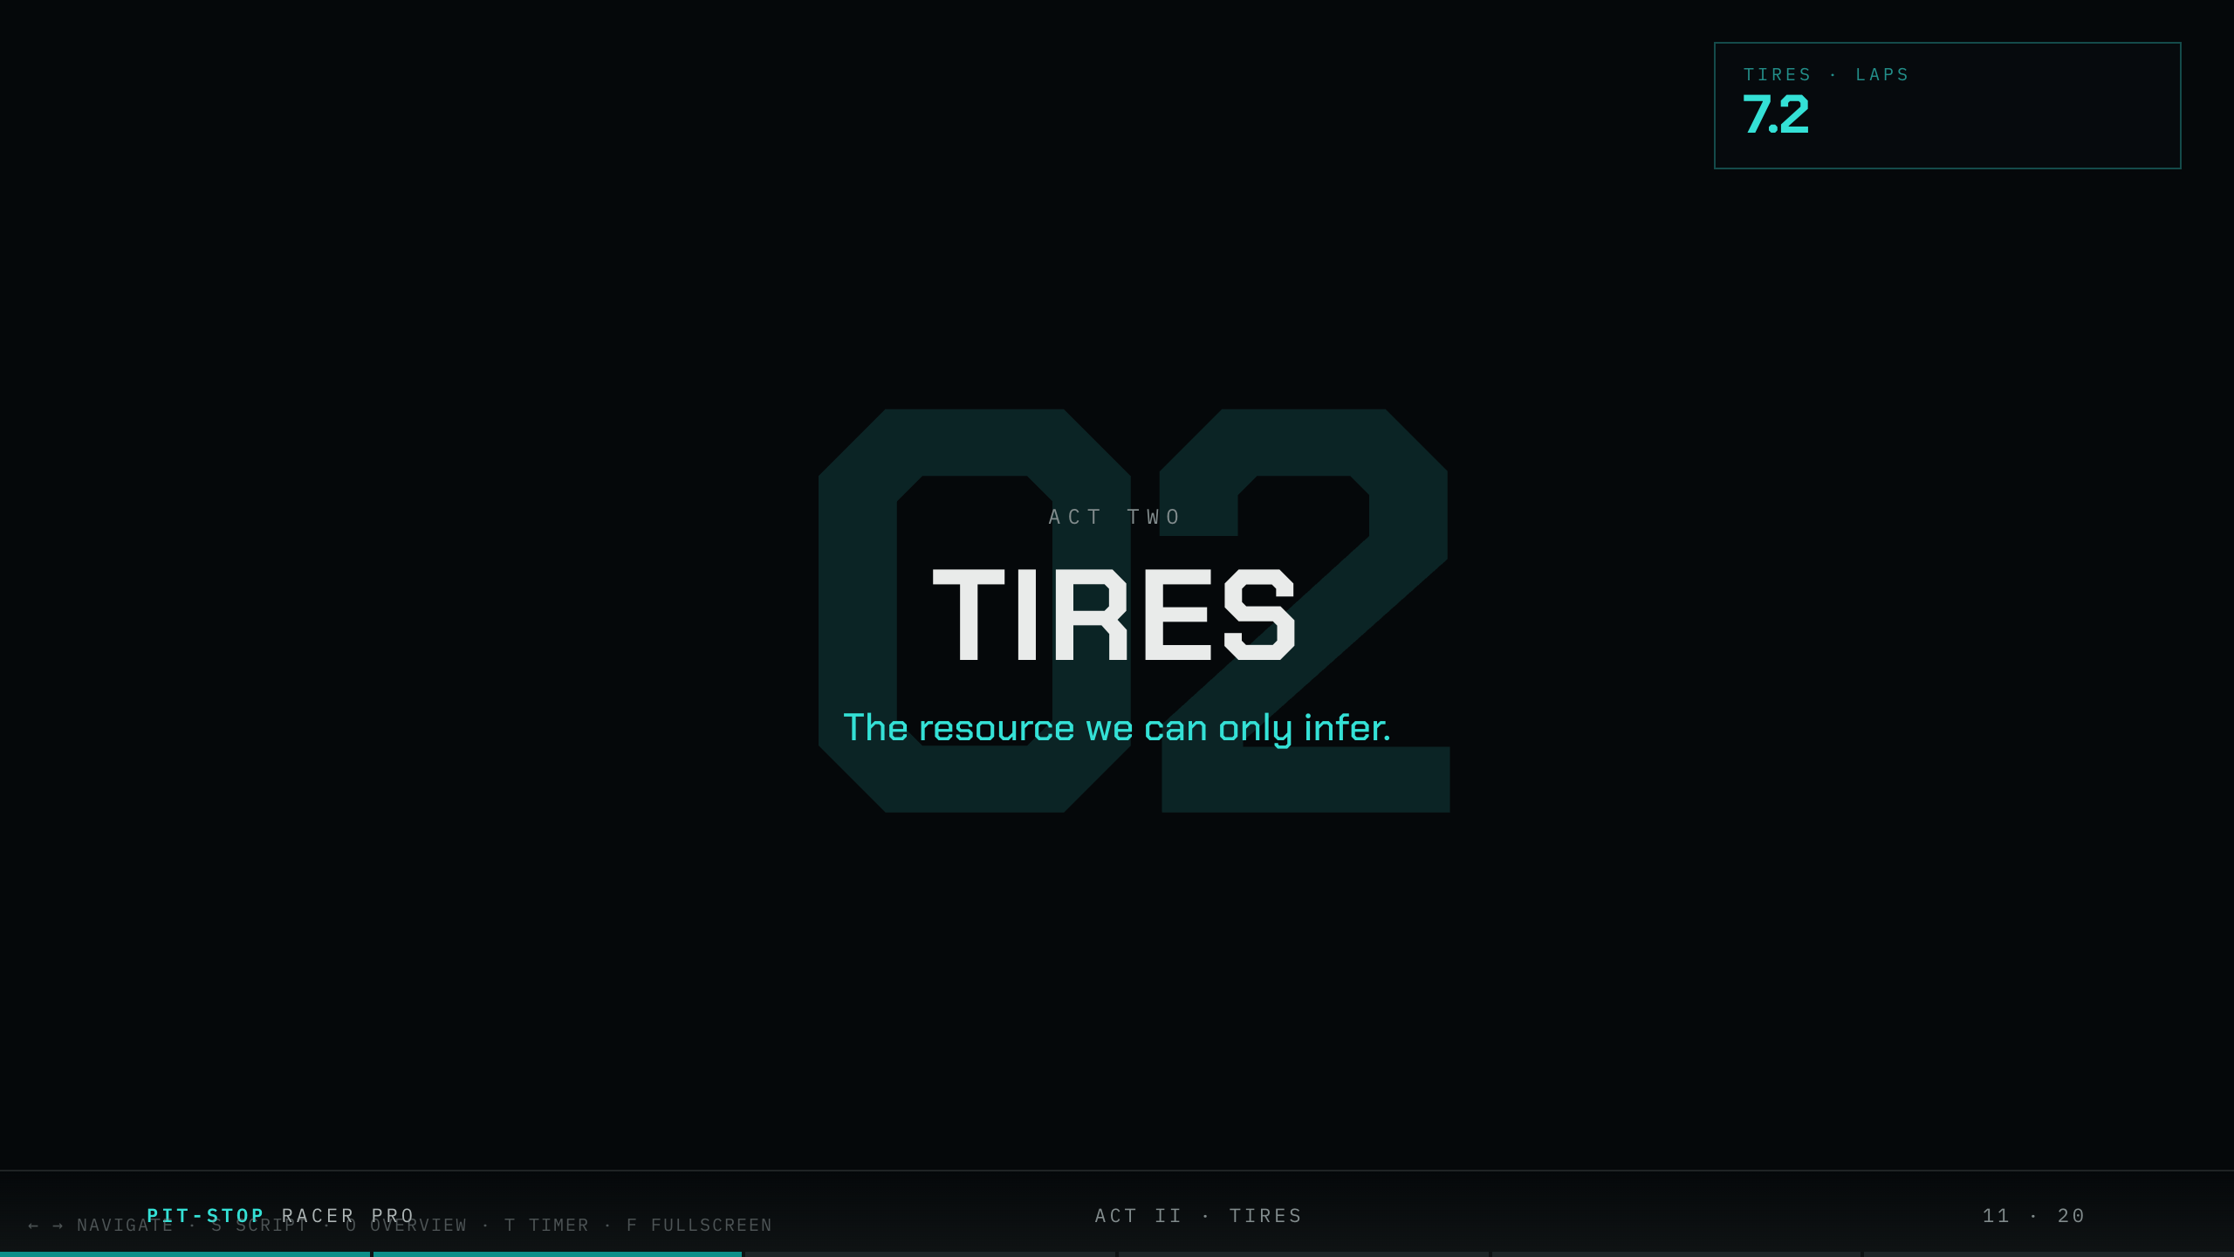
Notes:
GANG-YUN · Act II card: TIRES. Shift tone, this one is harder.
Second clock: the tires. And now I have to be honest with you, because this one is genuinely harder. There is no such thing as a tire-wear sensor on a car this small. It does not exist. So if we want a tire clock, we have to build it ourselves, out of what the car is already doing.

Slide 12
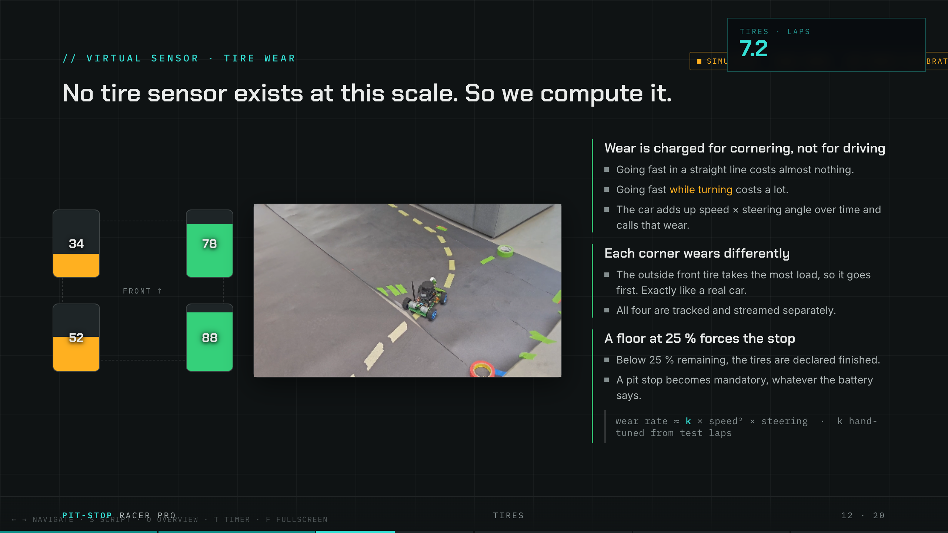
Notes:
GANG-YUN · Tires slide + curve video. Gesture at the corner clip.
Here is the trick, and it is the same physics as a real car. Tires do not wear out from going fast in a straight line, they wear out from cornering. So the car watches how hard and how fast it is turning, and every corner it takes, it charges a little bit of wear. Watch the clip, every time it leans into that curve, that is a moment we count against the tires. We even track all four separately, and the outside front wears fastest, exactly like the real thing. When any tire drops below twenty-five percent, we call it done and force a stop, no matter what the battery says. Now, this is a hand-tuned model, and we are the first to say so, that badge is there on purpose. But it behaves like real rubber, and that is what matters for the strategy.

Slide 13
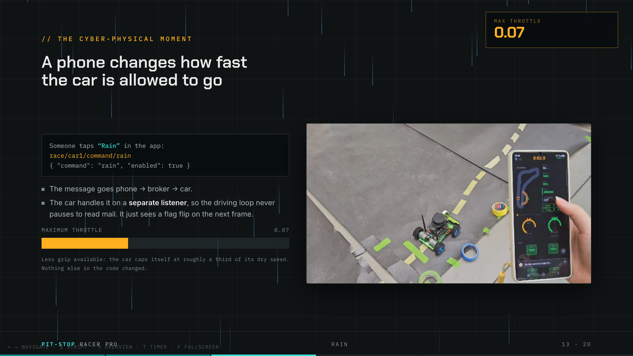
Notes:
KATRIN · Rain slide + rain video. This is the showpiece. Enjoy it.
Thank you, Gang-Yun. I want to show you my favourite moment in the whole project, because this is where the software world and the physical world touch. Watch. Someone, a human, taps a single button on a phone that says "Rain". That tap becomes a tiny message. It travels over Wi-Fi, through a little server, and onto the car. And on the very next camera frame, the car quietly caps its own top speed to about a third of normal, because the track is now "wet". Look at the clip, the app flips to RAIN ON, and the car slows itself down. We changed nothing in the code. We sent one message, and it changed what the machine is physically allowed to do. That, for me, is the whole point of a cyber-physical system, in one button press.

Slide 14
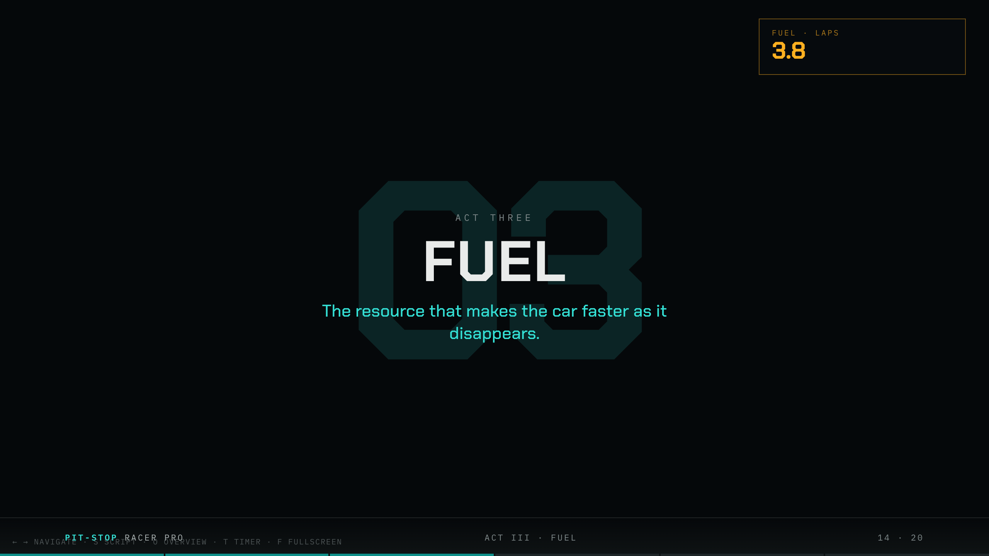
Notes:
KELLY · Act III card: FUEL. Take the handover, a little playful.
Thanks, Katrin. I get the third and strangest clock: the fuel. Strange, because this is the one resource where running low is actually good news. Let me explain what I mean.

Slide 15
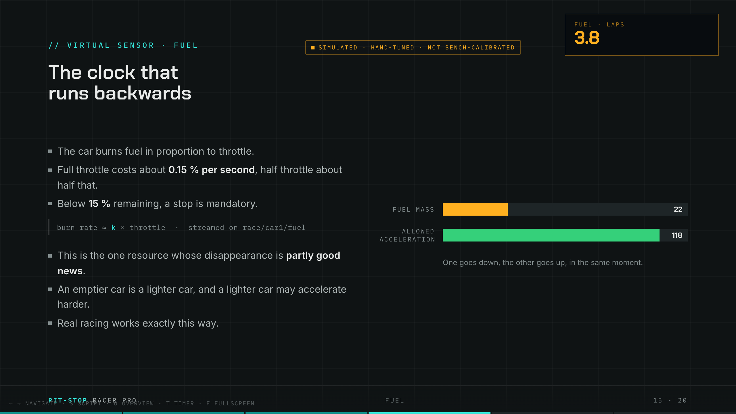
Notes:
KELLY · Fuel slide. Let the see-saw bars do the work.
Fuel burns in proportion to how hard you push the throttle, just like a real engine. Flat out, it drains fast; cruising, it barely moves. But here is the twist. As the fuel burns off, the car gets lighter. And a lighter car can accelerate harder and corner better. So this clock counting down actually makes the car quicker as it empties. That is why real race strategy is never just "stop as late as possible", sometimes a lighter, faster car earns back more time than the pit stop costs. Our car understands that trade-off, and it factors it in.

Slide 16
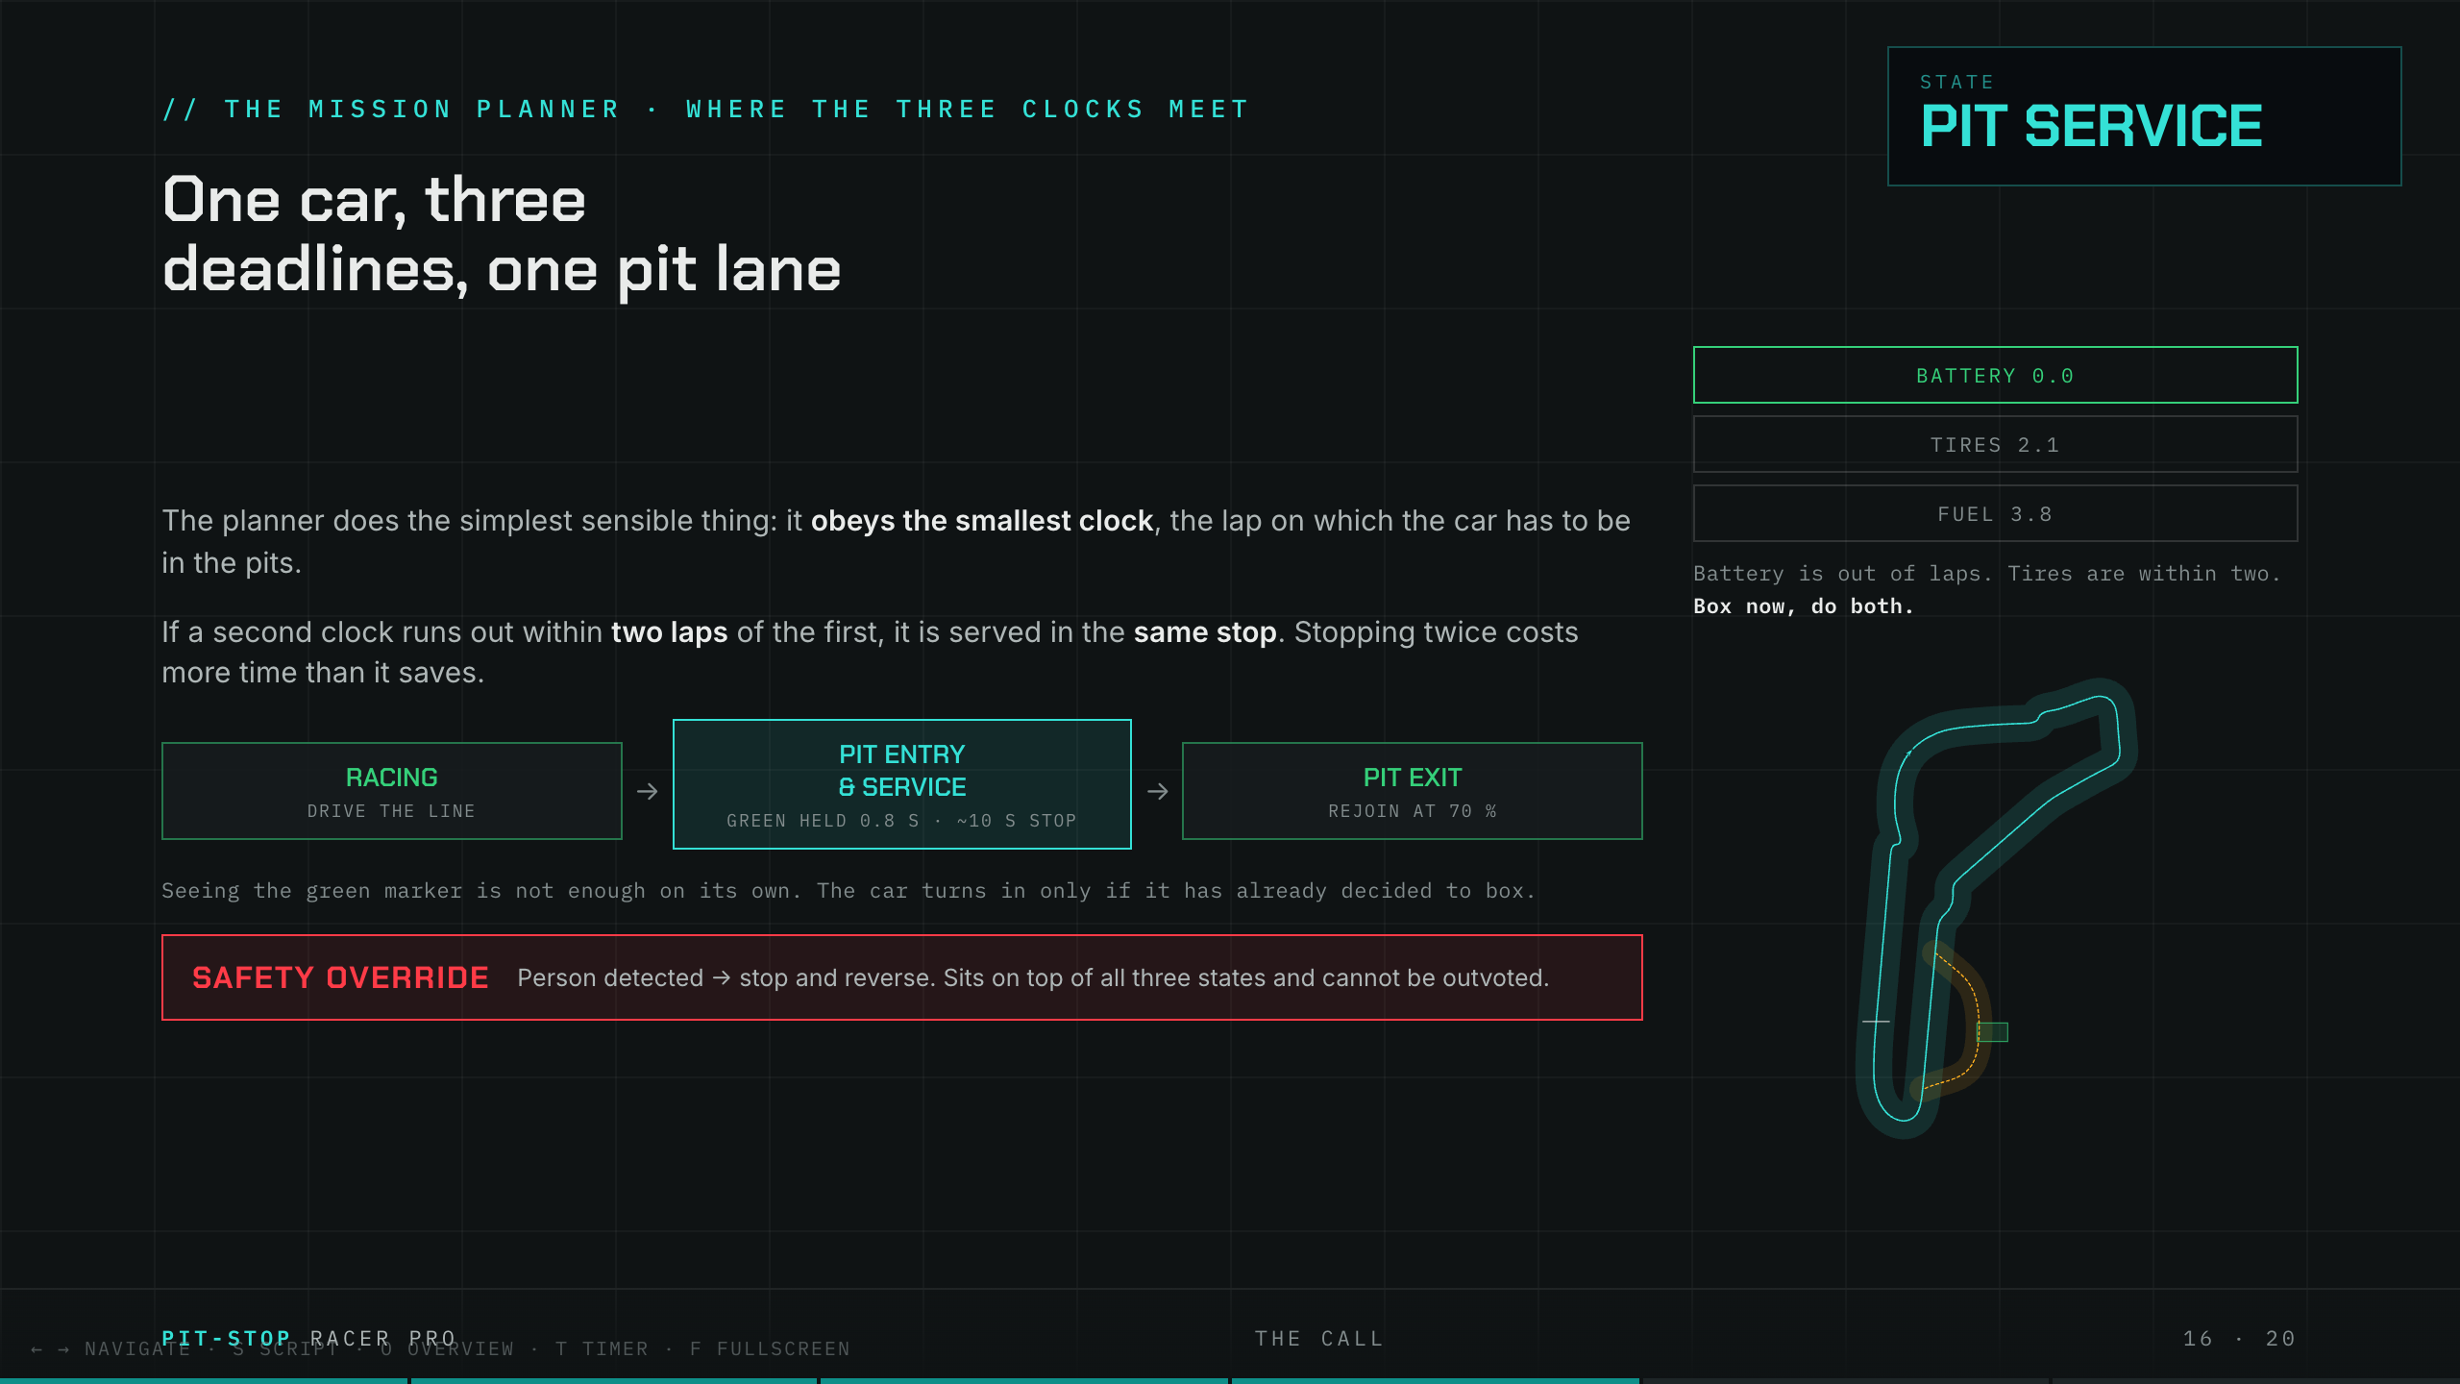
Notes:
KELLY · The call slide. The climax. Slow down, do not rush.
So now put all three clocks in one place, because this is where it all comes together. The car is watching battery, tires and fuel at the same time, and each one is shouting a different deadline. The rule it follows is simple and smart: obey the clock that runs out first. But, and this is the clever part, if a second clock is going to run out within a lap or two of the first, it does both jobs in the same stop, because stopping twice always costs more than it saves. And sitting on top of everything, untouchable, is the safety rule: if a person steps in front of the car, it stops, full stop, no matter what the strategy wants. One car, three deadlines, one pit lane, and it sorts the whole thing out by itself.

Slide 17
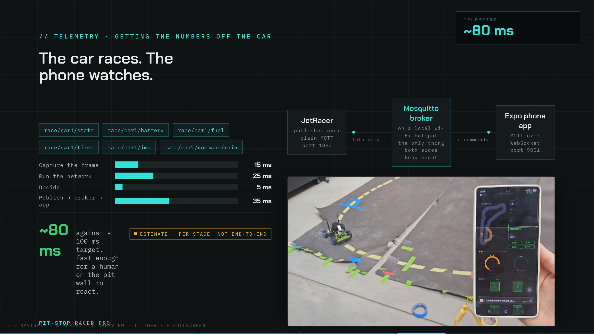
Notes:
KATRIN · Telemetry slide + driving video. Point at the live numbers.
Thanks, Kelly. Now, how do we, the humans, see any of this? The car and the phone never actually talk to each other directly. Instead there is a little post office in the middle, a message broker, and both sides just leave messages there. That means either one can drop off Wi-Fi and nothing breaks. Watch the clip: the car is driving, and every number on that phone, speed, battery, fuel, all four tires, the mode, is arriving live, a fraction of a second after it happens on the car. Start to finish, the whole loop runs in well under a tenth of a second, which is fast enough for a person on the pit wall to react in real time.

Slide 18
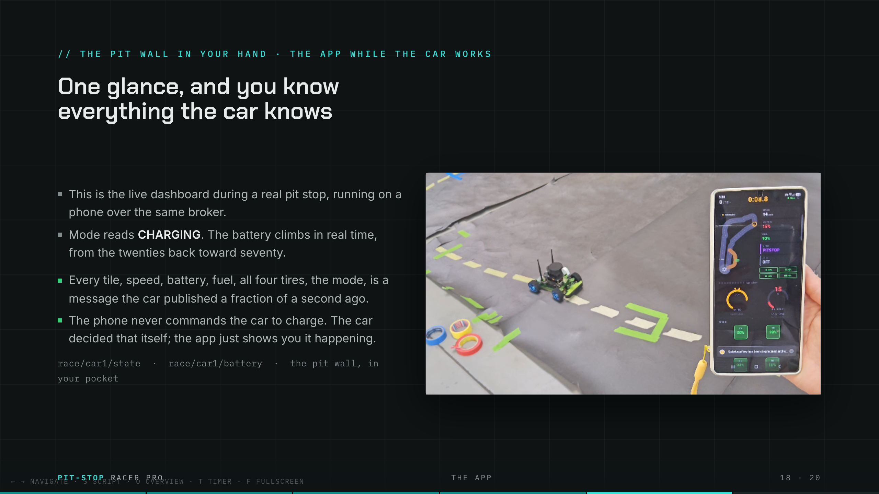
Notes:
KATRIN · App slide + charging video (starts mid-stop). Sell the dashboard.
And this is what it looks like in your hand during an actual pit stop. This is the live app, and right now the car is on charge, you can see the mode says CHARGING and the battery is ticking upward in real time. Every tile you see, the speed, the fuel, each tire, is a message the car sent a heartbeat ago. And I want to be really clear about one thing: the phone is not driving the car and it did not order this stop. The car decided to pit all by itself. The app is simply the window we watch it through. It is the entire pit wall, shrunk down to fit in your pocket.

Slide 19
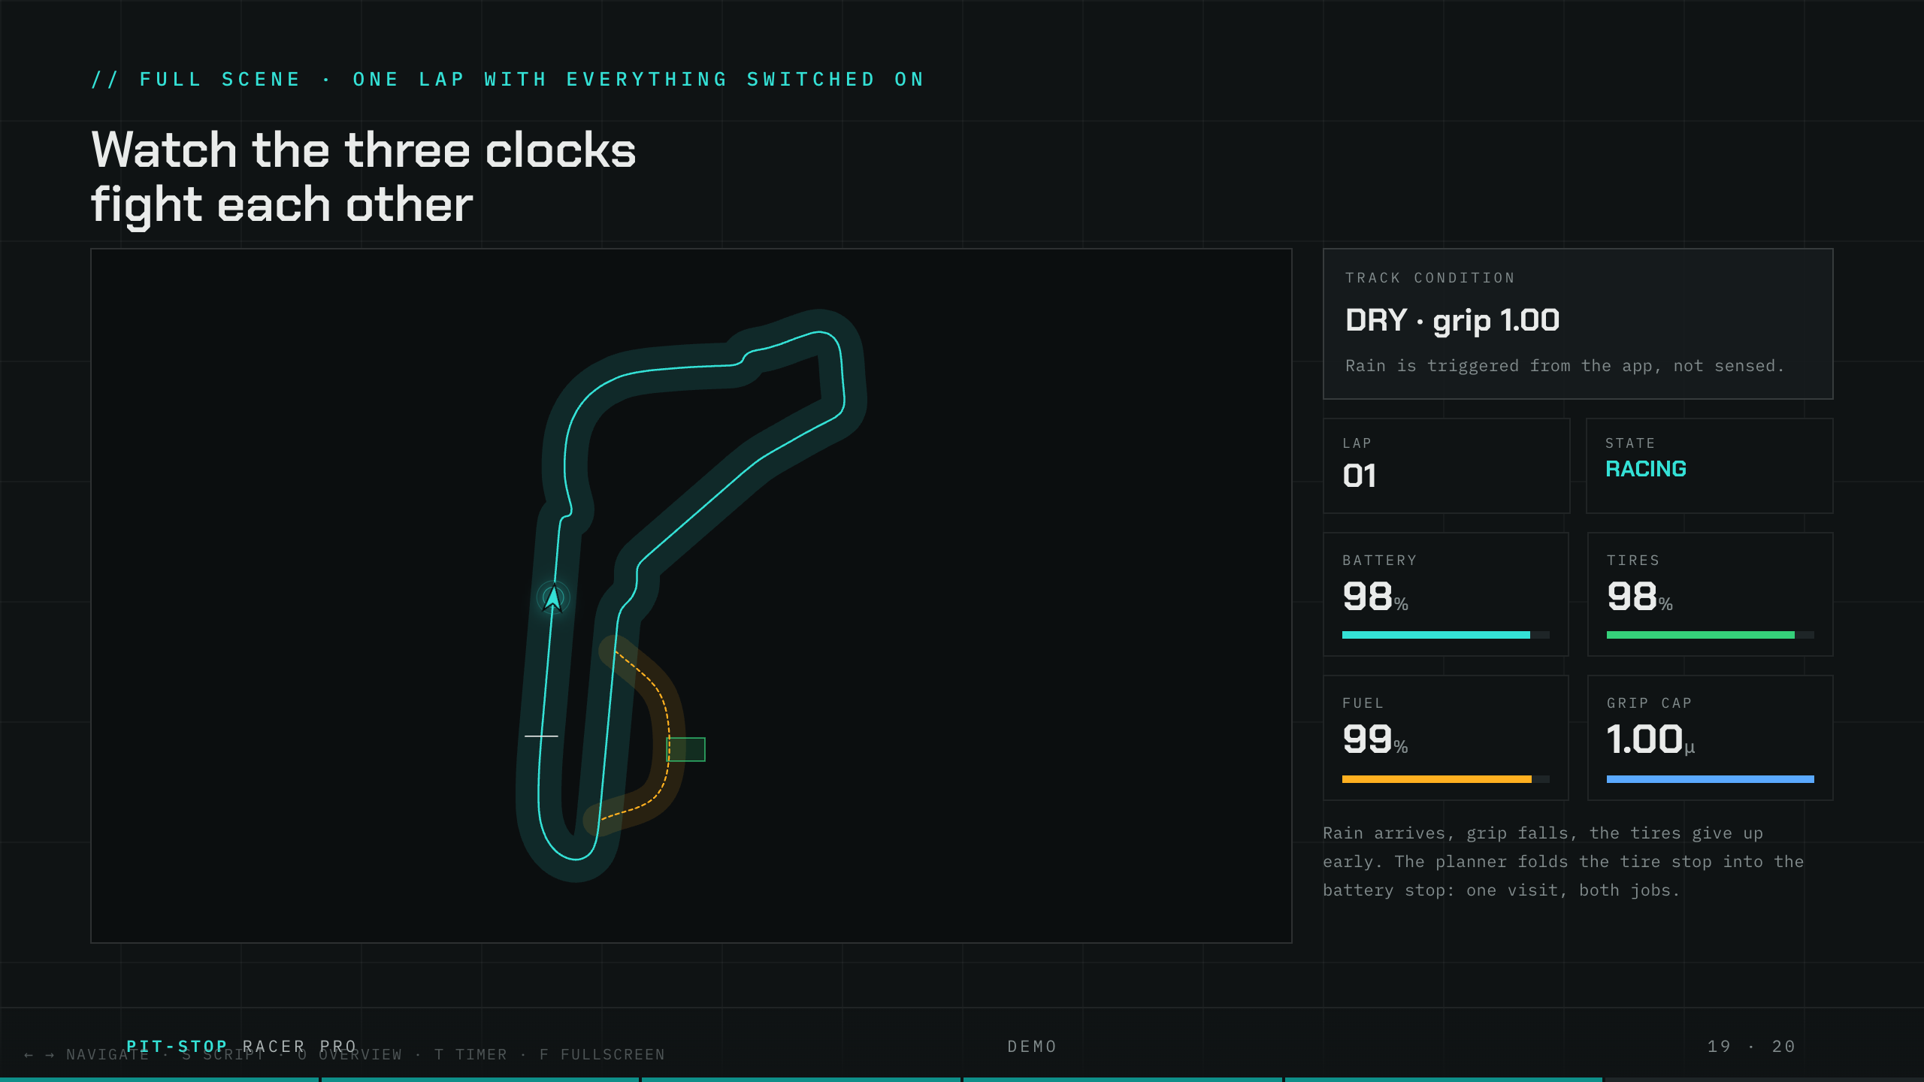
Notes:
KATRIN · Race sim slide. Stay quiet ~15s, then narrate softly.
Let me pull it all together in one simulated lap, with everything switched on at once. Just watch for a moment. ... There, the rain arrives, and the grip drops. ... The tire clock collapses. ... The pit window opens up. ... And the car dives into the pit lane, takes its service, and rejoins. Three clocks, all fighting each other, and the car resolving the whole argument on its own, in real time, without a single human input. One quick side note on the track itself: the original Monza layout you are watching here was hand-built out of foam. Unfortunately it got locked away in a storage room on Etzelstraße and we were never able to get it back out. So every clip we are showing you today, including this one, had to be recorded on a temporary replacement layout we built in the meantime.

Slide 20
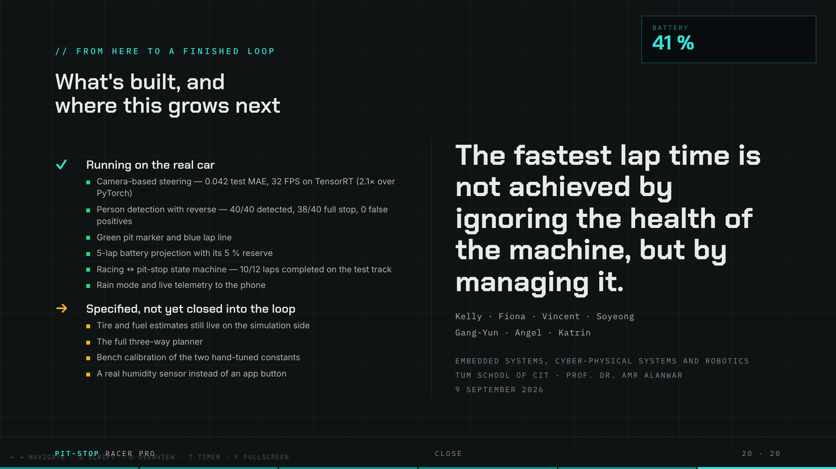
Notes:
KATRIN · Close slide. Be honest, then land the last line and stop.
So, to be straight with you about where we are: the perception, the driving, the battery strategy and the whole app, that all runs on the real car today, exactly as you have seen it. The tire and fuel models are built and simulated, and the next step is closing them fully into the live control loop. We think that honesty is a strength, not a weakness. Because what we have built is a tiny car that treats every lap like a real race: it knows what it is spending, it knows when it will run out, and it decides for itself when to pit. Thank you very much, we would love to take your questions.

