Slide 1

GlobalMart Supply Chain Analytics
Executive Dashboard Presentation
Prepared by: Fathiu Ligali
Tools used: Power Query & Power BI

Slide 2
Business Problem Overview
• Improve delivery performance
• Optimize inventory
• Reduce damaged goods
• Evaluate supplier performance
• Improve profitability

Slide 3
Methodology (Excel → Power BI → Insights)
1. Excel & Power Query cleaning
2. Power BI data model
3. DAX measures & KPIs
4. Interactive dashboards
5. Business insights

Slide 4
Data Overview & Structure
Dataset contains Orders, Products, Customers, Suppliers, Locations and Sales.
Star schema with Fact Sales and Dimension tables.
KPIs: Revenue, Profit, Margin, AOV, Delivery KPIs.

Slide 5
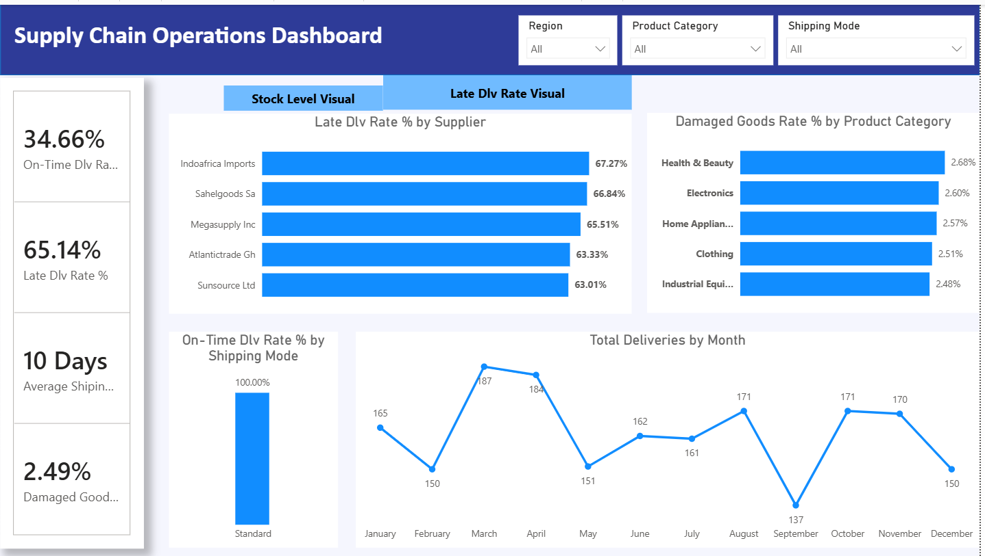
Delivery Performance Insights
• On-Time Delivery Rate: 34.66%
• Late Delivery Rate: 65.14%
• Average Shipping Time: 10 Days
• Standard shipping achieved highest on-time performance.
• Indoafrica Imports, Sahelgoods SA and Megasupply Inc recorded the highest late delivery rates.

Slide 6
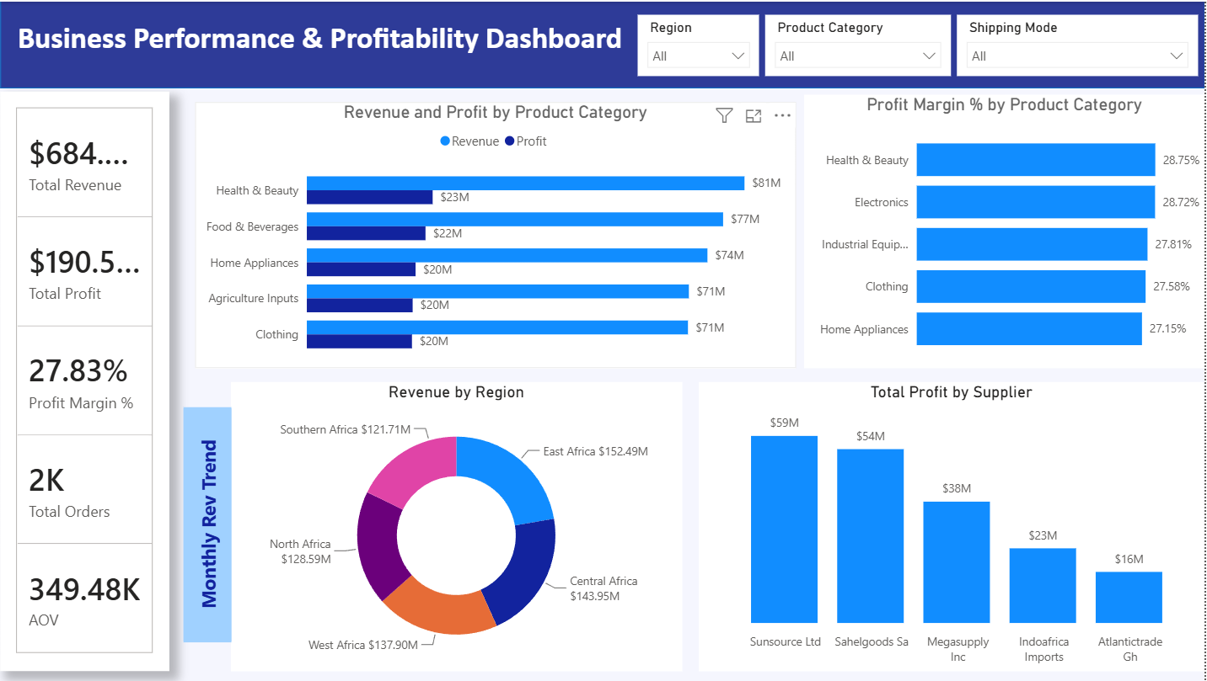
Profitability Analysis Insights
• Revenue ≈ $684M
• Profit ≈ $190.5M
• Profit Margin: 27.83%
• Health & Beauty generated highest revenue and profit.
• Sunsource Ltd is the top profit-contributing supplier.

Slide 7
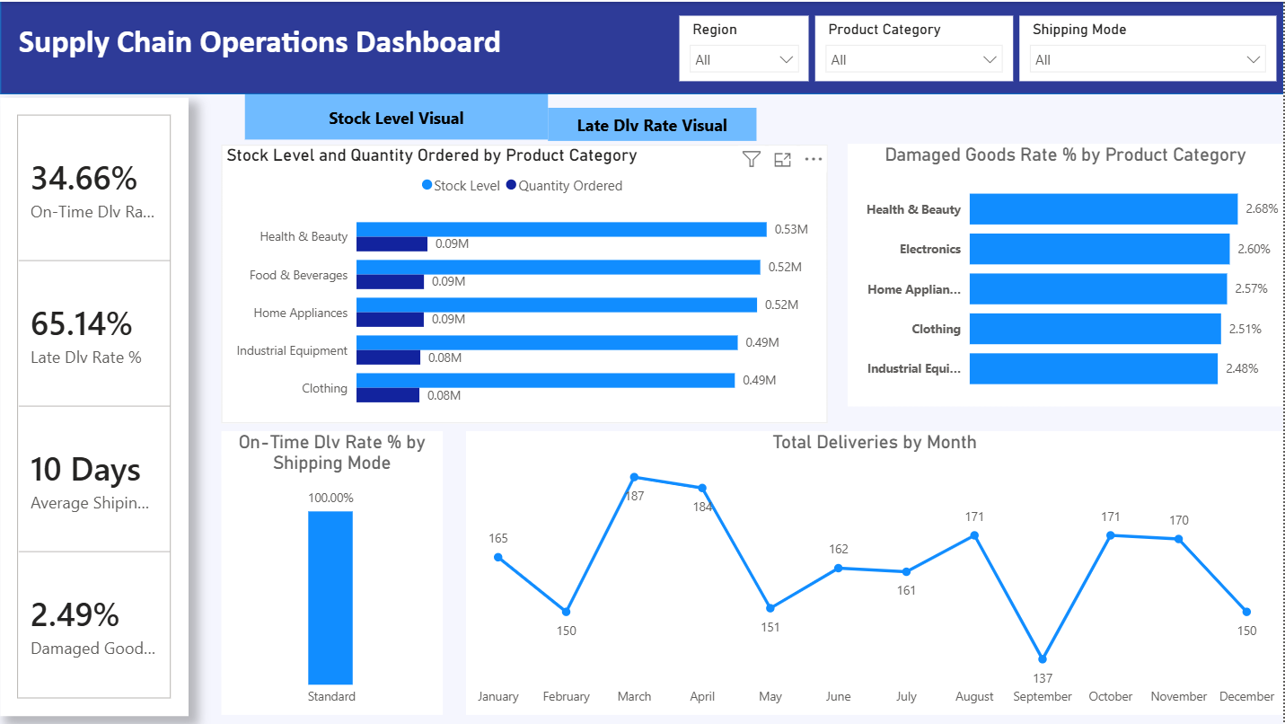
Inventory Optimization Insights
• Stock levels exceed demand across categories.
• Health & Beauty holds the highest stock.
• Highest damage rates: Health & Beauty (2.68%), Electronics (2.60%), Home Appliances (2.57%).
• Delivery performance weakens around September.

Slide 8
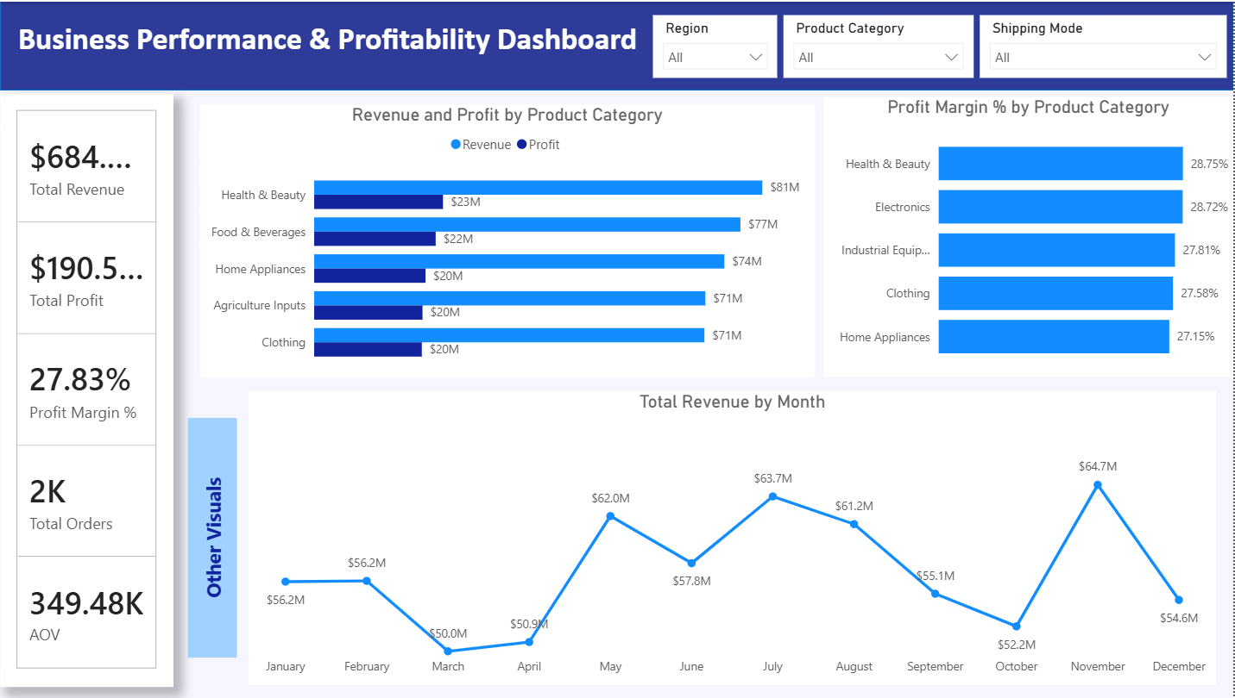
Business Trends & Patterns
• Revenue peaks around July and November.
• East Africa contributes the highest regional revenue (~22%).
• Profitability remains consistent across categories.

Slide 9
Strategic Recommendations
• Improve supplier performance.
• Optimize logistics and delivery scheduling.
• Align inventory with demand.
• Improve packaging for high-damage products.
• Invest in high-margin product categories.

Slide 10

Conclusion & Next Steps
GlobalMart demonstrates strong financial performance but operational improvements are needed.
Next Steps:
• Continuous KPI monitoring
• Better forecasting
• Supplier scorecards
• Real-time dashboards

